Slide 1
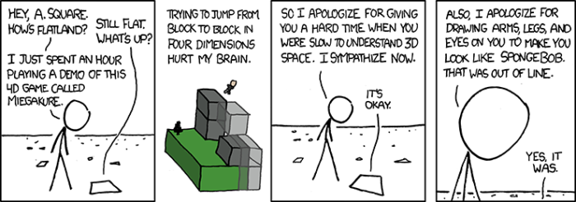
Module 3
Understanding data in reduced dimensions
xkcd

Slide 2

What data reduction is occurring here?

Slide 3
Visualizing high-dimensional data
How would you visualize…
1 variable?
2 variables?
3 variables?
4 variables?
Systems biology problem → ~1000s of variables?

Slide 4
Supervised versus unsupervised learning methods
Classification
Develop predictive model based on both input and output data
Regression
Machine learning
Clustering
Group and interpret data based only on input data
PCA

Slide 5
Supervised versus unsupervised learning methods
Supervised: Infer from training examples
Unsupervised: Exploratory data analysis
Classification
Supervised learning
Develop predictive model based on both input and output data
Regression
Machine learning
Unsupervised learning
Clustering
Group and interpret data based only on input data
PCA
→ Don’t have a priori knowledge of expected relationships.
→ Extract knowledge from our dataset rather than impose a structure on it.

Slide 6
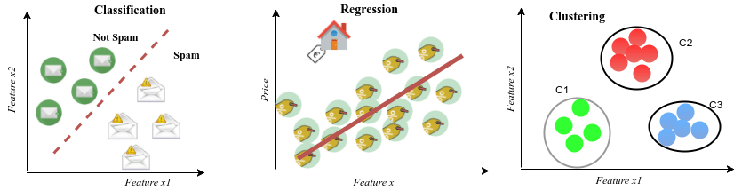
Supervised versus unsupervised learning methods
https://www.researchgate.net/publication/319093376

Slide 7
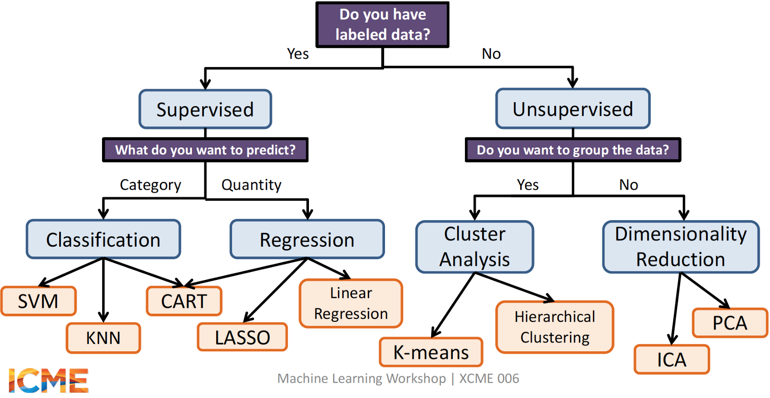
https://medium.com/@sandramoerch

Slide 8
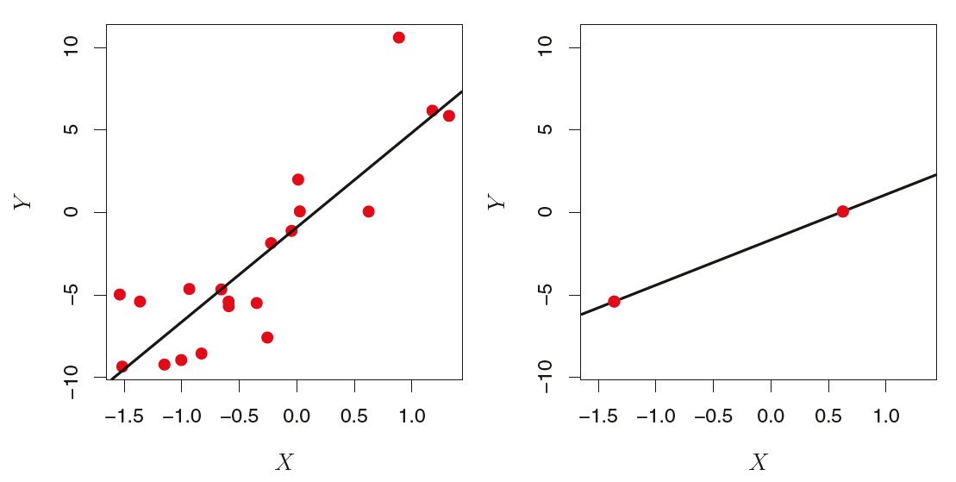
Curse of dimensionality and least squares regression
n = number of observations (samples, cell lines)
p = number of variables or features (expressed genes)
n observations on two features (p)
Low dimension, n >> p
High dimension, n ~ p
n = 20 (•)
n = 2 (•)
For least squares regression with n = p =2, the fit is always perfect: Overfitting.
G. James, D. Witten, T. Hastie, R, Tibshirani. An Introduction to Statistical Learning with Applications in R. Springer 2013. ISBN 978-1-4614-7137-0

Slide 9
Which model will do a better job of predicting independent data?
n observations on two features (p)
Low dimension, n >> p
High dimension, n ~ p
n = 20 (•)
n = 2 (•)
More samples than features?
OR
More features than samples?

Slide 10
Curse of dimensionality and least squares regression
Low dimension, n >> p
High dimension, n = p
•
•
•
•
The model obtained when there are more samples than features is more predictive. Overfitting leads to poor performance on an independent data set.

Slide 11

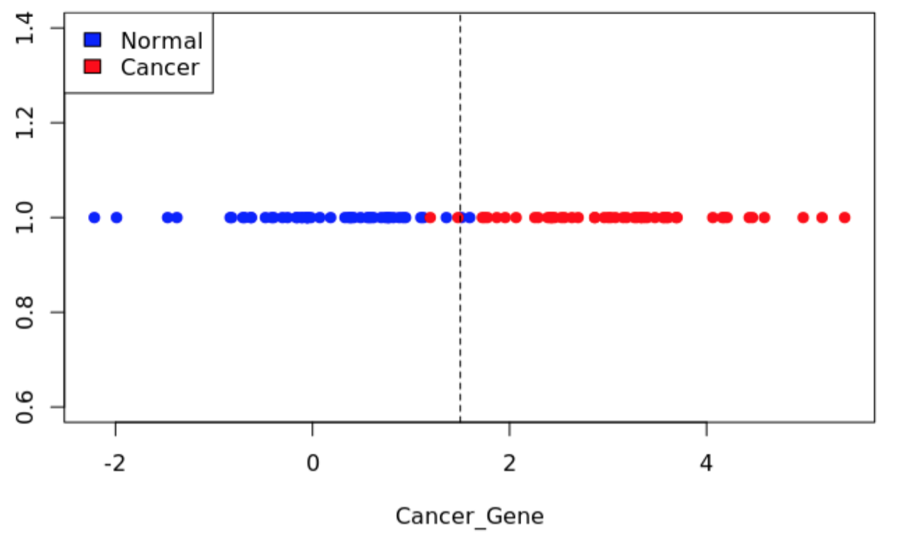
Curse of dimensionality: spurious findings
Pretend there’s a gene whose expression level correlates with disease state: higher expression indicates a greater likelihood of cancer. We can simulate this condition by sampling from two distributions, one for non-cancer (normal) and one for cancer.
Because there is only 1 gene, this is a 1-dimensional problem. The optimal dividing line between states is not perfect, but separates the vast majority of samples.

Slide 12
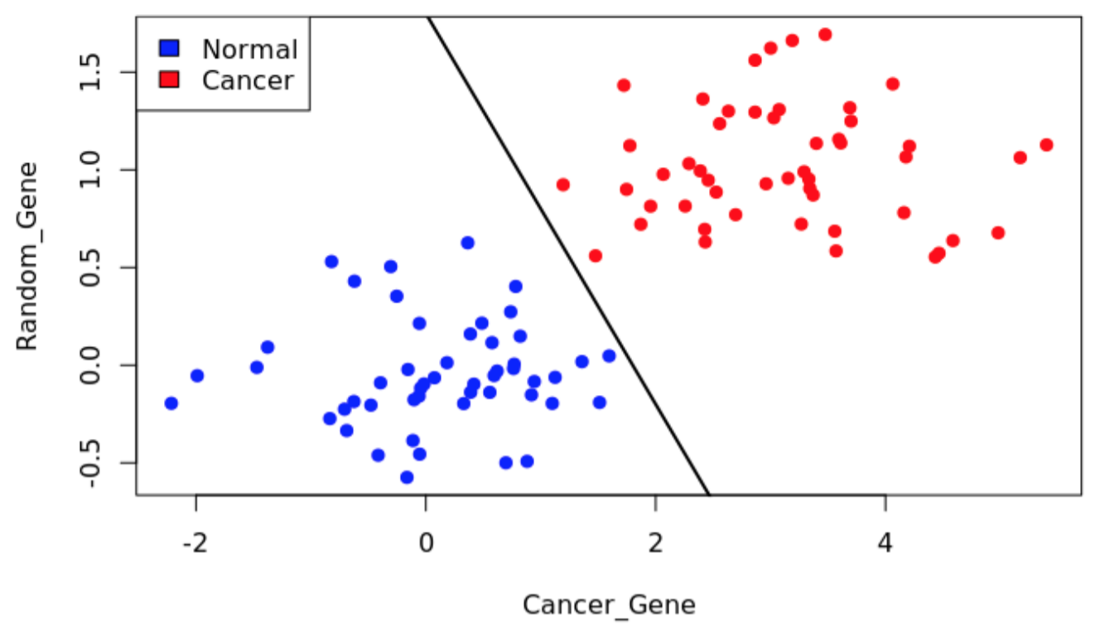
Curse of dimensionality: spurious findings
We can simulate a second, random gene and add it to the plot. We are now operating in 2 dimensions. We can easily find a dividing line that separates all points into cancer / non-cancer, even though only the first gene is a true biomarker.
This is an example of how adding more features (dimensions) can lead to overfitting. The more features one adds, the easier it is to develop a model that over fits the data.

Slide 13
Low dimensional data example
Number of observations (n) >> number of features (p)
Develop a model to predict a patient’s blood pressure based on age, gender, and body mass index data from 5,000 patients.
n = 5,000 (patients)
p = 3 (age, gender, body mass index)
Adding a few additional features, e.g. cholesterol and exercise levels, may improve predictive power of model.

Slide 14
High dimensional data example
Number of observations (n) << number of features (p)
Develop a model to predict a patient’s blood pressure based on age, gender, body mass index data from 5,000 patients and 500K SNPs.
n = 5,000 (patients)
p ~ 500K
Predict patient survival from mRNA gene expression, DNA methylation, microRNA and copy number alterations for breast invasive carcinoma samples collected by TCGA.
n = 400
p ~ 40K

Slide 15
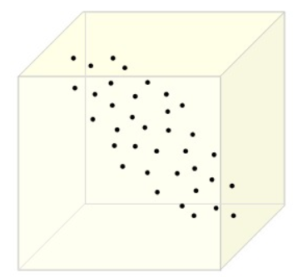
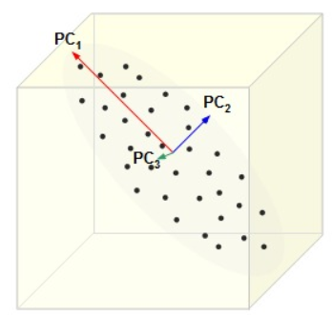
Dimensionality Reduction is the process of compressing data into something that captures the essence of the original data
Principal component analysis (PCA) reduces dimensionality, retaining most of the variation
y
We have a three-dimensional dataset: x-, y-, z-components of spatial coordinates of atoms in a protein structure.
We note that the spread of coordinate values is greater in some dimensions than others.
x
z
y
Principal components are directions along which variation in the data is maximal.
PC1 carries most of the variation.
PC2 carries most of the variation in a direction perpendicular to PC1.
PC3 is perpendicular to PC1 and PC3.
x
z
Which PC is the “most important”?

Slide 16
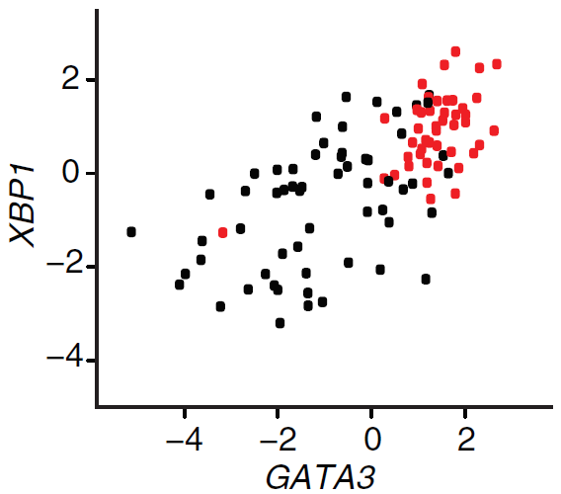
Principle component analysis for gene expression data.
Consider a simple problem:
Visualizing the expression levels of two genes, XBP1 and GATA3, in 105 breast tumor samples.
Only 2 genes out of 28,000! Note: We can also do this analysis with transcript counts.
We assume the data are normalized and have zero mean
Estrogen receptor classification of breast cancer samples, ER+ and ER-
XBP1: X-box-binding protein
GATA3: Trans-acting T-cell-specific transcription factor
Each dot represents a sample with the coordinates log2(expression level) of XBP1 versus GATA3.
The samples are colored ER+ and ER-
PMID: 18327243

Slide 17
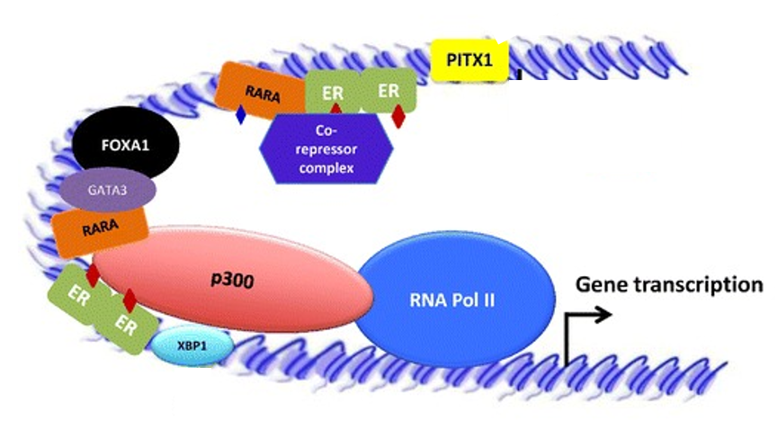
Biological aside 1: Estrogen receptor (ER) status, ER+ and ER-
70% of all newly diagnosed breast cancers express ERα (ER+).
Antiestrogens: tamoxifen (TAM) and fulvestrant are widely used.
Resistance, either de novo or acquired, limits their curative potential.
More die from ERα+ breast cancer than from any other breast cancer subtype.
Biological aside 2: GATA3 and XBP1 and Estrogen-mediated transcription in breast carcinoma cell lines
• FOXA1, GATA3, and ER complex regulates estrogen transcription.
• XBP1 promotes ER transcriptional activity.

Slide 18
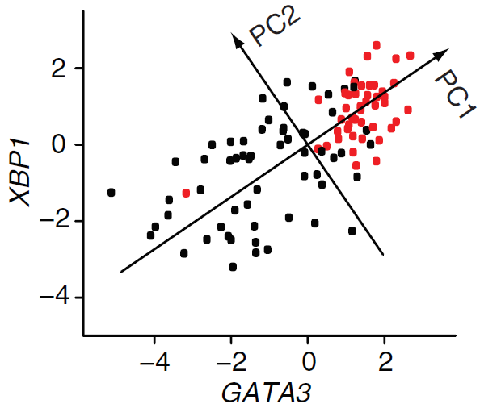
Principle component analysis for gene expression data.
PC1 captures most of the variance
PC2 is orthogonal to PC1; captures additional spread.
PC1 = 0.89 × GATA3 + 0.46 × XBP1
0.89 and 0.46 are loading values that tell us how important each feature (gene) is in PC1.
PMID: 18327243

Slide 19
Principle component analysis: Loading values
PC1 = 0.89 × GATA3 + 0.46 × XBP1
PC2 = -0.61 x GATA3 + 0.80 x XBP1
Loading values that tell us how important each feature (gene) is in each principal component.
Note that the samples have zero average expression, and 0.89^2 + 0.46^2 = 1.
PMID: 18327243

Slide 20
Principle component analysis for gene expression data.
Each component can be interpreted as the direction, uncorrelated to previous components, which maximizes the variance of the samples when projected onto the component.
So we have two PCs for 2D data.
Where is the dimensionality reduction?!
PMID: 18327243

Slide 21
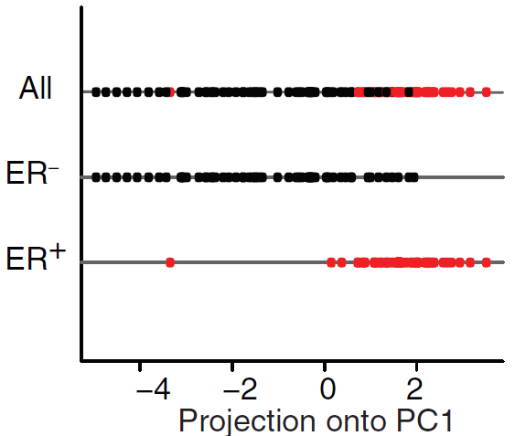
Principle component analysis for gene expression data.
Each component can be interpreted as the direction, uncorrelated to previous components, which maximizes the variance of the samples when projected onto the component.
So we have two PCs for 2D data.
Where is the dimensionality reduction?!
2D to 1D
The projection of the data to 1D retains the separation with respect to estrogen receptor status, ER+ and ER-.
PC1 = 0.89 × GATA3 + 0.46 × XBP1
PC1 can be considered a “metagene”

Slide 22
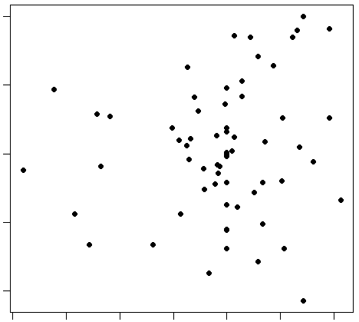
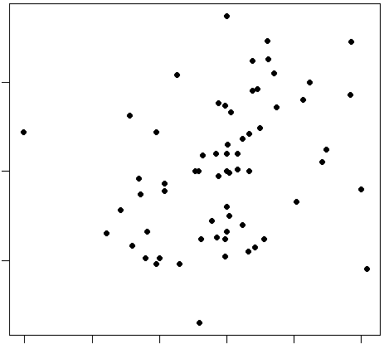
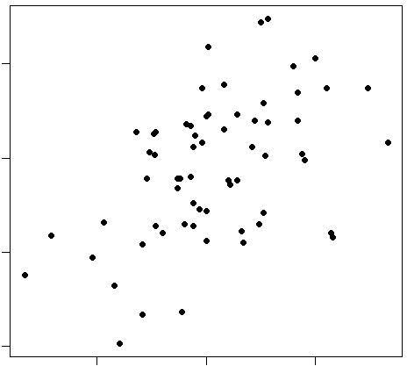
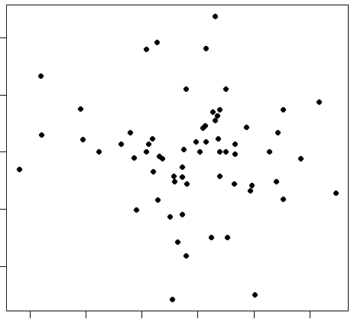
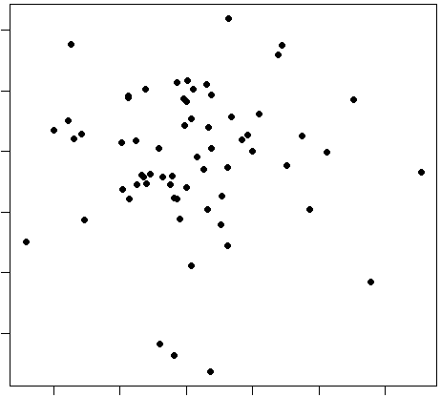
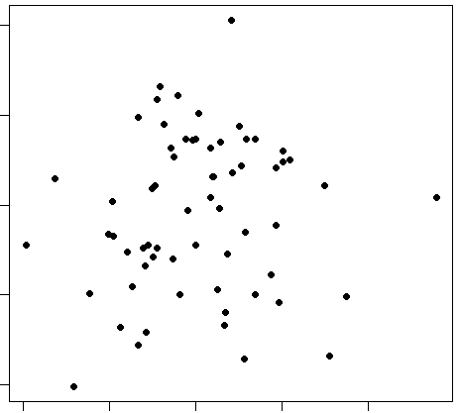
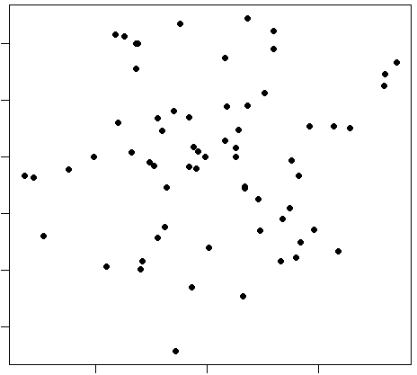
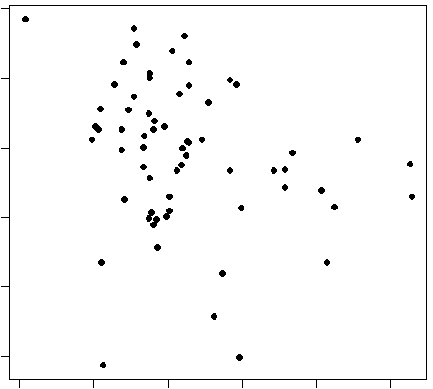
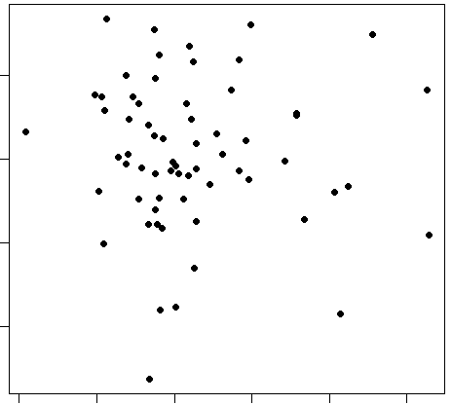
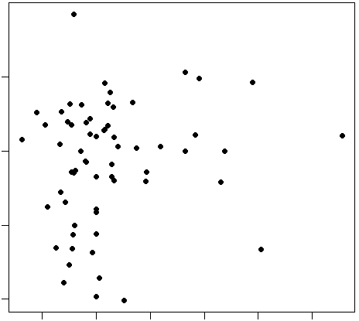
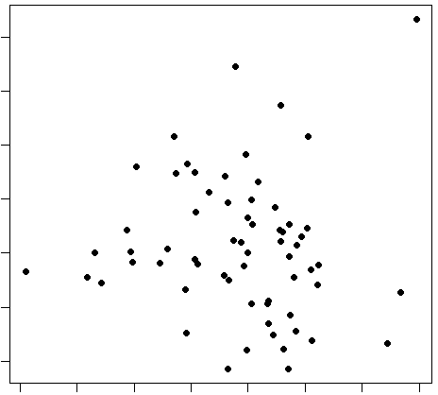
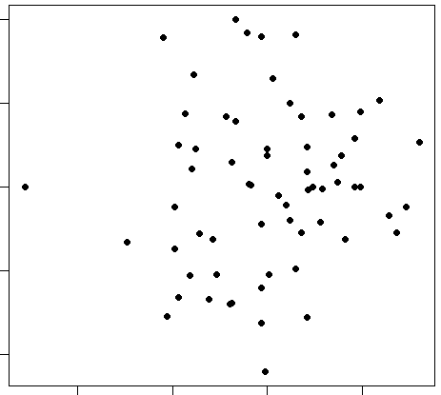
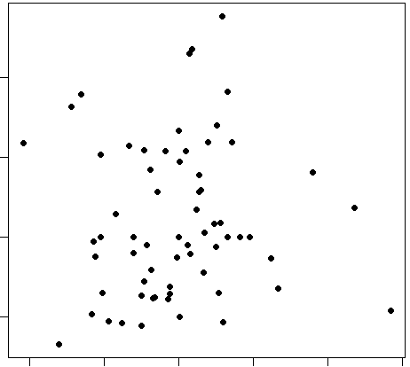
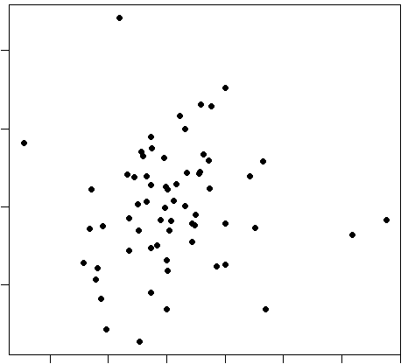
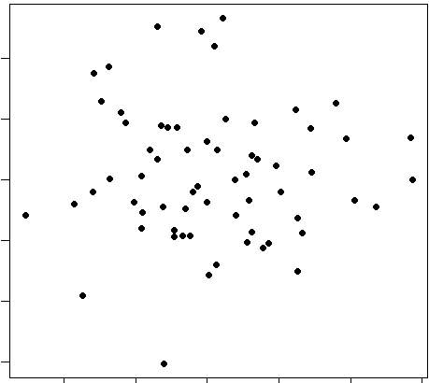
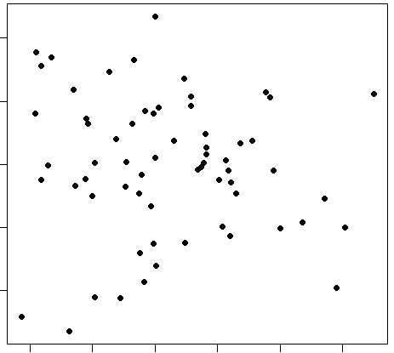
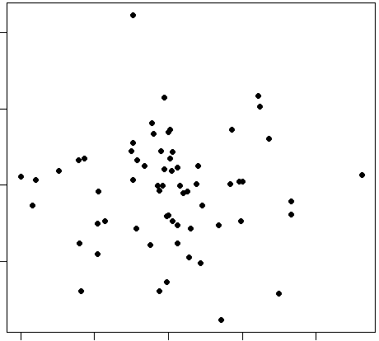
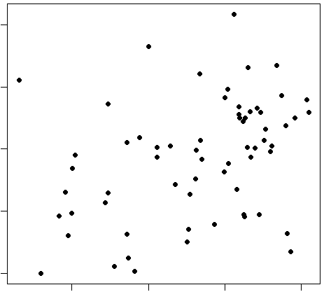
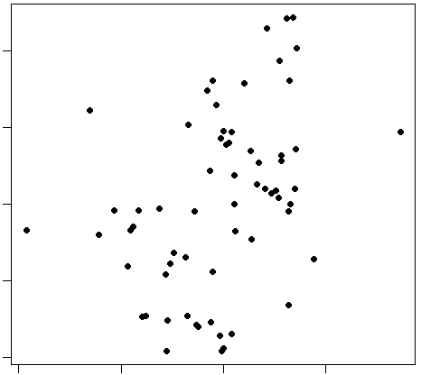
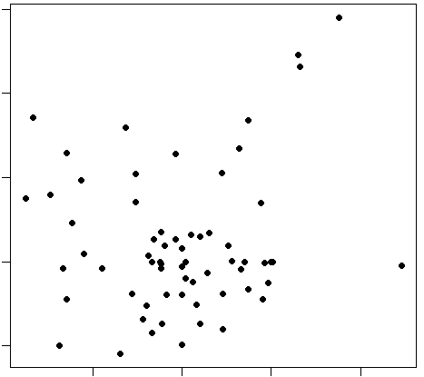
How do we visualize the expression of 8,500 genes (features, p)
across 105 breast cancer samples (n).
Do we have to consider all possible p(p-1)/2 ~ 36M 2D scatterplots?

Slide 23
How do we visualize the expression of 8,500 genes (features, p)
across 105 breast cancer samples (n).
Do we have to consider all possible p(p-1)/2 ~ 36M 2D scatterplots?
No! Let R worry about the computation.

Slide 24
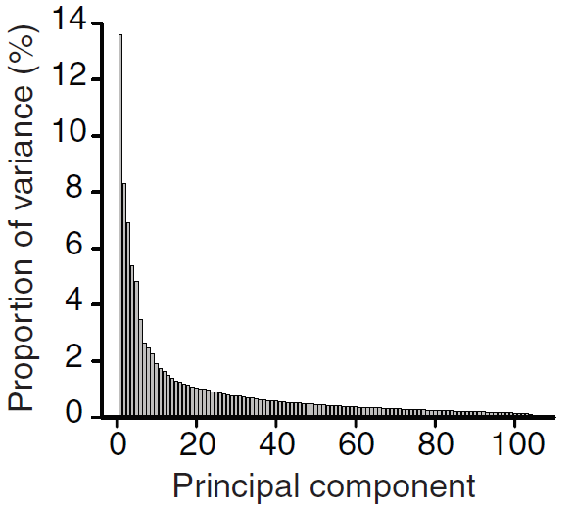
Principle component analysis: n =105 breast tumor samples, p = 8,500 genes
We get min(n-1, p) principal components, so 104 PCs.
But a small subset of these contains most of the information.
Proportion of the variance present in all genes contained within each principal component
22% of the variance is captured by PC1 and PC2
~50% of the variance by the first 10 components
104 components are required to retain the original variance.
14
12
10
8
Proportion of variance, %
6
2 to 10 is much less than 8,500
Dimensionality of our problem is greatly reduced.
4
2
0
0
20
40
60
80
100
Principal component
PMID: 18327243

Slide 25
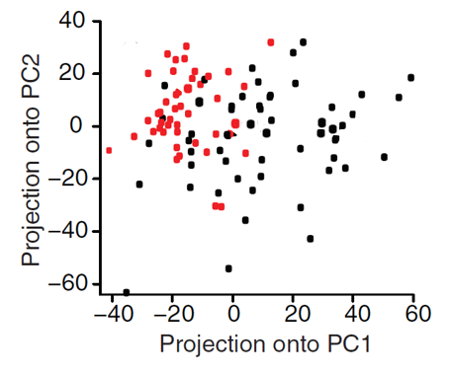
105 samples are plotted in 2D using their projections onto PC1 and PC2
What does a point on this plot mean?
Sample 17

Slide 26
105 samples with 2 genes are plotted in 2D as projections onto PC1 and PC2
Sample 17:
PC1 loading vector
0.89
0.46
PC1 = 0.89 · GATA3 + 0.46 · XBP1
[φ(1,1), φ(2,1)]^{T} =
pc(17,1) = φ(1,1) · χ(17,1) + φ(2,1) · χ(17,2)
χ(17,1), χ(17,2) are the expression
values for sample 17
PC2 = -0.61 · GATA3 + 0.80 · XBP1
PC2 loading vector
-0.61
0.80
pc(17,2) = φ(1,2) · χ(17,1) + φ(2,2) · χ(17,2)
[φ(1,2), φ(2,2)]^{T} =
pc(17,1) and pc(17,2) are PC scores for sample 17

Slide 27
105 samples with 8,500 genes are plotted in 2D as projections onto PC1 and PC2
What does a point on this plot mean?
Sample 17
{χ} original data (expression levels of genes
{φ} loading values from PCA
pc(17,1) = φ(1,1) · χ(17,1) + φ(2,1) · χ(17,2) + φ(3,1) · χ(17,3) + …… + φ(p,1) · χ(17,p)
pc(17,2) = φ(1,2) · χ(17,1) + φ(2,2) · χ(17,2) + φ(3,2) · χ(17,3) + …… + φ(p,2) · χ(17,p)

Slide 28
105 samples are plotted in 2D using their projections onto PC1 and PC2
ER+ and ER- samples are projected onto PC1 and PC2, which are linear combinations of the expression levels of genes.
Do PC1 and PC2 contain relevant information?
PMID: 18327243

Slide 29
105 samples are plotted in 2D using their projections onto PC1 and PC2
ER+ and ER- samples are projected onto PC1 and PC2, which are linear combinations of the expression levels of genes.
Do PC1 and PC2 contain relevant information?
ER+ and ER- are still separated
though not strictly distinct clusters
PMID: 18327243

Slide 30
What are some other clinical or phenotypic characteristics of breast cancer?
1. Estrogen receptor status, ER+ and ER-

Slide 31
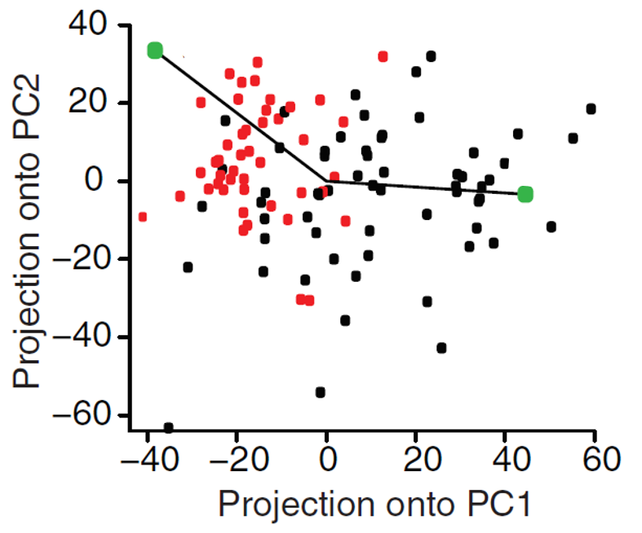
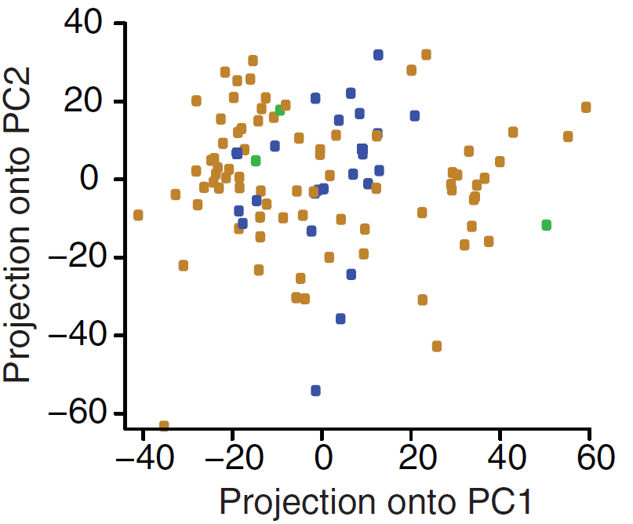
PCA and phenotypic relevance
ER+
ER-
ERBB2+
ERBB2-
unknown
PCA does not generate
two separate clusters
ERBB2 copy number info is lost in reduced dimension.
PCA emphasizes sources of greatest variability,
but doesn’t guarantee interpretability.
PMID: 18327243

Slide 32
PCA: Limitations
Linearity : PCA assumes that the principle components are a linear combination of the original features. If this is not true, PCA will not give you sensible results.
Large variance implies more structure: PCA uses variance as the measure of how important a particular dimension is. So, high variance axes are treated as principle components, while low variance axes are treated as noise. Centering and scaling.
Orthogonality: PCA assumes that the principle components are orthogonal.

Slide 33
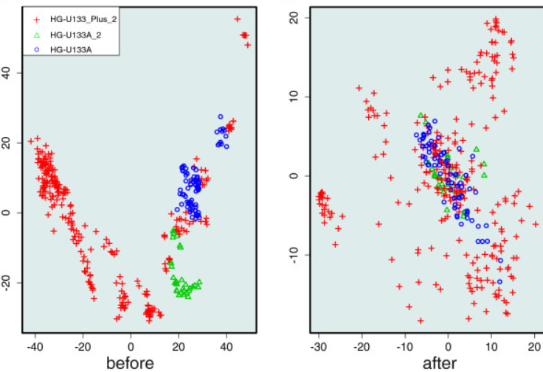
Principal Component Analysis and batch effect correction algorithms
● Integration and analysis of new high-throughput gene-expression and proteomic-profiling data. ● Technical heterogeneity or batch effects (different experiment times, handlers, reagent lots, etc.) are a major hurdle.
PMID: 24528953

Slide 34
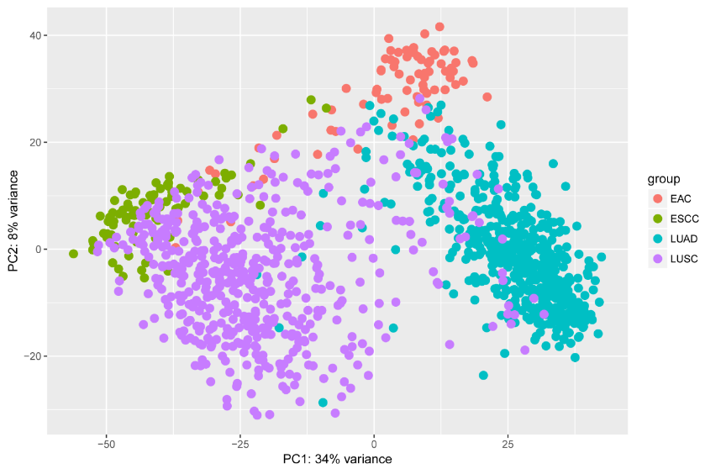
PCA, TCGA, and histology
Two major histological classes of solid tumors:
1) Adenocarcinomas: from cells that form glands
2) Squamous cell carcinomas: from cells that line organs
From TCGA:
80 esophageal adenocarcinomas (EAC),
81 esophageal squamous cell carcinomas (ESCC),
533 lung adenocarcinomas (LUAD),
502 lung squamous cell carcinomas (LUSC)
PMID: 28787442

Slide 35
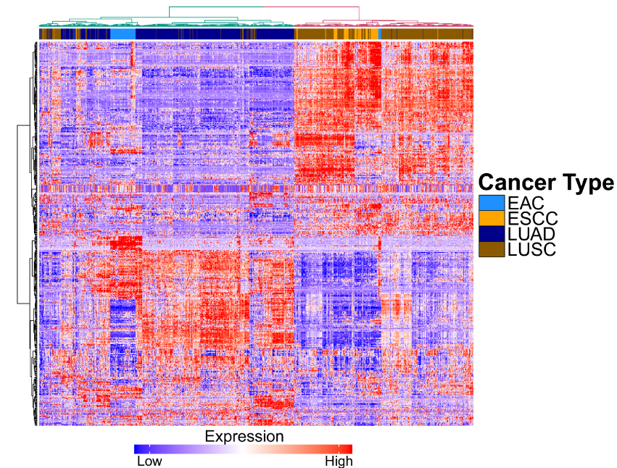
Heatmap of differentially expressed genes between esophageal cancers and lung cancers, with hierarchical clustering.
Adenocarcinomas
Squamous cell carcinomas
PMID: 28787442

