Slide 1
100%
Análise de Dados de Commodities
80%
Bruno Reina
Lerina Mastruian
10%

Slide 2


Apresentação
Lerina Mastruian
Joinville/SC
Analista de Dados
Bruno Reina
Concórdia/SC
Tutor Facilitador
de Engenharia

Slide 3
Premissas para a Análise
DATASET
Commodities Prices - Investing.com
Foram escolhidas as seguintes commodities: Petróleo, Trigo, Ouro e Gás Natural, entre os anos de de 2004 a 2022.
DADOS
As colunas disponíveis no conjunto foram: data e valores de negociação (abertura, fechamento, mínimo, máximo, alteração percentual e volume) separados para cada commodity.
DADOS FALTANTES
Podemos notar que no conjunto de dados não possuímos negociação no Trigo entre os anos de 2010 a 2015.

Slide 4
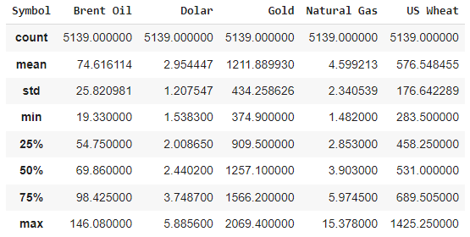
Análise estatística descritiva dos preços
Acumulados para cada commodity

Slide 5
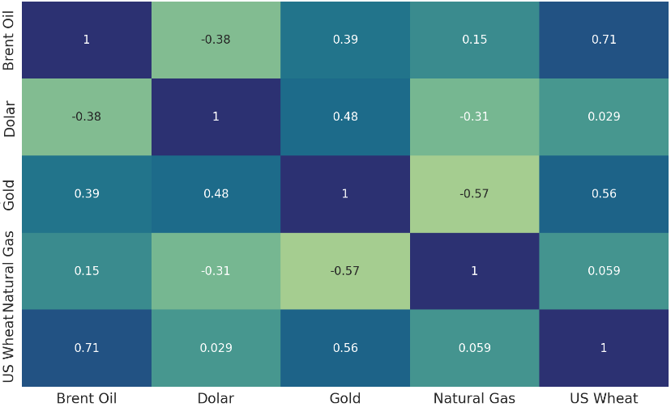
Correlações entre Preços

Slide 6
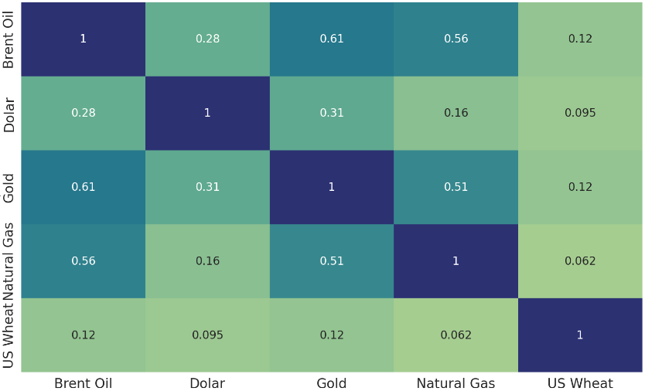
Correlações entre Volumes

Slide 7
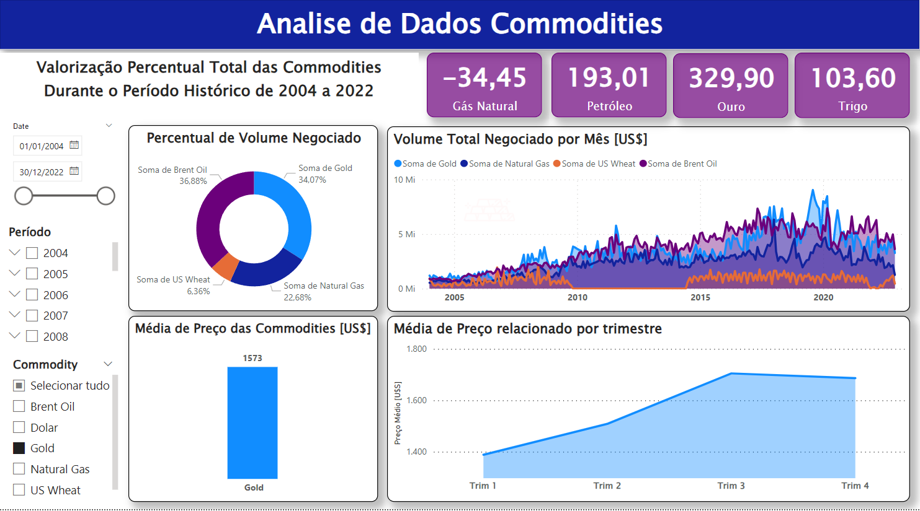

Slide 8
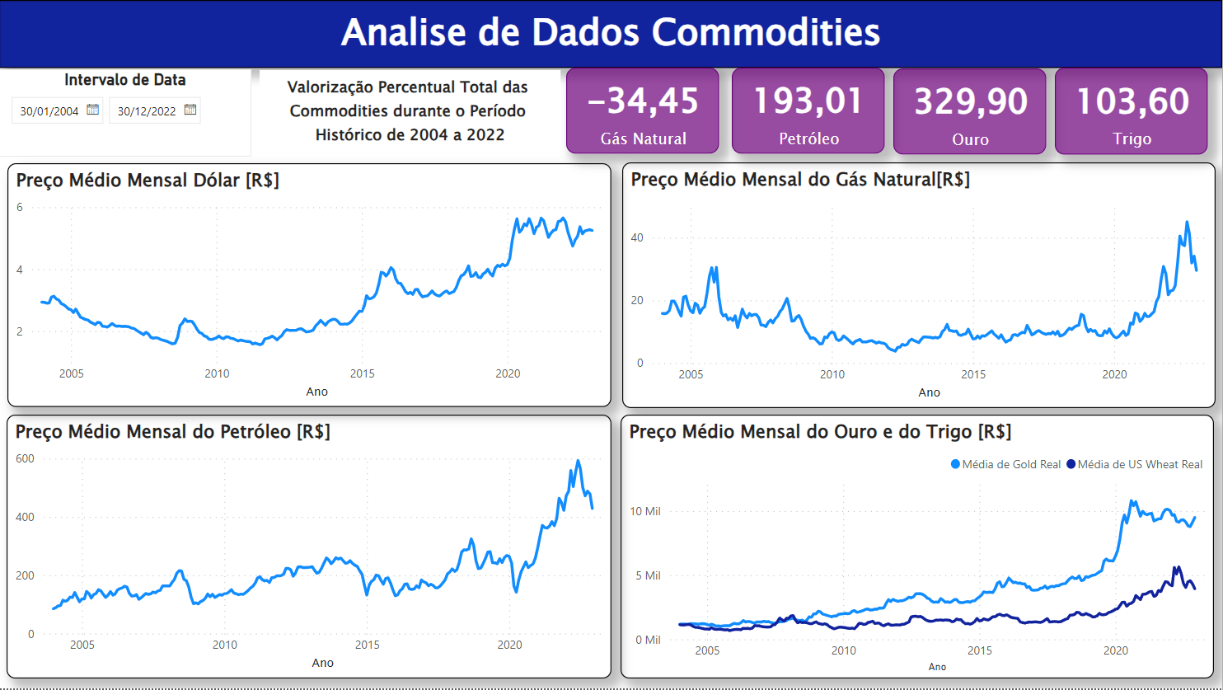

Slide 9
Conclusões da Análise
Na análise histórica, entendemos que o ouro e o trigo possuem comportamentos de gráficos parecidos, onde realizamos análise de correlação e houve a confirmação.
Notamos que o petróleo entra em estágio de valores mínimos em média a cada 5 anos.
Durante o período histórico completo analisado, o ouro foi a commodity que teve a maior valorização percentual.
Não conseguimos encontrar evidência da falta de dados para o trigo no período entre 2010 e 2015.
Apesar dos últimos aumentos recentes, devido a guerra entre Rússia e Ucrânia, o gás natural foi a única commodity que ainda teve um decréscimo percentual entre 2004 e 2022.

Slide 10
Conclusões da Análise
O volume negociado do ouro, do trigo e do petróleo estão diretamente correlacionados, quando um aumenta o outro aumenta, visto que os 3 possuem correlações positivas acima de 50%.
O preço do ouro está diretamente relacionado aos preços do gás natural e do trigo, apresentando correlações positivas de 57% e 56%, respectivamente.
O preço do petróleo e do trigo estão fortemente relacionados e de maneira positiva, ou seja, quando um aumenta o outro aumenta, apresentando uma correlação de 71%.
A commodity mais impactada pelo dólar é o ouro, apresentando uma correlação positiva de 48%.
Apesar do ouro ter um preço médio muito superior às demais commodities, a commodity com o maior volume negociado no período foi o petróleo, com 37% do volume total, enquanto o ouro ficou em segundo lugar, com 34%.

Slide 11
Escopo
MARS
JUPITER
Despite being red, Mars is actually a very cold place
Jupiter is a gas giant and the biggest planet
OUR COMPANY
MERCURY
SATURN
Mercury is the closest planet to the Sun
It’s composed of hydrogen and also helium

Slide 12
Budget Infographics
10%
20%
30%
40%
MERCURY
MARS
JUPITER
VENUS
Mercury is the closest planet to the Sun
Despite being red, Mars is actually a cold place
Jupiter is a gas giant and the biggest planet
Venus is the second planet from the Sun

Slide 13
Budget Infographics
MERCURY
Mercury is the closest planet to the Sun and the smallest one
VENUS
Venus has a beautiful name and is the second planet from the Sun
MARS
Despite being red, Mars is a very cold place full of iron oxide dust

Slide 14
Escopo
MARS
JUPITER
Despite being red, Mars is actually a very cold place
Jupiter is a gas giant and the biggest planet
OUR COMPANY
MERCURY
SATURN
Mercury is the closest planet to the Sun
It’s composed of hydrogen and also helium

Slide 15
Budget Infographics
SATURN
JUPITER
It’s composed of hydrogen and also helium
Jupiter is a gas giant and the biggest planet
MARS
MERCURY
Despite being red, Mars is actually a cold place
Mercury is the closest planet to the Sun
VENUS
NEPTUNE
Venus is the second planet from the Sun
Neptune is the farthest planet from the Sun

Slide 16
Budget Infographics
MONTH 2
MONTH 4
Venus has a beautiful name and is the second planet
Neptune is the farthest planet from the Sun and the fourth-largest
MONTH 1
MONTH 3
MONTH 5
Mercury is the closest planet to the Sun and the smallest
Despite being red, Mars is actually a very cold place
Jupiter is a gas giant and the biggest planet in the Solar System

Slide 17
Budget Infographics
MARS
JUPITER
Despite being red, Mars is actually a cold place
Jupiter is a gas giant and the biggest planet of them all
VENUS
MERCURY
Venus has a beautiful name and is the second planet
Mercury is the closest planet to the Sun and the smallest one

Slide 18
Budget Infographics
MARS
VENUS
Despite being red, Mars is actually a very cold place
Venus is the second planet from the Sun
MERCURY
JUPITER
Mercury is the closest planet to the Sun
Jupiter is a gas giant and the biggest planet

Slide 19
Budget Infographics
10%
40%
30%
20%
50%
MONTH 1
MONTH 2
MONTH 3
MONTH 4
MONTH 5
Saturn has several rings
Mars is a very cold place
Mercury is the smallest planet
Jupiter is a gas giant
Earth is the third planet
Venus has a beautiful name and is the first

Slide 20
Budget Infographics
MARS
JUPITER
100,000,000
400,000,000
200,000,000
500,000,000
300,000,000
600,000,000
200,000,000
200,000,000

Slide 21
Budget Infographics
10%
Neptune is the farthest planet from the Sun
20%
Venus is the second planet from the Sun
30%
Jupiter is the biggest planet in the Solar System
40%
Mercury is the closest planet to the Sun

Slide 22
Budget Infographics
SATURN
JUPITER
MERCURY
MARS
Saturn is a gas giant and has several rings
It’s a gas giant and the biggest planet of them all
Mercury is the smallest planet in the Solar System
Despite being red, Mars is actually a very cold place
10%
20%
30%
40%

Slide 23
Jan
Feb
Mar
Apr
May
Jun
Jul
Aug
Sep
Oct
Nov
Dec
Budget Infographics
2024
2023
2022
2021
2020
MERCURY
MARS
Mercury is the closest planet to the Sun and the smallest one
Despite being red, Mars is actually a cold place place

Slide 24
Budget Infographics
Jan
Feb
Mar
Apr
May
Jun
Jul
Aug
Sep
Oct
Nov
Dec
MERCURY
NEPTUNE
Mercury is the closest planet to the Sun and the smallest one
Neptune is the fourth-largest planet in the Solar System

Slide 25
Budget Infographics
Jan
Feb
Mar
Apr
May
Jun
Jul
Aug
Sep
Oct
Nov
Dec
MERCURY
MARS
JUPITER
NEPTUNE
Mercury is the closest planet to the Sun
Despite being red, Mars is a cold place
Jupiter is a gas giant and the biggest planet
Neptune is the farthest planet

Slide 26
Budget Infographics
1000
900
800
MERCURY
700
Mercury is the closest planet to the Sun and the smallest one
600
500
400
300
MARS
200
100
Despite being red, Mars is actually a cold place
2020
2021
2022
2023
2024

Slide 27
Budget Infographics
MARS
Neptune is the fourth-largest planet in the Solar System
VENUS
JUPITER
Venus has a beautiful name and is the second one from the Sun
Jupiter is a gas giant and the biggest planet in the Solar System

Slide 28
Budget Infographics
MARS
JUPITER
Despite being red, Mars is actually a very cold place
Jupiter is the biggest planet in the Solar System
10%
40%
MERCURY
SATURN
Mercury is the closest planet to the Sun and the smallest
Saturn is composed of hydrogen and also helium
20%
30%

Slide 29
Budget Infographics
MERCURY
2020
Mercury is the smallest planet of all of them
2019
MARS
2018
Despite being red, Mars is actually a cold place
100
300
500
700
900

Slide 30
Budget Infographics
MERCURY
SATURN
Mercury is the closest planet to the Sun and the smallest one
Saturn is composed mostly of hydrogen and helium
40%
30%
20%
MARS
VENUS
10%
Despite being red, Mars is a very cold place full of iron oxide dust
Venus has a beautiful name and is the second planet from the Sun

Slide 31
Budget Infographics
MERCURY
MARS
NEPTUNE
Mercury is the closest planet to the Sun
Despite being red, Mars is a cold place
Neptune is the farthest planet

Slide 32
Budget Infographics
JUPITER
70%
Jupiter is a gas giant and the biggest planet of them all
MERCURY
Mercury is the closest planet to the Sun and the smallest
20%
VENUS
10%
Venus has a beautiful name and is the second planet

Slide 33
Budget Infographics
MARS
Despite being red, Mars is a very cold place full of iron
VENUS
Venus has a beautiful name and is the second
MERCURY
Mercury is the closest planet to the Sun and the smallest
JUPITER
Jupiter is a gas giant and the biggest planet

Slide 34
Budget Infographics
Mercury is the closest planet to the Sun and the smallest
Jupiter is the biggest planet in the Solar System
MERCURY
JUPITER
Despite being red, Mars is actually a very cold place
Saturn is composed of hydrogen and also helium
MARS
SATURN

Slide 35

Juanje Millán
7:56 Hoy
Mirar el espacio entre párrafos, sobre todo en la columna de la izquierda
Budget Infographics
100,000,000
200,000,000
300,000,000
MARS
VENUS
JUPITER
Despite being red, Mars is actually a very cold place
Venus is the second planet from the Sun
Jupiter is a gas giant and the biggest planet

Slide 36
Budget Infographics
SATURN
JUPITER
Saturn is a gas giant and has several rings
Jupiter is a gas giant and the biggest planet
MERCURY
SATURN
Mercury is the closest planet to the Sun
Despite being red, Mars is actually a cold place
OUR COMPANY
VENUS
NEPTUNE
Venus is the second planet from the Sun
Neptune is the farthest planet from the Sun

Slide 37
Budget Infographics
Mercury is the closest planet to the Sun
Despite being red, Mars is a cold place
Venus is the second planet from the Sun
SATURN
20%
JUPITER
40%
NEPTUNE
60%
10%
MERCURY
30%
MARS
50%
VENUS
Saturn is a gas giant and has several rings
Jupiter is the biggest planet in the Solar System
Neptune is the farthest planet from the Sun

Slide 38
Budget Infographics
MARS
VENUS
Despite being red, Mars is actually a cold place
Venus is the second planet from the Sun
OUR COMPANY
MERCURY
JUPITER
Mercury is the closest planet to the Sun
Jupiter is the biggest planet of them all
SATURN
NEPTUNE
It’s composed of hydrogen and helium
Neptune is the farthest planet from the Sun

Slide 39
Budget Infographics
SATURN
JUPITER
NEPTUNE
It’s composed of hydrogen and helium
Jupiter is the biggest planet of them all
Neptune is the farthest planet from the Sun
10%
20%
30%
40%
50%
MERCURY
MARS
Mercury is the closest planet to the Sun
Despite being red, Mars is a cold place

Slide 40
Budget Infographics
10%
20%
30%
40%
SATURN
JUPITER
MERCURY
MARS
This gas giant has several rings
Jupiter is the biggest planet
Mercury is the smallest planet
Despite being red, Mars is a very cold

Slide 41
Budget Infographics
50%
40%
30%
20%
10%
2017
2018
2019
2020
MERCURY
MARS
SATURN
NEPTUNE
Mercury is the closest planet to the Sun
Despite being red, Mars is a cold place
It’s the only one with rings of all of them
It’s the farthest one from the Sun

Slide 42
Instructions for use
In order to use this template, you must credit Slidesgo and Freepik in your final presentation and include links to both websites.
You are allowed to:
- Modify this template.
- Use it for both personal and commercial projects.
You are not allowed to:
- Sublicense, sell or rent any of Slidesgo Content (or a modified version of Slidesgo Content).
- Distribute Slidesgo Content unless it has been expressly authorized by Slidesgo.
- Include Slidesgo Content in an online or offline database or file.
- Offer Slidesgo templates (or modified versions of Slidesgo templates) for download.
- Acquire the copyright of Slidesgo Content.
For more information about editing slides, please read our FAQs or visit Slidesgo School:
https://slidesgo.com/faqs and https://slidesgo.com/slidesgo-school

Slide 43
Infographics
You can add and edit some infographics to your presentation to present your data in a visual way.
Choose your favourite infographic and insert it in your presentation using Ctrl C + Ctrl V or Cmd C + Cmd V in Mac.
Select one of the parts and ungroup it by right-clicking and choosing “Ungroup”.
Change the color by clicking on the paint bucket.
Then resize the element by clicking and dragging one of the square-shaped points of its bounding box (the cursor should look like a double-headed arrow). Remember to hold Shift while dragging to keep the proportions.
Group the elements again by selecting them, right-clicking and choosing “Group”.
Repeat the steps above with the other parts and when you’re done editing, copy the end result and paste it into your presentation.
Remember to choose the “Keep source formatting” option so that it keeps the design. For more info, please visit Slidesgo School.

