Slide 1

Circuit Theory and Electronics Fundamentals
Lab 2: RC Circuit Analysis

Slide 2
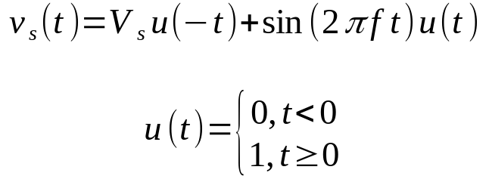
The RC circuit
1
2
3
R₁
R₂
+
-
+
V_{b}
-
R₃
I_{b} = K_{b} V_{b}
5
6
R₄
R₅
+
-
I_{c}
R₆
I_{d}
V_{d} = K_{d} I_{d}
C
7
R₇
8

Slide 3
Simulation Analysis
Simulate the operating point for t<0, to obtain the voltages in all nodes and the currents in all branches. Print a table with the results.
Simulate the operating point for v_{s}(0)=0, replacing the capacitor with with a voltage source V_{x} = V(6)-V(8), where V(6) and V(8) are the voltages in nodes 6 and 8 as obtained in 1). Explain why you need this step. Print a table with the results.
Simulate the natural response of the circuit, using the boundary conditions V(6) and V(8) as obtained in 2) (use Ngspice directive .ic V(6)=... v(9)=...). Use Ngpice’s transient analysis mode to get v₆(t) in the interval [0, 20] ms. Plot the result.
Simulate the natural and forced response on node 6 by repeating step 3) with v_{s}(t) as given in Fig. 1 and f=1kHz. Plot both the stimulus and the response.
Simulate the frequency response in node 6 (frequency logscale, magnitude in dB, phase in degrees) for the frequency range 0.1 Hz to 1 MHz. Plot both v_{s}(f) and v₆(f) in the same figure and explain how and why they differ.

Slide 4
Theoretical Analysis
Use the nodal method to determine the voltages in all nodes and currents in all branches for t<0. Print a table with the results.
Determine the equivalent resistance R_{eq} as seen from the capacitor terminals. Suggestion: make V_{s}=0 and replace the capacitor with a voltage source V_{x}= V(6)-V(8), where V(6) and V(8) are the voltages in nodes 6 and 8 as obtained in 1); run nodal analysis to determine the current I_{x} supplied by V_{x}; compute the equivalent resistor as R_{eq} = V_{x}/I_{x},and the time constant. Explain why you need this procedure, and print a table with the computed results.
With the results obtained in 2), determine the natural solution v_{6n}(t), in the interval [0, 20] ms, using the capacitor voltage V_{x} for t<0 as the initial condition. Plot the result, identifying all axes, signals displayed and units used.
Determine the forced solution v_{6f}(t) in the same interval. Suggestion: use a phasor voltage source V_{s}; replace C with its impedance Z_{C}; run nodal analysis to determine the phasor voltages in all nodes. Print a table with the results.
Determine the final total solution v₆(t), converting the phasors to real time functions for f=1KHz, and superimposing the natural and forced solutions. Plot both v_{s}(t) and v₆(t) in the same figure in the interval [-5, 20] ms.
Determine the frequency responses v_{c}(f)=v₆(f)-v₈(f), and v₆(f) (frequency logscale magnitude in dB, phase in degrees) for frequency range 0.1 Hz to 1 MHz. Plot v_{s}(f), v_{c}(f) and v₆(f) in the same figure and explain how and why they differ.

Slide 5
Lab report
The Python script, t2_datagen.m output should be redirected to a file data.txt using bash’s “>” facility.
The octave script should read and use the data file data.txt, and output a data file for Ngspice (directive .include). Use file I/O functions such as fprintf and fscanf.
Ideally, generating a new data set with a different student number and re-running the top Makefile should produce consistent results.
Produce all tables and plots required in the simulation and analysis sections
Compare Octave and Ngspice results side by side looking for exactness or discrepancy, and explaining both. Read the repository’s README file.

