Slide 1
Software Product Line Analysis Techniques
Ramy Shahin
Qualifying Oral - March 19th 2018

Slide 2
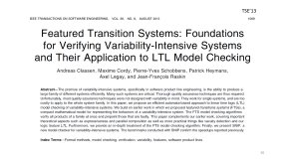
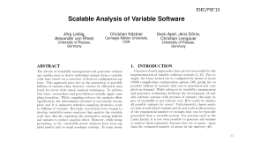
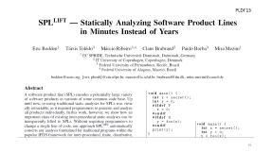
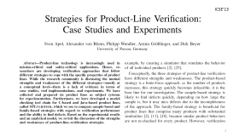
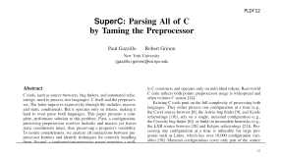
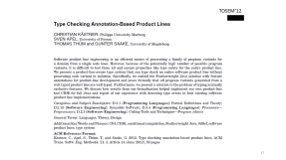
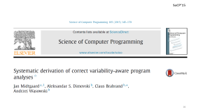

Slide 3
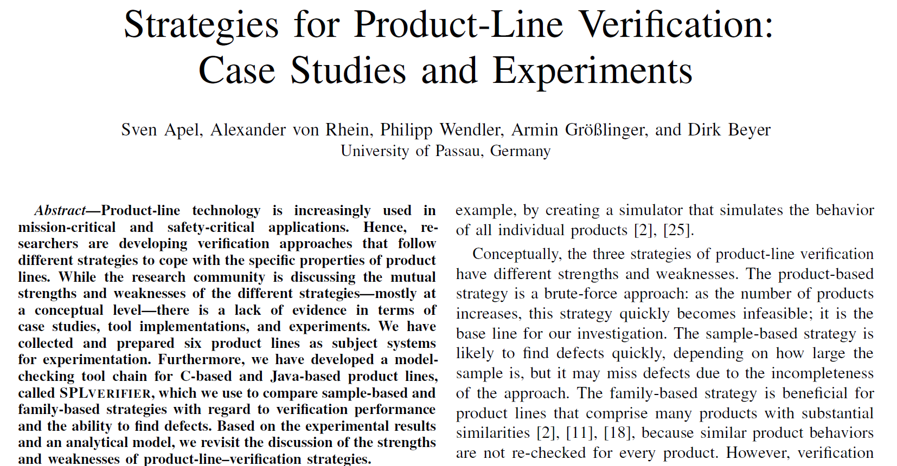
ICSE’13

Slide 4
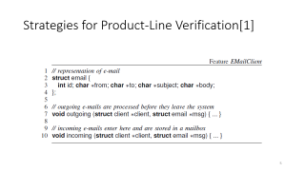
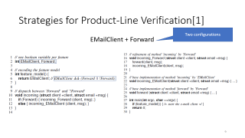
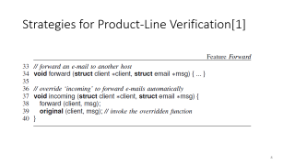
Strategies for Product-Line Verification[1]
Generative SPL

Slide 5
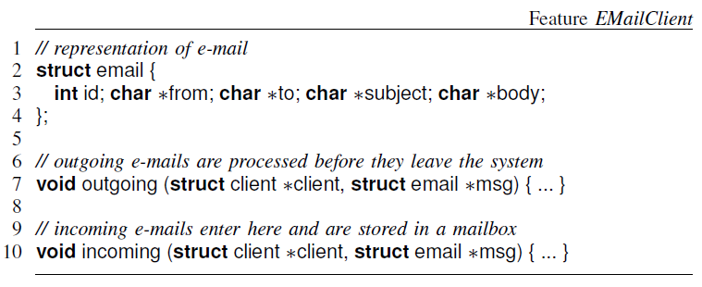
Strategies for Product-Line Verification[1]

Slide 6
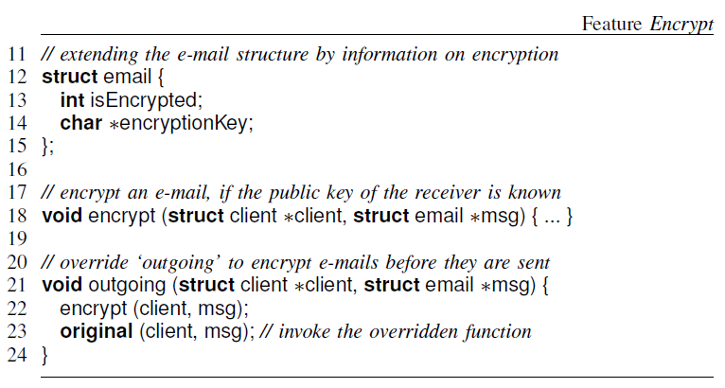
Strategies for Product-Line Verification[1]
Notes:
ICSE’13 – Sven Apel et al. – University of Passau, Germany
Product-based, Sample-based and Family-based strategies

Slide 7
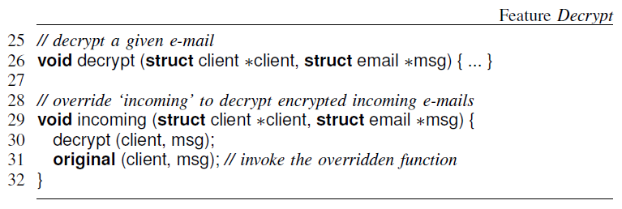
Strategies for Product-Line Verification[1]
Notes:
ICSE’13 – Sven Apel et al. – University of Passau, Germany
Product-based, Sample-based and Family-based strategies

Slide 8
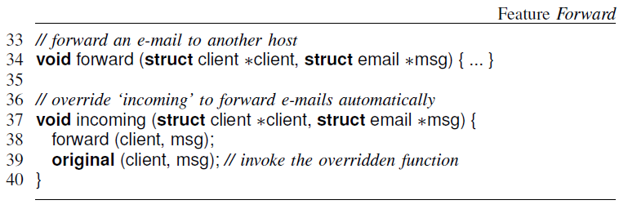
Strategies for Product-Line Verification[1]
Notes:
ICSE’13 – Sven Apel et al. – University of Passau, Germany
Product-based, Sample-based and Family-based strategies

Slide 9
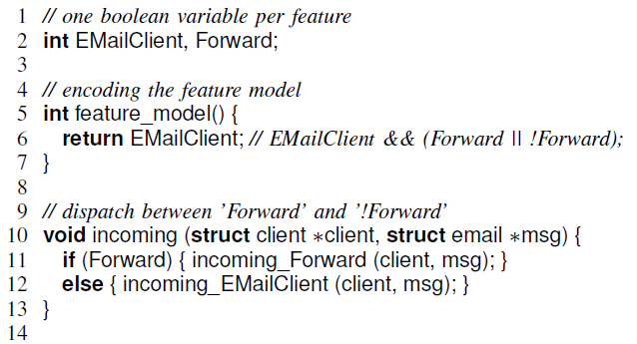
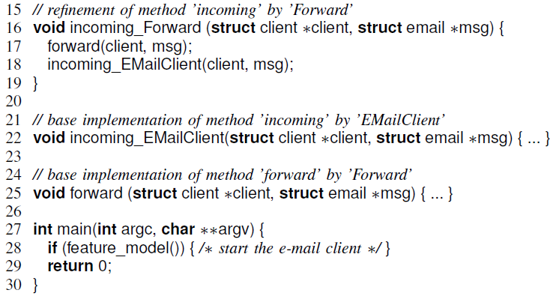
Strategies for Product-Line Verification[1]
Two configurations
EMailClient + Forward
Notes:
Aspect weaving
Boolean variable per feature
Feature model predicate
Incoming dispatch function

Slide 10
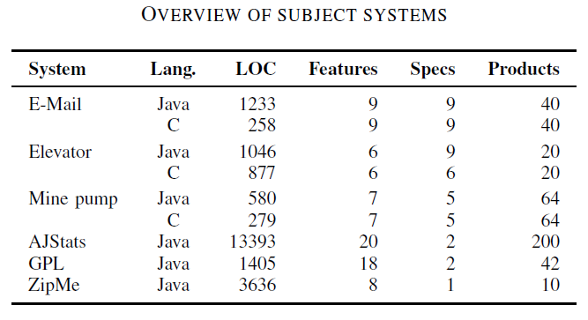
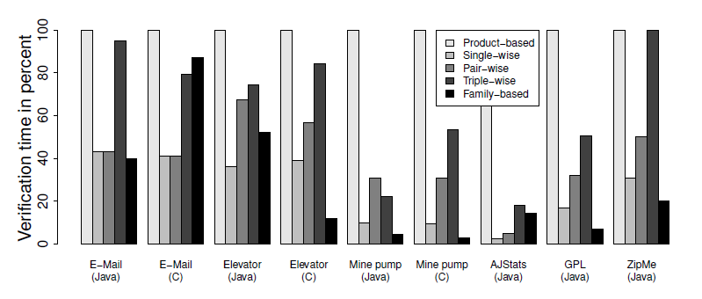
Strategies for Product-Line Verification[1]
Notes:
Evaluation: small systems (LOC, features, specifications and # of products)
CPAChecker for C code, Java Pathfinder for Java
Product-based is the baseline
Sampling does not find all defects
In some cases family-based outperform sampling

Slide 11
Strategies for Product-Line Verification[1]
Compares product-based, sampling-based and family-based strategies
Uses existing model checkers (CPAChecker and Java Pathfinder) as is
Applicable only to generative product lines
Only supports very basic forms of variability
Generates a new function per configuration
Evaluates only single-wise, pair-wise and triple-wise sampling
Notes:
Evaluation: small systems (LOC, features, specifications and # of products)
CPAChecker for C code, Java Pathfinder for Java
Product-based is the baseline
Sampling does not find all defects
In some cases family-based outperform sampling

Slide 12
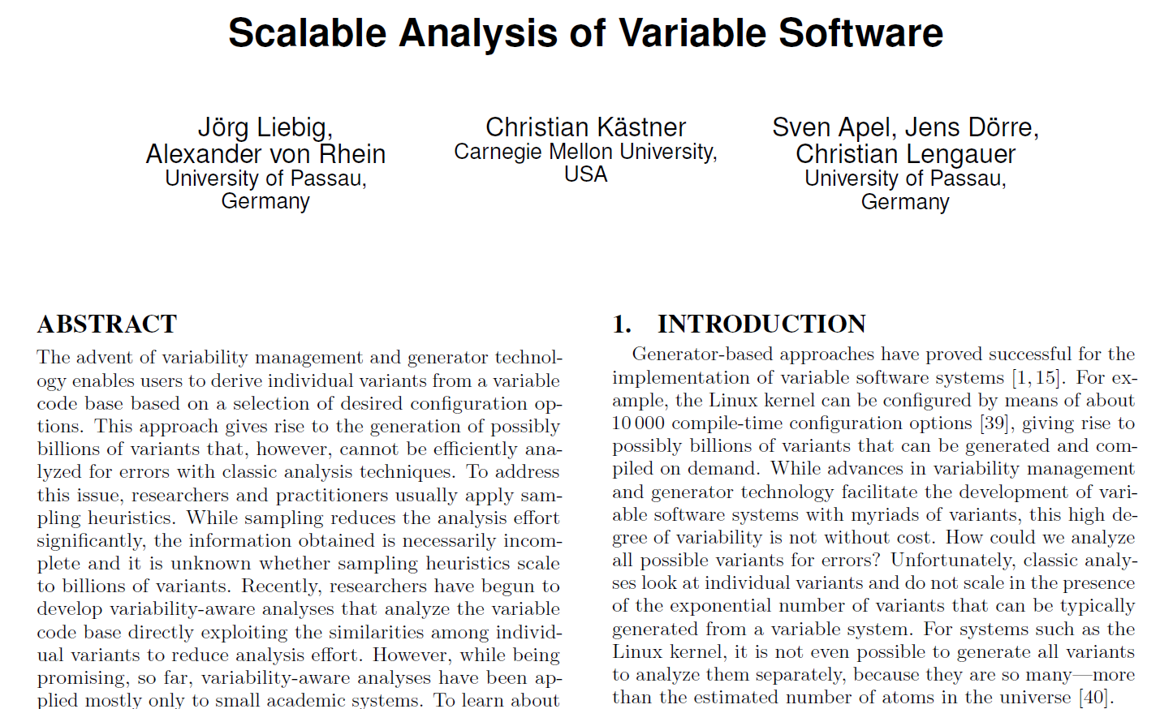
ESEC/FSE’13

Slide 13
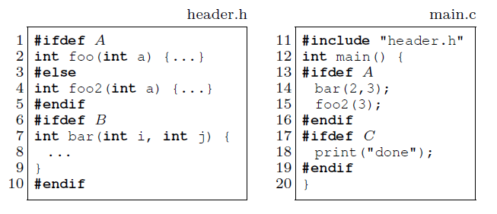
Scalable Analysis of Variable Software
Sampling Strategies:
Single-conf (e.g. {B,C})
Random
Code-coverage (e.g. {}, {A,B,C})
Pair-wise ({}, {A,B}, {B,C}, {A,C})
Annotative SPL (3 optional features)

Slide 14
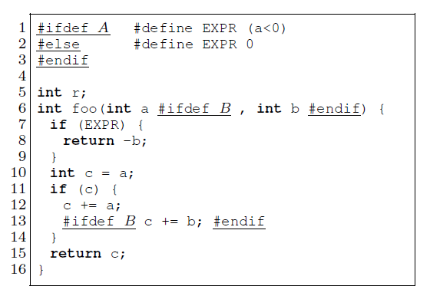
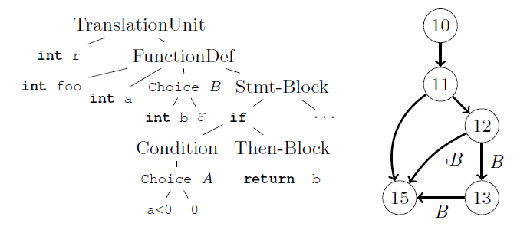
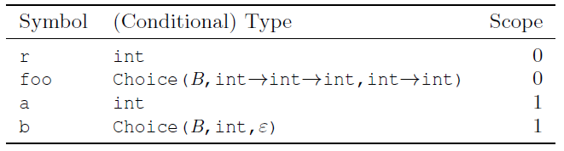
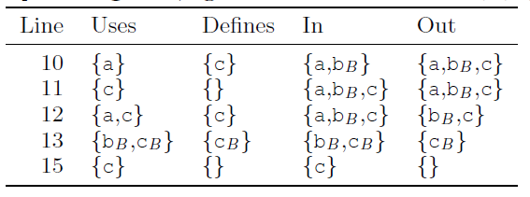
Scalable Analysis of Variable Software

Slide 15
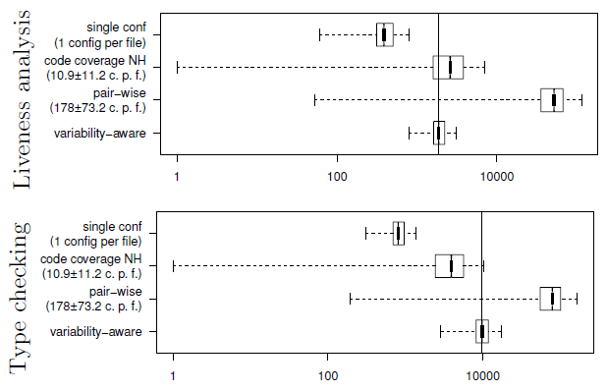
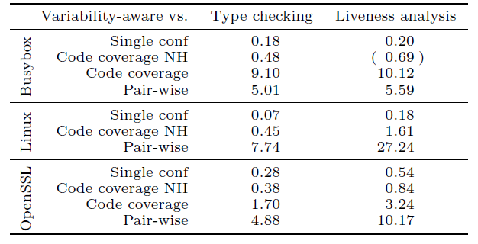
Scalable Analysis of Variable Software

Slide 16
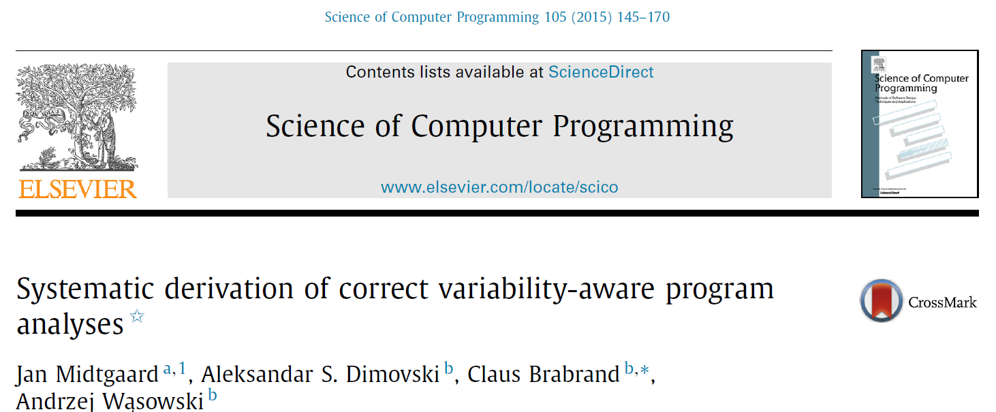
SoCP’15

Slide 17
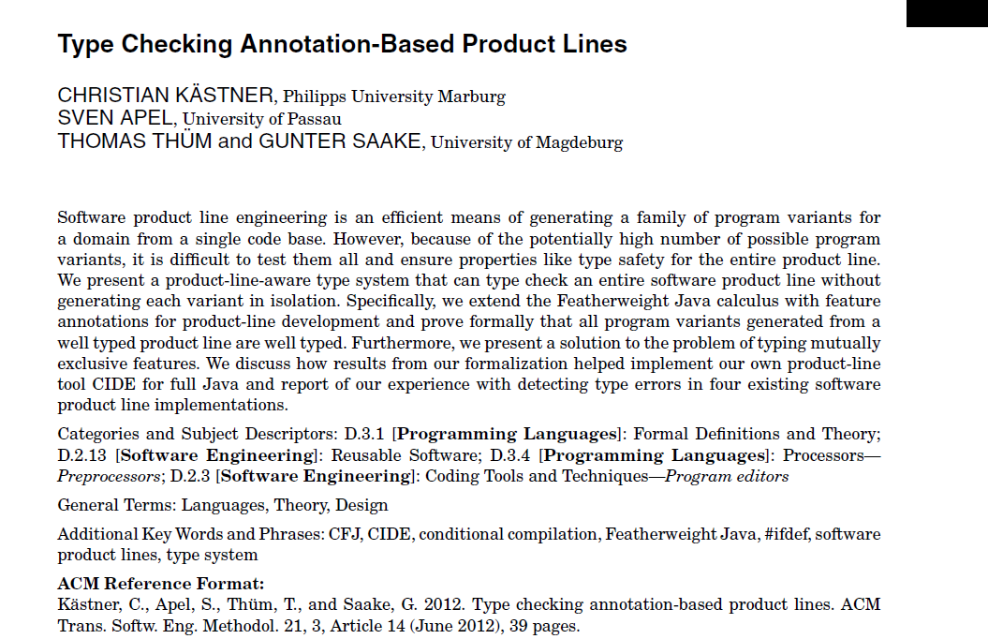
TOSEM’12

Slide 18
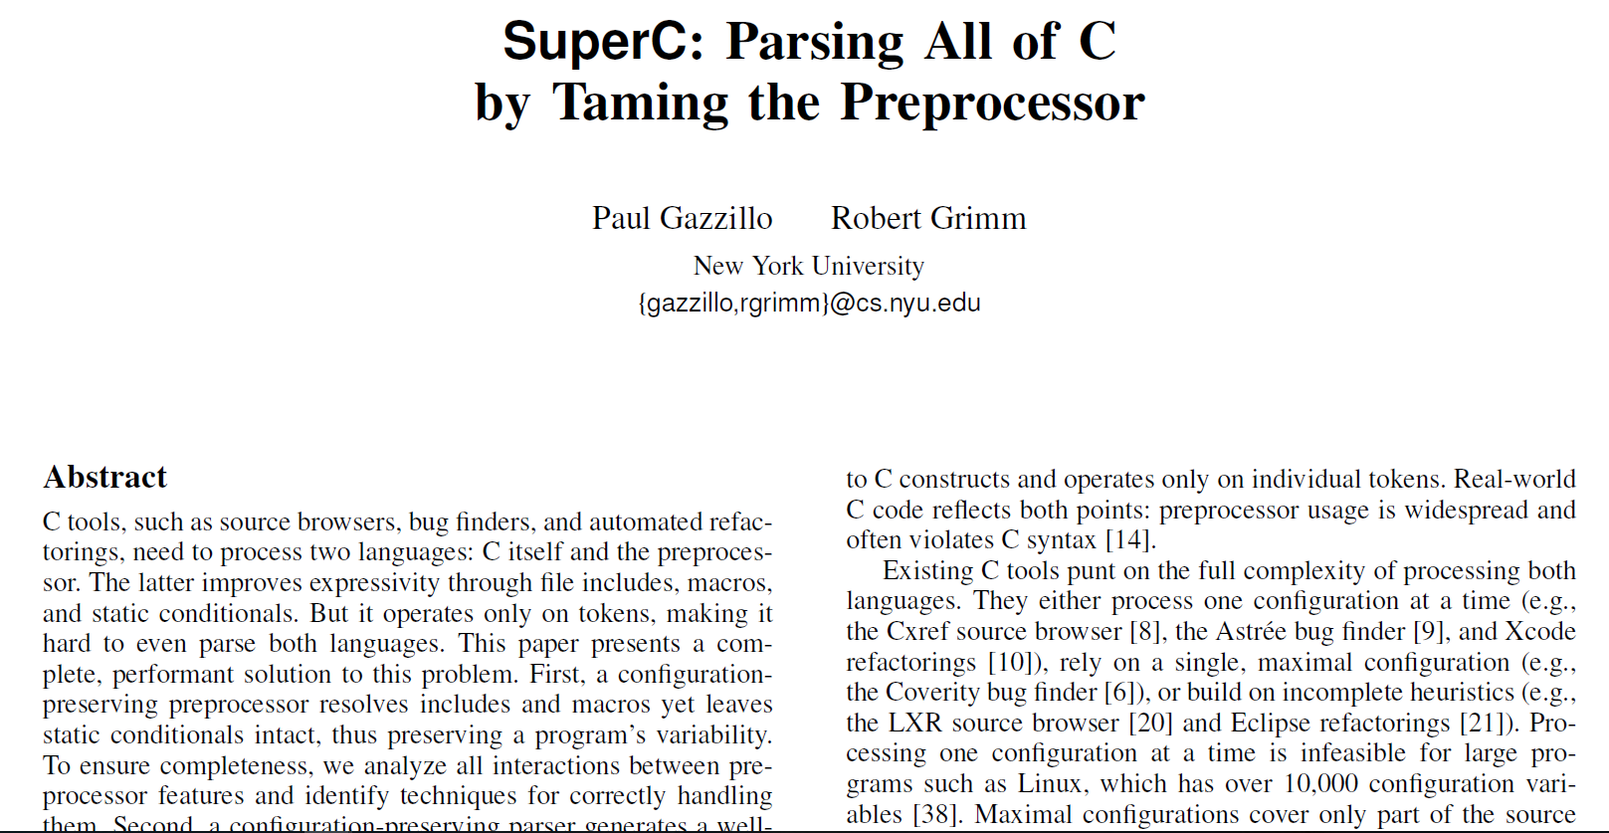
PLDI’12

Slide 19
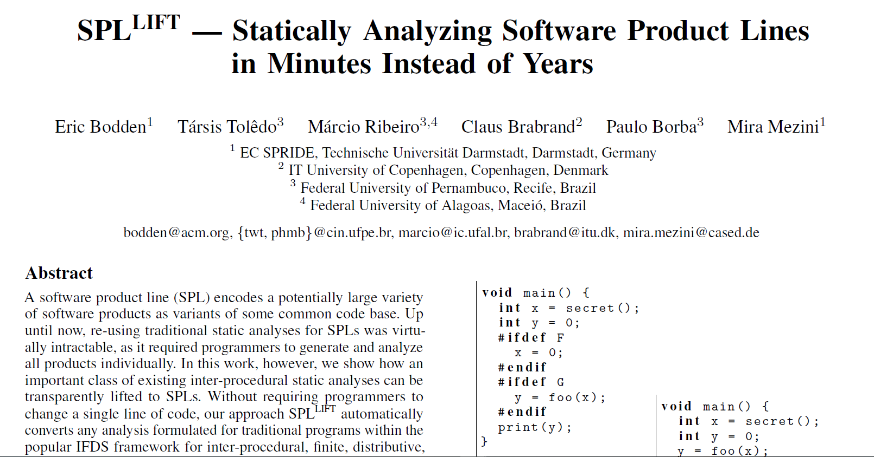
PLDI’13

Slide 20
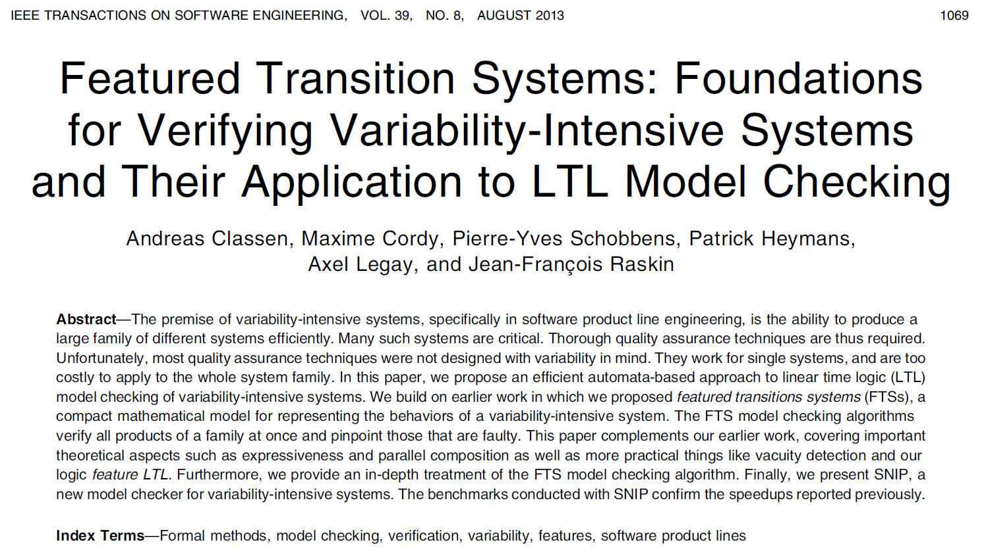
TSE’13

Slide 21
References
[1] S. Apel, A. v. Rhein, P. Wendler, A. Gröÿlinger, and D. Beyer. Strategies for Product-Line Verification: Case Studies and Experiments. In Proceedings of the 2013 International Conference on Software Engineering, ICSE '13, pages 482491, Piscataway, NJ, USA, 2013. IEEE Press.
[2] J. Liebig, A. von Rhein, C. Kästner, S. Apel, J. Dörre, and C. Lengauer. Scalable Analysis of Variable Software. In Proceedings of the 2013 9th Joint Meeting on Foundations of Software Engineering, ESEC/FSE 2013, pages 8191, New York, NY, USA, 2013. ACM.
[3] J. Midtgaard, A. S. Dimovski, C. Brabrand, and A. W¡sowski. Systematic derivation of correct variability-aware program analyses. Sci. Comput. Program., 105(C):145170, July 2015.
[4] C. Kästner, S. Apel, T. Thüm, and G. Saake. Type Checking Annotation-Based Product Lines. ACM Trans. Softw. Eng. Methodol., 21(3):14:114:39, July 2012.
[5] P. Gazzillo and R. Grimm. SuperC: Parsing All of C by Taming the Preprocessor. In Proceedings of the 33rd ACM SIGPLAN Conference on Programming Language Design and Implementation, PLDI '12, pages 323334, New York, NY, USA, 2012. ACM.
[6] E. Bodden, T. Tolêdo, M. Ribeiro, C. Brabrand, P. Borba, and M. Mezini. SPLLIFT: Statically Analyzing Software Product Lines in Minutes Instead of Years. In Proceedings of the 34th ACM SIGPLAN Conference on Programming Language Design and Implementation, PLDI '13, pages 355364, New York, NY, USA, 2013. ACM.
[7] A. Classen, M. Cordy, P.-Y. Schobbens, P. Heymans, A. Legay, and J.-F. Raskin. Featured Transition Systems: Foundations for Verifying Variability-Intensive Systems and Their Application to LTL Model Checking. IEEE Trans. Softw. Eng., 39(8):1069-1089, Aug. 2013.

