Slide 1
Safety Cases for Software Product Lines: Terminology and Example
Ramy Shahin Marsha Chechik
University of Toronto
November 16, 2017

Slide 2
Goals
Introduce terminology of:
Software Product Lines
Safety Case concepts
Demonstrate concepts on a simple exemplar
Present some relevant technical questions

Slide 3
Running Example
Fuel Level Display Product Line (FLDPL) with 2 functionalities:
Displaying the fuel level of a fuel tank on the driver's dashboard
Triggering a warning when the fuel level goes below a certain threshold (optional feature)
Four variants based on vehicle type and fuel type:
Truck with liquid fuel
Bus with liquid fuel
Truck with gas (doesn't include the fuel level warning feature)
Bus with gas
Smoothing filters are used to avoid fluctuations in reporting:
a Kalman filter is used in trucks
a Low-Pass filter is used in buses

Slide 4
Software Product Lines (SPLs)
Software Product Line (SPL) is a set of similar software products built from a common set of artifacts (e.g., design/specification models, code constructs, test cases, etc...).
Feature is an externally visible property, aspect or quality of a software system.
The FLDPL list of features is:
FuelLevel
FuelWarning (not present in trucks with gas)
Truck
Bus
Liquid
Gas

Slide 5
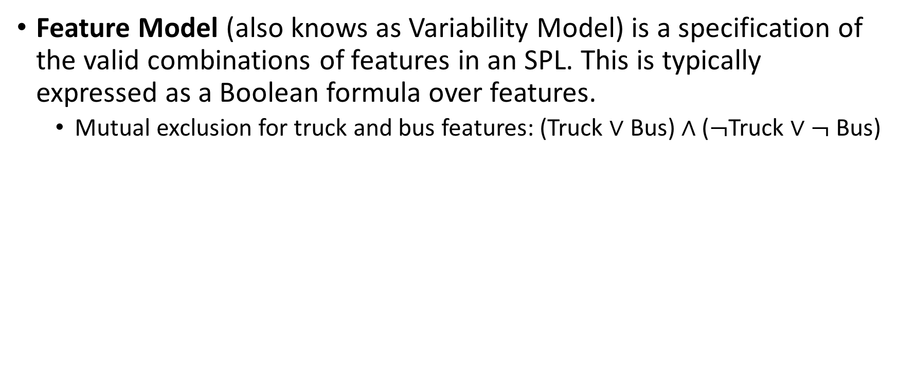
Software Product Lines (SPLs)
Feature Model (also knows as Variability Model) is a specification of the valid combinations of features in an SPL. This is typically expressed as a Boolean formula over features.
Mutual exclusion for truck and bus features: (Truck $∨$ Bus) $∧$ ($¬$Truck $∨¬$Bus)

Slide 6
Software Product Lines (SPLs)
Feature Diagram is a hierarchical graphical representation of a Feature Model, where each non-root feature depends on its parent.

Slide 7
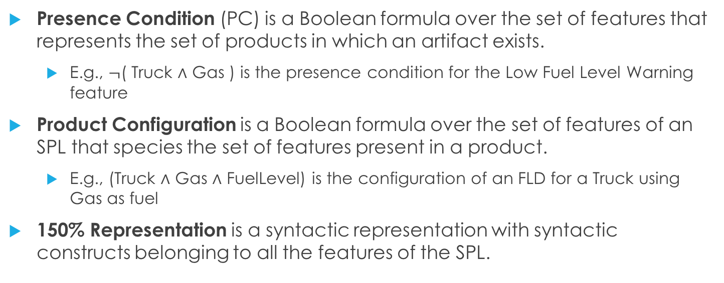
Software Product Lines (SPLs)
Presence Condition (PC) is a Boolean formula over the set of features that represents the set of products in which an artifact exists.
E.g., $¬$( Truck $∧$ Gas ) is the presence condition for the Low Fuel Level Warning feature
Product Configuration is a Boolean formula over the set of features of an SPL that species the set of features present in a product.
E.g., (Truck $∧$ Gas $∧$ FuelLevel) is the configuration of an FLD for a Truck using Gas as fuel
150% Representation is a syntactic representation with syntactic constructs belonging to all the features of the SPL.

Slide 8
SPL Engineering Techniques
Generative SPLs
each feature is designed and implemented separately
given a product configuration, a product is automatically generated
E.g., Feature-Oriented Programming, Aspect-Oriented Programming
Annotative SPLs
a single set of artifacts is maintained
feature expressions are used to annotate different syntactic constructs
E.g., C Preprocessor macros
Delta-Oriented SPLs
a base product is fully defined
variants (deltas) are defined in terms of their differences with respect to the base product
E.g., DeltaJava

Slide 9
Generative Example

Slide 10
Generative Example
Generated Product for (Liquid $∧$ Truck $∧$ FuelWarning)

Slide 11
Annotative Example

Slide 12
Delta-Oriented Example

Slide 13
Safety Cases
Safety Case a structured argument demonstrating the safety of a system with respect to a set of identified hazards.
Goal Structuring Notation (GSN):
Goals: These are the safety goals (requirements) identified as a result of hazard analysis techniques.
Solutions (Evidences): These are pieces of evidence that a risk/hazard is mitigated. Evidences can be test case results, formal verification outputs, or manual investigation reports.
Strategies: a strategy provides the logical argument connecting safety goals to their corresponding mitigating evidences.

Slide 14
Safety Case Example

Slide 15
Questions
Is the example used in this document (FLDPL) representative of the SPLs developed at GM?
What is the product line engineering approach used by GM engineers (annotative, generative or delta-oriented)?
What are the safety case constructs used by GM safety engineers? Is there a standard notation (e.g., GSN) used?
How is safety case variability currently managed by GM safety engineers?
How are hazards, safety case goals and pieces of evidence managed across different products in a product line by GM safety engineers?
How is variability traced throughout the end-to-end Software Lifecycle at GM? In particular, how does safety case variability map to variability in design and code artifacts?

