Slide 1
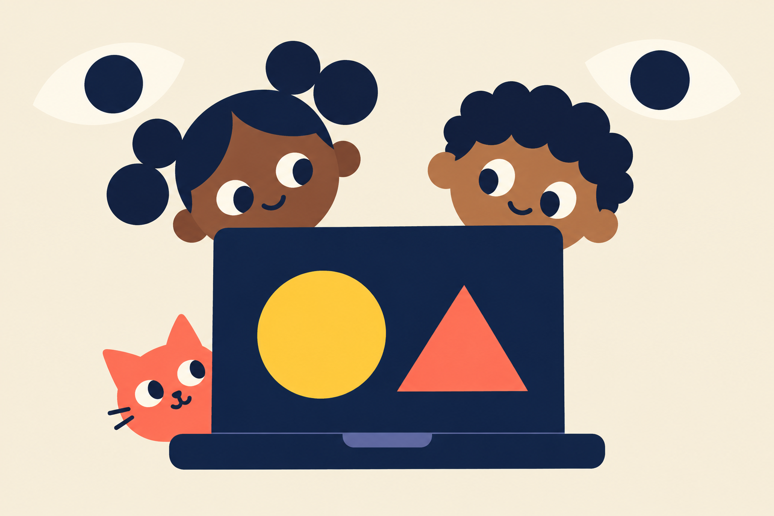
AI
for Kids
Ages 6–12
Bruno Melício, PhD
01
Notes:
SLIDE 1
Target duration: 20 seconds
Narration
Hello, explorers! I'm Bruno Melício. Today we will meet AI, send it to our pretend school, and discover some things it can help us create. At the end, you get to be the teacher! You only need your voice and imagination.
Original illustrations for this course. Student/teacher story is a simplified analogy for supervised learning, one of several learning methods. Pictures are illustrative.

Slide 2

Hello, AI!
Artificial intelligence
Bruno Melício, PhD
02
Notes:
SLIDE 2
Target duration: 30 seconds
Narration
AI means artificial intelligence. People build these computer tools to do tasks such as recognising a picture, making a helpful guess, or creating something new. Different AI tools do different jobs. You can find them inside everyday devices. They can do impressive things and still make mistakes. Let's play a little guessing game.
Background source:
https://www.ibm.com/think/topics/artificial-intelligence

Slide 3
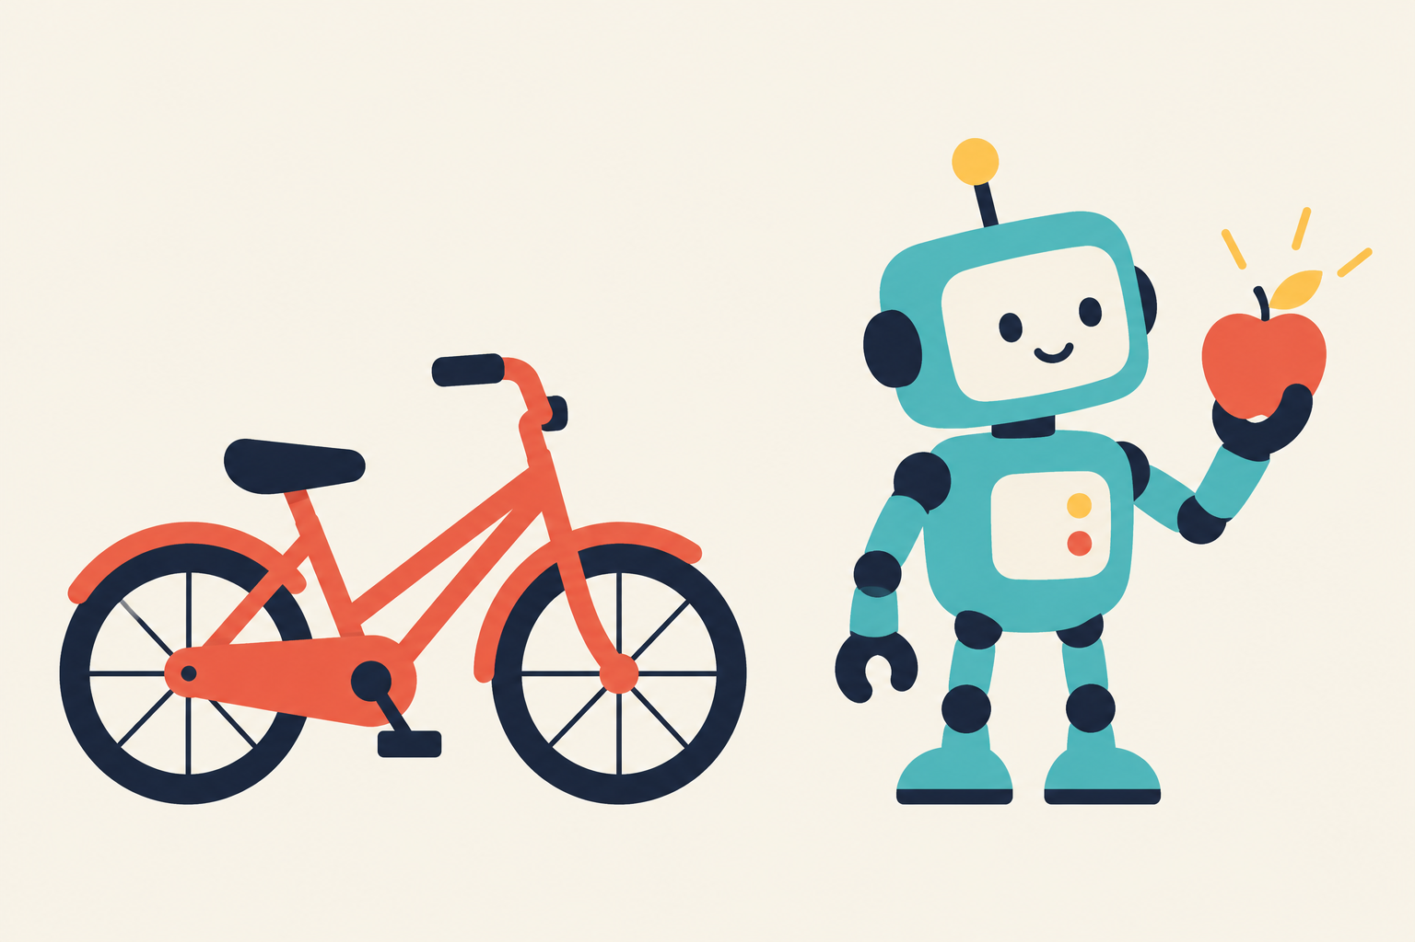
Which one uses AI?
Bicycle
Robot
Bruno Melício, PhD
03
Notes:
SLIDE 3
Target duration: 35 seconds
Narration
Which one uses AI: our ordinary bicycle, or this robot? Point at your answer. [Pause 8 seconds.] In our example, the robot uses AI to recognise the apple it is holding. Our ordinary bicycle works when we pedal it. A robot is a machine. Some robots use AI, and some simply follow fixed instructions. We chose an AI robot for this example.

Slide 4
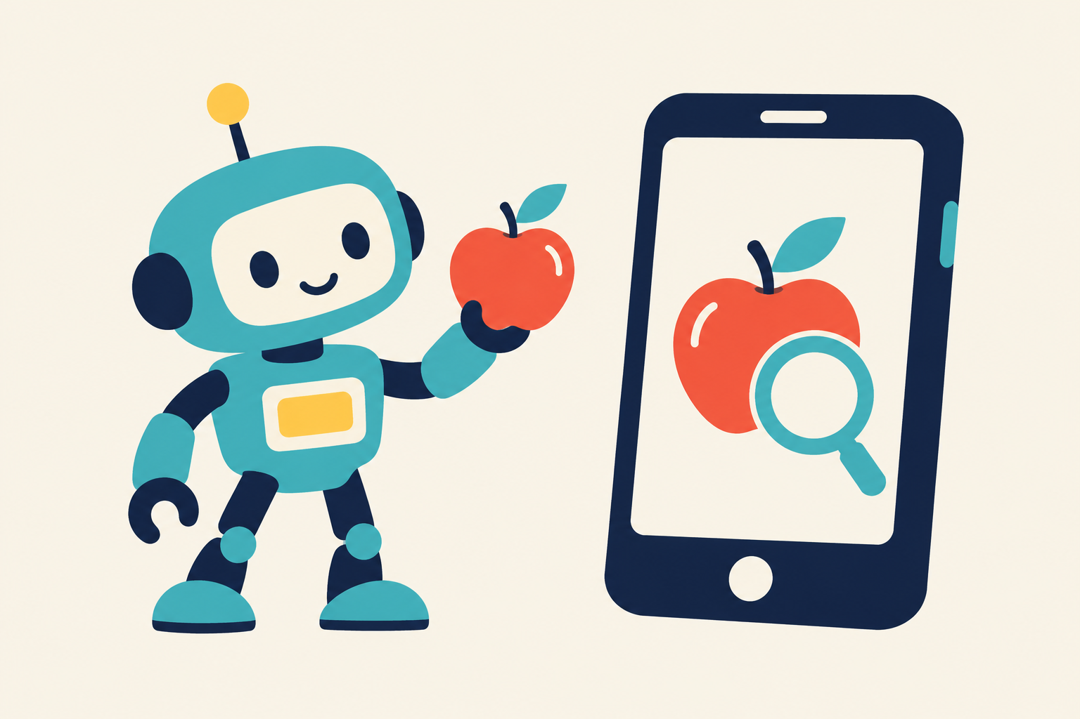
Robot or phone?
Your guess?
Bruno Melício, PhD
04
Notes:
SLIDE 4
Target duration: 35 seconds
Narration
What about these two? Our apple-recognising robot, and a phone using an AI camera feature to recognise an apple. Which one uses AI? You can point to one, or maybe you think there is another answer. [Pause 10 seconds.] Keep your guess ready. Let's find out.

Slide 5
Both!
AI can work in different devices.
Bruno Melício, PhD
05
Notes:
SLIDE 5
Target duration: 20 seconds
Narration
Both! The robot uses AI, and the phone's picture-recognition feature uses AI too. AI can work inside different devices. It does not need arms, legs or a robot body. Other phone features may work without AI. It depends on the task and the software.

Slide 6
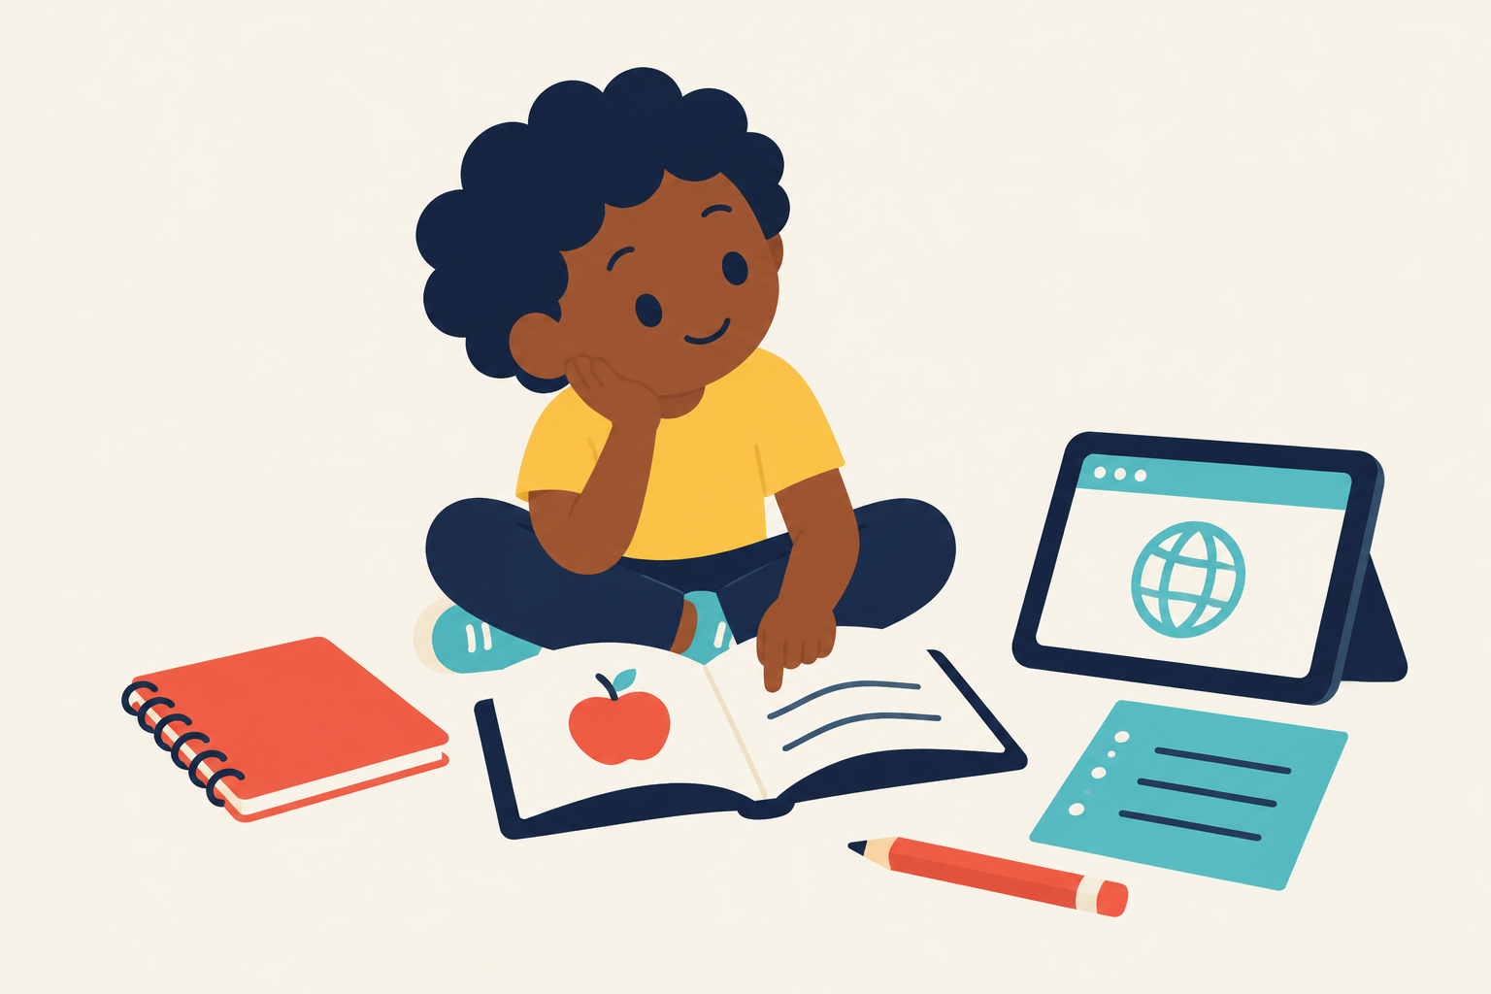
Study materials = data
Imagine AI as a student.
Bruno Melício, PhD
06
Notes:
SLIDE 6
Target duration: 50 seconds
Narration
Imagine AI as a student in a pretend school. This is a comparison to help us understand one way AI learns. A real AI is a computer tool, not a child or a human brain. Where do students get learning material? Books, notebooks, notes and useful websites. For AI, the examples and information we choose are called data. They might be pictures, words or sounds. Can you name one thing you use to learn? [Pause 8 seconds.] People need to choose suitable material and check it carefully.
Presenter background (not narration):
https://www.ibm.com/think/topics/supervised-learning

Slide 7
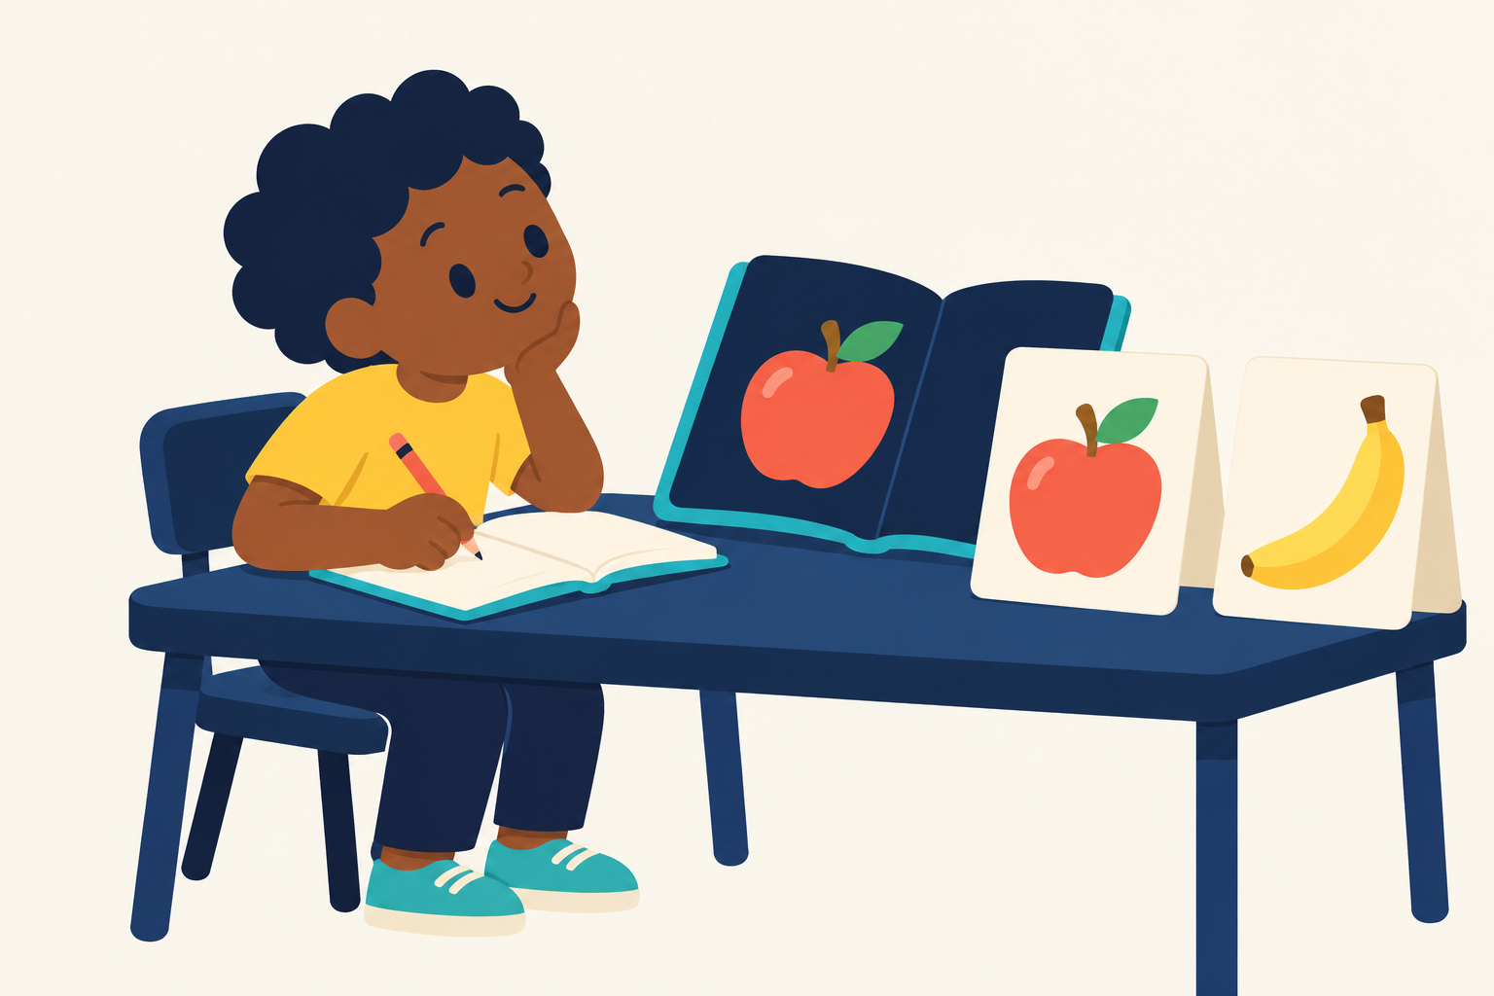
Learning = training
Bruno Melício, PhD
07
Notes:
SLIDE 7
Target duration: 60 seconds
Narration
When a student studies and practises, we call that learning. When people build an AI model and help it learn from examples, we call that training. In our pretend school, the student is the AI, and studying is training. Imagine a fruit picture in a book with its correct name underneath. AI can practise matching many pictures to names. During training, the computer changes numbers inside the model to help its answers improve. It does not read or think exactly like you. Point to the book, then the learner. [Pause 5 seconds.] The book is like the data. The practice is like training.
Presenter background (not narration):
https://www.ibm.com/think/topics/supervised-learning

Slide 8
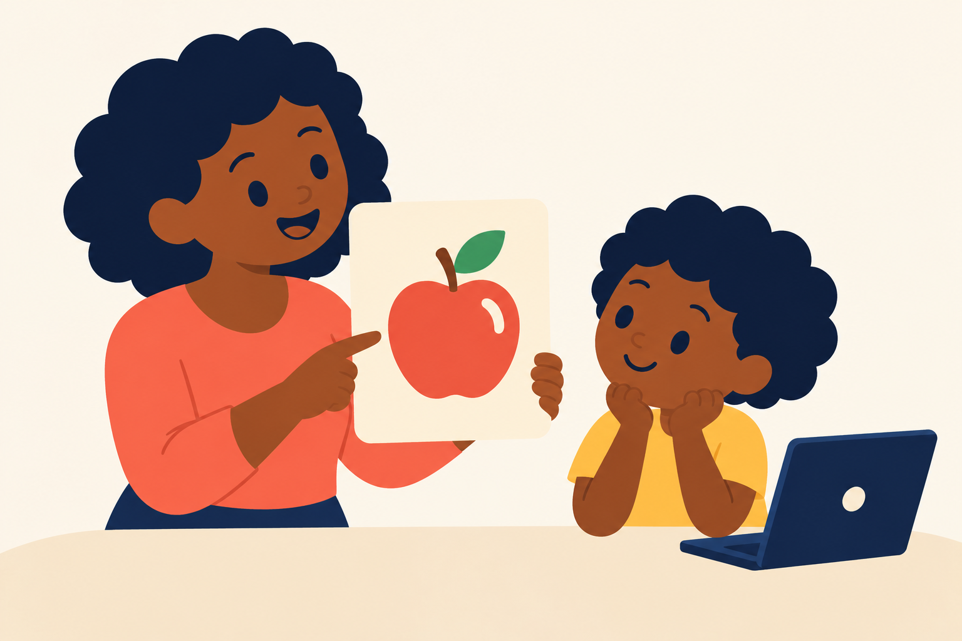
Teacher = supervisor
Correct answers guide practice.
Bruno Melício, PhD
08
Notes:
SLIDE 8
Target duration: 60 seconds
Narration
What does a teacher do when we are learning? They show us examples and help us check our answers. In this AI school, the teacher stands for supervision. People can prepare examples with correct answers, such as a picture of an apple with the name apple. We call those names labels. The correct answers help the training process measure its guesses and adjust the model. This is one way to train AI, called supervised learning. A teacher does not have to stand next to every real AI tool. Computers can compare the examples with prepared correct answers. Let's say this picture's label together: apple! [Pause 5 seconds.]
Presenter background (not narration):
https://www.ibm.com/think/topics/supervised-learning

Slide 9
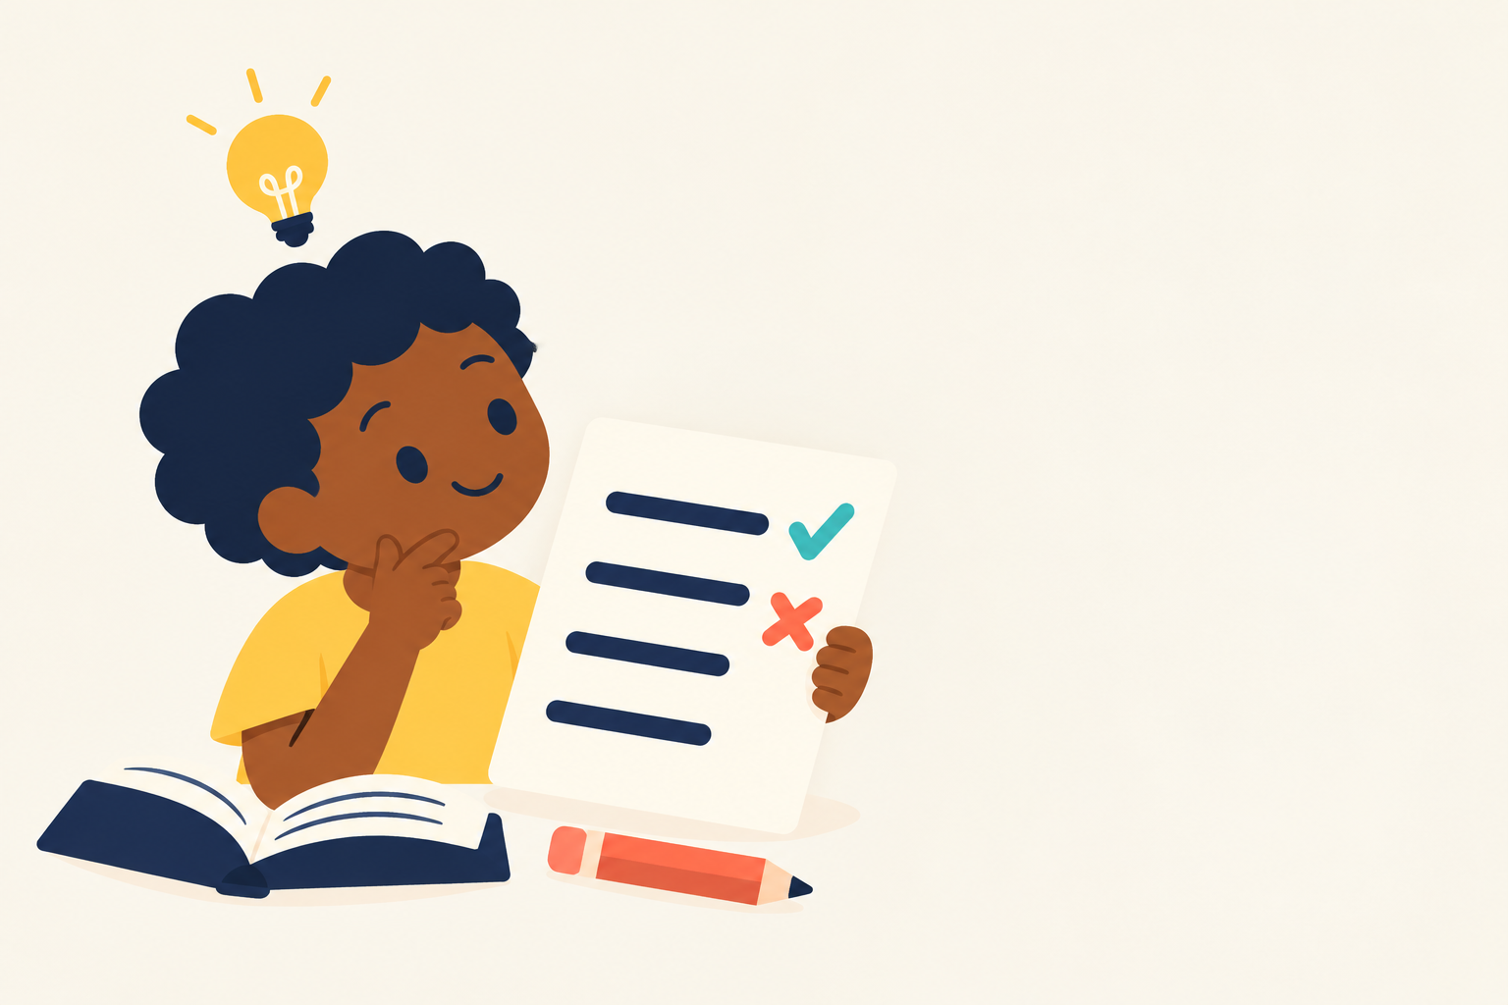
A practice quiz
8 / 10
Error: 2 mistakes
Bruno Melício, PhD
09
Notes:
SLIDE 9
Target duration: 50 seconds
Narration
Our pretend learner takes a practice quiz with ten questions. Eight answers are right, and two are wrong. That makes eight out of ten. How many answers need fixing before all ten are right? [Pause 8 seconds.] Two! Error means a difference between a guess and the correct answer. In this simple quiz, we can count the mistakes. AI training also uses an error score to help work out what to change. Real AI tasks can measure error in different ways. The useful part is the feedback: which answers need work?
Presenter background (not narration):
https://www.ibm.com/think/topics/supervised-learning

Slide 10
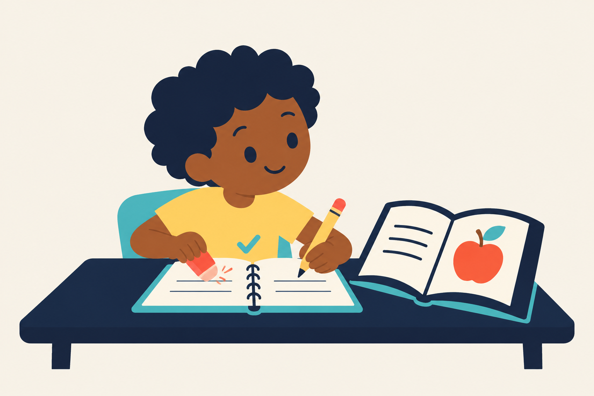
Another try
9 / 10
Error: 1 mistake
Bruno Melício, PhD
10
Notes:
SLIDE 10
Target duration: 30 seconds
Narration
Now the learner checks the corrections and practises again. Imagine the next practice quiz has nine right answers out of ten. Just one mistake to work on! Feedback can help training improve, but improvement is not guaranteed every time. A mistake can tell us what needs another look. We keep checking the examples and the answers.
Presenter background (not narration):
https://www.ibm.com/think/topics/supervised-learning

Slide 11
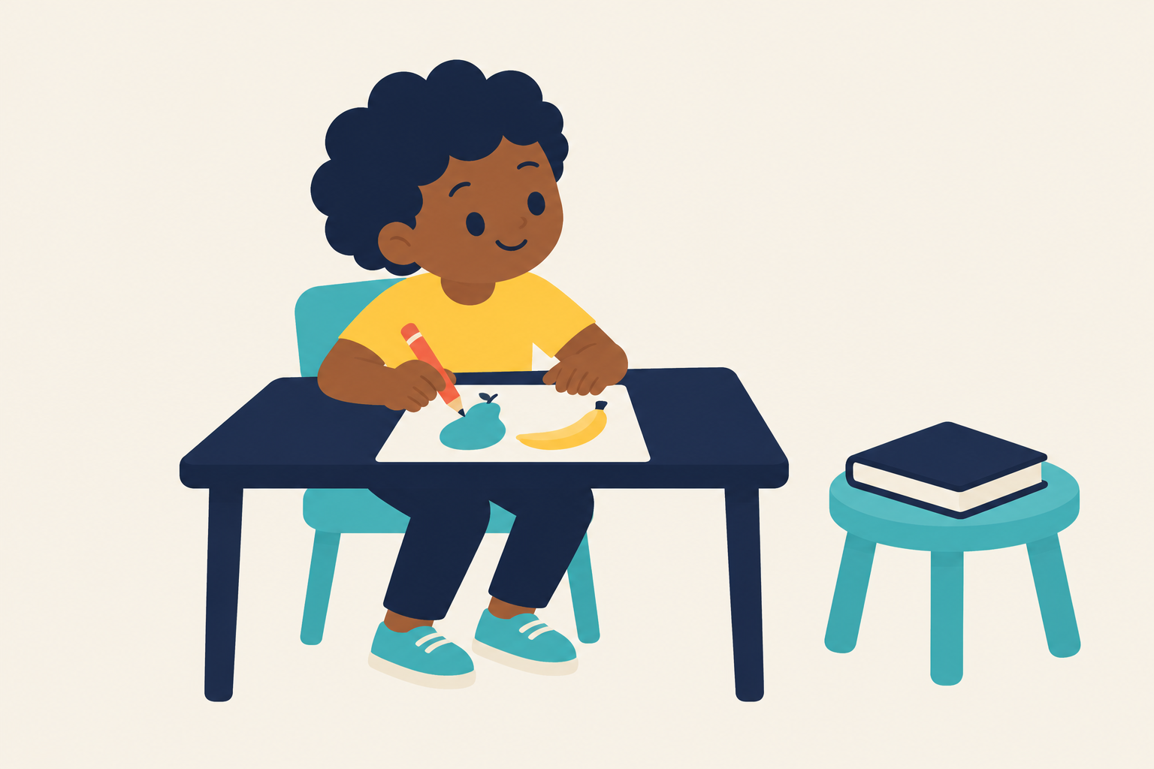
New questions!
Testing
Bruno Melício, PhD
11
Notes:
SLIDE 11
Target duration: 35 seconds
Narration
For the final test, we need new questions. If the learner only repeats answers from the practice sheet, we do not know how well it will do on something new. People test AI with examples kept separate from its training practice. That helps us check how well it works beyond the examples it practised on. In our school picture, the studybook is closed and the test paper is new.
Presenter background (not narration):
https://developers.google.com/machine-learning/crash-course/overfitting/dividing-datasets

Slide 12

AI learns from examples
Apple
Banana
Bruno Melício, PhD
12
Notes:
SLIDE 12
Target duration: 40 seconds
Narration
Let's bring our AI school to fruit class. People show an AI model many pictures, with correct names such as apple or banana. Those pictures and names are training data. The model practises matching them. What clues might help? Look at the shapes. [Pause 6 seconds.] Apples and bananas can have different colours, so colour alone will not always give a good answer. Real tools need many more examples than this small illustration.

Slide 13
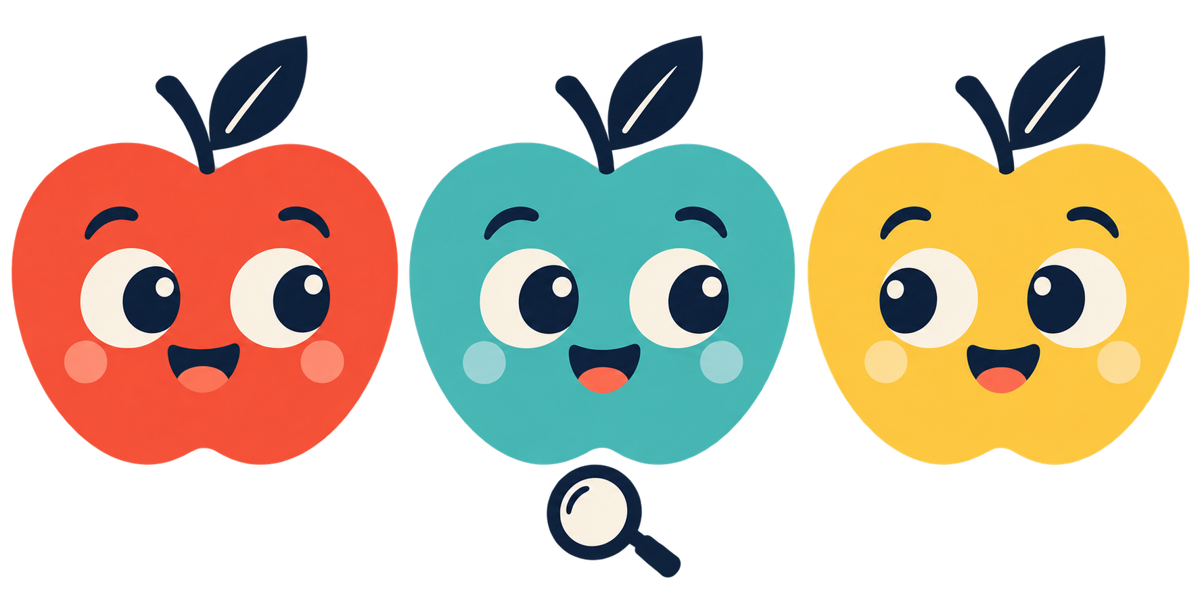
Still an apple!
Bruno Melício, PhD
13
Notes:
SLIDE 13
Target duration: 35 seconds
Narration
Different colours, still apples! What if all the apple pictures in our study materials looked exactly alike? A new kind of apple picture might confuse the model. Varied examples can help. We can include different colours, sizes and views, then test with fresh pictures. Can you think of another thing that can look different but have the same name? Different kinds of dogs are a good example. [Pause 5 seconds.]

Slide 14
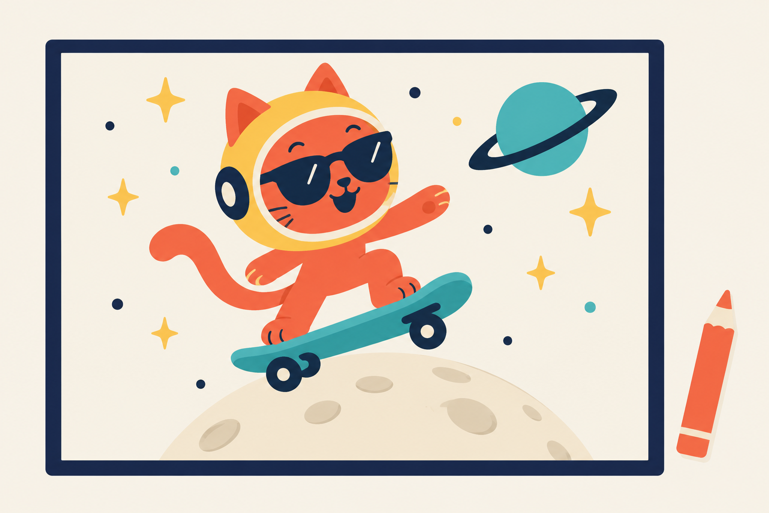
AI can create pictures
A skateboarding space cat?
Bruno Melício, PhD
14
Notes:
SLIDE 14
Target duration: 35 seconds
Narration
Some AI tools can create new pictures from a request. Look at this silly idea: a cat in an astronaut helmet on a skateboard! You could ask for an imaginary animal or a colourful birthday picture. A made-up image can look convincing, so we should not assume every picture shows a real event. What funny picture would you invent? [Pause 7 seconds.]

Slide 15
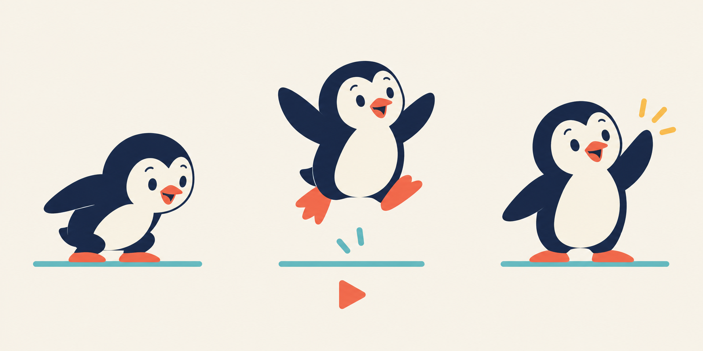
AI can create videos
A penguin that jumps!
Bruno Melício, PhD
15
Notes:
SLIDE 15
Target duration: 35 seconds
Narration
Some AI tools can create short videos too. Our picture shows a penguin getting ready to jump, jumping, and landing. Imagine these pictures moving as a short clip. An AI video tool can create movement from a request, and some can start from an image. The result can still contain mistakes. This slide is a storyboard to help us imagine the video. What would you make our penguin do next? [Pause 6 seconds.]

Slide 16
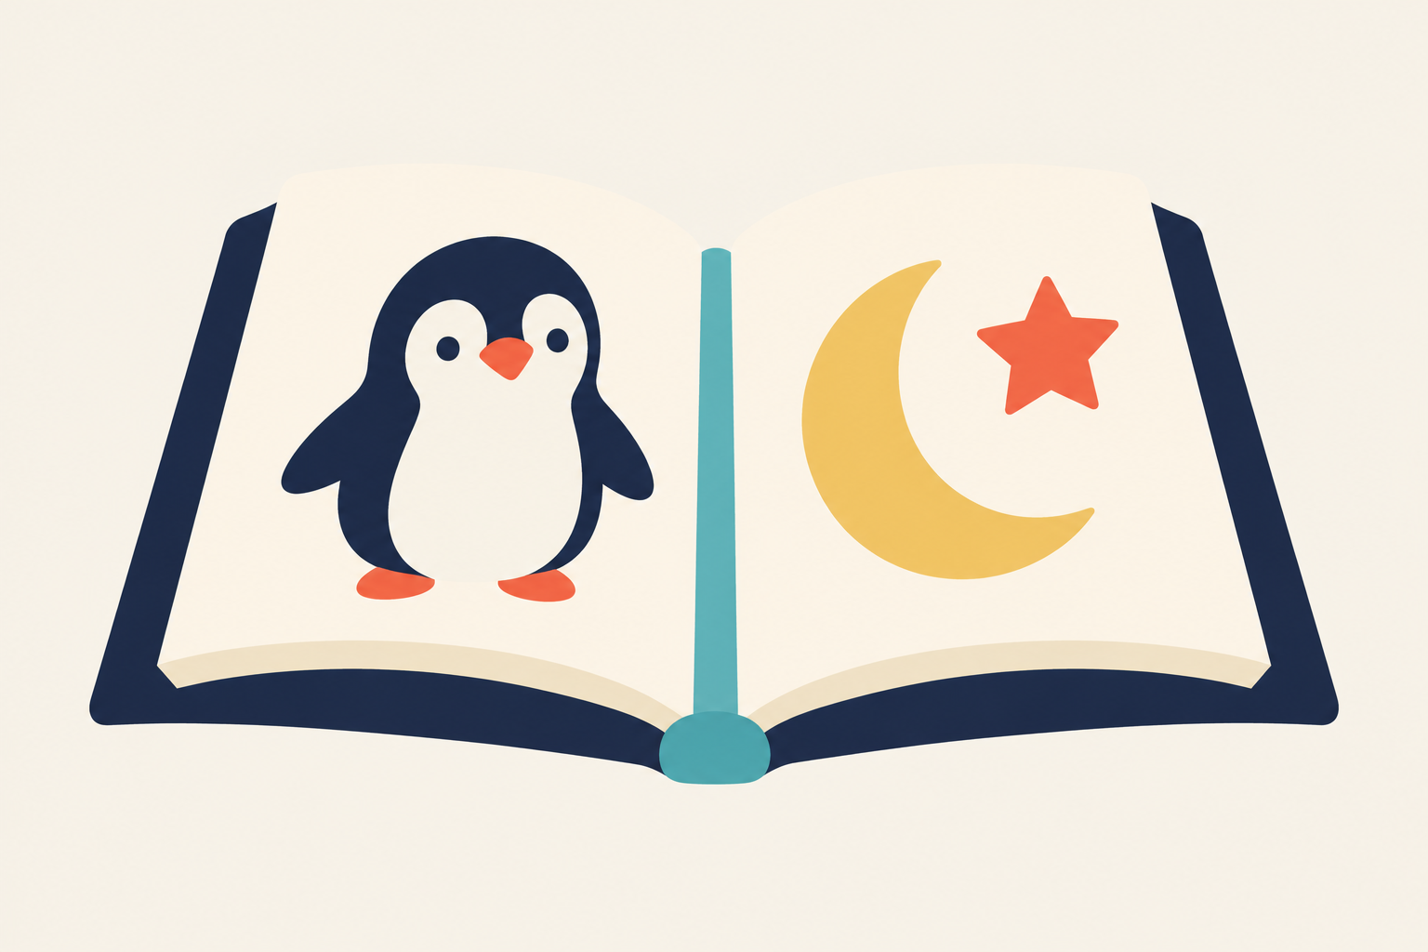
AI can create stories
A penguin on the Moon…
Bruno Melício, PhD
16
Notes:
SLIDE 16
Target duration: 35 seconds
Narration
AI can also help create stories. A penguin on the Moon could become a funny adventure. These tools use patterns from training to generate new words. The penguin does not have to be real for us to enjoy a make-believe story. We can choose which ideas to keep, and change the parts we do not like. Your imagination helps decide what to make.

Slide 17
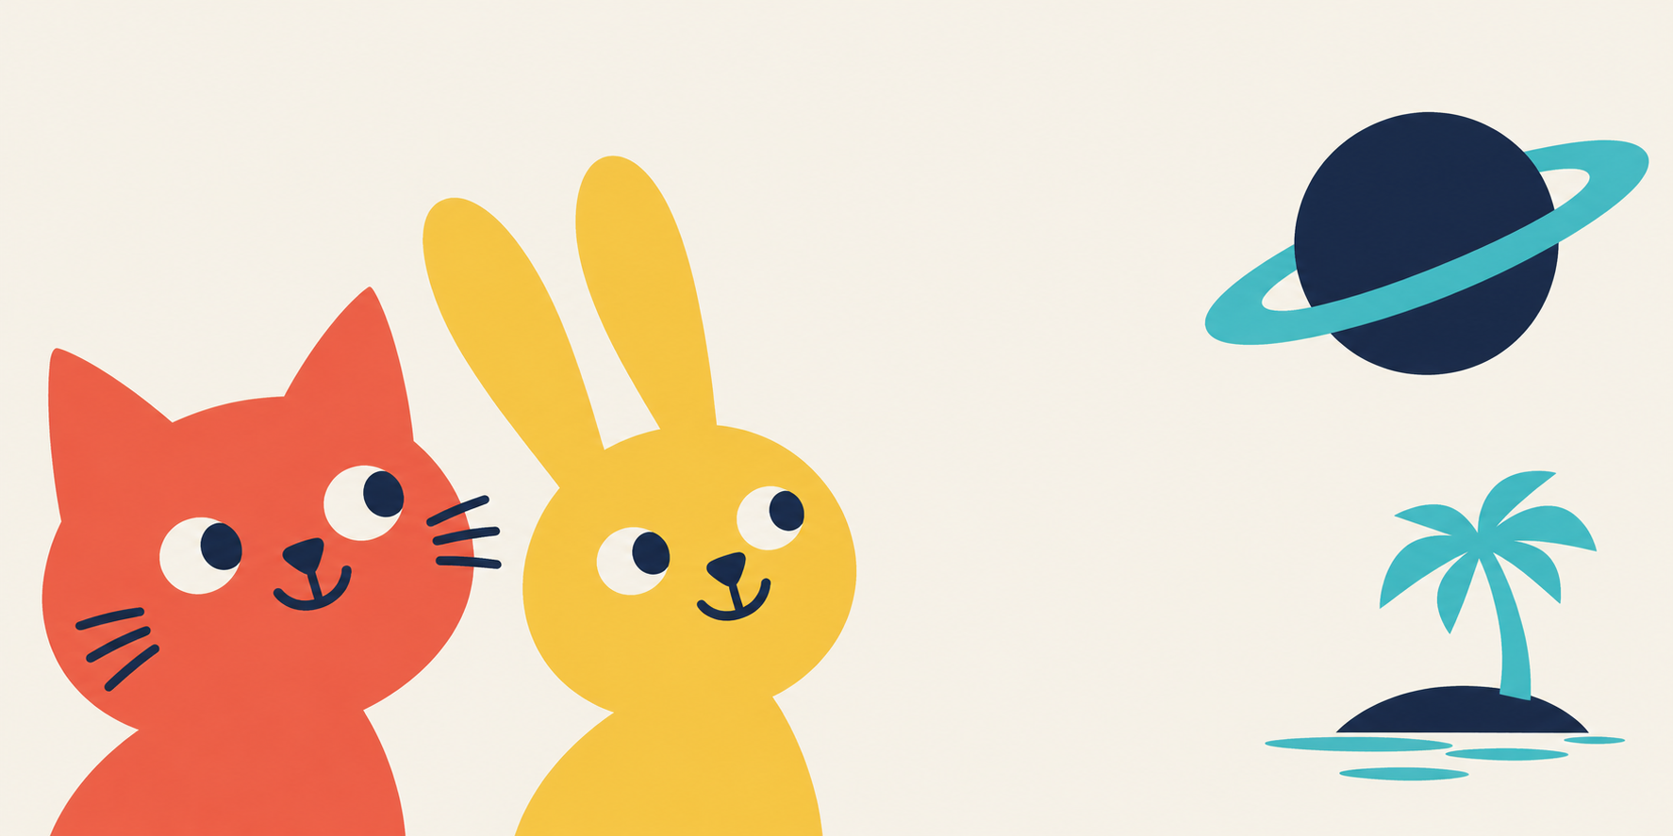
Your story!
An animal + a place
Bruno Melício, PhD
17
Notes:
SLIDE 17
Target duration: 40 seconds
Narration
Your turn to imagine a story. Choose an animal. [Pause 5 seconds.] Now choose a place. [Pause 5 seconds.] A rabbit on a planet? A cat on an island? Say your choice aloud. A request to an AI tool is often called a prompt. We can practise making one without opening any app or account. Your idea can be completely different from the pictures.

Slide 18
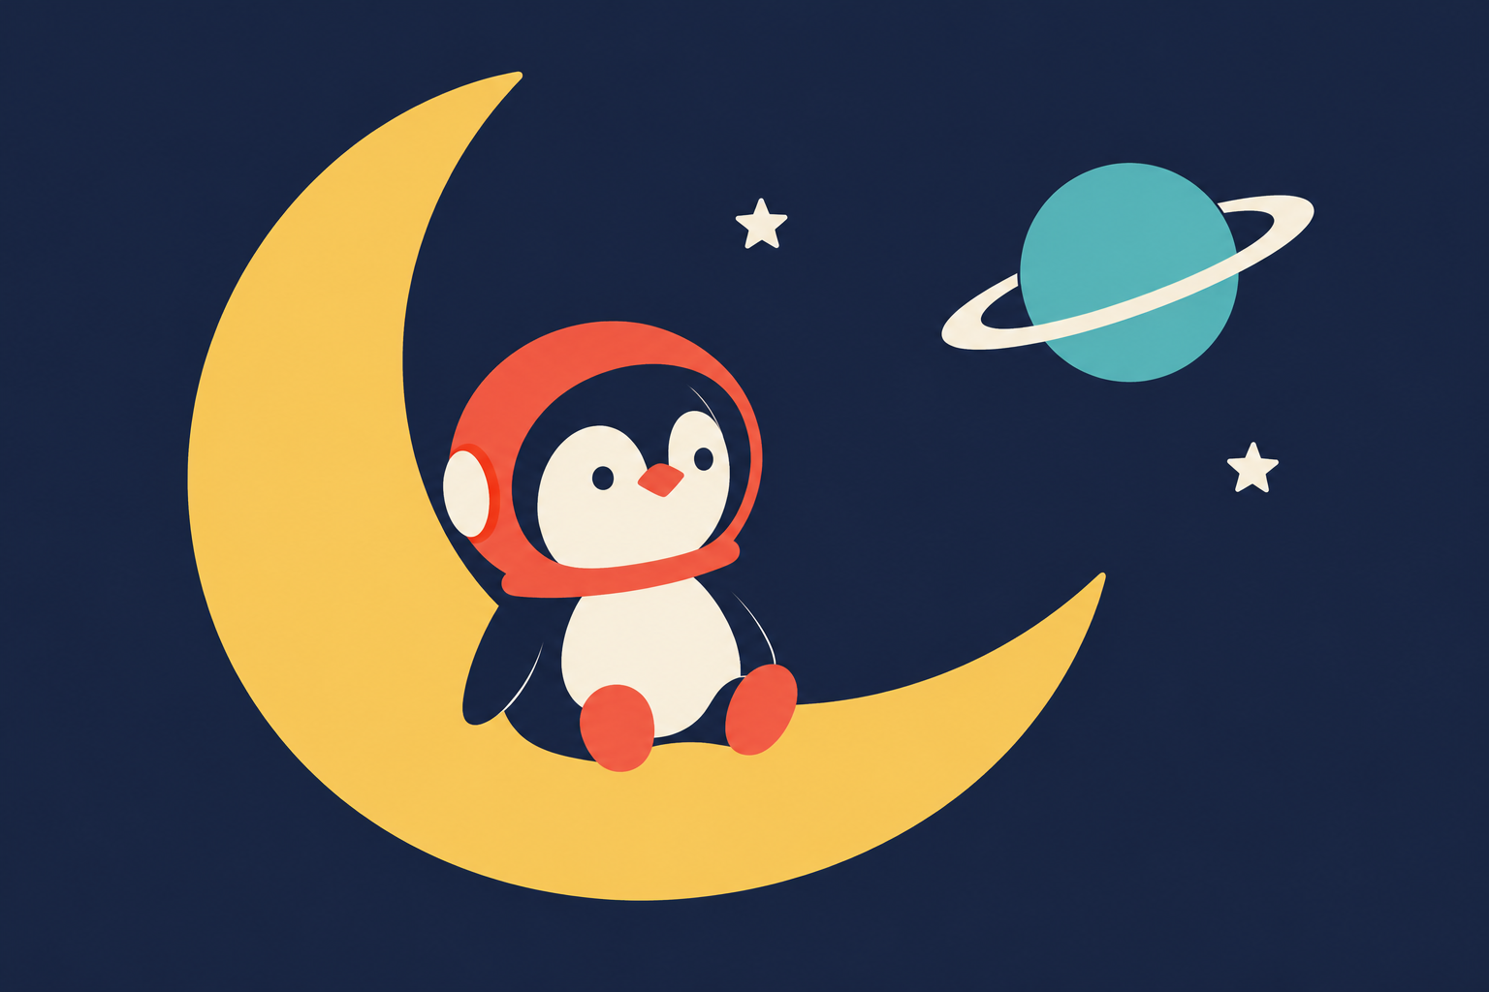
A clearer request
A funny penguin story.
On the Moon.
Use easy words.
Bruno Melício, PhD
18
Notes:
SLIDE 18
Target duration: 35 seconds
Narration
Here is a clear prompt: Tell me a short, funny story about a penguin on the Moon. Use easy words. We have chosen a character, a place and the kind of story we want. Now say your own version with your animal and place. [Pause 10 seconds.] If you try an AI tool another day, ask a trusted grown-up to choose one suitable for your age and use it with you.

Slide 19
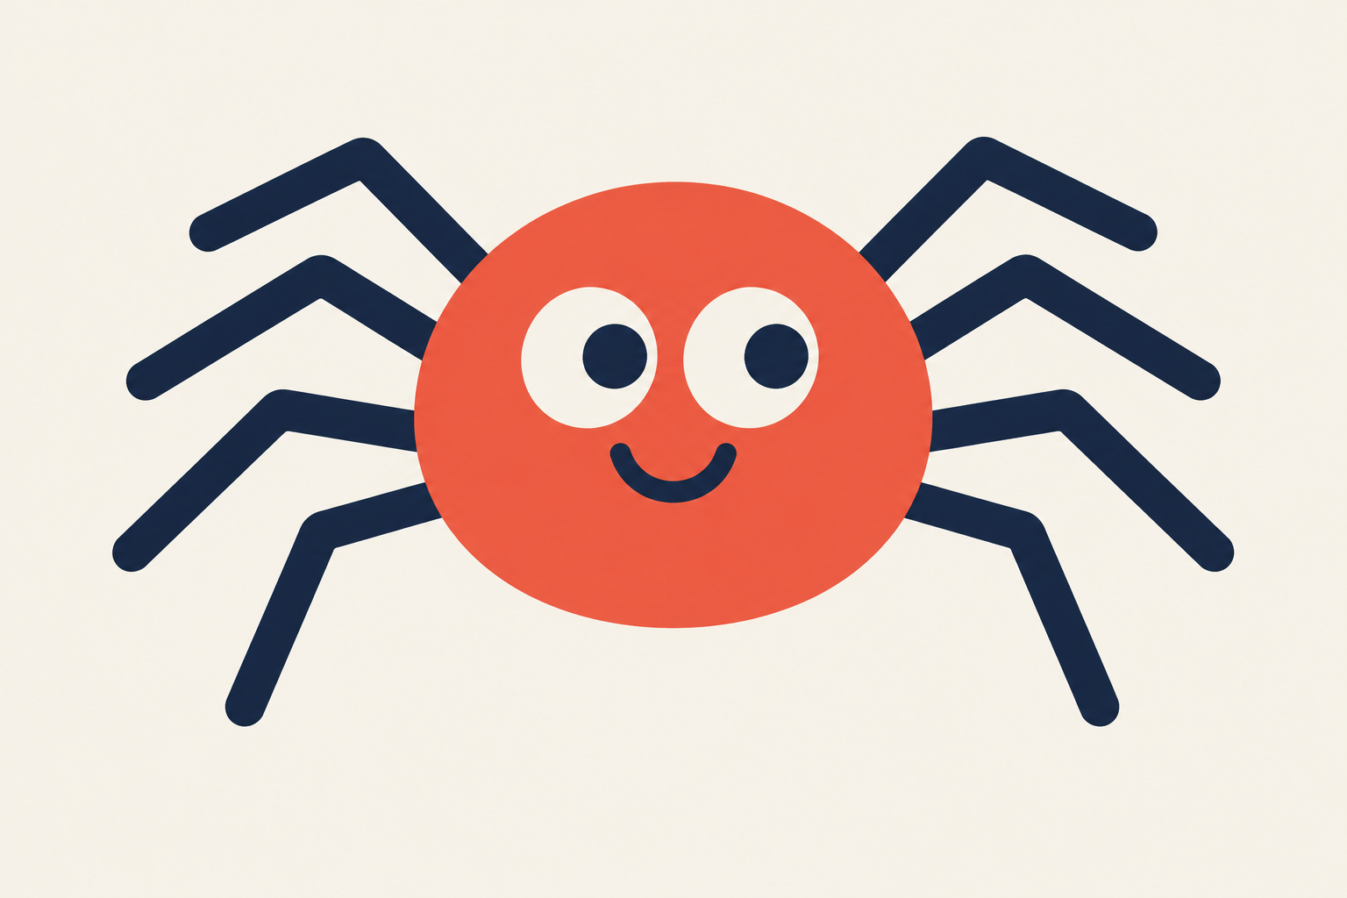
Spot the mistake!
“10 legs?”
A made-up AI answer
Bruno Melício, PhD
19
Notes:
SLIDE 19
Target duration: 30 seconds
Narration
Can you spot a mistake? This is a made-up example of a wrong AI answer: a spider has ten legs. Count the legs in our picture, or ask a grown-up to count with you. [Pause 10 seconds.] A clear answer can still be wrong. What could help us check: a nature book or a trusted grown-up?

Slide 20
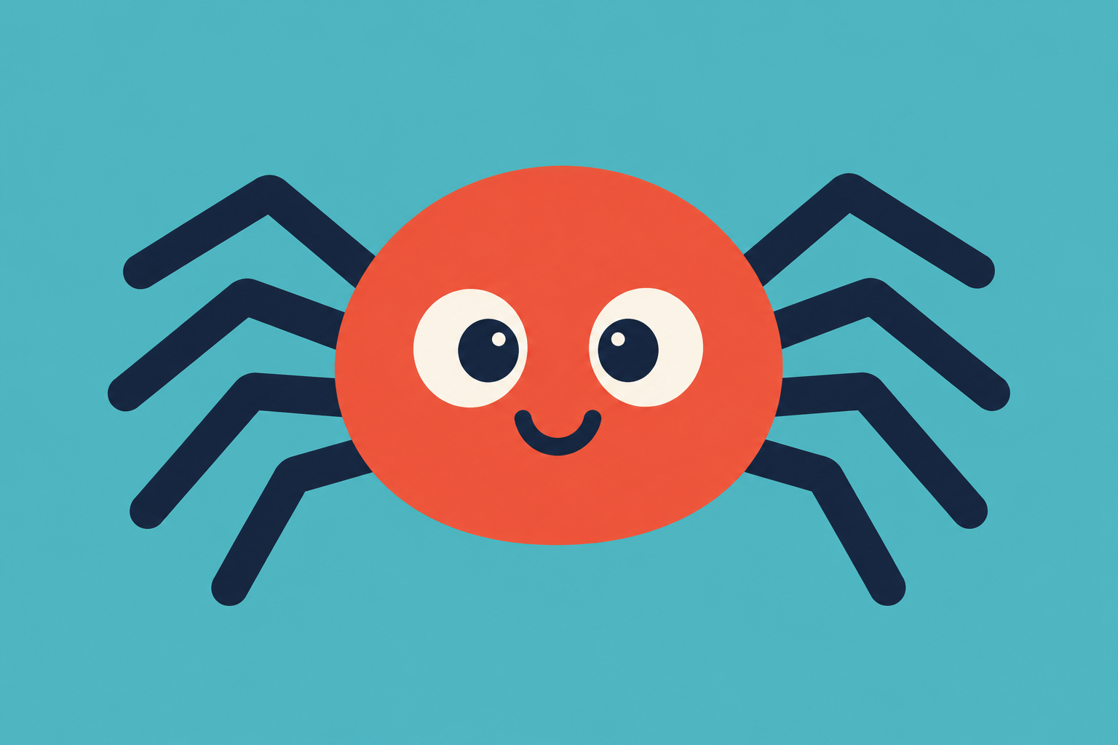
8 legs!
Check important answers.
Bruno Melício, PhD
20
Notes:
SLIDE 20
Target duration: 30 seconds
Narration
Eight legs! Four on each side. Even a trained AI tool can make mistakes. Checking matters when we want facts. A suitable book or a trusted grown-up can help us find a reliable answer. A story about a talking spider is make-believe. The number of a real spider's legs is a fact we can check.
Background source:
https://australian.museum/learn/teachers/learning/spider-anatomy/

Slide 21
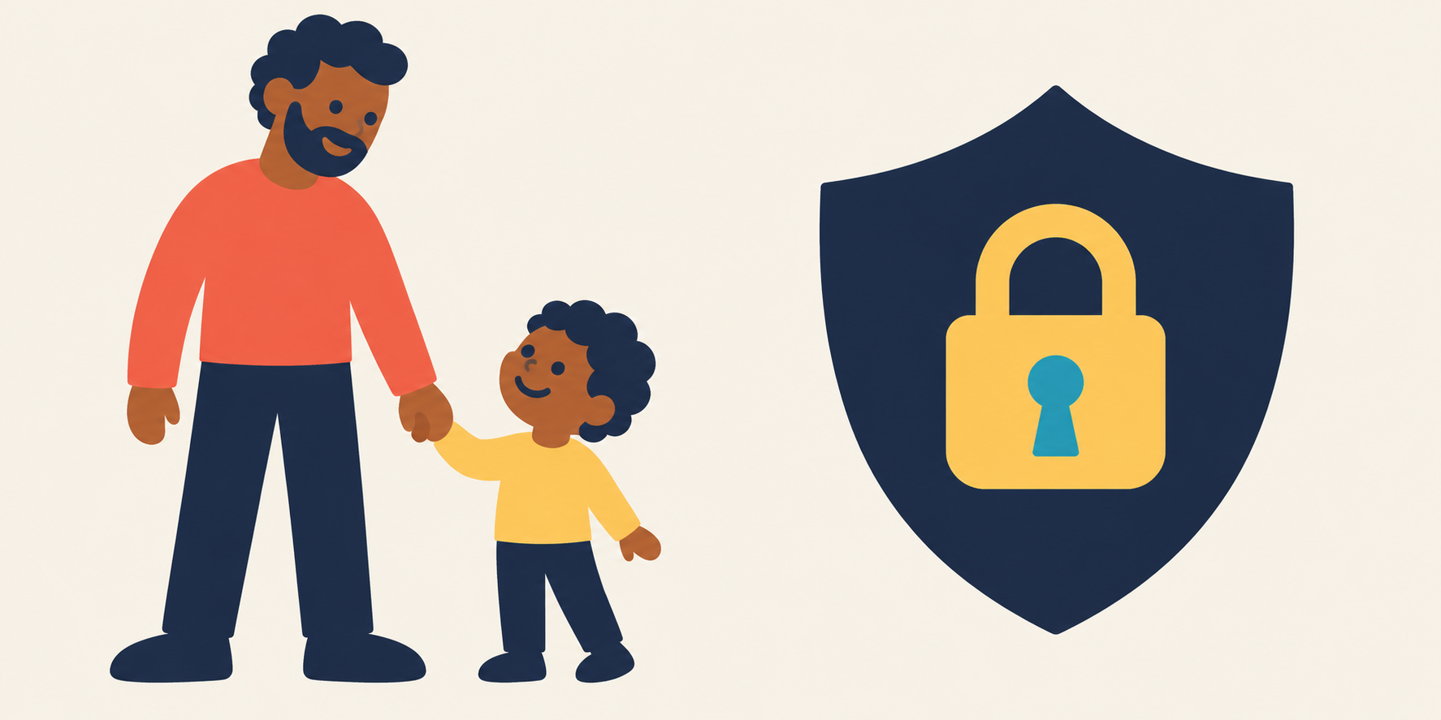
Safe explorers
Ask a grown-up.
Keep private things private.
Bruno Melício, PhD
21
Notes:
SLIDE 21
Target duration: 55 seconds
Narration
Here are our safe explorer habits. First, use AI with a trusted grown-up who can choose a suitable tool. Second, keep private things private. Do not type your password, home address or school details into an AI tool. Ask before sharing photos. Third, check important answers. And if something feels strange, upsetting or confusing, stop and tell a grown-up. Let's practise. A tool asks for your home address to make a funny story. Should you share it? [Pause 8 seconds.] No. You can use an imaginary place instead. AI can be helpful, but trusted people are the ones to turn to for help.
Background source:
https://www.unicef.org/innocenti/reports/policy-guidance-ai-children

Slide 22
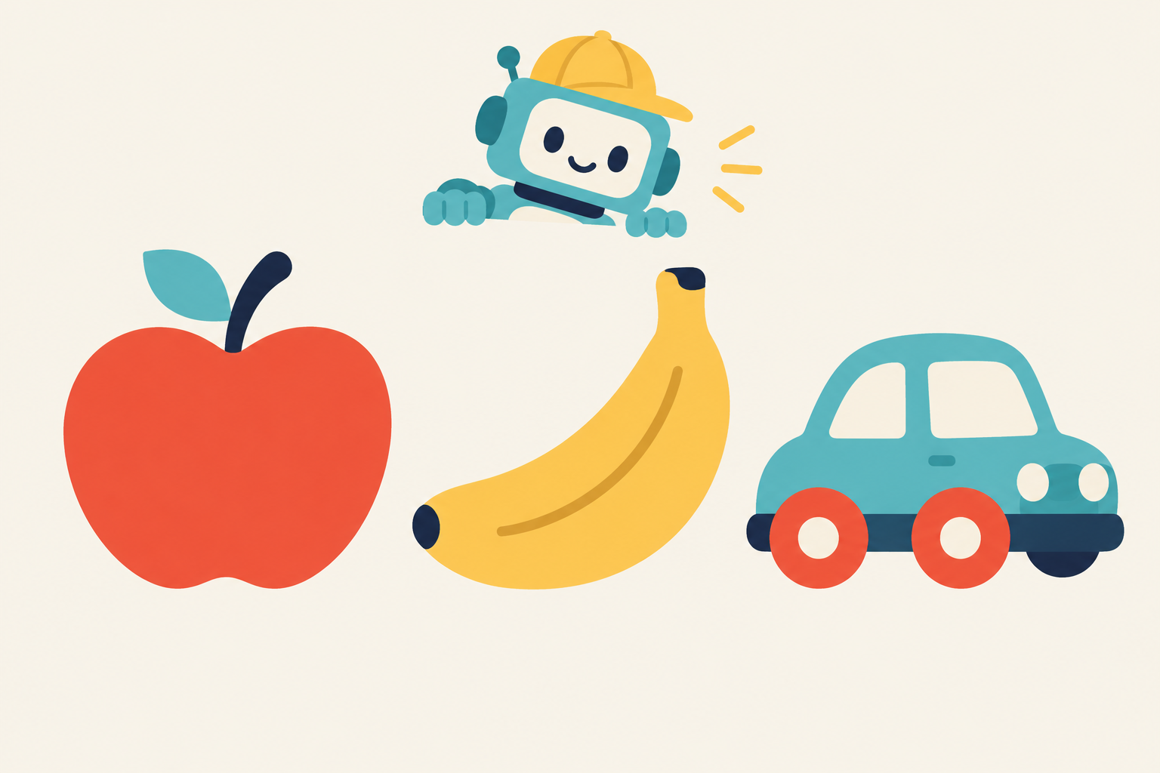
You are the teacher!
Fruit
Fruit
Toy
Bruno Melício, PhD
22
Notes:
SLIDE 22
Target duration: 45 seconds
Narration
Our last game is a pretend AI classroom, and you are the teacher! We want our robot pupil to sort things into fruit and toys. Look at the examples. Apple: fruit. Banana: fruit. Toy car: toy. Say the labels with me. [Pause 8 seconds.] Those named examples are our teaching data. We are acting out training, rather than training a real robot. Now our pupil will see something new. Will it get the answer right?

Slide 23
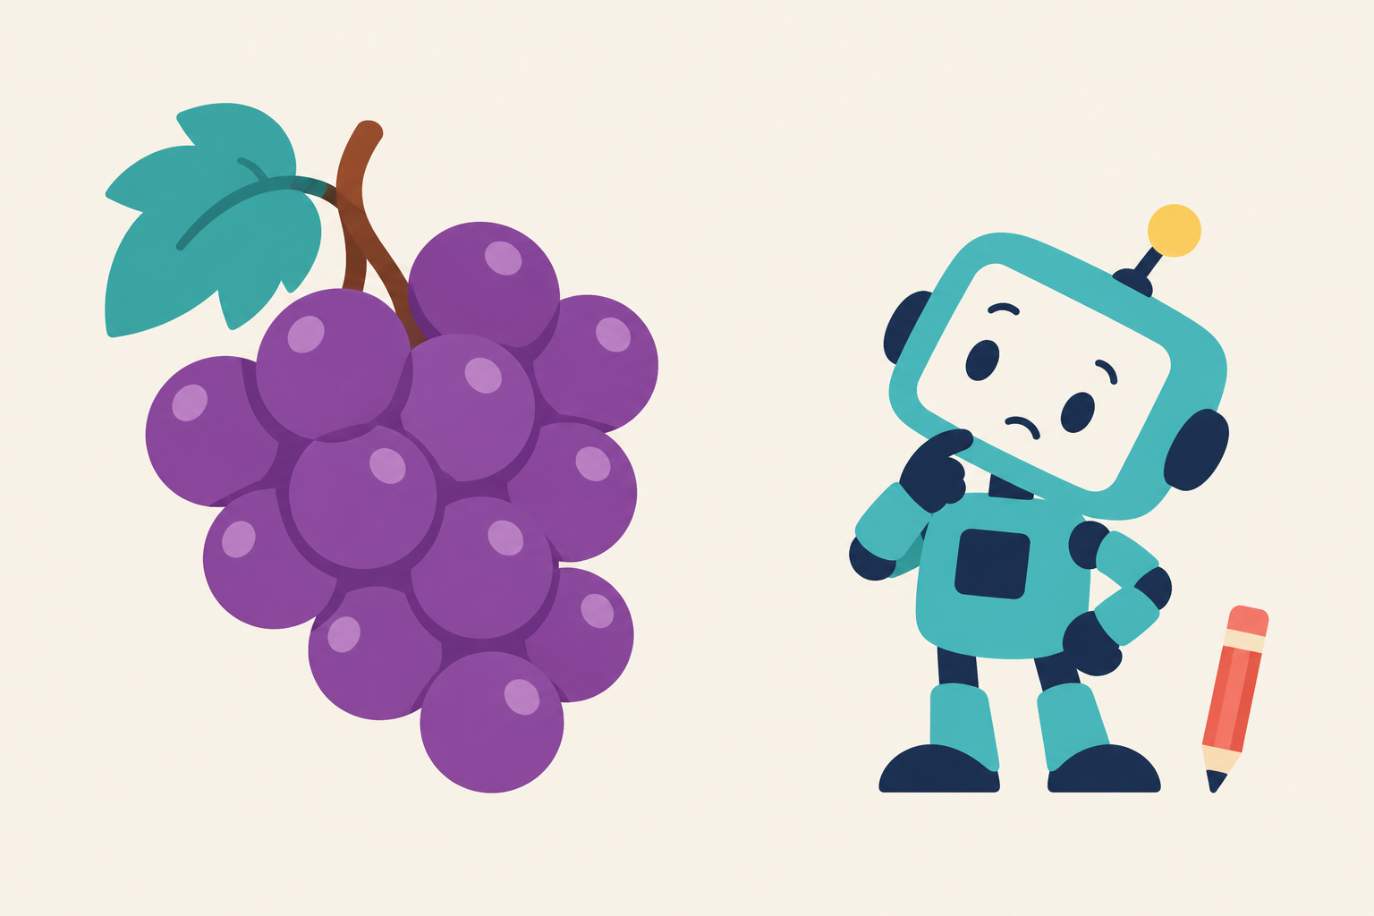
The surprise test
The AI guesses: “Toy?”
Bruno Melício, PhD
23
Notes:
SLIDE 23
Target duration: 40 seconds
Narration
Here are some grapes. Our pretend pupil guesses toy. Is that right? [Pause 8 seconds.] No! Grapes are fruit. Tell our pupil the correct answer. [Pause 5 seconds.] Well done, teacher! We can add a labelled grape example to the practice materials, then use a different new picture for the next test. Even though grapes look different from apples and bananas, they are fruit too. What other fruit would you show our pupil? [Pause 5 seconds.]

Slide 24
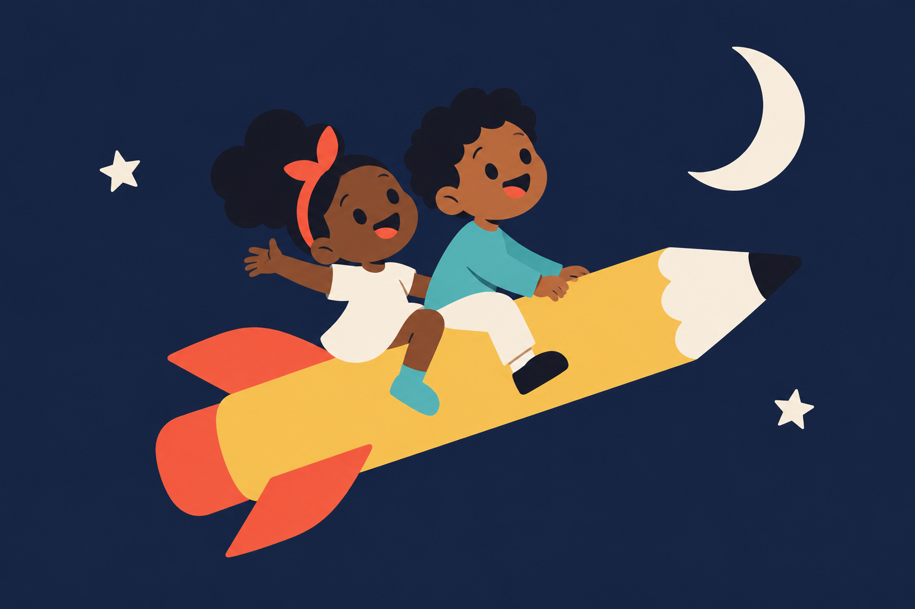
Class dismissed, AI teacher!
Bruno Melício, PhD
24
Notes:
SLIDE 24
Target duration: 20 seconds
Narration
Class dismissed, AI teacher! You explored where AI can work, followed its pretend school day, imagined creative projects and checked its mistakes. Tell a grown-up one thing you learned. You can also draw your own AI helper or the next picture for our fruit class. Thank you for exploring with me!

