Slide 1

BRUNO MELÍCIO, PhD
Learn AI
Foundations
A visual introduction
for curious beginners
Bruno Melício, PhD
01
Notes:
LEARN AI FOUNDATIONS
Slide 1: Learn AI Foundations
Recording guide: 00:00–01:09 (69 seconds, including any guided pauses)
NARRATION
Hello, I'm Bruno Melício. Welcome to Learn AI Foundations. This course is for anyone who wants to understand the ideas behind AI without starting with code or advanced mathematics. We will use everyday situations, a small café and a few simple numbers. By the end, you should be able to explain what machine learning does, describe how a neural network learns, and ask better questions about an AI tool. You will also practise checking its limitations. When you see a pause prompt, give yourself a moment to think before moving on. You only need a pen and paper. You can follow the entire course without opening an AI account. Let's begin with something familiar.
VISUAL / EXAMPLE NOTES
Original course text and illustrations. Café figures, model parameters and plotted curves are invented teaching examples. Diagrams simplify the mechanisms described in the narration.

Slide 2
WELCOME
The next hour
01
AI, machine learning and deep learning
02
Learning from examples
03
Neural networks, images and language
04
Your first AI project
No coding needed.
Bruno Melício, PhD
02
Notes:
LEARN AI FOUNDATIONS
Slide 2: The next hour
Recording guide: 01:09–02:23 (74 seconds, including any guided pauses)
NARRATION
Here is our route. First, we will make sense of AI, machine learning and deep learning. Then we will build a tiny prediction example, see how mistakes guide learning, and discover why a good training result is only part of the story. After that, we will open up a neural network and connect it to images, language and creative tools. Finally, you will design a small AI project yourself. Keep one question in mind throughout: what goes in, what comes out, and how would I check it? That question is useful whether you are studying, running a business or choosing a tool at work. You do not need to remember every new term immediately. We will return to the important ideas through examples.
VISUAL / EXAMPLE NOTES
Original course text and illustrations. Café figures, model parameters and plotted curves are invented teaching examples. Diagrams simplify the mechanisms described in the narration.

Slide 3

01 MAKING SENSE OF AI
AI in everyday life
Where did you meet AI today?
Bruno Melício, PhD
03
Notes:
LEARN AI FOUNDATIONS
Slide 3: AI in everyday life
Recording guide: 02:23–03:50 (87 seconds, including any guided pauses)
NARRATION
Think about the last time a phone suggested a word, a music service recommended a song, or an email service moved a suspicious message into spam. AI can help with each of those tasks. It can work in an app, a server or a physical device. A robot is one possible body for an AI system, but most encounters with AI do not involve a robot. Also, a device can contain both ordinary software and AI features. The useful question is which task the software performs and how. Pause for fifteen seconds and name one task where you have encountered AI today. [Pause 15 seconds.] If you chose a chatbot, that counts too. It is one example within a much larger field.
Guided pause: 15 seconds. The learner may pause the recording for longer.
VISUAL / EXAMPLE NOTES
Original course text and illustrations. Café figures, model parameters and plotted curves are invented teaching examples. Diagrams simplify the mechanisms described in the narration.

Slide 4
01 MAKING SENSE OF AI
What is artificial intelligence?
Computer systems
that perform tasks such as…
Recognising patterns
Making predictions
Planning actions
Creating content
Bruno Melício, PhD
04
Notes:
LEARN AI FOUNDATIONS
Slide 4: What is artificial intelligence?
Recording guide: 03:50–05:02 (72 seconds, including any guided pauses)
NARRATION
Artificial intelligence is a broad field concerned with building computer systems that perform tasks such as recognising patterns, making predictions, planning actions or generating content. The task matters more than a human-looking appearance. A system may recognise a coffee cup extremely well and still be unable to explain your café's accounts. Its ability on one task does not establish human-like understanding across every task. People choose the goal, build or select the system, and decide how to evaluate it. For this course, think of AI as a family of approaches to useful computer behaviour. Some approaches use rules. Others learn from examples. Those different approaches can also work together within one product. We will compare them using an inbox.
BACKGROUND SOURCES (not narration)
https://www.ibm.com/think/topics/artificial-intelligence
VISUAL / EXAMPLE NOTES
Original course text and illustrations. Café figures, model parameters and plotted curves are invented teaching examples. Diagrams simplify the mechanisms described in the narration.

Slide 5

01 MAKING SENSE OF AI
A rule for the inbox
“free” = spam?
What could go wrong?
Bruno Melício, PhD
05
Notes:
LEARN AI FOUNDATIONS
Slide 5: A rule for the inbox
Recording guide: 05:02–06:23 (81 seconds, including any guided pauses)
NARRATION
Suppose we write a rule: if an email contains the word free, mark it as spam. The computer can apply that rule consistently. But a genuine message might say your appointment is free, while a scam might avoid the word completely. Can you think of another message that would break this rule? [Pause 10 seconds.] Adding more rules can help, but maintaining a large collection becomes difficult when language changes. Rules remain useful when a condition is clear and stable. Some AI systems use sophisticated rules for reasoning and planning. Our tiny inbox rule is simply a way to see the limitation of writing every decision by hand. What if we could provide examples of spam and genuine mail instead?
Guided pause: 10 seconds. The learner may pause the recording for longer.
BACKGROUND SOURCES (not narration)
https://www.ibm.com/think/topics/artificial-intelligence
VISUAL / EXAMPLE NOTES
Original course text and illustrations. Café figures, model parameters and plotted curves are invented teaching examples. Diagrams simplify the mechanisms described in the narration.

Slide 6

01 MAKING SENSE OF AI
Machine learning
Examples help a model learn patterns.
Bruno Melício, PhD
06
Notes:
LEARN AI FOUNDATIONS
Slide 6: Machine learning
Recording guide: 06:23–07:40 (77 seconds, including any guided pauses)
NARRATION
In machine learning, we use examples to fit a model. A model is a mathematical system whose internal values can change during training. For our inbox, the examples might be past messages together with labels saying spam or genuine. A learning algorithm adjusts the model so its predictions better match those examples. Later, the trained model receives a new message and predicts a category. We still write software and make important choices. We choose the data, the model family and the way to measure success. Learning from data does not remove human responsibility. It changes how we build the decision-making part. The model can also learn an unhelpful shortcut, so success on the familiar examples is not enough. We must check messages it has not practised on.
BACKGROUND SOURCES (not narration)
https://developers.google.com/machine-learning/intro-to-ml/what-is-ml
https://www.ibm.com/think/topics/supervised-learning
VISUAL / EXAMPLE NOTES
Original course text and illustrations. Café figures, model parameters and plotted curves are invented teaching examples. Diagrams simplify the mechanisms described in the narration.

Slide 7

01 MAKING SENSE OF AI
AI, ML and deep learning
AI
The broad field
AI
ML
Machine learning
Patterns from data
DL
Deep learning
Multilayer neural networks
Bruno Melício, PhD
07
Notes:
LEARN AI FOUNDATIONS
Slide 7: AI, ML and deep learning
Recording guide: 07:40–08:58 (78 seconds, including any guided pauses)
NARRATION
These terms describe related scopes. AI is the broad field. Machine learning is a part of AI that learns patterns from data. Deep learning is a part of machine learning that uses neural networks with multiple processing layers. We will see those layers later. A deep neural network is therefore an example of machine learning and AI at the same time. Other machine learning approaches include decision trees and linear models. They can be excellent choices, especially for structured data in rows and columns. Deep learning is not automatically the best option for every problem. The circles show a relationship between terms, rather than a ranking of quality. Generative AI describes systems that create content. It is a capability category, and many current generative systems use deep learning.
BACKGROUND SOURCES (not narration)
https://www.ibm.com/think/topics/artificial-intelligence
https://developers.google.com/machine-learning/crash-course/neural-networks/nodes-hidden-layers
VISUAL / EXAMPLE NOTES
Original course text and illustrations. Café figures, model parameters and plotted curves are invented teaching examples. Diagrams simplify the mechanisms described in the narration.

Slide 8
01 MAKING SENSE OF AI
A quick check
Which systems learn from data?
A timer that rings after 10 minutes
An inbox filter trained on messages
A deep neural network recognising a cup
Pause and explain your choice.
Bruno Melício, PhD
08
Notes:
LEARN AI FOUNDATIONS
Slide 8: A quick check
Recording guide: 08:58–09:45 (47 seconds, including any guided pauses)
NARRATION
Here are three systems. A timer rings after ten minutes. An inbox filter learns from labelled messages. A photo app uses a deep neural network to recognise a cup. Which ones clearly use machine learning? Pause for twenty seconds and explain your answer aloud. [Pause 20 seconds.]
Guided pause: 20 seconds. The learner may pause the recording for longer.
BACKGROUND SOURCES (not narration)
https://developers.google.com/machine-learning/intro-to-ml/what-is-ml
VISUAL / EXAMPLE NOTES
Original course text and illustrations. Café figures, model parameters and plotted curves are invented teaching examples. Diagrams simplify the mechanisms described in the narration.

Slide 9
01 MAKING SENSE OF AI
Both use machine learning
The inbox filter
Machine learning
The photo recogniser
Machine learning + deep learning
Bruno Melício, PhD
09
Notes:
LEARN AI FOUNDATIONS
Slide 9: Both use machine learning
Recording guide: 09:45–10:32 (47 seconds, including any guided pauses)
NARRATION
The inbox filter and the photo recogniser learn from examples, so both use machine learning. The photo recogniser also uses deep learning. The simple timer follows a fixed instruction and does not learn from data. A product might combine all three kinds of software, so we should identify the feature rather than label the entire device. If you can explain why a system belongs in a category, you understand more than someone who has only memorised the names.
BACKGROUND SOURCES (not narration)
https://developers.google.com/machine-learning/intro-to-ml/what-is-ml
Original teaching example. These values are illustrative.

Slide 10

02 LEARNING FROM EXAMPLES
A café with a prediction problem
How many cups
will we sell
tomorrow?
Bruno Melício, PhD
10
Notes:
LEARN AI FOUNDATIONS
Slide 10: A café with a prediction problem
Recording guide: 10:32–11:52 (80 seconds, including any guided pauses)
NARRATION
Meet Lina, who runs a neighbourhood café. Each morning she needs to decide how many takeaway cups to prepare. Too few and customers wait. Too many and she wastes time and materials. She wonders whether tomorrow's temperature could help predict demand. This gives us a concrete input and output: temperature goes in, and predicted cups sold comes out. Before choosing AI, Lina should compare the idea with a simple baseline, such as last week's average. If a complicated tool cannot improve a useful decision, complexity has added little value. What else might affect demand? [Pause 10 seconds.] Rain, opening hours and a nearby event are possible answers. We will begin with just temperature so we can follow every step.
Guided pause: 10 seconds. The learner may pause the recording for longer.
VISUAL / EXAMPLE NOTES
Original course text and illustrations. Café figures, model parameters and plotted curves are invented teaching examples. Diagrams simplify the mechanisms described in the narration.

Slide 11

02 LEARNING FROM EXAMPLES
Data for the café
Relevant examples. Clear meaning.
Bruno Melício, PhD
11
Notes:
LEARN AI FOUNDATIONS
Slide 11: Data for the café
Recording guide: 11:52–13:08 (76 seconds, including any guided pauses)
NARRATION
Data is information we collect for a purpose. For this project, Lina could combine dated sales totals with weather records and a calendar of opening days. A dataset is the collection we use for analysis or learning. It might be a spreadsheet, a set of labelled images, recordings or text. More files do not automatically make a better dataset. We need relevant, reliable examples, suitable permission to use them and a clear definition of what each value means. Does a sales total include refunded orders? Does temperature mean a morning reading or the day's maximum? Those details change what a model learns. We should also only use information available at the time of prediction. Tomorrow's final sales total cannot be an input to tomorrow morning's forecast.
BACKGROUND SOURCES (not narration)
https://developers.google.com/machine-learning/intro-to-ml/what-is-ml
VISUAL / EXAMPLE NOTES
Original course text and illustrations. Café figures, model parameters and plotted curves are invented teaching examples. Diagrams simplify the mechanisms described in the narration.

Slide 12
02 LEARNING FROM EXAMPLES
Features and labels
FEATURE
LABEL / TARGET
Temperature
Cups sold
Information we know
before predicting
The observed answer
we learn to predict
One row = one recorded day.
Bruno Melício, PhD
12
Notes:
LEARN AI FOUNDATIONS
Slide 12: Features and labels
Recording guide: 13:08–14:24 (76 seconds, including any guided pauses)
NARRATION
A feature is an input we give the model. A label, also called a target, is the answer we want it to learn to predict. In our café example, temperature is the feature and cups sold is the target. Each row connects an input with its observed outcome for one day. In the inbox example, the message provides input information and spam or genuine is the label. Features are not necessarily single words or numbers people type into a spreadsheet. An image model receives numerical information representing pixels. The same distinction still applies: information enters, and we ask for an output. When a term feels abstract, ask what one example looks like. Then identify what we know before the prediction and what answer we want afterwards.
BACKGROUND SOURCES (not narration)
https://www.ibm.com/think/topics/supervised-learning
VISUAL / EXAMPLE NOTES
Original course text and illustrations. Café figures, model parameters and plotted curves are invented teaching examples. Diagrams simplify the mechanisms described in the narration.

Slide 13

02 LEARNING FROM EXAMPLES
Supervised learning
Examples with answers guide learning.
Bruno Melício, PhD
13
Notes:
LEARN AI FOUNDATIONS
Slide 13: Supervised learning
Recording guide: 14:24–15:38 (74 seconds, including any guided pauses)
NARRATION
Supervised learning uses examples with target answers. Imagine an adult learning a new skill from worked exercises. They try a question, compare their answer with a reference and adjust their approach. That is a useful analogy for training, although a computer model does not learn in exactly the way a person does. The training process makes a prediction, compares it with the target using a loss function, and updates internal values. A person does not need to correct every prediction live. We can prepare the labelled examples first, and software performs the comparisons. For the café, historical sales provide the reference answers. Later we will introduce training without ready-made labels, but this supervised setting is the simplest way to understand our prediction example.
BACKGROUND SOURCES (not narration)
https://www.ibm.com/think/topics/supervised-learning
VISUAL / EXAMPLE NOTES
Original course text and illustrations. Café figures, model parameters and plotted curves are invented teaching examples. Diagrams simplify the mechanisms described in the narration.

Slide 14

02 LEARNING FROM EXAMPLES
Other ways to learn
Supervised
Unsupervised
Reinforcement
Self-supervised learning creates targets from the data itself.
Bruno Melício, PhD
14
Notes:
LEARN AI FOUNDATIONS
Slide 14: Other ways to learn
Recording guide: 15:38–17:00 (82 seconds, including any guided pauses)
NARRATION
Supervised learning is one important setting. In unsupervised learning, we look for structure without providing a target answer for each example. Grouping customers by similar purchasing patterns is one possible use. We would still need to interpret whether the groups are useful. In reinforcement learning, an agent chooses actions, receives rewards and learns a strategy through interaction. A simulated delivery robot might receive rewards for reaching a destination and penalties for collisions. A reward measures a chosen objective, which may be an incomplete version of what people actually want. There is also self-supervised learning, where the training task creates targets from the data itself, such as predicting hidden parts of text. Different training stages can combine these approaches. The purpose here is to recognise that labelled examples are one route, rather than the whole field.
BACKGROUND SOURCES (not narration)
https://www.ibm.com/think/topics/unsupervised-learning
https://www.ibm.com/think/topics/reinforcement-learning
https://developers.google.com/machine-learning/crash-course/llm/transformers
VISUAL / EXAMPLE NOTES
Original course text and illustrations. Café figures, model parameters and plotted curves are invented teaching examples. Diagrams simplify the mechanisms described in the narration.

Slide 15
02 LEARNING FROM EXAMPLES
A number or a category?
Regression
Classification
A number
A category
How many minutes
until delivery?
Will the delivery
be late?
Same situation. Different prediction tasks.
Bruno Melício, PhD
15
Notes:
LEARN AI FOUNDATIONS
Slide 15: A number or a category?
Recording guide: 17:00–18:25 (85 seconds, including any guided pauses)
NARRATION
Two common supervised tasks are regression and classification. Regression predicts a numerical quantity, such as tomorrow's cups sold or a delivery duration. Classification predicts a category, such as spam or genuine, or cup versus notebook. Think about these two café questions: how many minutes will an order take, and will an order arrive late? The first asks for a number. The second asks for a category, using a chosen definition of late. Pause and decide which is regression and which is classification. [Pause 15 seconds.] Minutes is regression. Late or on time is classification. Notice that the same real situation can lead to different tasks. We should define the decision we need before choosing a model or collecting labels.
Guided pause: 15 seconds. The learner may pause the recording for longer.
BACKGROUND SOURCES (not narration)
https://developers.google.com/machine-learning/intro-to-ml/what-is-ml
VISUAL / EXAMPLE NOTES
Original course text and illustrations. Café figures, model parameters and plotted curves are invented teaching examples. Diagrams simplify the mechanisms described in the narration.

Slide 16
03 A TINY PREDICTION MODEL
Five days of café data
Temperature (°C) | Cups sold
12 | 38
16 | 44
20 | 50
24 | 56
28 | 62
Invented teaching data
Bruno Melício, PhD
16
Notes:
LEARN AI FOUNDATIONS
Slide 16: Five days of café data
Recording guide: 18:25–19:38 (73 seconds, including any guided pauses)
NARRATION
This is a deliberately small, invented dataset for teaching. At twelve degrees, Lina sold thirty-eight cups. At sixteen degrees, forty-four. At twenty degrees, fifty. At twenty-four degrees, fifty-six. At twenty-eight degrees, sixty-two. These numbers form a neat pattern so that we can inspect the arithmetic. Real sales records would be noisier, include many more days, and require checks for changes in opening hours and other causes. What happens to sales when temperature rises by four degrees in this table? Give yourself a few seconds. Sales rise by six cups. That suggests a straight line could describe this toy relationship. It does not show that temperature causes higher sales, and it does not establish a reliable forecast for a real café.
VISUAL / EXAMPLE NOTES
Original course text and illustrations. Café figures, model parameters and plotted curves are invented teaching examples. Diagrams simplify the mechanisms described in the narration.

Slide 17
03 A TINY PREDICTION MODEL
A line that predicts demand
Predicted cups
1.5 × °C + 20
At 22°C…
Your prediction?
A simple linear regression example
Bruno Melício, PhD
17
Notes:
LEARN AI FOUNDATIONS
Slide 17: A line that predicts demand
Recording guide: 19:38–21:07 (89 seconds, including any guided pauses)
NARRATION
A linear regression model uses a straight-line relationship. For our invented data, the line is predicted cups equals one point five times temperature, plus twenty. The one point five controls the slope: how much the prediction changes for each extra degree. The twenty is the intercept: where the mathematical line crosses the vertical axis. We should not assume that intercept represents real sales at a temperature outside the data range. Now imagine tomorrow's forecast is twenty-two degrees. What does the model predict? [Pause 15 seconds.] One point five times twenty-two is thirty-three. Add twenty and we predict fifty-three cups. This is an estimate of demand, not an instruction to prepare exactly that many. A business decision can also consider uncertainty and the cost of being wrong.
Guided pause: 15 seconds. The learner may pause the recording for longer.
BACKGROUND SOURCES (not narration)
https://developers.google.com/machine-learning/crash-course/linear-regression
VISUAL / EXAMPLE NOTES
Original course text and illustrations. Café figures, model parameters and plotted curves are invented teaching examples. Diagrams simplify the mechanisms described in the narration.

Slide 18
03 A TINY PREDICTION MODEL
How wrong was the prediction?
PREDICTED
ACTUAL
53
58
Absolute error = 5 cups
Squared error = 25 cups²
Bruno Melício, PhD
18
Notes:
LEARN AI FOUNDATIONS
Slide 18: How wrong was the prediction?
Recording guide: 21:07–22:38 (91 seconds, including any guided pauses)
NARRATION
Suppose a new day arrives. Our model predicts fifty-three cups and the café actually sells fifty-eight. The prediction is five cups too low. The signed residual is actual minus predicted, so it is positive five here. For a simple measure of size, the absolute error is five cups. Squaring the error gives twenty-five squared cups. Different loss functions measure mistakes in different ways. Mean squared error averages squared differences over a set of examples and gives larger errors extra influence. We will avoid calculating a full dataset here. What would the absolute error be if the prediction were sixty-one and actual sales were fifty-eight? [Pause 15 seconds.] Three cups. The point is to make better or worse performance measurable, rather than judging a prediction by how convincing it sounds.
Guided pause: 15 seconds. The learner may pause the recording for longer.
BACKGROUND SOURCES (not narration)
https://developers.google.com/machine-learning/crash-course/linear-regression/loss
VISUAL / EXAMPLE NOTES
Original course text and illustrations. Café figures, model parameters and plotted curves are invented teaching examples. Diagrams simplify the mechanisms described in the narration.

Slide 19
03 A TINY PREDICTION MODEL
Training adjusts the model
Measure error.
Adjust parameters.
Repeat.
Illustrative training history
Bruno Melício, PhD
19
Notes:
LEARN AI FOUNDATIONS
Slide 19: Training adjusts the model
Recording guide: 22:38–23:56 (78 seconds, including any guided pauses)
NARRATION
Before training, our slope and intercept could be poor guesses. Training adjusts them to reduce a chosen loss across the training examples. This chart shows an illustrative loss history, not a real training experiment. The vertical axis is a squared-error score, and the horizontal axis counts updates. The overall score falls as the model improves on those examples. Real training curves can be uneven and do not always improve smoothly. Also, a low training loss only tells us about the examples used to fit the model. It does not prove performance on future days. There are different methods for fitting a line. One common numerical method is gradient descent. Its useful idea is to use information about the current error to choose an adjustment, rather than changing parameters blindly.
BACKGROUND SOURCES (not narration)
https://developers.google.com/machine-learning/crash-course/linear-regression/loss
https://developers.google.com/machine-learning/crash-course/linear-regression/gradient-descent
VISUAL / EXAMPLE NOTES
Original course text and illustrations. Café figures, model parameters and plotted curves are invented teaching examples. Diagrams simplify the mechanisms described in the narration.

Slide 20
03 A TINY PREDICTION MODEL
Gradient descent, without calculus
Parameters
Small updates
Slope
Intercept
Direction: lower loss
Step size: learning rate
A local direction for improving the current model
Bruno Melício, PhD
20
Notes:
LEARN AI FOUNDATIONS
Slide 20: Gradient descent, without calculus
Recording guide: 23:56–25:18 (82 seconds, including any guided pauses)
NARRATION
Think of slope and intercept as two adjustable controls. The loss tells us how well their current settings work. A gradient tells us which direction makes the loss increase most quickly near the current settings. Gradient descent takes a small step in the opposite direction. The learning rate controls the step size. A very large step may overshoot a useful setting. A very small step can make progress slow. We repeat the process using the training data, sometimes a small batch at a time. We are simplifying the geometry here because the complete surface has both parameters as dimensions. You do not need to calculate derivatives to retain the core idea: measure error, work out a local adjustment, and update the model. Later, neural networks will use the same general principle with many more parameters.
BACKGROUND SOURCES (not narration)
https://developers.google.com/machine-learning/crash-course/linear-regression/gradient-descent
VISUAL / EXAMPLE NOTES
Original course text and illustrations. Café figures, model parameters and plotted curves are invented teaching examples. Diagrams simplify the mechanisms described in the narration.

Slide 21
03 A TINY PREDICTION MODEL
Training and inference
Training
Inference
Examples + targets
A new input
Parameters change
A prediction
Using a model does not automatically retrain it.
Bruno Melício, PhD
21
Notes:
LEARN AI FOUNDATIONS
Slide 21: Training and inference
Recording guide: 25:18–26:36 (78 seconds, including any guided pauses)
NARRATION
These are two different activities. During training, we use examples and an objective to change the model's parameters. During inference, we use a trained model to produce an output for a new input. Our calculation at twenty-two degrees is inference. Comparing that forecast with the eventual sales does not automatically retrain the model. A separate process would need to collect the outcome and perform an update. This distinction also helps when using a chatbot. Giving information in a conversation can change the answer through its current context, without changing the underlying model weights during that conversation. A service might separately retain data or use it for future improvement, depending on its settings and policies. We should inspect those details rather than assume every interaction immediately teaches the model.
BACKGROUND SOURCES (not narration)
https://developers.google.com/machine-learning/intro-to-ml/what-is-ml
https://developers.google.com/machine-learning/crash-course/llm/transformers
VISUAL / EXAMPLE NOTES
Original course text and illustrations. Café figures, model parameters and plotted curves are invented teaching examples. Diagrams simplify the mechanisms described in the narration.

Slide 22

03 A TINY PREDICTION MODEL
Practice, selection and a final test
Training
Fit parameters
Validation
Compare choices
Test
Final assessment
New examples reveal generalisation.
Bruno Melício, PhD
22
Notes:
LEARN AI FOUNDATIONS
Slide 22: Practice, selection and a final test
Recording guide: 26:36–27:54 (78 seconds, including any guided pauses)
NARRATION
If we test only on the examples used for training, we can fool ourselves. We commonly separate data into a training set for fitting parameters, a validation set for comparing choices, and a test set for a final assessment. The test set should remain separate from model selection. Generalisation means doing useful work on examples beyond those used to fit the model. For a café forecast, time matters. Using earlier days for training and later days for evaluation can better reflect predicting the future. Randomly mixing near-duplicate or closely related examples can make results look better than they really are. There is no universal split percentage for every project. We need enough relevant examples in each part and a separation that matches how the system will actually be used.
BACKGROUND SOURCES (not narration)
https://developers.google.com/machine-learning/crash-course/overfitting/dividing-datasets
VISUAL / EXAMPLE NOTES
Original course text and illustrations. Café figures, model parameters and plotted curves are invented teaching examples. Diagrams simplify the mechanisms described in the narration.

Slide 23
03 A TINY PREDICTION MODEL
When memorising looks like learning
Overfitting
Training improves.
New examples get worse.
Conceptual curves, not experimental results
Bruno Melício, PhD
23
Notes:
LEARN AI FOUNDATIONS
Slide 23: When memorising looks like learning
Recording guide: 27:54–29:11 (77 seconds, including any guided pauses)
NARRATION
This illustrative chart compares training and validation loss as a model becomes more complex. The training curve keeps dropping. The validation curve improves at first, then worsens. That pattern can signal overfitting: the model has captured details of the training set that do not help on fresh examples. Imagine learning only the exact answers on a practice sheet. A changed question can expose the gap. Underfitting is the other problem: a model can be too restricted to capture the useful relationship at all. We seek useful performance on new examples, not maximum complexity. Possible responses include a simpler model, better data, regularisation or stopping training earlier. The validation examples guide those choices. The separate test set gives us a final check after those choices have been made.
BACKGROUND SOURCES (not narration)
https://developers.google.com/machine-learning/crash-course/overfitting/overfitting
https://developers.google.com/machine-learning/crash-course/overfitting/dividing-datasets
VISUAL / EXAMPLE NOTES
Original course text and illustrations. Café figures, model parameters and plotted curves are invented teaching examples. Diagrams simplify the mechanisms described in the narration.

Slide 24

03 A TINY PREDICTION MODEL
Better data changes the result
What is missing from our examples?
Bruno Melício, PhD
24
Notes:
LEARN AI FOUNDATIONS
Slide 24: Better data changes the result
Recording guide: 29:11–30:27 (76 seconds, including any guided pauses)
NARRATION
Suppose all our café examples come from sunny weekdays. A rainy weekend may behave differently. Collecting another thousand sunny weekdays could leave the same gap. We need to ask which situations the model will encounter and which are represented in the data. Missing values, duplicate records and incorrect labels can also create trouble. Another problem is leakage: information about the answer accidentally enters the inputs. Using tomorrow's final sales revenue to predict tomorrow's cup sales would reveal something unavailable at forecast time. That can produce an impressive score and a useless real system. A useful data review asks whether values are trustworthy, whether inputs are available when needed, and whether the evaluation resembles use. These checks often matter more than choosing a more complicated model.
BACKGROUND SOURCES (not narration)
https://developers.google.com/machine-learning/crash-course/overfitting/dividing-datasets
https://nvlpubs.nist.gov/nistpubs/ai/NIST.AI.600-1.pdf
VISUAL / EXAMPLE NOTES
Original course text and illustrations. Café figures, model parameters and plotted curves are invented teaching examples. Diagrams simplify the mechanisms described in the narration.

Slide 25
03 A TINY PREDICTION MODEL
Which model would you choose?
Average absolute error | Model A | Model B
Training | 1 cup | 4 cups
Validation | 14 cups | 6 cups
Which is the stronger candidate for new days?
Same validation days and metric. Pause for 20 seconds.
Bruno Melício, PhD
25
Notes:
LEARN AI FOUNDATIONS
Slide 25: Which model would you choose?
Recording guide: 30:27–31:23 (56 seconds, including any guided pauses)
NARRATION
Model A has an average training error of one cup and an average validation error of fourteen cups. Model B has an average training error of four cups and an average validation error of six cups. Assume we used the same representative validation days and the same absolute-error metric. Which model is the stronger candidate for forecasting new days? [Pause 20 seconds.]
Guided pause: 20 seconds. The learner may pause the recording for longer.
BACKGROUND SOURCES (not narration)
https://developers.google.com/machine-learning/crash-course/overfitting/dividing-datasets
VISUAL / EXAMPLE NOTES
Original course text and illustrations. Café figures, model parameters and plotted curves are invented teaching examples. Diagrams simplify the mechanisms described in the narration.

Slide 26
03 A TINY PREDICTION MODEL
Model B is the stronger candidate
Average absolute error | Model A | Model B
Training | 1 cup | 4 cups
Validation | 14 cups | 6 cups
Better validation performance. A final test still matters.
Bruno Melício, PhD
26
Notes:
LEARN AI FOUNDATIONS
Slide 26: Model B is the stronger candidate
Recording guide: 31:23–32:03 (40 seconds, including any guided pauses)
NARRATION
Model B is the stronger candidate on this evidence, because its validation error is lower. Model A's excellent training score is not enough. We should still check how consistent the difference is and assess our final choice on the untouched test data. A useful follow-up question is whether either model beats a simple baseline, such as predicting the average sales for that day of the week.
BACKGROUND SOURCES (not narration)
https://developers.google.com/machine-learning/crash-course/overfitting/dividing-datasets
Original teaching example. These values are illustrative.

Slide 27
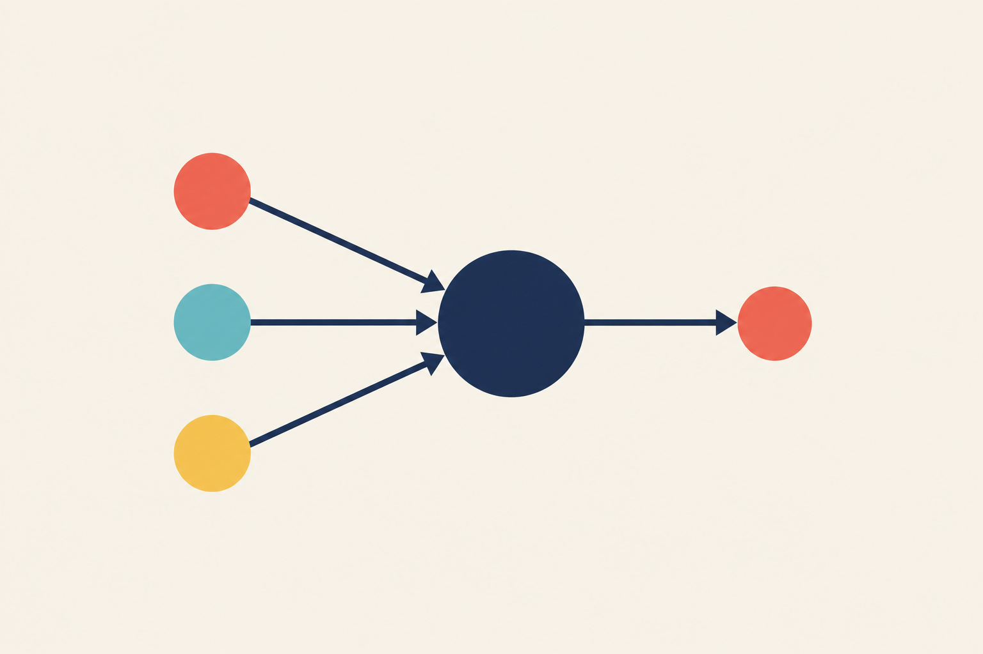
04 NEURAL NETWORKS
One artificial neuron
Inputs
Weighted sum
+ bias + activation
Output
Bruno Melício, PhD
27
Notes:
LEARN AI FOUNDATIONS
Slide 27: One artificial neuron
Recording guide: 32:03–33:19 (76 seconds, including any guided pauses)
NARRATION
An artificial neuron is a small mathematical operation. It combines numerical inputs using weights, adds a bias, and applies an activation function. A weight controls how strongly an input contributes. The bias shifts the combined value. The activation function transforms it. Some activations help a network represent relationships that a straight line cannot capture. This is a simplified computational unit inspired loosely by biology. It is not a miniature human brain or a conscious decision-maker. Our line model already had adjustable numbers: slope and intercept. A neuron extends that weighted-combination idea and can work with several inputs. On this diagram, each incoming connection carries information into the central calculation. The outgoing connection carries its result. We will first work through a deliberately small numerical example.
BACKGROUND SOURCES (not narration)
https://developers.google.com/machine-learning/crash-course/neural-networks/nodes-hidden-layers
VISUAL / EXAMPLE NOTES
Original course text and illustrations. Café figures, model parameters and plotted curves are invented teaching examples. Diagrams simplify the mechanisms described in the narration.

Slide 28
04 NEURAL NETWORKS
A neuron with two inputs
Warm = 1
Event = 1
Score = (2 × 1) + (3 × 1) − 4
If score > 0, output “high demand”
Hand-picked parameters for this teaching example
Bruno Melício, PhD
28
Notes:
LEARN AI FOUNDATIONS
Slide 28: A neuron with two inputs
Recording guide: 33:19–34:15 (56 seconds, including any guided pauses)
NARRATION
Imagine a toy classifier for whether café demand will be high. We encode warm weather as one and an event nearby as one. These are simplified yes-or-no features, not raw temperatures. Give warmth a weight of two and the event a weight of three, then add a bias of minus four. The combined score is two times one, plus three times one, minus four. What is the result? [Pause 15 seconds.]
Guided pause: 15 seconds. The learner may pause the recording for longer.
BACKGROUND SOURCES (not narration)
https://developers.google.com/machine-learning/crash-course/neural-networks/activation-functions
VISUAL / EXAMPLE NOTES
Original course text and illustrations. Café figures, model parameters and plotted curves are invented teaching examples. Diagrams simplify the mechanisms described in the narration.

Slide 29
04 NEURAL NETWORKS
The neuron outputs “high demand”
(2 × 1) + (3 × 1) − 4 = 1
1 > 0
Output = 1
High demand
A hand-built step activation for this example
Bruno Melício, PhD
29
Notes:
LEARN AI FOUNDATIONS
Slide 29: The neuron outputs “high demand”
Recording guide: 34:15–34:52 (37 seconds, including any guided pauses)
NARRATION
The score is one. For this hand-built example, use a step activation that outputs one when the score is above zero, and zero otherwise. We get one, meaning high demand. We chose these numbers ourselves to explain the operation. A trained classifier would learn parameters from suitable examples, and commonly uses smooth activations and probability-based outputs rather than this teaching rule.
BACKGROUND SOURCES (not narration)
https://developers.google.com/machine-learning/crash-course/neural-networks/activation-functions
Original teaching example. These values are illustrative.

Slide 30
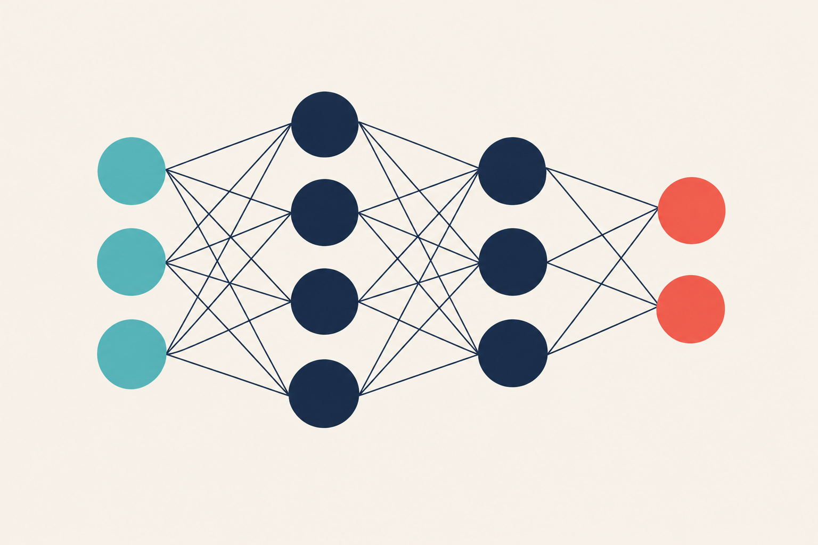
04 NEURAL NETWORKS
Neurons form layers
Input
Hidden layers
Output
Bruno Melício, PhD
30
Notes:
LEARN AI FOUNDATIONS
Slide 30: Neurons form layers
Recording guide: 34:52–36:12 (80 seconds, including any guided pauses)
NARRATION
A neural network connects many computational units into layers. The input layer represents the features. Hidden layers transform those values. The output layer produces the result for the task. Information in this feed-forward example travels from left to right. Each unit combines values arriving from the previous layer using its own weights. The word hidden means that we do not directly provide target answers for those intermediate units. It does not mean the system is magically inaccessible. Researchers can inspect activations and analyse behaviours, although interpreting a large network can be difficult. The number of inputs and outputs depends on the problem. This diagram is a small illustration, rather than the exact architecture of our café predictor. Its purpose is to show how a collection of simple operations becomes a larger model.
BACKGROUND SOURCES (not narration)
https://developers.google.com/machine-learning/crash-course/neural-networks/nodes-hidden-layers
VISUAL / EXAMPLE NOTES
Original course text and illustrations. Café figures, model parameters and plotted curves are invented teaching examples. Diagrams simplify the mechanisms described in the narration.

Slide 31
04 NEURAL NETWORKS
What makes learning deep?
Deep learning
Multiple layers learn
useful representations.
More layers do not guarantee a better model.
Bruno Melício, PhD
31
Notes:
LEARN AI FOUNDATIONS
Slide 31: What makes learning deep?
Recording guide: 36:12–37:33 (81 seconds, including any guided pauses)
NARRATION
Deep learning uses neural networks with multiple processing layers. Those layers can learn successive representations of the data. In an image task, early features may respond to local edges, later ones to combinations of shapes, and other features to patterns useful for recognising an object. This is an intuition, not a rule that every unit has a single human-readable meaning. In many tasks, deep models can learn useful representations from rich inputs such as images, audio and text. That can reduce the need to hand-design every feature. We still decide what data to use, how to train and how to evaluate. More layers do not guarantee better results. Data, computation, architecture and the task all affect what works. A small linear model can remain a better practical choice for a simple prediction problem.
BACKGROUND SOURCES (not narration)
https://developers.google.com/machine-learning/crash-course/neural-networks/nodes-hidden-layers
VISUAL / EXAMPLE NOTES
Original course text and illustrations. Café figures, model parameters and plotted curves are invented teaching examples. Diagrams simplify the mechanisms described in the narration.

Slide 32
04 NEURAL NETWORKS
Why activation functions matter
ReLU
Negative?
Return zero.
Positive?
Keep the value.
Bruno Melício, PhD
32
Notes:
LEARN AI FOUNDATIONS
Slide 32: Why activation functions matter
Recording guide: 37:33–38:51 (78 seconds, including any guided pauses)
NARRATION
If we stack layers that only perform linear transformations, the whole stack is still equivalent to one linear transformation. Extra layers alone would not give us the flexibility we want. Nonlinear activation functions change that. A common example is ReLU, which returns zero for a negative input and leaves a positive input unchanged. For inputs minus two, zero and three, its outputs are zero, zero and three. That simple bend helps networks combine features into more flexible patterns. Other activations have different roles. For a binary classifier, a sigmoid at the output can map a score into a value between zero and one. We should still check whether a model's probability estimates match reality. A number that looks like eighty percent is not a guarantee about any individual case.
BACKGROUND SOURCES (not narration)
https://developers.google.com/machine-learning/crash-course/neural-networks/activation-functions
VISUAL / EXAMPLE NOTES
Original course text and illustrations. Café figures, model parameters and plotted curves are invented teaching examples. Diagrams simplify the mechanisms described in the narration.

Slide 33
04 NEURAL NETWORKS
How a network learns
1
Predict
2
Measure loss
3
Backpropagation computes gradients
4
The optimiser updates parameters
Bruno Melício, PhD
33
Notes:
LEARN AI FOUNDATIONS
Slide 33: How a network learns
Recording guide: 38:51–40:11 (80 seconds, including any guided pauses)
NARRATION
The training loop returns with more adjustable parameters. First, a forward pass produces a prediction. We compare it with the target to calculate a loss. Backpropagation then efficiently computes gradients of that loss with respect to the model's parameters by applying the chain rule through the network. An optimiser uses those gradients to update the weights and biases. Backpropagation computes the gradients. Gradient descent is one way of using them to update parameters. Those are related but distinct jobs. We repeat across many batches of examples. The network does not receive a little written explanation of what each neuron should mean. Its parameters change according to the training objective. That is why an unsuitable objective or misleading dataset can produce behaviour we did not intend, even when the training software operates correctly.
BACKGROUND SOURCES (not narration)
https://developers.google.com/machine-learning/crash-course/neural-networks/backpropagation
https://developers.google.com/machine-learning/crash-course/linear-regression/gradient-descent
VISUAL / EXAMPLE NOTES
Original course text and illustrations. Café figures, model parameters and plotted curves are invented teaching examples. Diagrams simplify the mechanisms described in the narration.

Slide 34

05 IMAGES AND LANGUAGE
An image becomes numbers
Pixels carry numerical colour information.
Bruno Melício, PhD
34
Notes:
LEARN AI FOUNDATIONS
Slide 34: An image becomes numbers
Recording guide: 40:11–41:26 (75 seconds, including any guided pauses)
NARRATION
Here is an original illustrated café scene. To a computer, a digital image is numerical data. A colour image commonly represents each pixel using red, green and blue channel values. A model processes numerical patterns across those values. Recognising a cup requires handling changes in viewpoint, lighting, size and background. A dark cup on a dark table may look very different from our coral cup here. A useful training collection includes varied examples and evaluation cases that reflect use. The picture on this slide is an illustration for explanation, rather than a dataset. The important idea is that objects are not supplied to the model as named pieces. The system starts with the input representation and learns or applies operations that support the task.
BACKGROUND SOURCES (not narration)
https://www.ibm.com/think/topics/convolutional-neural-networks
VISUAL / EXAMPLE NOTES
Original course text and illustrations. Café figures, model parameters and plotted curves are invented teaching examples. Diagrams simplify the mechanisms described in the narration.

Slide 35

05 IMAGES AND LANGUAGE
Convolutional neural networks
Edges
Parts
Useful patterns
Bruno Melício, PhD
35
Notes:
LEARN AI FOUNDATIONS
Slide 35: Convolutional neural networks
Recording guide: 41:26–42:43 (77 seconds, including any guided pauses)
NARRATION
A convolutional neural network, or CNN, is one architecture well suited to spatial patterns in images. A small learned filter examines local regions, and the same filter can be applied across different positions. That weight sharing makes it useful for detecting a pattern wherever it appears. Several filters can respond to different features. Later layers combine earlier responses to support the final task. The illustration suggests edges, parts and a whole cup to build intuition. Real feature maps contain numbers, and features are often more distributed than these tidy pictures suggest. CNNs are important, but they are not the only way to process images. Transformer-based vision models also exist. The common theme is learning useful representations, then assessing them on the recognition problem we actually care about.
BACKGROUND SOURCES (not narration)
https://www.ibm.com/think/topics/convolutional-neural-networks
VISUAL / EXAMPLE NOTES
Original course text and illustrations. Café figures, model parameters and plotted curves are invented teaching examples. Diagrams simplify the mechanisms described in the narration.

Slide 36
05 IMAGES AND LANGUAGE
One image, different AI tasks
What is it?
Where is it?
Describe it.
What would a robot need to pick up the cup?
Bruno Melício, PhD
36
Notes:
LEARN AI FOUNDATIONS
Slide 36: One image, different AI tasks
Recording guide: 42:43–44:09 (86 seconds, including any guided pauses)
NARRATION
We can ask different questions about the same café image. What object is present? Where is the cup? Which pixels belong to the cup? Describe the scene in a sentence. These are different tasks, even though the starting image is the same. Pause and choose which question you would ask if a robot needed to pick up the cup. [Pause 15 seconds.] It would need information about location and probably shape or depth, not simply the word cup. An image classifier's category alone would be insufficient. Before selecting a tool, specify the output your application needs. We will compare two common outputs next. We are deliberately returning to the same illustration so you can focus on how the question changes.
Guided pause: 15 seconds. The learner may pause the recording for longer.
VISUAL / EXAMPLE NOTES
Original course text and illustrations. Café figures, model parameters and plotted curves are invented teaching examples. Diagrams simplify the mechanisms described in the narration.

Slide 37
05 IMAGES AND LANGUAGE
Recognition and location
Classification
Object detection
“A cup”
“A cup, here”
A category
A category + a location
The output should match the job.
Bruno Melício, PhD
37
Notes:
LEARN AI FOUNDATIONS
Slide 37: Recognition and location
Recording guide: 44:09–45:27 (78 seconds, including any guided pauses)
NARRATION
Image classification assigns categories to an image or object. Object detection adds locations, commonly using bounding boxes for objects and their categories. Segmentation goes further by assigning categories or object identities at pixel level. A captioning model generates a description, such as a cup beside a notebook. Different outputs answer different needs. Suppose a stockroom camera needs to count separate cups. Detecting each cup is more suitable than producing one image-level label saying cup. Even then, we should test crowded shelves, partial objects and unusual lighting. A box drawn on an image can look precise while still missing an object. Good evaluation should match the real task, including the kinds of mistakes that matter. We can now extend the same input-and-output thinking from images to language and sequences.
BACKGROUND SOURCES (not narration)
https://www.ibm.com/think/topics/convolutional-neural-networks
VISUAL / EXAMPLE NOTES
Original course text and illustrations. Café figures, model parameters and plotted curves are invented teaching examples. Diagrams simplify the mechanisms described in the narration.

Slide 38
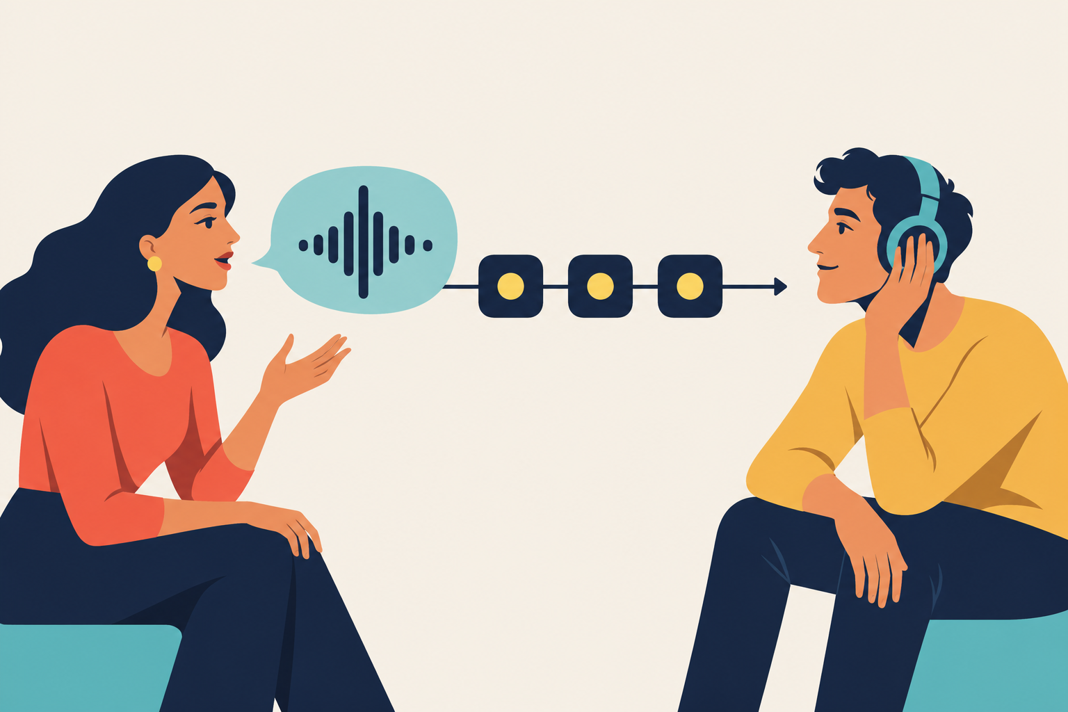
05 IMAGES AND LANGUAGE
Order and memory
RNNs carry a learned state across a sequence.
Bruno Melício, PhD
38
Notes:
LEARN AI FOUNDATIONS
Slide 38: Order and memory
Recording guide: 45:27–46:43 (76 seconds, including any guided pauses)
NARRATION
Some inputs arrive in an order that matters. Compare Lina thanked Omar with Omar thanked Lina. The names are the same, but the meaning changes. Speech, text, sensor readings and sales over time all contain sequential structure. A recurrent neural network, or RNN, processes a sequence while passing a hidden state from one step to the next. That state is a learned numerical summary of earlier information. It is a useful model of sequence processing, although basic RNNs can struggle with long-range dependencies. LSTM and GRU architectures were designed to help manage information over time. We do not need their gate equations here. The key question is how a model uses context beyond the current input. Many modern language models use a different architecture: the Transformer.
BACKGROUND SOURCES (not narration)
https://www.ibm.com/think/topics/recurrent-neural-networks
VISUAL / EXAMPLE NOTES
Original course text and illustrations. Café figures, model parameters and plotted curves are invented teaching examples. Diagrams simplify the mechanisms described in the narration.

Slide 39
05 IMAGES AND LANGUAGE
Transformers and attention
Lina put the cup beside the notebook
because it was empty.
What changes if the last word is “blank”?
Attention combines relevant context.
Bruno Melício, PhD
39
Notes:
LEARN AI FOUNDATIONS
Slide 39: Transformers and attention
Recording guide: 46:43–48:08 (85 seconds, including any guided pauses)
NARRATION
A Transformer uses attention mechanisms to combine information from relevant positions in a context. Consider this sentence: Lina put the cup beside the notebook because it was empty. Which object does it most likely refer to? [Pause 10 seconds.] We would normally choose the cup. Change the final word to blank, and the notebook becomes a more plausible interpretation. Context changes relationships between words. Attention computes learned numerical weights between representations and combines information using those weights. It does not literally look or think like a person. Models also need information about position so word order is available. This is a simplified intuition rather than a full architecture lesson. Many modern language models use Transformers, and the architecture also supports tasks involving images, audio and other data.
Guided pause: 10 seconds. The learner may pause the recording for longer.
BACKGROUND SOURCES (not narration)
https://developers.google.com/machine-learning/crash-course/llm/transformers
VISUAL / EXAMPLE NOTES
Original course text and illustrations. Café figures, model parameters and plotted curves are invented teaching examples. Diagrams simplify the mechanisms described in the narration.

Slide 40

05 IMAGES AND LANGUAGE
Generative AI
Text, images, audio and video
Bruno Melício, PhD
40
Notes:
LEARN AI FOUNDATIONS
Slide 40: Generative AI
Recording guide: 48:08–49:26 (78 seconds, including any guided pauses)
NARRATION
A generative model produces content such as text, images, audio or video. We could ask for a café announcement, a new sailboat illustration or a short storyboard. Different model families generate different kinds of output through different processes. A language model commonly predicts successive tokens. Many image models use diffusion-based generation, although there are other approaches. Learning patterns from data makes flexible generation possible, but it also brings limitations. An output can reproduce a misleading pattern, include a factual error or resemble existing material. We should review what we publish and understand any usage conditions that apply to the tool and content. For our café, a generated announcement could be a starting draft. Lina still supplies the true opening times and decides whether the result is accurate and appropriate.
BACKGROUND SOURCES (not narration)
https://www.ibm.com/think/topics/generative-ai
https://nvlpubs.nist.gov/nistpubs/ai/NIST.AI.600-1.pdf
VISUAL / EXAMPLE NOTES
Original course text and illustrations. Café figures, model parameters and plotted curves are invented teaching examples. Diagrams simplify the mechanisms described in the narration.

Slide 41
05 IMAGES AND LANGUAGE
How a language model writes
“The café opens at…”
Possible next tokens
9
noon
sunrise
What information would make the time reliable?
Bruno Melício, PhD
41
Notes:
LEARN AI FOUNDATIONS
Slide 41: How a language model writes
Recording guide: 49:26–50:54 (88 seconds, including any guided pauses)
NARRATION
A token is a unit used to represent text. It can be a word, part of a word or punctuation, depending on the tokenizer. A language model uses the available context to assign scores to possible next tokens. A generation process selects one, adds it to the context, and continues. After The café opens at, several continuations might be plausible. What information would we need to produce a reliable opening time? [Pause 10 seconds.] We need the café's actual schedule. Patterns in language alone cannot establish that fact. The model's training, instructions and any connected tools influence the output. Some products retrieve information or perform searches before answering. Even then, we should check sources. Plausible text and verified information are different qualities, which is why fluent answers can still contain mistakes.
Guided pause: 10 seconds. The learner may pause the recording for longer.
BACKGROUND SOURCES (not narration)
https://developers.google.com/machine-learning/crash-course/llm/transformers
VISUAL / EXAMPLE NOTES
Original course text and illustrations. Café figures, model parameters and plotted curves are invented teaching examples. Diagrams simplify the mechanisms described in the narration.

Slide 42

06 USING AI THOUGHTFULLY
A useful prompt
Task + audience
Known facts
Output constraints
A way to check
Your turn: write a request you could verify.
Bruno Melício, PhD
42
Notes:
LEARN AI FOUNDATIONS
Slide 42: A useful prompt
Recording guide: 50:54–52:36 (102 seconds, including any guided pauses)
NARRATION
A prompt is the request and context we provide to an AI system. Compare write something about my café with this request: write a friendly fifty-word announcement for a neighbourhood café. We open Saturday at nine. Mention our new outdoor seating. Use only these facts and ask if anything essential is missing. The clearer version gives the task, audience, known facts and a useful output constraint. It does not guarantee a correct answer. We still check whether the draft invented a discount, changed the time or misunderstood the tone. Pause and write your own request for a harmless everyday task. Include the result you need, relevant context and one way you will check it. [Pause 25 seconds.] You can practise on paper. No live tool is required for this activity.
Guided pause: 25 seconds. The learner may pause the recording for longer.
BACKGROUND SOURCES (not narration)
https://www.ibm.com/think/topics/generative-ai
VISUAL / EXAMPLE NOTES
Original course text and illustrations. Café figures, model parameters and plotted curves are invented teaching examples. Diagrams simplify the mechanisms described in the narration.

Slide 43

06 USING AI THOUGHTFULLY
A convincing answer can be wrong
Fluency does not establish accuracy.
Bruno Melício, PhD
43
Notes:
LEARN AI FOUNDATIONS
Slide 43: A convincing answer can be wrong
Recording guide: 52:36–53:49 (73 seconds, including any guided pauses)
NARRATION
Imagine an AI draft says Lina's café won a local award, even though Lina never provided that fact. That is an invented claim. Generative systems can produce confident errors, often called hallucinations or confabulations. They can also invent citations or give explanations that sound convincing. Asking are you sure is not an independent fact-check. For an opening time, use the café's confirmed schedule. For a quotation, inspect the original source. For arithmetic, recalculate. The amount of checking should fit the consequences of being wrong. Review also matters for images and video, which may show events that never happened. A useful habit is to separate suggestions from factual claims, then verify the claims that will affect a decision or reach an audience.
BACKGROUND SOURCES (not narration)
https://nvlpubs.nist.gov/nistpubs/ai/NIST.AI.600-1.pdf
VISUAL / EXAMPLE NOTES
Original course text and illustrations. Café figures, model parameters and plotted curves are invented teaching examples. Diagrams simplify the mechanisms described in the narration.

Slide 44
06 USING AI THOUGHTFULLY
Bias, privacy and human judgement
Whose examples are missing?
What information may we share?
Who reviews and corrects mistakes?
Bruno Melício, PhD
44
Notes:
LEARN AI FOUNDATIONS
Slide 44: Bias, privacy and human judgement
Recording guide: 53:49–55:05 (76 seconds, including any guided pauses)
NARRATION
A model can perform differently across people, languages or situations. A single average score may hide those differences. Think back to our missing rainy days. In a human-facing service, missing examples or biased labels can affect people unfairly. Evaluation should include relevant groups and conditions, with care about how that information is collected and used. Privacy is another practical issue. Before putting customer records or confidential work into a tool, check your permission, the organisation's policy and the service's data handling. For an early experiment, invented or properly anonymised examples may be more appropriate. Human oversight should be concrete: who reviews outputs, who can correct a mistake, and who is accountable for the decision? Those questions belong in the project design, alongside accuracy and cost.
BACKGROUND SOURCES (not narration)
https://nvlpubs.nist.gov/nistpubs/ai/NIST.AI.600-1.pdf
VISUAL / EXAMPLE NOTES
Original course text and illustrations. Café figures, model parameters and plotted curves are invented teaching examples. Diagrams simplify the mechanisms described in the narration.

Slide 45
07 PUTTING IT TOGETHER
Your café AI project
Forecast demand
Your plan
Task
Input
Output
Success check
One limitation
Sort booking messages
Draft an announcement
Pause for 45 seconds, or take longer.
Bruno Melício, PhD
45
Notes:
LEARN AI FOUNDATIONS
Slide 45: Your café AI project
Recording guide: 55:05–57:09 (124 seconds, including any guided pauses)
NARRATION
You are now helping Lina design a small project. Choose one goal: forecast tomorrow's takeaway demand, sort incoming booking messages, or draft a café announcement. On paper, write five things: the task, the input, the desired output, how you would check success, and one risk or limitation. Be specific enough that another person could understand what the tool should do. If you choose forecasting, ask when each input becomes available. If you choose message sorting, decide how you would notice an important message placed in the wrong group. If you choose the announcement, decide which facts the model may use. Pause for forty-five seconds, or longer if you want. [Pause 45 seconds.] You do not need to choose a neural network just because we studied one. Begin with the problem and a useful baseline.
Guided pause: 45 seconds. The learner may pause the recording for longer.
VISUAL / EXAMPLE NOTES
Original course text and illustrations. Café figures, model parameters and plotted curves are invented teaching examples. Diagrams simplify the mechanisms described in the narration.

Slide 46
07 PUTTING IT TOGETHER
One possible project design
Demand forecast
Input
Weather, weekday, opening hours
Output
Predicted cups sold
Check
Later days + a simple baseline
Lina uses the forecast and keeps the final decision.
Bruno Melício, PhD
46
Notes:
LEARN AI FOUNDATIONS
Slide 46: One possible project design
Recording guide: 57:09–58:29 (80 seconds, including any guided pauses)
NARRATION
Here is one answer for the demand forecast. The task is regression. Inputs might be the weather forecast available that morning, the weekday and opening hours. The output is predicted cups sold for that day. We would start with dated historical records, compare a simple model against a weekday-average baseline, and evaluate on later days kept separate from training. Average absolute error in cups gives an understandable measure, while large underestimates deserve a separate check because they affect queues and stock. A limitation is that an unusual local event may change demand. Lina should see the forecast as decision support and retain a way to override it. A good project plan joins the model to a real decision. It also states how the people using it will discover and respond to mistakes.
BACKGROUND SOURCES (not narration)
https://developers.google.com/machine-learning/crash-course/overfitting/dividing-datasets
VISUAL / EXAMPLE NOTES
Original course text and illustrations. Café figures, model parameters and plotted curves are invented teaching examples. Diagrams simplify the mechanisms described in the narration.

Slide 47

07 PUTTING IT TOGETHER
AI foundations, in your own words
A task. Some data.
A model we can test.
How would you explain
machine learning now?
Bruno Melício, PhD
47
Notes:
LEARN AI FOUNDATIONS
Slide 47: AI foundations, in your own words
Recording guide: 58:29–60:00 (91 seconds, including any guided pauses)
NARRATION
You have followed the full path from a task to data, a model, training, evaluation and responsible use. AI is the broad field. Machine learning learns patterns from data. Deep learning uses multilayer neural networks. Training adjusts parameters, while inference uses a trained model. Evaluation asks whether the system works beyond familiar examples. And generative AI can create useful material that still needs judgement and checking. For a final challenge, explain machine learning to someone in one sentence using the café example. [Pause 15 seconds.] If you want a next step, take a small, non-sensitive dataset and compare a simple baseline with a basic model, or practise drafting and checking an everyday AI response. Thank you for learning with me. I'm Bruno Melício, and this has been Learn AI Foundations.
Guided pause: 15 seconds. The learner may pause the recording for longer.
VISUAL / EXAMPLE NOTES
Original course text and illustrations. Café figures, model parameters and plotted curves are invented teaching examples. Diagrams simplify the mechanisms described in the narration.

