Slide 1

HollidayAcc
Bruno Carmo 57418
Sahil Kumar 57449

Slide 2
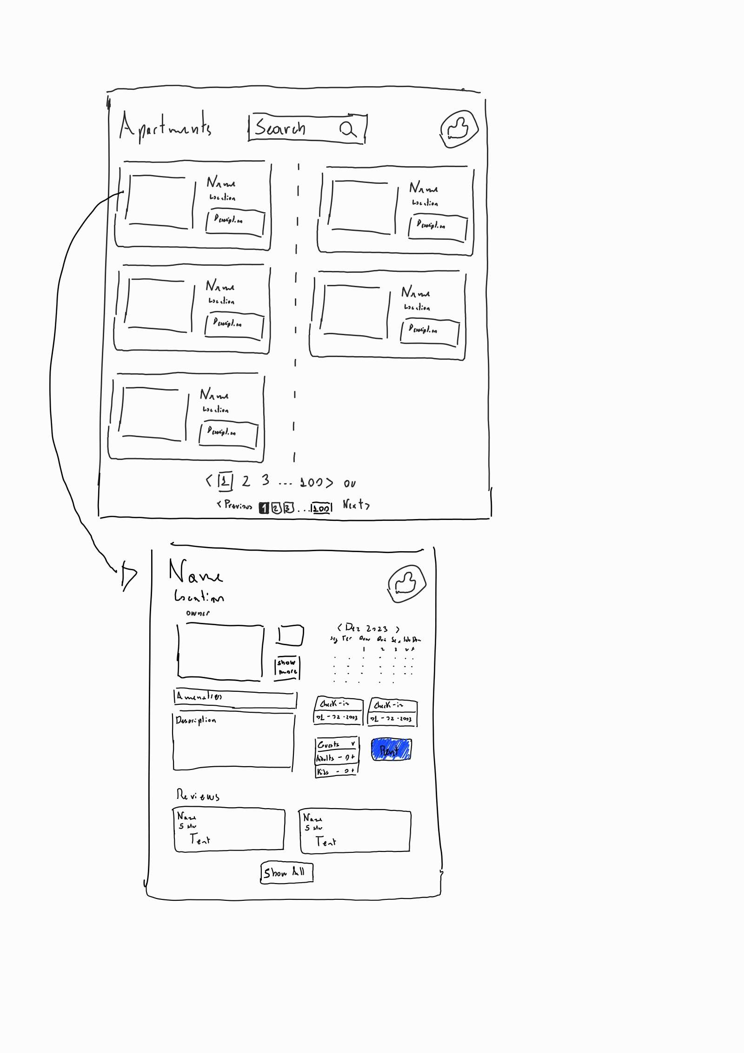
User Stories and Mock-ups
As a client, I want to see the first page of a list of apartments so that I can choose one to rent and see its details.
As a client, I want to see the next page in the list of apartments so that I can choose one to rent and see its details.
As a client, I want to see the details of an apartment so that I can read its description and amenities and decide if I want to rent it.
As a client, I want to see the calendar of an apartment so that I can decide when to rent it.
As a client, I want to see the reviews of an apartment so that I can decide if I want to rent it.
As a client, I want to select a starting date and an ending date in the calendar of an apartment to start making a reservation.

Slide 3
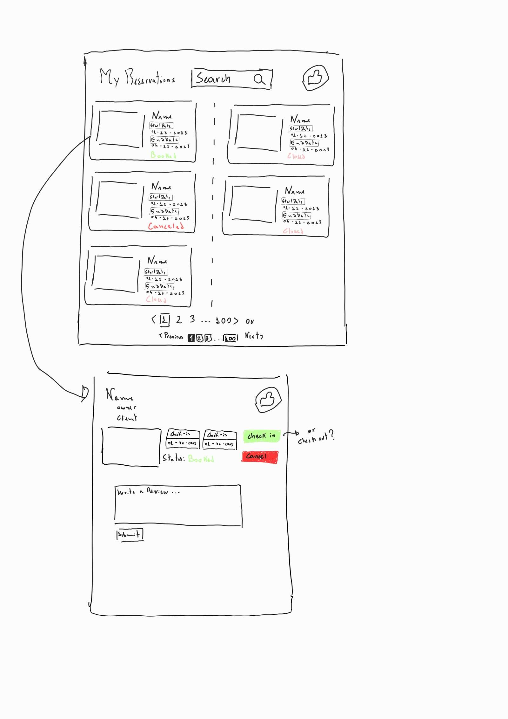
User Stories and Mock-ups
As a client, I want to see the details of a reservation so that I can see if it was accepted.
As a client, I want to see the details of a reservation so that I can cancel it and see the result in the details of the reservation.
As a client, I want to see the details of a reservation so that I can check in and see the result in the details of the reservation.
As a client, I want to see the details of a reservation so that I can check out and see the result in the details of the reservation.

Slide 4
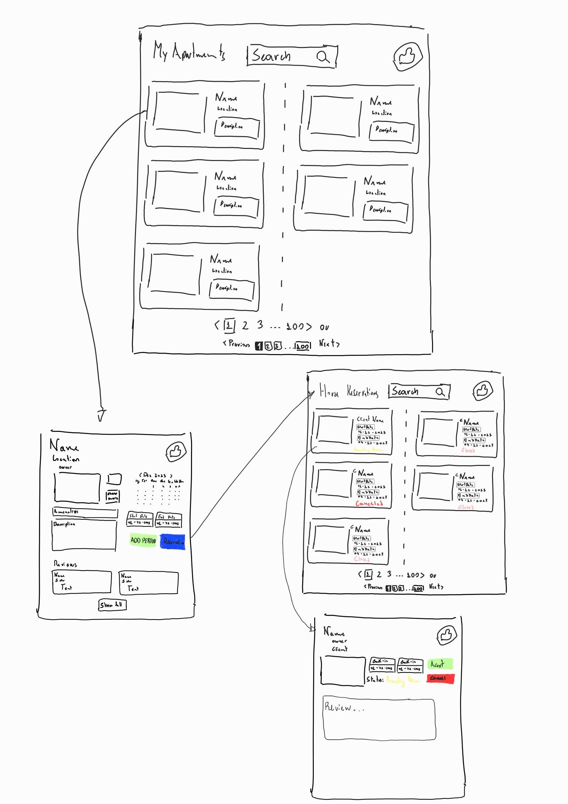
User Stories and Mock-ups
As an owner, I want to see the list of my apartment so that I can select one apartment and see its details.
As an owner, I want to see the details of an apartment so that I can add a period of availability and see the result in the calendar.
As an owner, I want to see the details of an apartment so that I can see the list of reservations for it.
As an owner, I want to see the details of a reservation so that I can accept it and see the result in the list of reservations.

Slide 5
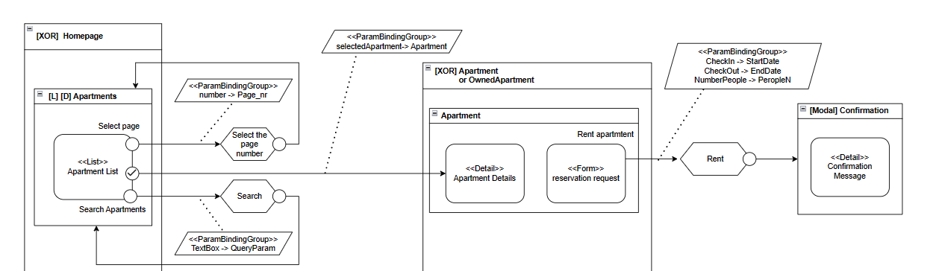
IFML

Slide 6
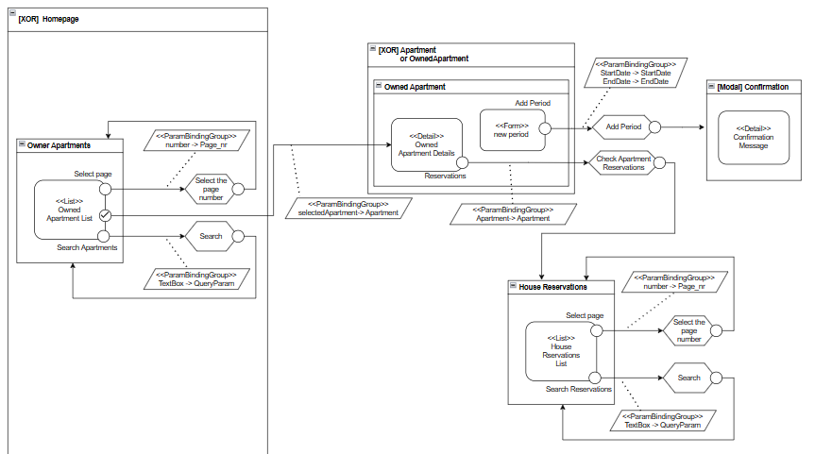
IFML

Slide 7
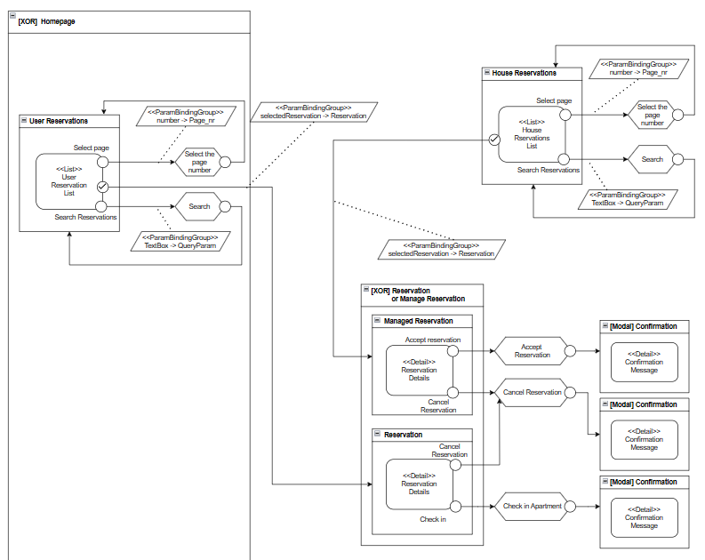
IFML

Slide 8
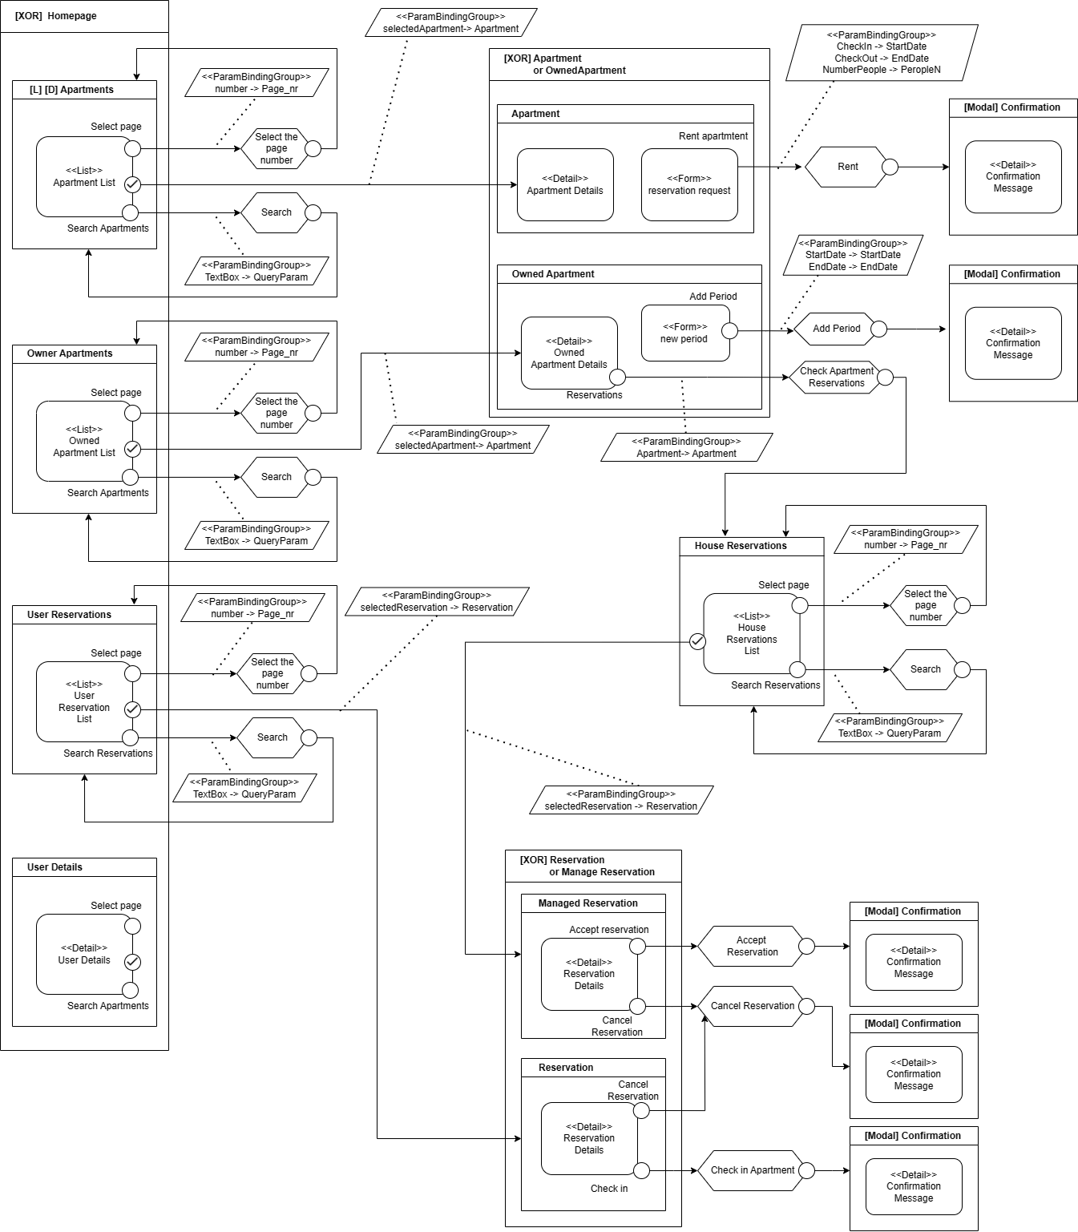
IFML

Slide 9
Major Challenges
Front-end calendar component.
Outdated documentation.
Debugging Spring.

Slide 10
Extra Stuff
Login in Navigation Bar.
Bootstrap and CSS Animations.
Review functionality.

Slide 11
END
Bruno Carmo 57418
Sahil Kumar 57449

