Slide 1
Technical Evaluation 2 – Open Scope
My Free Games Library
Bruno Pimentel Struminski

Slide 2
Technologies Used
JDK 11
Maven (Last Version)
Springfox
JUnit
MySQL
Docker Engine
Postman

Slide 3
External API
Free-to-Play Games Database API
https://www.freetogame.com/api-doc

Slide 4
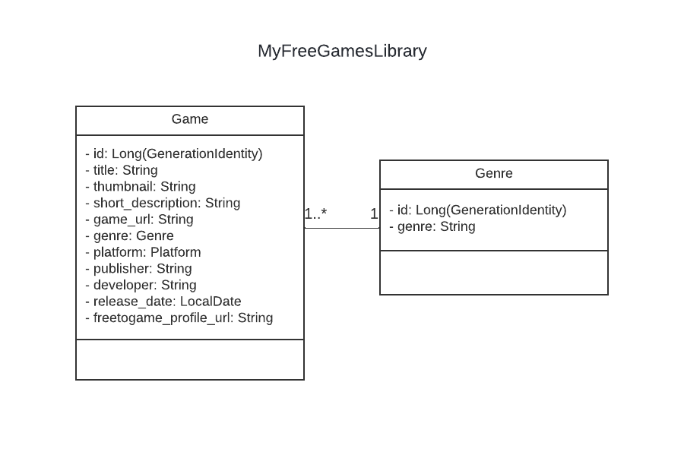
UML Class Diagram

Slide 5
API Workflow
Request
My Free Games Library
Free-to-Play Games Database API
Response
MySQL DB

Slide 6
Endpoints
Get Games List
http://localhost:8081/game
Get Game by title
http://localhost:8081/game?title={title}
Get Genres List
http://localhost:8081/genre
Post Game
http://localhost:8081/game?id={id}
Delete Game
http://localhost:8081/game?title={title}
Get Games List
https://www.freetogame.com/api/games
Get Game by id
https://www.freetogame.com/api/game?id={id}

