Slide 1


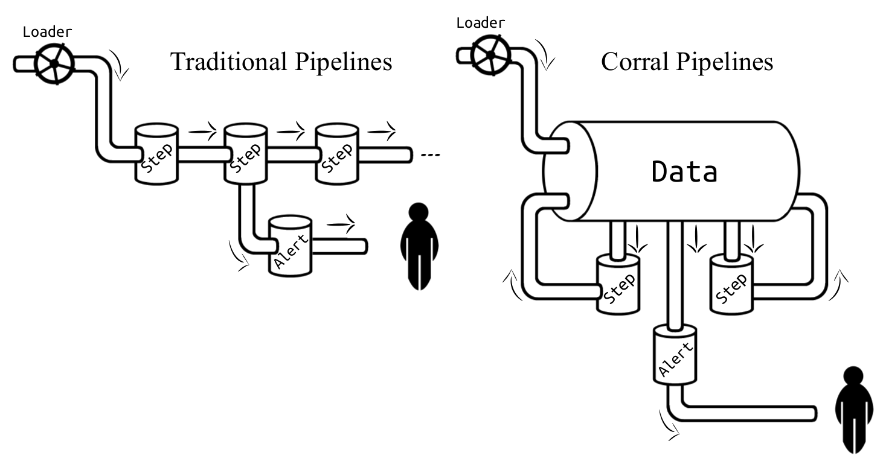
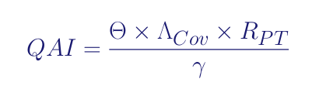
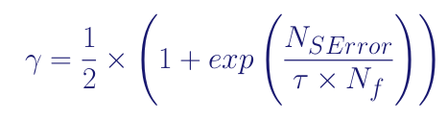
Trustworthy and Fully Functional Data Intensive Parallel Astronomical Pipelines
Designed for remote data processing of small telescopes
located at inaccesible sites.
P118
Features:
MVC model to MSA
On top of SQLAlchemy (dialect agnostic)
Full python implementation
Quality report and autodocumentation
Data parallelism and multi processing capabilities
Useful for:
Reducing telescope images
Operations on data tables
Generation of reports
Monitoring remote hardware
Works at small environments (laptops)
Works in big environments (clusters)
Prototyiping larger data processing software
Automating small processes with DB’s
Quality Assurance Index
Check it @ghithub/toros-astro/corral
Simply ~$ pip install corral-pipeline
arxiv: 1701.05566

