Slide 1
Big Data 2 Final Presentation
Group Members:
Bruno Simione Beltrame
Nilton Antonio De Oliveira Paes
Fabio Cesar Torres De Araujo Hercules
Oleksii Kachan
Francisco Isaac De La Rosa Rivero

Slide 2
Project analysis slide 3
Dataset
About
Dataset of Stock Market in the S&P 500 index which shows the information of all stock available in the index from Feb 2013 to Feb 2018 (Source of dataset https://www.kaggle.com/camnugent/sandp500)
Approach
Predict the closing value of Amazon (AMZN) taking the open value with the max and min of the day.
Preprocess data
Use Machine Learning to create a model
Validate the Model
Use Spark MLlib and TensorFLow

Slide 3
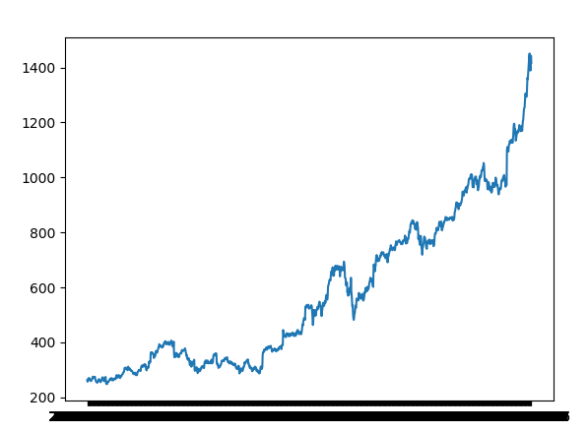
Project analysis slide 5
Tensor Flow Approach
Take only the AMZN’s stock and create two files: one for training (predict the closing value) and one for testing
Load Training Data and Testing Data
Preprocess data creating scalers for the inputs and outputs
Scale both the training inputs and outputs
Create the model
define model parameters
define the number of input and output nodes
define the number of nodes per layer
define layers
Run TensorFlow operations
Visualize the predicted and actual values using matplotlib

Slide 4
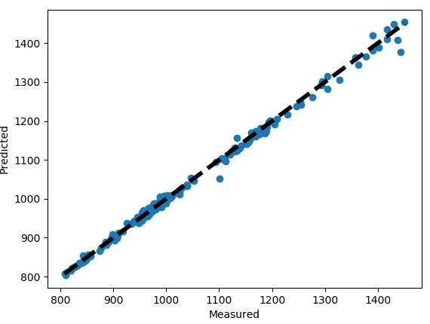
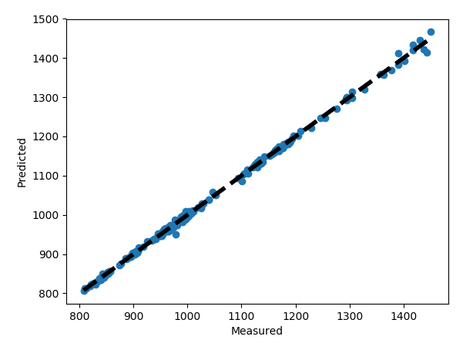


Project analysis slide 5
Tensor Flow Approach
Findings
Matplotlib Visualization – Predicted X Actual Values
learning_rate = 0.001
training_epochs = 200
layer_1_nodes = 75
layer_2_nodes = 100
layer_3_nodes = 75
learning_rate = 0.001
training_epochs = 800
layer_1_nodes = 1024
layer_2_nodes = 512
layer_3_nodes = 256
Target:
1416.78
1436.1113
1433.7349

Slide 5
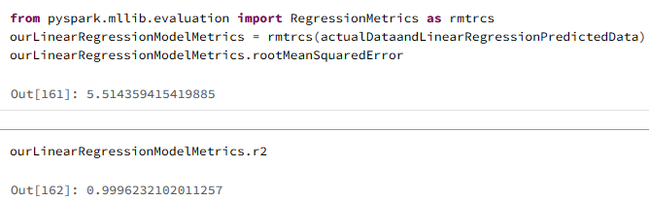
Project analysis slide 5
Spark MLlib Approach
Load the data – Dataframe
Creates a resilient distributed dataset (RDD) form the Dataframe
Use “Map” to get rid of “keys”
Process with LabeledPoint using the “close” value as the label and the “open, high and low” as the features.
Split data for training and testing
Use the Training Data to make a model with linear regression
Test the model and validate how accurate it is
Calculate the R2 value
Findings
R2 is greater than 0.5 there is a good model

Slide 6
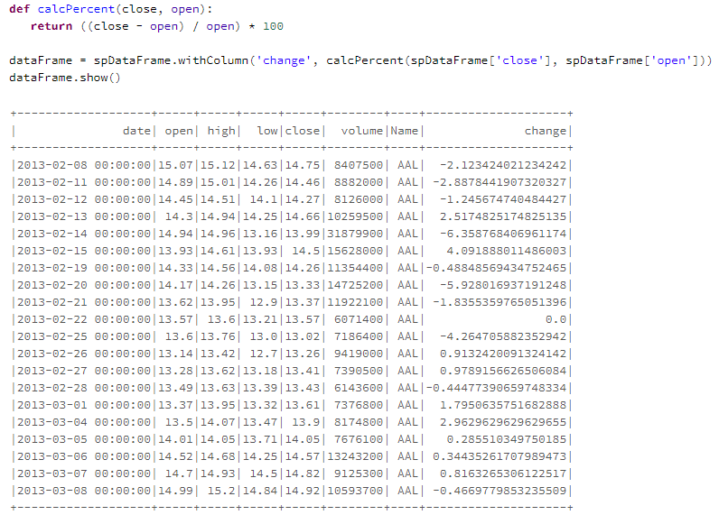
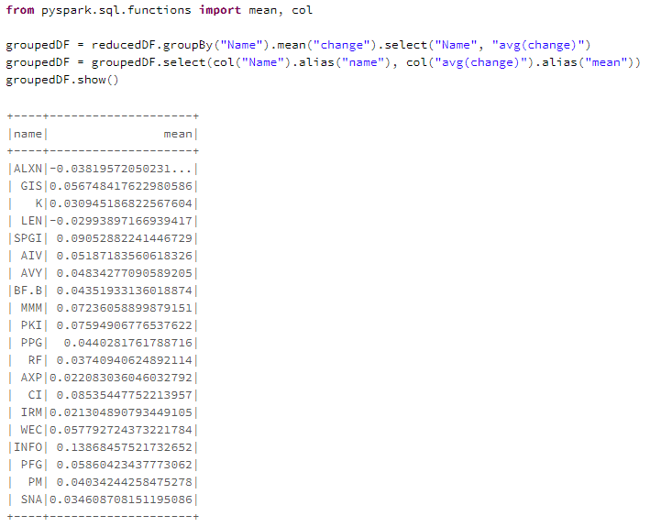
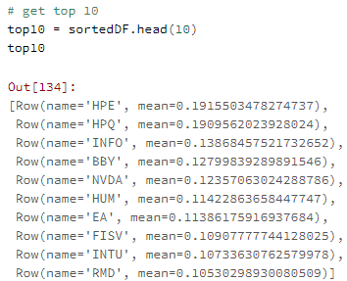
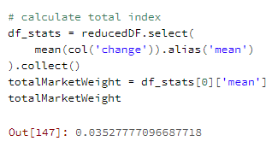
Project analysis slide 5
Data Application

Slide 7
Project analysis slide 5
Difficulties & Learnings
Clean the data
What parameters should we set? (Layers, epochs, nodes)
After finish, how to know how good is our model?
A good model requires technology AND mathematical skills.

Slide 8
Thank You
Bruno Simione Beltrame
Nilton Antonio De Oliveira Paes
Fabio Cesar Torres De Araujo Hercules
Oleksii Kachan
Francisco Isaac De La Rosa Rivero

