Slide 1

Biometrics System Concepts
Presentation for the Assignments
Bruno Vandekerkhove

Slide 2

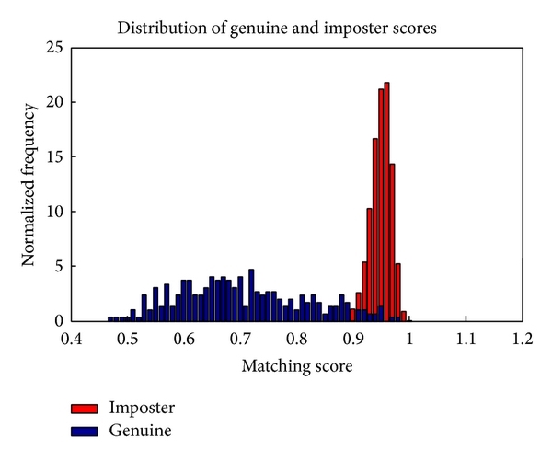
Validation & Evaluation
Part 1

Slide 4
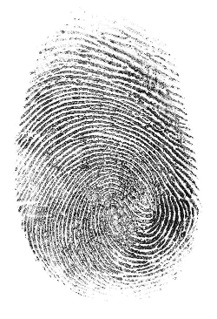
Fingerprint Recognition
Part 2

Slide 6
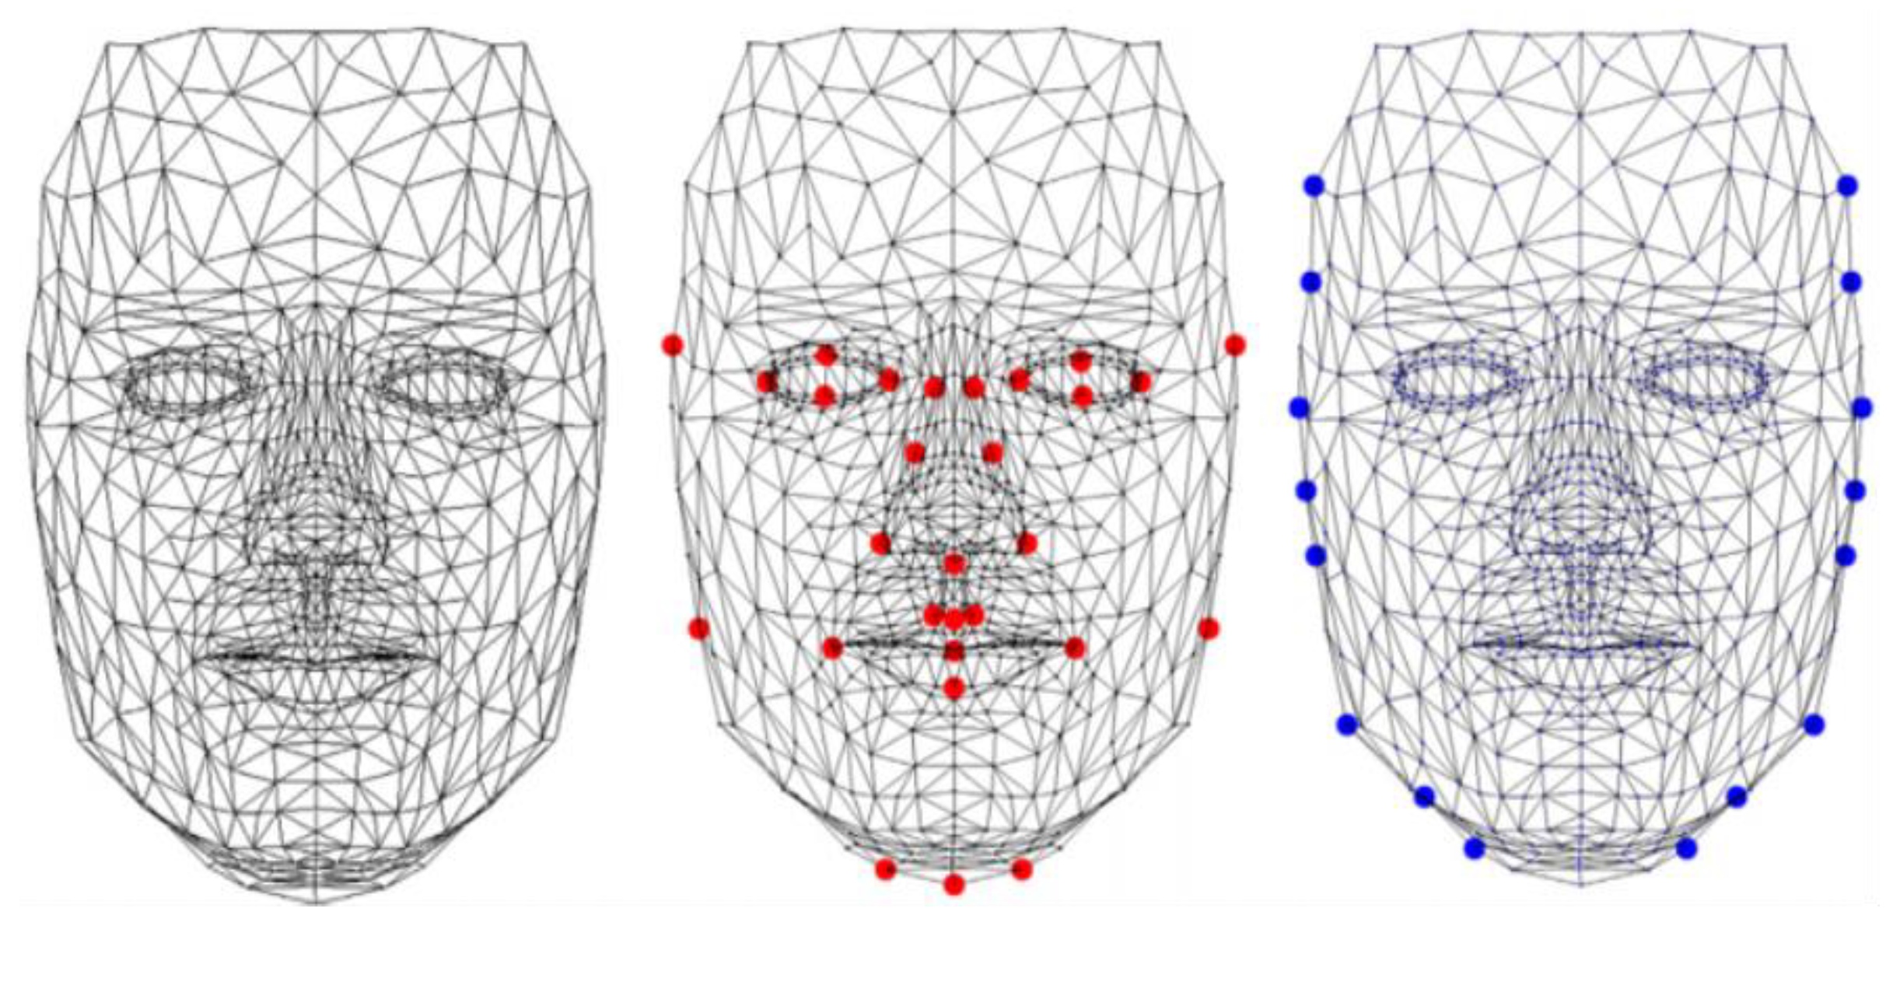
Face Recognition
Part 3

