Slide 1
Fechamento Claro
Settlement differences with source-row evidence
Bruno Fernandes
Accounting graduate, solo builder
Notes:
Open Agent Hackathon 2026. Primary track: The Agent That Can Explain Why. Working prototype demonstrated on 23 October. Source: project README and actual local execution evidence.

Slide 2
The missing R$10
A small-business owner sees an order and a smaller processor settlement.
Order A-1002 | BRL
Gross order | 200.00
Stated fee | 6.00
Received | 184.00
Unexplained | 10.00
The stated fee explains part of the gap. The remaining cause needs evidence.
For owners and bookkeepers reviewing a settlement close
Notes:
Fictional example from src/fixtures.mjs. These are supplied records, not independently audited facts. Formula: 20000 - 600 - 0 = 19400 cents. Observed 18400 cents. Difference 1000 cents.

Slide 3
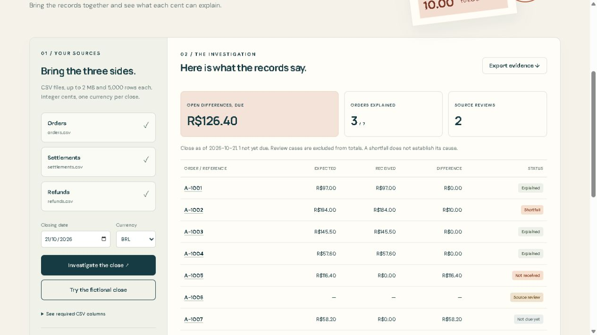
An investigation tied to the records
R$126.40
open due differences
3 of 7 orders explained
2 source reviews
1 order not yet due
Conflicting IDs stay outside the totals.
Notes:
Screenshot captured from the running local application after real Zetaris registration and SQL checks. Seven orders, nine settlements and one refund. Close cutoff 21 October 2026. All records fictional.

Slide 4
Local architecture
01 Source snapshots
02 Zetaris and cent checks
Strict CSV parsing, original cells, physical line numbers and text checksums.
Registered file sources, SQL joins and an independent integer-cent comparison.
03 Evidence tools
04 Nightshift investigator
Meterless H-MEM recalls recorded findings. Case inspection exposes cited rows.
Nightshift selects bounded search and inspection tools. Only inspected findings reach the answer.
Notes:
Implemented modules: src/staging.mjs, src/zetaris.mjs, scripts/register-zetaris-sources.py, src/core.mjs, src/memory.ts, src/nightshift.mjs, src/investigator.ts, scripts/live-server.ts. Official contracts: https://kbase.zetaris.com/knowledge/sql-manual and https://github.com/Meterless/Meterless/blob/1742dec56a66e58eef9dda2d2b865823758ca8cd/docs/agent-ready/add-meterless-provider.md

Slide 5
Execution evidence and limits
Verified
Limits
Zetaris matched all counted cent totals. Nightshift selected evidence tools locally.
19 automated checks passed.
Actual Cursor review led to recorded fixes.
Seven fictional orders demonstrate behavior, not production accuracy.
A model can fail to select a valid tool within six turns. The app then returns an error.
Source truth and the cause of a gap remain unverified.
Notes:
Actual evidence: evidence/zetaris-close.json. Development review: docs/CURSOR-REVIEW.md. Automated tests: tests/*.test.ts. Current readiness: docs/READINESS.md. No measured accuracy, time savings, customers or fraud-detection performance is claimed.

Slide 6
Next development
Demonstrated workflow
After the hackathon
Register sources in Zetaris, verify totals and inspect the original rows.
Use Nightshift to select evidence tools and export the accepted trail.
Validate the workflow with bookkeepers using authorized records.
Add explicit fee-contract policies and broader date and source-format coverage.
github.com/Brunof94-debug/fechamento-claro-open-agent
Notes:
Left: demonstrated workflow. Right: future plans, not completed features. Project repository: https://github.com/Brunof94-debug/fechamento-claro-open-agent . Event: https://hackathon.genai.works/event/open-agent-hackathon-2026#rules

