Slide 1
The DUngeon
Bruno Santos 113446
Introduction to Computer Graphics – 2024/2025

Slide 2

Introduction
Bossfight in dark “dungeon theme”
Blender usage requires GLTFLoader module
Project available on:
https://github.com/BrunommSantos/ICG_proj_113446

Slide 3
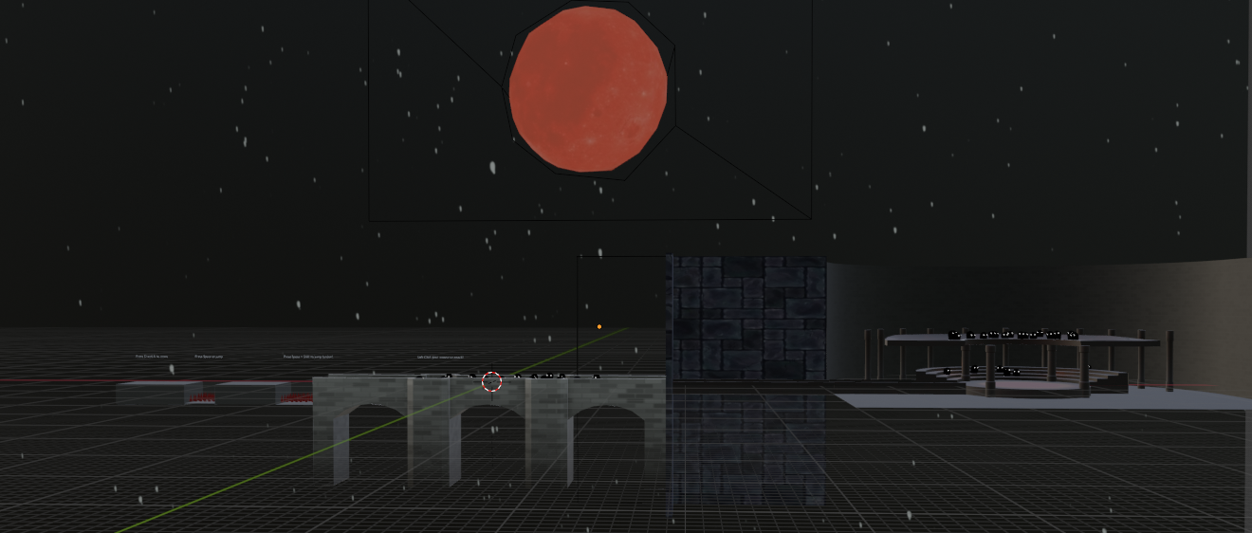
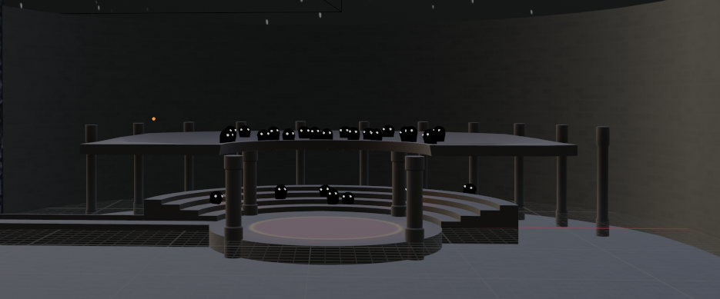
Scene development
Scene layout planning
Division in subáreas
Created Models
Figure 1 : Scene layout overview
Figure 2 : Arena model

Slide 4
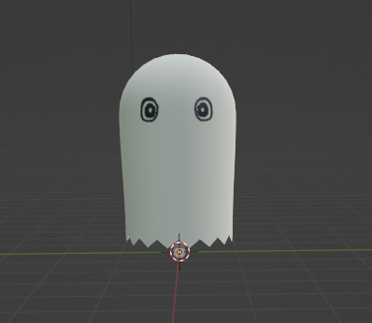
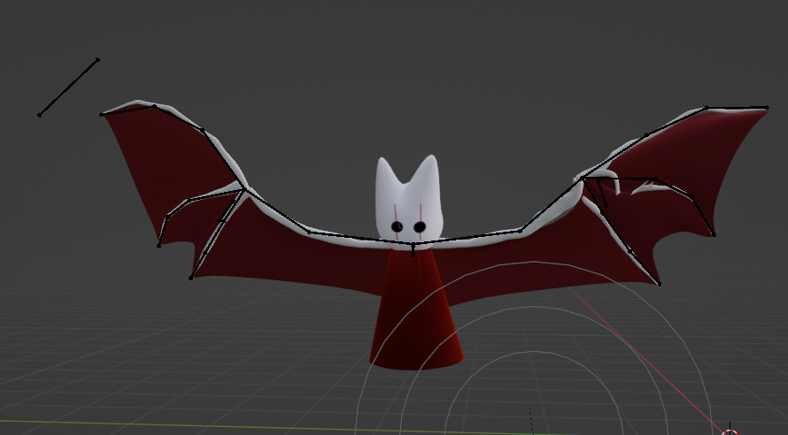
Actor Models
Boss and player models created in Blender.
Rigged to enable animations in threejs.
Figure 3 : Player avatar model
Figure 4 : Boss model

Slide 5
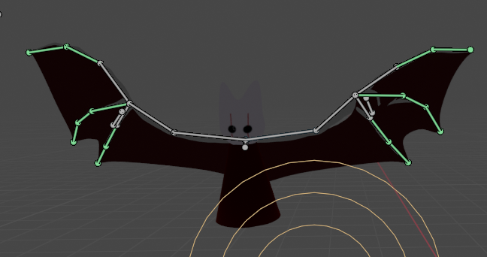
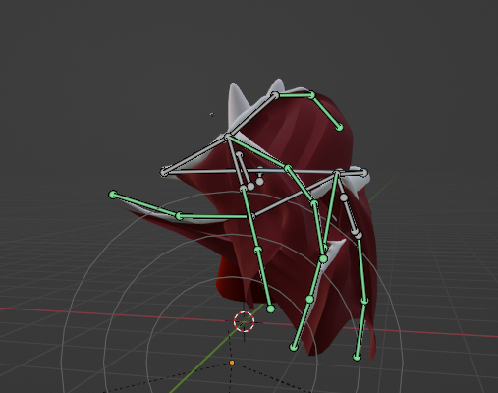
Animation
Game behavior requires dynamic animation of player and boss.
Animations created to support diferente scenarios
But how to manage what animation to play?
Figure 3 : Boss rig
Figure 4 : Pose example

Slide 6
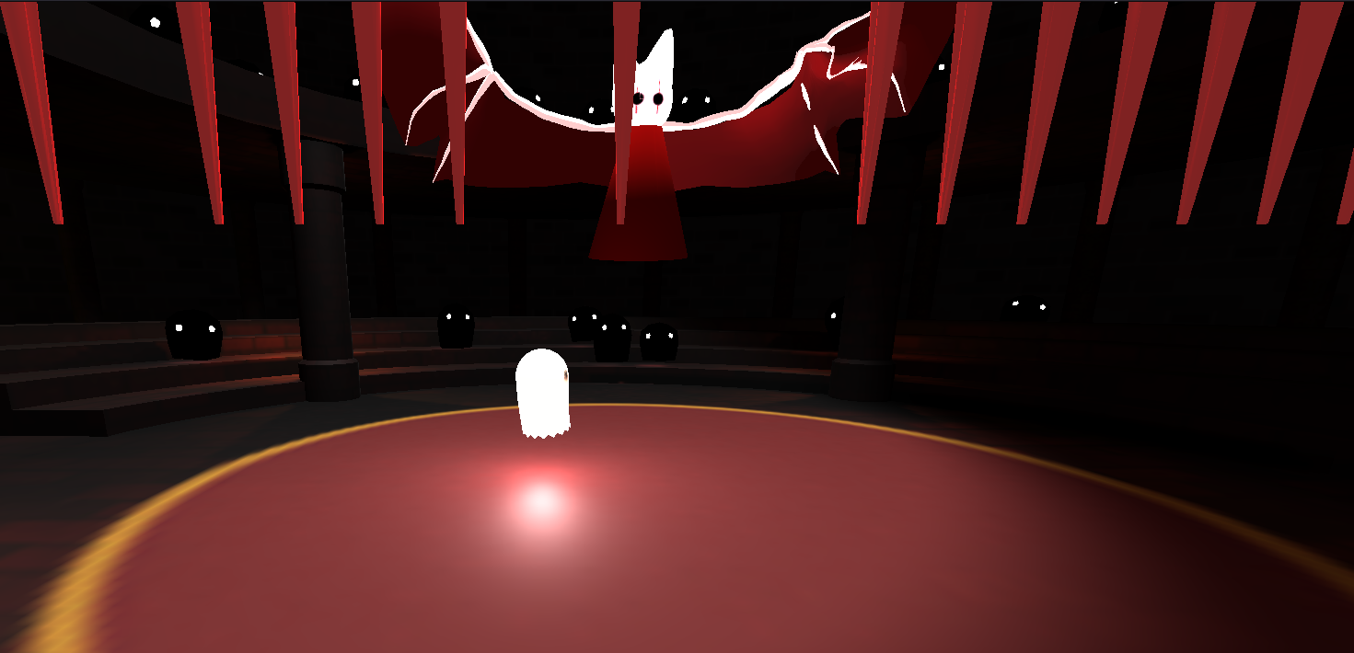
Boss behavior
State based behavior management
Various “attacks” with common starting point enable random behavior
3 distinct attacks developed
Figure 3 : Boss attack example

Slide 7
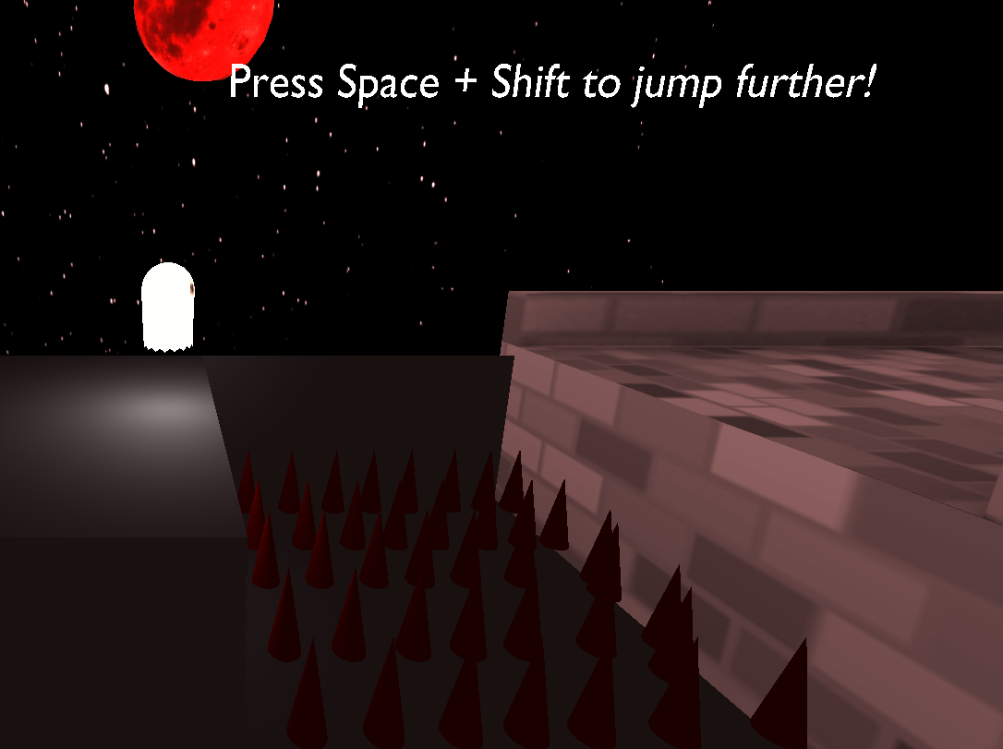
User Interaction
Players introduced to controls in brief tutorial
2D movement control
4 Keyboard based movement controls
1 Mouse based attack control
Figure 3 :Movement tutorial example

Slide 8
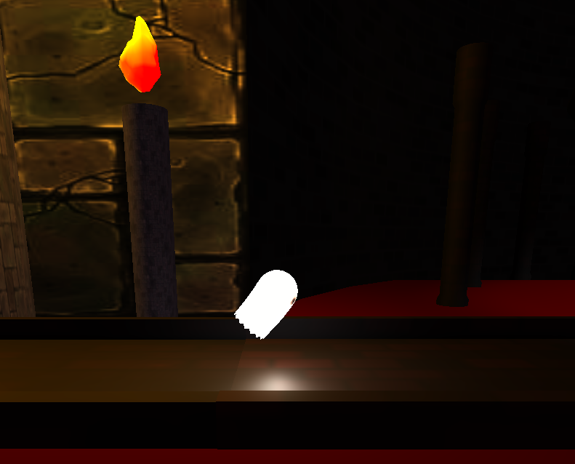
Player animations
State machine based animation control.
Animations change depending on user command.
Movement control flags allow consistent behavior.
Figure 3 : Move animation

Slide 9
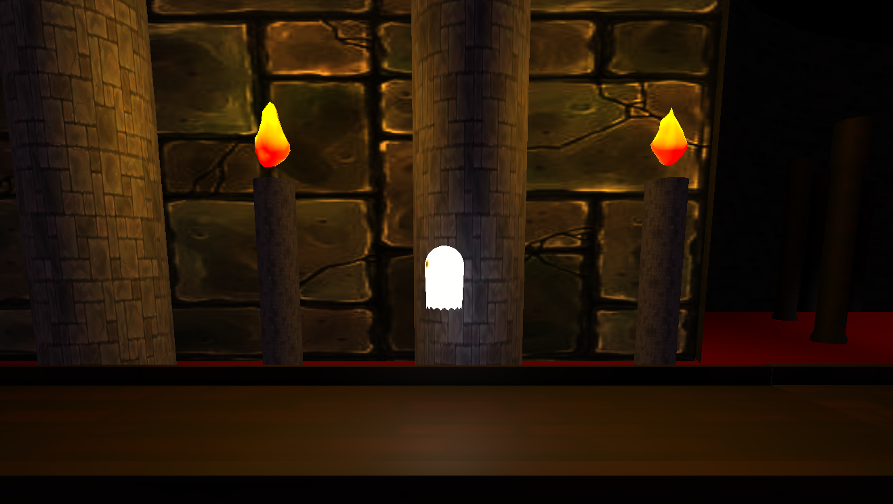
Illumination
Dark theme without compromising visibility
Ambient light to set base luminosity
Dynamic light following player
Spotlights and point lights to improve visibility in important areas
Figure 3 : Illumination example

Slide 10
Development & Challenges
Implementation focus on integrating blender imported assets with threejs environment.
Focus on consistent interaction and “bossfight” behavior without using a physics/collision engine.
Efficient management of model animations.

Slide 11
Conclusion
Bossfight interaction achieved using state machine logic for random boss behavior.
Integration of blender assets with threejs creating a coherent environment.
Animation management for improved interaction.

Slide 12
Demo

Slide 13
References
Threejs Documentation
Threejs examples
www.blenderguru.com

