Slide 1

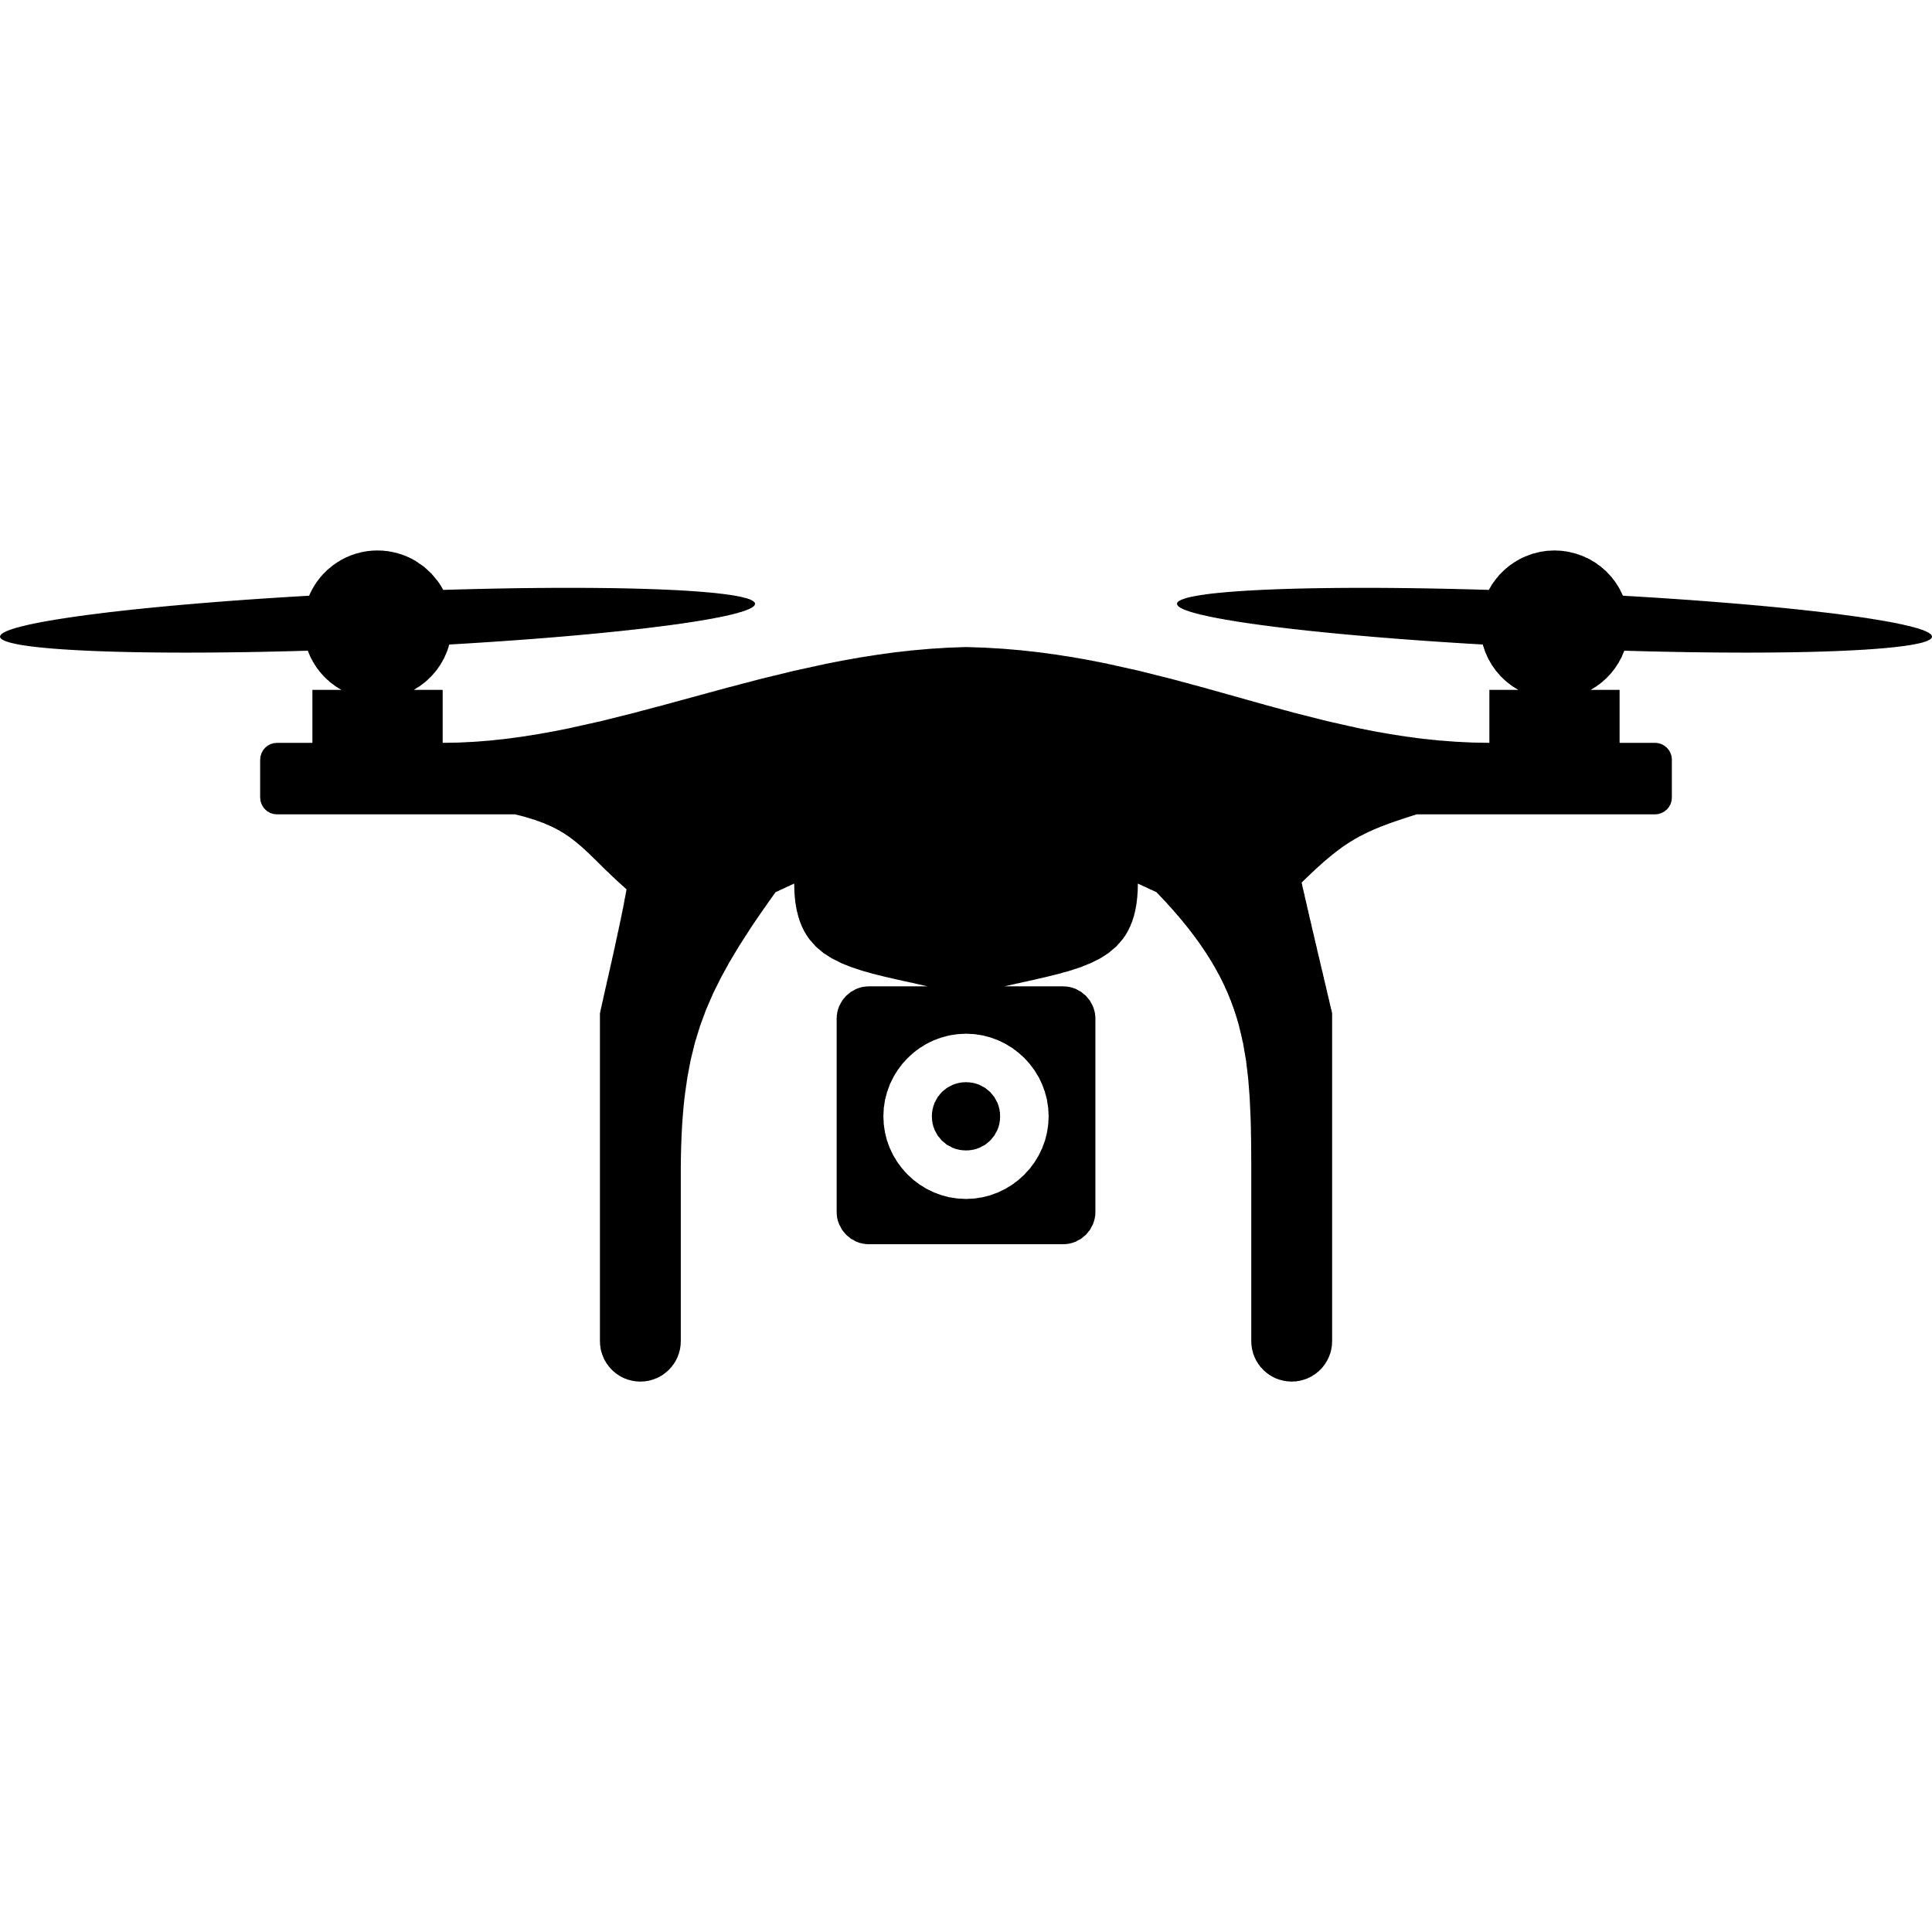


Swarm of Aerial Drones in Disaster Scenarios
Projeto em Engenharia de Computadores e Informática
Susana Sargento
Pedro Rito
Pedro Valente
Diogo Correia
Bruno Oliveira, Bruno Santos, João Su, João Bastos, Rúben Gomes, Simão Almeida
PECI

Slide 2
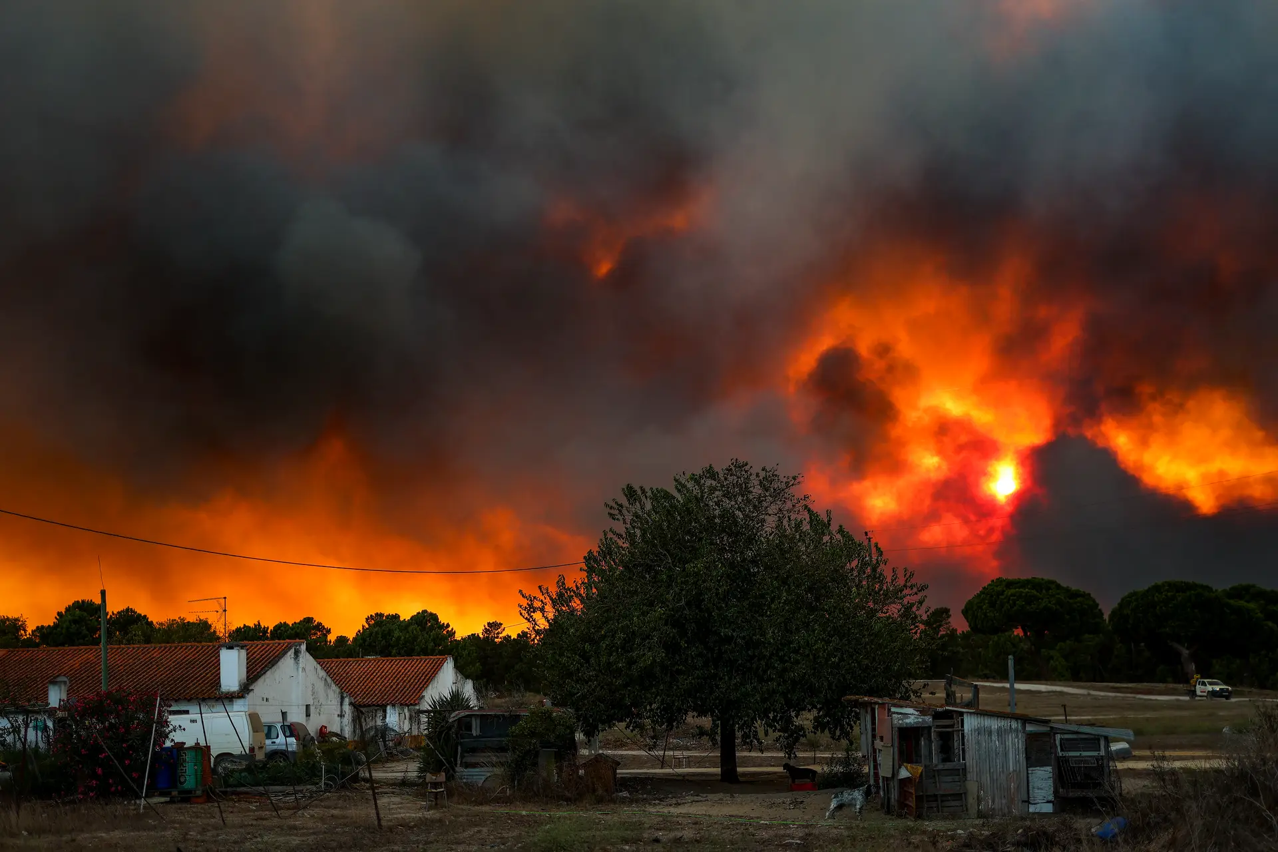
Problem
Swarm of Aerial Drones in Disaster Scenarios
Catastrophic scenarios
Earthquakes
Tsunamis
Wildfires
Compromised infrastructure
“Anacom confirma cortes nas redes de telecomunicações nas regiões de Aveiro e Viseu”, Expresso Notícias, 17 de Setembro 2024
Bruno Oliveira, Bruno Santos, João Su, João Bastos, Rúben Gomes, Simão Almeida
PECI

Slide 3
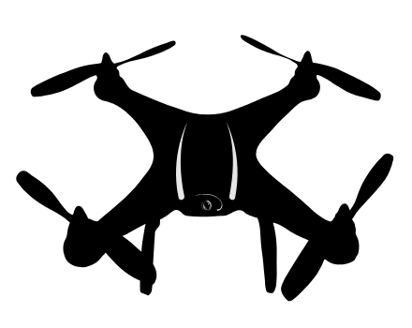

Objectives
Swarm of Aerial Drones in Disaster Scenarios
Use of multiple unmanned aerial vehicles (UAV)
Strategic positioning of drones (dynamically and autonomously)
Develop a drone positioning algorithm
Use the ROS 2 framework for communication between drones
Private 5G network distributed among several drones
Mesh network
Internet access via Starlink
Bruno Oliveira, Bruno Santos, João Su, João Bastos, Rúben Gomes, Simão Almeida
PECI

Slide 4
Project timeline
Swarm of Aerial Drones in Disaster Scenarios
September
October
November
December
Objectives
State of the art
Requirements and system architecture
Construction Phase
Milestone 1
Milestone 2
First Report
Bruno Oliveira, Bruno Santos, João Su, João Bastos, Rúben Gomes, Simão Almeida
PECI

Slide 5
Related Work and Technologies
Swarm of Aerial Drones in Disaster Scenarios
Related Work:
Ana Margarida Silva’s master thesis
Diogo Correia and Tiago Rodrigues’ RSA project
António Almeida, Francisco Ribeiro, Guilherme Vieira, Miguel Vila and Tiago Rodrigues’ PECI project
Resources:
IT’s drone wiki
Drone infrastructure setup scripts
Drone core Source code
Fleet Manager API
Bruno Oliveira, Bruno Santos, João Su, João Bastos, Rúben Gomes, Simão Almeida
PECI
Notes:
Framework de planeamento de missoes de frotas de drones interligados Ligacoes de drones
Missoes de drones com 5G

Slide 6

Tasks
Swarm of Aerial Drones in Disaster Scenarios
Requirement gathering for a private 5G network
Study of communication architectures between drones
Integration of use cases suggested by Beyond Vision
Adaptation of the drone control platform for dynamic allocation of multiple drones
Implementation of mesh network in the drone swarm
Testing in a laboratory environment and on the UA campus
Writing of documentation
Bruno Oliveira, Bruno Santos, João Su, João Bastos, Rúben Gomes, Simão Almeida
PECI

Slide 7
Task distribution
Swarm of Aerial Drones in Disaster Scenarios
The tasks will be distributed among pairs of members:
Explore how 5G technology works
Understand how mesh networks operate and apply them to the drone swarm to ensure connectivity
Develop strategies for the dynamic adaptation of drone positions in real-time
Bruno Oliveira, Bruno Santos, João Su, João Bastos, Rúben Gomes, Simão Almeida
PECI

Slide 8
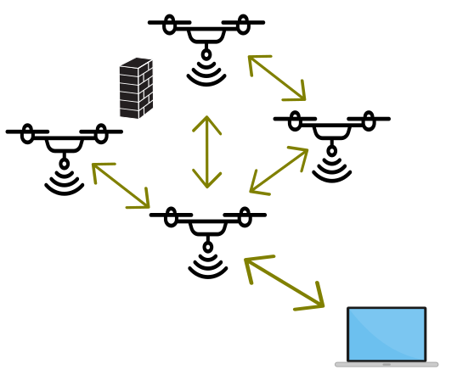
Expected results
Swarm of Aerial Drones in Disaster Scenarios
Drone coordination
Private 5G network in each drone
Internet connection using Starlink satellite
Data transfer to the Internet (5G)
Bruno Oliveira, Bruno Santos, João Su, João Bastos, Rúben Gomes, Simão Almeida
PECI

Slide 9



Communication Plan
Swarm of Aerial Drones in Disaster Scenarios
Social Platform Discord
Slack Platform
GitLab
Bruno Oliveira, Bruno Santos, João Su, João Bastos, Rúben Gomes, Simão Almeida
PECI

