Slide 1

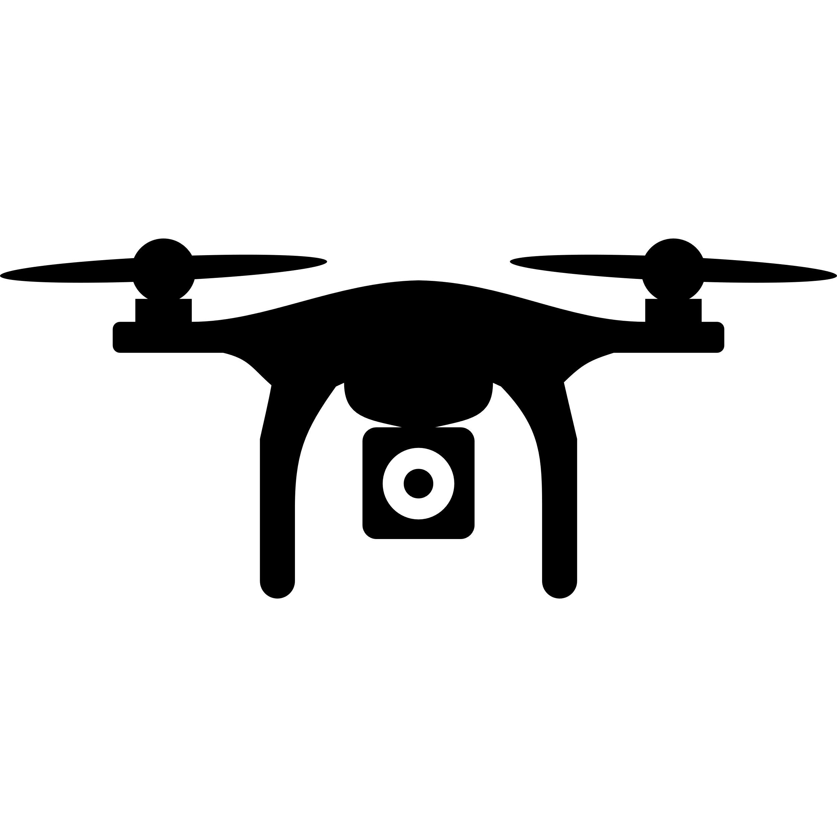


M2 - Elaboration phase
Swarm of Aerial Drones in Disaster Scenarios
Projeto em Engenharia de Computadores e Informática
Susana Sargento
Pedro Rito
Pedro Valente
Diogo Correia
Duarte Raposo
Bruno Oliveira, Bruno Santos, João Su, João Bastos, Rúben Gomes, Simão Almeida
PECI

Slide 2
Table of contents
Swarm of Aerial Drones in Disaster Scenarios
State of the Art (PECI 2023/2024)
Use cases and objectives
Related Work (State of the Art)
Requirements
Functional requirements
Non-Functional requirements
Actors
Architecture
Bruno Oliveira, Bruno Santos, João Su, João Bastos, Rúben Gomes, Simão Almeida
PECI

Slide 3
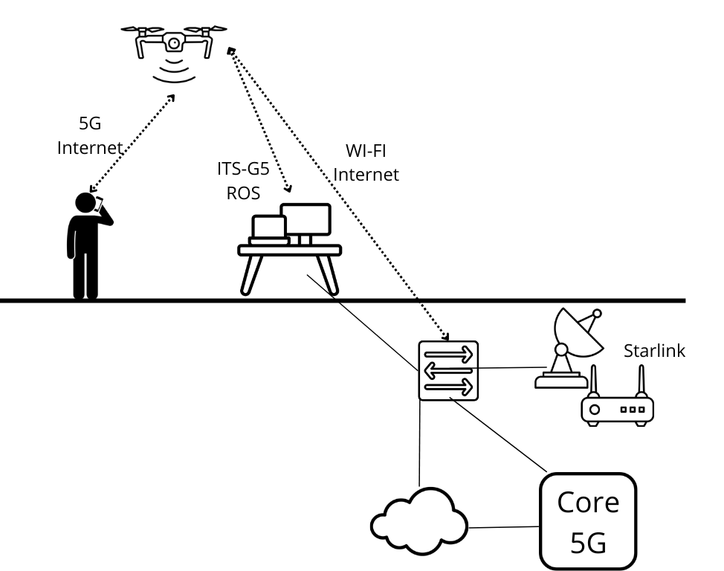
State of the Art (PECI 2023/2024)
Swarm of Aerial Drones in Disaster Scenarios
Aerial Drones Missions With 5G And Starlink Support - PECI project 2023/2024
UAVs:
Dodge algorithm
Person following
Communications:
Private 5G Network
Drone connected to a Starlink router via Wi-Fi
Vision:
Live-feed
Simplified architecture - Project PECI 2023/2024
Bruno Oliveira, Bruno Santos, João Su, João Bastos, Rúben Gomes, Simão Almeida
PECI

Slide 4
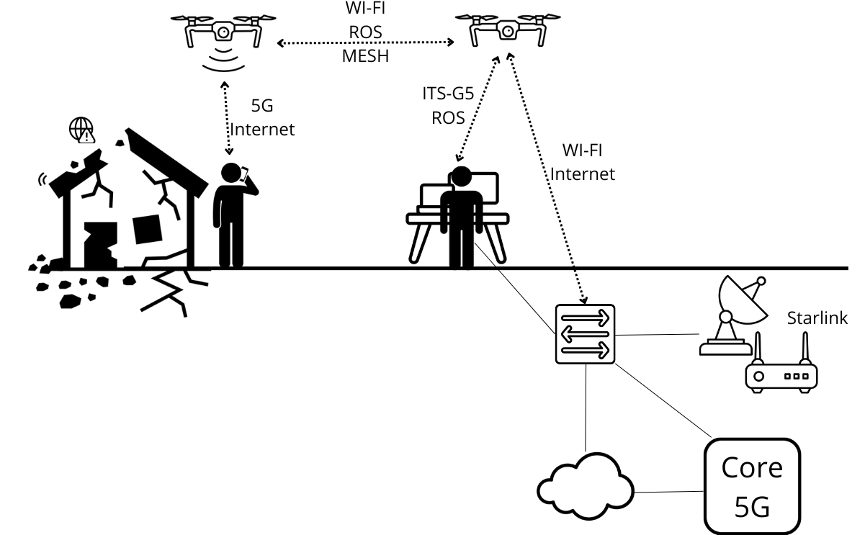
Current Project
Swarm of Aerial Drones in Disaster Scenarios
Use cases and objectives
Swarm formation and coordination for a mission
Border or event control
Disaster, rescue and restore communication
Exemplification of the use case in a catastrophe scenario
Bruno Oliveira, Bruno Santos, João Su, João Bastos, Rúben Gomes, Simão Almeida
PECI
Notes:
Swarm formation and coordination for a mission : algoritmo de coordenação
Border or event control : monitorização, live feed com câmera
Disaster, rescue and restore communication : new approach for the drone following feature, rede 5G e mesh para ter uma rede comunicação entre os drones

Slide 5
State of the Art
Swarm of Aerial Drones in Disaster Scenarios
Related Work and Technologies
UAVs:
Ana Margarida Silva’s master thesis (1)
Communications:
Easy to Deploy UAV-based Non-Public 5G Network
Diogo Correia and Tiago Rodrigues’ RSA project
André Filipe Nascimento Rodrigues’ master thesis (2)
Vision:
Diogo Correia and Tiago Rodrigues’ RSA project
(1) A mission planning framework for fleets of connected drones
(2) Control and Communication in a System with Multiple Interconnected Aerial Drones
Bruno Oliveira, Bruno Santos, João Su, João Bastos, Rúben Gomes, Simão Almeida
PECI

Slide 6
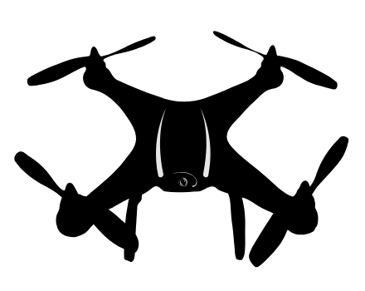

Requirements
Swarm of Aerial Drones in Disaster Scenarios
Functional requirements
Algorithm for strategic drone positioning
Track a person and follow them
Drone monitoring of certain events
The Wi-Fi mesh network must guarantee connection between UAV´s
To access the Internet, the network backhaul must be connected to a Starlink satellite
Bruno Oliveira, Bruno Santos, João Su, João Bastos, Rúben Gomes, Simão Almeida
PECI

Slide 7
Requirements
Swarm of Aerial Drones in Disaster Scenarios
Non-Functional requirements
UAVs must be able to adapt to different scenarios
The network must be reliable and secure
The network must be able to support a large number of users
Bruno Oliveira, Bruno Santos, João Su, João Bastos, Rúben Gomes, Simão Almeida
PECI
Notes:
Uavs : na adaptação n esquecer de mencionar que para tal o swarm tem de evitar colisões entre drones e que para tal se pode derivar o caso de uso de awareness entre drones: UAVs must be aware of other UAVs
UAVs must stay in range, without colliding with each other

Slide 8
Requirements
Swarm of Aerial Drones in Disaster Scenarios
Actors
Operator - Responsible for setting up a mission for the drone swarm
Technician - Responsible for setting up the multiple network components/technologies
Catastrophe victim - Person affected by a catastrophe and in need of internet connection
Bruno Oliveira, Bruno Santos, João Su, João Bastos, Rúben Gomes, Simão Almeida
PECI

Slide 9
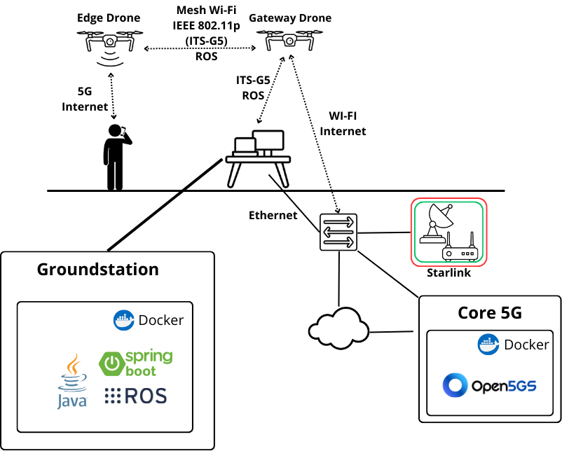
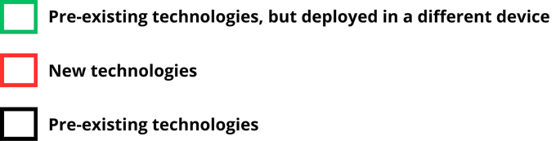
Architecture (Infrastructure)
Swarm of Aerial Drones in Disaster Scenarios
Bruno Oliveira, Bruno Santos, João Su, João Bastos, Rúben Gomes, Simão Almeida
PECI
Notes:
falar das existing projects, open5gs, srsRAN …
srsRAN
IEEE 802.11p
IEEE 802.11s
Q Ground Control
ROS
ROS2 falar na arch
arquitetura compacta e funcional - falar projeto do ano passado APU, Jetson e Nuc
e o que muda para o nosso, nova tentativa, tudo na Jetson …
sperar as coisa

Slide 10
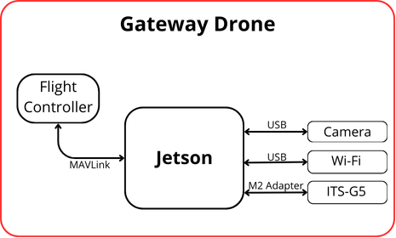
Architecture (Gateway Drone)
Swarm of Aerial Drones in Disaster Scenarios
Bruno Oliveira, Bruno Santos, João Su, João Bastos, Rúben Gomes, Simão Almeida
PECI
Notes:
falar das existing projects, open5gs, srsRAN …
srsRAN
IEEE 802.11p
IEEE 802.11s
Q Ground Control
ROS
ROS2 falar na arch
arquitetura compacta e funcional - falar projeto do ano passado APU, Jetson e Nuc
e o que muda para o nosso, nova tentativa, tudo na Jetson …
sperar as coisa

Slide 11
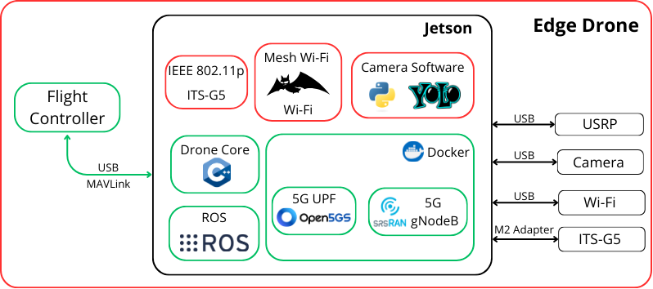
Architecture (Edge Drone)
Swarm of Aerial Drones in Disaster Scenarios
Bruno Oliveira, Bruno Santos, João Su, João Bastos, Rúben Gomes, Simão Almeida
PECI
Notes:
falar das existing projects, open5gs, srsRAN …
srsRAN
IEEE 802.11p
IEEE 802.11s
Q Ground Control
ROS
ROS2 falar na arch
arquitetura compacta e funcional - falar projeto do ano passado APU, Jetson e Nuc
e o que muda para o nosso, nova tentativa, tudo na Jetson …
sperar as coisa

Slide 12
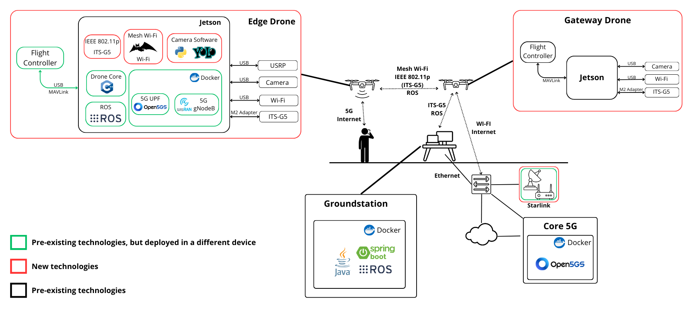
Architecture
Swarm of Aerial Drones in Disaster Scenarios
Bruno Oliveira, Bruno Santos, João Su, João Bastos, Rúben Gomes, Simão Almeida
PECI
Notes:
falar das existing projects, open5gs, srsRAN …
srsRAN
IEEE 802.11p
IEEE 802.11s
Q Ground Control
ROS
ROS2 falar na arch
arquitetura compacta e funcional - falar projeto do ano passado APU, Jetson e Nuc
e o que muda para o nosso, nova tentativa, tudo na Jetson …
sperar as coisa

