Slide 1
Translating Data into Information
Dr. Bruno Lee
Assistant Professor
Concordia University
bruno.lee@concordia.ca

Slide 2
Who needs data analysis
If you need
to predict the energy demand so as to adjust the energy supply and distribution
to optimize operation and maintenance cost when analyzing the building operation data
to customize energy incentive program when analyzing energy consumption patterns
to detect fraud when analyzing energy consumption patterns
to figure out the correlation of the input parameters and outcome in multidimensional space

Slide 3
Why data analysis
Difficult to comprehend massive amount of simulation data .
One-factor-at-a-time method may present distorted results.

Slide 4
Data vs Information
Decision cannot be made based on only one set of experimental data or one set of simulated data
Hidden or implicit knowledge is not easy to extracted by statistical tools, but statistical tools helps to comprehend the nature of the data.
We found that a close relationship between the built year and the energy cost of a house. A pattern emerges when all of the data related to energy consumption are aggregated. Then energy consumption can be predicted based on built year.

Slide 5
Data-mining
Knowledge discovery from data (KDD)
Automated or convenient extraction of pattern representing knowledge implicitly stored or captured in large databases, data warehouses, massive information repositories.

Slide 6
Data-mining
Incorporated many techniques from other domains

Slide 7
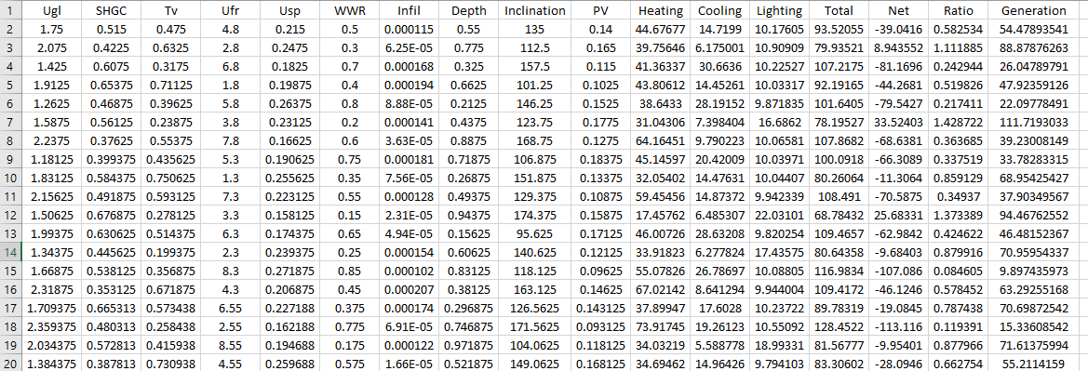
Terminology in data science
Column
Attribute
Row
Data object = entity

Slide 8
Types of attributes
 | Description | Example
Nominal attributes | Symbols or name of things | Types of glazing Types of insulation | Qualitative | Discrete
Binary attributes | A type of nominal attribute but only two categories: 0 or 1 | True or False On or Off | Qualitative | Discrete
Ordinal attributes | Ranking | Wind direction Building orientation | Qualitative | Discrete
Numeric attributes | Measurable quantity, integer or real values |  | Quantitative | Discrete or Continuous

Slide 9
Data preprocessing
Data cleaning
Data integration
Data reduction
Data transformation
Data discretization

Slide 10
Data cleaning
Filling missing values
Smoothing noisy data
Identifying or outliers
Resolving inconsistencies

Slide 11
Filling missing values
Ignore the tuple
Fill in the missing value manually
Use a global constant to fill in the missing value
Use a measure of central tendency for the attribute
Use the attribute mean or median for all sample belonging to the same class as the given tuple
Use the most probable value

Slide 12
Smoothing noisy data
Binning
Bining method consult neighbourhood values, local smoothing is performed. For example, each bin is replaced by the mean value of the bin.
Regression
Conform data values to a function
Outlier analysis
Outliers are different from noisy data which are “variance” or “random errors”.
To remove the outliers, outlier can be detected by clustering.

Slide 13
Resolving inconsistencies
Inconsistencies are discrepancies
Poorly designed data entry
Human error in data entry
Deliberate error (not willing to divulge occupancy information)
Data decay (outdated address)
Inconsistent data representations
Inconsistent coding
Require discrepancies detection and data transformation

Slide 14
Data integration
Helps to reduce and avoid redundancies and inconsistencies
Entity identification
Redundancy and correlation analysis
χ² (Chi-square) test

Slide 15
Data reduction
Dimensionality reduction
Reduce the number of random variables or attributes
Numerosity reduction
Replace the original data volume by alternative, smaller form of data representation
Data compression
Transformation are applied to obtain a reduce or “compressed” representation of the original data

Slide 16
Data transformation
Data is transformed or consolidated so that the resulting mining process may be more efficient, the pattern is easier to comprehend.
Smoothing
Attribute construction
Aggregation
Normalization
Discrezation
Concept hierarchy generation for nominal data

Slide 17
Data analysis techniques
Pattern mining
Associations
Correlations
Data classification
Data clustering
Outlier detection

Slide 18
Pattern mining
Pattern mining includes
frequent pattern mining
It searches for recurring relationship in a given data set.
rare pattern mining
Negative pattern mining

Slide 19
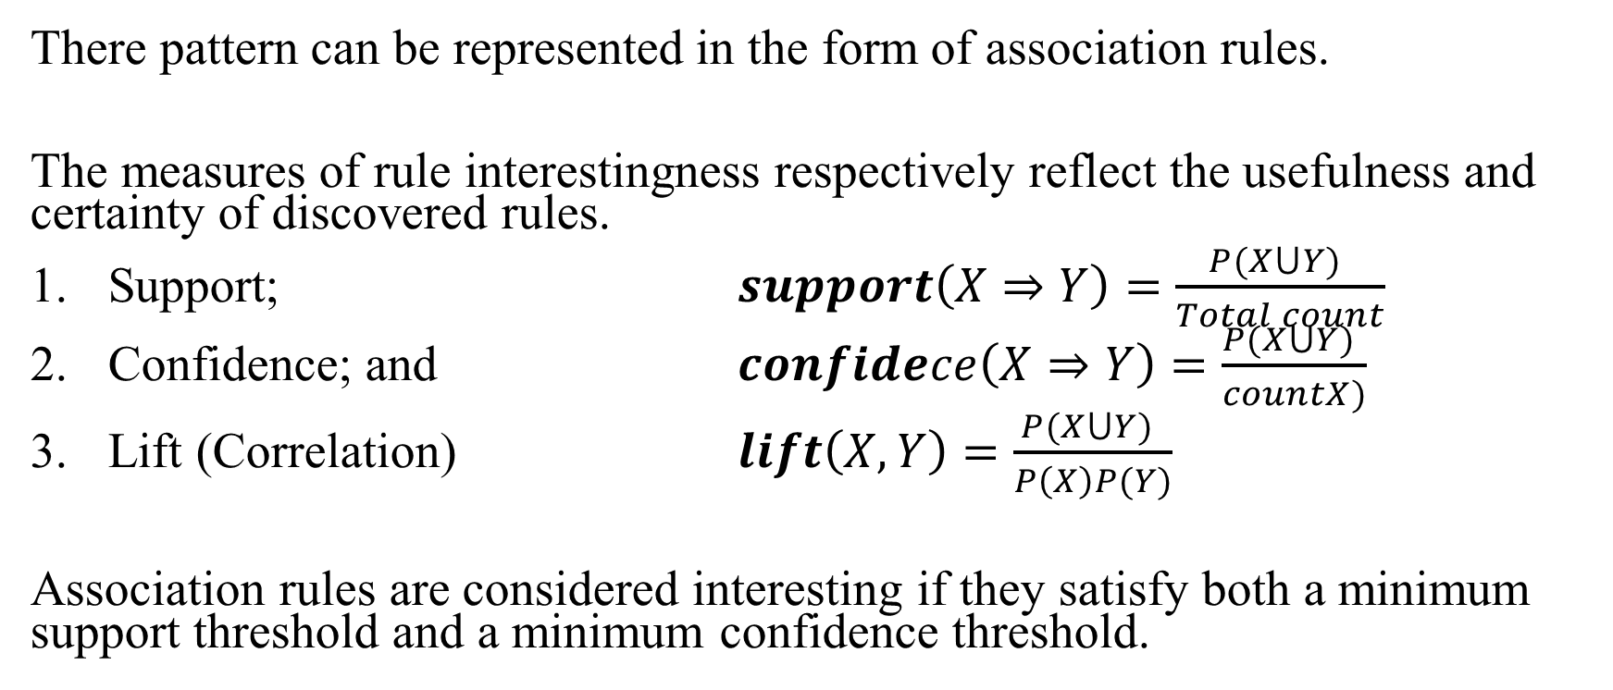
Pattern mining
There pattern can be represented in the form of association rules.
The measures of rule interestingness respectively reflect the usefulness and certainty of discovered rules.
Support; $support\left(X⇒Y\right)=\frac{P(X⋃Y) }{Total count}$
Confidence; and $confidece\left(X⇒Y\right)=\frac{P(X⋃Y) }{countX)}$
Lift (Correlation) $lift\left(X,Y\right)=\frac{P(X⋃Y) }{P\left(X\right)P(Y)}$
Association rules are considered interesting if they satisfy both a minimum support threshold and a minimum confidence threshold.

Slide 20
Data classification
Classification has a lot of applications.
Example
Fault detection;
Performance prediction; and
Performance diagnosis
Data classification is a two-step process,
learning step (where a classification model is constructed);and
classification step(where the model is used to predict class labels for a given data)

Slide 21
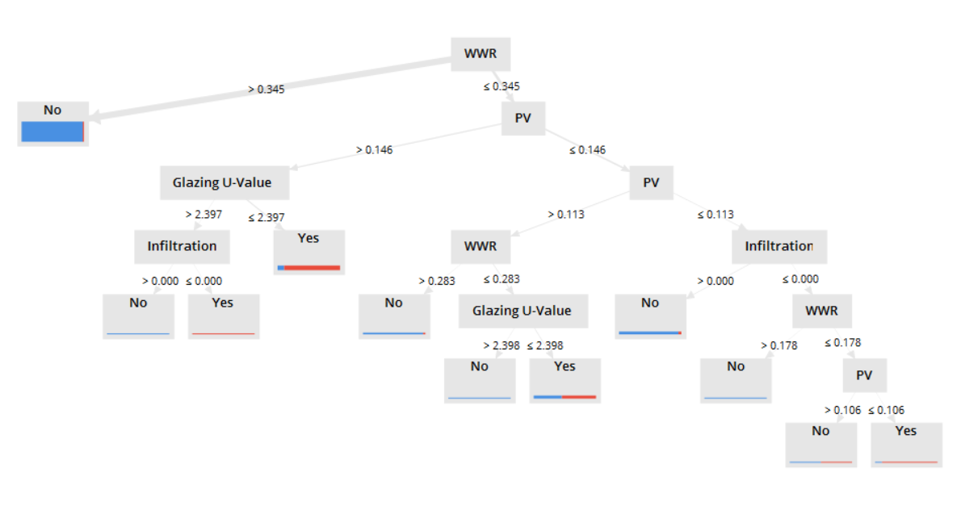
Decision tree induction
Decision tree induction is the learning of decision trees from class-labeled training tuples. A decision tree is a flowchart-like tree structure, where each internal node (non-leaf node) denotes a test on the attribute, each branch represents an outcome of the test, and each leaf node (or terminal node) holds a class label. The topmost node in a tree is the root node.

Slide 22
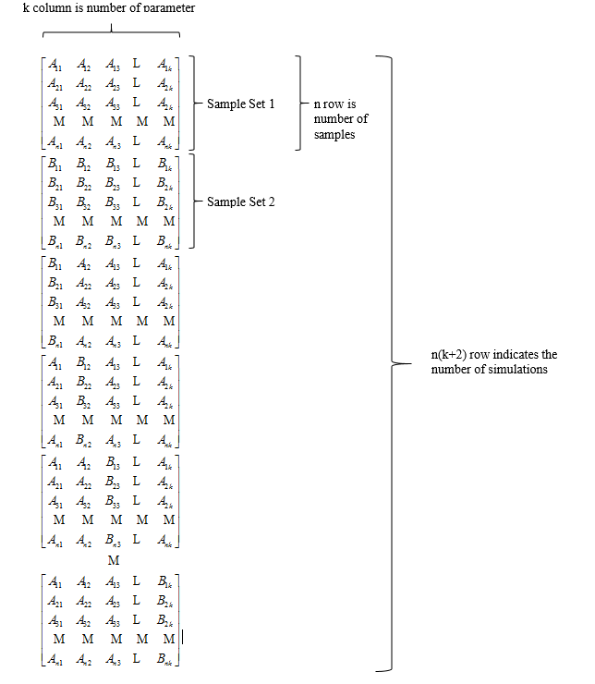
Sobol DOE

Slide 23
Sobol Total sensitivity index
Rank | East
1 | WWR | 0.87
2 | PV | 0.09
3 | Ugl | 0.05
4 | Infiltration | 0.03
5 | Depth | 0.02
6 | Inclination | 0.02
7 | Ufr | 0.02
8 | SHGC | 0.02
9 | Tv | 0.02
10 | Usp | 0.02

Slide 24
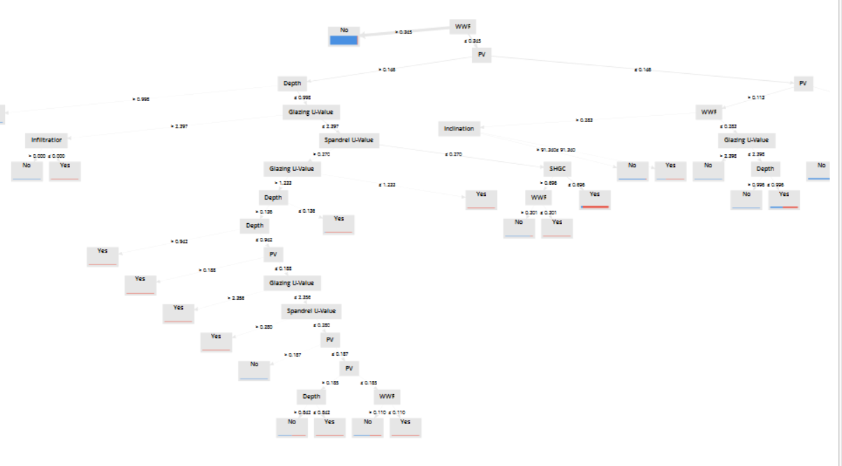

Slide 25
Decision tree induction
Attribute selection measure
A splitting criterion that “best” separate a given data partition which is closely results in such a scenario.
Information gain
Gain ratio
Gini index

Slide 26
Data clustering
Data segmentation
Cluster analysis is the process of partitioning a set of data objects into subsets according to their similarity
Partitioning methods
Hierarchical methods
Density-based methods
Grid-based methods

Slide 27
Data clustering
Method | General Characteristics
Partitioning methods | Distance based Use mean or medoid to represent cluster center Effective for small to medium size data sets
Hierarchical methods | Hierarchical decomposition Correct erroneous merges or split
Density-based methods | Serch arbitrarity shaped clusters Vluster are dense regions of objects in space that are separated by low0density regions Cluster density: Each point must have a minimum number of points within its neighbourhood Filter out outliers
Grid-based methods | Multiresolution grid data structure Fast processing time (typically independent of the number of data objects, yet dependent on grid size)

Slide 28
Outlier detection
The process of finding data objects with behaviors that are very different from expectation.
Similar values are organized into groups.
Values fall outside of the set of clusters are considered as outliers.
Clustering | Outlier detection
Search the majority patterns in a data set and organizes the data accordingly | Capture those exceptional cases that deviate substantially from the majority patterns

Slide 29
Identifying or outliers
Types of Outliers
Global outliers
It deviates significantly from the rest of the data
Contextual outliers
It deviates significantly with respect to a specific context of the object
Collective outliers
A subset of data forms a collective outlier if the objects as a whole deviate significant from the entire data set.

Slide 30
Outlier detection methods
Supervised method
To learn a classifier to recognize outlier
Unsupervised method
Assume normal objects follow a pattern far more than outliers
Semi-supervised method
For cases where only small set of the normal and/or outlier objects are labeled, but most of the data are unlabled.

Slide 31
Outlier detection methods
Statistical methods
Parametric methods
Assume that normal data objects are generated by a parametric distribution
Non-Parametric methods
No priori statistical model is assumed.
Proximity-based methods
Distance-based outlier detection methods
A given radius is defined then the neighbourhood is consulted
Density-based outlier detection method
The density of an object and the objects’ neighbours are investigated
Clustering-based methods
Detects outliers by examining the relationship between objects and clusters.

Slide 32
Conclusion
Data analysis can help to comprehend the data sets and draw a macroscopic decision with considering multidimensional aspects.
Same techniques such as binning can be used for different purposes such as smoothing noisy data and data discretization.
Sequences of the different techniques can lead to different conclusion.
No universal combination of techniques can lead to absolute results.

Slide 33
END

Slide 34
Outline handout
To demonstrate the following techniques in RapidMiner Studio
Decision tree
To predict most probable value to fill in the missing value (Data cleaning purpose)
To classify data sets (Data classification purpose)
Clustering
To remove noisy data (Data cleaning purpose)
To classify data sets (Data classification purpose)
Association
To draw association rule
Pattern mining
To classify data sets (Data classification purpose)

Slide 35
Outline handout
To observe different conclusions from different order of minig techniques

