Slide 1
TOP 3 RESTAURANT FINDING SYSTEM IN CHENNAI

Slide 2
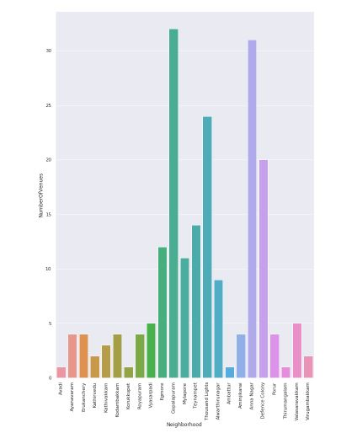
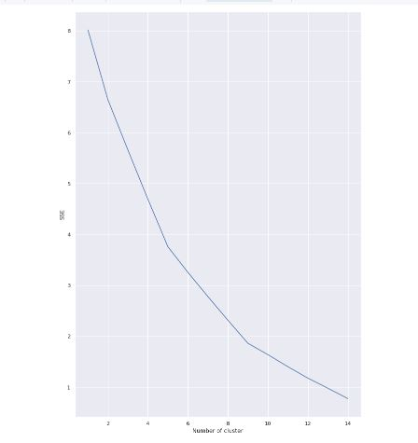
METHODOLOGY

Slide 3

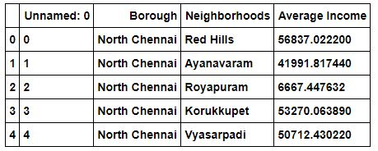

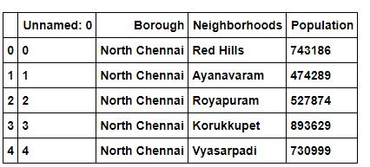
DATASETS

Slide 4
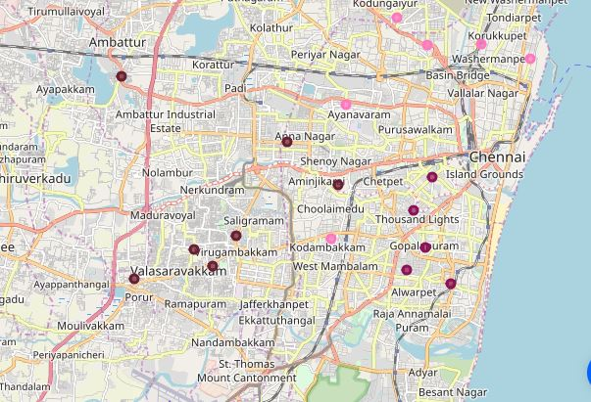
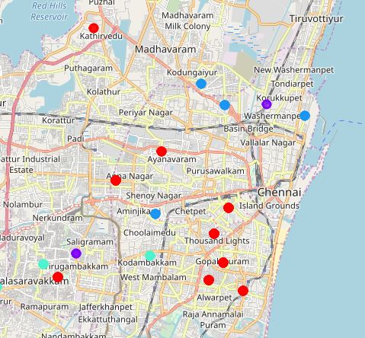
Mapping and Clustering

Slide 5
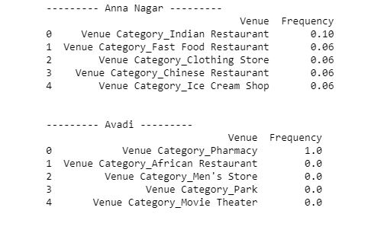

RESULTS

Slide 6
THANK YOU!

