Slide 1
Blerta_Project

Slide 2
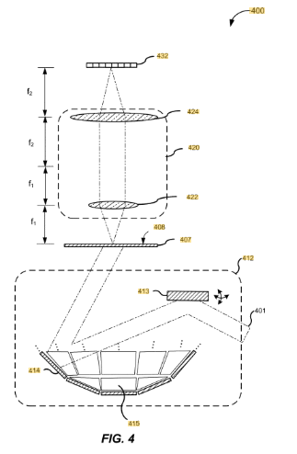
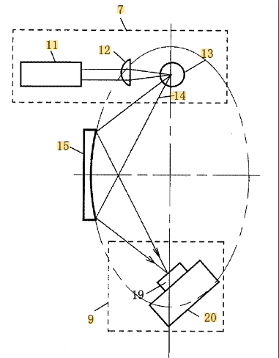
pATENt Research
Laser-based Fourier ptychographic imaging systems and methods
  US20190331902A1, Status Abandoned
Soft x-ray processing device and soft x-ray processing method
  US2007165782A1, Publication : 2007-07-19, status : Abandoned

Slide 3
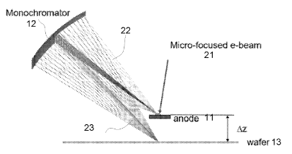
pATENt Research
Soft x-ray monochromator
  WO2025149950A1
  2025-07-17 Publication by Nova Measuring Instrument Inc
Summary:
Describes a soft X-ray monochromator for precise focusing of X-ray beams. It uses a curved polished substrate with optically bonded crystal platelets that follow the curvature, reducing aberrations and surface roughness. Operating at 0.8–10 keV, it is suitable for ptychography, XPS, X-ray reflectometry, and XRF, and supports nanometer-scale measurements in semiconductor metrology.
How?
Curved polished substrate directs and focuses the incoming X-ray beam toward a precise focal point.
Optically bonded crystal platelets follow the curvature of the substrate and act as diffraction elements, selecting specific X-ray wavelengths (monochromatization).
Minimizes aberrations and surface roughness, ensuring high beam quality.
Produces a highly focused, monochromatic X-ray beam suitable for high-resolution applications such as ptychography, XPS, X-ray reflectometry, and XRF.

Slide 4
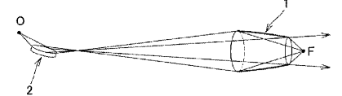
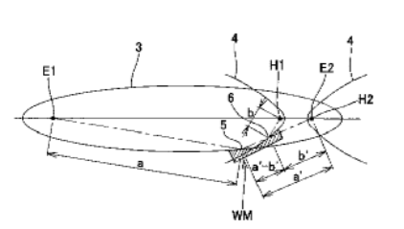
pATENt Research
Optical design method for X-ray focusing system using rotating mirror, and X-ray focusing system
  US2016163409A1
  2016-06-09 Pubication by University of Tokyo
  2034-08-28 Adjusted expiration
Double reflection x-ray mirror and grazing incidence x-ray imaging optical device using the same
  JP2014006457A
  2014-01-16 Publication by Osaka University NUC, JTec Corp
  2032-06-27 Anticipated expiration

