Slide 1
Diffusion Policy
for Robot Manipulation
Teaching a Robot to Push using Generative Models
ML 6140 — Machine Learning | Northeastern University | April 2026
Yashvardhan Gupta · Vineeth Sakhamuru · Sai Krishna Reddy Maligireddy
4%
80%
92%
98%
BC Baseline
DDPM
DDIM
Flow Matching
github.com/BrutalCaeser/Diffusion_Robot_Control_Policy | 120 unit tests passing

Slide 2
The Task: Push a T-Shaped Block onto a Target
✓
📍
Agent:
Circular end-effector, moves in 2D
T-block
≥90% overlap
📦
Goal:
Push T-block onto gray target region
→
✅
Success:
Block covers target by ≥ 90%
Push!
🤖
TARGET
📊
State:
5 numbers: agent (x,y) + block (x,y,θ)
Agent (end-effector)
🎮
Actions:
2 numbers: velocity (vₓ, vy)
💾
Data:
206 expert demos · 25,650 steps
Receding-horizon control: predict 16 future actions → execute first 8 → replan with fresh observations

Slide 3
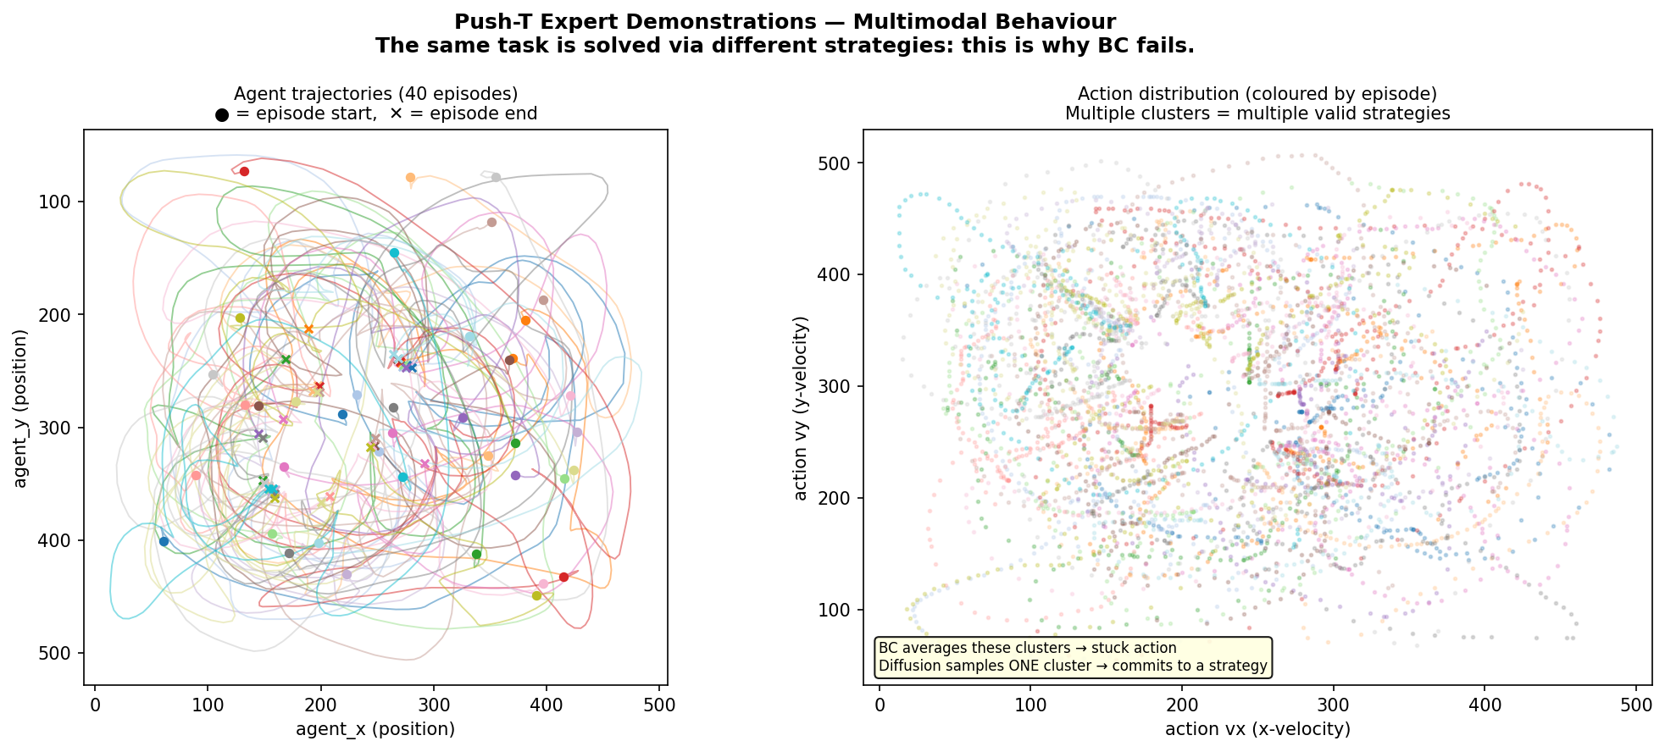
Why Standard ML Fails: Expert Behavior is Multi-Modal
Expert strategies
Each colored line = one expert's
approach to the task.
Multiple valid strategies exist!
BC averages modes
The action space is bimodal.
BC predicts the middle →
robot gets stuck.
BC result: 4% success | Averaging valid strategies produces an INVALID strategy

Slide 4
The Diffusion Idea: Iteratively Remove Noise to Get an Action
1
2
3
→
→
→
→
→
→
→
→
→
→
→
→
→
→
→
→
→
→
→
→
→
→
→
→
→
→
Start:
Pure Noise
Iterate:
Denoise
Result:
Clean Action
Random action sequence
U-Net removes noise
10 times
Valid robot motion
emerges!
Different starting noise → Different valid action | This is how diffusion handles multi-modal expert behavior!

Slide 5
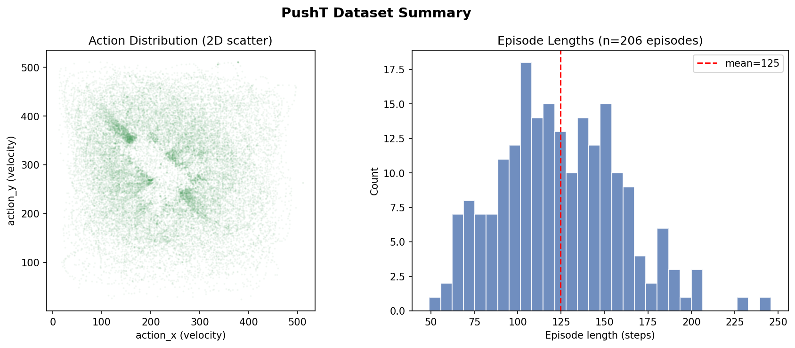
Training Data: 206 Expert Demonstrations
206
25,650
~25K
Expert Episodes
Total Timesteps
Training Windows
Human demos from Columbia
Observations + actions
After sliding-window split
How training windows work:
1
Observe last 2 timesteps (T_obs = 2)
2
Predict next 16 actions (T_pred = 16)
3
Execute first 8, then replan (T_action = 8)
4
Repeat until task done or timeout
All values normalised to [−1, 1] before training

Slide 6
Model Architecture: Conditional 1D Temporal U-Net
In: (16, 2) 2 ch
Conditioning Inputs
↓
Observation history (2 × 5 = 10 numbers)
Down 1 256 ch
Diffusion timestep k (noise level)
↓
→ embed each → concat → 512-d vector
Down 2 512 ch
→ FiLM: scale & shift every ResBlock
↓
Bottleneck 1024 ch
↓
Output
Up 2 512 ch
DDPM: predict noise ε → shape (16 × 2)
↓
FM: predict velocity v = ε − a₀
Up 1 256 ch
68.95 M params | EMA decay = 0.995
Out: (16, 2) 2 ch
Skip connections (encoder → decoder)

Slide 7
Three Ways to Run the Model at Inference Time
DDPM
DDIM
Flow Matching ★
Denoising steps:
Denoising steps:
Denoising steps:
×10 more
Steps:
100
Steps:
10
Steps:
10
Time:
84 ms
Time:
10 ms
Time:
8.9 ms
Success:
80%
Success:
92%
Success:
98%
Full stochastic reverse chain.
Slowly denoises over 100 steps.
Skips most timesteps algebraically.
8× faster — same trained model.
Straight-line ODE from noise to action.
Best conditioned — best results.
Flow Matching: x_t = (1−t)·action + t·noise → target: v = noise − action → inference: Euler ODE

Slide 8
The Bug That Took DDIM from 0% → 92% Success
THE PROBLEM
THE FIX (2 lines)
Cosine noise schedule at K = 100 steps:
Before (broken):
ᾱ₉₉ ≈ 2 × 10⁻⁸ (essentially zero)
a0 = (noisy − √(1−ᾱ)·ε) / √ᾱ
DDIM recovers the clean action by dividing by √ᾱ_t
After (fixed):
At t=99: √ᾱ = 0.00016
a0 = (noisy − √(1−ᾱ)·ε) / √ᾱ
.clamp(min=1e-3)
Prediction explodes to ±millions
VS
a0 = a0.clamp(−1.0, 1.0)
Agent never moves → 0% success
…despite perfect training loss! 🤯
Result:
0% → 92% success rate
Lesson: perfect loss ≠ working policy. Check edge cases in math.

Slide 9
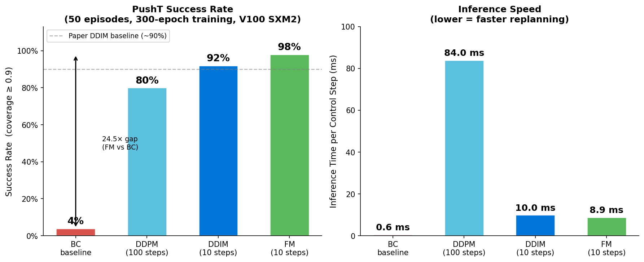
Results: Diffusion Crushes the BC Baseline
98%
Flow Matching
8.9ms · 10 steps
92%
DDIM
10ms · 10 steps
80%
DDPM
84ms · 100 steps
4%
BC Baseline
0.6ms · 1 step
24.5× gap between BC (4%) and Flow Matching (98%) | FM matches & exceeds Chi et al. 2023 (paper: ~90%)

Slide 10
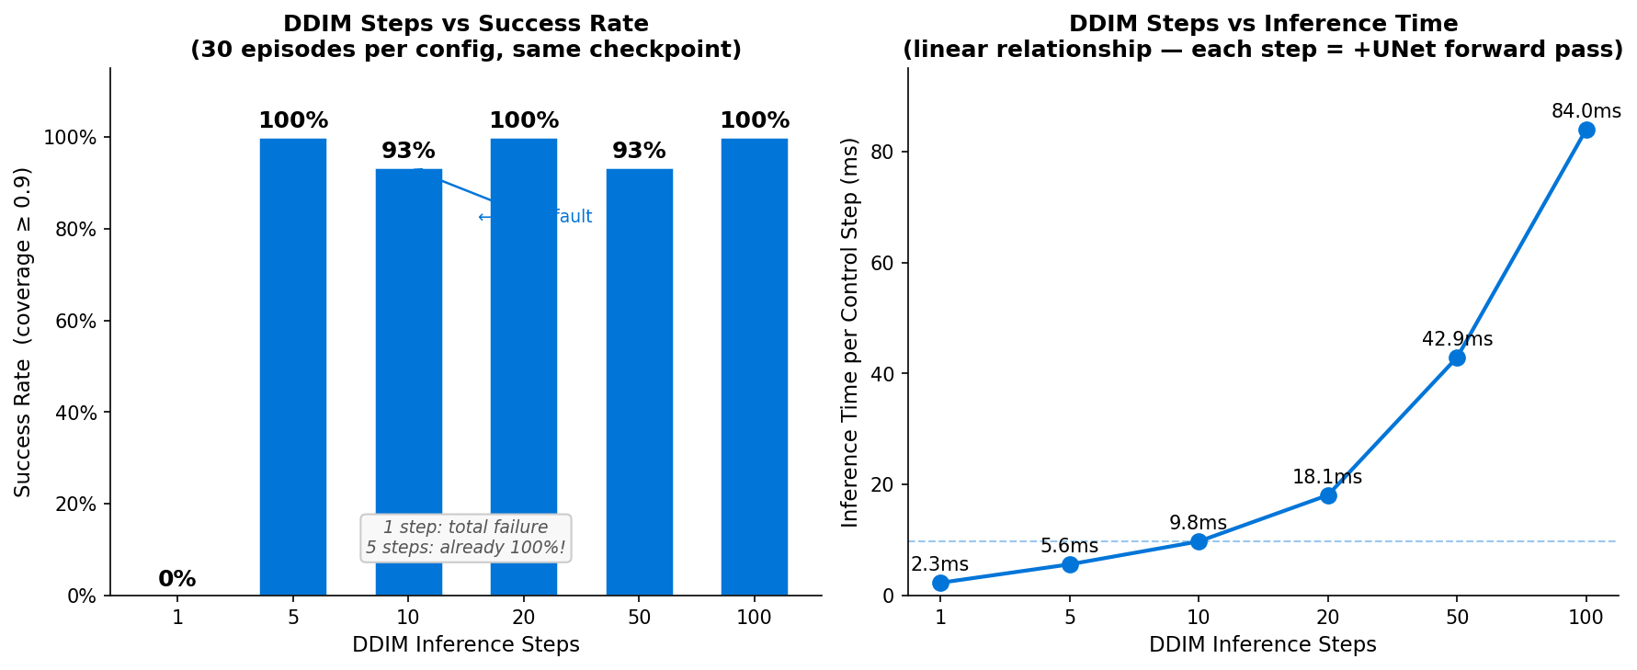
Ablation: How Many Denoising Steps Does DDIM Really Need?
❌ 1 step
Complete failure. Proves iterative denoising is genuinely needed.
⭐ 5 steps
100% success at 2× the speed of default. Sweet spot for deployment!
⚡ 100 steps
No better than 5 steps. 20× more compute, zero gain.
Same trained model — no retraining needed. Just change the number of inference steps.
The denoising landscape is so well-conditioned that 5 steps suffice for 100% success.

Slide 11
Why Flow Matching Beats DDPM: Straight Paths Are Easier to Invert
DDPM / DDIM
Flow Matching ★
Clean Action
Clean Action
a₀
a₀
Curved, roundabout path
Straight line: x_t = (1−t)·a₀ + t·ε
10 steps
(each perfectly
along straight line)
↖
100 tiny steps
(many model calls)
↗
ε
ε
Pure Noise
Pure Noise
Straight paths are easier to invert. The model learns a simpler mapping → better convergence → 98% success.

Slide 12
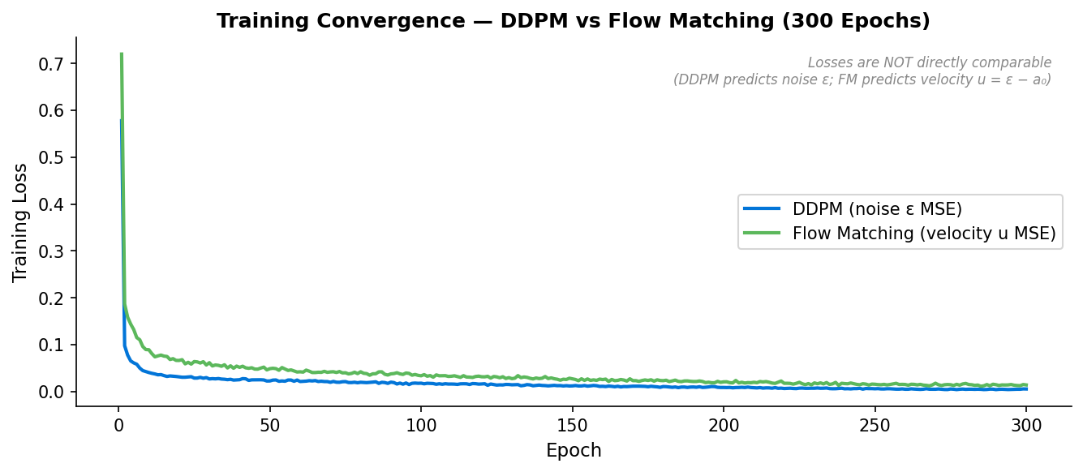
Training Convergence: 300 Epochs on NVIDIA V100 SXM2
Training Details
Optimizer:
AdamW (lr = 1e-4)
Schedule:
Cosine decay
Warmup:
500-step linear
Epochs:
300 each method
GPU:
V100 SXM2 (32 GB)
Time:
~11 hrs each
EMA decay:
0.995
Note: losses aren't
directly comparable.
DDPM predicts ε;
FM predicts velocity v.

Slide 13
120 Unit Tests — Every Module Verified End-to-End
120
test_bc_policy
Shape, gradients, determinism
19
test_unet1d
20
FiLM, skip connections, gradients
test_ddpm
11
Noise schedule, forward & reverse
tests
test_ddim
8
Determinism, numerical fix
all passing ✓
test_flow_matching
7
Straight-line ODE step
test_ema
10
Decay, apply/restore cycle
test_normalizer
14
Fit, round-trip, checkpoint
test_integration
8
End-to-end forward pass
test_vision_encoder
23
ResNet, frozen backbone, FiLM
$ pytest tests/ -v → 120 passed in 43s

Slide 14
What We Learned
🔀
The multimodal problem is real
BC averages → 4%. Diffusion picks one valid strategy → 98%. The gap is architectural, not a tuning issue.
📈
Flow Matching > DDPM
Straight-line ODE paths give the model a simpler job. Better accuracy (98%), faster inference (8.9ms).
🔧
One missing clamp = 0% success
DDIM divided by ᾱ ≈ 2×10⁻⁸ at the final step → explosion. Two lines of code fixed it.
⚡
5 denoising steps achieves 100%
The model learns such a clean landscape that 5 inference steps are enough. Real robots need speed.
🏗️
Diffusion is learnable from scratch
68.95M-parameter U-Net, built line by line, matches published results. No black box — every piece understood.
FM: 98% | DDIM: 92% | DDPM: 80% | BC: 4% | 120 tests | github.com/BrutalCaeser/Diffusion_Robot_Control_Policy

