Slide 1
CASE STUDY · SOLUTION PRESENTATION
NorthStar Airlines
Control Tower + Account Factory for Terraform + CI/CD
Notes:
Good morning everyone, thanks for your time today.
For this case I chose AWS because I am more familiar with that platform.
I will introduce AWS Control Tower to build a Landing Zone.
I will then recommend Account Factory for Terraform, or AFT, to create and configure accounts with Terraform code.
First, lets see the agenda for today.

Slide 2
Agenda
The challenge
Why AWS Control Tower
Landing zone architecture
Governance per environment
Automation: Terraform and CI/CD
Operations at scale
Questions
NorthStar Airlines · Landing Zone Governance · 2/12
Notes:
First we start to review together the challenge to be sure that we are on the same page.
Than I will explain why I will use AWS Control Tower,
Than I will show you my proposal architecture for the Landing Zone, and how we can govern 100+ accounts.
I will then show you the Infrastracture as a Code in Terraform and than
How we can monitor that everything works perfectly.
Than we will leave the time for questions for later.

Slide 3
The challenge
1
Hundreds of AWS accounts in Dev, Test and Prod
100s
accounts to manage
2
Each environment needs different access and security controls
3
environments, 3 sets of rules
3
All accounts must follow the same company standards
0
manual changes in accounts
4
New accounts come often. Policy changes must reach every account
NorthStar Airlines · Landing Zone Governance · 3/12
Notes:
First, the problem.
- NorthStar has hundreds of accounts in Dev, Test and Prod.
- Each environment needs different permissions and security controls.
- But all accounts must follow the same company standards.
- New accounts come all the time. A policy change must go to every account.
So the goal is simple: one base for everyone, different rules per environment, and no manual change in single accounts.

Slide 4
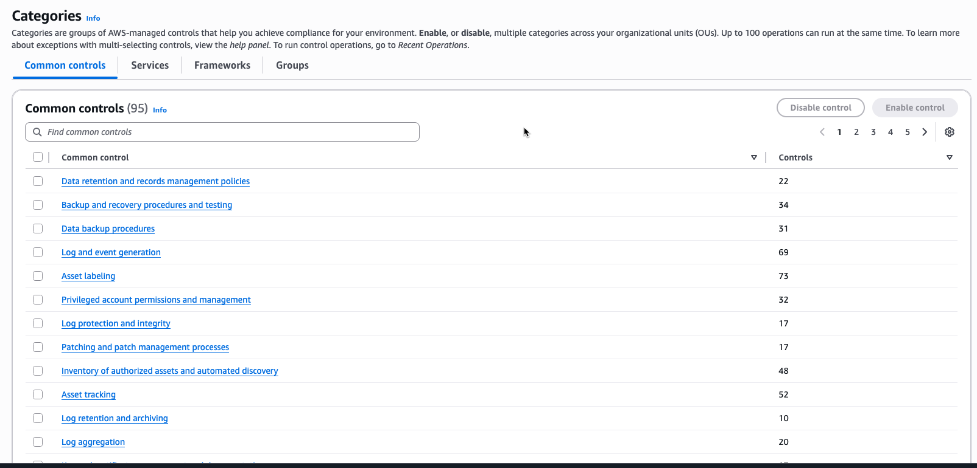
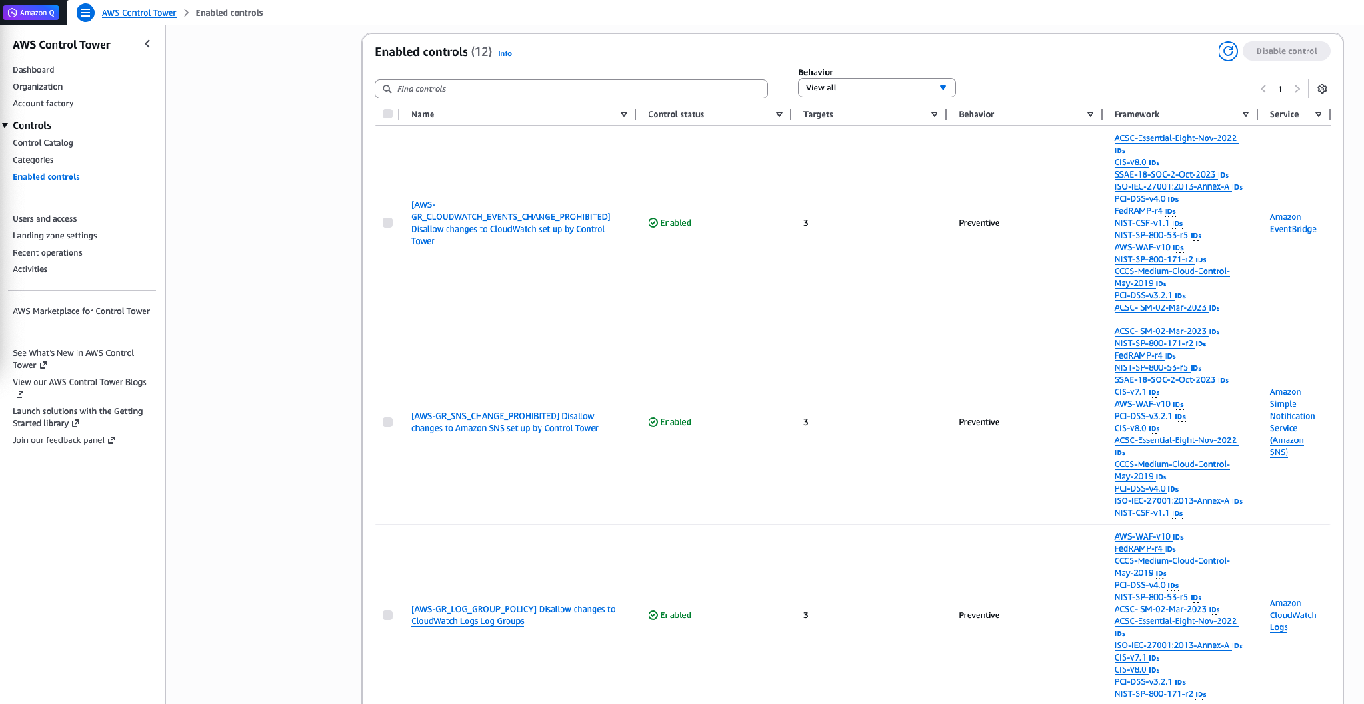
Why AWS Control Tower
Covers all requirements
Accounts, identity, logging, controls, account creation
Ready-made controls
Hundreds of AWS-managed controls. Turn on per OU
Proven pattern
Same approach used by many large companies
Works with Terraform
AFT adds Terraform and CI/CD on top
Control Tower console: control catalog and enabled controls
NorthStar Airlines · Landing Zone Governance · 4/12
Notes:
Why Control Tower? Because it covers all the requirements of the case.
- It creates the multi-account setup for us: management account, logging account and audit account.
- It has the Account Factory.
- It has a dashboard to see compliance.
- - Many large companies use the same pattern. We do not invent something new. We use a proven AWS service, and we add Terraform on top.
REFERENCE:
- What is Control Tower: https://docs.aws.amazon.com/controltower/latest/userguide/what-is-control-tower.html
- Controls reference: https://docs.aws.amazon.com/controltower/latest/controlreference/controls.html

Slide 5
Solution in four blocks
Control Tower
AFT + Terraform
The base: accounts structure, central logging, single sign-on and controls
The automation: accounts and configuration as code in Git, applied by a pipeline
Governance
Operations
The rules: SCPs and Config rules for Dev, Test and Prod
The safety: find drift, roll out safely, manage exceptions
NorthStar Airlines · Landing Zone Governance · 5/12
Notes:
The solution has four blocks.
1. Control Tower. It creates the accounts structure, central logging, login (single sign-on) and the controls.
2. AFT is the automation. Where the creation and the configuration of the Accounts requests and configuration are via Terraform code in Git. A pipeline applies the code.
3. Governance: we can attach a SCPs and AWS Config rules give different rules to Dev, Test and Prod.
4. An operations process manages drift, failures and exceptions.
Everything is code. Everything goes through Git. Nobody changes an account by hand.
REFERENCE: AFT overview: https://docs.aws.amazon.com/controltower/latest/userguide/aft-overview.html

Slide 6






Proposed architecture
Management account
AWS Organization
Security OU (not in scope)
Infrastructure OU
(optional, later)
Log Archive
Audit
Git repos
(Terraform)
Control Tower
Organizations
IAM Identity Center
Sandbox OU
(optional, later)
Workloads OU (focus today)
Engineer makes
a pull request
AFT account
Terraform pipelines
(CodePipeline + CodeBuild)
Dev
Test
Prod
NorthStar Airlines · Landing Zone Governance · 6/12
Notes:
In the Landing Zone we will have more Organizations Unit.
1 for Managament, 1 for Workload, 1 for Security.
In the ManagamentOU we will have 1 account and we will keep AWS IAM Identity Center, AWS Organizations, AWS Control Tower.
In the WorkLoadOU we will had three more OU for dev test and prod. Where we are going to organize 100+ accounts.
In ManagementOU we have a special account AFT, we use to automate the creation of the accounts via Terraform as code.
In SecurityOU we will have Log Archive that use S3 bucket and Audit that monitor the log with CloudWatch.
REFERENCE: Recommended OUs: https://docs.aws.amazon.com/whitepapers/latest/organizing-your-aws-environment/recommended-ous-and-accounts.html

Slide 7
Landing zone structure (simple view)
Management account + AFT account
Security OU
Workloads OU
Infrastructure OU
Sandbox OU
Log archive
Dev OU
optional, later
optional, later
Audit
Test OU
Prod OU
Grey = part of a full landing zone, not in scope today
NorthStar Airlines · Landing Zone Governance · 7/12
Notes:
Rules are attached to OUs, not to single accounts. This is why it scales.
- Management account: only Control Tower, billing and identity. No applications here.
- Workloads OU: this is our focus. Three sub-OUs, Dev, Test and Prod. Each one has its own controls.
- The Security OU (Log Archive and Audit) is created by Control Tower.
- The AFT account in the management account and runs the pipelines.
- - The grey OUs are part of a full landing zone. I keep them out today to keep it simple.
WHY IT SCALES: "Account number 501 goes into Prod OU, and it gets all Prod rules automatically."
REFERENCE: Organizational units: https://docs.aws.amazon.com/organizations/latest/userguide/orgs_manage_ous.html

Slide 8
Governance: three types of controls
Preventive
Detective
Proactive
Is this action allowed?
Is something wrong?
Is it OK before creating?
Like: Locked door
In AWS: Service Control Policy (SCP) on the OU
Example: Nobody can delete CloudTrail logs
Like: Security camera
In AWS: AWS Config rule
Example: Finds an S3 bucket without encryption
Like: Guard at the door
In AWS: Hook checks the resource first
Example: Refuses a bucket without encryption
Workloads OU | Dev | Test | Prod
People can | Write, budget limit | Limited write | Only read
Deny unapproved Regions | Other regions | Deny public S3 configurations | Deny log deletion and access-key creation
NorthStar Airlines · Landing Zone Governance · 8/12
Notes:
In the Governance we have three types of controls.
1. PREVENTIVE = In AWS this is a Service Control Policy (SCP), attached to the OU. If the SCP says "deny", nobody in the account can do the action, not even an administrator. Example: in the Prod OU, nobody can delete the CloudTrail logs, and nobody can leave the approved regions. "Is this action allowed?"
2. DETECTIVE = "it finds the problem and reports it, they are all the rules that are not respecting in AWS Config. Example: a rule finds an S3 bucket without encryption, and marks the account as non-compliant.
3. PROACTIVE = "It checks the resource before it is created. Example: a hook refuses an S3 bucket without encryption.
- - At the bottom you see how the rules change per environment. In Dev, developers have freedom with a budget limit. In Prod, people can only read, and every change comes from the pipeline.
KEY MESSAGE: "Block what is dangerous, detect what is wrong, check before creating. More risk, more control."
REFERENCE:
- Control behaviours (preventive, detective, proactive): https://docs.aws.amazon.com/controltower/latest/controlreference/controls.html
- SCPs: https://docs.aws.amazon.com/organizations/latest/userguide/orgs_manage_policies_scps.html
- AWS Config rules: https://docs.aws.amazon.com/config/latest/developerguide/evaluate-config.html
- Proactive controls: https://docs.aws.amazon.com/controltower/latest/controlreference/proactive-controls.html

Slide 9
Creating a new account
1
Pull
aft-account-request / terraform / main.tf
Get the latest example file from the aft-account-request repo
module "crew_app_dev" {
source = "./modules/aft-account-request"
control_tower_parameters = {
AccountEmail = "crew-dev@northstar.example"
AccountName = "crew-app-dev"
ManagedOrganizationalUnit = "Dev (ou-abcd-12345678)"
SSOUserEmail = "platform@northstar.example"
SSOUserFirstName = "Platform"
SSOUserLastName = "Team"
}
account_tags = { environment = "dev" }
change_management_parameters = {
change_requested_by = "Crew team"
change_reason = "New Dev account"
}
account_customizations_name = "dev"
}
2
Edit
Fill in main.tf: email, name, OU, owner (code on the right)
3
Push
Git add, git commit, git push to the repository. Last manual step
4
AFT creates the account
Pipeline in the AFT account asks Control Tower to create it in the Dev OU
5
Governed + configured
Gets the SCPs of its OU. AFT applies global + "dev" customizations
NorthStar Airlines · Landing Zone Governance · 9/12
Notes:
Let me show how a team gets a new account, and what AFT does automatically.
1. PULL: the engineer pulls the latest example file from the Git repository aft-account-request template.
2. EDIT: the engineer fills in the file, this is the code on the right. Account email, account name, the OU (here Dev), the owner for single sign-on, tags, and the reason for the request. The last line, account_customizations_name = "dev", says which environment configuration to use.
3. PUSH: the engineer pushes the file. This is the last manual action.
4. The push starts the ct-aft-account-request pipeline (CodePipeline) in the AFT management account. AFT asks Control Tower Account Factory to create the account in the Dev OU.
5. As soon as the account is in the OU, it gets the SCPs of that OU. Then AFT creates a customizations pipeline for this account and applies the global customizations (for all accounts) and the "dev" account customization.
KEY MESSAGE: "The engineer changes one file and pushes it. AFT and Control Tower do the rest, and the account is governed from the first minute."
IF ASKED: the values in control_tower_parameters cannot be changed during the account creation, so we check the file before the push.
REFERENCE:
- Provision a new account with AFT: https://docs.aws.amazon.com/controltower/latest/userguide/aft-provision-account.html
- AFT architecture: https://docs.aws.amazon.com/controltower/latest/userguide/aft-architecture.html
- LEFT: the engineer writes Terraform code in Git and makes a pull request.
- AFT ACCOUNT: the pipeline runs here (CodePipeline and CodeBuild). It reads the code.
- MANAGEMENT ACCOUNT: Control Tower, AWS Organizations and IAM Identity Center (single sign-on). The pipeline asks Control Tower to create the account.
- RIGHT: the new account goes into the Workloads OU, in Dev, Test or Prod.
The grey boxes (Security OU with Log Archive and Audit, Infrastructure, Sandbox) are part of a full landing zone
KEY MESSAGE: "One pipeline. Each account goes into the right OU, so it gets the right rules automatically."

Slide 10
Changing all accounts: a global customization
1
Edit
aft-global-customizations / terraform / s3-public-block.tf
Add s3-public-block.tf in the aft-global-customizations repo
resource "aws_s3_account_public_access_block" "this" {
block_public_acls = true
block_public_policy = true
ignore_public_acls = true
restrict_public_buckets = true
}
2
Push
git push. For existing accounts this alone does not apply it
3
Start the update
Run aft-invoke-customizations and choose the target accounts
aft-invoke-customizations: input (which accounts)
4
AFT runs a pipeline per account
{
"include": [ { "type": "all" } ]
}
terraform apply in each account: global, then account customization
5
Every account is updated
Public access blocked everywhere. New accounts get it too
Account customizations (e.g. the "dev" folder) work the same way: change, push, re-invoke for Dev accounts only.
NorthStar Airlines · Landing Zone Governance · 10/12
Notes:
WHAT TO SAY (follow the numbers, point to the code):
"Now the key question: how do we change hundreds of EXISTING accounts? Example: block public S3 access in every account."
1. EDIT: the engineer adds one small file, s3-public-block.tf, in the aft-global-customizations repository. This is the code on the top right. Global means: for all accounts.
2. PUSH: the engineer pushes the file. Be careful: for existing accounts, the push alone does not start the change.
3. START: in the AFT management account we start aft-invoke-customizations (a Step Functions state machine). We choose the targets with the code at the bottom right: all accounts, or include and exclude by OU, tag or account.
FROM HERE AFT DOES EVERYTHING AUTOMATICALLY:
4. AFT runs one customizations pipeline for each target account. Each pipeline runs terraform apply: first global customizations, then the account customization.
5. Every existing account now has Block public access On. New accounts get it at creation, because they use the same code.
ACCOUNT CUSTOMIZATION works the same way: change the folder, for example "dev", push, and re-invoke for the Dev accounts only.
KEY MESSAGE: "Change one file, start one job, AFT updates every account."
REFERENCE:
- Global and account customizations, re-invoke customizations: https://docs.aws.amazon.com/controltower/latest/userguide/aft-account-customization-options.html

Slide 11
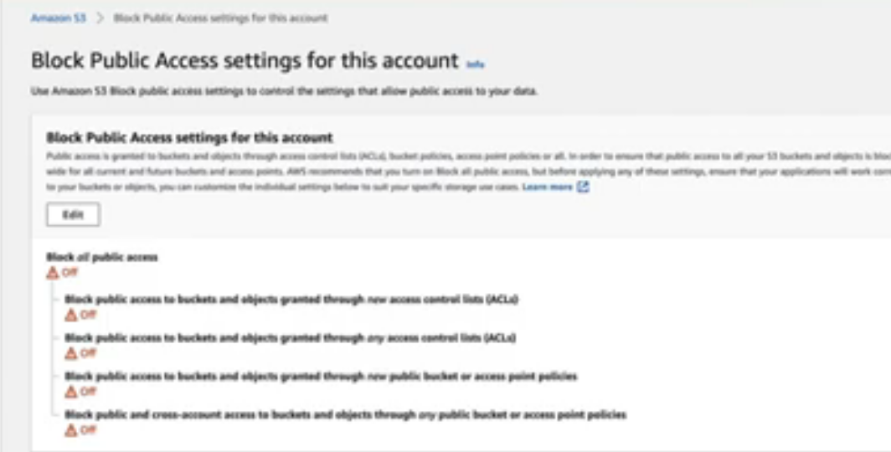
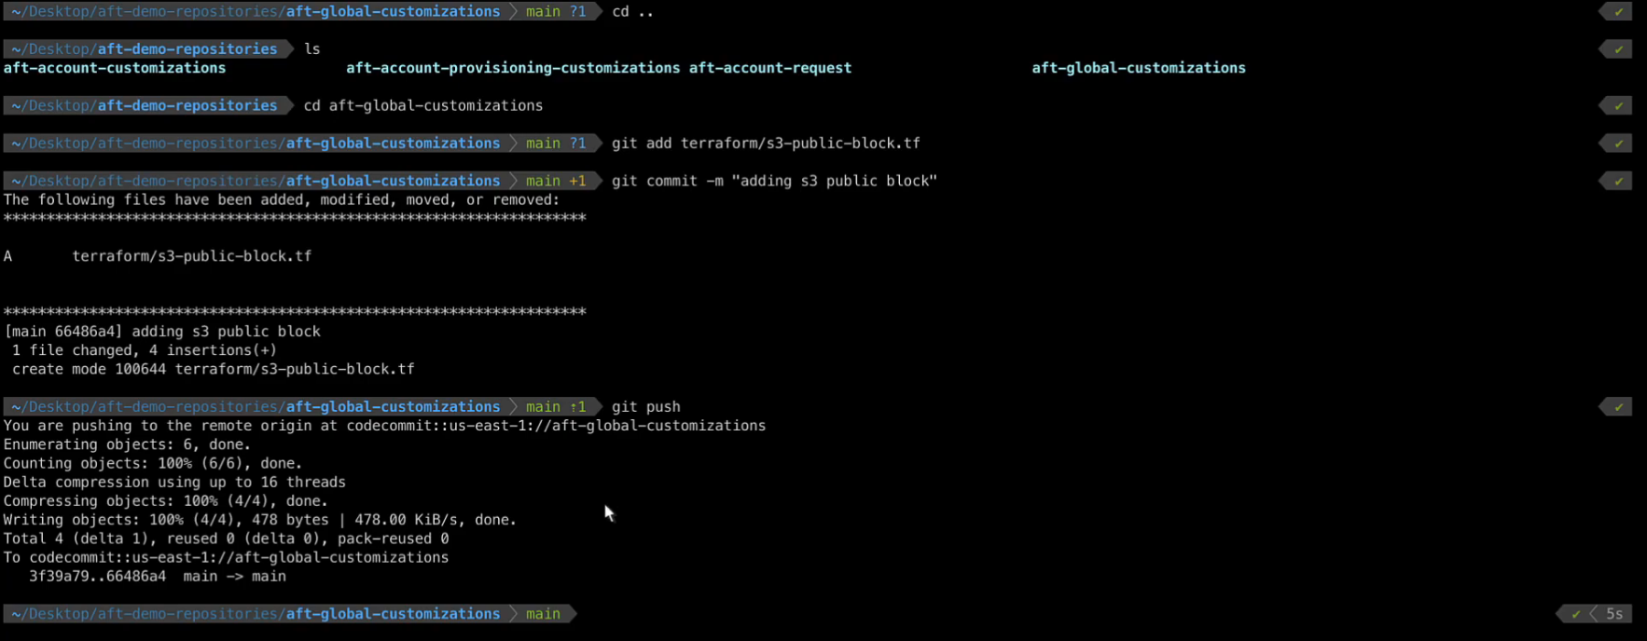
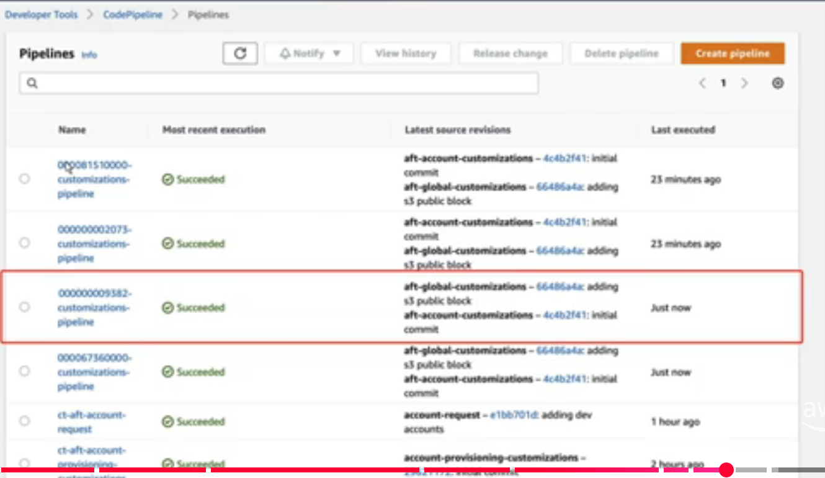
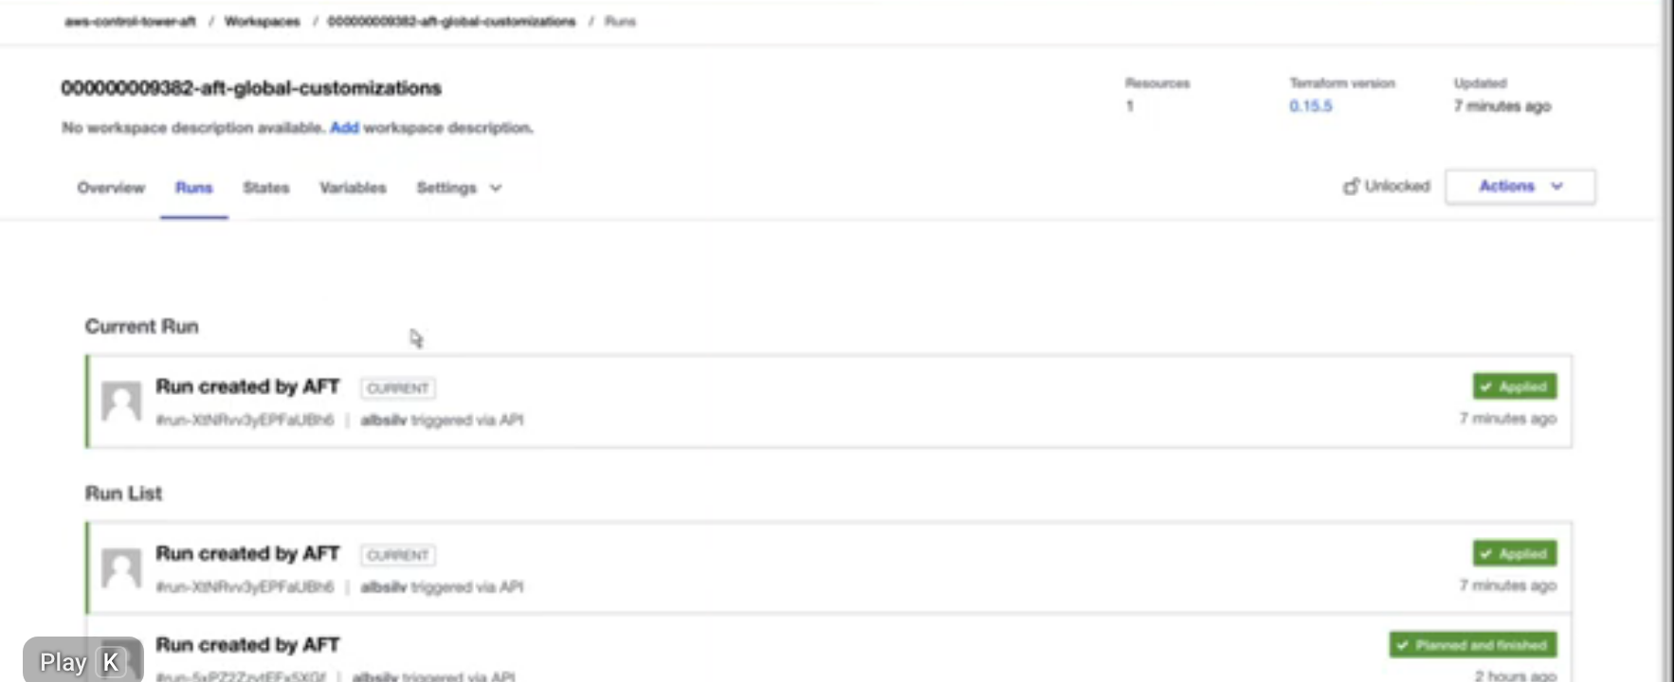
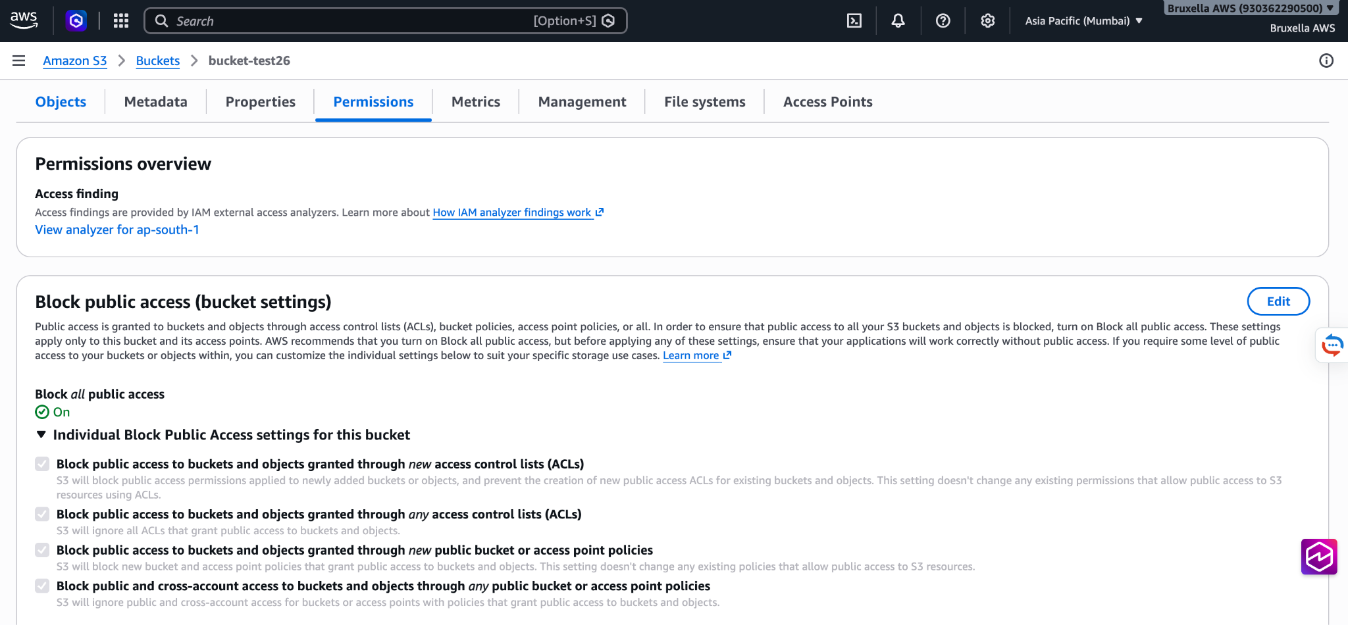
Example: a global change in real life
1
2
3
Before: Block public access is Off
Push s3-public-block.tf (global)
4
5
One pipeline per account: Succeeded
Terraform run: Applied in the account
Check the bucket after account creation
Screenshots: AWS demo videos (YouTube) · SCP check: illustration
See it: AWS Bucket → Permission → Block Public = On
NorthStar Airlines · Landing Zone Governance · 11/12
Notes:
1. BEFORE: in the S3 console of a workload account, Block all public access is still Off. The push alone does not change the accounts yet.
2. PUSH (step 2 of the previous slide): the engineer adds s3-public-block.tf to the aft-global-customizations repository and pushes it.
3. PIPELINES (steps 3 and 4): after we start aft-invoke-customizations, AFT runs one customizations pipeline for each account. In CodePipeline every pipeline says Succeeded. This is how we check that it ran everywhere.
4. TERRAFORM RESULT: the Terraform run shows Applied. Now Block public access is On in the account.
5. SCP CHECK: be precise here. The S3 setting is a Terraform customization INSIDE the account. An SCP is different: it is attached to the OU in AWS Organizations, it is managed by Control Tower in the management account, and it is not changed by the AFT customization pipeline. Every account in the OU gets it automatically, also new ones. To check it: open the account in AWS Organizations, Policies tab, or try a blocked action like deleting CloudTrail. It fails with Access Denied because of the SCP.
KEY MESSAGE: "We check every step: the pipelines are green, the setting is applied, and the SCP blocks what it must block."
SOURCES (AWS videos):
- https://youtu.be/eDbNvHz02dk
- https://www.youtube.com/watch?v=8Ot5wn7kxI0
REFERENCE:
- Re-invoke customizations: https://docs.aws.amazon.com/controltower/latest/userguide/aft-account-customization-options.html
- SCPs: https://docs.aws.amazon.com/organizations/latest/userguide/orgs_manage_policies_scps.html

Slide 12
Operations at scale
Configuration drift
Deployment failures
Found by Control Tower, Config rules and a Terraform plan over night. Fix: run the pipeline again. Git is the truth.
The pipeline stops. Try again or go back to the last good version. Prod is never first.
Exceptions
Hundreds of accounts
Requested by pull request, approved, limited in time and tagged on the account.
Fixed versions, limited parallel runs, quota monitoring. Rules on OUs, not on accounts.
NorthStar Airlines · Landing Zone Governance · 12/12
Notes:
- DRIFT: "Someone changes a setting in the console. Control Tower finds drift in its own resources. Config rules find wrong resources. A Terraform plan runs over night and shows any difference with Git. To fix it, we run the pipeline again. Git always wins."
- FAILURES: "A deployment fails in Dev. The pipeline stops, we try again, and if needed we go back to the previous module version. Prod is not touched."
- EXCEPTIONS: "A team needs a public bucket for a website. They make a pull request for an exception. It is approved for a limited time, for example 90 days. It is tagged on the account until it ends."
- SCALE: "We fix the versions of AFT and modules, we limit how many accounts run at the same time (API limits), and we watch the service quotas."
REFERENCE:
- Control Tower drift: https://docs.aws.amazon.com/controltower/latest/userguide/drift.html
- AFT best practices / versions: https://docs.aws.amazon.com/controltower/latest/userguide/aft-overview.html

Slide 13
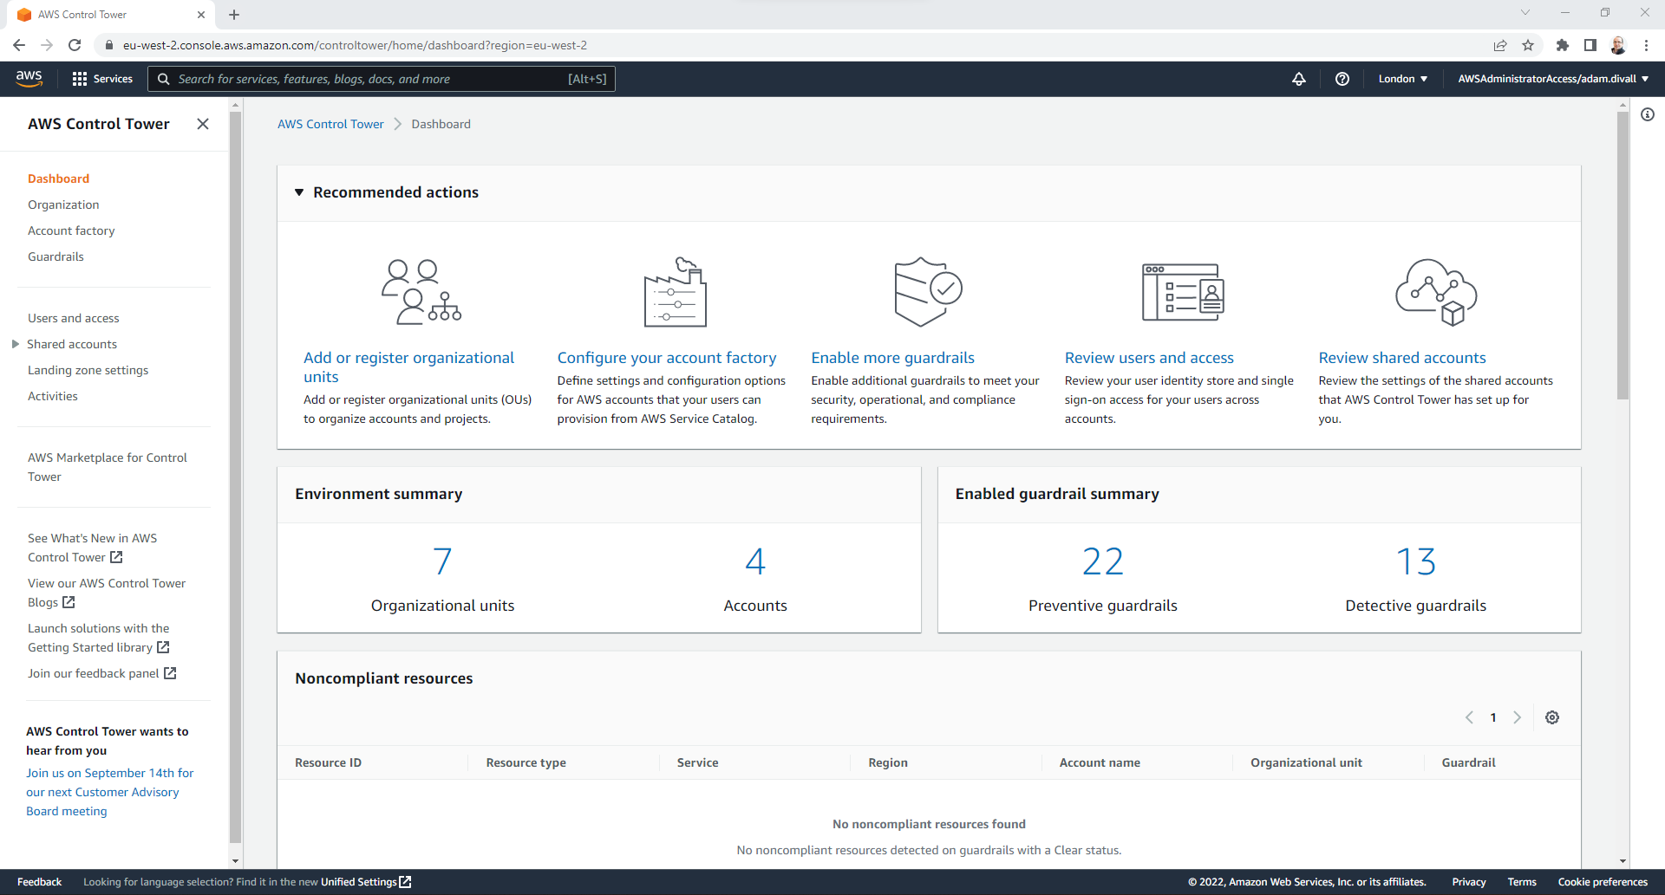

Slide 14
CODE DEMO/REVIEW

