Slide 1
Go 3 Months In
Benjamin Bryant

Slide 2
Short Background
Recent-ish Graduate
Discovered Go in September 2018 after being invited to the pre-drinks before GopherCon London.
Been to most London Go MeetUps since.
Have a Background in Java and C#.

Slide 3
Plan for the next ‘x’ minutes
Talk about my experience with my first small Go project.
Create a list of things I’ve learnt and mistakes I encountered.
Showcase the thoughts of a developer when starting to learn a new language.

Slide 4
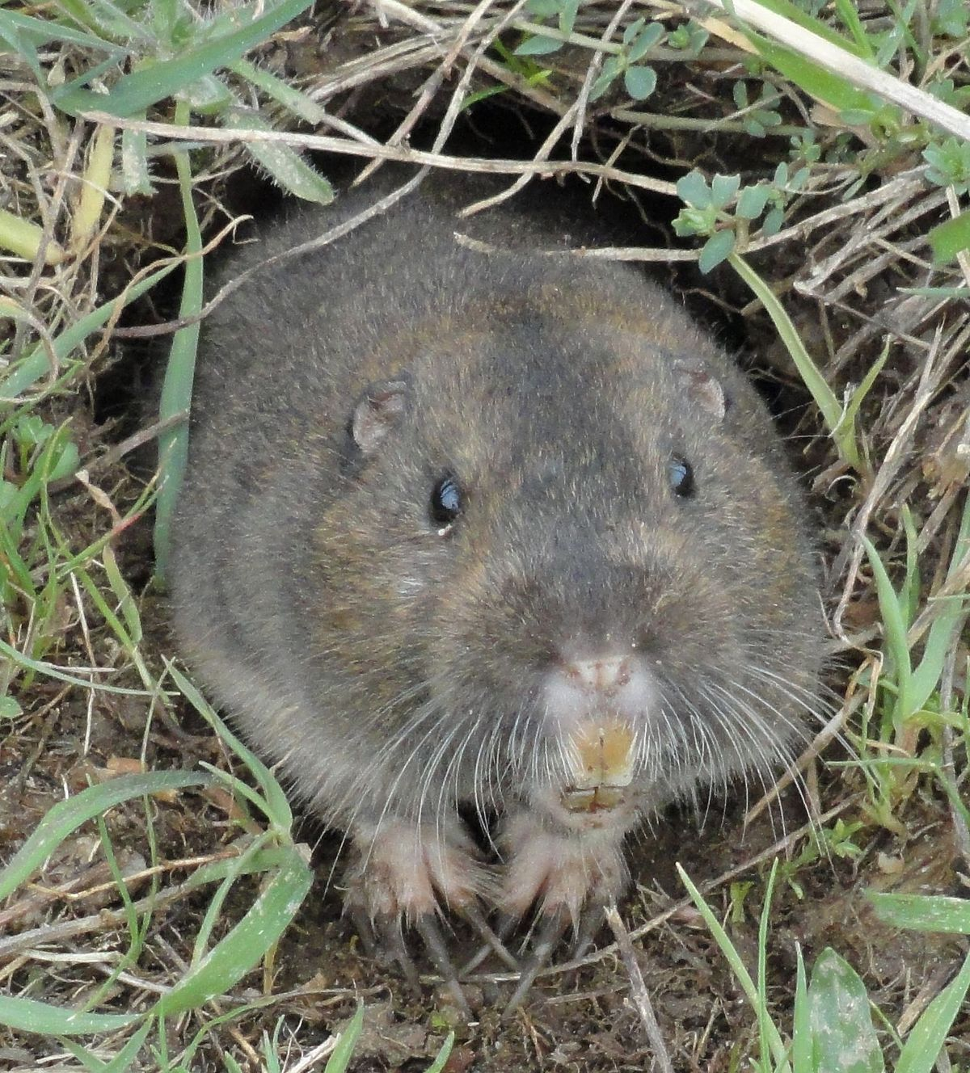
My First Project Idea
Build a program that would model the life of 1 million gophers (the animal) using Go (obviously)
Before beginning the program I looked online for some facts about gophers. https://www.livescience.com/57623-gopher-facts.html

Slide 5
Part 1 – Getting Started
How do I even create a program in Golang?
What are the syntactical differences between Golang and languages I already know?

Slide 6
Solutions
Installing Go (https://golang.org/)
Creating a ‘Hello World’ Program.
Learning syntax from basic tutorials.
Completing the Go tour

Slide 7
Progress Checklist - 1
Can run a basic ‘Hello World’ Go Program on our computer 
Have gained a basic understanding of unfamiliar Go syntax 
Gained a basic understanding of the structure of a .go file 

Slide 8
Confessions – Part 1
I missed the Go Tour

Slide 9
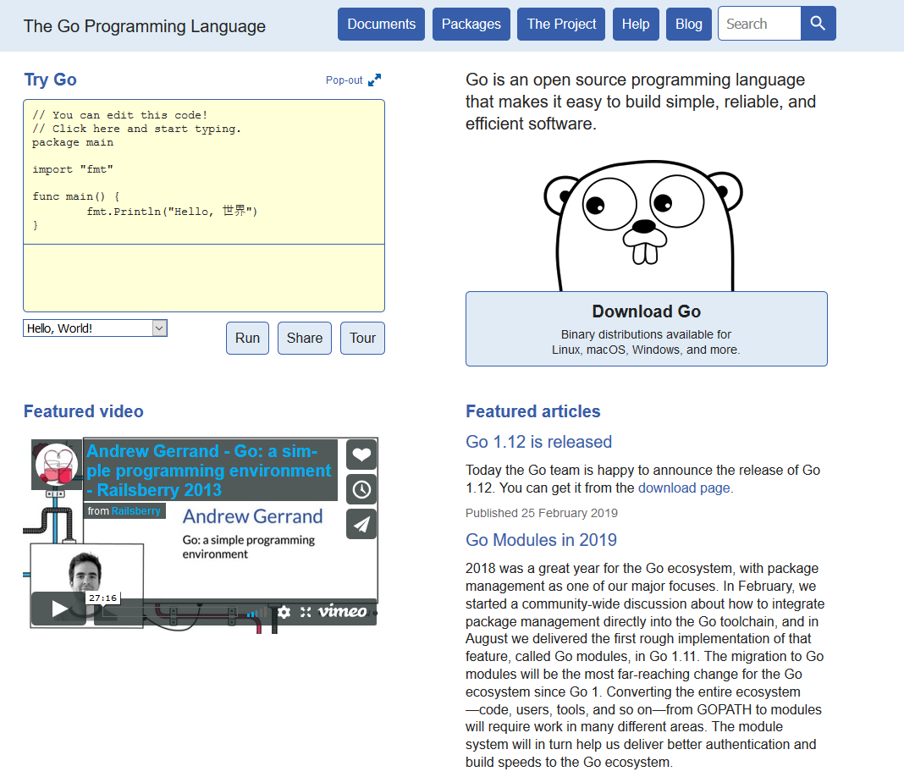

Slide 10
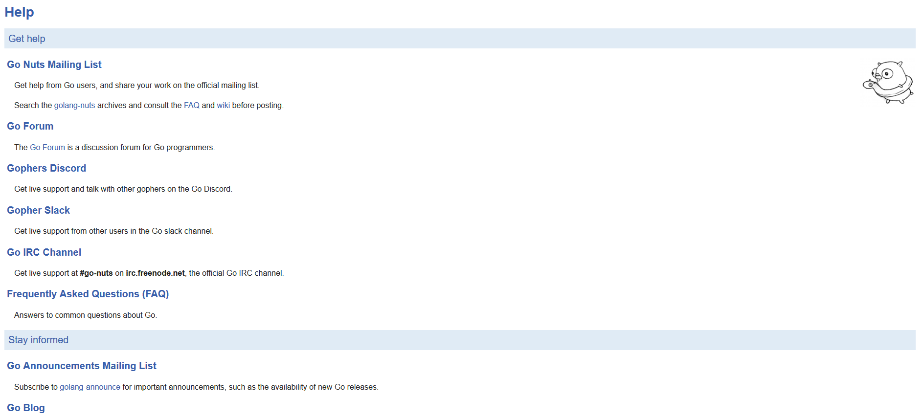

Slide 11
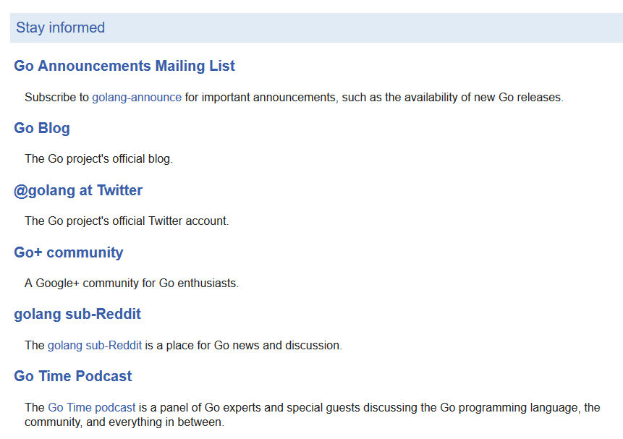
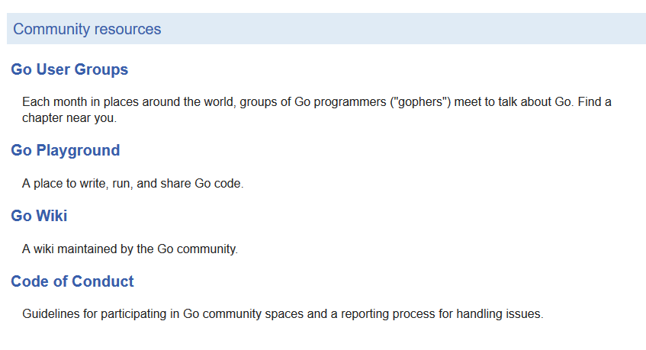

Slide 12
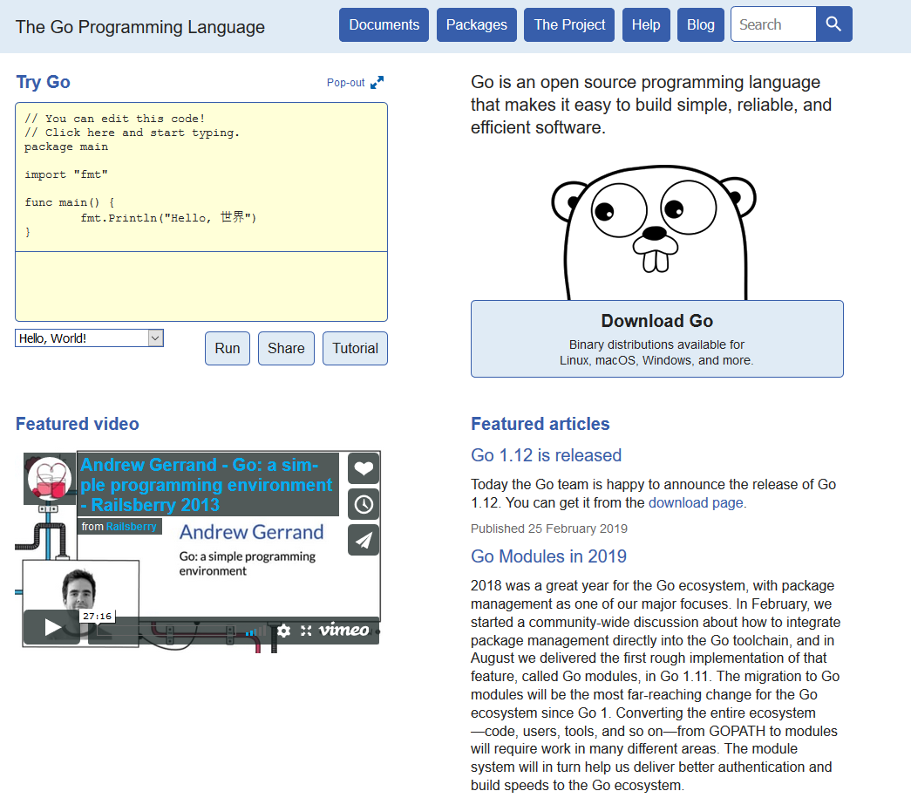

Slide 13
Part 2 Modelling the life of 10 Gophers

Slide 14
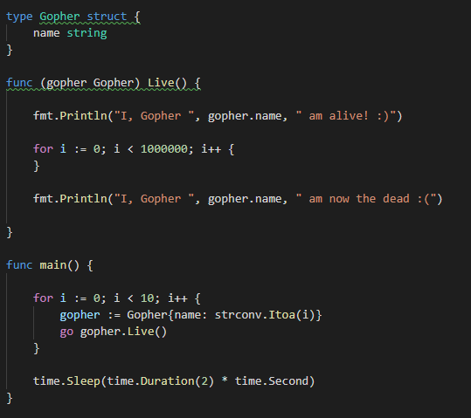
Solution A
Gopher Struct with a ‘Name’ variable
Gopher life represented by ‘Live()’ method

Slide 15
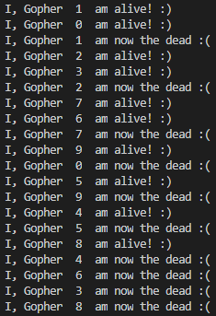
Solution A - Output
Not all Gophers came to life at the same time. Why?
In short, I messed up the basics of concurrency.

Slide 16

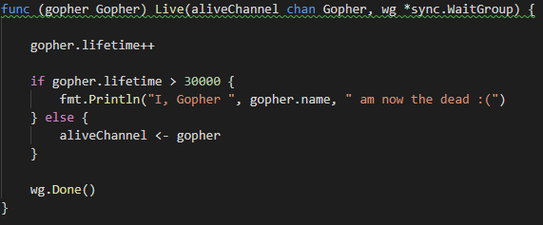
Solution B
Slight tweaks to the Gopher struct and ‘Live’ method
No longer hog the CPU

Slide 17
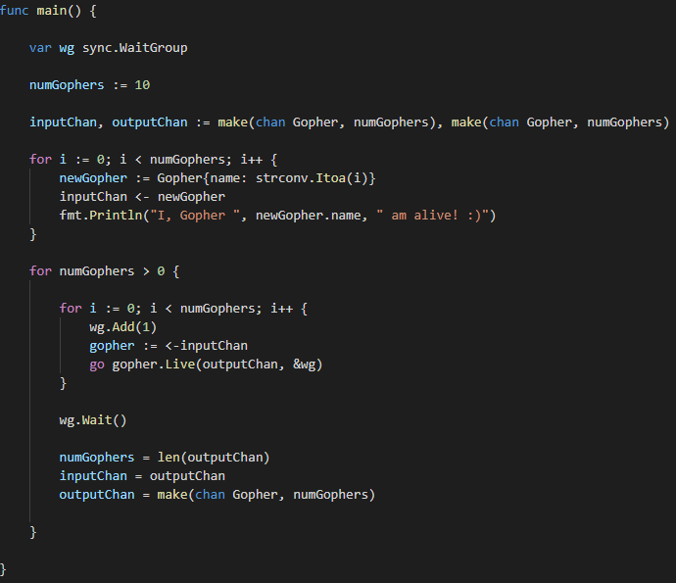
Solution - B
Usage of syncing and channels

Slide 18
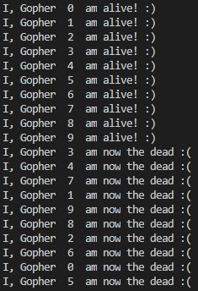
Solution B - Output
Better!
Gophers come to life and reach the afterlife ‘simultaneously’.

Slide 19
Progress Checklist - 2
Watched Rob Pike’s ‘Concurrency is Not Parallelism’ 
https://www.youtube.com/watch?v=cN_DpYBzKso&feature=youtu.be
Re-learnt the fundamentals of Concurrency 
Practiced with Structs, Methods, Goroutines, Channels and Syncing 
Usage of Packages beyond ‘fmt’ 
$GOPATH is a thing. 

Slide 20
Part 3 There’s more to life than this right?

Slide 21
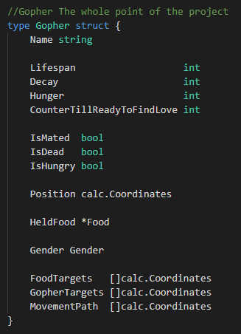
I expanded on what a gopher could do with it’s life

Slide 22
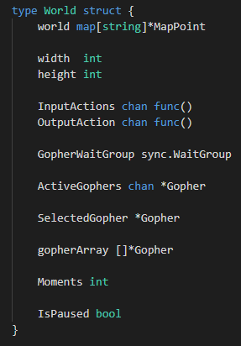

The world is now represented as a 2D map
Each Coordinate can contain a gopher and some food but not multiple of each

Slide 23
Part 3 - Continued
Each world ‘frame’ a gopher would decide what to do.
This would range from moving towards food, eating food it picked up, feeling hungry, or just wandering around because it couldn’t find any food.
This was pretty difficult to see using text so I needed to find a way to visualize what I was doing

Slide 24
Part 3 - Continued
Go fortunately had packages for rendering to html
Here is an example of what the project first looked like:
(This is where you show something on your laptop!)
! – Carrot G - Gopher

Slide 25
Gopherlife (Alpha)
Key: (! = Carrot) (G = Gopher) (/ = Grass)

Slide 26
Gopherlife (Beta)

Slide 27
Performance wasn’t great…

Slide 28
Progress Checklist 3
Project Structure and avoiding Circular Dependencies 
Implementing Basic Pathing Using Coordinates 
Improve understanding of how different structures interact concurrently 
Learnt how to use http/html packages for rendering a webpage 
Learnt how to use http function handlers 
Learnt a bit about css grid (Not go-related) 

Slide 29
Part 4
Optimization!

Slide 30
Part 5 - Optimization
As the number of gophers increased the time it takes to process all gophers also increases.
In order to reach the goal of 1 million gophers was taking an incredibly long time.

Slide 31
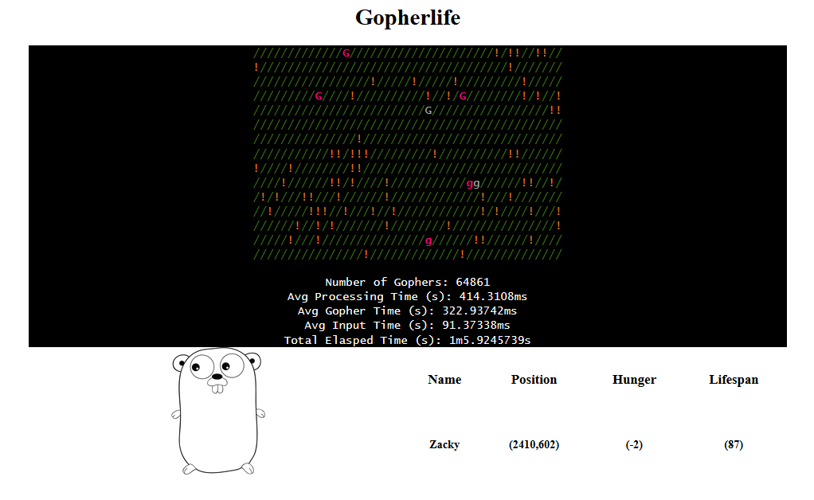
Part 4 - Optimization
At only 6% of my target goal it was taking nearly ½ a second to process a single frame.
Is this just how fast it takes to process things?
Was my goal un-reasonable?

Slide 32
Test Parameters
Time how many gophers are generated in a minute and time how long it takes to reach 1 million gophers
Starting Number Of Gophers is 5000
Gopher lifespans are around 500 frames
Gophers can reproduce at 150 frames
Number Of Food on the map is around 1 million
World Size is 3000 x 3000
Hunger per frame is 5
Birth-rate is 20 – because I forgot to change it to 7

Slide 33
Initial Investigation
It was clear the method I used to find food was inefficient
I switched to using a spiral search method to find the nearest food to a gopher

Slide 34
The Results of Spiral Searching
(Image of Spiral Search Results)

Slide 35
Spatial Partitioning Investigation
Instead of using one giant map and checking each square in a circle, why not split it up into different grids?
Each smaller grid keeps track of the positions of gophers and food inside of it
Searching for food and other gophers should be faster right?

Slide 36

The Results of the investigation
It was less efficient

Slide 37
The Results of the investigation
(Display Image results for 1 minute)

Slide 38
Discovering Go Benchmark
I wanted to find a way to prove my idea was right and I had simply made a mistake in my code.
If only there was some way to find out how fast methods were taking?
Well, there is. Go Benchmark

Slide 39


Discovering Go Benchmark
Turns out this method was the culprit!
Maps in go work different to how I was used to so I made this method to generate a key from Coordinates.
It was called whenever you needed to access tiles on the world map. Even more so when the map was split into separate grids.

Slide 40
Discovering Go Benchmark
I switched from using my method with a map to a 2-dimensional slice (As the world size never changes)
The speed of map tile access reduced significantly.

Slide 41
The Results of the Benchmark Investigation
It was still less efficient

Slide 42
The Results of the Benchmark Investigation
However, the solution was much faster at a lower population and only slowed down as the population increased.
(Explain why here, basically, the number of gophers and food pulled in from the grid got too large as the world size is too small)
(Where there is a much smaller population it performs a lot faster than the spiral search method).

Slide 43
The Results of the Benchmark Investigation
(Display images of a 1 minute in and then 10 minutes in)

Slide 44
Spiral Search with 2-Dimensional Array
I went back to an older branch and converted it to use a 2-dimensional array instead of the over-use of the map-key method and here are the results
1 minute in :
Time to reach 1 million:

Slide 45
Problem 5 Checklist
A lot
Searching in a 2-D Space in Go 
Spatial Petitioning Methodologies (Grids/Quadtrees) in Go 
Mutexes and More Fundamentals of Concurrency 
Go Benchmarking 
Go Race Detector 
Finding out slices contain pointers to arrays 
Denial is a powerful motivator 

Slide 46
Final Showcase

Slide 47
Final Checklist
Can run a basic ‘Hello World’ Go Program on our computer 
Have gained a basic understanding of unfamiliar Go syntax 
Gained a basic understanding of the structure of a .go file 
Watched Rob Pike’s ‘Concurrency is Not Parallelism’ 
Re-learnt the fundamentals of Concurrency 
Practiced with Structs, Methods, Goroutines, Channels and Syncing 
Usage of Packages beyond ‘fmt’ 
$GOPATH is a thing. 
Project Structure and avoiding Circular Dependencies 
Implementing Basic Pathing Using Coordinates 
Improve understanding of how different structures interact concurrently 
Learnt how to use http/html packages for rendering a webpage 
Learnt how to use http function handlers 
Learnt a bit about css grid (Not go-related) 
Searching in a 2-D Space in Go 
Spatial Petitioning Methodologies (Grids/Quadtrees) in Go 
Mutexes and More Fundamentals of Concurrency 
Go Benchmarking 
Go Race Detector 
Finding out slices contain pointers to arrays 
Denial is a powerful motivator 
To Be Continued? 
It is slightly larger than when we first started right?

Slide 48
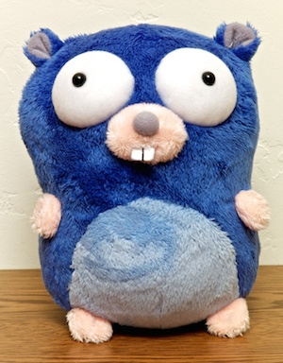
What I like about Go so Far
It helps teach good habits to have as a programmer
In-built tooling makes it easier to test programs and ideas
The community around the language
The mascot is kinda cute

Slide 49
Thank you for listening to my talk

Slide 50
Everything below this slide is not part of the presentation

Slide 51
Checklist of Mistakes
Concurrency is not parallelism 
You can read from maps concurrently, but you can not write to maps.
Importance of structure to avoid circular dependencies and for ease of readability 
By saving your files where the GOPATH is you can access local packages without using relative paths.

Slide 52
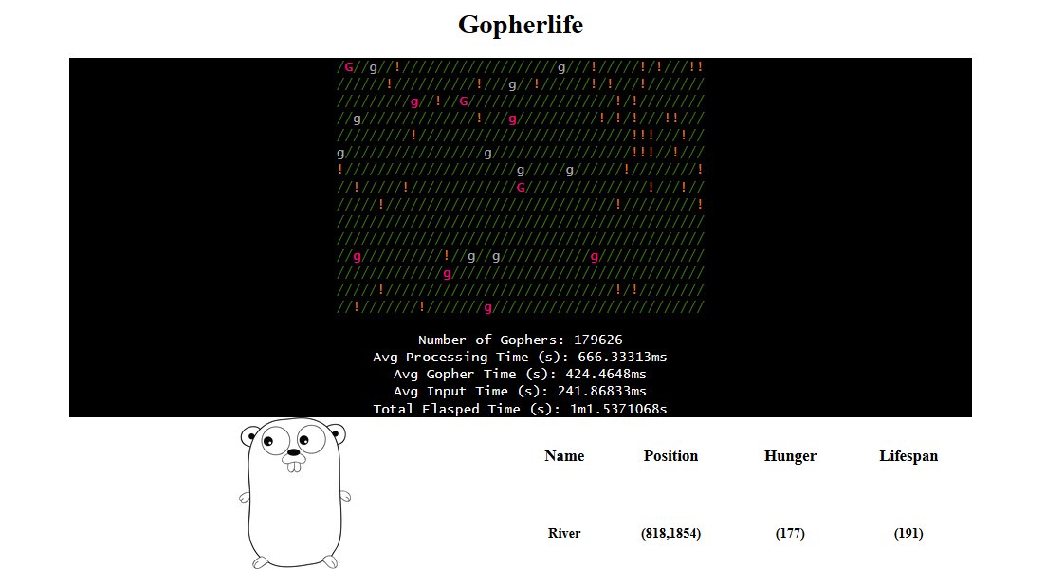

Slide 53
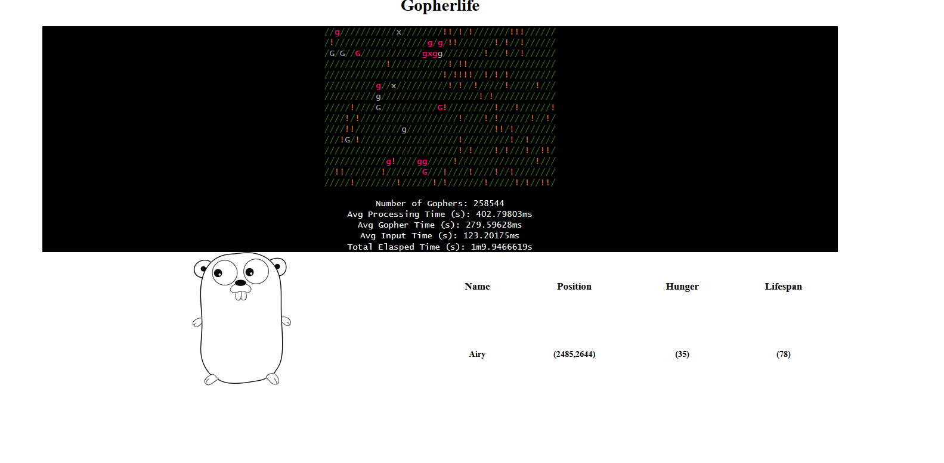

Slide 54
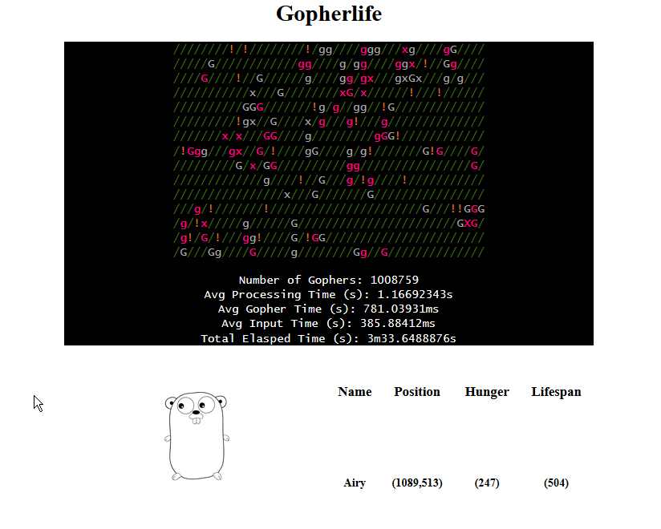
After The Spiral Change

