Slide 1
Go Getting Started After Getting Started
Lightning Talk – Benjamin Bryant

Slide 2
The Power of Potentially "Pointless” Personal Projects

Slide 3
Short Background
Discovered Go in September 2018 at the pre-drinks before GopherCon London.
Been to each London Go MeetUp since.
Have a Background in Java and C#.

Slide 4
Plan for the next 9 minutes
Talk about a small starter project I’m working on and keep a checklist of different skills or ideas I bumped into along the way.

Slide 5
The Idea
Attempt to Model the life of 1 million Gophers (the animal)
Or At least build the framework for it.

Slide 6
Problem 1 – Getting Started
How do I even create a program in Golang?
What are the syntactical differences between Golang and languages I already know?

Slide 7
Solutions
Installing Go (https://golang.org/)
Creating a ‘Hello World’ Program.
Learning syntax from basic tutorials.

Slide 8
Progress Checklist - 1
Can run a basic ‘Hello World’ Go Program on our computer 
Have gained a basic understanding of unfamiliar Go syntax 
Gained a basic understanding of the structure of a .go file

Slide 9
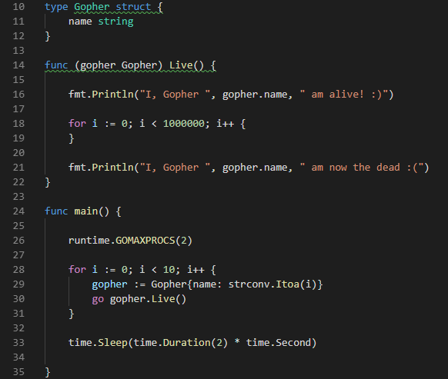
Problem 2 – Modelling the life of 10 Gophers

Slide 10
Solution A
Gopher Struct with a ‘Name’ variable
Gopher life represented by ‘Live()’ method

Slide 11
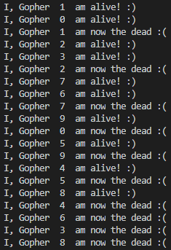
Solution A - Output
Not all Gophers Come to life at the same time. Why?

Slide 12
Progress Checklist - 2
Watched Rob Pike’s ‘Concurrency is Not Parallelism’ 
https://www.youtube.com/watch?v=cN_DpYBzKso&feature=youtu.be
Re-learnt the fundamentals the Concurrency 
Practice with Structs, Methods, Goroutines and Syncing 
Imports beyond ‘fmt’ 

Slide 13
Preparation
I had an idea. To practice concurrency what if I modelled the lives of 1 million gophers within go.

Slide 14
Problem 3 – Life is a bit Empty isn’t it?

Slide 15
Perseverance
Talking about your project with other developers
Getting help

Slide 16
Go – Starter Pack
Installing GO.
Learning the syntax

Slide 17
Finding A Catalyst

Slide 18
Managing Scope and Completing Projects

Slide 19
Getting past the feeling of pointlessness
Finding a Catalyst, to improve motivation
Discussing your project with peers
Creating an actual deadline
Notes:
It isn’t a good idea to do a project in isolation.

Slide 20
Insert Here, Example of 5 gophers one alive, 4 dead

Slide 21
Checklist
Concurrency is not parallelism 

Slide 22
Checklist of Mistakes
Concurrency is not parallelism 
You can read from maps concurrently, but you can not write to maps.
Importance of structure to avoid circular dependencies and for ease of readability 
By saving your files where the GOPATH is you can access local packages without using relative paths.

