Slide 1
Go 3 Months In
Benjamin Bryant

Slide 2
Short Background
Recent-ish Graduate
Discovered Go in September 2018 after being invited to the pre-drinks before GopherCon London.
Been to most London Go MeetUps since.
Have a Background in Java and C#.

Slide 3
Plan for the next ‘x’ minutes
Talk about my experience with my first small go project.
Create a list of things I’ve learnt and mistakes I encountered.
Showcase the thoughts of a developer when starting to learn a new language.

Slide 4
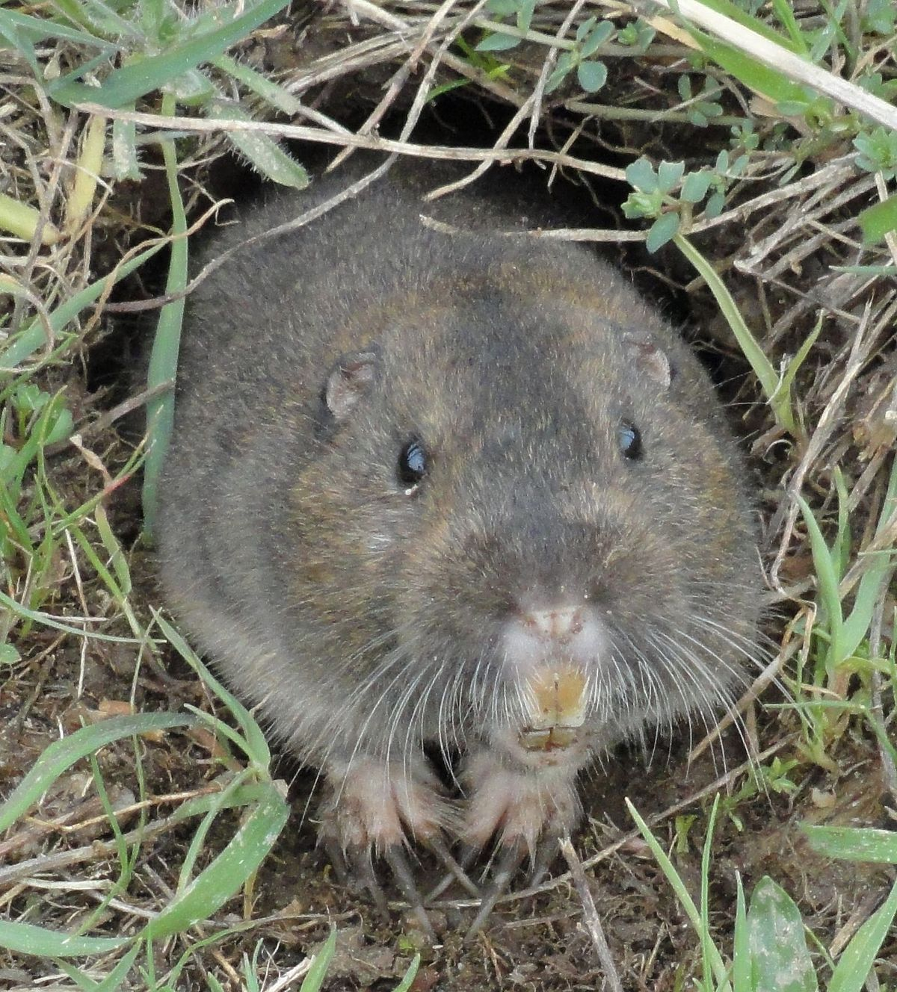
My First Project Idea
Build a program that would model the life of 1 million gophers (the animal) using Go (obviously)
Before beginning the program I looked online for some facts about gophers. https://www.livescience.com/57623-gopher-facts.html

Slide 5
Part 1 – Getting Started
How do I even create a program in Golang?
What are the syntactical differences between Golang and languages I already know?

Slide 6
Solutions
Installing Go (https://golang.org/)
Creating a ‘Hello World’ Program.
Learning syntax from basic tutorials.
Completing the Go tour

Slide 7
Progress Checklist - 1
Can run a basic ‘Hello World’ Go Program on our computer 
Have gained a basic understanding of unfamiliar Go syntax 
Gained a basic understanding of the structure of a .go file 

Slide 8
Mistakes Checklist -1
I missed the Go Tour
(Mention the website gobyexample and gophercises as good resources)

Slide 9
Problem 2 – Modelling the life of 10 Gophers
How do I define what a Gopher is?
How do I model what life is?
Why 10?

Slide 10
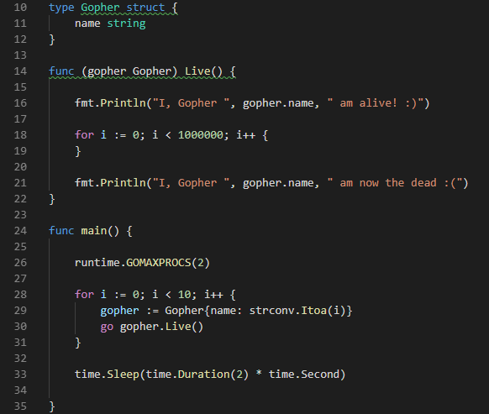
Solution A
Gopher Struct with a ‘Name’ variable
Gopher life represented by ‘Live()’ method

Slide 11
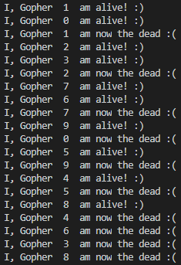
Solution A - Output
Not all Gophers Come to life at the same time. Why?
In short, I messed up the basics of concurrency.

Slide 12

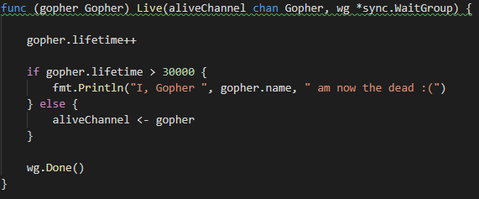
Solution B
Slight tweaks to the Gopher struct and ‘Live’ method
No longer hog the CPU

Slide 13
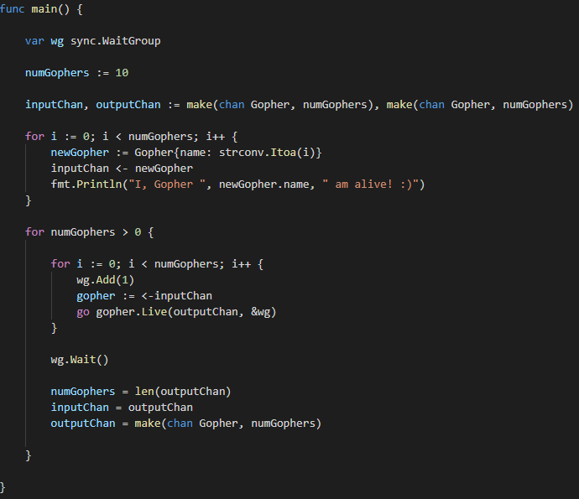
Solution - B
Usage of syncing and channels

Slide 14
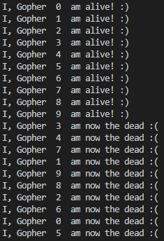
Solution B - Output
Better!
Gophers come to life and reach the afterlife ‘simultaneously’.

Slide 15
Progress Checklist - 2
Watched Rob Pike’s ‘Concurrency is Not Parallelism’ 
https://www.youtube.com/watch?v=cN_DpYBzKso&feature=youtu.be
Re-learnt the fundamentals of Concurrency 
Practiced with Structs, Methods, Goroutines, Channels and Syncing 
Usage of Packages beyond ‘fmt’ 
$GOPATH is a thing. 

Slide 16
Problems 3 – 10 Life is a bit Empty isn’t it?
Gophers need things to do.
They need space to wonder around and frolic freely!
They need food to stop from going hungry.
They need companionship?

Slide 17
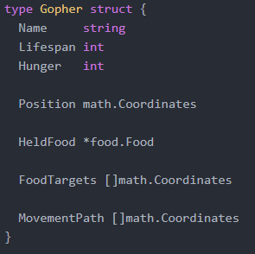
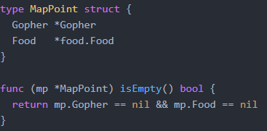
Solutions
Creating a World and giving gophers a position in it.
Creating objectives for gophers to do during their lives.

Slide 18
Solutions

Slide 19
Progress Checklist 3 - 10
Project Structure and avoiding Circular Dependencies 
GOPATH and where to place your projects 
Implementing Basic Pathing Using Coordinates 
Improve understanding of how different structures interact concurrently 

Slide 20
Problem 4 – Visual Representation
I have no idea what I’m doing or if it works

Slide 21
Solutions
Render the world using

Slide 22
Progress Checklist 11-14
Learnt how to use http/html packages for rendering a webpage 
Learnt how to use http function handlers 
Learnt a bit about css grid 

Slide 23
Solutions – Early Demo

Slide 24
Problem 5 - Optimization
As the number of gophers increased the time it takes to process each gopher also increases.

Slide 25
Solutions
Optimizing how long it takes Gophers to find food.
Spiral Searching,
Quadtree Queries
Spatial Partitioning

Slide 26
Variables
Starting Number Of Gophers is 5000
Gopher lifespans are around 500
Number Of Food on the map is around 1 million,
World Size is 3000 x 3000
Hunger per moment is 5

Slide 27
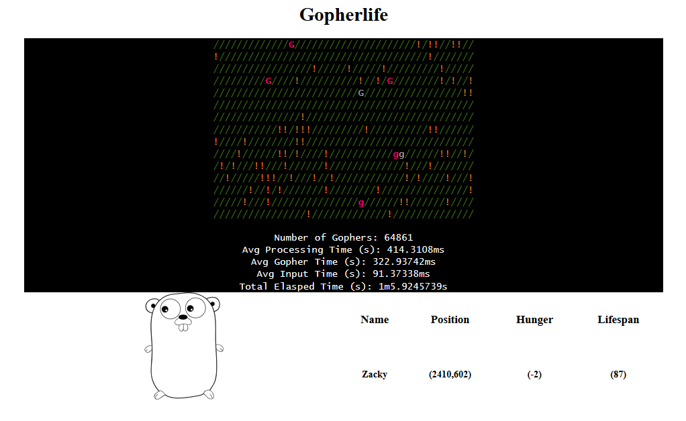
How many gophers a minute?

Slide 28
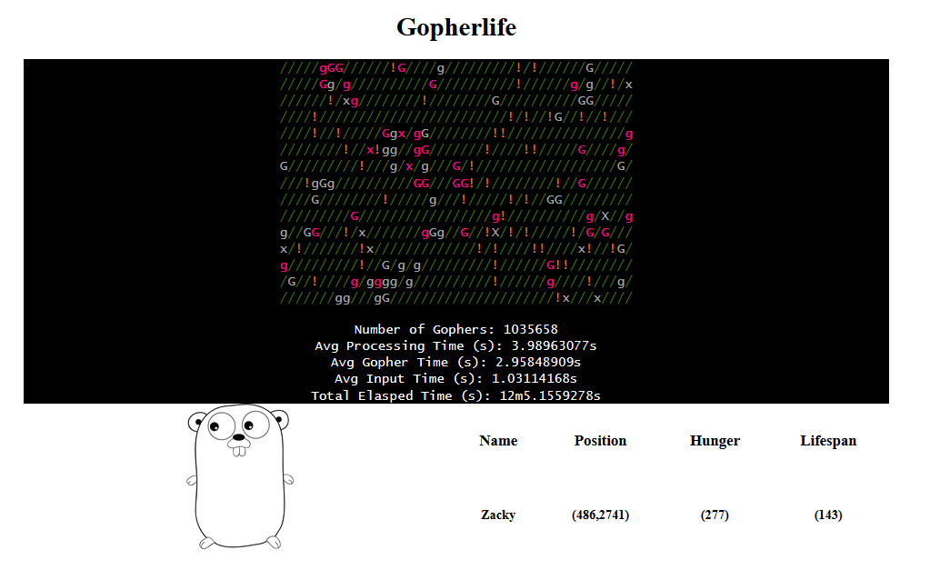
Getting to 1 million Gophers

Slide 29
After a few optimisations

Slide 30
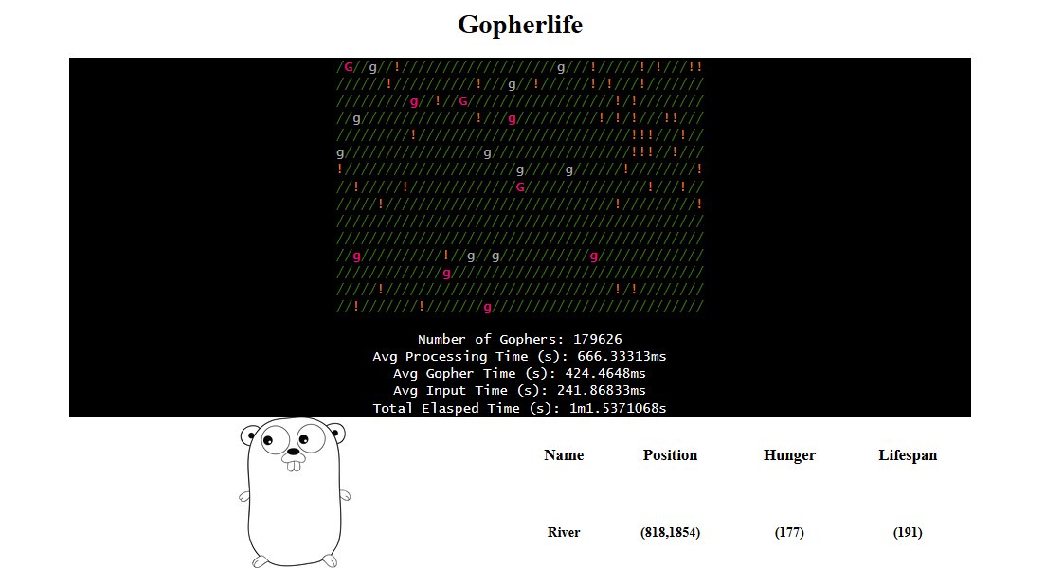

Slide 32
Progress Checklist
Introduction to using go benchmark and go race.
Increased knowledge of different ways to optimize searching problems.

Slide 34
Final Showcase

Slide 35
Final Checklist

Slide 36
Conclusion

Slide 37
Perseverance
Talking about your project with other developers
Getting help

Slide 38
Go – Starter Pack
Installing GO.
Learning the syntax

Slide 39
Finding A Catalyst

Slide 40
Managing Scope and Completing Projects

Slide 41
Getting past the feeling of pointlessness
Finding a Catalyst, to improve motivation
Discussing your project with peers
Creating an actual deadline
Notes:
It isn’t a good idea to do a project in isolation.

Slide 42
Insert Here, Example of 5 gophers one alive, 4 dead

Slide 43
Checklist
Concurrency is not parallelism 

Slide 44
Checklist of Mistakes
Concurrency is not parallelism 
You can read from maps concurrently, but you can not write to maps.
Importance of structure to avoid circular dependencies and for ease of readability 
By saving your files where the GOPATH is you can access local packages without using relative paths.

Slide 45
Solution: Modelling the lives of 1 million Gophers
Create a PowerPoint presentation talking about the cyclical nature of Learning how to Program.
For Newcomers
Talk about how by making a presentation those who aren’t Gopher or are new Gophers might see the first steps

Slide 46
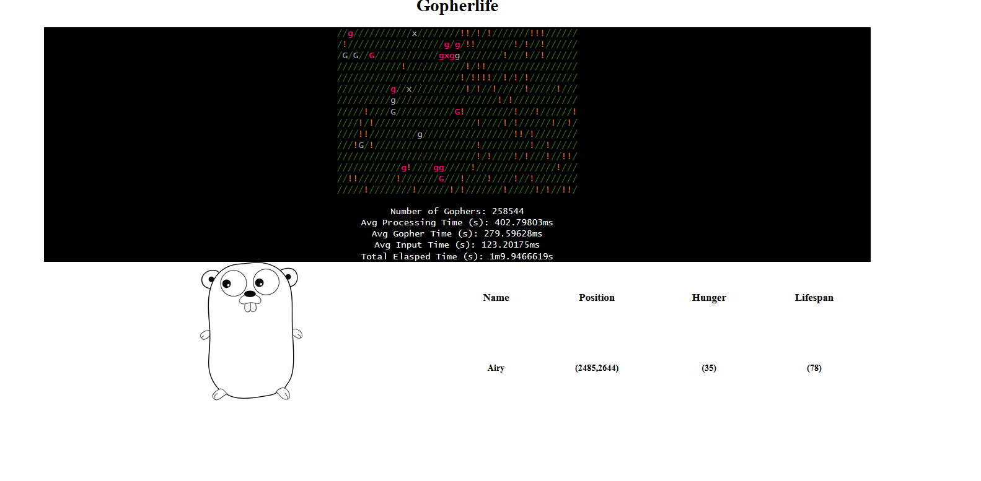

Slide 47
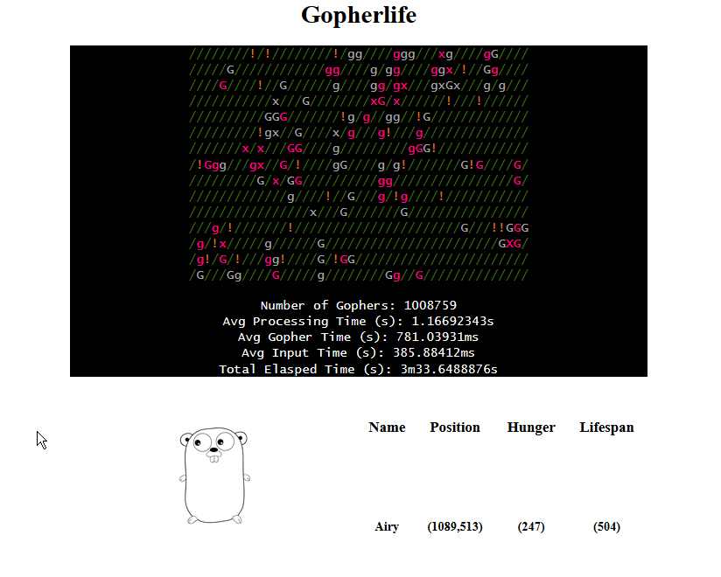
After The Spiral Change

