Slide 1
Go 3 Months In
Benjamin Bryant

Slide 2
Short Background
Recent-ish Graduate
Discovered Go in September 2018 after being invited to the pre-drinks before GopherCon London.
Been to most London Go MeetUps since.
Have a Background in Java and C#.

Slide 3
Plan for the next ‘x’ minutes
Talk about my experience with my first small Go project.
Create a list of things I’ve learnt and mistakes I encountered.
Showcase the thoughts of a developer when starting to learn a new language.

Slide 4
Part 1 The Idea

Slide 5
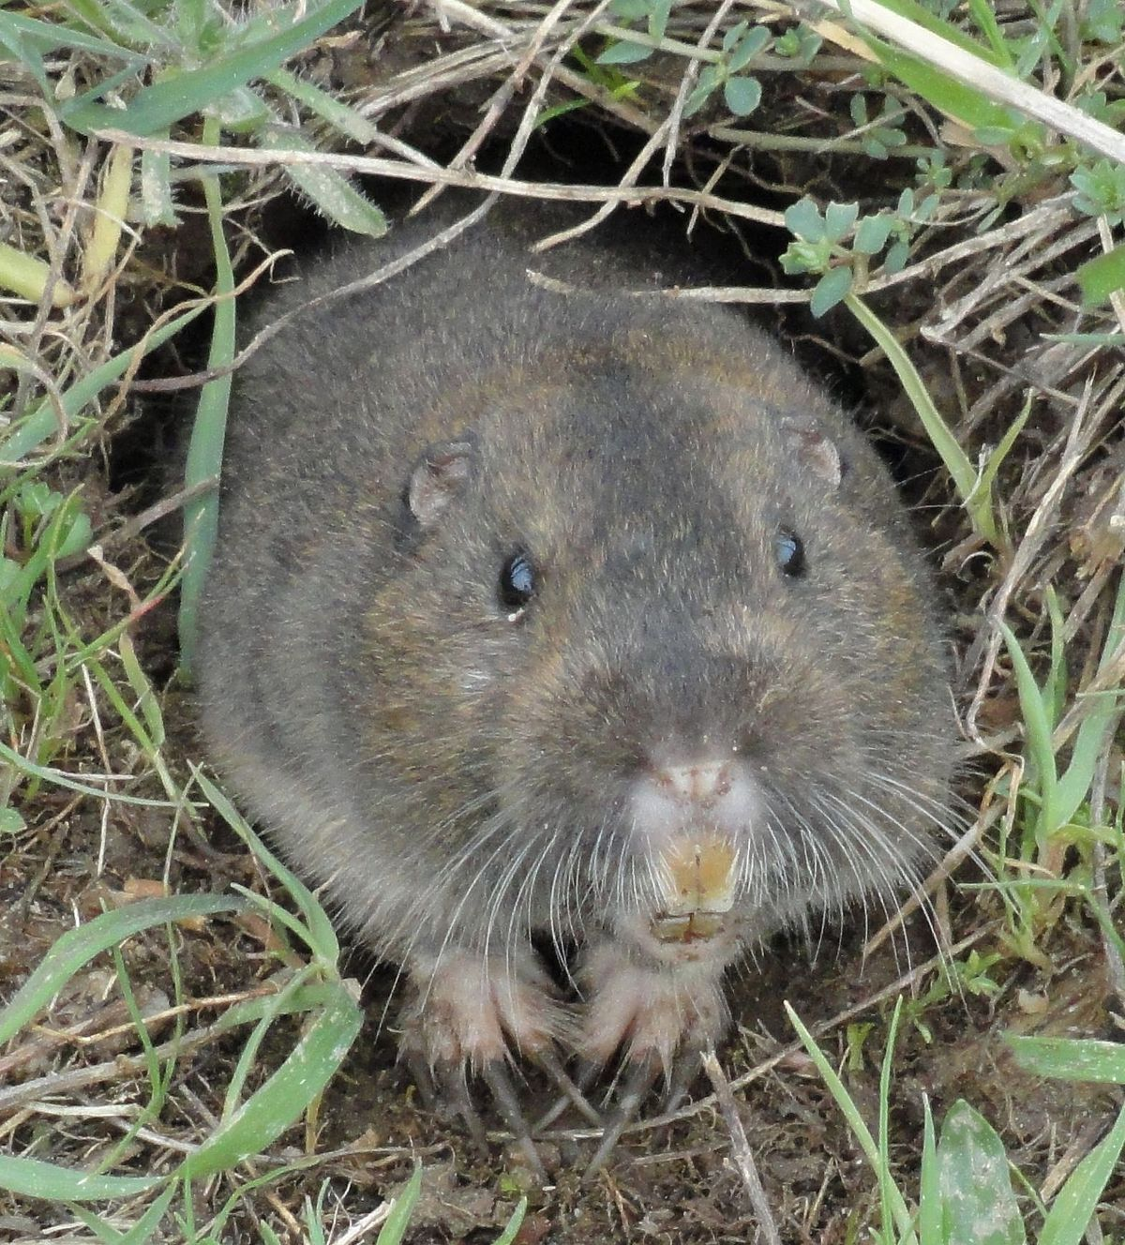
Build a program that would model the life of 1 million gophers (the animal) using Go (obviously)
Before beginning the program I looked online for some facts about gophers. https://www.livescience.com/57623-gopher-facts.html

Slide 6
Getting Started
How do I even create a program in Golang?
What are the syntactical differences between Golang and languages I already know?

Slide 7
Solutions
Installing Go (https://golang.org/)
Creating a ‘Hello World’ Program.
Learning syntax from basic tutorials.
Completing the Go tour

Slide 8
Progress Checklist - 1
Can run a basic ‘Hello World’ Go Program on our computer 
Have gained a basic understanding of unfamiliar Go syntax 
Gained a basic understanding of the structure of a .go file 

Slide 9
Confessions – Part 1
I missed the Go Tour

Slide 10
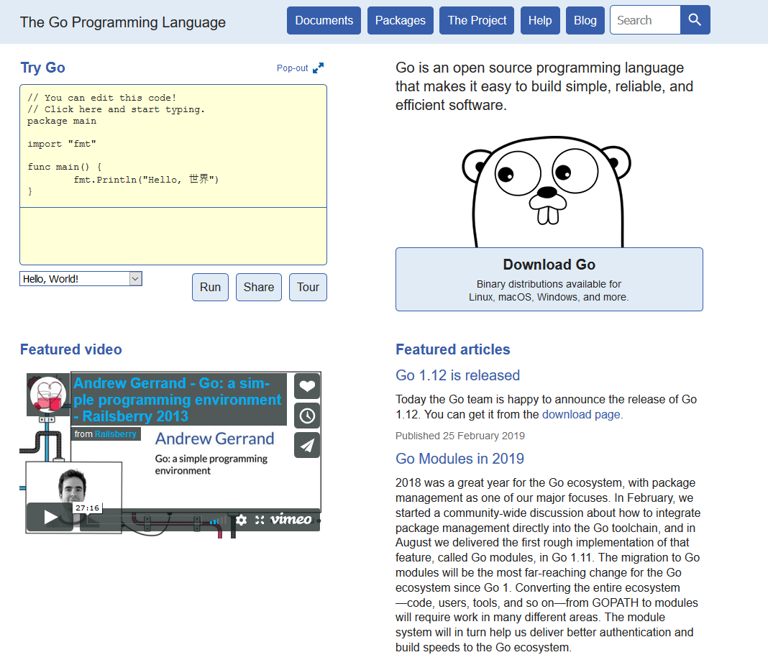

Slide 11
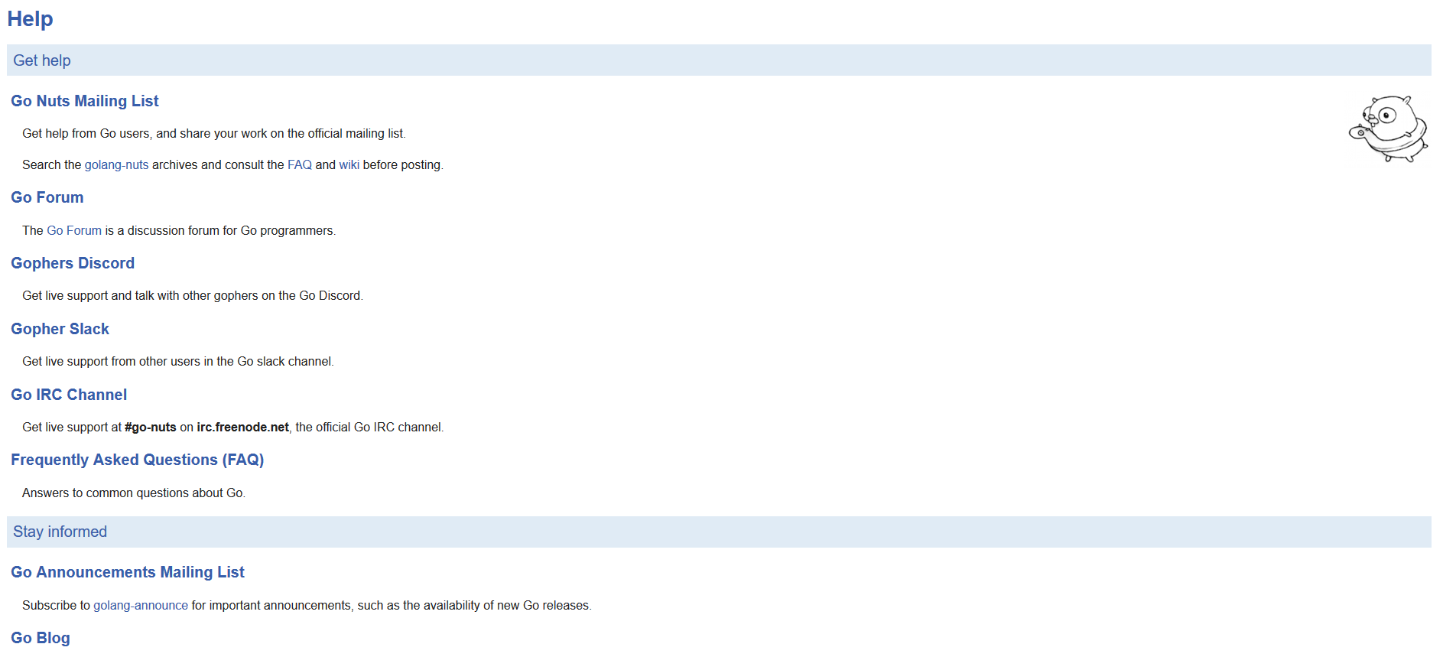

Slide 12
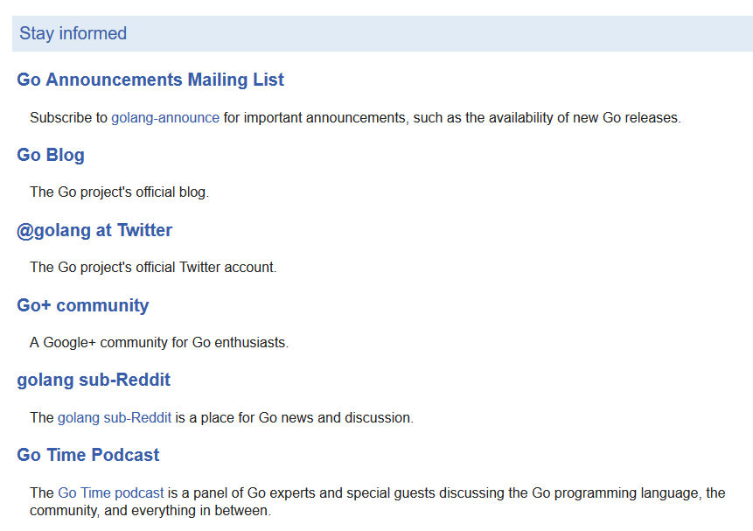
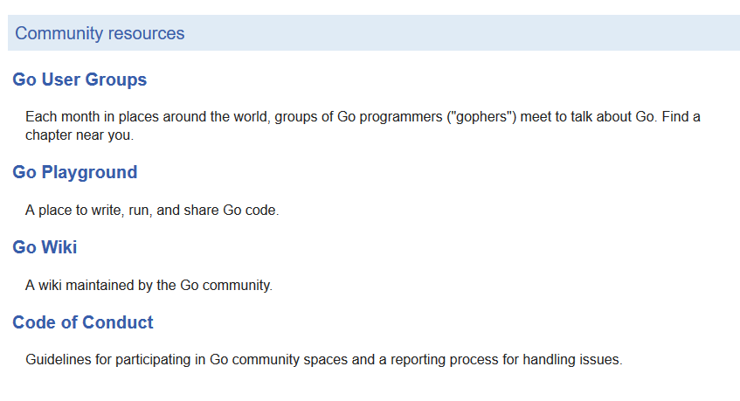

Slide 13
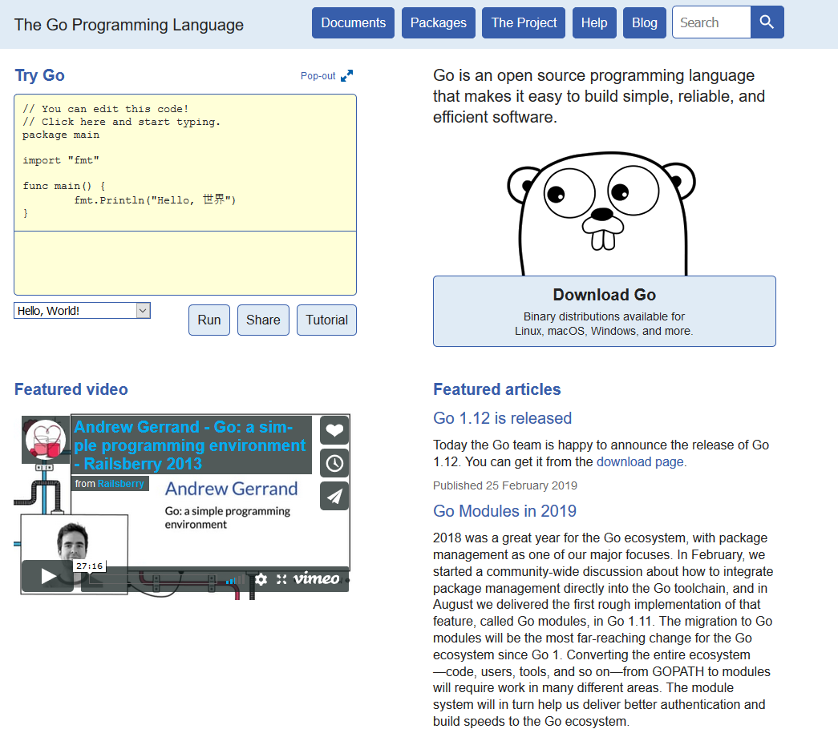

Slide 14
Part 2 Modelling the life of 10 Gophers

Slide 15
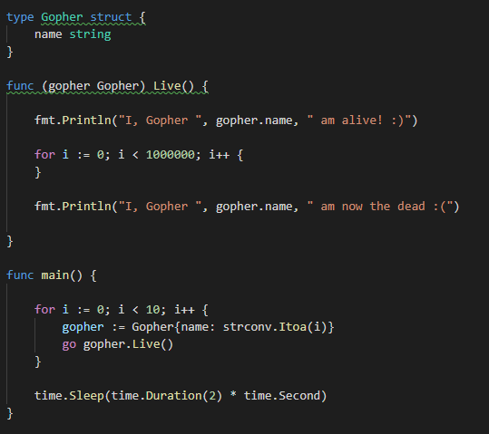
Solution A
Gopher Struct with a ‘Name’ variable
Gopher life represented by ‘Live()’ method

Slide 16
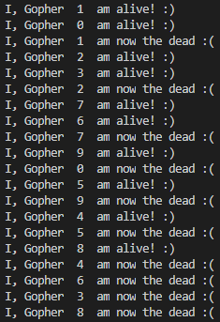
Solution A - Output
Not all Gophers came to life at the same time. Why?
In short, I messed up the basics of concurrency.

Slide 17

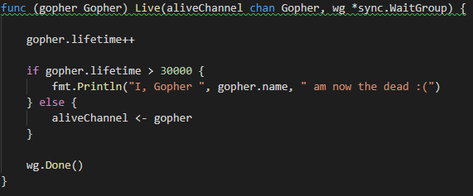
Solution B
Slight tweaks to the Gopher struct and ‘Live’ method
No longer hog the CPU

Slide 18
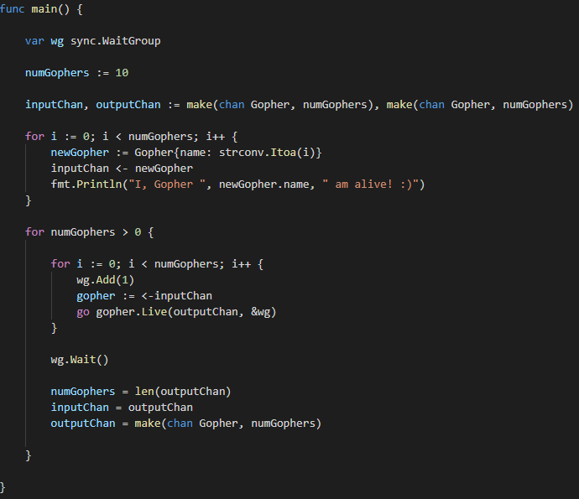
Solution - B
Usage of syncing and channels

Slide 19
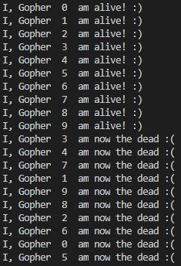
Solution B - Output
Better!
Gophers come to life and reach the afterlife ‘simultaneously’.

Slide 20
Progress Checklist - 2
Watched Rob Pike’s ‘Concurrency is Not Parallelism’ 
https://www.youtube.com/watch?v=cN_DpYBzKso&feature=youtu.be
Re-learnt the fundamentals of Concurrency 
Practiced with Structs, Methods, Goroutines, Channels and Syncing 
Usage of Packages beyond ‘fmt’ 
$GOPATH is a thing. 

Slide 21
Part 3 There’s more to life than this right?

Slide 22
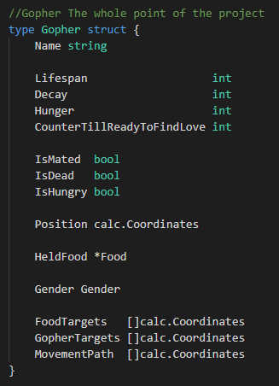
I expanded on what a gopher could do with it’s life

Slide 23
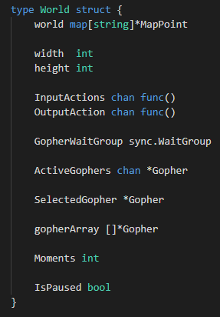

The world is now represented as a 2D map
Each Coordinate can contain a gopher and some food but not multiple of each

Slide 24
Part 3 - Continued
Each world ‘frame’ a gopher would decide what to do.
This would range from moving towards food, eating food it picked up, feeling hungry, or just wandering around because it couldn’t find any food.
This was pretty difficult to see using text so I needed to find a way to visualize what I was doing

Slide 25
Part 3 - Continued
Go fortunately had packages for rendering to html
Here is an example of what the project first looked like:
(This is where you show something on your laptop!)
! – Carrot G - Gopher

Slide 26
Gopherlife (Alpha)
Key: (! = Carrot) (G = Gopher) (/ = Grass)

Slide 27
Gopherlife (Beta)

Slide 28
Performance wasn’t great…

Slide 29
Progress Checklist 3
Project Structure and avoiding Circular Dependencies 
Implementing Basic Pathing Using Coordinates 
Improve understanding of how different structures interact concurrently 
Learnt how to use http/html packages for rendering a webpage 
Learnt how to use http function handlers 
Learnt a bit about css grid (Not go-related) 

Slide 30
Part 4
Optimization!

Slide 31
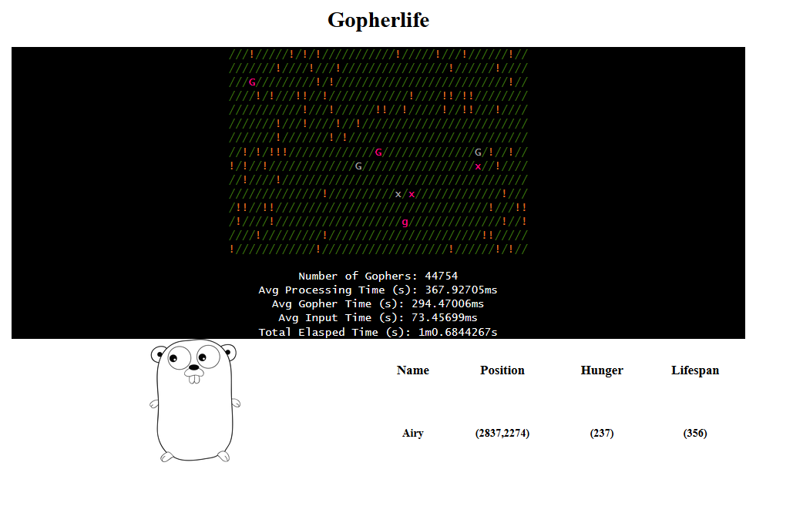
Part 4 - Optimization
At only 4.4754% of my target goal it was taking nearly ½ a second to process a single frame.
Is this just how fast it takes to process things?
Was my goal un-reasonable?

Slide 32
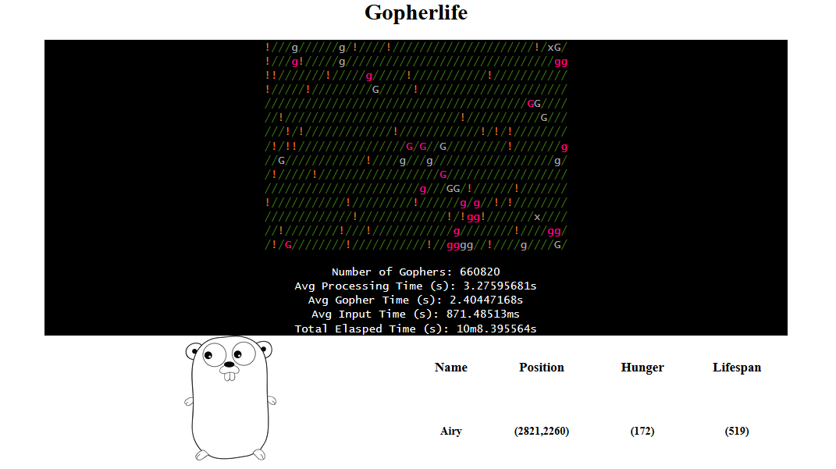
Notes:
Couldn’t quite get to 1 million

Slide 33
Test Parameters
Time how many gophers are generated in a minute and time how long it takes to reach 1 million gophers
Starting Number Of Gophers is 5000
Gopher lifespans are around 500 frames
Gophers can reproduce at 150 frames
Number Of Food on the map is around 1 million
World Size is 3000 x 3000
Hunger per frame is 5
Birth-rate is 7

Slide 34
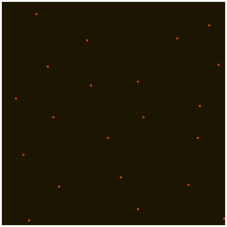
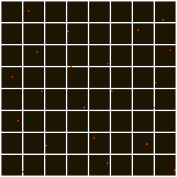
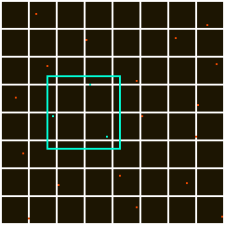
Spatial Partitioning Investigation
Instead of using one giant map and checking each square in a circle, why not split it up into different grids?
Each smaller grid keeps track of the positions of gophers and food inside of it
Searching for food and other gophers should be faster right?

Slide 35

The Results of the investigation
It was less efficient

Slide 36
Discovering Go Benchmark
I wanted to find a way to prove my idea was right and I had simply made a mistake in my code.
If only there was some way to find out how fast methods were taking?
Well, there is. Go Benchmark

Slide 37


Discovering Go Benchmark
Turns out this method was the culprit!
Maps in go work different to how I was used to so I made this method to generate a key from Coordinates.
It was called whenever you needed to access tiles on the world map. Even more so when the map was split into separate grids.

Slide 38
Discovering Go Benchmark
I switched from using my method with a map to a 2-dimensional slice (As the world size never changes)
The speed of map tile access reduced significantly.

Slide 39
The Results of the Benchmark Investigation
It was still less efficient (At higher populations)

Slide 40
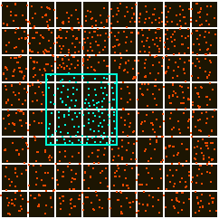
Notes:
However, the solution was much faster at a lower population and only slowed down as the population increased.
(Explain why here, basically, the number of gophers and food pulled in from the grid got too large as the world size is too small)
(Where there is a much smaller population it performs a lot faster than the spiral search method).

Slide 41
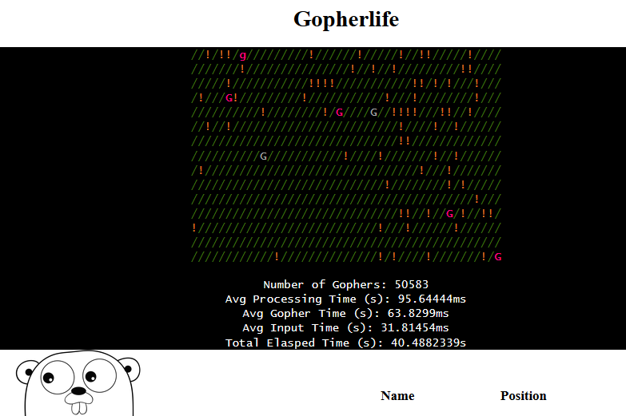
Spiral Search With 2D Slice
(Before)

Slide 42
Going for the million

Slide 43
Problem 4 Checklist
Searching in a 2-D Space in Go 
Spatial Petitioning Methodologies (Grids/Quadtrees) in Go 
Mutexes and More Fundamentals of Concurrency 
Go Benchmarking 
Go Race Detector 
Finding out slices contain pointers to arrays 
Denial is a powerful motivator 

Slide 44
Final Checklist
Can run a basic ‘Hello World’ Go Program on our computer 
Have gained a basic understanding of unfamiliar Go syntax 
Gained a basic understanding of the structure of a .go file 
Watched Rob Pike’s ‘Concurrency is Not Parallelism’ 
Re-learnt the fundamentals of Concurrency 
Practiced with Structs, Methods, Goroutines, Channels and Syncing 
Usage of Packages beyond ‘fmt’ 
$GOPATH is a thing. 
Project Structure and avoiding Circular Dependencies 
Implementing Basic Pathing Using Coordinates 
Improve understanding of how different structures interact concurrently 
Learnt how to use http/html packages for rendering a webpage 
Learnt how to use http function handlers 
Learnt a bit about css grid (Not go-related) 
Searching in a 2-D Space in Go 
Spatial Petitioning Methodologies (Grids/Quadtrees) in Go 
Mutexes and More Fundamentals of Concurrency 
Go Benchmarking 
Go Race Detector 
Finding out slices contain pointers to arrays 
Denial is a powerful motivator 
To Be Continued? 
It is slightly larger than when we first started right?

Slide 45


Slide 46
Go 3 More Months In
Benjamin Bryant

Slide 48
Part 1 The Idea

Slide 49
I was still interested in investigating the performance of spatial partition, but using different parameters
I needed to find a way to easily hop between different versions of Gopherlife
That’s it.

Slide 50
Part 2 Modelling the design of 10 Worlds

Slide 51
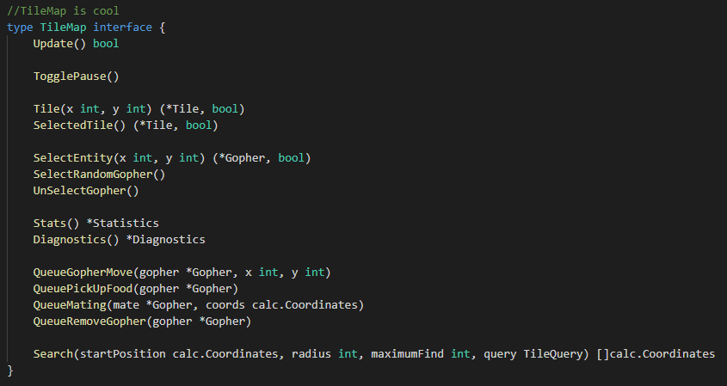
Introduction to Interfaces
Notes:
My First interface.
It is quite large

Slide 52
Part 3 There’s more to Gopherlife than this right?

Slide 53
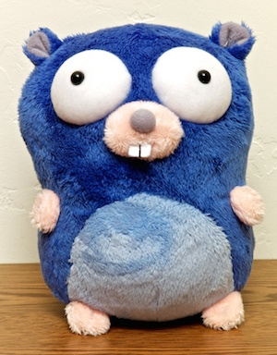
What I like about Go so Far
It helps teach good habits to have as a programmer
In-built tooling makes it easier to test programs and ideas
The community around the language
The mascot is kinda cute

Slide 54
Thank you for listening to my talk

Slide 55
Everything below this slide is not part of the presentation

Slide 56
Checklist of Mistakes
Concurrency is not parallelism 
You can read from maps concurrently, but you can not write to maps.
Importance of structure to avoid circular dependencies and for ease of readability 
By saving your files where the GOPATH is you can access local packages without using relative paths.

Slide 57
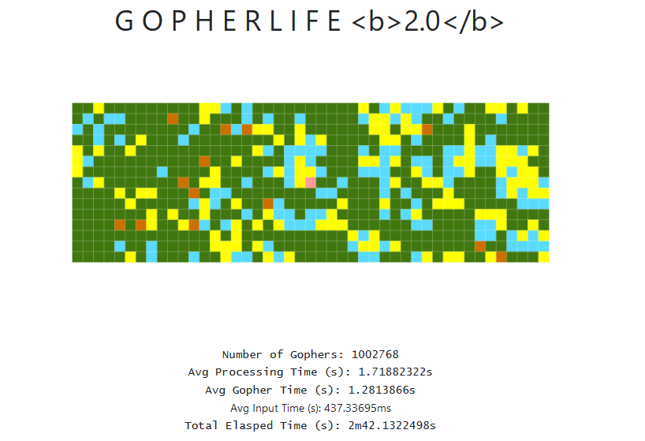

Slide 58
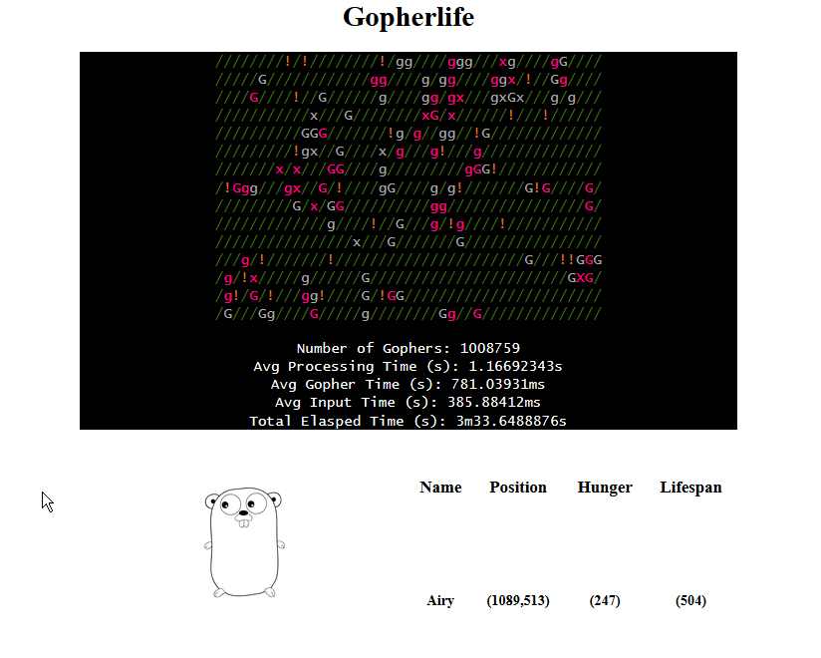
After The Spiral Change

Slide 59
