Slide 1
SCC GAME SPACE INVADERS
BRYAN TYRRELL - 15441012

Slide 2
Game Chosen:
“You are a space ship who must destroy the invading enemy space ships as they descend upon your little 8-bit world.”[1]
The alien spaceships will move horizontally across the screen until they reach the edge/wall where they will descend 1 row and move back across the screen
The goal is to shoot all the alien invaders before the reach your spaceship
A link to this game will be supplied in the references section

Slide 3
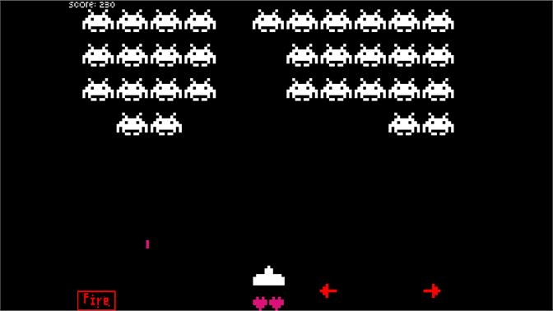
Game Chosen:
Score for each alien hit
Rows of aliens which move side to side
Each time the aliens hit the wall they will drop down a row
The ability to move the spaceship left and right
A spaceship that can fire bullets

Slide 4
Game goals for this project:
For this project below is a list of goals I implemented:
The player can select how many aliens they want in the two rows at the start of the game, the choices are 4, 5 or 6 aliens 6 aliens, with 6 being the hardest and 4 being the easiest.
A spaceship that can move left and right but not through the walls.
The spaceship can fire bullets
The aliens shift right and left across the screen
Each time the aliens hit a wall either the left side or right side, they drop down a level/row
A score count keeps track of the number of aliens hit on the seven segment display
Each time 3 aliens are killed the alien speed increases(shorter interrupt) making the game harder
If the aliens reach the spaceship row the game will end and the 7 segment display will show FFFF to show the player lost
If the player kills all the aliens the 7 segment display will show AAA on it to show the player won.

Slide 5
Assumptions:
The aliens start at the top of the screen 1Fh
The user can fire 1 bullet at a time
The spaceship can move right or left but not up and down
The shoot bit(up toggle) will stay high once the player shoots the first bullet

Slide 6
Register and memory address uses:
Register | Use | Memory Address | Use
R2 | Used to store a reference to the bottom row of the aliens in memory | Ch upto 1Fh | Memory array for game
R3 | Individual bits are used as flags within the game to tell the system certain actions have occurred | 20h | Used to store bullet row address
R0,R1,R4,R5,R6,R7 | Used throughout the program for various purposes | 21h | Used to store the position of the bullet in the row e.g index 5

Slide 7
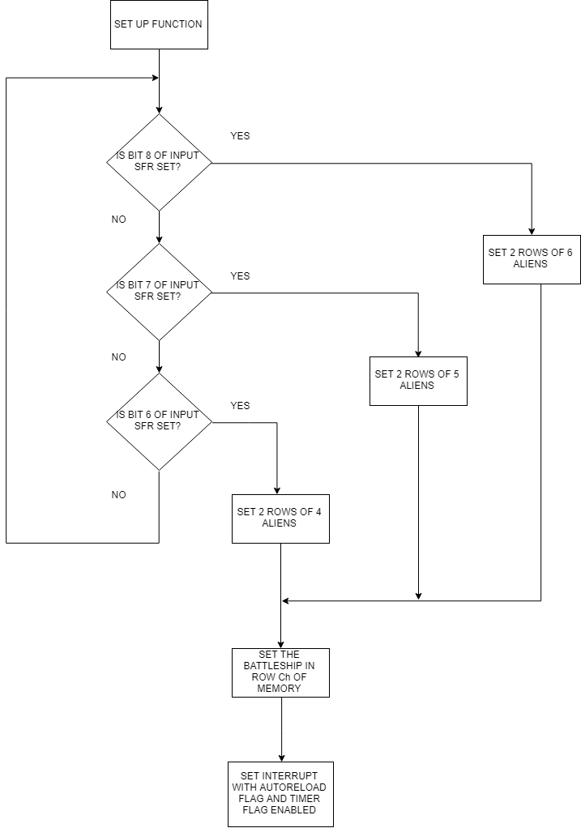
Detailed flowcharts:
Set Up Loop:
This is a loop that waits from input from SFR12(inPort)
Once it receives the input it will either set 2 rows of 4, 5 or 6 aliens
This part sets the spaceship at index 8 in row Ch of memory
Then the interrupt timer will be set up with an auto reload flag enabled

Slide 8
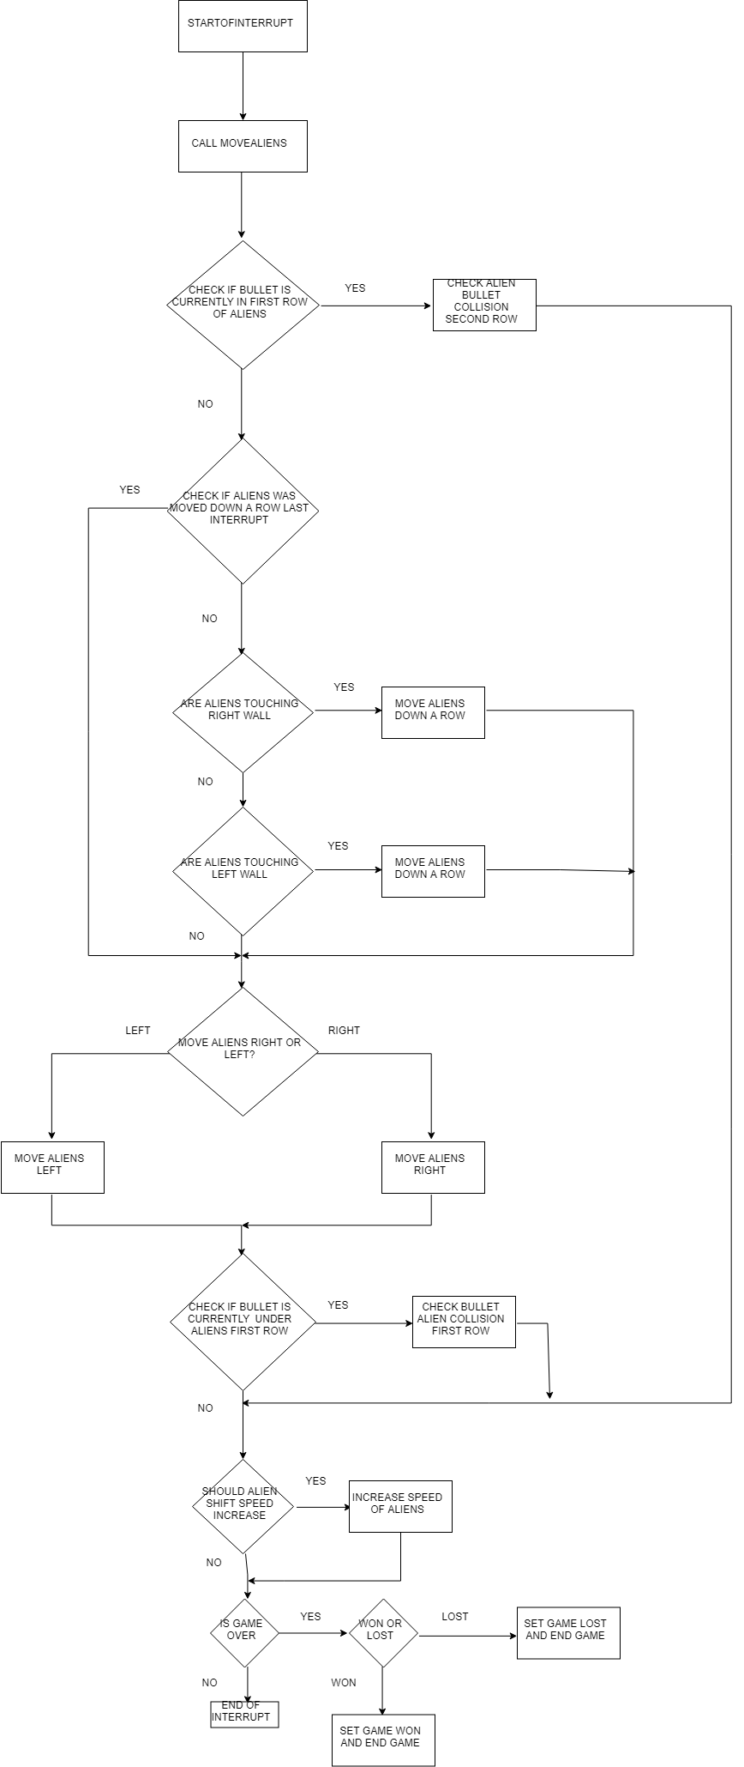
If the above statement is true then the bullet will be taken out of the first row of aliens and checked to see if a collision has occurred in the second roe
This is run after then aliens have been moved and check if the bullet is under or on the same row as the aliens
If the aliens were moved down a row last interrupt cycle then skip to the move label in code
This section checks if the interrupt timer should be shortened/quicker aliens
This part will check if the bullet that was fired is currently in the first row
And finally check if the game is finished/won/lost
Interrupt loop:
This will also set a row moved down flag
1
Check if collision occurred on first row

Slide 9
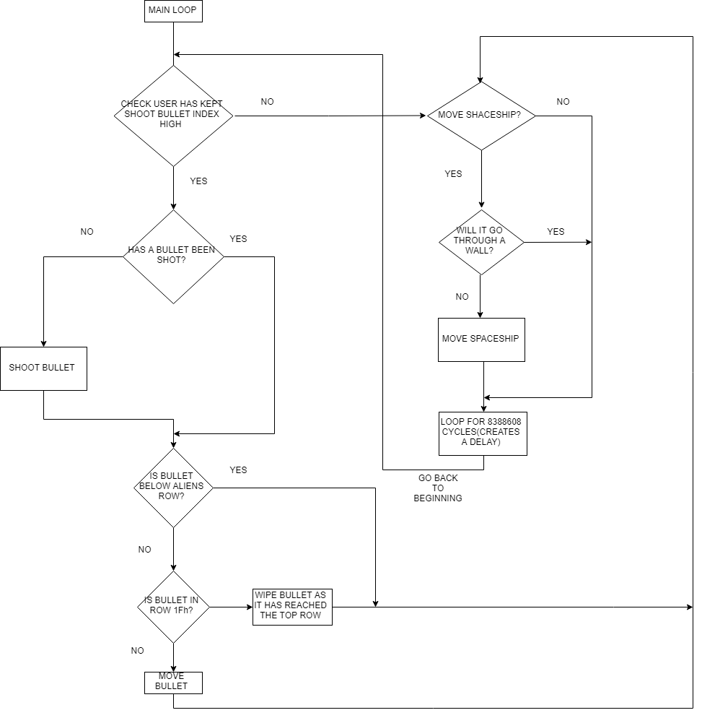
Main loop/Bullet move + spaceship move:
This section handles the spaceship move left and right
This checks SFR12 to check if up toggle high
This statement checks if either left toggle or right toggle in SFR12 asserted high
2
Check if the bullet fired flag in R3 is set to high
This checks if moving the spaceship the desired direction will move it through a wall
This will shoot a bullet on screen from the spaceship
If the above statement is false then the spaceship will move
Check is the fired bullet below the aliens row (this means a collision is imminent and should be handled by the interrupt)
This section will create a delay of 8 million clock cycles 8/25= .32 of a second roughly for paddle move and bullet move
This means the bullet is in the top row in memory 1F and should be wiped
Move the bullet
Back to the beginning

Slide 10
Detailed explanation of register 3 use:
Register 3 is used as a bit flag register with certain bits being used to signal that actions have been carried out by other sections of the system
To check if a bit flag is asserted within R3 set a single bit at the desired index and AND the two registers if the result is 1(not zero) then flag is set else the result is 0 and the flag is not set
R3 | INDEX | 15 | 14 | 13 | 12 | 11 | 10 | 9 | 8 | 7 | 6 | 5 | 4 | 3 | 2 | 1 | 0
Index 12 is set and cleared within interrupt call to tell the system that row two has been checked for bullet collision and not to check row one of the aliens
Index 5 is used as the bullet fired flag and is set high when a bullet is fired, it will be cleared when the bullet collides with an alien or the bullet reaches row 1F
Index 2 is used to tell the interrupt system that the aliens have been moved down a row last interrupt cycle and to not move them down a row again instead jump straight to move aliens left or right
Index 0 is used to the interrupt loop to state which direction the aliens are moving on screen
0= shift aliens right
1= shift aliens left
Index 7 is used to tell the interrupt system that row one currently has a bullet in it that has not collided with an alien in its row

Slide 11
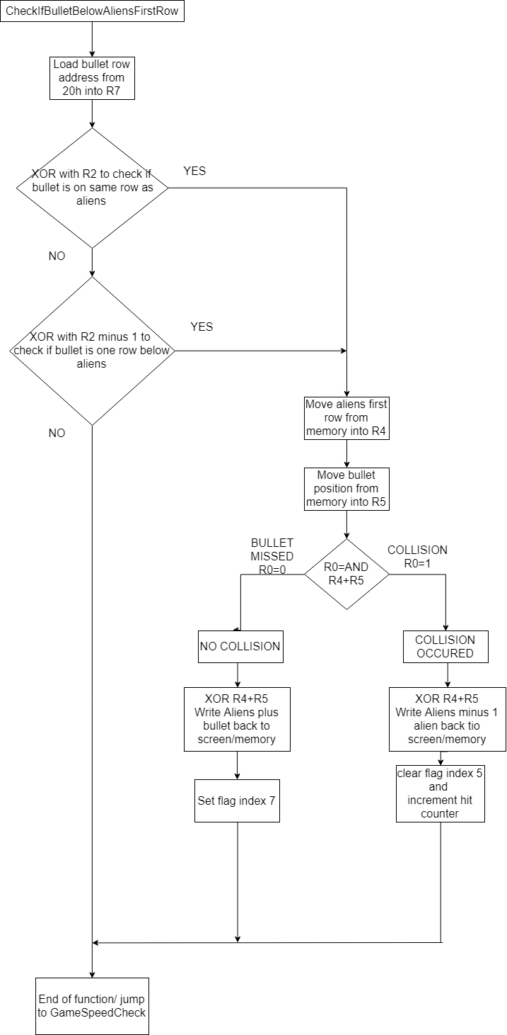
Function specific flowcharts:
It should be noted if flag 12 is set in R3 this function will never be run as a second row bullet check has occured
1. Check If collision occurred on first row of aliens:
These two diamonds check if the bullet row is on the same row as the aliens or one row below the aliens this means that a collision check will occur and needs to be handled
Aliens bottom row moved into R4
Bullet bottom row moved into R5
A collision is checked
Index 5 flag wiped as bullet/alien collision has occurred
Counter incremented
Index 7 flag set to tell the next interrupt cycle bullet is in first row

Slide 12
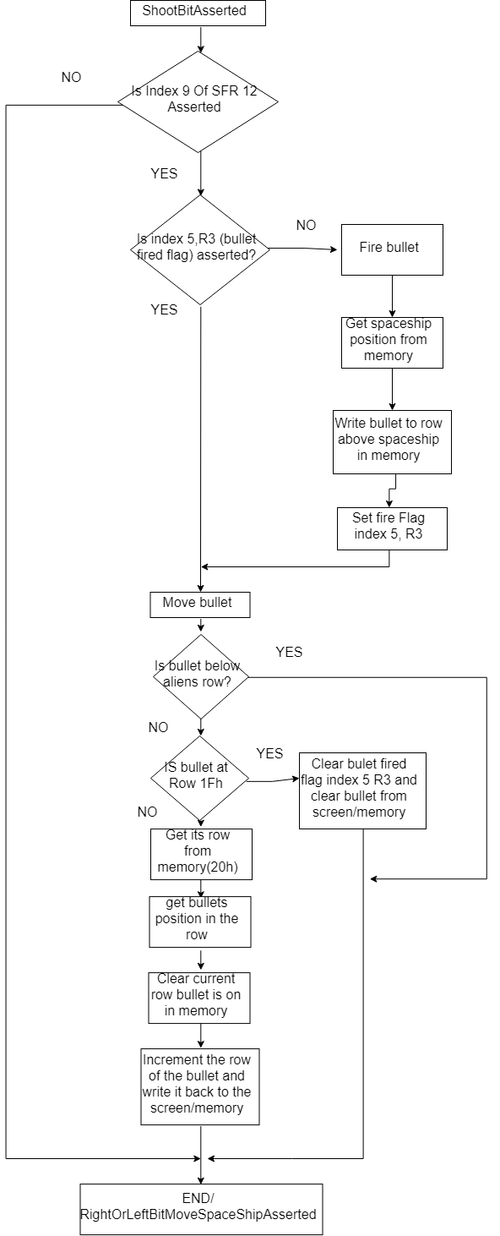
2. Check If bullet should be moved/fired:
Checks if up toggle/fire button asserted
If the fire bullet fired flag is not set the function will fire a bullet
Gets current position on screen of spaceship and fires a bullet in the row above the spaceship
Checks if bullet fired flag index 5 of R3 is asserted this tells the system if there is currently a bullet on sceen/ in memory
It will set the fire flag once the bullet is fired
Checks if the bullet row is below the alien row this means a collision check needs to be handled by the interrupt and not to move the bullet
Check has bullet reached the top of the screen

Slide 13
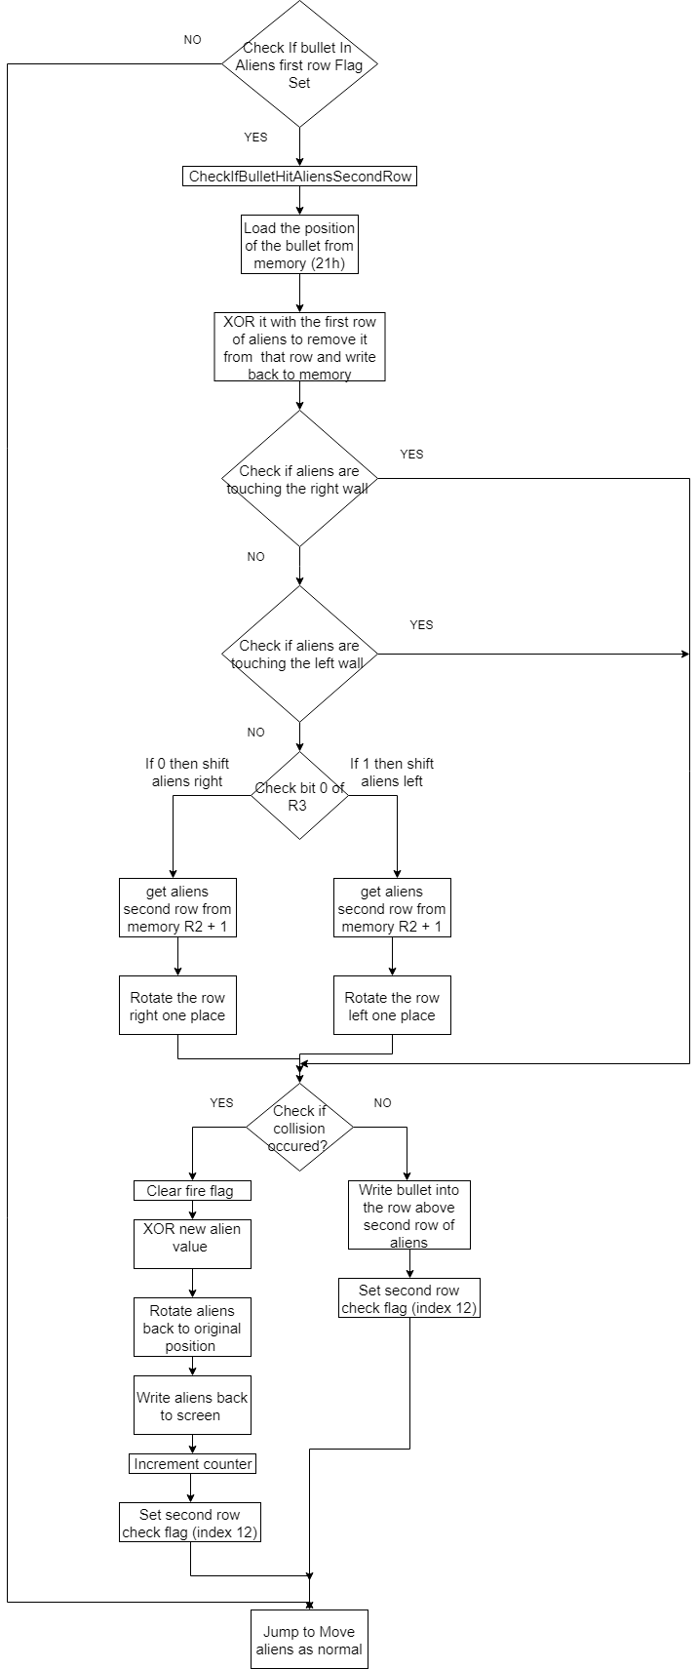
The final part is important: the interrupt will carry out move aliens like usual but it will not check if a bullet is below or on the first row as index 12 flag is set
Else the second row of aliens will need to be shifted one place and then check if a collision has occurred with the bullet that travelled in a straight line upwards
If a collision occurred the new value of the aliens is shifted back to its original position and written back to memory
These two diamonds check if the aliens are due to shift down one level if they are true then there is no need to rotate the rows right or left one place
This checks if the bullet is currently in the first row of aliens
This section wipes the bullet from the first row
3. Check If bullet collided with second row of aliens:
This writes the bullet into the row above the aliens because it didn’t collide

Slide 14
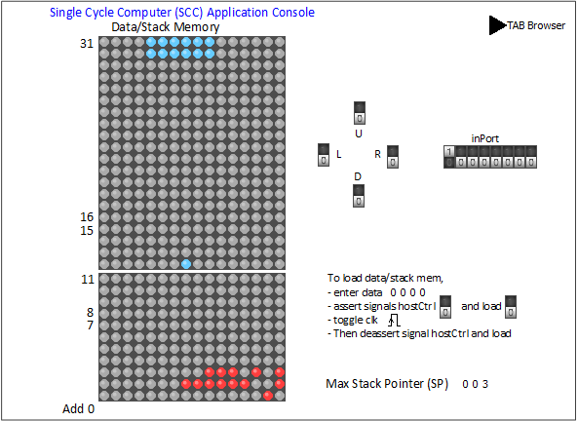
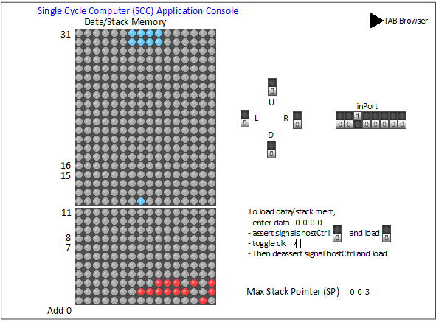

Game Screenshots:
Set Up:
This section shows how the player can choose how many aliens they want in the two rows, the choices are 6,5 and 4 aliens with the most significant bit toggle equal to 6 aliens
6 alien set Up
2 rows of 4 aliens show on the screen
The third bit is toggled
5 alien set Up
4 alien set Up

Slide 15


Aliens moving and bullet firing:
The up toggle/fire toggle is asserted and the bullet has been fired and can be seen on screen
In this instance the bullet has missed and it can be seen in the first row beside the aliens
The aliens have moved across the screen and dropped down a row

Slide 16

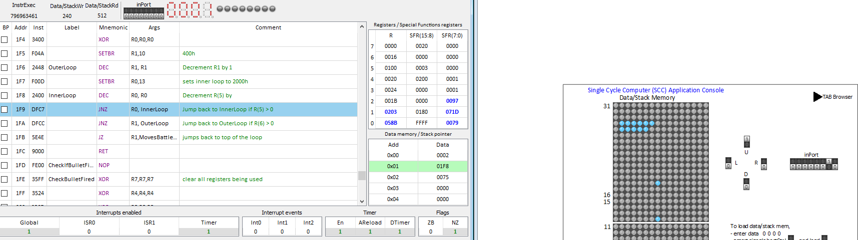
Bullet colliding with aliens:
The second bullet is on course to hit the aliens
Since aliens shift and the bullet travels in a straight line the bullet will kill the bottom right corner alien in the row
The counter has incremented by 1 since one alien has been hit
The alien has been hit an wiped in this screenshot

Slide 17
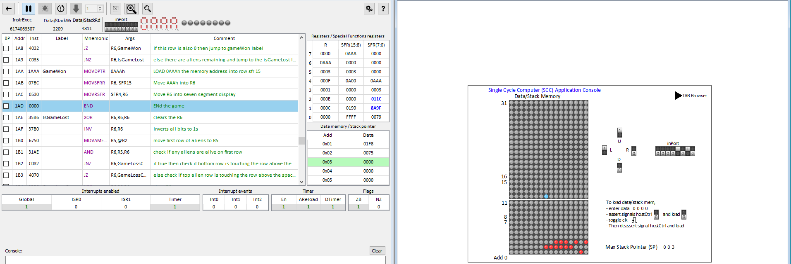
Win condition:
AAA is displayed to the player to show them they have won the game
All aliens have been destroyed on screen

Slide 18
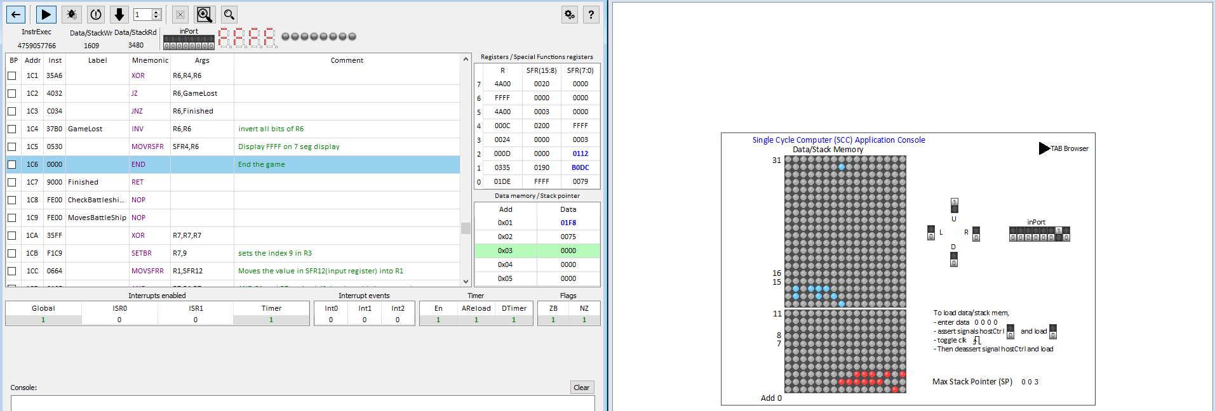
Lose condition:
The aliens have reached the row above the player which signals the player has lost
The player has lost and FFFF is shown on the score counter

Slide 19
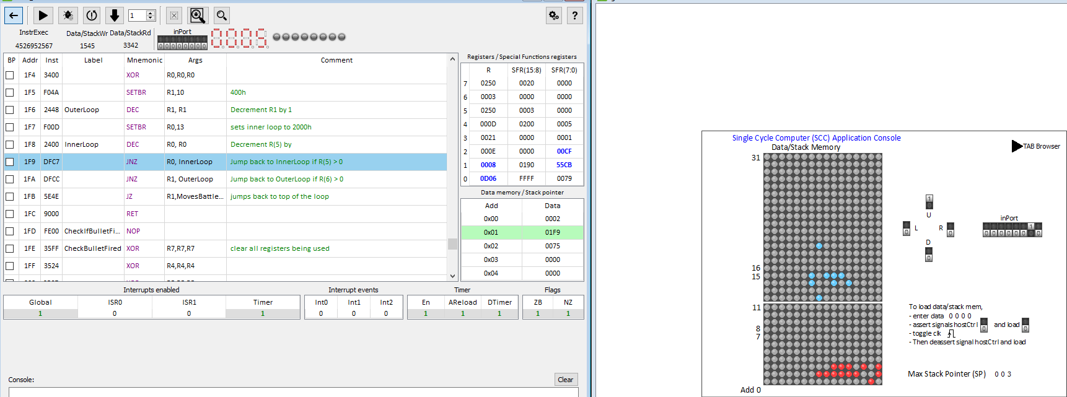
Lose condition:
As can be seen below the player is not very good at space invaders, they have killed 5 aliens and 7 are left on screen if the aliens drop to the next row then the player loses as can be seen on the next slide
Bullet has missed the aliens and is continuing on
5 aliens shot
Two alien rows left/ 7 aliens left

Slide 20
Known issues with the game:
The up bit must be toggled, if it down toggles the bullet will freeze on screen

Slide 21
References:
Link to space invaders game: http://www.pacxon4u.com/space-invaders/
[1]

