Slide 1

Hannes Tschofenig
IETF OAuth WG Co-Chair
<hannes.tschofenig@gmx.net>

Slide 2
Acknowledgments
Some content adapted from “Why you should care about OAuth2” by Justin Richer, The MITRE Corporation, jricher@mitre.org

Slide 3
What is OAuth?

Slide 4
OAuth
Is an Open Authorization protocol
Built for delegated access
For secure data sharing
Lots of implementations available
Widely deployed across the Internet
Has gotten a lot of press attention recently
Triggered by unhappy document editor.

Slide 5
The Problem: Secure Data Sharing

Slide 6
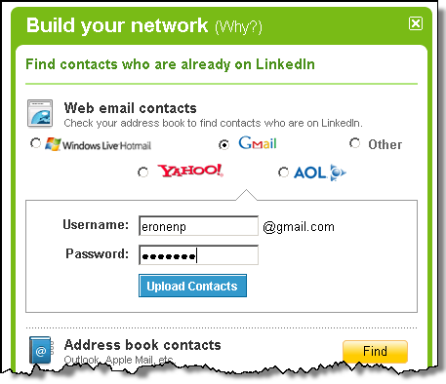

Slide 7
Example OAuth Exchange

Slide 8
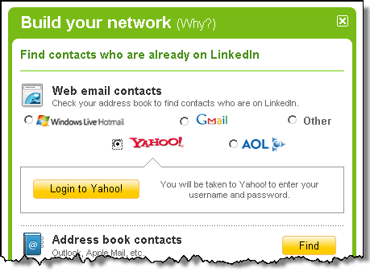
User navigates to Client

Slide 9
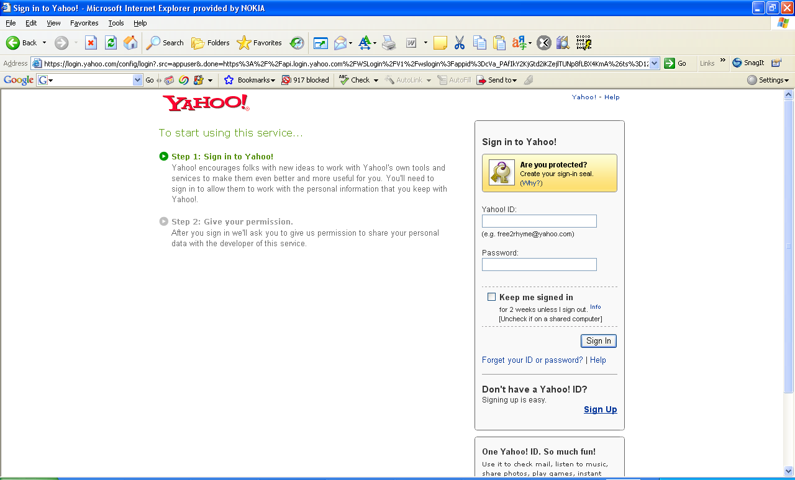
User authenticated by Authorization Server

Slide 10
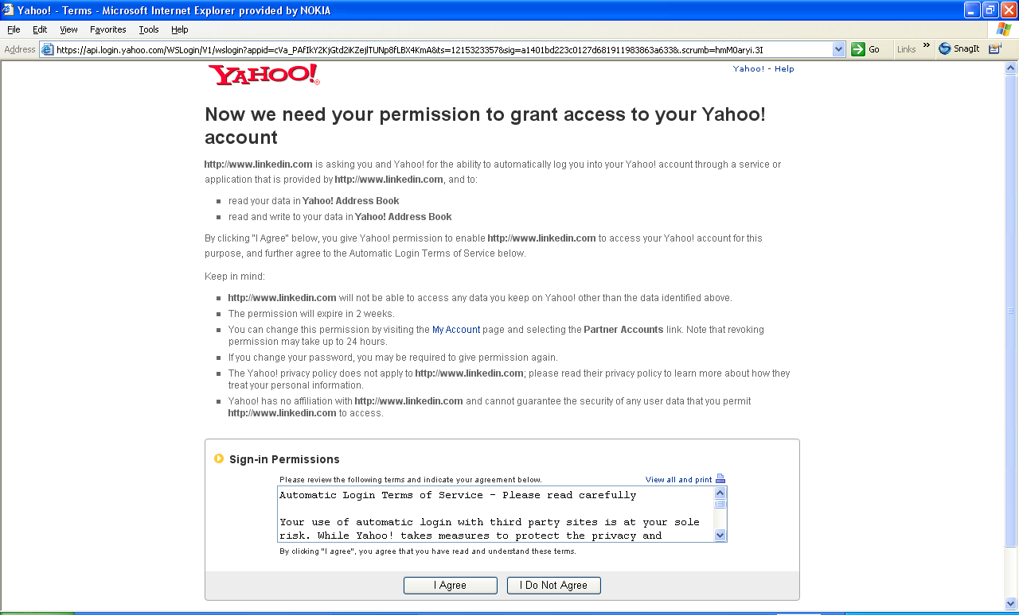
User authorizes Client to access Protected Resource @ Resource Server

Slide 11
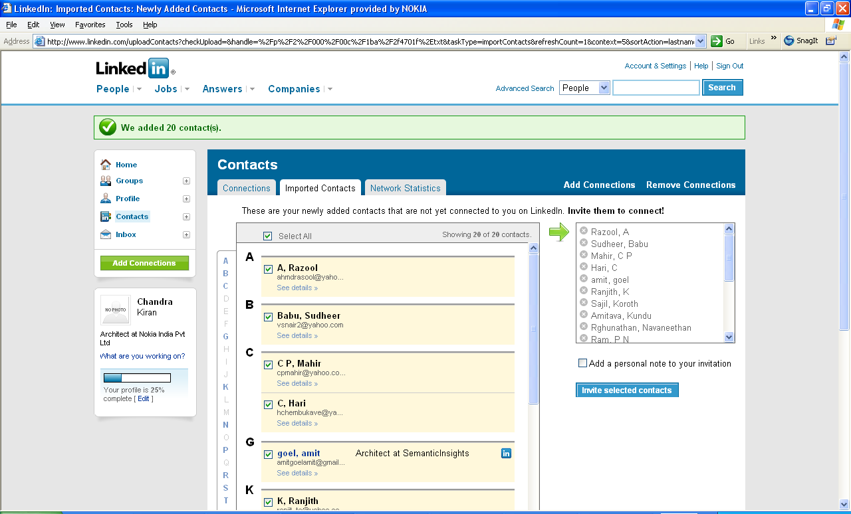
Client calls the Resource Server API

Slide 12

Entities
User Agent
(Web Browser)
Authorization
Request
User
Client
(LinkedIn)
Access Token Request
Authorization
Server (Yahoo)
Resource Server
(Yahoo)
Resource Request
(incl. Access Token)

Slide 13
Key Points
User’s long-term credentials are never transferred between servers
User consent / authorization phase built into the protocol
Works across domains
Main use case: HTTP-based applications; but
Integration to SASL/GSS-API exists: http://tools.ietf.org/html/draft-ietf-kitten-sasl-oauth-06
Allows support for many other protocols (e.g., XMPP,
Integration to XMPP available as well:http://xmpp.org/extensions/xep-0235.html
Unfortunately fairly insecure; luckily not widely used and if then in a different way.

Slide 14
OAuth 1.0 & OAuth 1.0a
Some history

Slide 15




The Beginning
November 2006
Twitter, Ma.gnol.ia, and others want to use OpenID to connect between services
OpenID Can’t close the bottom of the triangle
?

Slide 16
State of the Practice
Others had tried to solve this problem
FlickrAuth (Flicker)
AuthSub (Google)
BBAuth (Yahoo)
Tokens replace long-term credentials
Explicit user consent
Focus on inter-domain usage

Slide 17

IETF Standardization
Take the best practices and experience from existing solutions together into one protocol
OAuth 1.0 was the community specification.
Revision had to be released soon afterwards because of a severe vulnerability
1.0a closed session fixation attack
RFC 5849
New terminology
More security considerations
Changes regarding security (e.g., TLS usage)
Lots of code available
In any language you can think of
Not necessarily interoperable.

Slide 18
OAuth 2.0
OAuth 2.0 is not wire-compatible with OAuth 1.0

Slide 19
RFC 5849 vs. Community Specification
Deploying first and then standardizing is a nice idea
But it has also some challenges.
OAuth means different things to different people.
Lots of specifications, extensions, implementation and ideas were flying around.
Everyone was using parts of the OAuth specification (in some form) for their application use case and called it OAuth as well.
This is like say “My application uses XML and therefore it is a standard as well.”
Community specification was heavily driven by “it has to be deployable right NOW” mentality.
Lots of compromises regarding security.
RFC 5849 standardized on two aspects:
Definition of access to protected resource with new authentication protocol
Obtaining user authorization for a Web-based redirect mechanism.

Slide 20
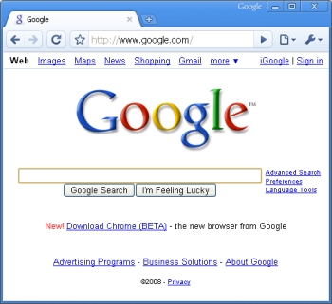

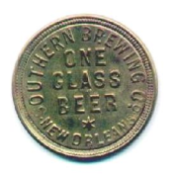
OAuth 1 Concepts
Request Token
(Lets client ask for access tokens)
User
(Owns stuff)
User Agent
(Web browser)
Access Token
(Lets client get stuff)
Client/Consumer
(Wants stuff)
Server/Provider
(Has stuff)

Slide 21
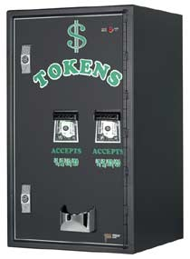
OAuth 2 Concepts
Refresh Token
(Lets client ask for access tokens without bugging the user again)
User
(Owns stuff)
User Agent
(Web browser)
Access Token
(Lets client get stuff)
Client
(Wants stuff)
Protected Resource
(Has stuff)
Authorization Server
(Issues tokens)

Slide 22
New to OAuth 2.0
Clear separation of protocol interaction:
Obtain User’s Authorization
Obtain Access Token
Access protected resource
Separation between Authorization Server and Resource Server
Security mechanisms
Bearer tokens over TLS
Client authentication: custom mechanism + HTTP-based auth.
Additional security mechanisms specified (token security, SAML interaction, etc.)
Authorization Explicit
What is this token good for? → Scope
How long is the token valid? → Lifetime

Slide 23
Also New to OAuth 2.0
Various ways to obtain user authorization specified
Introduced refresh tokens to allow usage of shorter access tokens
Allows for easy rotation of access tokens
Extensibility and error handling specified
Extensive security description and guidance
Internationalization support incorporated
Extensive IETF reviews to clarify language and to fix bugs

Slide 24
Making OAuth2

Slide 25
Timeline of OAuth2
MAC Token
OAuth 1.0
OAuth 1.0a
RFC 5849
OAuth2 Core
OAuth2
2010
2011
2007
2009
2010
Bearer Token
OAuth WRAP
JWT, JWS
OpenID Connect
SWD
Dynamic Registration
UMA
SAML Binding
…
2009

Slide 26
Current Draft Status
Core specification
http://datatracker.ietf.org/doc/draft-ietf-oauth-v2/
In RFC Editor Queue
Bearer Token
In RFC Editor Queue
http://datatracker.ietf.org/doc/draft-ietf-oauth-v2-bearer/
IETF URN Sub-Namespace for OAuth
In RFC Editor Queue
http://datatracker.ietf.org/doc/draft-ietf-oauth-urn-sub-ns/
Threat Model and Security Considerations
In IESG Evaluation
http://datatracker.ietf.org/doc/draft-ietf-oauth-v2-threatmodel/
Various other WG documents work in progress.
Related work in JOSE working group

Slide 27
OAuth 2 Protocol Flows

Slide 28
OAuth2 Endpoints
Endpoints are URIs for HTTP communication.
Token endpoint
Where authorization server issues access tokens
Authorization endpoint
Where the client sends the resource owner to authorize the token request
Extensions can define new endpoints
e.g., Revocation endpoint

Slide 29
Authorization Code Grant
Offers widest range of security features
Allows refresh tokens to be used
Best path for web-server-based clients and for good for native clients
Authorization server issues a one-time-use authorization code through the user agent to the client
Makes use of back-channel
Client trades authorization code for an access token

Slide 30
Refresh Tokens
Can be issued alongside of access tokens
Allow for rotation of access tokens without asking the user for consent again
Can have different expirations
Refresh token: long grant, saved by client between sessions
Access token: short grant, deleted at end of session
Can have different scopes
New access tokens must have equal or lesser scope

Slide 31
Implicit Grant
Best path for clients implemented in a browser using JavaScript
Client gets the access token directly
Without having to deal with authorization code.
Can’t use refresh tokens
No good place to store them (yet)
Should use short-lived access tokens

Slide 32
Resource Owner Password Credentials Grant
Bootstrap old password-based systems
Until they disappear
Client prompts user for username and password
Client presents those directly to token endpoint
User authorization is implied through provision of username and password
Long-term credential is discarded after access token is obtained.

Slide 33
Client Credentials Grant
Covers the case where the client and the resource owner are the same entity.
Client authorizes a transaction directly
Not on behalf of a particular user

Slide 34
Off the Web
Native clients with OAuth

Slide 35
Native Clients
Many implementations rely on browsers for user authentication
There is no good authentication framework in the Web.
Easy integration with existing deployments
Browser can be embedded in application or external application
Must support callback of some kind. Examples:
Embedded web server (http://localhost/)
Custom URI scheme (app://oauth)
Clients don’t have to store sensitive user credentials (passwords)
Clients never even have to see the password!
Misbehaving clients can be revoked by users
Works with systems that don’t use passwords

Slide 36
User Consent, Privacy, and Trust Frameworks

Slide 37
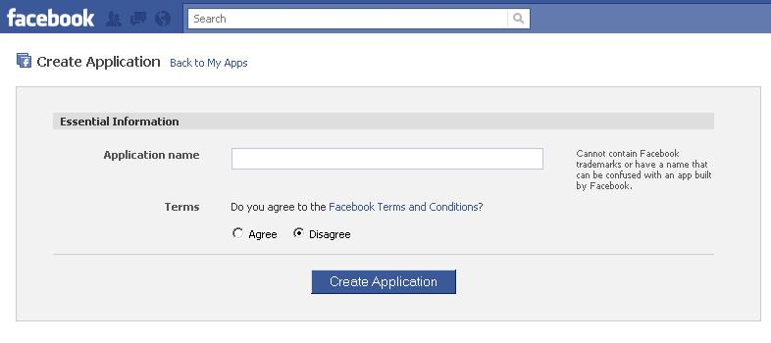
Facebook Prior-Registration Example
In many cases you cannot just deploy OAuth between two sides without going through a client registration step.
Consequence: Using OAuth on two random web sites does not work (today)
Not a technology limitation but a deployment choice!
Next, we need to go through the Facebook registration pages to obtain application credentials.
Facebook also requires additional information from “application developer”, such as mobile phone number and credit card information.

Slide 38
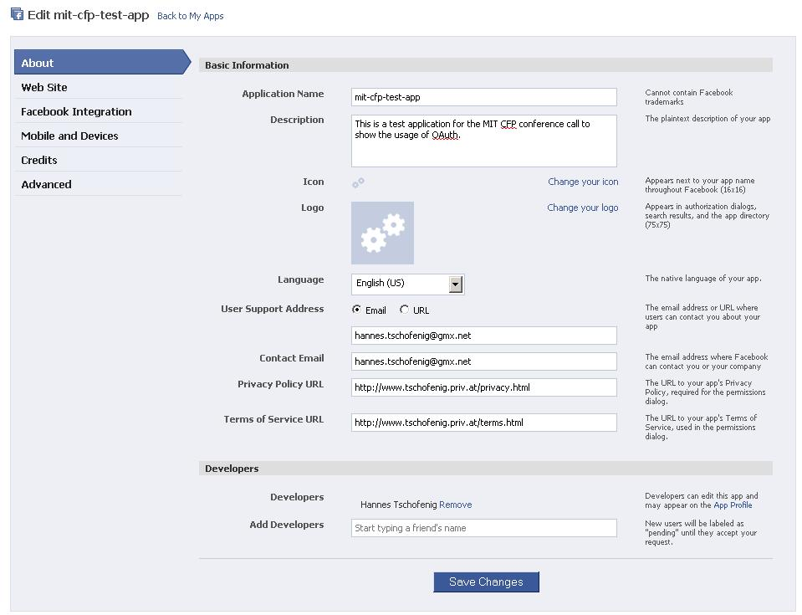

Slide 39
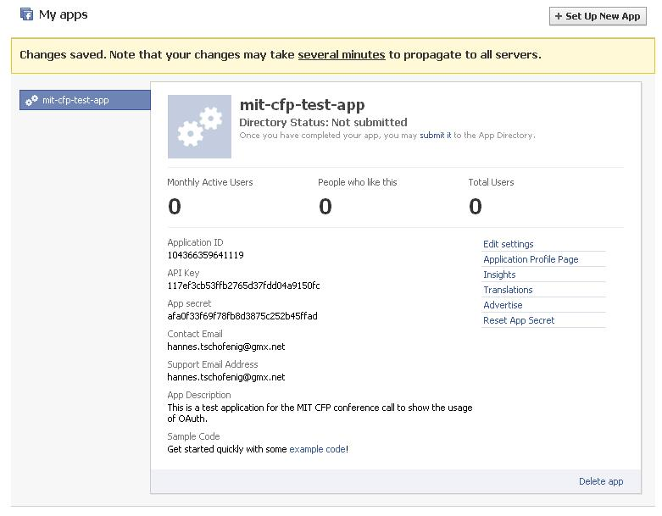
Obtaining the client id & key

Slide 40
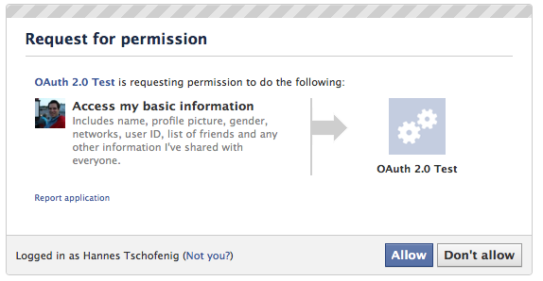
Authorization Example, Facebook

Slide 41
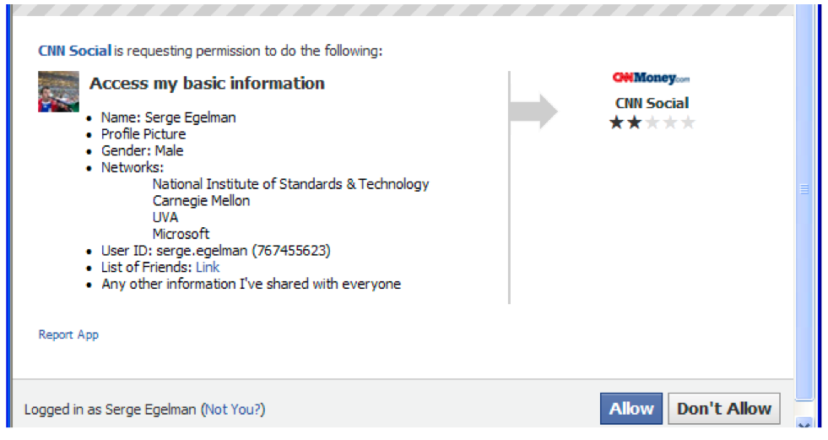
Authorization Example: Theoretical

Slide 42
Trust Layers
Whitelist
Trusted partners, business contracts, customer organizations, trust frameworks
Graylist
User-based authorization decisions
keep logs
Organizations decide these
End-users decide these
Blacklist
Very bad sites we don’t
want to deal with, ever

Slide 43
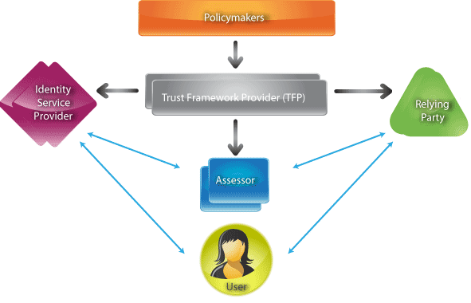
Trust Frameworks
Also known as Circle of Trust, Federations, etc.
Rules (technical, business, and legal rules) for interaction between Relying Party and Identity Provider
Example: OIX http://openidentityexchange.org/

Slide 44
Where OAuth 2 is Going

Slide 45
Deployment
Basis for many APIs: Examples
Google+ API
Facebook Graph API
SalesForce Force.com API
37Signals API
Lots of library implementations
Spring Security OAuth (Java Spring)
Apache Amber (Java)
iOS
Ruby
Python
JavaScript

Slide 46
OpenID Connect
Identity system built on top of OAuth 2.0
Adds provisions for:
Sharing of authentication information
Discovery
Dynamic registration
Session management
Takes advantage of JSON based security mechanisms.
JWT, JWS, JWE, SWD
Work done in the Open Identity Foundation: http://openid.net/connect/
A number of implementations available and interoperability events happening on a regular basis.

Slide 47
User Managed Access (UMA)
Developed in the Kantara Initiative
http://kantarainitiative.org/confluence/display/uma/Home
Idea: Give users full control over authorization process
Provides dynamic registration of client to Authorization Server
Allows outsourcing of Authorization Server to be operated by party trusted by user.
UMA work introduced to IETF:
http://datatracker.ietf.org/doc/draft-ietf-oauth-dyn-reg/

Slide 48
OAuth 2 and SAML
Goal: Leverage existing deployment of SAML and let it interwork with OAuth.
Useful for many enterprise and b2b deployments.
Assertion Framework:
http://datatracker.ietf.org/doc/draft-ietf-oauth-assertions/
SAML Assertion Profile:
http://datatracker.ietf.org/doc/draft-ietf-oauth-saml2-bearer/

Slide 49
OAuth and Additional Security
Bearer Token provides the baseline solution for access to protected resource.
Security threats and guidance is provided in great detail in
http://datatracker.ietf.org/doc/draft-ietf-oauth-v2-threatmodel/
Work on improved security mechanism is work in progress
Requirements gathering in progress:
http://datatracker.ietf.org/doc/draft-tschofenig-oauth-security/
Various mechanisms proposed, such as MAC token
http://tools.ietf.org/html/draft-ietf-oauth-v2-http-mac

Slide 50
Conclusion
It solves a real problem: long term credential sharing
Many industry players deploy OAuth 2.0 today.
Standardization activities are still ongoing.
To extend security functionality
To provide WebSSO functionality
To take new developments into consideration
Getting feedback regarding security from NIST would be highly appreciated.

