Slide 1
Drown Attack
Stephen O’Kennedy
15305690
Acknowledgements to Aviram et al.[3]

Slide 2

What is DROWN
Decrypting RSA using Obsolete and Weakened eNcryption
Cross Protocol Attack
Allows for the decryption of intercepted TLS connections
Can be used to perform
A man in the middle attack
Eavesdropping
Only focuses on a single session
Affects 33% of all servers, prior to publication of report

Slide 3
How it works
Uses a variant of the Bleichenbacher padding Oracle attack
Creates specially crafted connections to an SSLv2 server using the same private key
Exploits SSLv2 flaws and OpenSSL bugs

Slide 4
Bleichenbacher’s attack
Exploits the fact that RSA ciphertexts should decrypt to plaintexts compliant with the PKCS#1 v1.5 padding format
If an RSA decrypts to an invalid PKCS#1 v1.5 message, it might naturally leak this via
Error message
Closing the connection
Taking longer to process the error condition
Leaked information about the plaintext that can be modelled as a cryptographic oracle for the decryption process

Slide 5
OpenSSL Bug
SSLv2 Has been removed from OpenSSL v1.1.0+
OpenSSL servers do not respect the cipher suites advertised in the ServerHello message
Client can select an arbitrary cipher suite in the ClientMasterKey message and force the use of ex- port cipher suites even if they are explicitly disabled in the server configuration
The SSLv2 protocol itself was still enabled by default in the OpenSSL standalone server

Slide 6
DROWN Variations
2 Types of DRAWN Attack
General DROWN Attack
Passive attack
Special DROWN Attack
Man in the Middle Attack

Slide 7
Breaking TLS with SSLv2
How an SSLv2 Oracle can break TLS connection
Attack Scenario
Target Server accepts TLS connections
The same RSA public key as the TLS connections is also used for SSLv2

Slide 8
Breaking TLS with SSLv2 Contd.
Attacker’s Position
Able to passively eavesdrop on traffic between the client and server
Records RSA-based TLS traffic
Can’t perform Man in the middle attacks
Can expect to decrypt one out of 1,000 intercepted TLS connections
A decrypted TLS connection might contain a cookie or plaintext password

Slide 9
Breaking TLS with SSLv2 Contd.
Attacker’s Position
To collect 1,000 TLS connections
Target: Server
DNS spoofing
BGP hijacking attack to redirect traffic transparently through themselves
Target: Client
Embed or inject malicious JavaScript on an site and force repeated connections
Needs to force an error with TLS connection to get a fresh handshake

Slide 10
Breaking TLS with SSLv2 Contd.
Generic SSLv2 Oracle
The attacks make use of a padding oracle that can be queried on a ciphertext and leaks information about decrypted plaintext
Can abstractly models the information gained from an SSLv2 server’s behaviour
Oracles reveal many bytes of plaintext

Slide 11
DROWN Attack Template
The attacker will use an SSLv2 oracle 𝒪 to decrypt a TLS ClientKeyExchange.
2 problems with the behaviour of 𝒪
A TLS ciphertext transmitted in a TLS key exchange decrypts to a 48-byte premaster secret. No SSLv2 has 48 bit key strength
𝒪 is very restrictive, since it strictly checks the length of the unpadded message. Would require 12 million oracle queries

Slide 12
DROWN Attack Template
Attack Flow
Overcomes the 𝒪 ’s problems by:
Collecting many encrypted TLS RSA key exchange messages
Tries to convert the intercepted TLS ciphertexts containing a 48-byte premaster secret to valid RSA PKCS#1 v1.5 encoded ciphertexts containing messages of length appropriate to the SSLv2 oracle 𝒪
Accomplish this by taking advantage of RSA ciphertext malleability and a technique of Bardou et al [1]
Once a valid SSLv2 RSA ciphertext is obtained, we can continue with a modified version of Bleichenbacher’s attack, and decrypt the message after many more oracle queries
Can then transform the decrypted plain- text back into the original plaintext, which is one of the collected TLS handshakes

Slide 13
General DROWN
CVE-2016-0800
Any correct SSLv2 implementation that accepts export grade cipher suites can be used as an oracle
SSLv2 is vulnerable to a direct message side channel vulnerability exposing a Bleichenbacher oracle to the attacker
The vulnerabilities follows 3 properties of SSLv2
The server immediately responds with a ServerVerify message after receiving the ClientMasterKey message
Includes the RSA ciphertext, without waiting for the ClientFinished message
Proves that the client knows the RSA plaintext
When choosing 40-bit export RC2 or RC4 as the symmetric cipher, only 5 bytes of the master_key are sent encrypted using RSA, and the remaining 11 bytes are sent in cleartext
Server implementation that correctly implements the anti-Bleichenbacher counter- measure and receives an RSA key exchange message with invalid padding will generate a random premaster secret and carry out the rest of the TLS handshake using this randomly generated key material

Slide 14
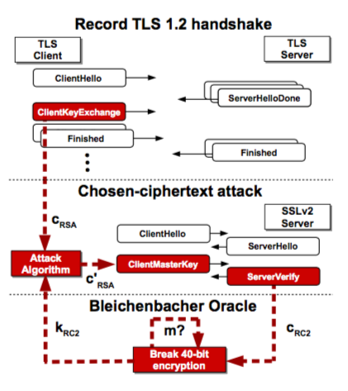
General DROWN
Validating RSA ciphertexts
The attacker sends a ClientMasterKey message
The server responds with a ServerVerify message, which contains the challenge encrypted using the server_write_key
The attacker performs an exhaustive search over the possible values of the 5 bytes of the master_key
Then computes the corresponding server_write_key and checks whether the ServerVerify message decrypts to the challenge
The attacker re-connects to the server with the same RSA cipher text
The server responds with another ServerVerify message that contains the current challenge encrypted using the current server_write_key
If the decrypted RSA cipher- text was valid, the attacker can directly decrypt a correct challenge value from the ServerVerify message by using the master_key
Otherwise, if the ServerVerify message does not correctly decrypt to the challenge, the RSA ciphertext was invalid
The attacker knows the mastery was generated at random

Slide 15
General DROWN
TLS Decryption Attack
Attack Scenario
A server that accepts TLS connections from clients using an RSA public key that is exposed via SSLv2
The server supports export cipher suites for SSLv2
The server implements the recommended countermeasure against Bleichenbacher’s attack in all protocol versions, including SSLv2
The attacker needs access to computing power sufficient to perform a 2^50 time attack, mostly brute forcing symmetric key encryption

Slide 16
General DROWN
TLS Decryption Attack
Constructing the Attack
Attacker passively collects 1,000 TLS handshakes from connections using RSA key exchange
The attacker then attempts to convert the intercepted TLS ciphertexts containing a 48-byte premaster secret to valid RSA PKCS#1 v1.5
Sends the modified ciphertexts to the server using fresh SSLv2 connections with weak symmetric ciphers and uses the ServerVerify messages to deduce ciphertext validity
For each RSA ciphertext the attacker needs to perform a brute force attack on the weak symmetric cipher
Can to obtain a valid SSLv2 cipher text after ~10,000 oracle queries or 20,000 connections to the server
Once the attacker has obtained a valid SSLv2 RSA ciphertext 𝑚1
A shifting technique is used find an integer 𝑆1 such that 𝑚2=𝑚1∙2^-40 ∙𝑆1
The attacker then applies the shifting technique again to find another integer 𝑆2 such that 𝑚3=𝑚2∙2^-40 ∙𝑆2
The attacker can continue with use an adapted Bleichenbacher iteration technique
Can then transform the decrypted plain- text back into the original plaintext

Slide 17
General DROWN
TLS Decryption Attack
Cost of the Attack
Most expensive computationally part of the attack is breaking the 40-bit attack
GPU implementation performed around 515MH/s, where MH measures the calculation of an MD5 hash and the RC2 decryption
The attack takes just under 8 hours, including startup and shutdown, using Amazon EC2 service for the cost of $440

Slide 18
Special DROWN Attack
CVE-2016-0703
There was vulnerability in OpenSSLv2 handshake code that allowed for that creates a powerful Bleichenbacher oracle, and drastically reduces the amount of computation required to implement the attack
Can cut the number of connections required by 50%
Reduces the computational work to a negotiable amount

Slide 19
Special DROWN Attack
“Extras Clear” Oracle
OpenSSL servers allowed the ClientMasterKey message to contain a clear_key_data bytes for non-export ciphers
When present, the server substitutes them for bytes from the encrypted key
Example:
Client chooses a 128-bit cipher and sends 16 byte key 𝑘[1].k[2],… 𝑘[16]
Contrary to protocol, it includes 4 null bytes of clear_key_data
OpenSSL generates this master_key [00 00 00 00 k[1] 𝑘[2] 𝑘[3] 𝑘[4] ... 𝑘[9] 𝑘[10] 𝑘[11] 𝑘[12]]
Enables a straightforward key-recovery attack against such versions
An attacker that has intercepted an SSLv2 connection takes the RSA ciphertext of the encrypted key and replays it in non-export handshakes to the server with varying lengths of clear_key_data

Slide 20
Special DROWN Attack
“Extras Clear” Oracle Contd.
Example:
For a 16-byte encrypted key, the attacker starts with 15 bytes of clear key, causing the server to use the master_key [00 00 00 00 00 00 00 00 00 00 00 00 00 00 00 k[1]]
The attacker can brute force the first byte of the encrypted key by finding the matching ServerVerify message among 256 possibilities
Knowing the first byte, the attacker makes another connection with the same RSA ciphertext but 14 bytes of clear key, resulting in the master_key [00 00 00 00 00 00 00 00 00 00 00 00 00 00 k[1] k[2]]
The attacker already knows k[1], The can easily brute force the second byte
With only 15 probe connections and an expected 15 · 128 = 1, 920 trial encryptions, the attacker learns the entire master_key for the recorded session
This session key-recovery attack can be directly converted to a Bleichenbacher oracle.

Slide 21
Special DROWN Attack
Attack Scenario
Same as general attack
The same RSA key pair used for TLS is also used on a server that is running a vulnerable version of OpenSSL

Slide 22
Special DROWN Attack
Constructing the Attack
Intercepts several hundred TLS hand- shakes using RSA key exchange
The attacker uses the fractional trimmers to convert the TLS cipher- texts into an SSLv2 conformant cipher text
Once a valid SSLv2 cipheertext is obtained, the attacker uses at the shifting technique to rotate the message by 25 bytes each iteration, learning 27 bytes with each shift. Takes several iterations to learn the entire plaintext
Then transforms the decrypted SSLv2 plaintext into the decrypted TLS plaintext

Slide 23
Special DROWN Attack
Attack Cost
Using 40 fractional trimmers is a more efficient oracle attack
Allows the attacker to recover 1 in 260 TLS keys using about 17,000 connections to the server
Computation cost is so low that a full attack could be done on a single workstation
Using the optimised version of this attack allows the Attacker to recover 1 in 100 at the cost of 27,000 connections

Slide 24
Man In the Middle
Special Drown is fast enough to decrypt a TLS premaster secret online, during a connection handshake that a MITM(Man in the Middle) is possible
A MITM can be used to compromise connections between modern browsers and TLS servers
Even those configured to prefer non-RSA cipher suites

Slide 25
Man In the Middle
Attack Scenario
The MITM attacker impersonates the server
Sends a ServerHello message that selects a cipher suite with RSA as the key-exchange method
The attacker uses special DROWN to decrypt the premaster secret
The difficulty is completing the decryption and producing a valid ServerFinished message before user is timed out
Most browsers allow a handshake to last for 1 minute before timing out
Using the fully optimised Special DROWN Attack is fast enough to not be timed out.

Slide 26
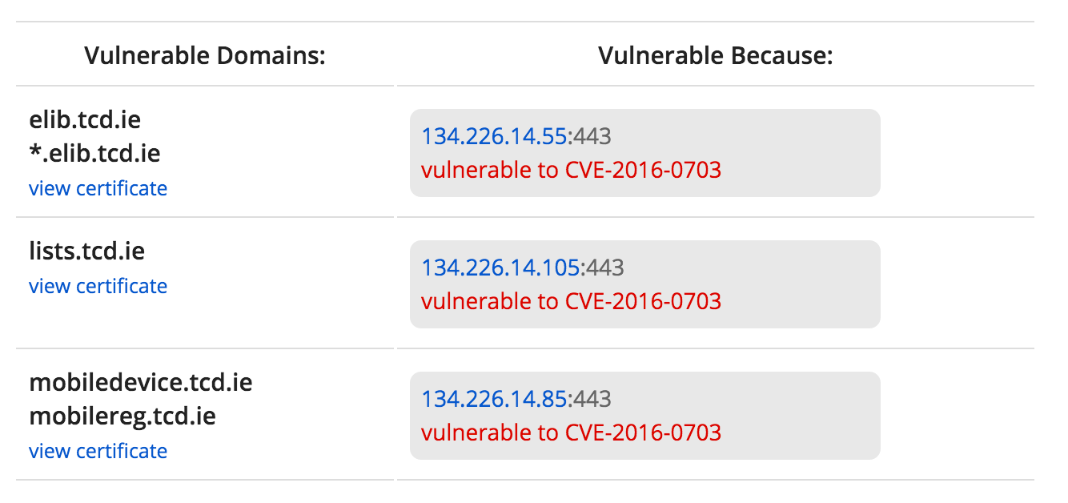
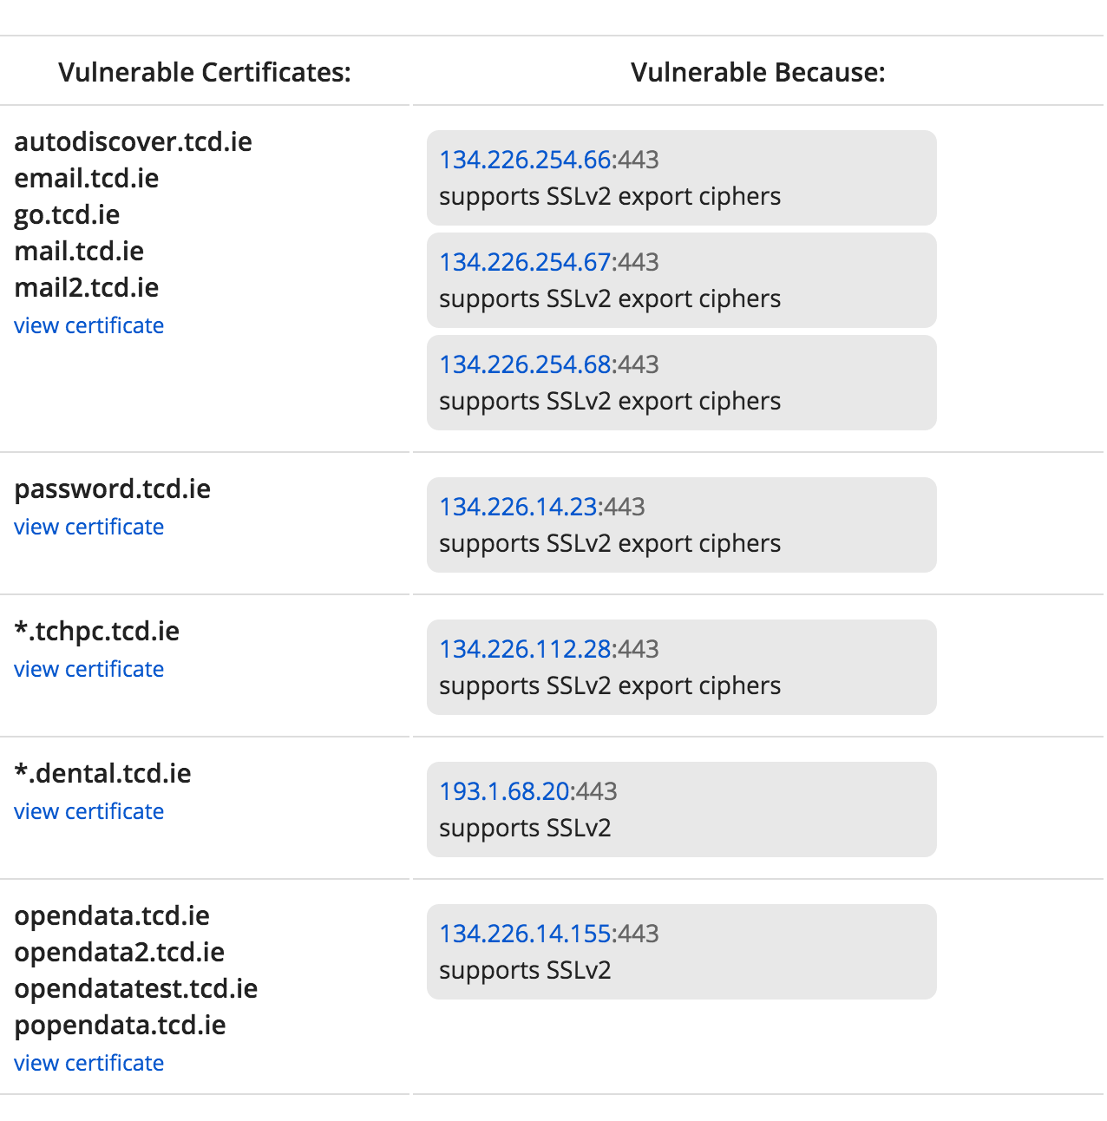
Vulnerable Websites
TCD.ie
Special DROWN Attack
General DROWN Attack
These domains are vulnerable to Man in the middle attacks

Slide 27
References
BARDOU, R., FOCARDI, R., KAWAMOTO, Y., SIMIONATO, L., STEEL, G., AND TSAY, J.-K. Efficient padding oracle attacks on cryptographic hardware. In Advances in Cryptology–CRYPTO 2012. Springer, 2012, pp. 608–625.
DROWN Attack. (2016). [online] Drownattack.com. Available at: https://drownattack.com/ [Accessed 4 Apr. 2016].
Nimrod Aviram, Sebastian Schinzel, Juraj Somorovsky, Nadia Heninger, Maik Dankel, Jens Steube, Luke Valenta, David Adrian, J. Alex Halderman, Viktor Dukhovni, Emilia Käsper, Shaanan Cohney, Susanne Engels, Christof Paar and Yuval Shavitt. DROWN: Breaking TLS using SSLv2. Available at https://drownattack.com/. March 1, 2016.

