Slide 1
YumTum: Restaurant Recommendation System
By Alexis Ambriz, Samarth Sharma, Joash Muganda and Justin Cho

Slide 2
Task:
To build a restaurant recommendation system based on: 1) Customer Details 2) Location details 3) Restaurant Details
Data Source: Dataset Link
Note: Data is masked for security reasons, but in such a way that it doesn’t lose the patterns.

Slide 3
Applications:
1) Based on Customer drop off location(Home, Office, Other) we can recommend a vendor.
2) We can be part of a food delivery app, where when a customer selects a Restaurant, a message pops up: Either ‘Recommended’ or ‘Not Recommended’

Slide 4
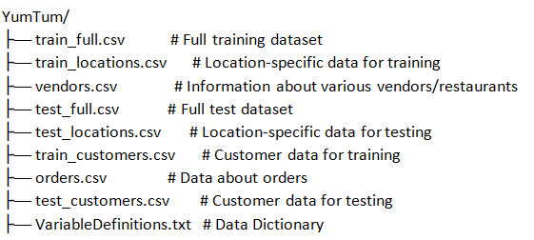
Initial Directory Structure:
As the size of the data is massive, we decided to use Databricks which can take care of the storage, database, and scaling of the model, and AWS to create the resources we will need for our project.

Slide 5
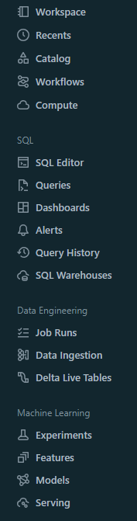
Databricks for Scalability and Flexibility
Databricks is a cloud-based platform leveraging Apache Spark for scalable data processing and machine learning, ideal for building recommendation systems.
It supports various machine learning libraries and real-time analytics, crucial for developing dynamic and effective recommendation models.
The platform facilitates data ingestion, preparation, and the development of sophisticated recommendation algorithms using collaborative and content-based methods.
Databricks enhances collaboration with shared notebooks and workflow management, including Git integration for version control and automated retraining pipelines.
Incorporates Delta Lake for reliable data storage, ensuring data integrity and accuracy in recommendation system outputs.

Slide 6
Exploratory Data Analysis
Address missing values across various features to ensure data completeness and reliability.
Convert features like operational hours into a uniform and interpretable format for consistent analysis.
Standardize fields like gender to correct formatting inconsistencies and maintain data uniformity.
Identify and handle features with a single value throughout, as they offer no variability and are thus redundant for model training.
Implement data cleaning and preprocessing steps to enhance data quality and effectiveness for subsequent modeling.
Detailed EDA: YumTum_EDA

Slide 7
Feature Engineering
Based on Exploratory Data Analysis:
Imputed/Dropped/Transformed the columns with missing values.
Ensured conversion of variables to numeric format for pattern mining and modeling.
Established data consistency by standardizing the format.
Stratified Sampling
Feature Aggregation: Calculating the haversine distance
Removed the single-valued redundant features.
YumTum Feature Engineering

Slide 8
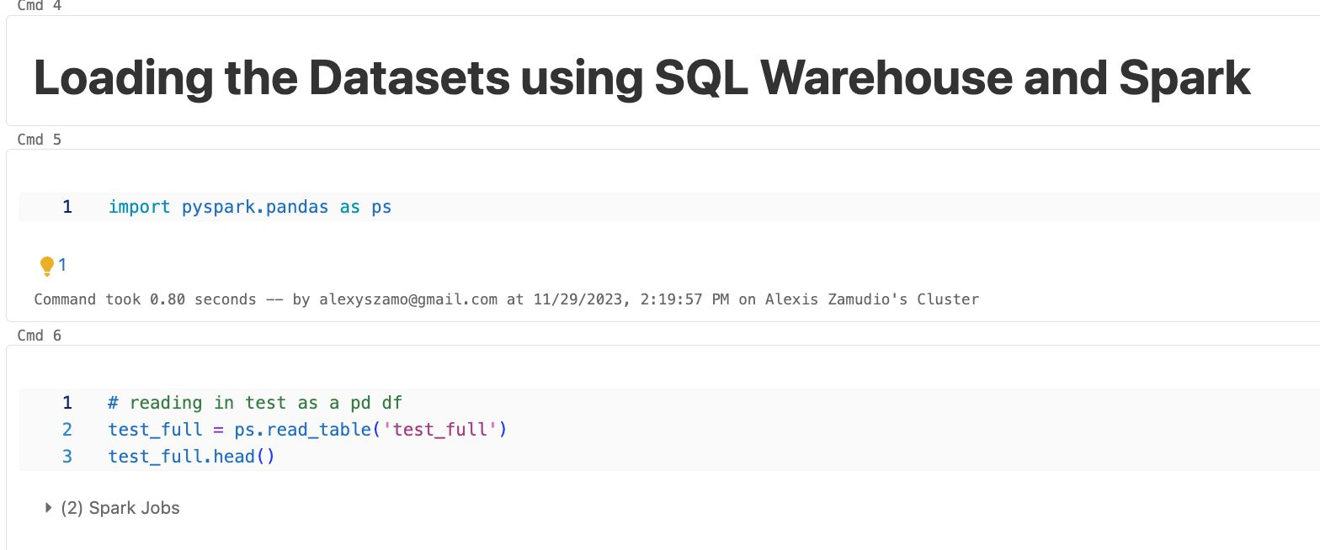
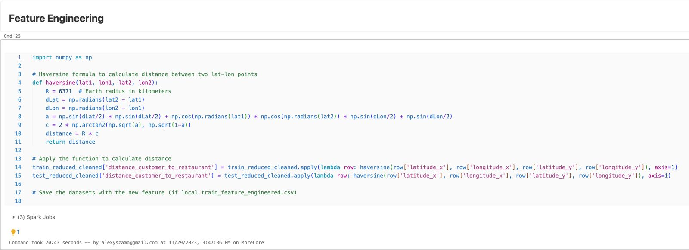

Slide 9
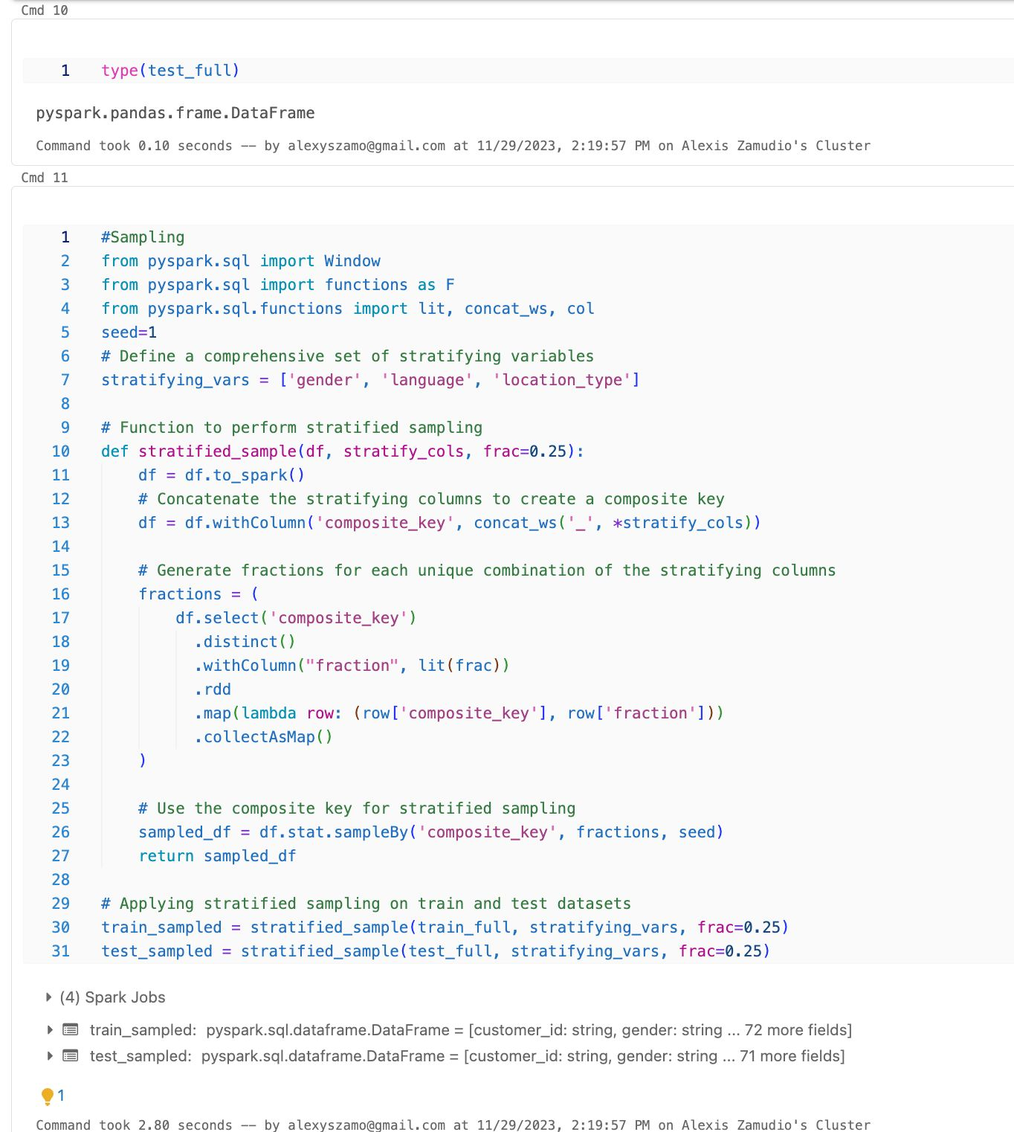
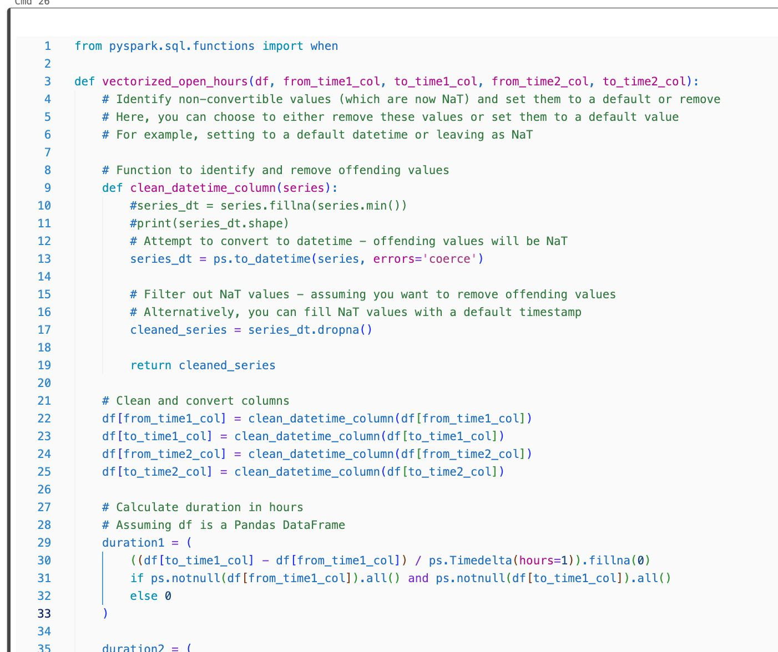
Feature Aggregation and Conversion

Slide 10
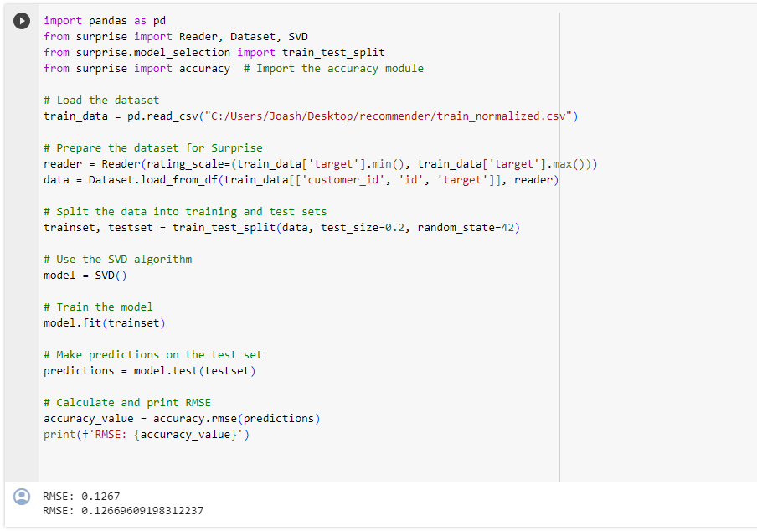
Collaborative Filtering
Collaborative Filtering utilizes collective user preferences to predict individual user interests, based on the principle that similar users have similar tastes.
We used the Singular Value Decomposition (SVD) algorithm from the 'surprise' library. It Decomposes user-item interaction matrices into latent factors representing underlying user preference patterns, enhancing recommendation accuracy.

Slide 11
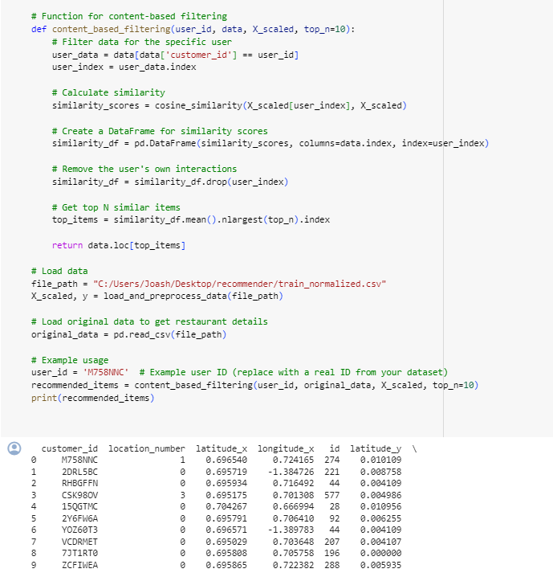
Content-Based Filtering
It primarily recommends items by aligning their characteristics with those preferred by the user in past selections.
highly personalized recommendations based solely on the analysis of item attributes and individual user-item interactions, without considering collective user behavior patterns.
Utilized cosine similarity for measuring the similarity between items or users, focusing on their attributes and preferences, thereby enhancing the accuracy of the personalized recommendations.

Slide 12
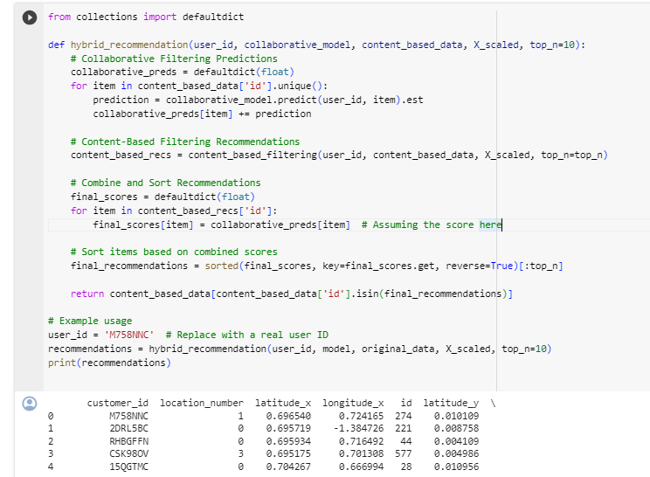
Hybrid Recommendation Model
A hybrid model combining collaborative and content-based filtering to overcome their individual limitations and capitalize on their strengths, enhancing overall recommendation quality.
This approach not only increased the precision of recommendations but also broadened their variety, catering to both general interests and specific user preferences.
Hybrid models exhibit enhanced adaptability and robustness, effectively serving a diverse range of users and items by utilizing both user behavioral patterns and item attributes.

Slide 13
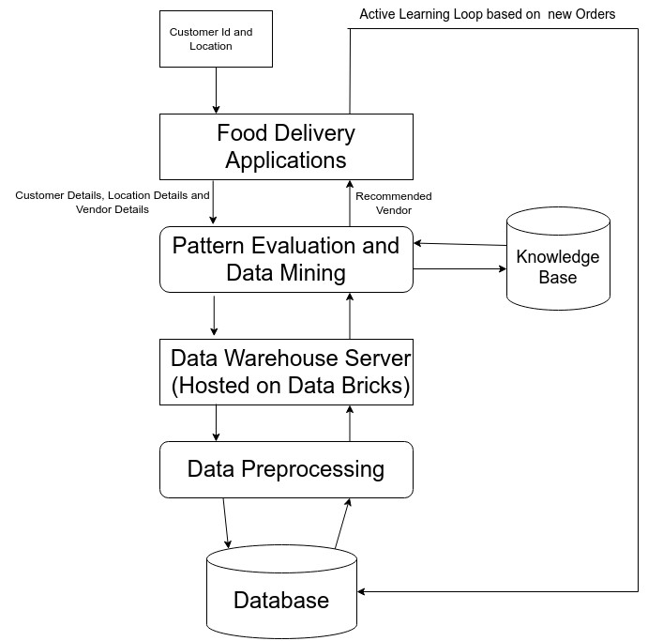
High-Level Architecture Design

Slide 14
THANK YOU

