Slide 1

ERP Transformation Strategy and Implementation Recommendations
Executive Presentation to the Executive Team · Alpha Manufacturing Group (AMG)
PREPARED BY FREDERICK OFORI

Slide 2
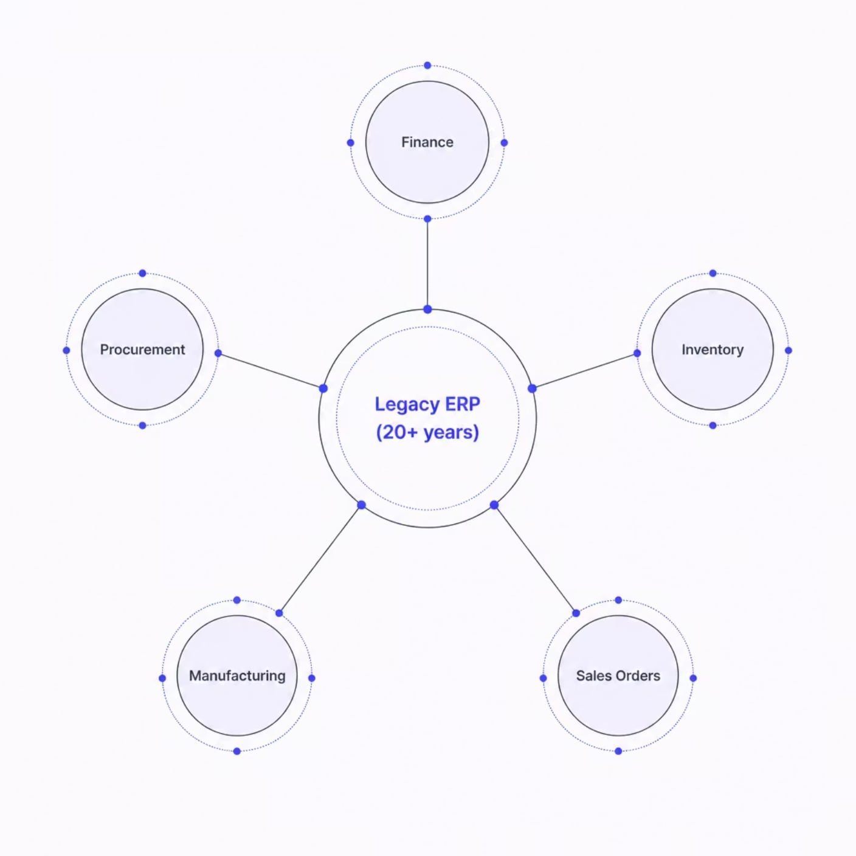

Why AMG Must Transform
Current Challenges
Legacy ERP system (20+ years) with no vendor support
Fragmented business systems with no integration
BOM synchronization failures across engineering and production
Heavy spreadsheet reliance for planning and reporting
Limited cost and margin visibility
Business Impact
Margin erosion on ~80% of custom orders
Manufacturing delays and poor operational visibility
Manual reporting and inefficient decision-making
Fragmented systems are limiting operational efficiency, profitability, and growth.

Slide 3
Strategic Vision
Implement a phased cloud ERP transformation that improves operational efficiency, strengthens data governance, and delivers enterprise-wide visibility while minimizing business disruption.
Business Continuity
Data Integrity
Operational Visibility
Zero disruption to live operations during transition
Accurate, governed data across all functions
Real-time KPIs and unified reporting
Controlled Delivery
Long-Term Scalability
Phased approach with clear governance
Platform built for future business demands

Slide 4
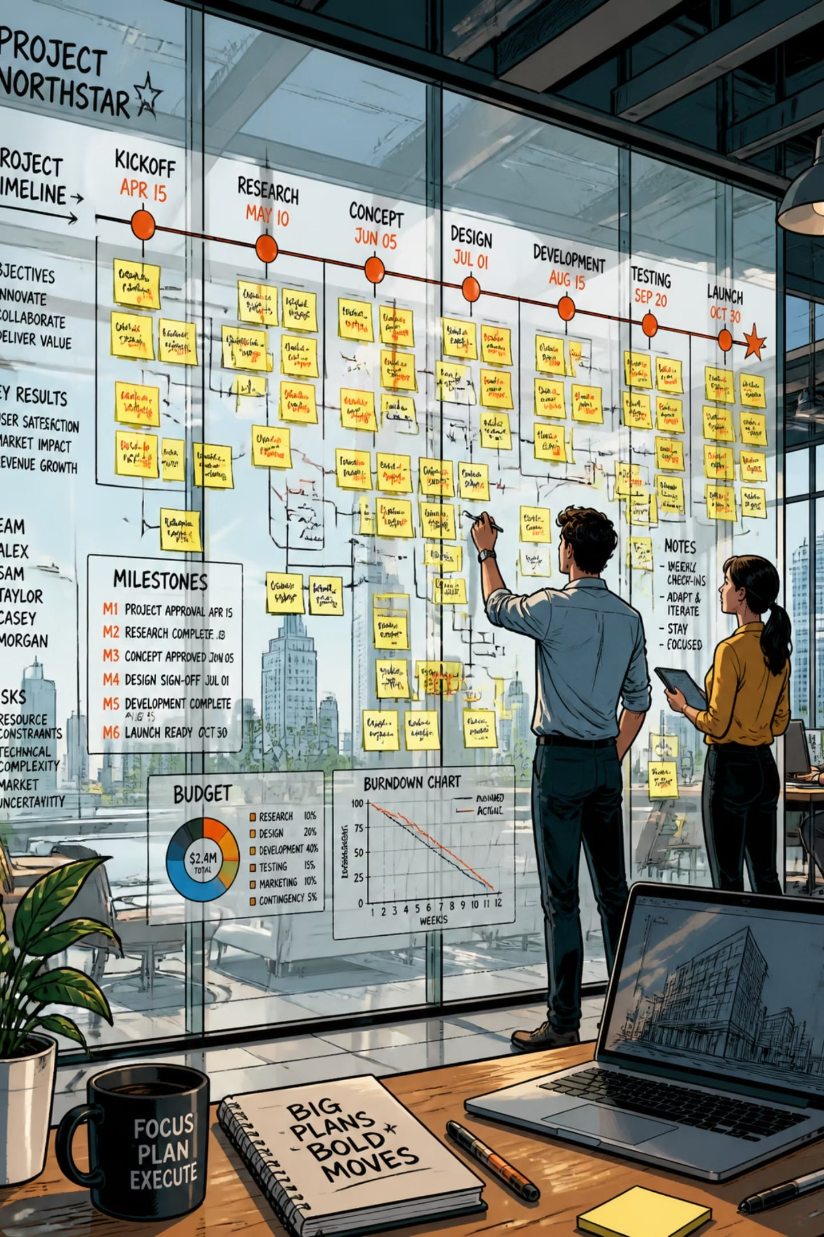
Recommended Delivery Approach
1
Discovery & Design
Months 1–2 · Process mapping, requirements definition, and solution design.
2
Core ERP Deployment
Months 3–7 · Finance, procurement, inventory, and manufacturing modules configured and tested.
3
Engineering Integration
Months 8–11 · BOM synchronization, MRP, and engineering-to-production workflows integrated.
4
Go-Live & Optimization
Month 12 · Controlled cutover, hypercare support, and post-launch optimization.

Slide 5

Deliver the Essentials First
Day-One Go-Live
Deferred to Later Phases
Finance
Procurement
Inventory
Manufacturing
MRP
BOM Integration
Sales Orders
CRM enhancements
Advanced analytics
Workflow automation
Non-essential reports
Additional integrations
Configuration before customization. Standardize first, then tailor only where business value is proven.

Slide 6
Data & Reporting Strategy
Historical Data
Unified Reporting
Month-End Close
Migrate 3–5 years of active records; archive older data for compliance and reference.
Deploy enterprise KPI dashboards; run parallel validation between legacy and new ERP during transition.
Execute parallel close procedures, validate financial reporting accuracy, then proceed to controlled cutover.
Contribution Margin
Labor Utilization
BOM Accuracy
Inventory Accuracy
On-Time Delivery

Slide 7
Risks & Mitigation
Risk
Mitigation
Data quality issues
Data governance framework established from Day 1
Scope creep
Formal Change Control Board with executive oversight
User adoption resistance
Structured training program with role-based onboarding
Integration failure
Early and iterative integration testing throughout build
Go-live disruption
Hypercare support model with contingency rollback plan
Proactive governance reduces implementation risk while protecting business continuity.

Slide 8
Executive Recommendation
Proceed with a phased cloud ERP transformation focused on:
Business Continuity
Engineering Integration
Data Governance
Disciplined Scope Control
Financial Transparency
Expected Outcomes
Improved profitability visibility
Reduced manufacturing delays
Accurate BOM management
Stronger executive reporting
Scalable digital platform
A disciplined, phased ERP transformation will enable AMG to modernize operations, improve profitability, and establish a scalable foundation for long-term growth.

