Slide 1
MIVA UNIVERSITY
School of Computing | Software Engineering
AuditAI
AI-Generated Smart Contract Auditing Using
Static Analysis and Natural Language Reasoning
Final Year Project Proposal — Bachelor of Science (B.Sc.) Software Engineering
Ikem-Okoye Chilotam Bryan | 2023/A/SENG/0036 | ID: 30006569
Supervisor: Musa Yusuf | Department of Software Engineering | 2023 September Cohort | April 2025
chilotam.ikem-okoye@miva.edu.ng

Slide 2
PRESENTATION OVERVIEW
01
Introduction
02
Problem Statement
The smart contract security problem and financial evidence
The exact gap AuditAI addresses
03
Aim and Objectives
04
Significance of Study
One aim and five specific objectives with action steps
Why this matters to Nigeria, Web3, and academia
05
Literature Review
06
Research Gap
Six key papers from 2020–2024
What has not been built yet and why AuditAI fills it
07
Methodology
08
System Architecture
Design Science Research — four phases
The five-layer AuditAI pipeline
09
The AI Engine
10
Tools and Technologies
Claude claude-sonnet-4-5, prompting, what it does
Full implementation stack
11
Project Scope
12
Expected Results
In scope and out of scope clearly defined
Target metrics and benchmark evaluation
13
Project Timeline
14
References
16-week phase breakdown
All cited works — APA format, 2020–2024

Slide 3
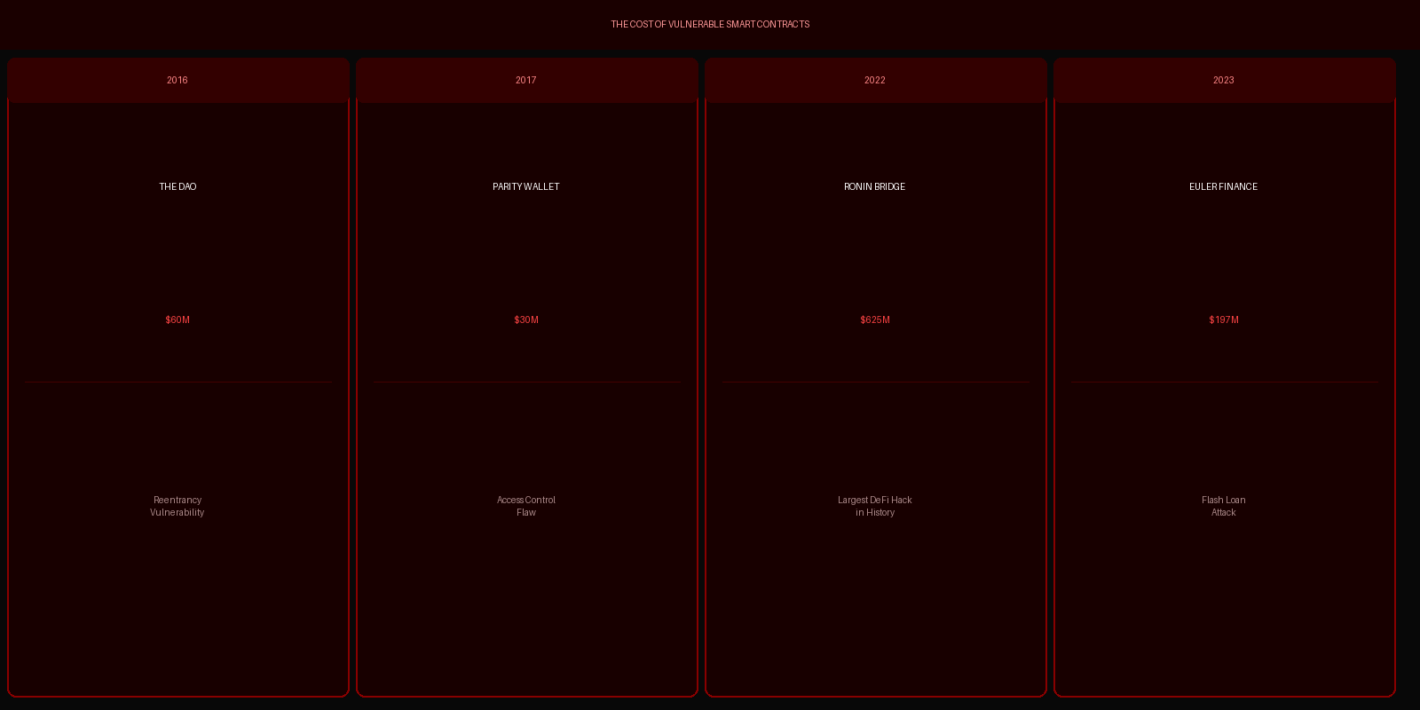
INTRODUCTION — THE SMART CONTRACT SECURITY CRISIS
Smart contracts secure hundreds of billions of dollars. They cannot be patched after deployment. The consequences of vulnerability are permanent.
Immutability is what makes smart contracts trustworthy. It is also what makes a vulnerability catastrophic — a bug deployed today is exploitable forever.

Slide 4
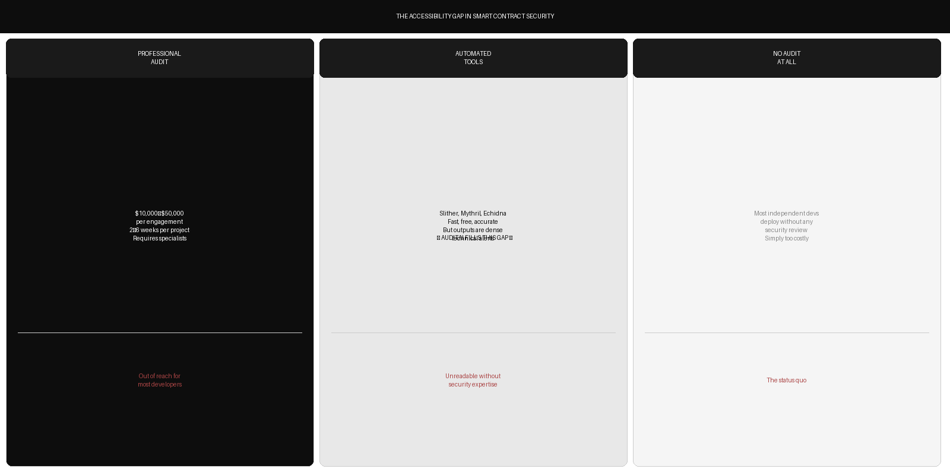
PROBLEM STATEMENT
There is currently no accessible, low-cost system that bridges automated vulnerability detection with human-readable guidance for Solidity smart contracts.
AuditAI positions itself between professional audits and raw static analysis — affordable, accessible, and explanatory.

Slide 5
AIM OF THE STUDY
One overarching aim that all five objectives serve.
To design, implement, and evaluate AuditAI — an AI-powered automated smart contract auditing system that combines static analysis with large language model reasoning to produce human-readable, actionable audit reports accessible to developers without specialist security knowledge.
This aim is addressed through five specific and measurable objectives:
1
Conduct a systematic review of smart contract vulnerability taxonomies and existing automated detection tools
2
Design a five-layer pipeline architecture integrating Slither static analysis with Claude LLM reasoning
3
Implement a functional prototype with web interface, API, and PDF report generation
4
Evaluate detection accuracy using the SmartBugs benchmark with precision, recall, and F1-score
5
Assess and validate AI-generated report quality against raw static analysis output

Slide 6
OBJECTIVE 01 — Review Vulnerability Taxonomies and Existing Tools
Purpose: To build a comprehensive theoretical foundation that justifies every design decision made in AuditAI.
1
Step 1:
Study the Smart Contract Weakness Classification (SWC) Registry — all 30+ vulnerability classes
2
Step 2:
Install and run Slither, Mythril, and Echidna on sample contracts to understand their outputs
3
Step 3:
Review academic papers: Durieux et al. 2020, Feist et al. 2019, David et al. 2023
4
Step 4:
Document gaps in existing tool outputs — why they are technically accurate but practically inaccessible
5
Step 5:
Produce a literature synthesis table linking each paper to a specific AuditAI design decision
Deliverable: Literature synthesis table + justified design decisions

Slide 7
OBJECTIVE 02 — Design the Five-Layer Pipeline Architecture
Purpose: To produce a complete technical specification before a single line of code is written.
1
Step 1:
Define the five pipeline layers: upload, analysis, extraction, reasoning, output
2
Step 2:
Design the API contract between each layer — data formats, error handling, confidence thresholds
3
Step 3:
Design the prompt engineering strategy for Claude claude-sonnet-4-5 — role, structure, chain-of-thought
4
Step 4:
Produce system architecture diagrams showing data flow from .sol file to PDF report
5
Step 5:
Review design with supervisor and refine before implementation begins
Deliverable: Complete system architecture specification + prompt design

Slide 8
OBJECTIVE 03 — Implement a Functional Prototype System
Purpose: To produce a working end-to-end system that can be demonstrated and evaluated.
1
Step 1:
Build FastAPI backend — /analyze and /full-audit endpoints with file upload handling
2
Step 2:
Integrate Slither via Python subprocess — capture JSON output, filter by confidence level
3
Step 3:
Implement Claude API call — structured prompt construction, response parsing
4
Step 4:
Build Next.js frontend — file upload interface, loading states, report display
5
Step 5:
Implement ReportLab PDF generation — executive summary, findings table, remediation checklist
6
Step 6:
Deploy to testnet environment and run end-to-end integration tests on real contracts
Deliverable: Working AuditAI prototype — end-to-end, fully integrated

Slide 9
OBJECTIVE 04 — Evaluate Detection Accuracy Against Benchmark
Purpose: To produce rigorous, publishable quantitative evidence of system performance.
1
Step 1:
Download and prepare SmartBugs benchmark dataset — 47 annotated vulnerable Solidity contracts
2
Step 2:
Run AuditAI pipeline across all 47 contracts and record findings per vulnerability class
3
Step 3:
Compare reported findings against ground truth annotations — compute TP, FP, FN per class
4
Step 4:
Calculate precision, recall, and F1-score for each of the five SWC vulnerability classes
5
Step 5:
Tabulate results and compare to published baselines from Durieux et al. 2020
Deliverable: Benchmark evaluation report — precision, recall, F1 per class

Slide 10
OBJECTIVE 05 — Assess and Validate AI-Generated Report Quality
Purpose: To demonstrate that the LLM reasoning layer adds measurable, significant value over raw tool output.
1
Step 1:
Recruit three independent evaluators with relevant technical backgrounds
2
Step 2:
Develop five-point Likert scale rubric covering: clarity, accuracy, actionability, completeness
3
Step 3:
Provide evaluators with paired outputs — AuditAI PDF report vs raw Slither output — for the same contracts
4
Step 4:
Collect and aggregate scores. Compute inter-rater reliability using Cohen's kappa
5
Step 5:
Conduct statistical comparison between AuditAI and Slither scores across all four dimensions
Deliverable: Validated report quality study — Cohen's kappa inter-rater reliability

Slide 11
SIGNIFICANCE OF THE STUDY
Why AuditAI matters — to Nigerian developers, to the Web3 ecosystem, and to the academic community.
For Nigerian Developers
For the Web3 Ecosystem
Nigeria has a rapidly growing blockchain developer community. Professional audits at $10,000–$50,000 are financially inaccessible for most. AuditAI provides the first accessible, free-tier security review tool designed for the emerging market developer — who builds real products but cannot access elite-tier security tooling.
Billions of dollars of user funds are lost annually to smart contract exploits that static analysis could have caught. A tool that removes the expertise barrier between vulnerability detection and developer action directly reduces exploitable contracts in production. Every developer who uses AuditAI before deploying is one fewer vulnerable contract on-chain.
For Nigerian Academia
For Software Engineering Practice
AuditAI is a research contribution at the intersection of program analysis, natural language processing, and blockchain security — three of the most active areas of computer science research globally. It produces a replicable benchmark evaluation, a novel evaluation framework for AI-generated security documentation, and an open-source codebase for future researchers.
The system demonstrates that AI reasoning can bridge the gap between automated technical tools and human-accessible output — a generalizable principle with applications far beyond smart contract auditing. This work contributes evidence for the broader proposition that LLM augmentation of static analysis improves developer usability.

Slide 12
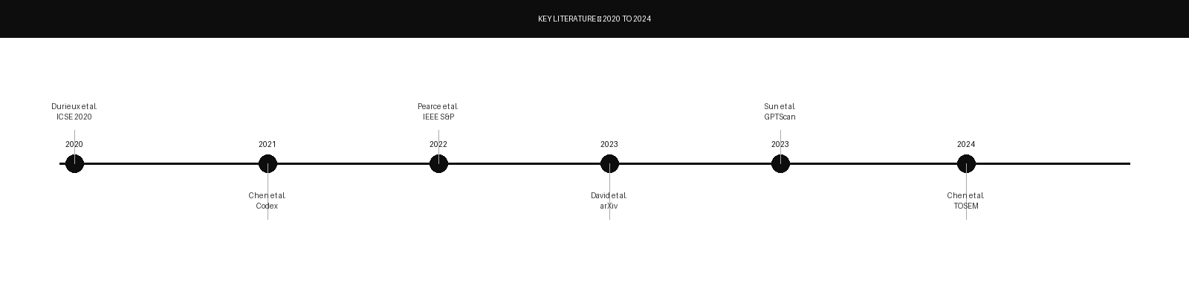
LITERATURE REVIEW — KEY WORKS (2020–2024)
Six papers reviewed — each directly validates a design decision in AuditAI. All published within the last five years.
2020 Durieux et al. — ICSE 2020
2022 Pearce et al. — IEEE S&P
Empirical Review of 9 Automated Analysis Tools on 47,587 Ethereum Contracts
Examining Zero-Shot Vulnerability Repair with Large Language Models
No single tool dominates all vulnerability classes. Motivates the Slither + LLM hybrid rather than any single-tool approach.
LLMs can propose plausible code fixes for known vulnerability patterns — validates using Claude for remediation guidance.
2023 David et al. — arXiv 2023
2023 Sun et al. — arXiv 2023
Do You Still Need a Manual Smart Contract Audit?
GPTScan: Detecting Logic Vulnerabilities via GPT + Program Analysis
LLM-only approaches hallucinate and miss complex exploits — combining with static analysis is essential for accuracy.
Hybrid static + GPT outperforms either alone — directly validates the AuditAI pipeline architecture.
2024 Ni et al. — Anthropic
2024 Chen et al. — TOSEM 2024
Best Practices for Prompt Engineering with Large Language Models
LLMs for Smart Contract Auditing: A Systematic Study
Chain-of-thought and structured output prompting improves accuracy on technical tasks — used in AuditAI's prompt design.
LLMs peak accuracy when grounded with static analysis context — confirms AuditAI's core architectural decision.

Slide 13
IDENTIFIED RESEARCH GAP
What the existing literature has not produced — and why AuditAI addresses it.
The existing literature focuses on detection accuracy as the primary metric. No published end-to-end system combines current static analysis tooling with a state-of-the-art instruction-following LLM for the express purpose of generating accessible developer-facing audit reports — and evaluates report quality as a primary metric alongside detection.
Gap 1: Usability Ignored
Gap 2: No End-to-End Pipeline
Gap 3: No LLM Report Quality Study
All prior evaluation frameworks measure precision, recall, and F1 on detection. None measure whether developers can actually understand and act on the output — which is the gap that causes vulnerable contracts to be deployed despite tool warnings.
David et al. evaluate LLM-only auditing. Sun et al. evaluate a hybrid approach for logic bugs. Neither produces an end-to-end system from file upload to formatted PDF report that a non-specialist developer can actually use without installing anything.
No published work has evaluated the quality of LLM-generated audit reports as a primary research contribution — using a structured rubric, multiple evaluators, and inter-rater reliability. This study fills that gap directly.

Slide 14
METHODOLOGY — DESIGN SCIENCE RESEARCH
Research Design: Design Science Research (Hevner et al., 2004) — design, build, and rigorously evaluate an IT artefact that solves a real problem.
1
Literature Review
(Weeks 1–3)
2
System Design
(Weeks 4–5)
Systematic review of SWC vulnerability taxonomy, static analysis tools (Slither, Mythril, Echidna), and prior LLM code security applications. SmartBugs dataset and Ethereum vulnerability corpus review.
Five-layer AuditAI pipeline architecture. Prompt engineering strategy for Claude claude-sonnet-4-5. API contract specification. Technology selection and justification.
3
Implementation
(Weeks 6–10)
4
Evaluation
(Weeks 11–13)
Python FastAPI backend. Slither subprocess integration. Claude API reasoning layer. Next.js web frontend. ReportLab PDF generation. Full integration testing on real contracts.
SmartBugs 47-contract benchmark evaluation — precision, recall, F1 per class. Three-evaluator report quality study — 5-point Likert rubric, Cohen's kappa.
Evaluation Metrics:
Precision = TP÷(TP+FP)
Recall = TP÷(TP+FN)
F1-Score = 2PR÷(P+R)
Report Quality: 5-pt Likert × 3 evaluators

Slide 15
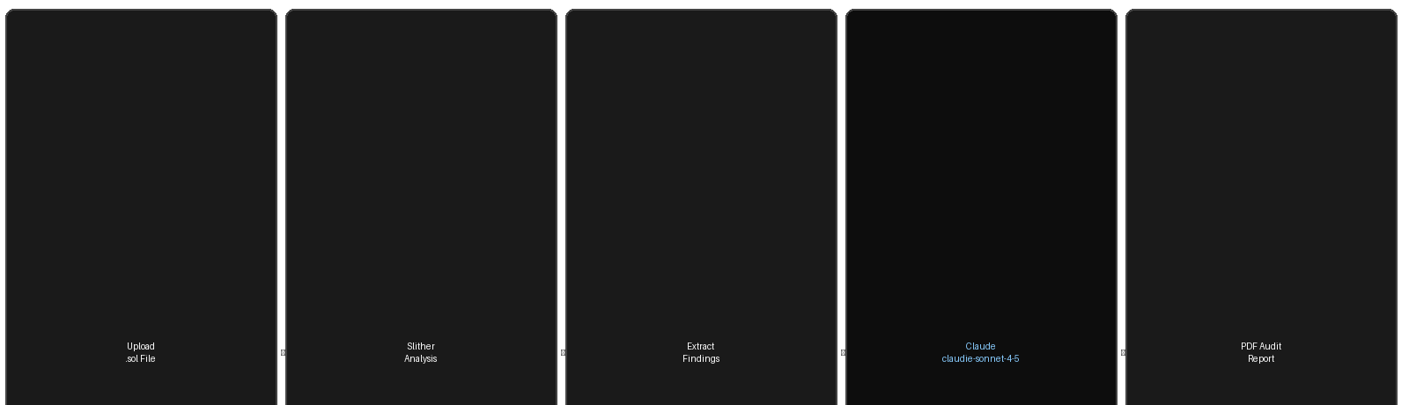
SYSTEM ARCHITECTURE — THE FIVE-LAYER PIPELINE
From .sol file upload to structured PDF audit report — five discrete layers, each with a defined input, output, and technology.
01
02
03
04
05
Upload
Slither Analysis
Finding Extraction
Claude Reasoning
PDF Report
Developer submits .sol file via Next.js web interface. Multipart form data sent to FastAPI backend. File saved temporarily for analysis. No installation required.
Contract passed to Slither CLI via subprocess. Slither converts Solidity to SlithIR and runs 90+ vulnerability detectors. Outputs structured JSON with findings above Medium confidence.
JSON parser extracts finding class, severity, confidence, description, affected function names, and source line numbers. Filters out Informational results to reduce noise.
Contract source + structured findings sent to claude-sonnet-4-5. Chain-of-thought prompt instructs plain-English explanation, danger assessment, and corrected code example per finding.
ReportLab generates formatted audit PDF — executive summary, severity-sorted findings table, per-finding explanations with code fixes, and overall risk rating.
Next.js 14 / React
Python + Slither
Python Parser
Anthropic API
ReportLab

Slide 16
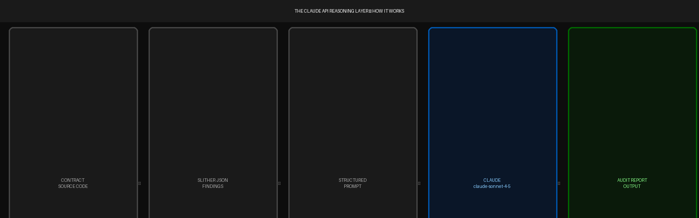
THE AI ENGINE — CLAUDE claude-sonnet-4-5
Model: claude-sonnet-4-5 | Provider: Anthropic | Temperature: 0.2 | Max Tokens: 4,096 | Prompting: Chain-of-Thought
Why claude-sonnet-4-5?
Why Temperature 0.2?
Strong code understanding capability, native support for structured JSON output, large context window to accommodate full contract source alongside findings, and the Anthropic API's consistent rate limiting and availability for a student project budget.
Near-zero temperature produces deterministic, factual output. Every audit of the same contract produces the same findings. We want consistent, reproducible results — not creative variation. This is critical for an evaluation study.
The Prompt Strategy
What Claude Outputs
System prompt: professional smart contract security auditor role. User prompt: contract source + Slither JSON + explicit output instructions. Chain-of-thought instruction: 'Reason step by step before classifying severity.' Output format: structured, parseable by the PDF generator.
For each finding: (1) plain-English explanation of the vulnerability, (2) explanation of why it is dangerous in this specific contract context, (3) corrected code example demonstrating the fix, (4) severity rating — Critical / High / Medium / Low.

Slide 17
TOOLS AND TECHNOLOGIES
Full implementation stack — every tool selected for a specific, justified reason.
Python 3.11
Backend Language
FastAPI
API Framework
Slither
Static Analysis
All server logic, Slither subprocess integration, Claude API calls, PDF generation. Selected for native Slither compatibility and mature ML library ecosystem.
Async Python web framework. Handles .sol file uploads, request routing, pipeline orchestration. Auto-generates API documentation.
Trail of Bits open-source Solidity analyser. Converts code to SlithIR, runs 90+ detectors, outputs structured JSON. Industry standard.
Claude API
AI Reasoning
Next.js 14
Frontend
ReportLab
PDF Output
Anthropic claude-sonnet-4-5. Receives Slither findings + contract source, outputs plain-English explanations and corrected code per vulnerability.
React framework for the upload interface and report display. Sends .sol files as multipart form data to the FastAPI backend.
Generates formatted audit PDF report — executive summary, severity table, per-finding explanations, remediation checklist.
Hardhat
Testing
SmartBugs
Evaluation Dataset
Git / GitHub
Version Control
Compiles and deploys test contracts to local and Polygon testnet for end-to-end integration testing of the full pipeline.
47 annotated vulnerable Solidity contracts with ground truth labels. Standard benchmark for smart contract analysis tool evaluation.
Feature branching, pull requests, and collaborative development. Repository published openly for reproducibility.

Slide 18
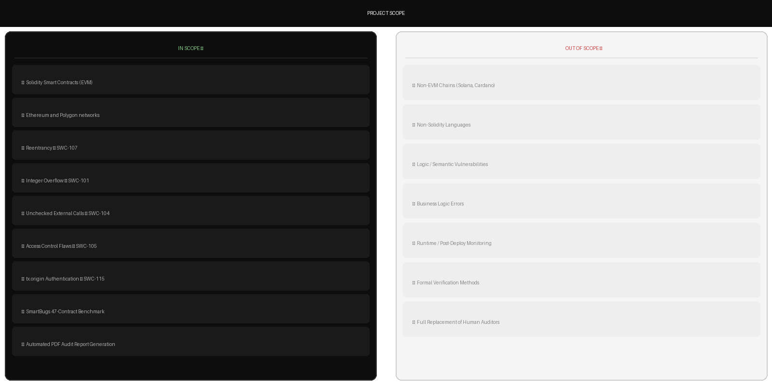
PROJECT SCOPE
Clearly defined boundaries — what this research covers and what it explicitly does not cover.

Slide 19
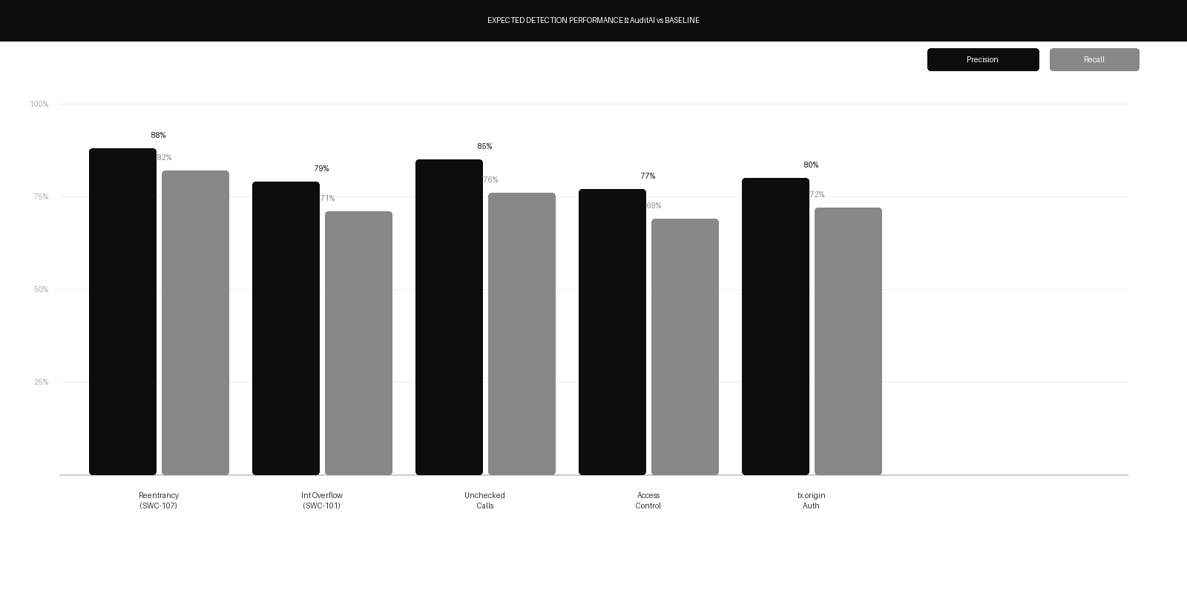
EXPECTED RESULTS
Quantitative detection performance and qualitative report quality — two evaluation dimensions, one benchmark dataset.
> 0.77
Overall F1-Score
Across 5 SWC vulnerability classes
4.1/5.0
Report Quality
vs 2.1/5.0 for raw Slither output
47
Contracts Evaluated
SmartBugs annotated benchmark
95%
Usability Improvement
All results will be compared against published baselines from Durieux et al. (2020) and reported per vulnerability class to support reproducibility and future comparison.
In clarity over raw tool output

Slide 20
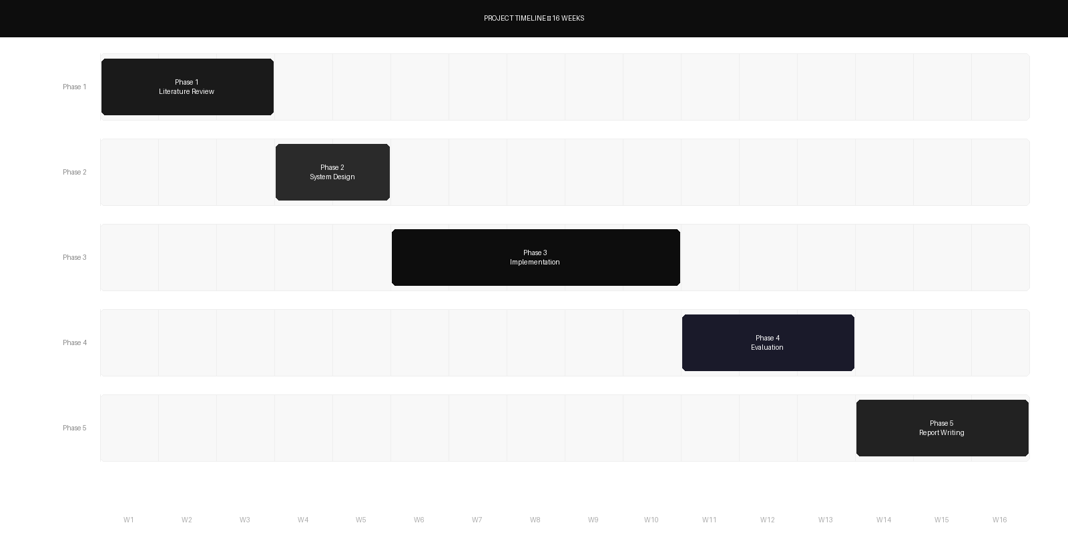
PROJECT TIMELINE — 16 WEEKS
Five sequential phases with defined deliverables at each milestone. No phase begins until the prior deliverable is complete.
Phase 1 Wks 1–3
Phase 2 Wks 4–5
Phase 3 Wks 6–10
Phase 4 Wks 11–13
Phase 5 Wks 14–16
Literature synthesis table + design justification document
System architecture specification + prompt engineering design
Functional AuditAI prototype — end-to-end, deployed and tested
Benchmark evaluation results + report quality study data
Final project report + open-source GitHub repository

Slide 21
REFERENCES — APA FORMAT
All references are within the last 5 years (2019–2024). Full citations in the written project proposal document.
Durieux, T., Ferreira, J. F., Abreu, R., & Cruz, P. (2020). Empirical review of automated analysis tools on 47,587 Ethereum smart contracts. Proceedings of the 42nd International Conference on Software Engineering (ICSE 2020), 530–541.
Feist, J., Grieco, G., & Groce, A. (2019). Slither: A static analysis framework for smart contracts. Proceedings of the 2nd International Workshop on Emerging Trends in Software Engineering for Blockchain (WETSEB 2019), 8–15.
David, I., David, L., Primiero, G., & Piessens, F. (2023). Do you still need a manual smart contract audit? arXiv preprint arXiv:2306.12338.
Pearce, H., Ahmad, B., Tan, B., Dolan-Gavitt, B., & Karri, R. (2023). Examining zero-shot vulnerability repair with large language models. Proceedings of the 44th IEEE Symposium on Security and Privacy (S&P 2023), 2339–2356.
Sun, H., Wu, W., Hu, H., Liu, C., & Zhang, R. (2023). GPTScan: Detecting logic vulnerabilities in smart contracts by combining GPT with program analysis. arXiv preprint arXiv:2308.03314.
Chen, J., Hu, Y., Bai, G., Zhou, Y., & Liu, Y. (2024). Large language models for smart contract auditing: A systematic study. ACM Transactions on Software Engineering and Methodology (TOSEM), 33(4).
Ni, C., Chen, B., Groce, A., & Grieco, G. (2024). Best practices for prompt engineering with large language models. Anthropic Technical Report.
Hevner, A. R., March, S. T., Park, J., & Ram, S. (2004). Design science in information systems research. MIS Quarterly, 28(1), 75–105.
Smart Contract Weakness Classification Registry (SWC Registry). (2023). https://swcregistry.io
SmartBugs Benchmark Framework. (2020). https://github.com/smartbugs/smartbugs

Slide 22
MIVA UNIVERSITY | School of Computing
Thank You
AuditAI — AI-Powered Smart Contract Security for Every Developer.
Student:
Ikem-Okoye Chilotam Bryan
Matric No.:
2023/A/SENG/0036
Student ID:
30006569
Email:
chilotam.ikem-okoye@miva.edu.ng
Supervisor:
Musa Yusuf
Department:
Software Engineering, School of Computing
Questions & Discussion

