Slide 1
Hyper-abrupt band pass filter
July 2023
Halcyon Circuits

Slide 2
Contents
Slide | topics
4 | Test circuit
4 | simulation
6 | Prototype results
8 | High resolution sweep
7 | Square wave to sine converter

Slide 3
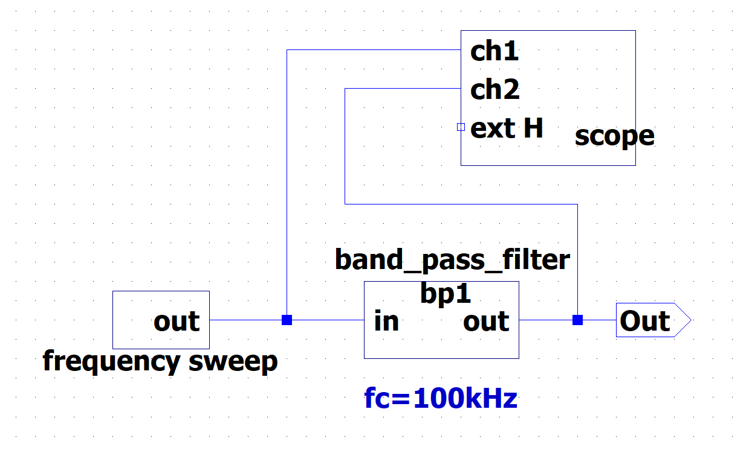
Test circuit
The center frequency is 100kHz. It is set digitally.
The pass band width is set by component values in this case.

Slide 4
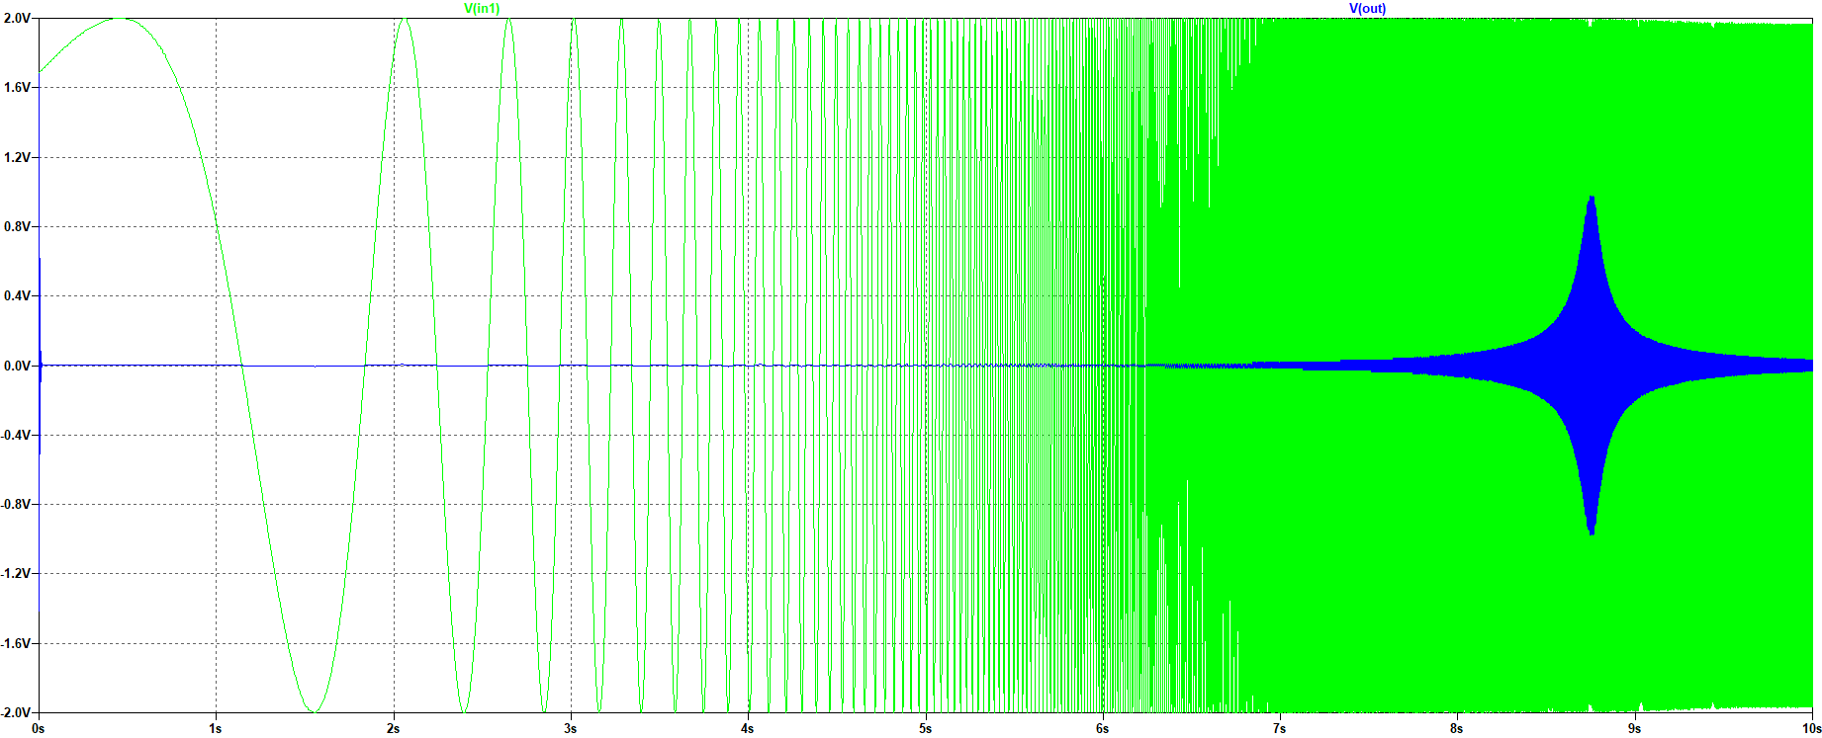
Band_pass1_id.asc Simulation
Green = input, constant amplitude over frequency
Blue: band pass filtered output

Slide 5
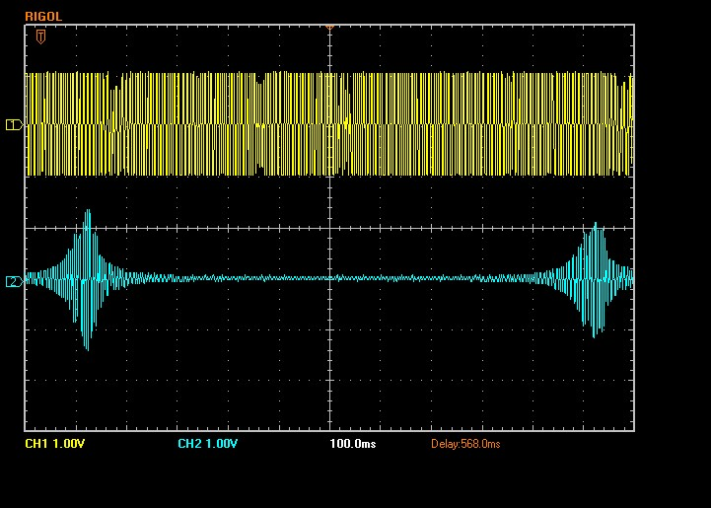
Prototype results:
Pass band <1kHz wide at
100kHz center frequency
Filter input: 2V pp swept from 99kHz to 101Khz
(saw tooth sweep up)
Filter output: output 2V pp at 100KHz.
99kHz
100kHz
100kHz
Scope photos (bpf_100khz.ult)

Slide 6
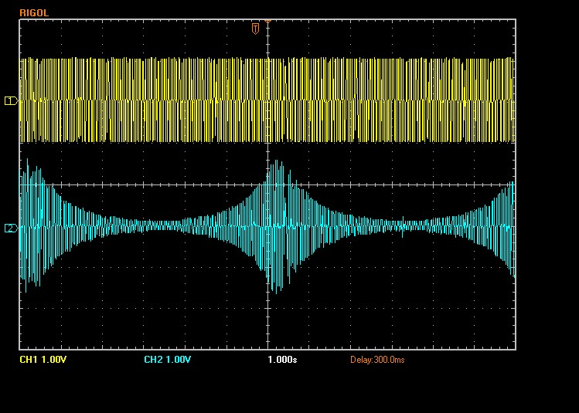
Pass band 3db width ~70Hz at f_{c} =100kHz
High resolution Sweep:
Filter input: 2V pp swept from 99.8kHz to 100.2Khz
(saw tooth sweep up)
Filter output:
3db full width ~70Hz
99.8kHz
100kHz

Slide 7
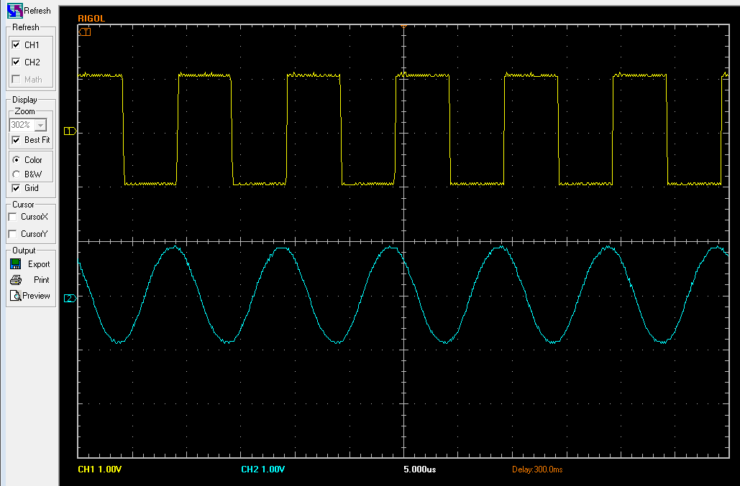
Square wave to sine converter: 100 kHz
Ch1=ch2= 1V/div, 5us/div
Filter input: 100kHz square wave
Filter output: 100 kHz sine wave
This circuit can convert square waves to sine waves from 1Hz to 100Mhz with no hardware changes.

