Slide 1
soil moisture automation starts with sensors to lorawan to your database...
placeholder: swap in your sensor and gateway montage showing how probes stream data
placeholder: drop pipeline diagram from probes → lorawan → processing → sqlite store
Notes:
Use this slide to insert real photos of the hardware and pipeline schematic.

Slide 2
lesson one check the raw ingest so you know the season span and anomalies...
eleven week window per plot covering july nineteenth to october thirteenth twenty twenty three
raw extract shows hourly rows with duplicated timestamps and sensor flatlines to flag
clean sample snippet reveals sorted indices and engineered time columns ready for modeling

Slide 3
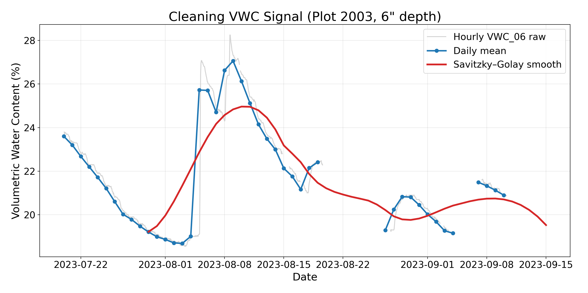
lesson two smooth without losing irrigation pulses so the agronomy signal stays crisp...
hourly vwc is noisy so we daily average then apply pchip interpolation to respect recharge
savitzky golay window of twenty one preserves irrigation peaks while suppressing jitter
resulting curve aligns with field behaviour and feeds the downstream feature engineering

Slide 4
lesson three engineer irrigation features that match how agronomists reason...
log precipitation plus one shrinks outliers while binary irrigation flag marks actuator hits
seven day cumulative precipitation approximates soil water budget for scheduling decisions
time since significant rainfall exposes stress buildup when irrigation is overdue

Slide 5
lesson four document the cuts so teammates trust the feature buffet they inherit...
kept buckets: soil moisture layers, temporal encodings, weather loads, irrigation context
removed bucket: forty two inch probe flatlines, sparse crop metadata, redundant elevation and stress indices
every cut is logged in the notebook so future seasons can revisit decisions quickly

Slide 6
lesson five explain the sequence framing before showing the model output...
seven day sliding window feeds the lstm with one hundred sixty eight hourly rows
forecast horizon of ninety six hours covers the next irrigation visit cycle
diagram makes the input output relation obvious to both data folks and agronomists

Slide 7
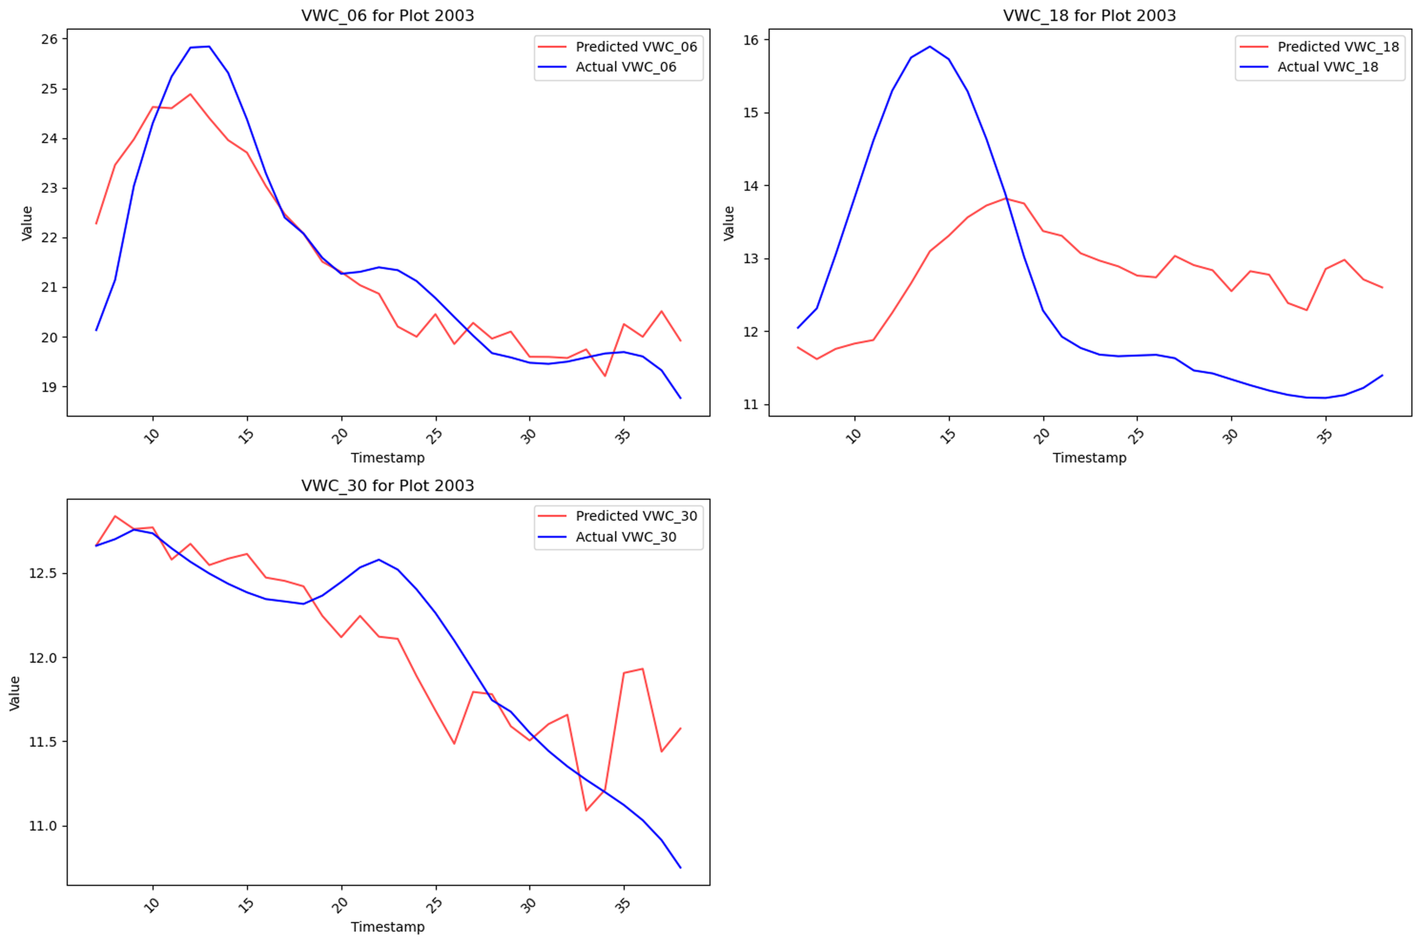
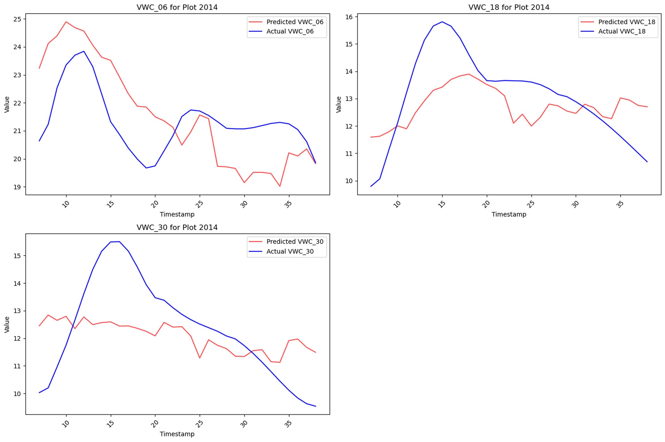
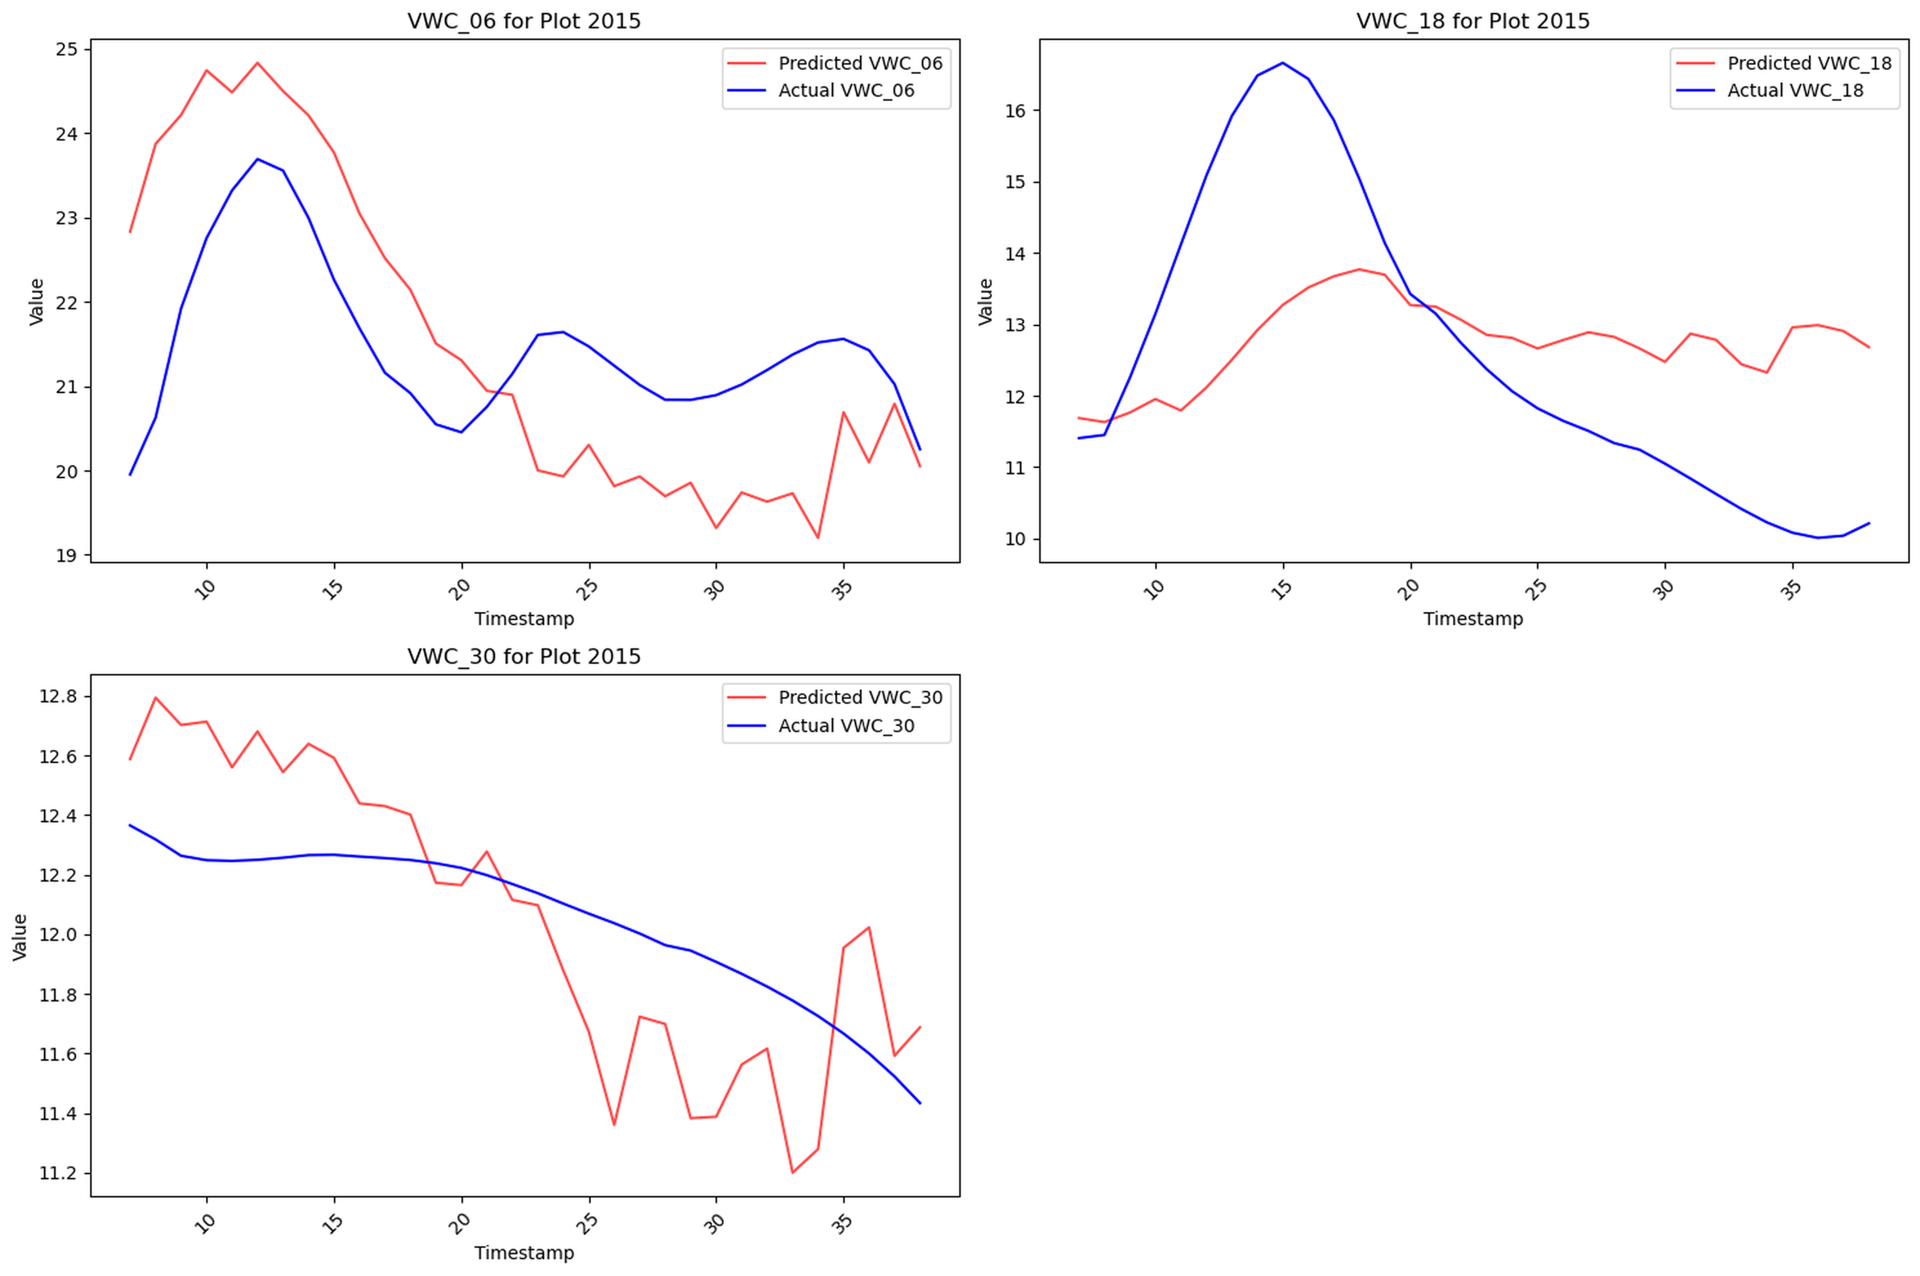
lesson six show case studies so audiences see what the model gets right and wrong...
plot two zero zero three surface layer tracks well yet deeper layers lag after irrigation
plot two zero one four bias high because dry down exemplars were missing in training
plot two zero one five lags forty eight hours proving the fold reuse bug and irrigation imbalance

Slide 8
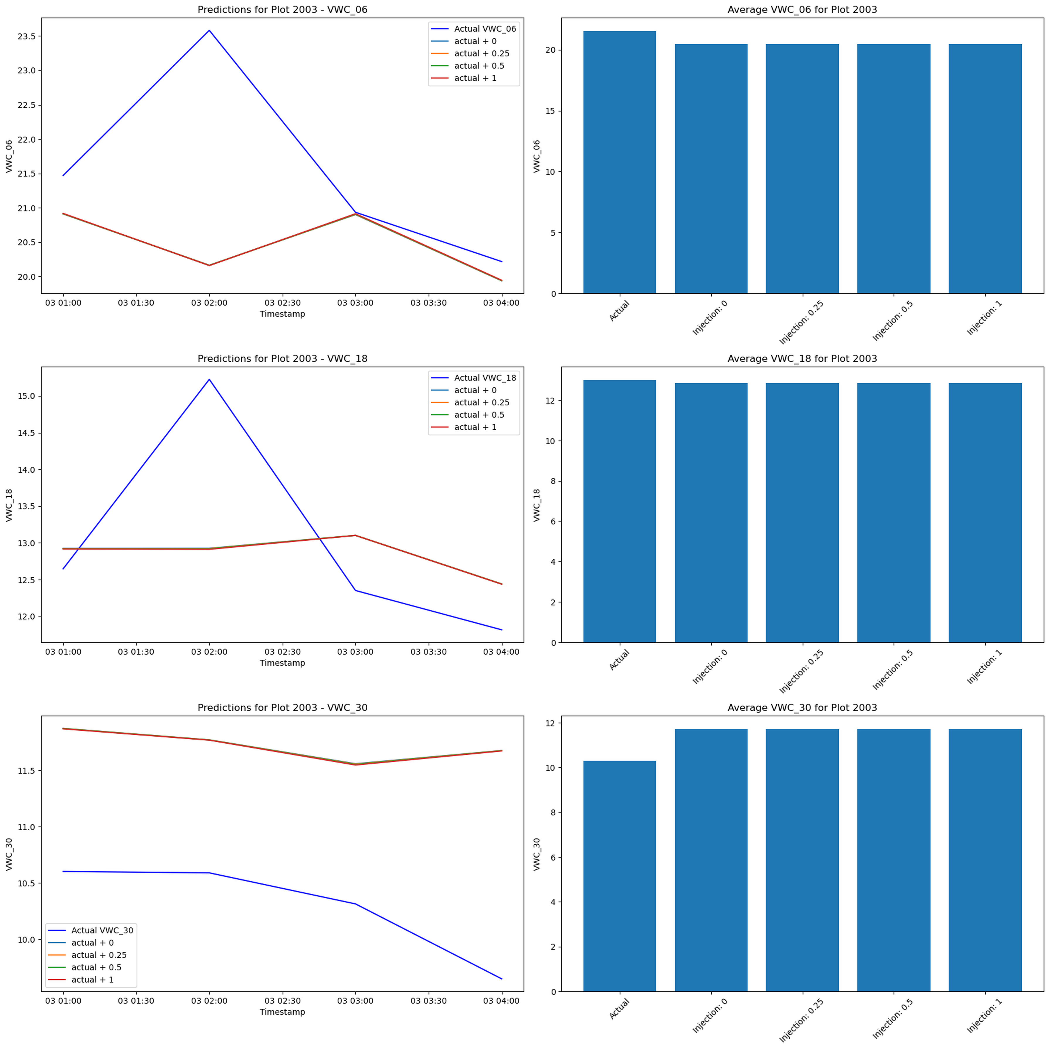
lesson seven dissect the failure so everyone learns how to avoid it next season...
injection happened after scaling so engineered features stayed frozen and the model saw no change
scaled precip irrigation exceeded buffered range which pushed the lstm off its training manifold
lack of cross plot diversity meant the network defaulted to trend continuation instead of reacting

Slide 9
lesson eight close with the reusable kit and the two fixes queued for next season...
data cleaning and irrigation feature stack are production ready and already documented
next tasks: recompute features before sensitivity tests and repair the timeseries split logic
share the notebook and slides as onboarding material for agronomists and controls teammates

