Slide 1
EDA Story – ML IoT Independent Study
Bryan Nsoh

Slide 2
Big Picture
Goal: forecast volumetric water content (VWC) to automate irrigation decisions for LoRaWAN-connected plots
Deliver 20–25 min walkthrough of messy field data → modeling → failure analysis
Focus on single notebook VWClstm-daily-injection.ipynb + SQLite store processed_data.db
Present every design decision, rationale, and outcome transparently

Slide 3
Data Context
Source: data_table in Archive/processed_data.db (37 704 rows, July 19 – Oct 13, 2023)
36 plots, hourly telemetry (weather, canopy temp, irrigation totals, four VWC depths)
Target depths used: 6“, 18”, 30“; 42” discarded after quality review
Short seasonal window ⇒ only ~11 weeks of signal per plot; must squeeze learning from dense feature stack

Slide 4
Initial Audit
Missingness: irrigation often zero; VWC sensors occasionally flatline or spike
Duplicate timestamps resolved via drop_duplicates() prior to indexing
Hourly cadence mostly consistent (≈1 080 samples per plot subset)
Takeaway: model must tolerate sparse irrigation events and noisy soil probes

Slide 5
Cleaning Pipeline
Trim leading/trailing NaN runs with trim_start_end_nans
Resample daily for visualization, but keep hourly data for modeling
PCHIP interpolation to fill interior gaps without step artefacts
Savitzky–Golay smoothing (window = 20) to suppress probe noise without lagging events

Slide 6
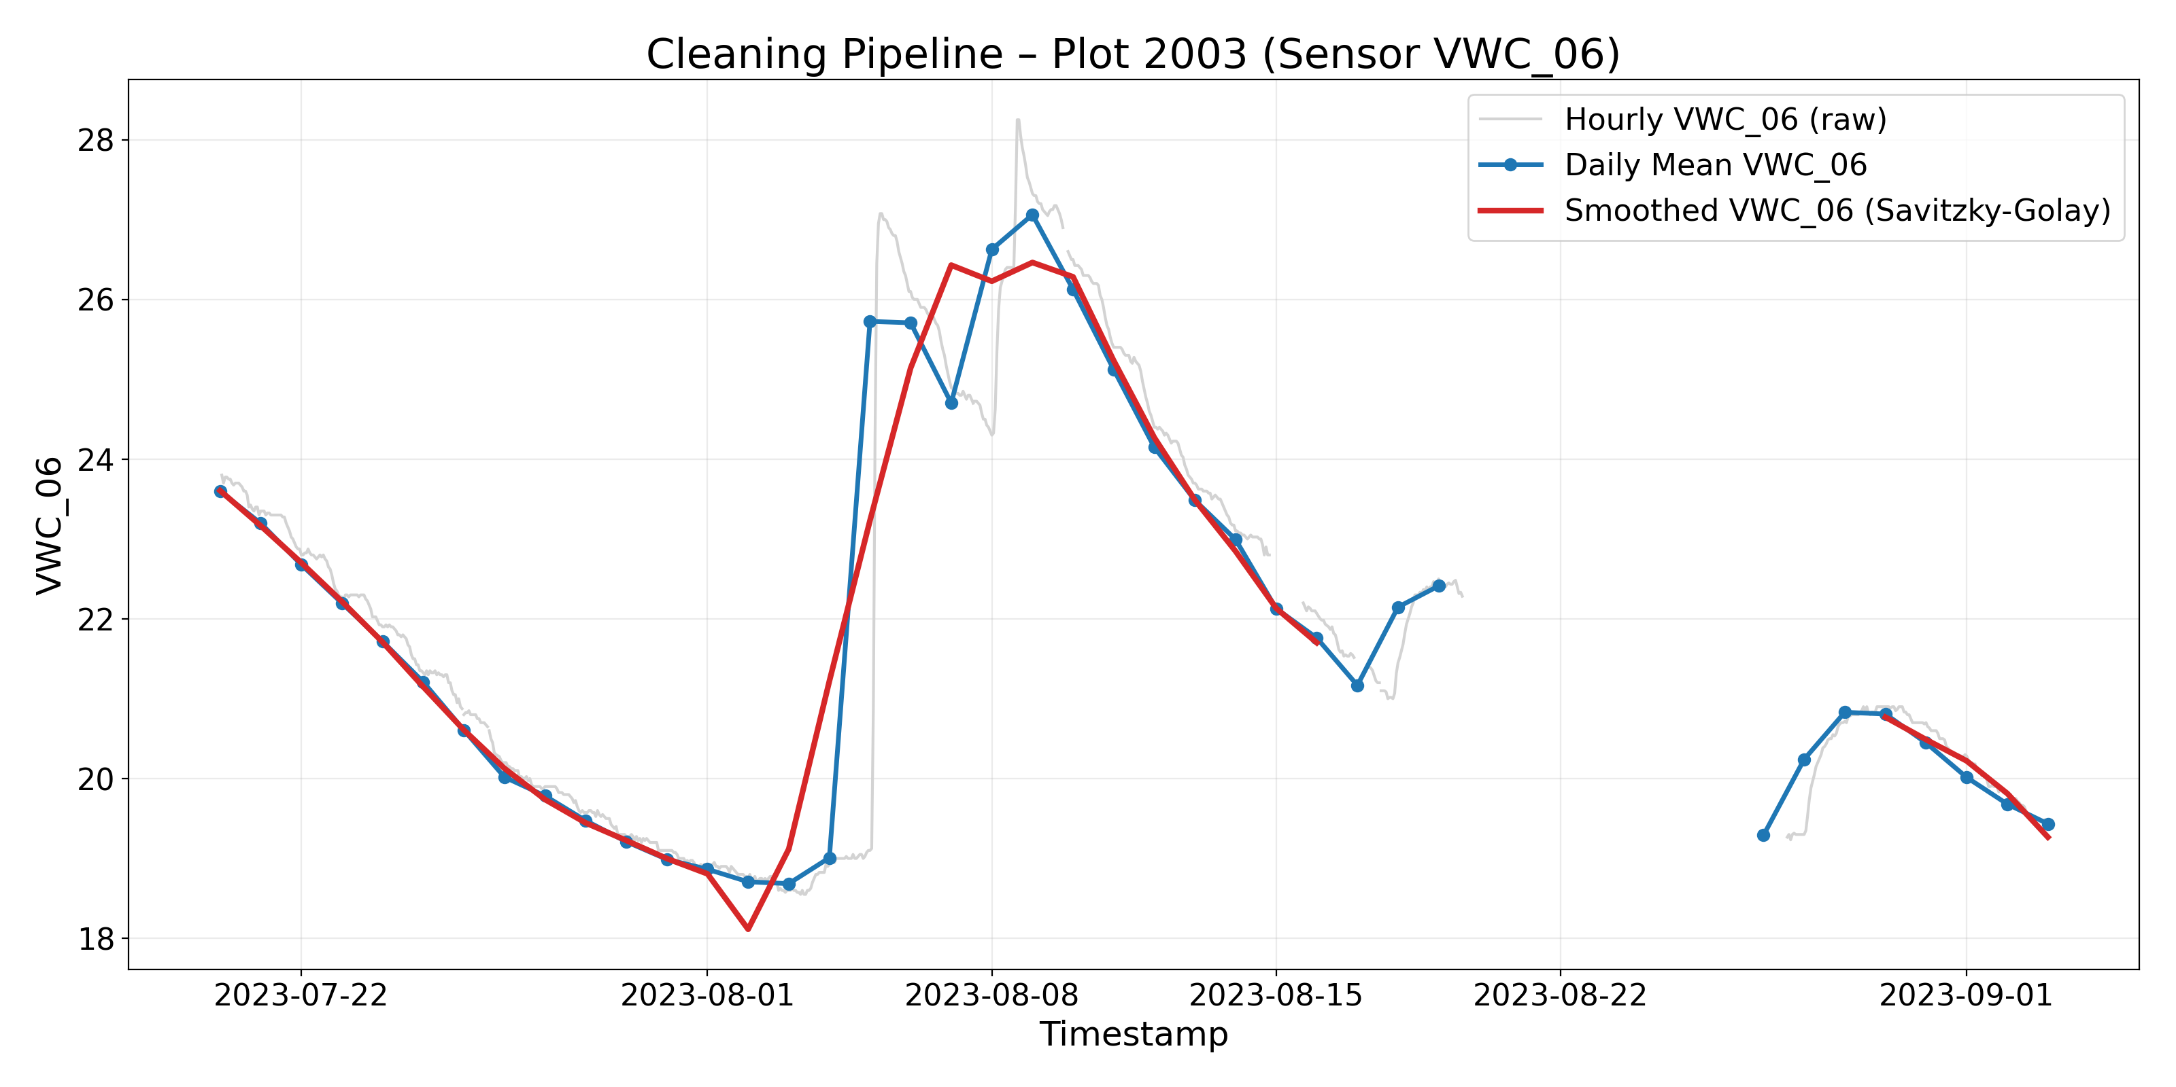
Cleaning pipeline

Slide 7
Feature Engineering
Spike flags: VWC_*_spike_up/down capture ±15 % day-to-day jumps
Irrigation history: time_since_last_significant_precip, time_since_last_half_max_precip, rolling 7-day cumulative
Log transform + binary flag for irrigation to boost rare-event visibility
Mean-centering + first-difference derivatives for each VWC depth before scaling

Slide 8
Reduced Feature Set
After cuts: 17 continuous + 3 VWC targets + 3 VWC derivatives + irrigation flag
Drops include: categorical crop/growth stage (sparse), VWC_42 (noisy), redundant weather extrema combinations
Scaling via buffered MinMaxScaler preserves future headroom (±30 %)

Slide 9
Training Workflow
Sliding window: 7-day input (168 hourly steps) → 4-day horizon (96 hourly steps)
TimeSeriesSplit (5 folds) intended for cross-plot validation, but bug feeds only first plot’s folds → limited generalization
LSTM stack: 512→256→128→128→64 with dropout + L2; Dense reshaped to horizon × targets
Early stopping on mean fold MSE; best weights saved in LSTM_dayhour/

Slide 10
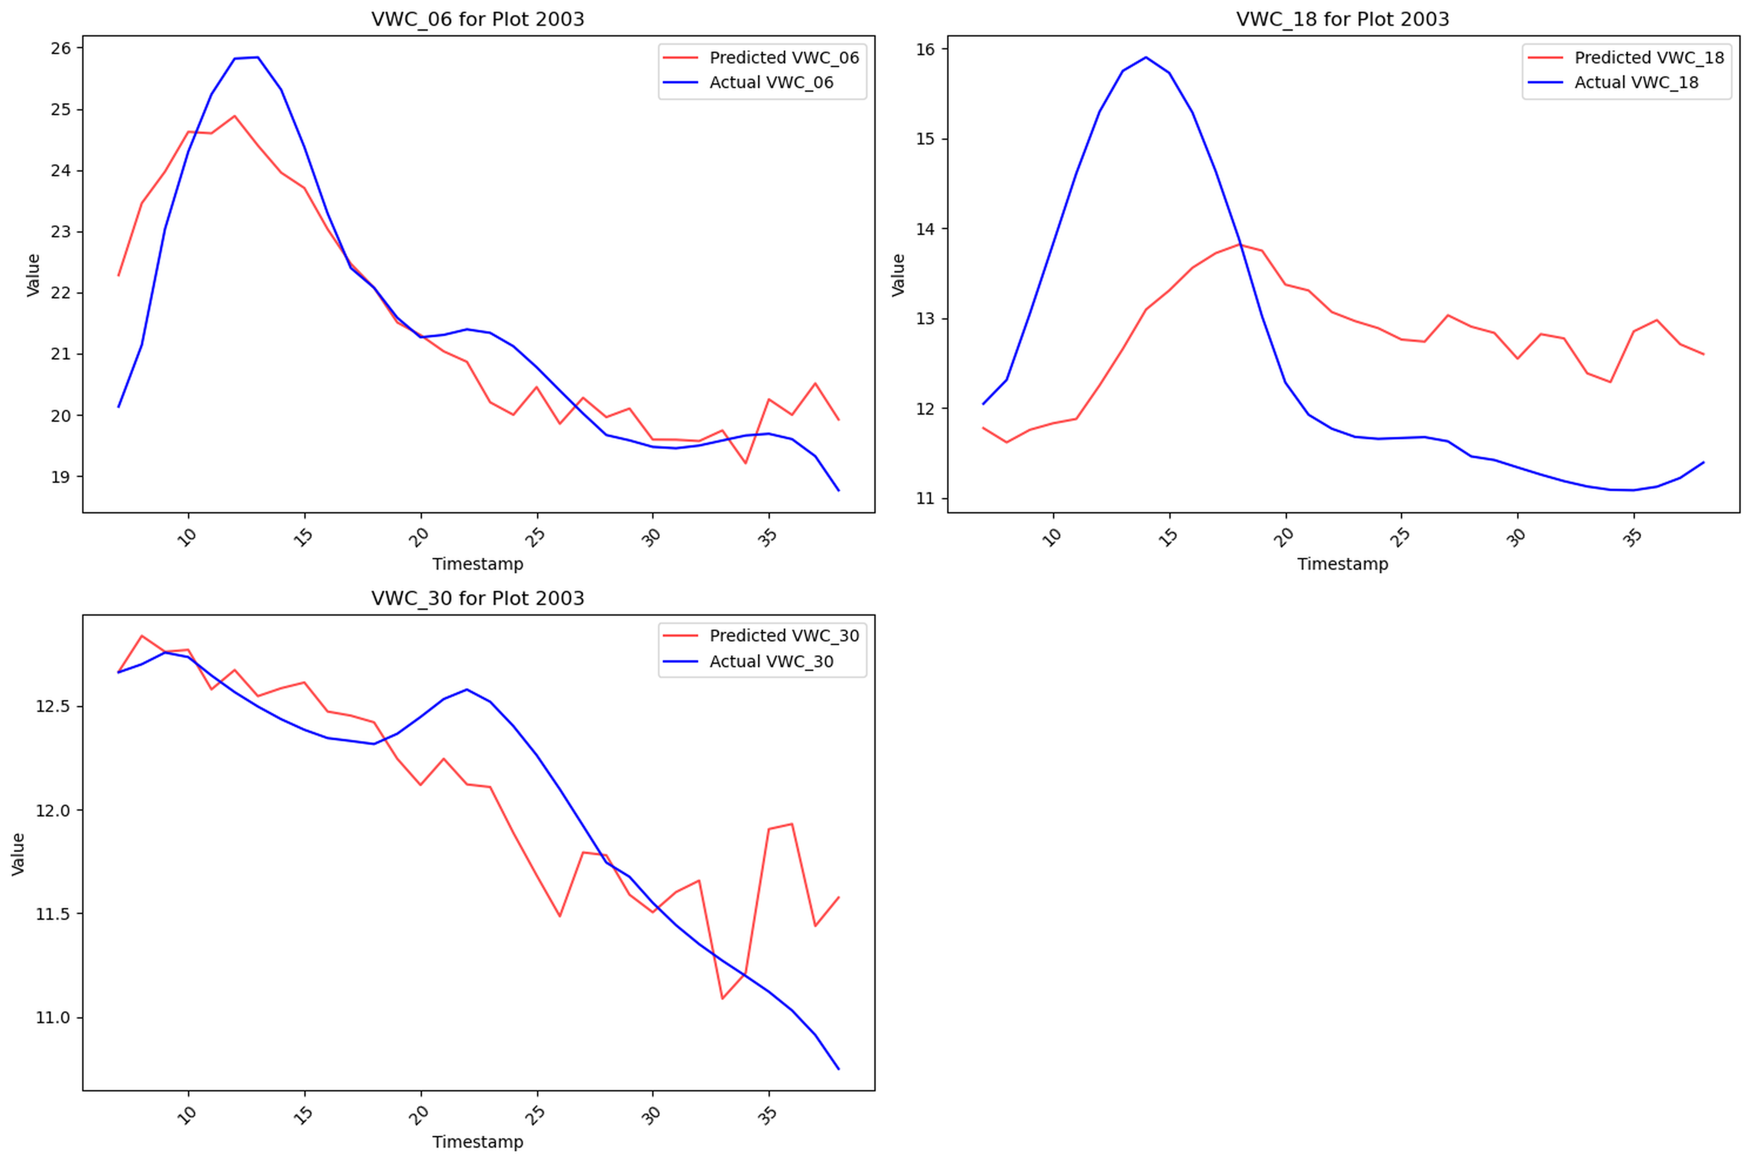
Model Behaviour – Plot 2003
Pred vs actual – Plot 2003

Slide 11
- Captures overall decay/trend but underestimates irrigation rebounds - Surface layer (6") best aligned; deeper probes drift shortly after forecast window starts

Slide 12
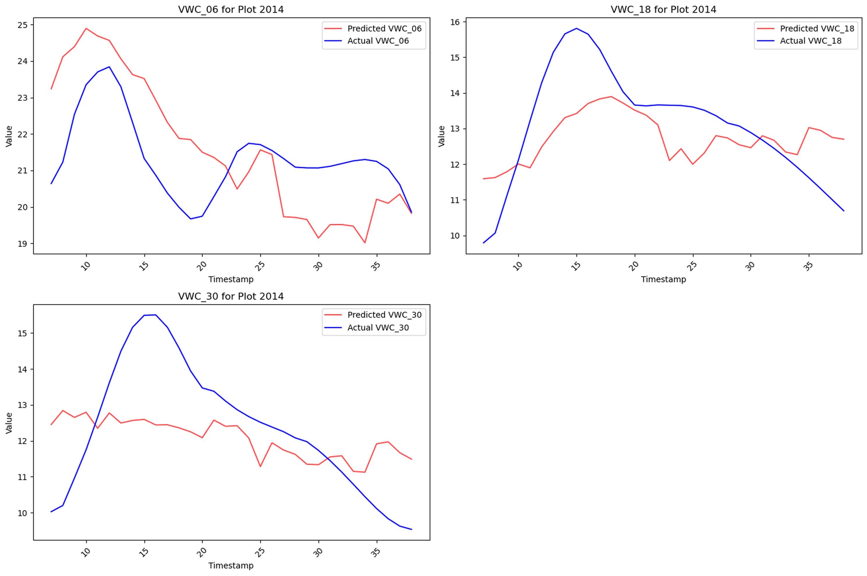
Model Behaviour – Plot 2014
Pred vs actual – Plot 2014

Slide 13
- Systematic positive bias on 6" depth → likely due to limited drydown examples in training folds - 18“/30” profiles miss the sharp post-irrigation peak entirely

Slide 14
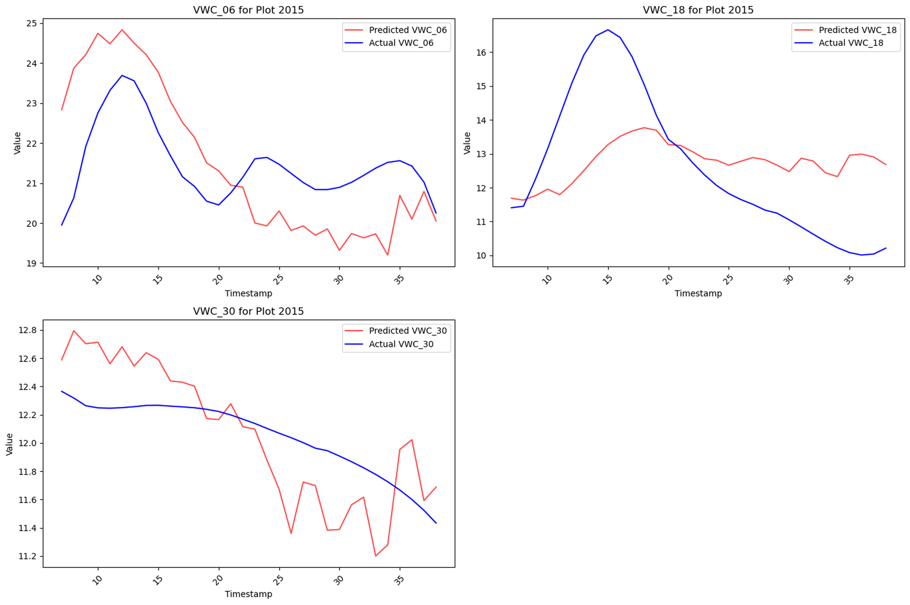
Model Behaviour – Plot 2015
Pred vs actual – Plot 2015

Slide 15
- Model follows trend but lags actuals by ~2 days; deeper probe diverges once soil drains - Highlights dataset imbalance: this plot irrigated more aggressively than training plots

Slide 16
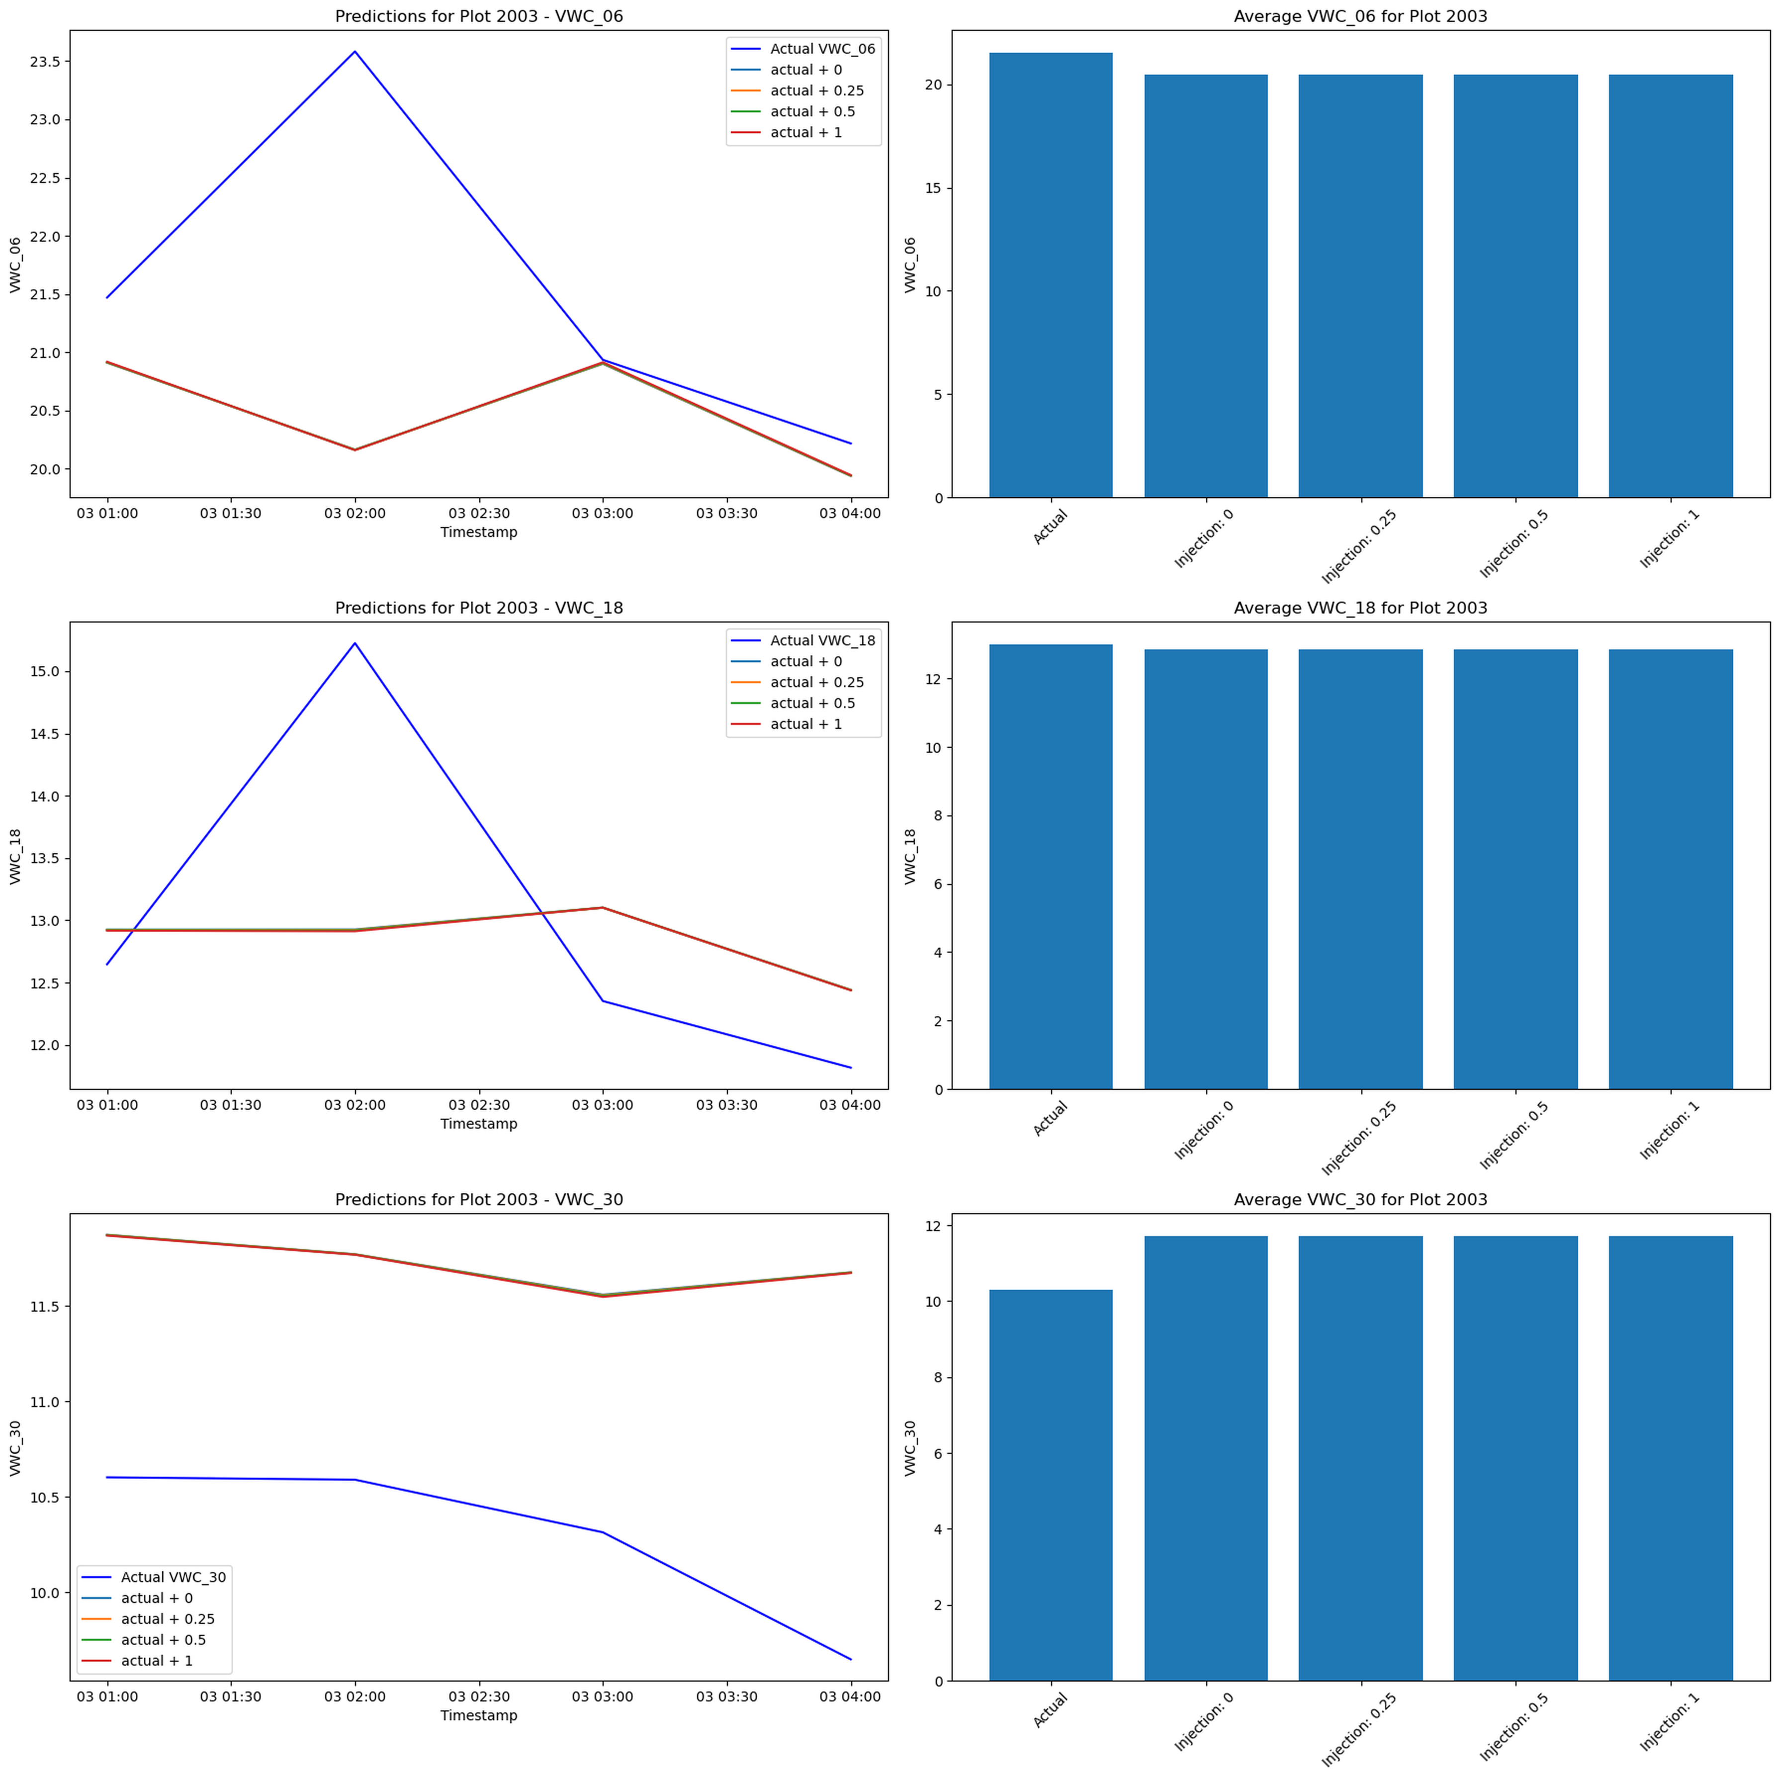
Injection Experiment
Injection sweep

Slide 17
- Synthetic irrigation (+0.25, +0.5, +1.0) applied just before forecast - Desired outcome: higher predicted VWC correlating with injection size - Observed: predictions nearly flat; averages barely change across injections

Slide 18
Why Irrigation Fails
Injection added after scaling ⇒ engineered features (precip_irrig_log, flags, rolling sums) unchanged, starving the network of irrigation cues
Adding 0.25–1.0 to the scaled feature pushes it beyond training range (MinMax [0,1]), inducing distribution shift the LSTM never saw
Training bug reused folds from the first plot only, so the model never learned cross-plot irrigation variability; unseen responses default to trend continuation

Slide 19
Lessons Learned
Cleaning pipeline solid, but engineered irrigation features must update whenever interventions occur
Fix fold selection to ensure each plot contributes to training/validation
Re-inject irrigation prior to scaling and recompute transforms to test sensitivity honestly
Future modelling: consider hybrid physics constraints or attention on precipitation signals

Slide 20
Next Steps
Rebuild training workflow with correct fold splitting + data augmentation on irrigation events
Create automated figure scripts (post-analysis) to regenerate slides as data evolves
Package notebook narrative into live demo for Q&A on transformation choices

