Slide 1

soil moisture automation needs sensor context so here is the field we logged...
lorawan nodes sample volumetric water content at 6, 18, and 30 inch depths every hour
the weather mast streams air temperature, humidity, wind, canopy temperature, and rainfall
irrigation totals sync from the controller so agronomists see actuations alongside sensors

Slide 2
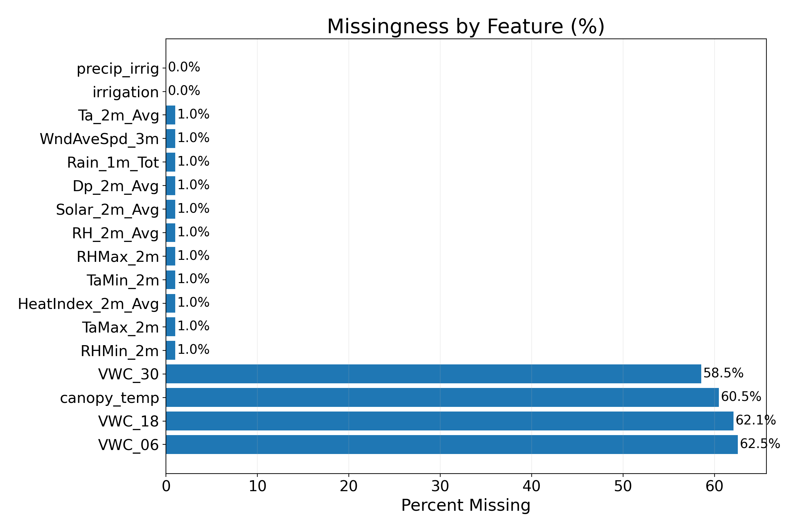
before modeling we check coverage so you see the telemetry gaps...
core soil moisture and weather channels exceed eighty percent availability for the season
stress indices such as cwsi swsi and daily et stayed too sparse to trust in training
categorical crop and growth stage notes were largely absent so we excluded them

Slide 3
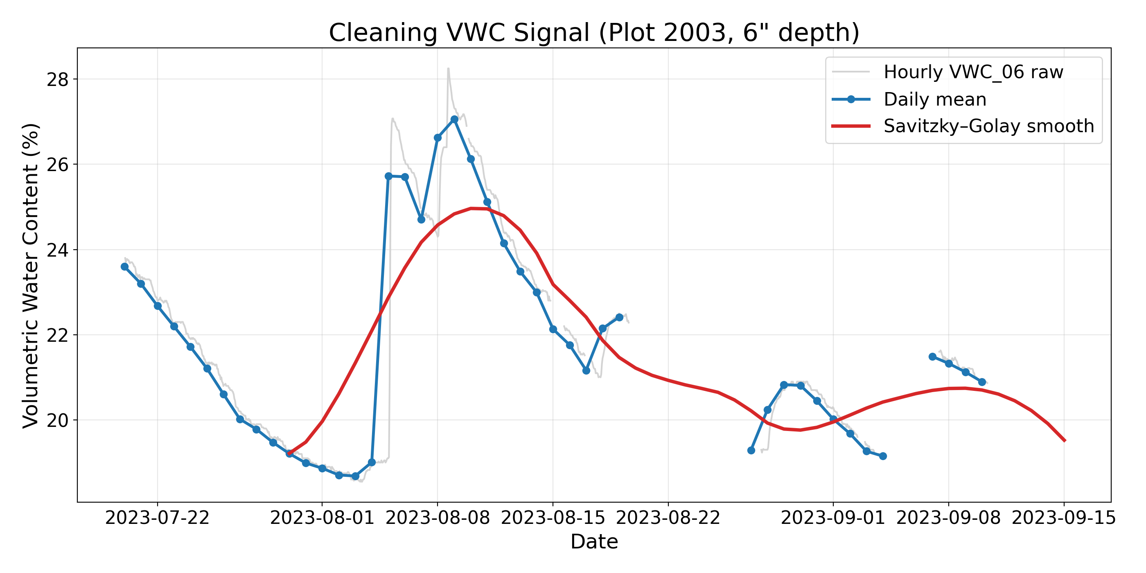
raw probes jitter so domain smoothing keeps irrigation pulses intact...
hourly volumetric water content is spiky because of sensor noise and extraction cycles
daily means plus pchip interpolation honour the recharge curve between irrigations
a savitzky golay window of twenty one keeps irrigation peaks while suppressing jitter

Slide 4
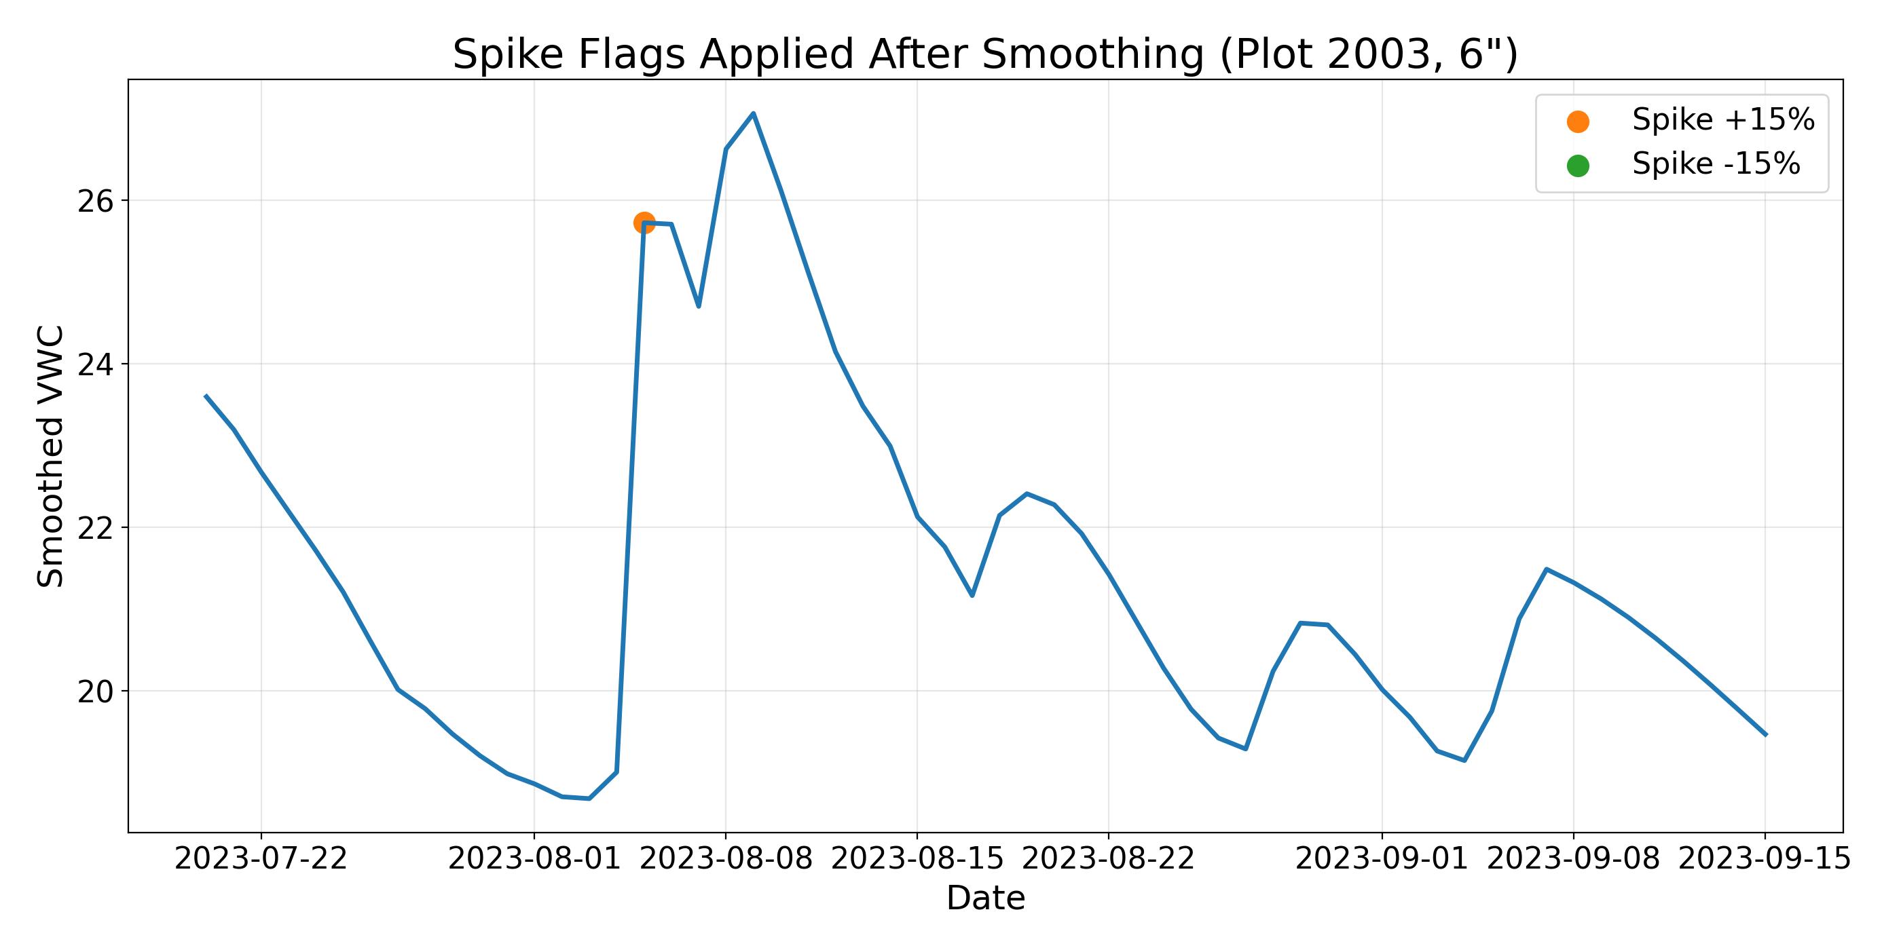
spike flags separate irrigation jumps from drift so alerts stay actionable...
we flag plus fifteen percent day over day jumps as irrigation or rainfall response candidates
minus fifteen percent drops reveal drainage events or sensor faults that need review
these flags feed downstream labelling and dashboard alerts for the irrigation team

Slide 5
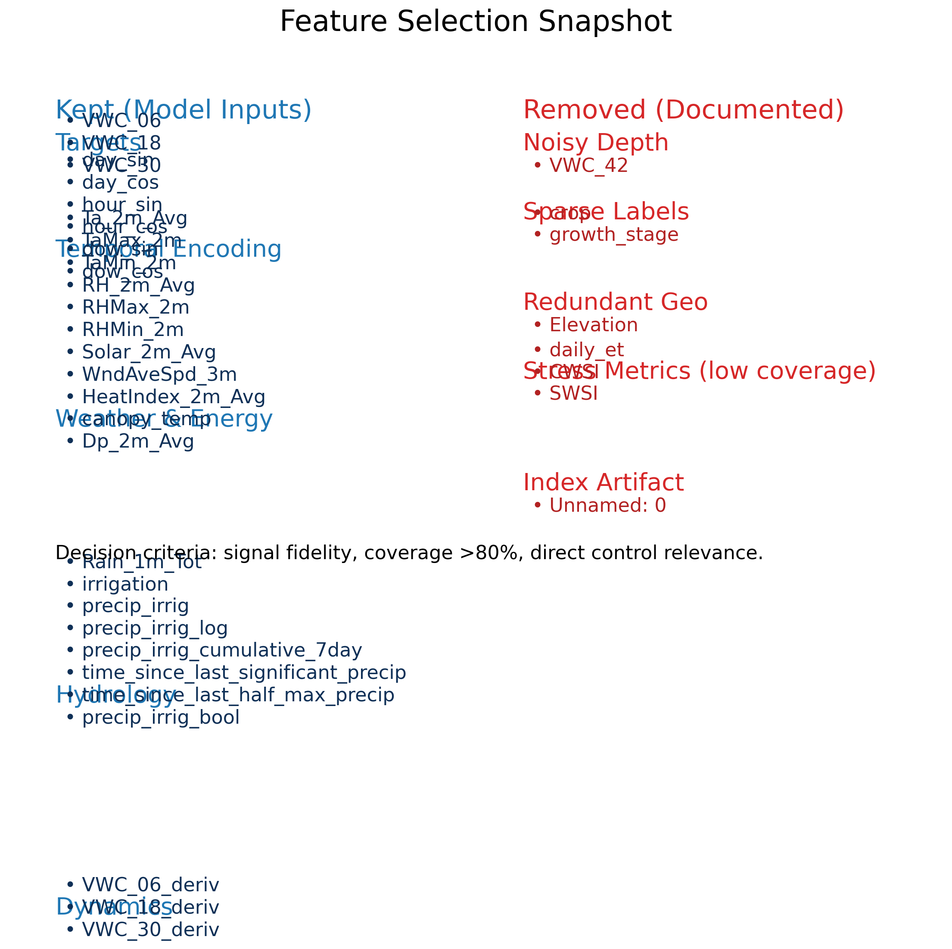
we cut noisy channels and keep agronomy signals so the feature set stays focused...
retained features cover soil moisture layers, time of day encoding, weather load, and irrigation context
forty two inch probes showed persistent flatlines so we documented and removed them
sparse crop metadata and redundant elevation columns were dropped to avoid leakage

Slide 6
domain transforms teach the lstm to feel rates and actuator events...
center each vwc depth per plot so the network learns deviations instead of static bias
compute delta vwc sub d of t equals vwc sub d of t minus vwc sub d of t minus one to encode drying velocity
log transform precipitation plus one and add a binary irrigation flag to highlight rare events

Slide 7
sequence framing and regularized lstm capture a week of history before forecasting four days...
one hundred sixty eight hour input window aligns with irrigation planning cadence
ninety six hour horizon meets the farm requirement for scheduling and monitoring
stacked five layer lstm 512 to 64 uses dropout and l2 regularisation to curb overfit
timeseriessplit was meant for leave one plot out yet the bug reused the first plot folds

Slide 8
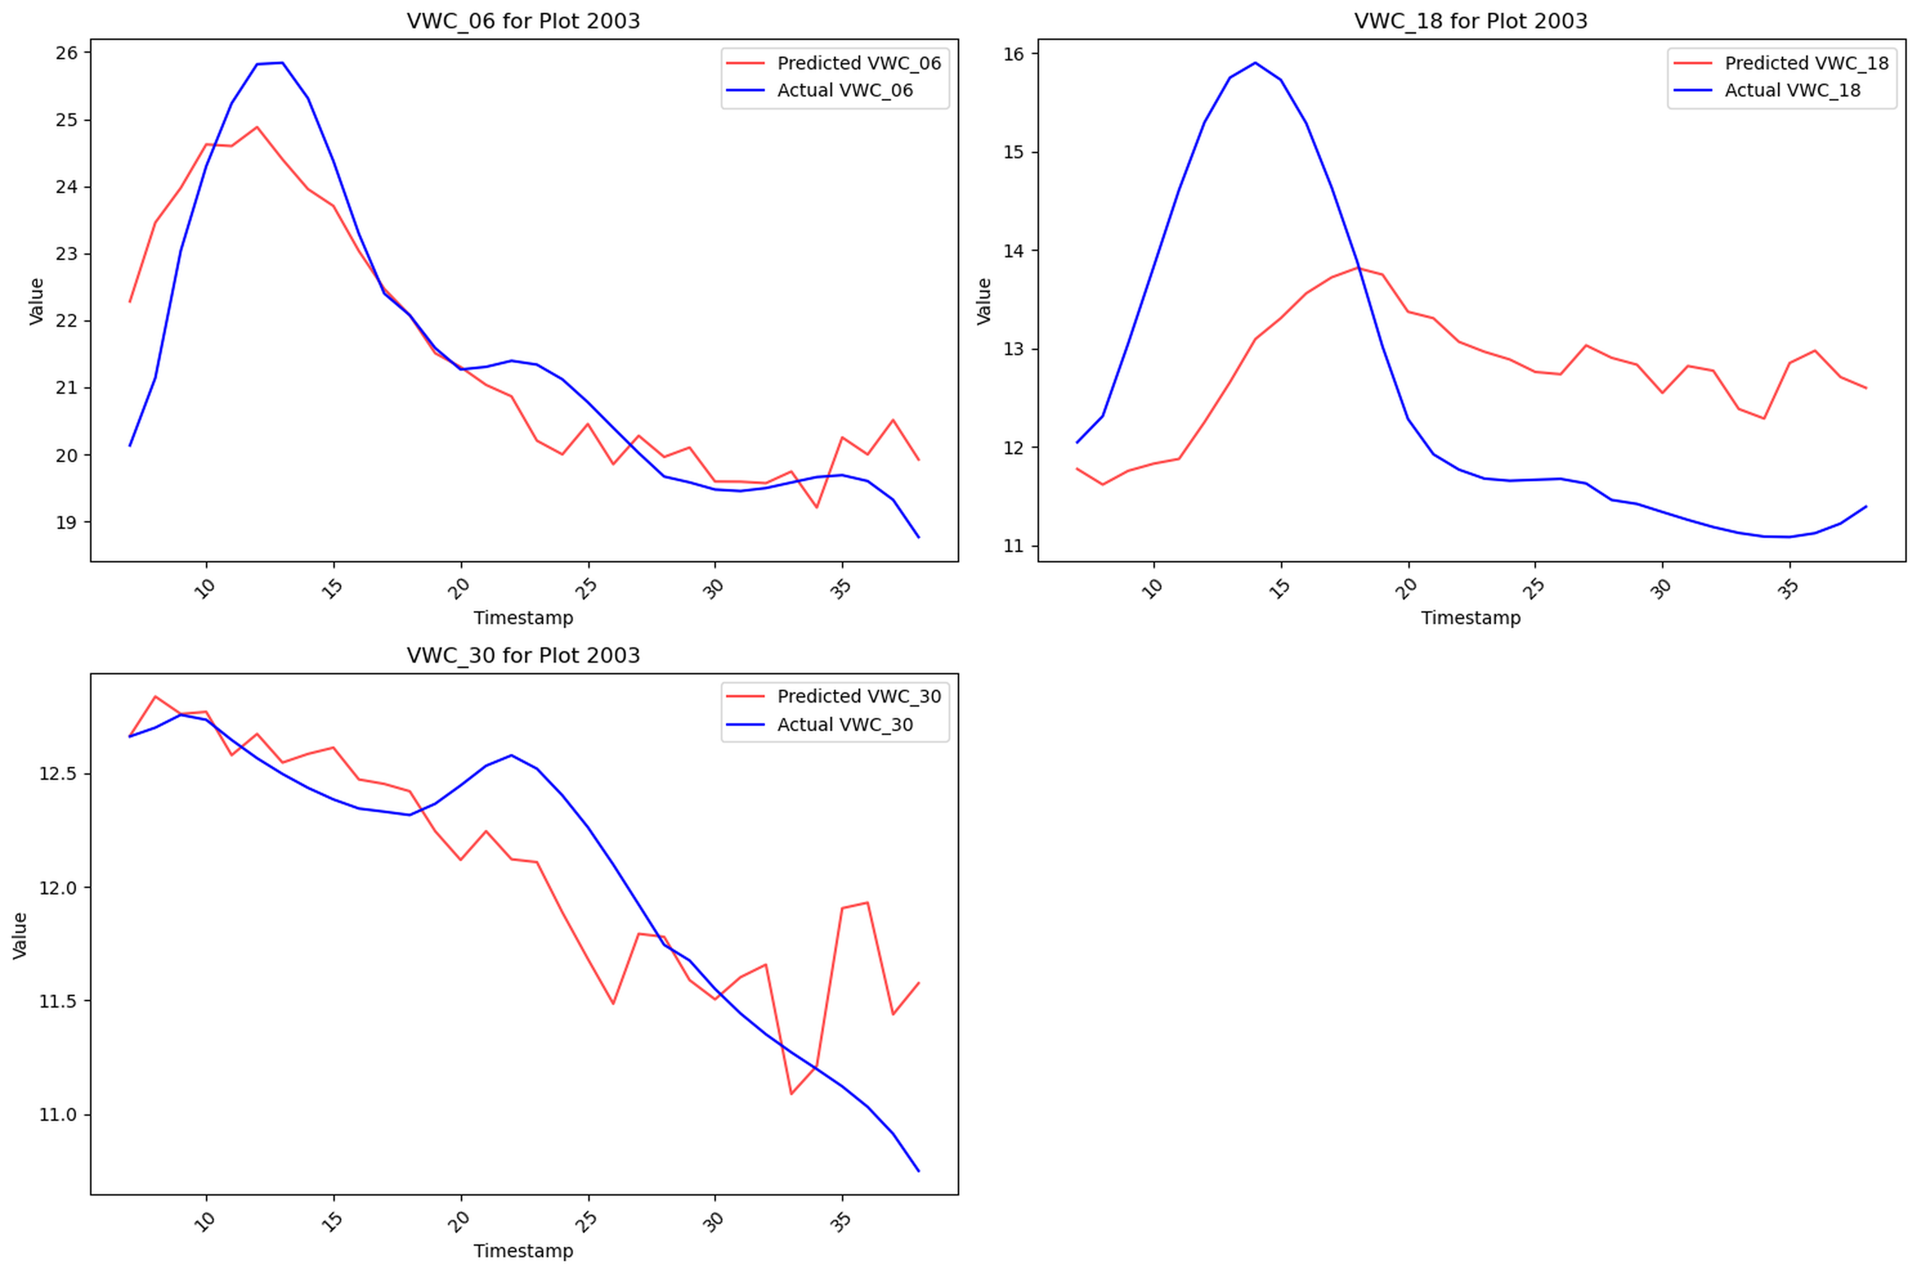
plot 2003 shows surface tracking while deeper layers lag revealing irrigation sensitivity gaps...
six inch predictions follow the smoothed trend but under react immediately after irrigation
eighteen and thirty inch layers respond too softly versus the ground truth rebounds
the model captured seasonal decline yet missed amplitude which is key for scheduling

Slide 9
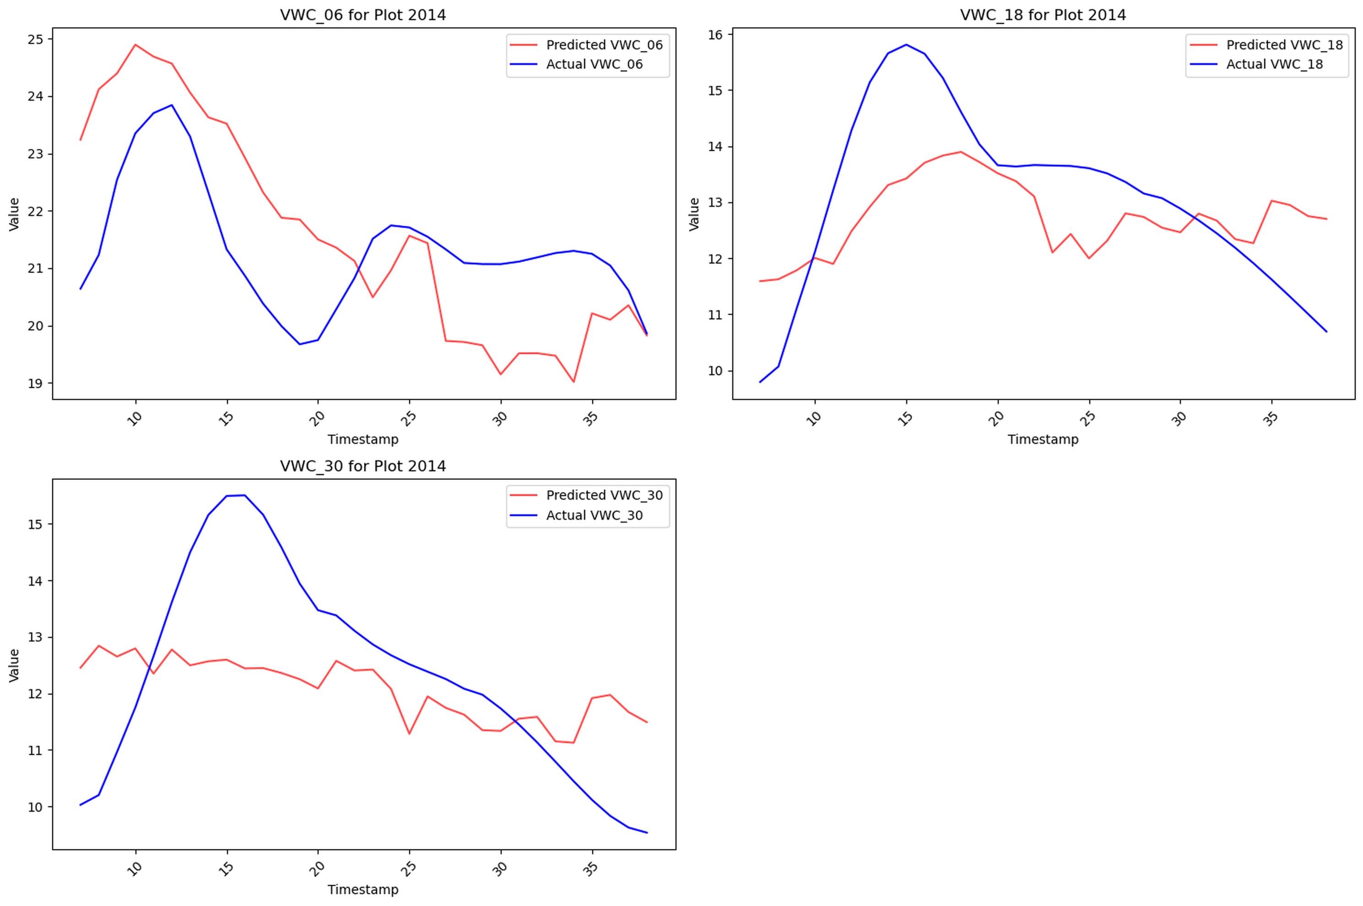
plot 2014 exposes positive bias because dry down exemplars were scarce in training...
surface depth stays elevated even as actual moisture declines after events
deeper probes fail to catch the sharp post irrigation spike that agronomists expect
highlights need for balanced dry and wet sequences from every plot in training

Slide 10
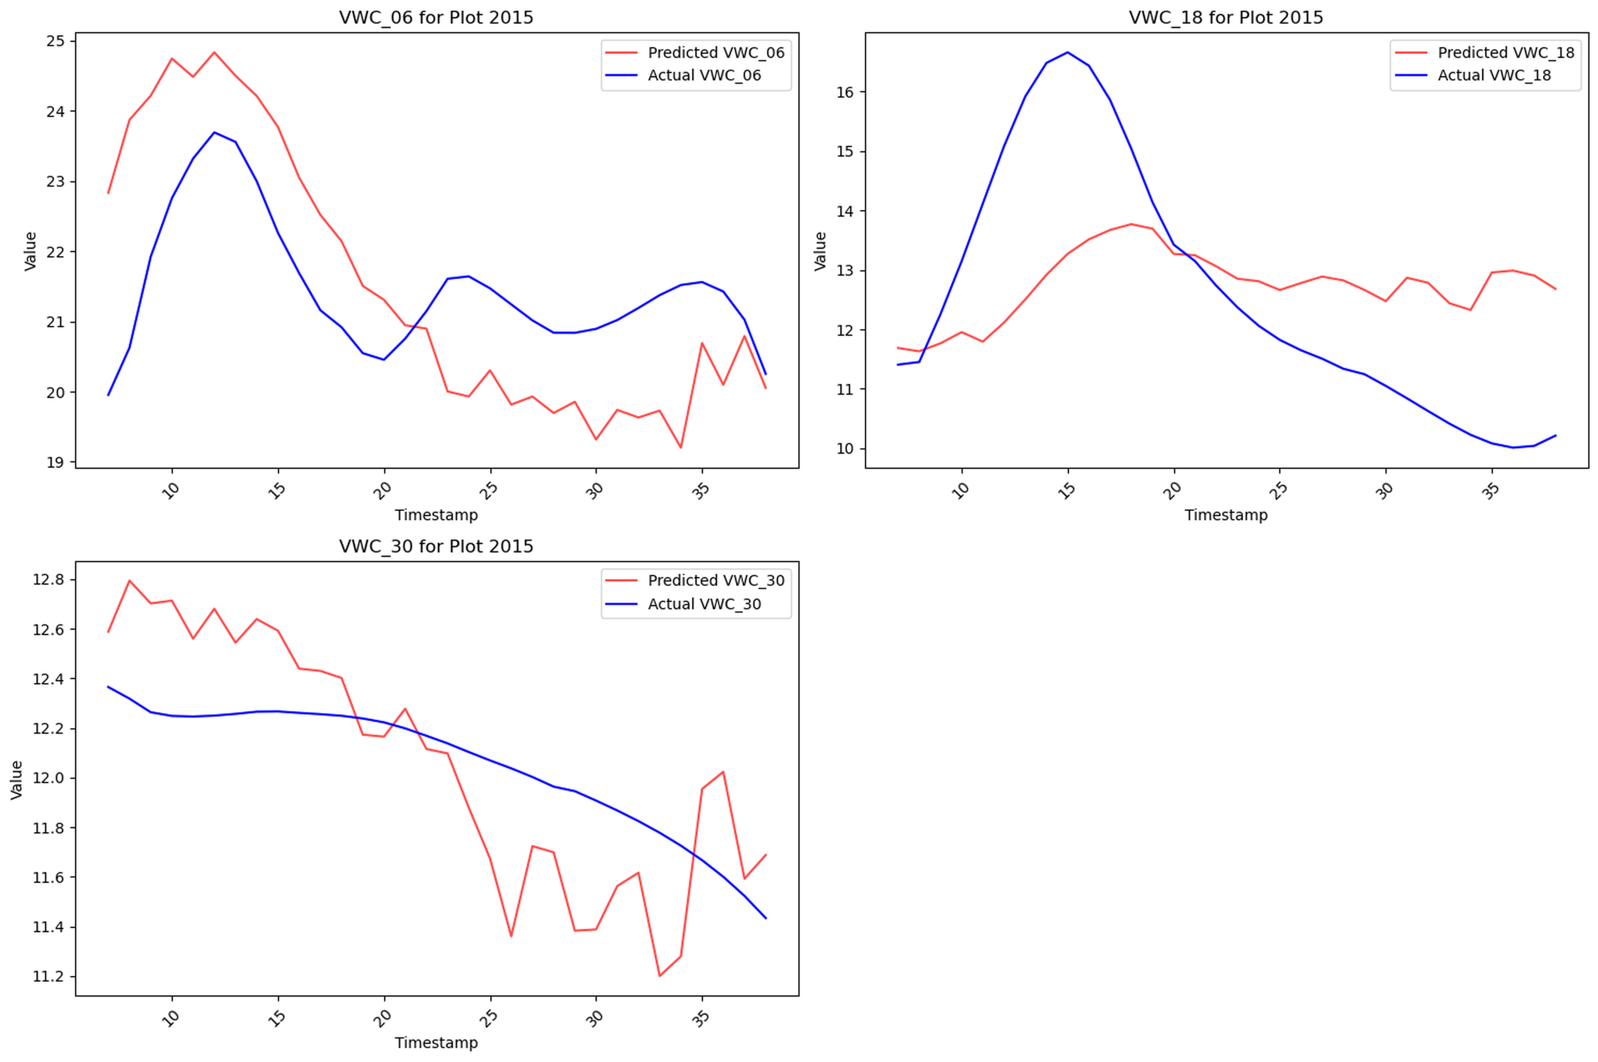
plot 2015 lags forty eight hours proving the fold reuse bug and irrigation imbalance...
forecasts trail the observed rebound by roughly two days across depths
training data lacked aggressive irrigation cycles represented in this plot
fixing the fold logic ensures each site contributes sequences and stops this lag

Slide 11
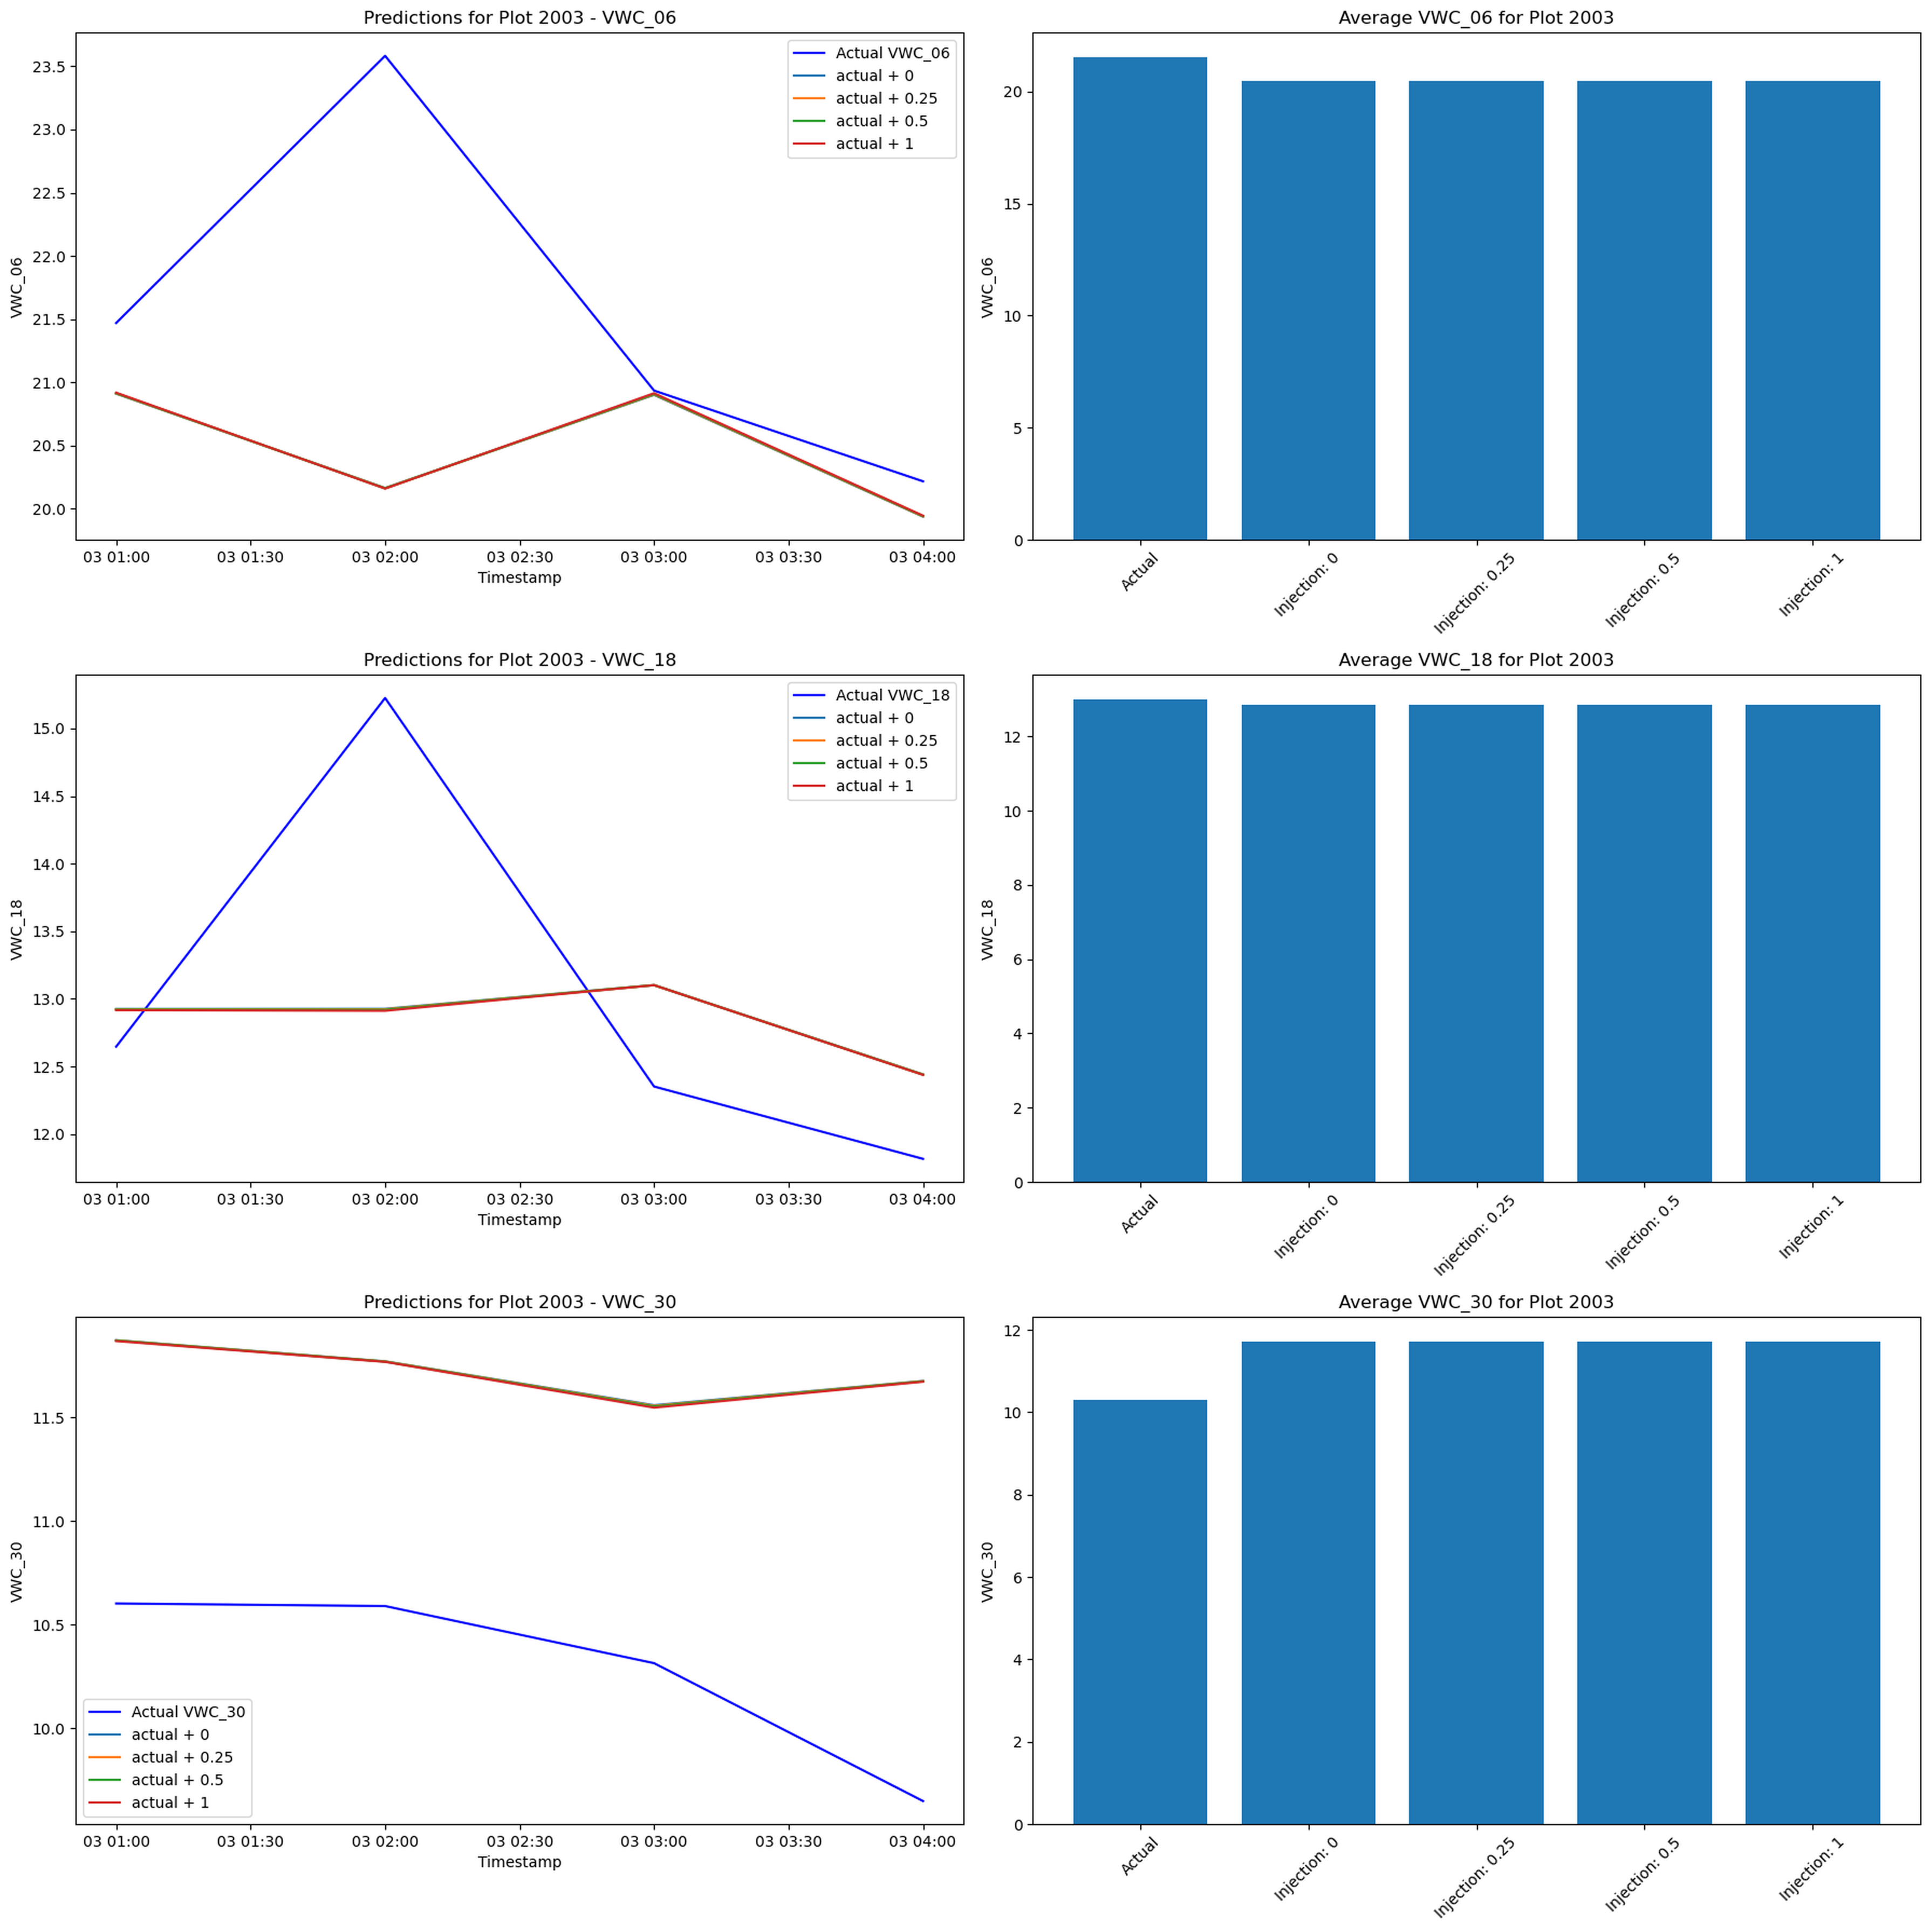
injection experiments fail because features never recompute and scaling shifts the inputs...
water gets added after scaling so engineered features like logs and cumulative sums stay frozen
scaled precip irrigation exceeds its buffered range which pushes the network off manifold
with little cross plot diversity the lstm defaults to trend continuation instead of reacting

Slide 12
lessons fuel next season so data prep stays but the modeling stack evolves...
current pipeline delivers clean engineered datasets ready for retraining and sharing
next iteration will recompute features before sensitivity tests and repair fold reuse
documented findings become onboarding material for agronomists and the controls team

