Slide 1
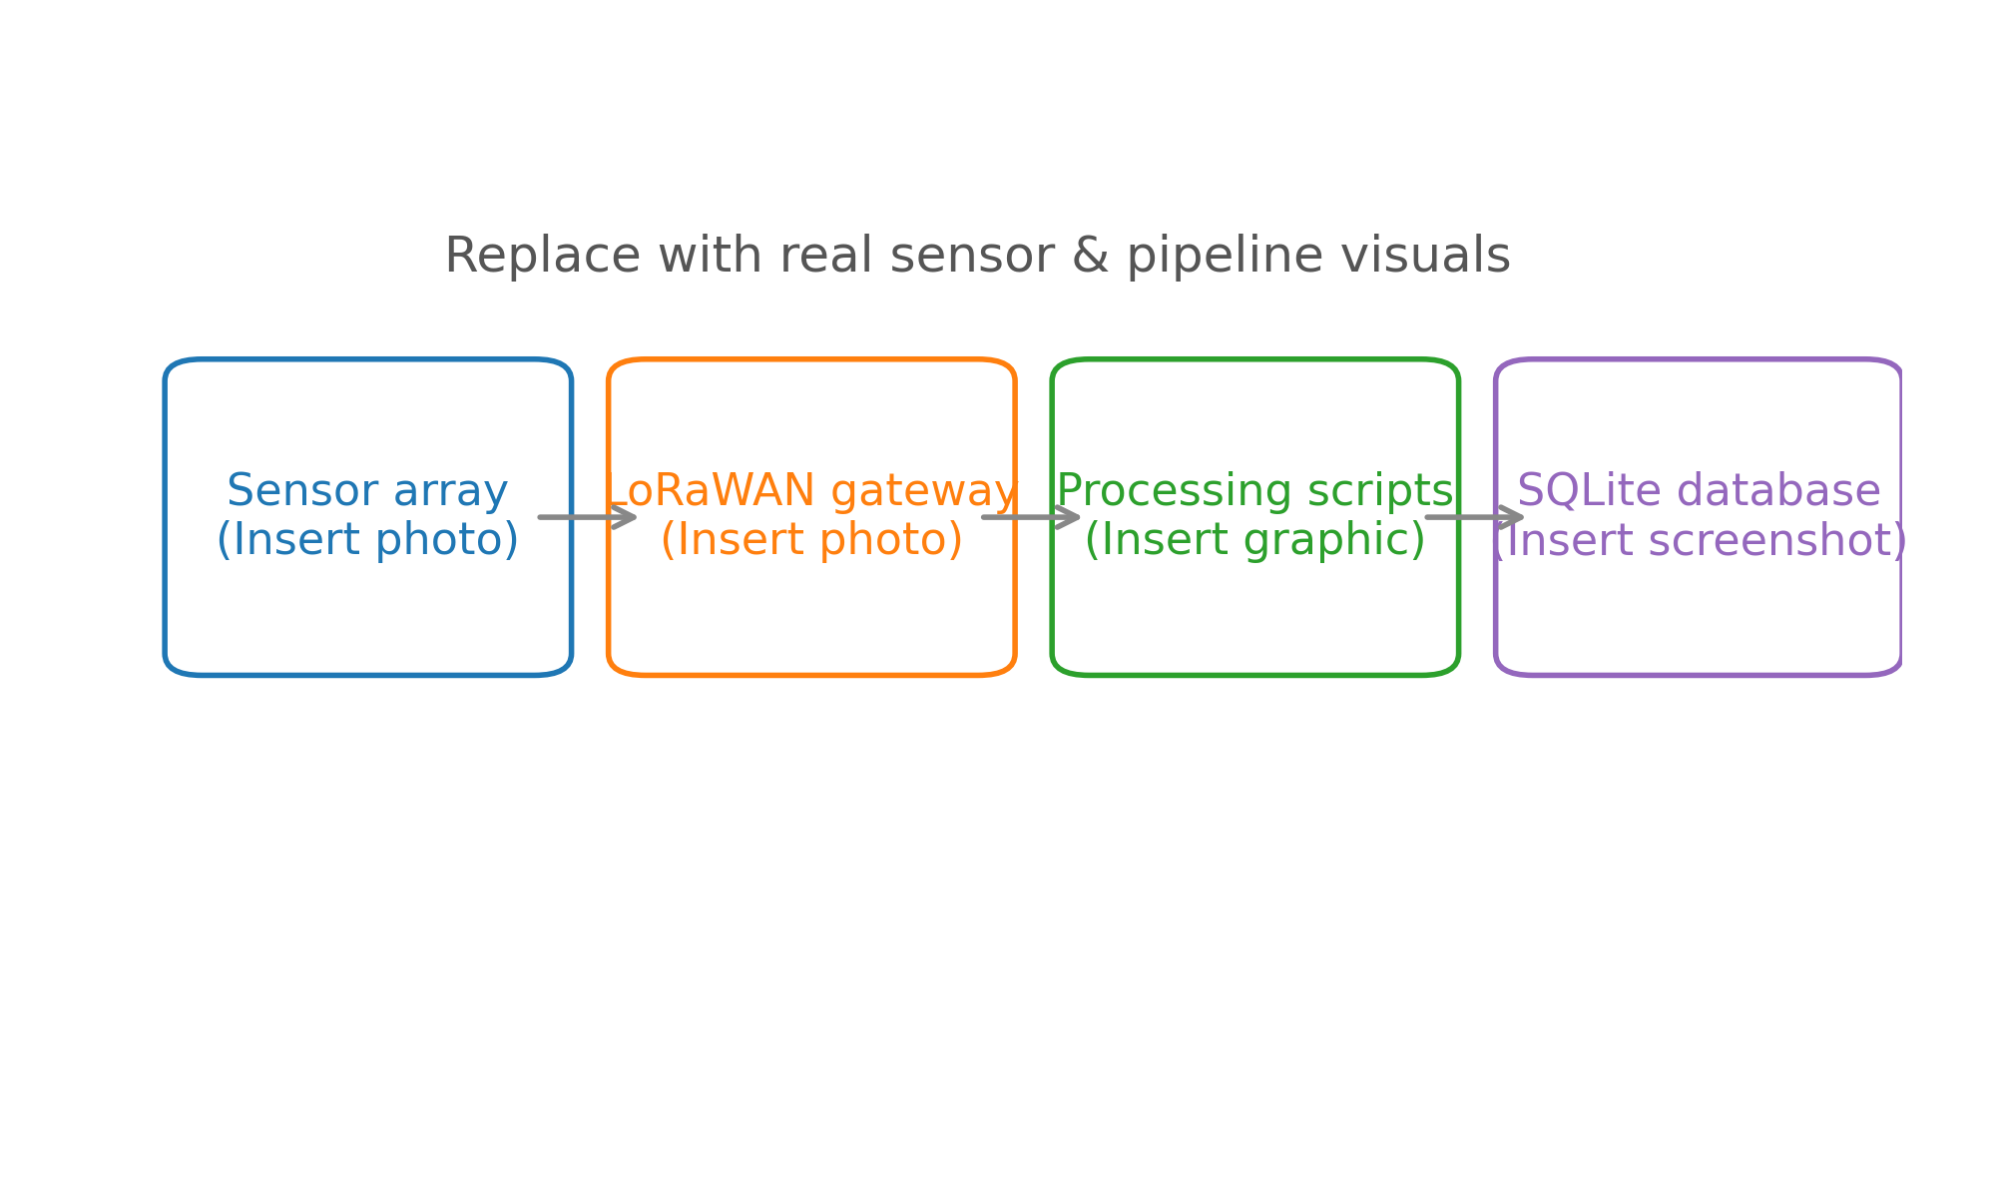
soil moisture automation flows from field sensors through lorawan into our sqlite project...
replace this placeholder with your sensor photos and pipeline schematic

Slide 2
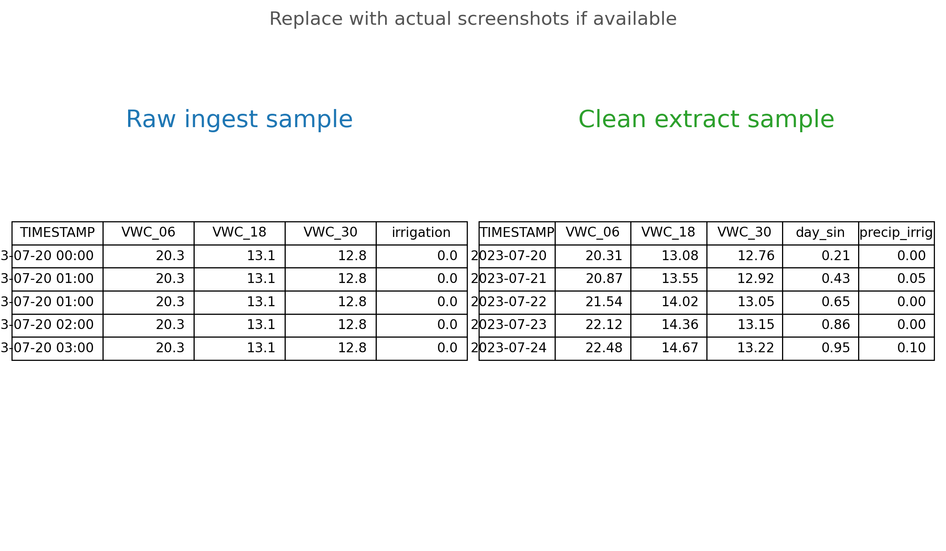
our july to october ingest covers thirty six plots of hourly soil moisture and weather...
dataset spans july 19 – october 13 2023 with 37k hourly records
targets include vwc at 6 18 30 inches plus irrigation totals and canopy weather channels

Slide 3
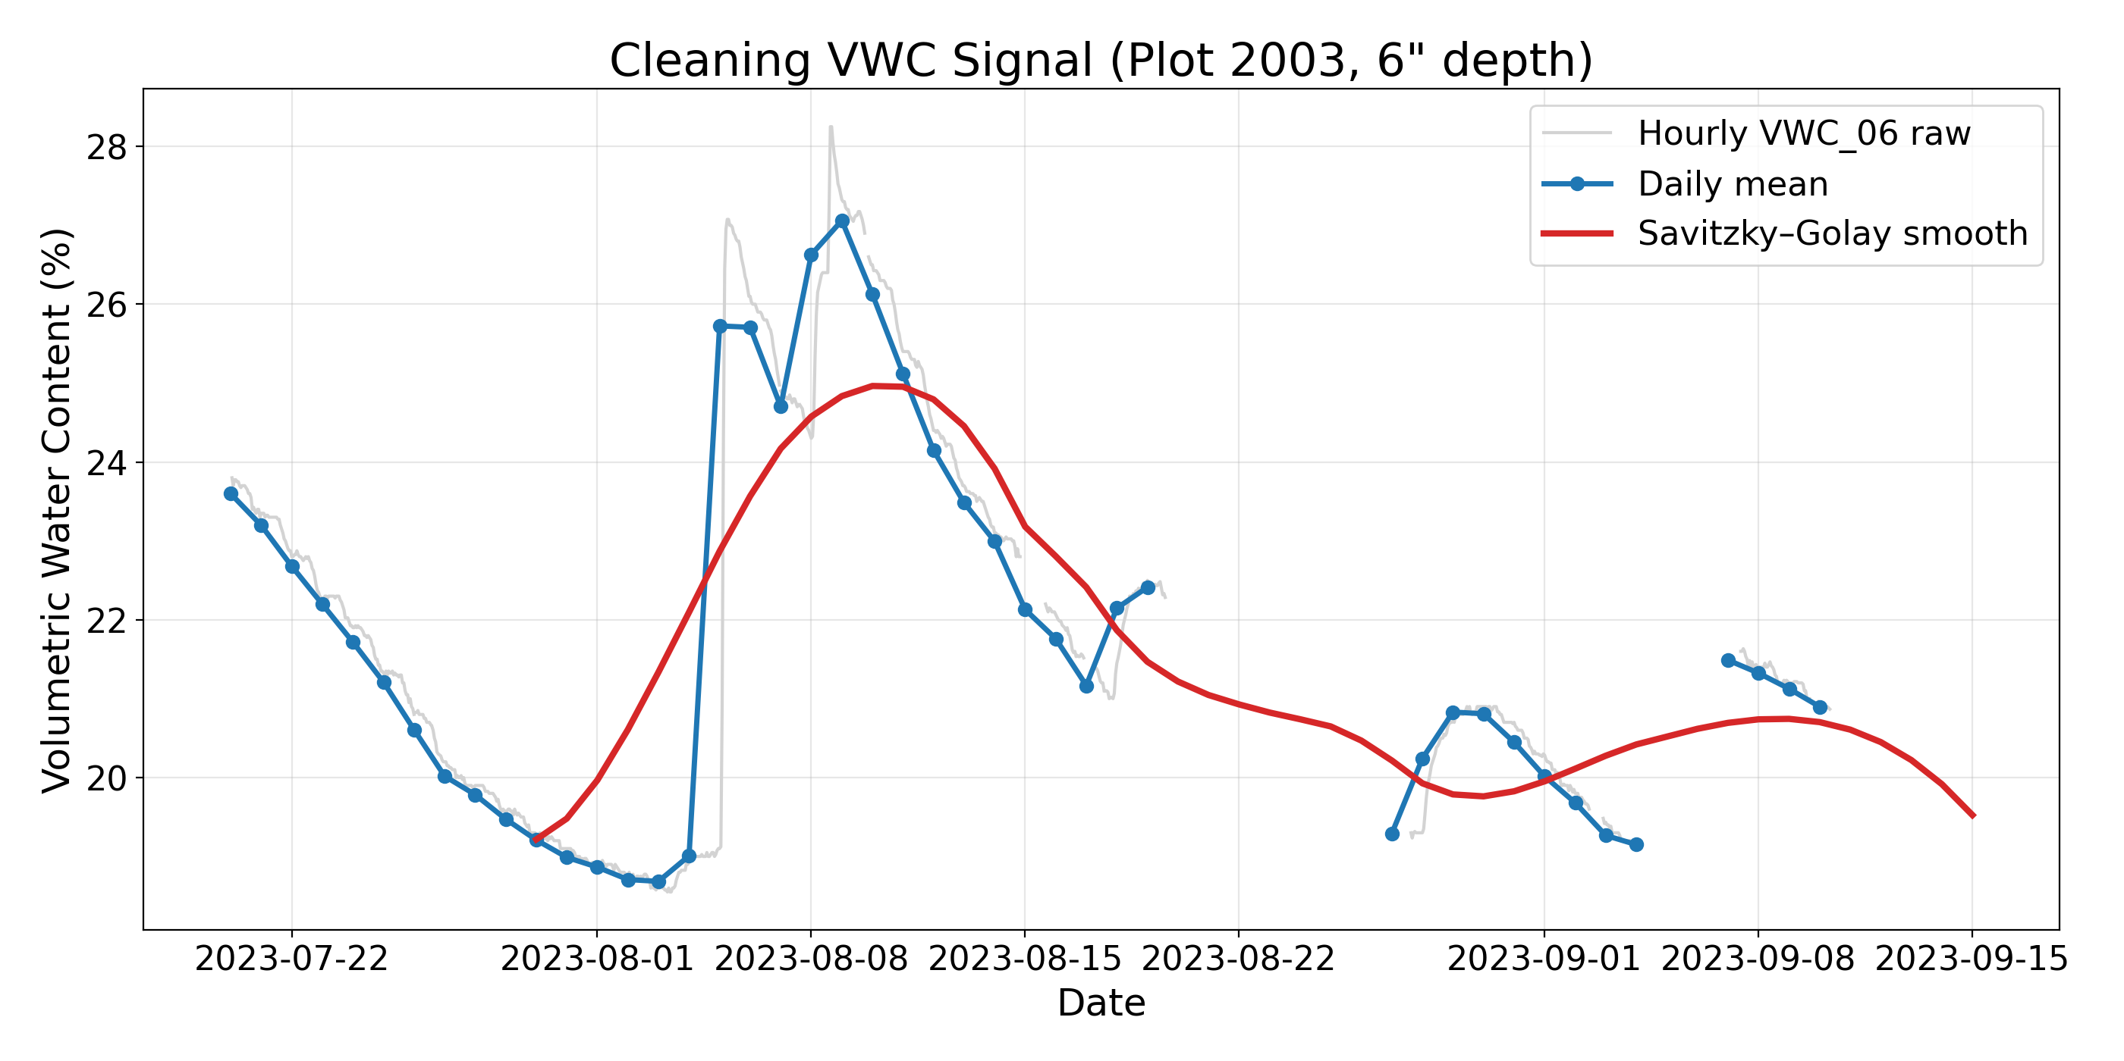
raw feed shows duplicates and flatlines so we trim resample and interpolate before modeling...
audited extract contrasts raw hourlies with cleaned daily series ready for features

Slide 4
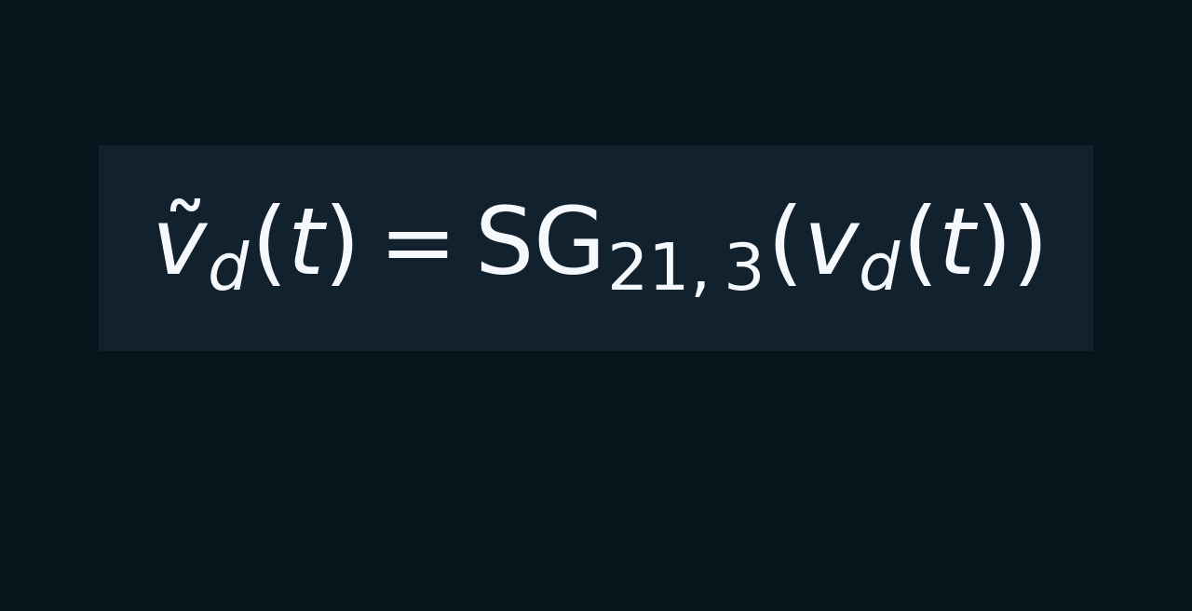
savitzky golay smoothing on the daily curve keeps irrigation pulses while calming probe noise...

Slide 5
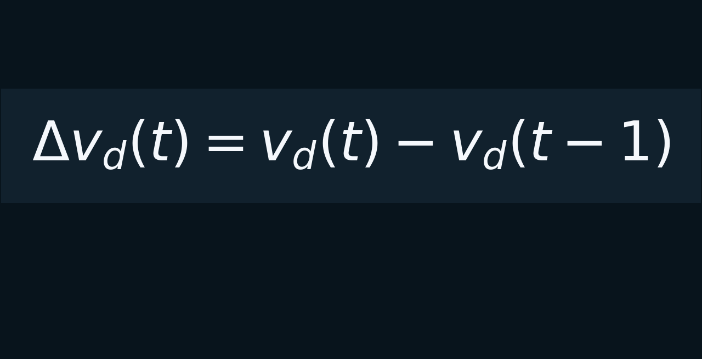
derivative transform captures drying velocity so the model senses rate not absolute level...

Slide 6
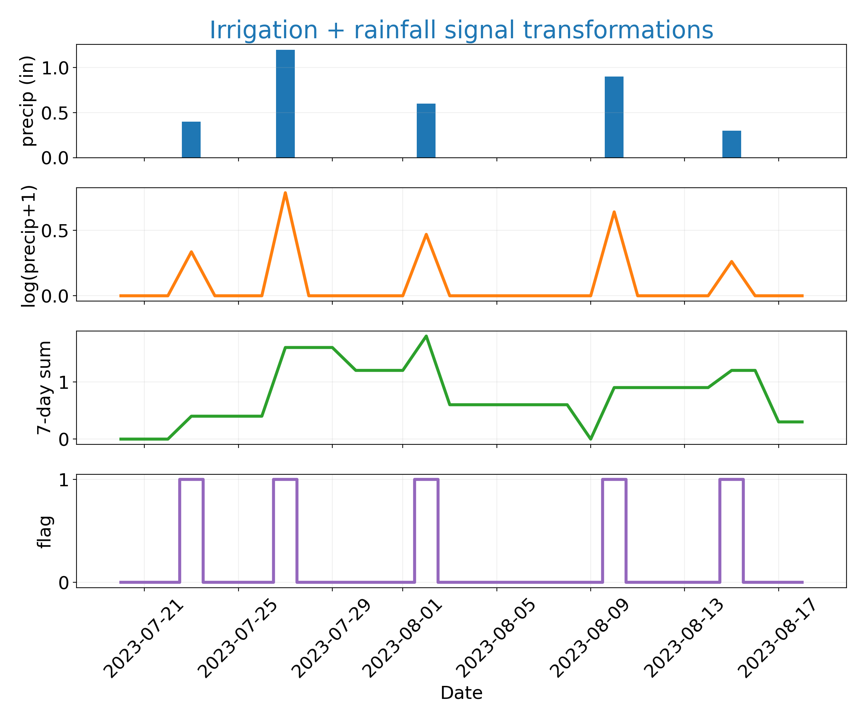
irrigation feature stack mirrors agronomist thinking about weekly water budget...
panel shows raw totals, log scaling, seven day sum, and actuator flag together

Slide 7
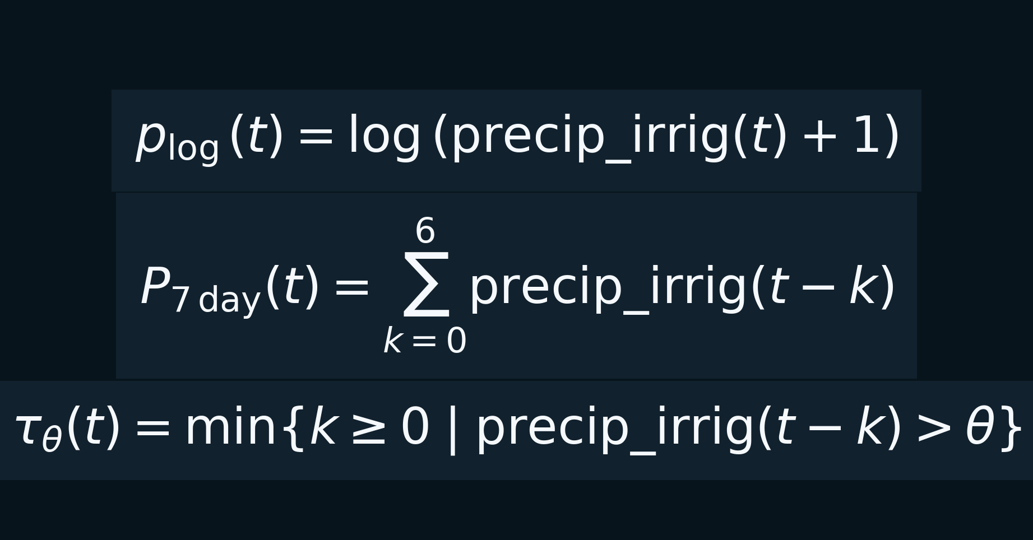
log sum and time since equations document the rare event signals feeding the network...

Slide 8
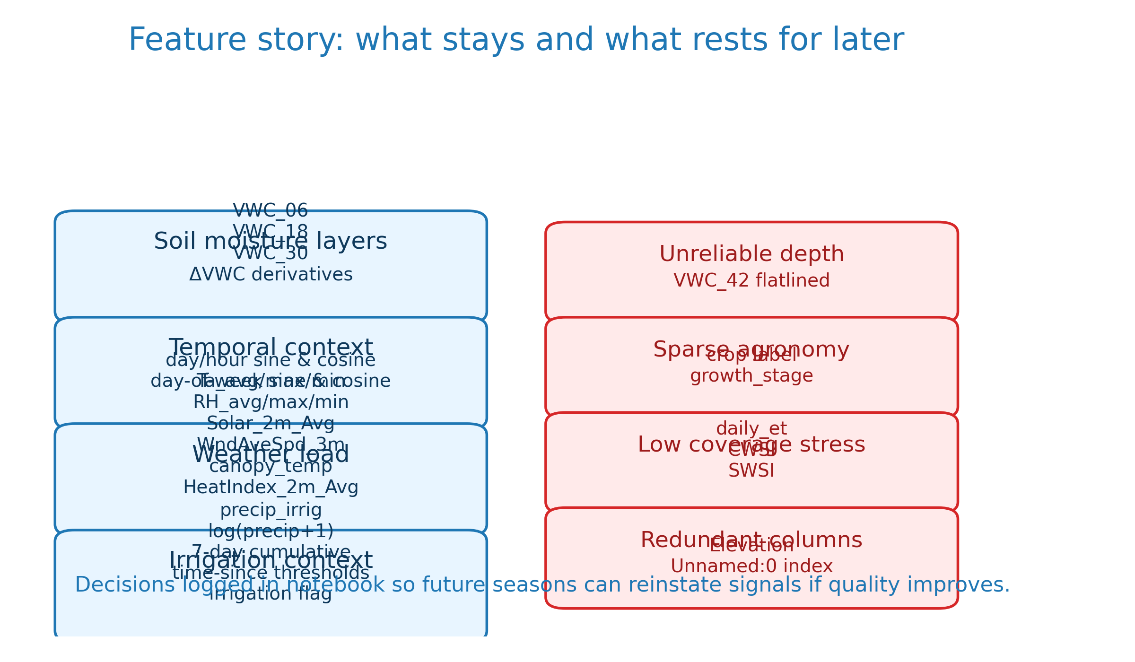
feature buffet slide calls out what stayed and what was documented for removal...
kept buckets: soil layers, temporal encoding, weather load, irrigation context
documented cuts: 42 inch probe flatlines, sparse crop metadata, redundant stress metrics

Slide 9
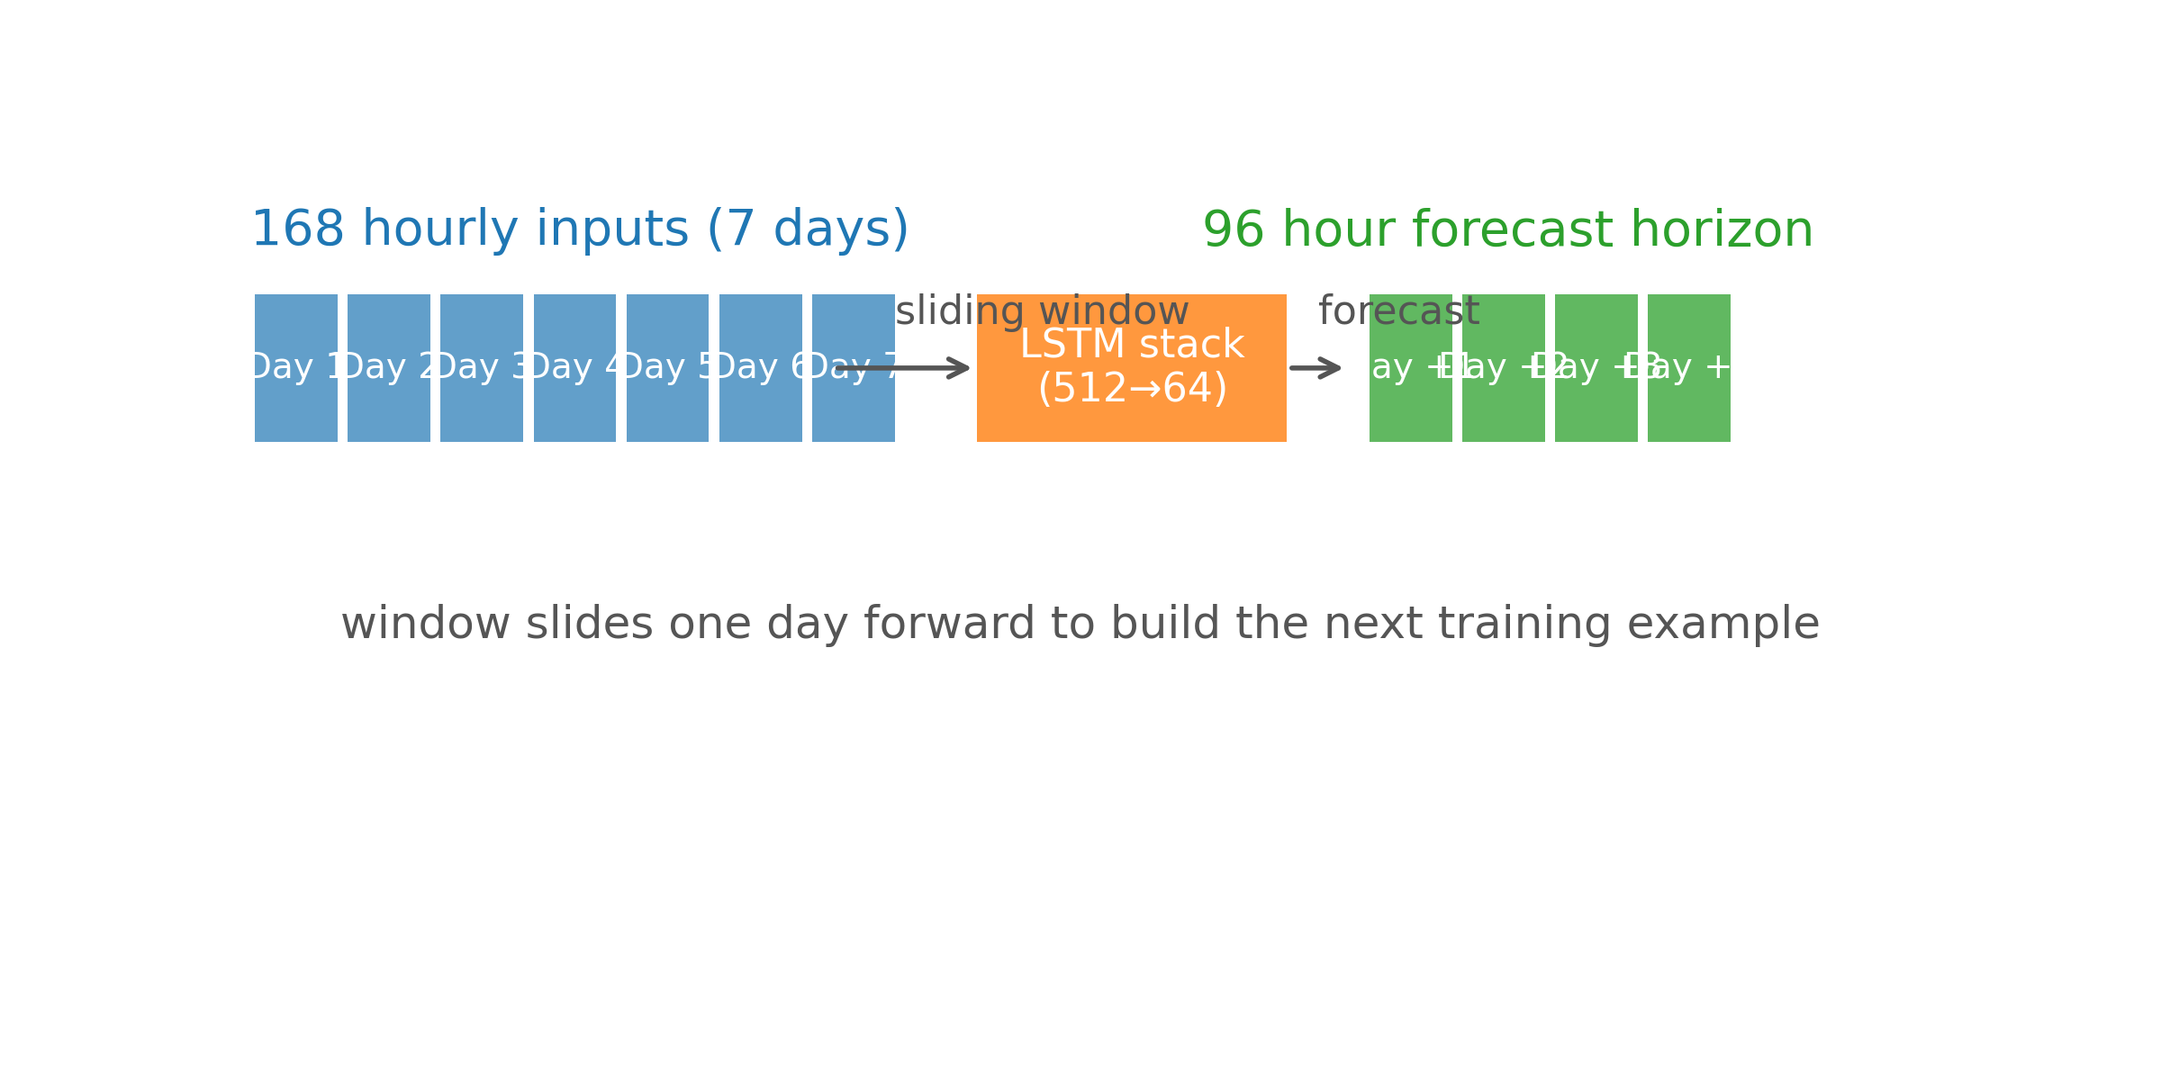
sliding window diagram shows the seven day input feeding a four day forecast horizon...
diagram explains 168 hourly inputs rolling into 96 hour predictions

Slide 10
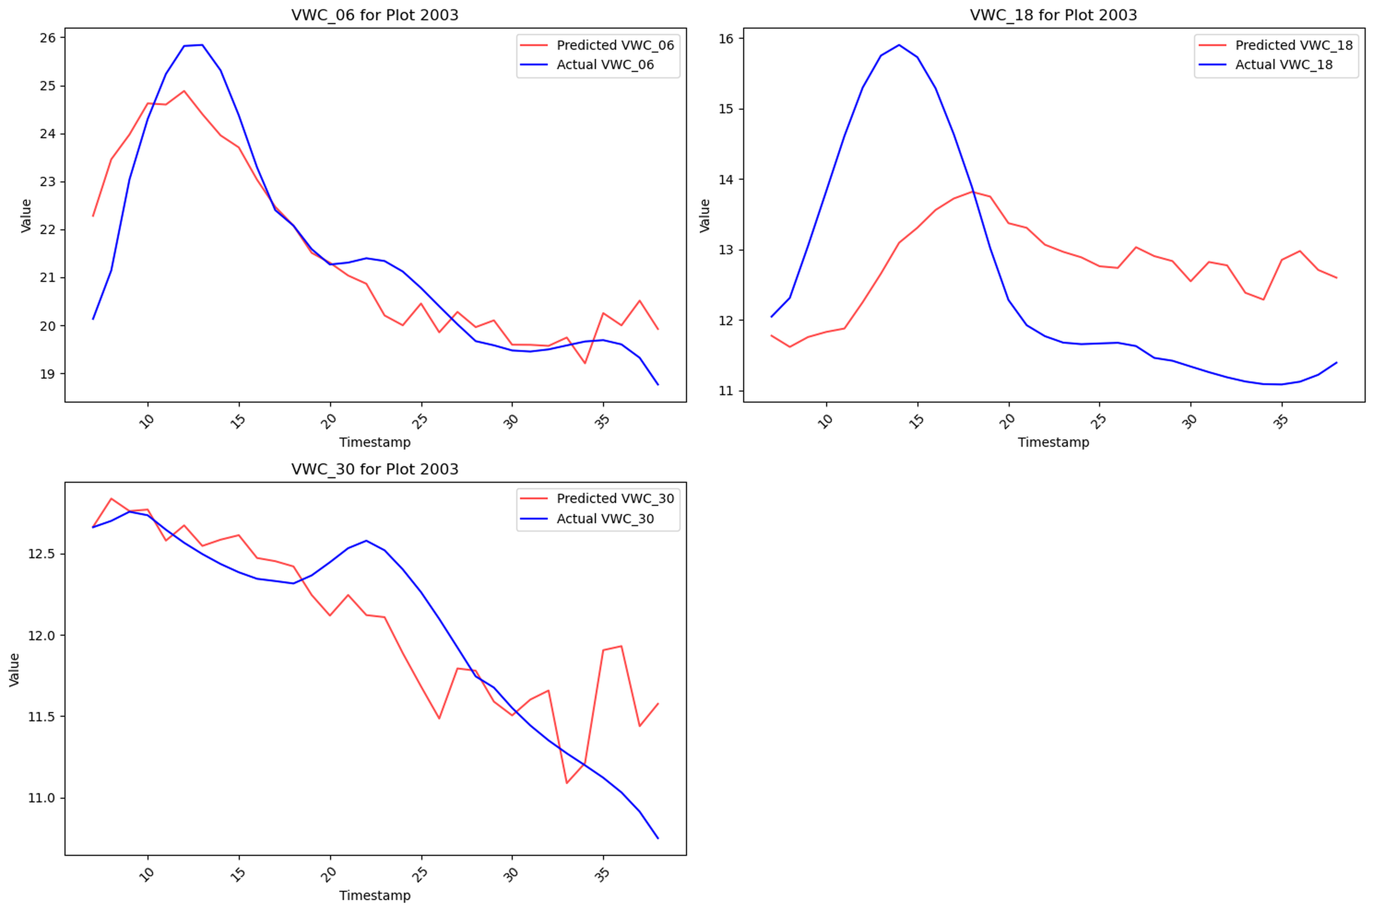
plot two zero zero three tracks surface moisture yet deeper layers lag after irrigation...
use this to discuss missing irrigation sensitivity below six inches

Slide 11
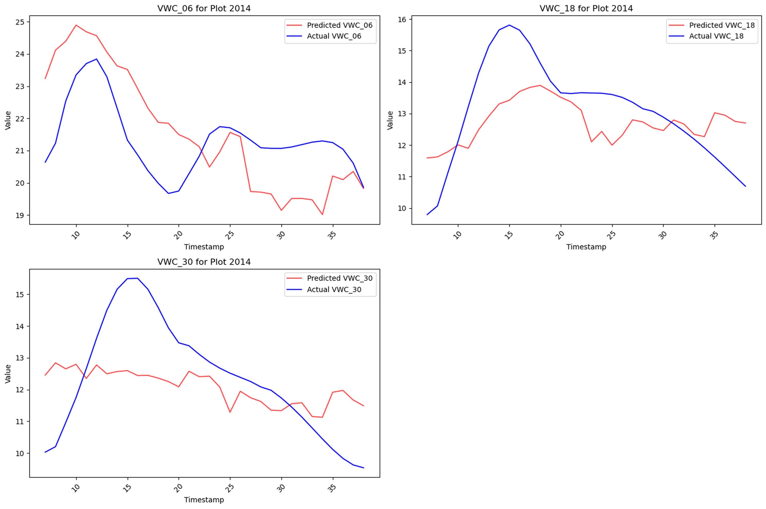
plot two zero one four stays biased high because dry down exemplars never hit training...
prime example of imbalance across plots and need for cross validation fix

Slide 12
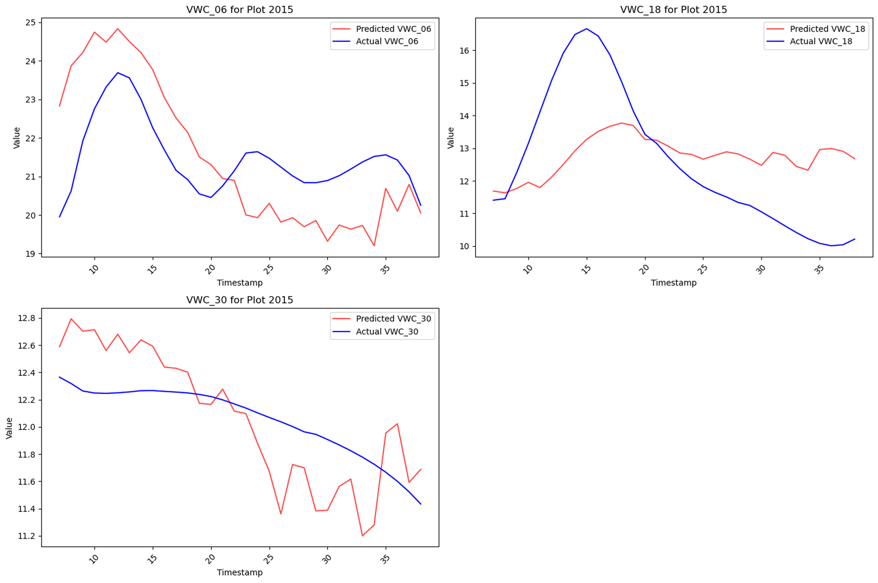
plot two zero one five lags forty eight hours exposing the fold reuse bug and irrigation imbalance...
reinforces why repairing timeseries split matters for responsiveness

Slide 13
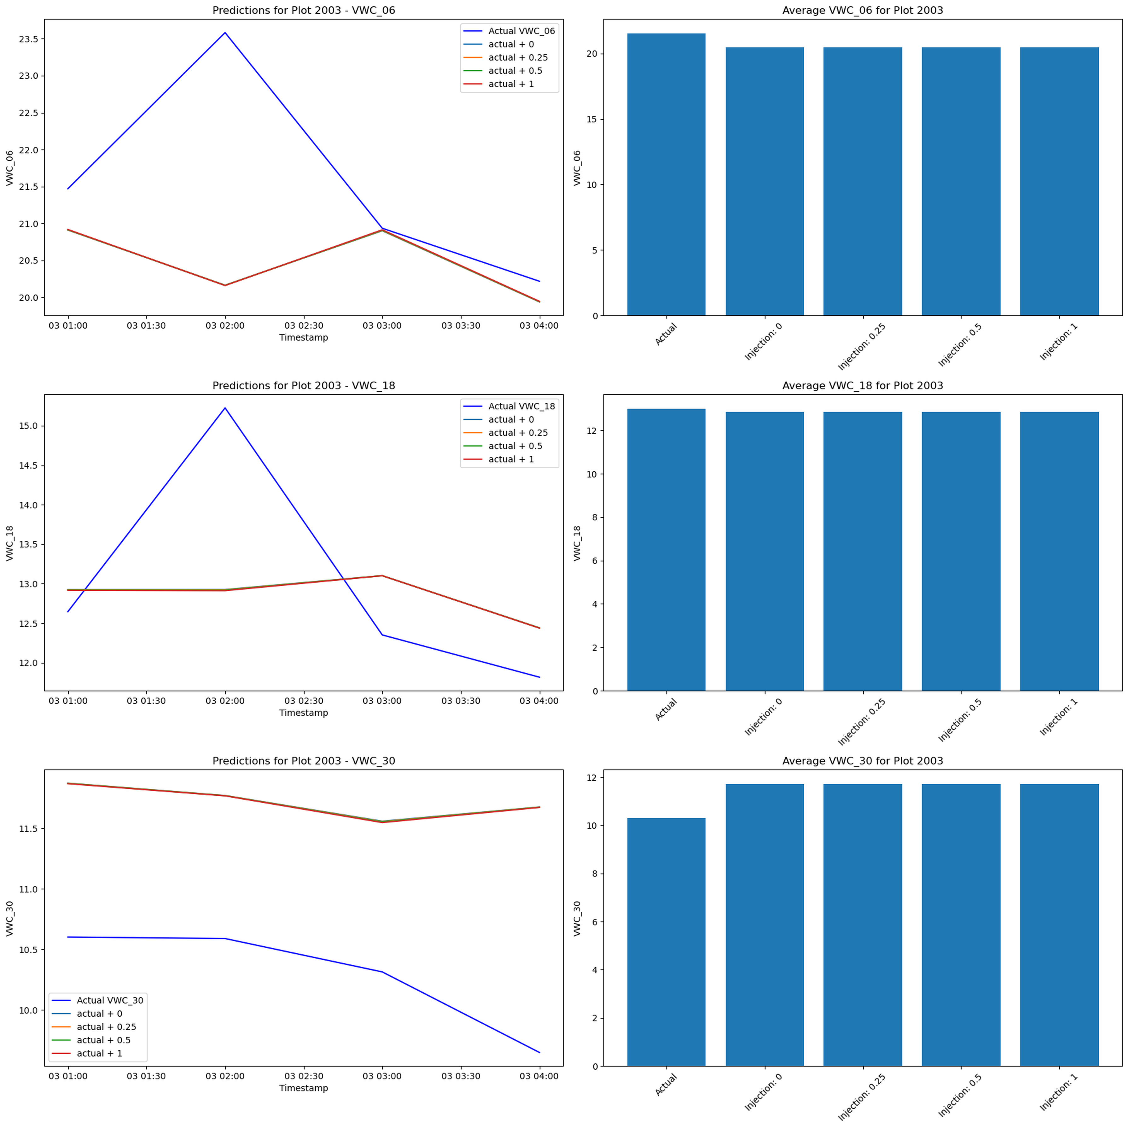
injection stress test froze features and pushed inputs off manifold so forecasts stayed flat...
next iteration recomputes engineered signals pre injection and respects scaler bounds

Slide 14
wrap with reusable cleaning kit and the two fixes queued for next season...
hand off the documented preprocessing and feature pipeline
repair timeseries split bug and sensitivity workflow before retraining
use this deck and notebook for agronomy and controls onboarding

