Slide 1
Exploratory Data Story – Soil Moisture LSTM
Bryan Nsoh

Slide 2

Field Snapshot
Sensor grid placeholder

Slide 3
LoRaWAN nodes log volumetric water content (VWC) at 6, 18, 30 in depths plus weather & irrigation telemetry
Replace the placeholder with your field photo when available – visual context matters for stakeholders

Slide 4
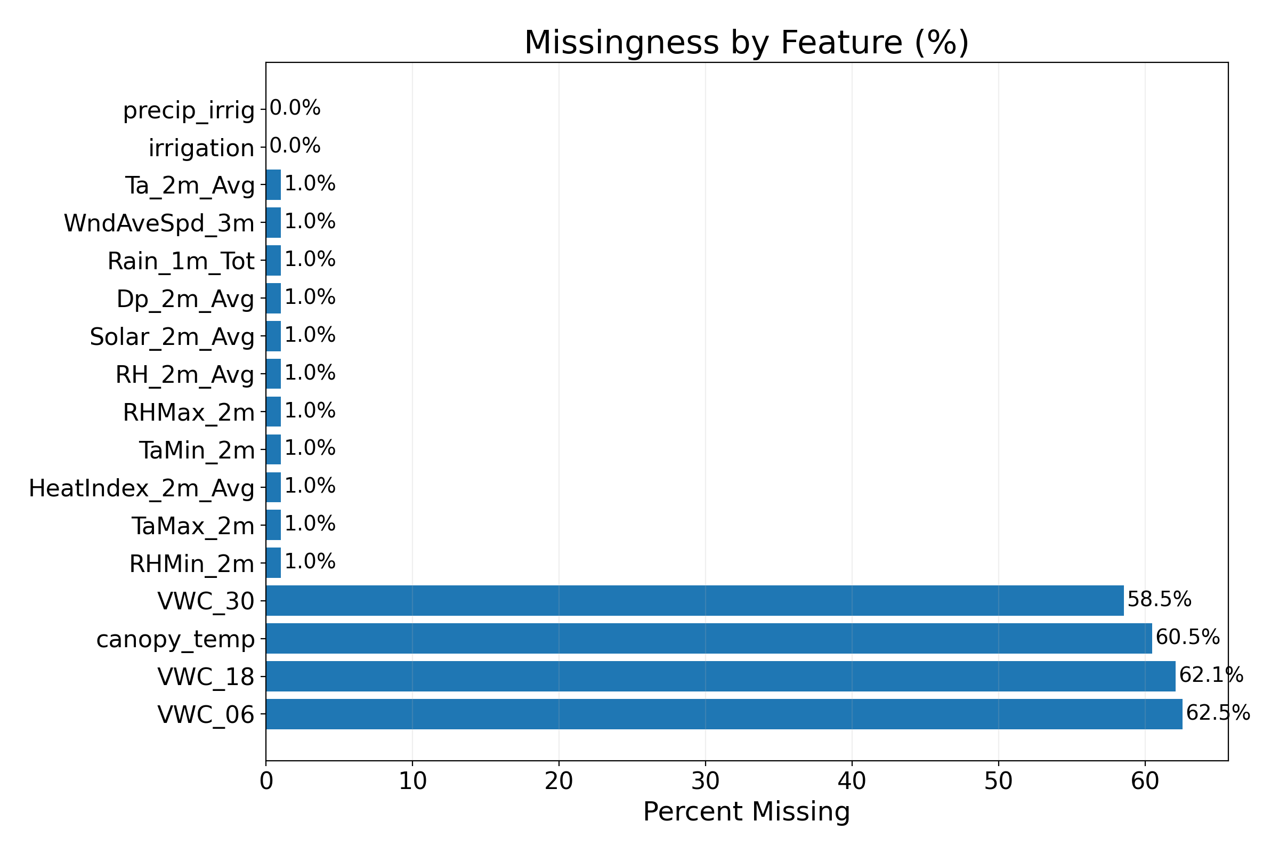
Coverage Check
Missingness chart

Slide 5
80% coverage on core soil & weather channels
Stress indices and categorical annotations (crop, stage) too sparse for modeling this season

Slide 6
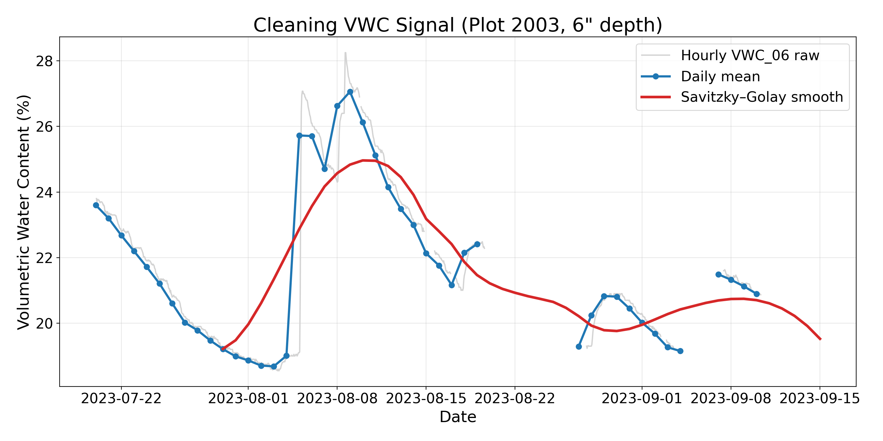
Raw Signal Behaviour
Cleaning pipeline

Slide 7
Hourly VWC oscillates with sensor noise and irrigation pulses
Daily averaging + Savitzky–Golay smooth preserves irrigation signature without dulling peaks

Slide 8
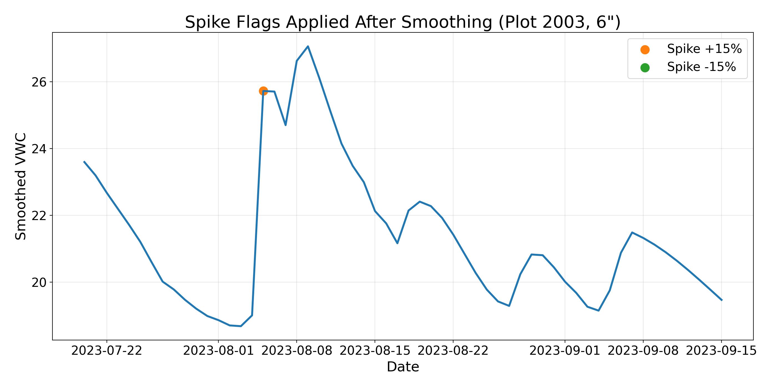
Domain Clean-up Moves
PCHIP interpolation retraces the natural recharge/decay curve
15% spike flags isolate true irrigation jumps from drift
Rolling 7-day precipitation = our soil water budget proxy
Log transform + binary flag emphasise rare irrigation events
Spike flags

Slide 9
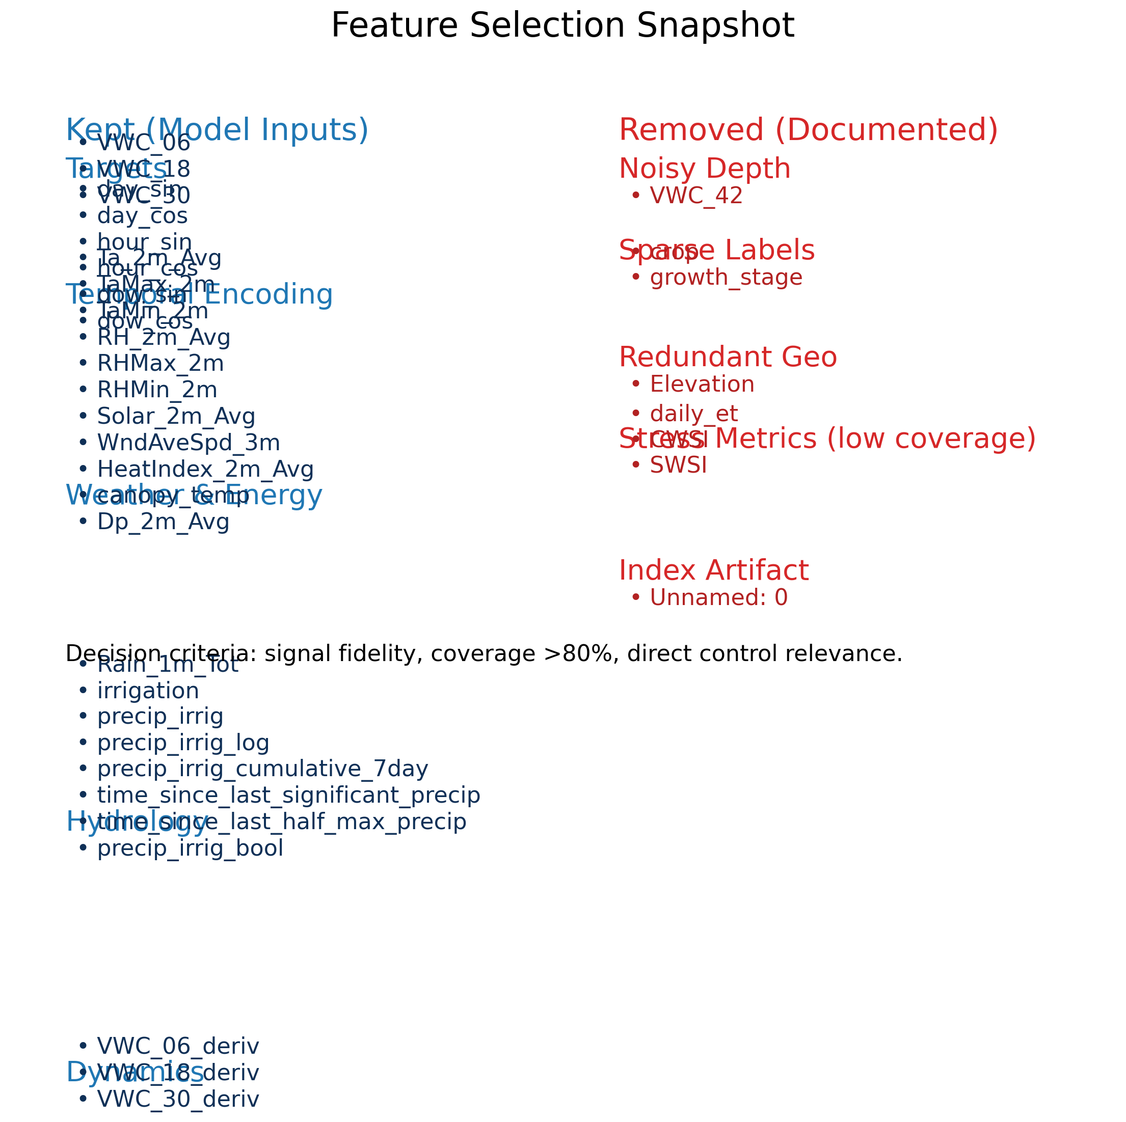
Feature Decisions
Feature selection

Slide 10
Domain-Specific Transforms
Center each VWC depth per plot to learn deviations, not absolute bias
Derivatives teach the LSTM to sense drying velocity
Binary irrigation flag tells the network when actuators fired
[ _d(t) = _d(t) - _d(t-1) (t) = ((t) + 1) ]

Slide 11
Modeling Pipeline (Kept Simple)
Sliding window: 168 hourly steps () 96-hour horizon
Heavy regularised LSTM stack (512→64) to respect temporal context
TimeSeriesSplit intended for leave-one-plot-out (bug limited generalisation – documented in findings)

Slide 12
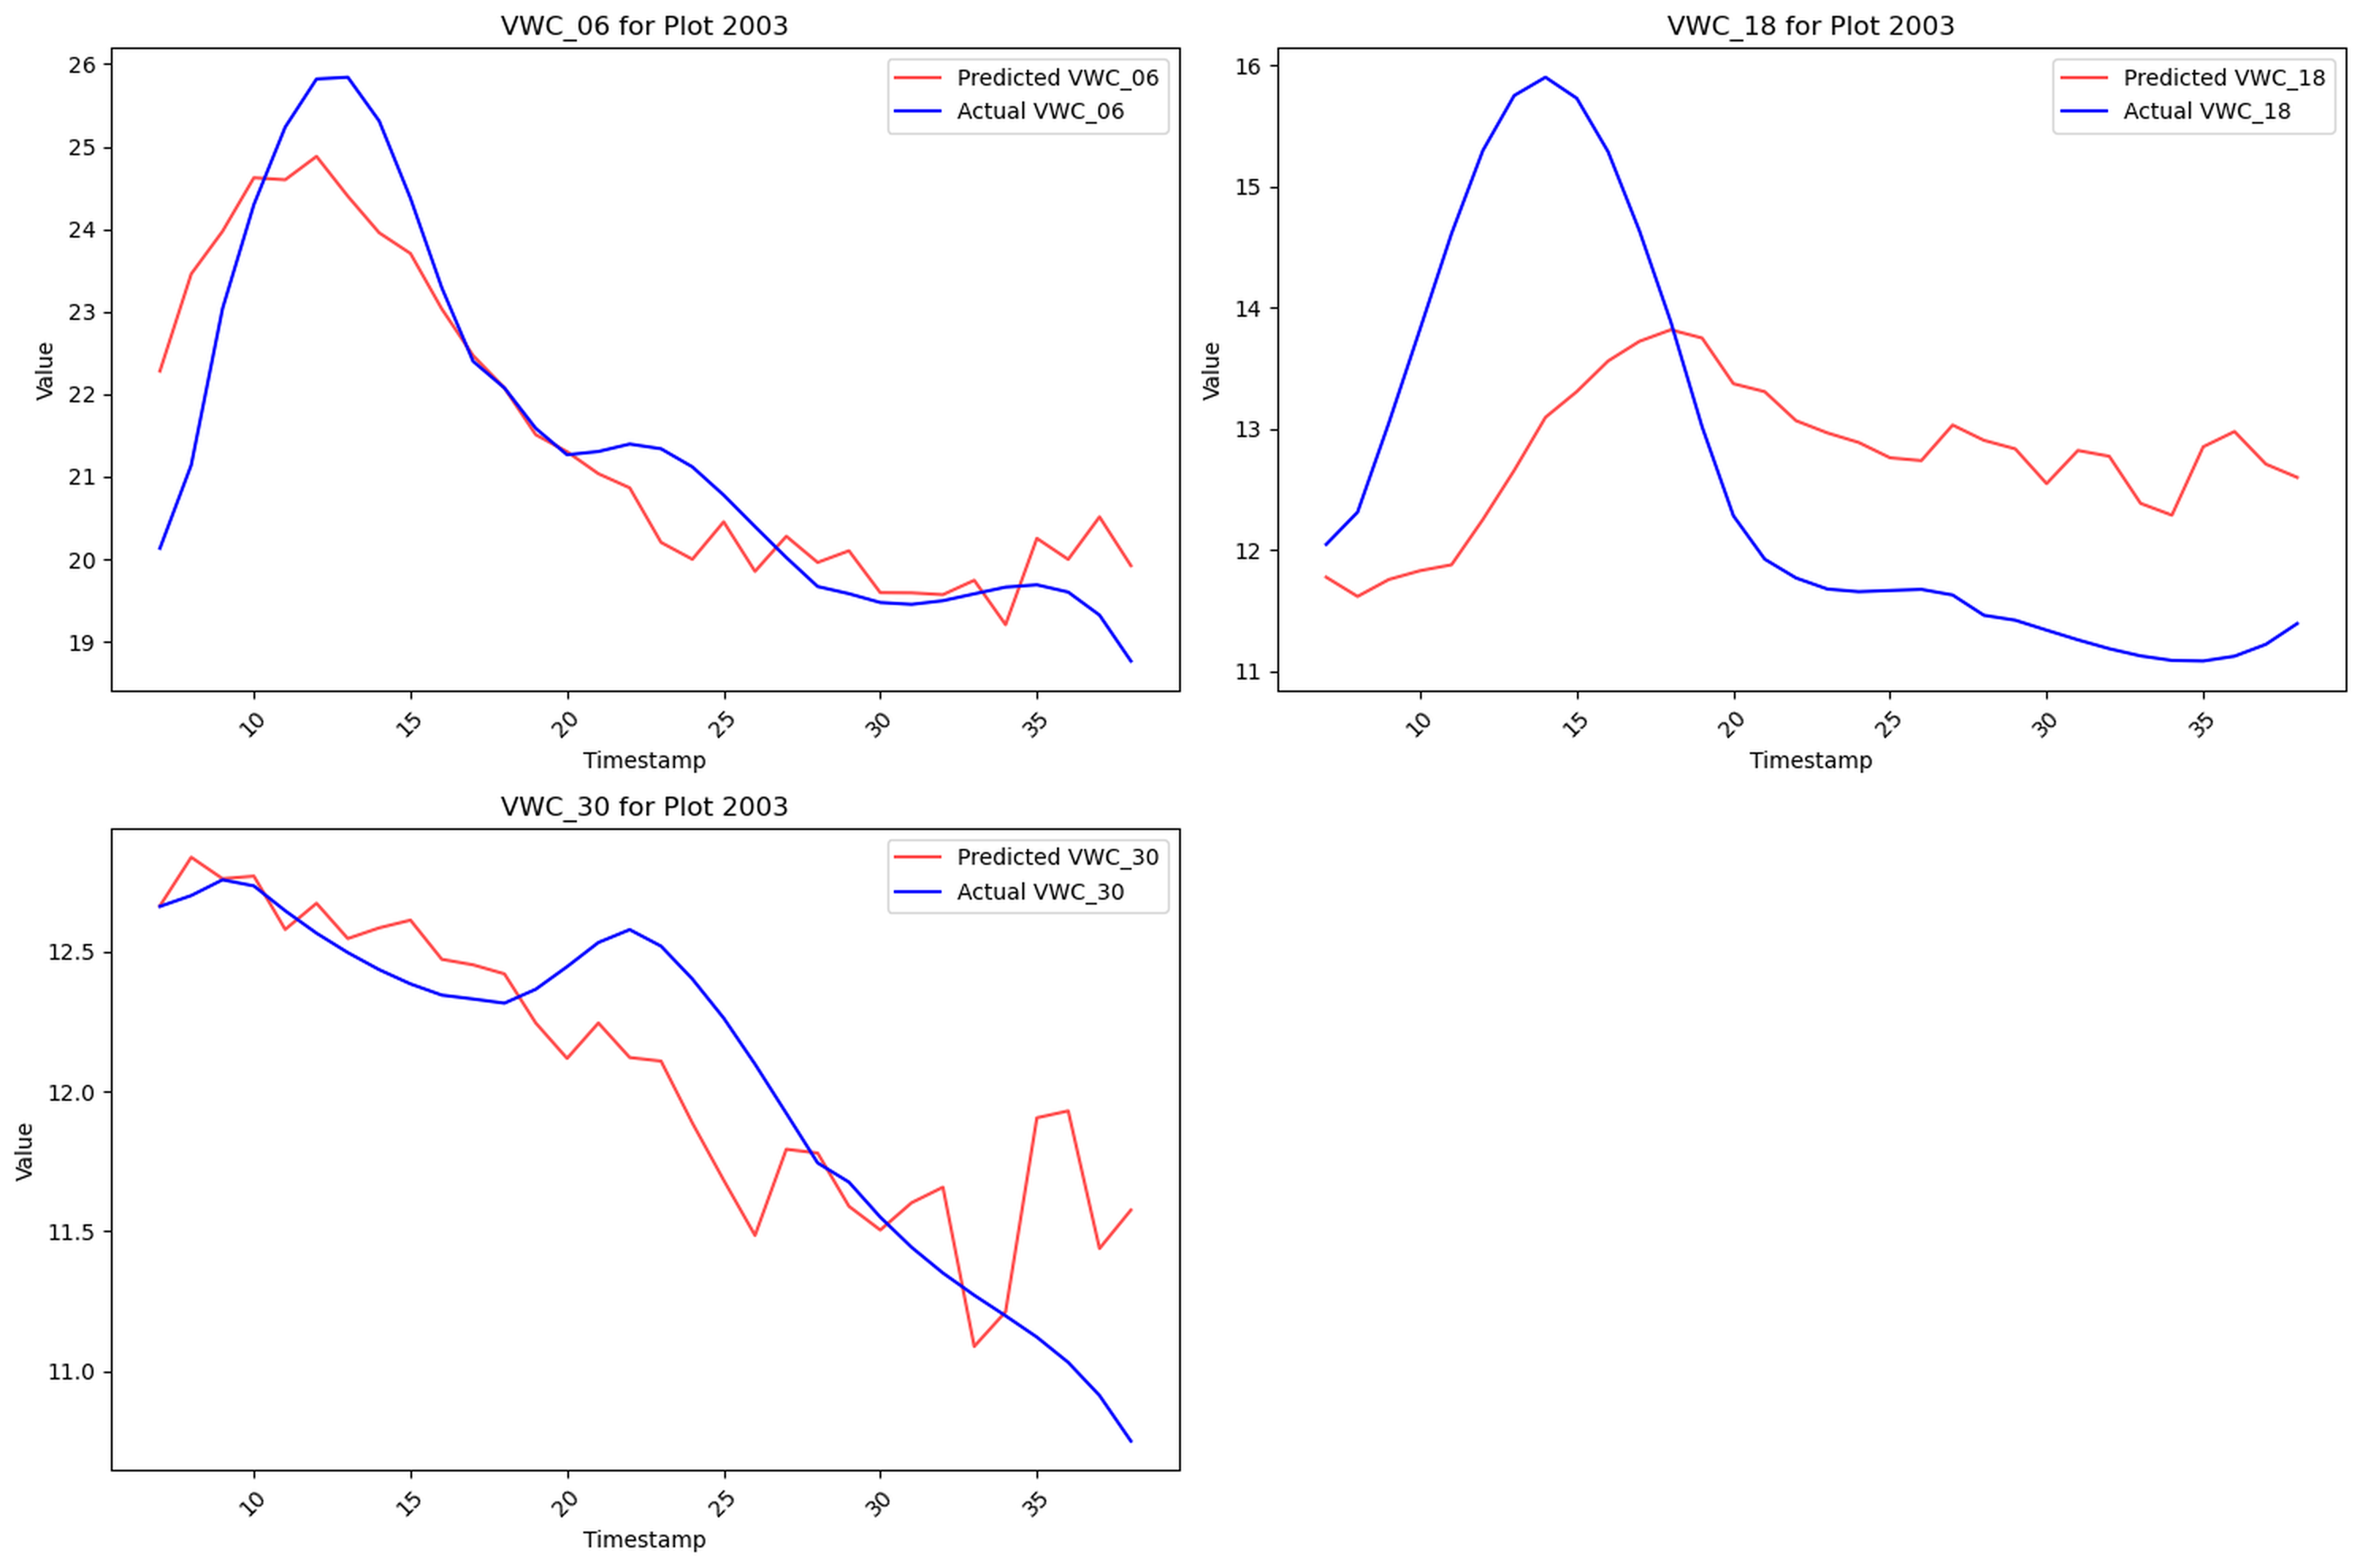
Forecast Behaviour – Plot 2003
Pred vs actual – Plot 2003

Slide 13
Captures trend but under-reacts to irrigation rebounds deeper than 6"

Slide 14
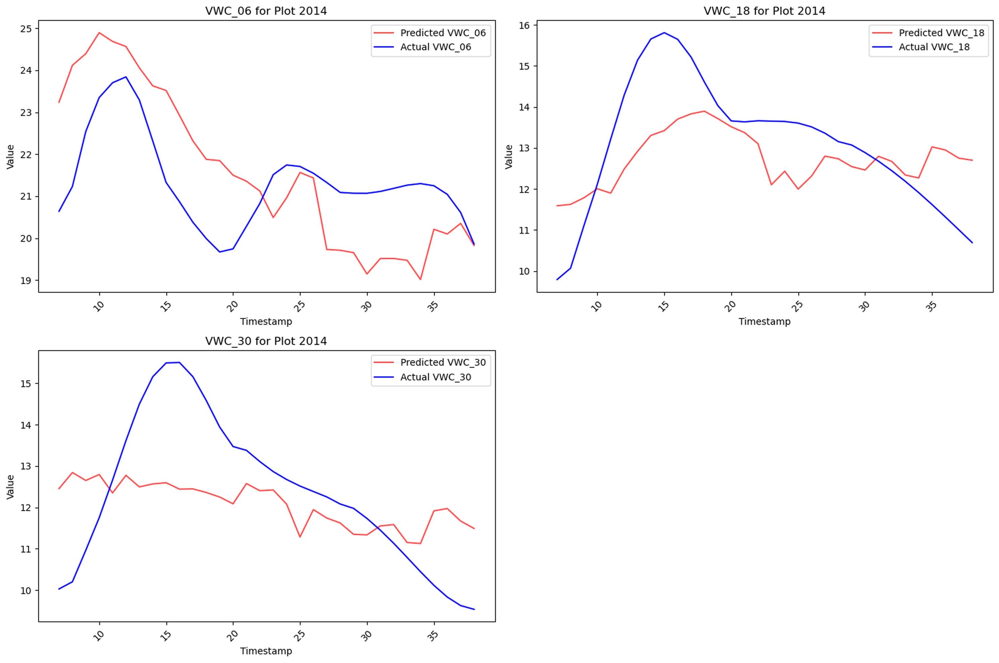
Forecast Behaviour – Plot 2014
Pred vs actual – Plot 2014

Slide 15
Bias high at surface; deeper probes miss sharp peaks → insufficient dry-down examples

Slide 16
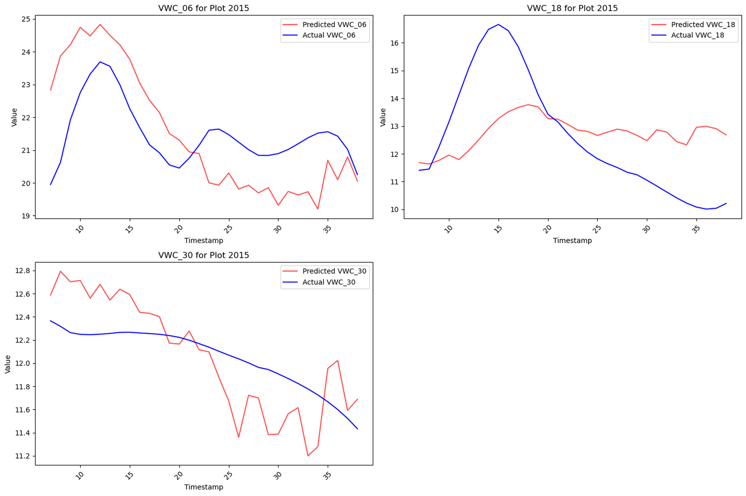
Forecast Behaviour – Plot 2015
Pred vs actual – Plot 2015

Slide 17
Tracks trend yet lags ~48 h; demonstrates training fold bug + irrigation imbalance

Slide 18
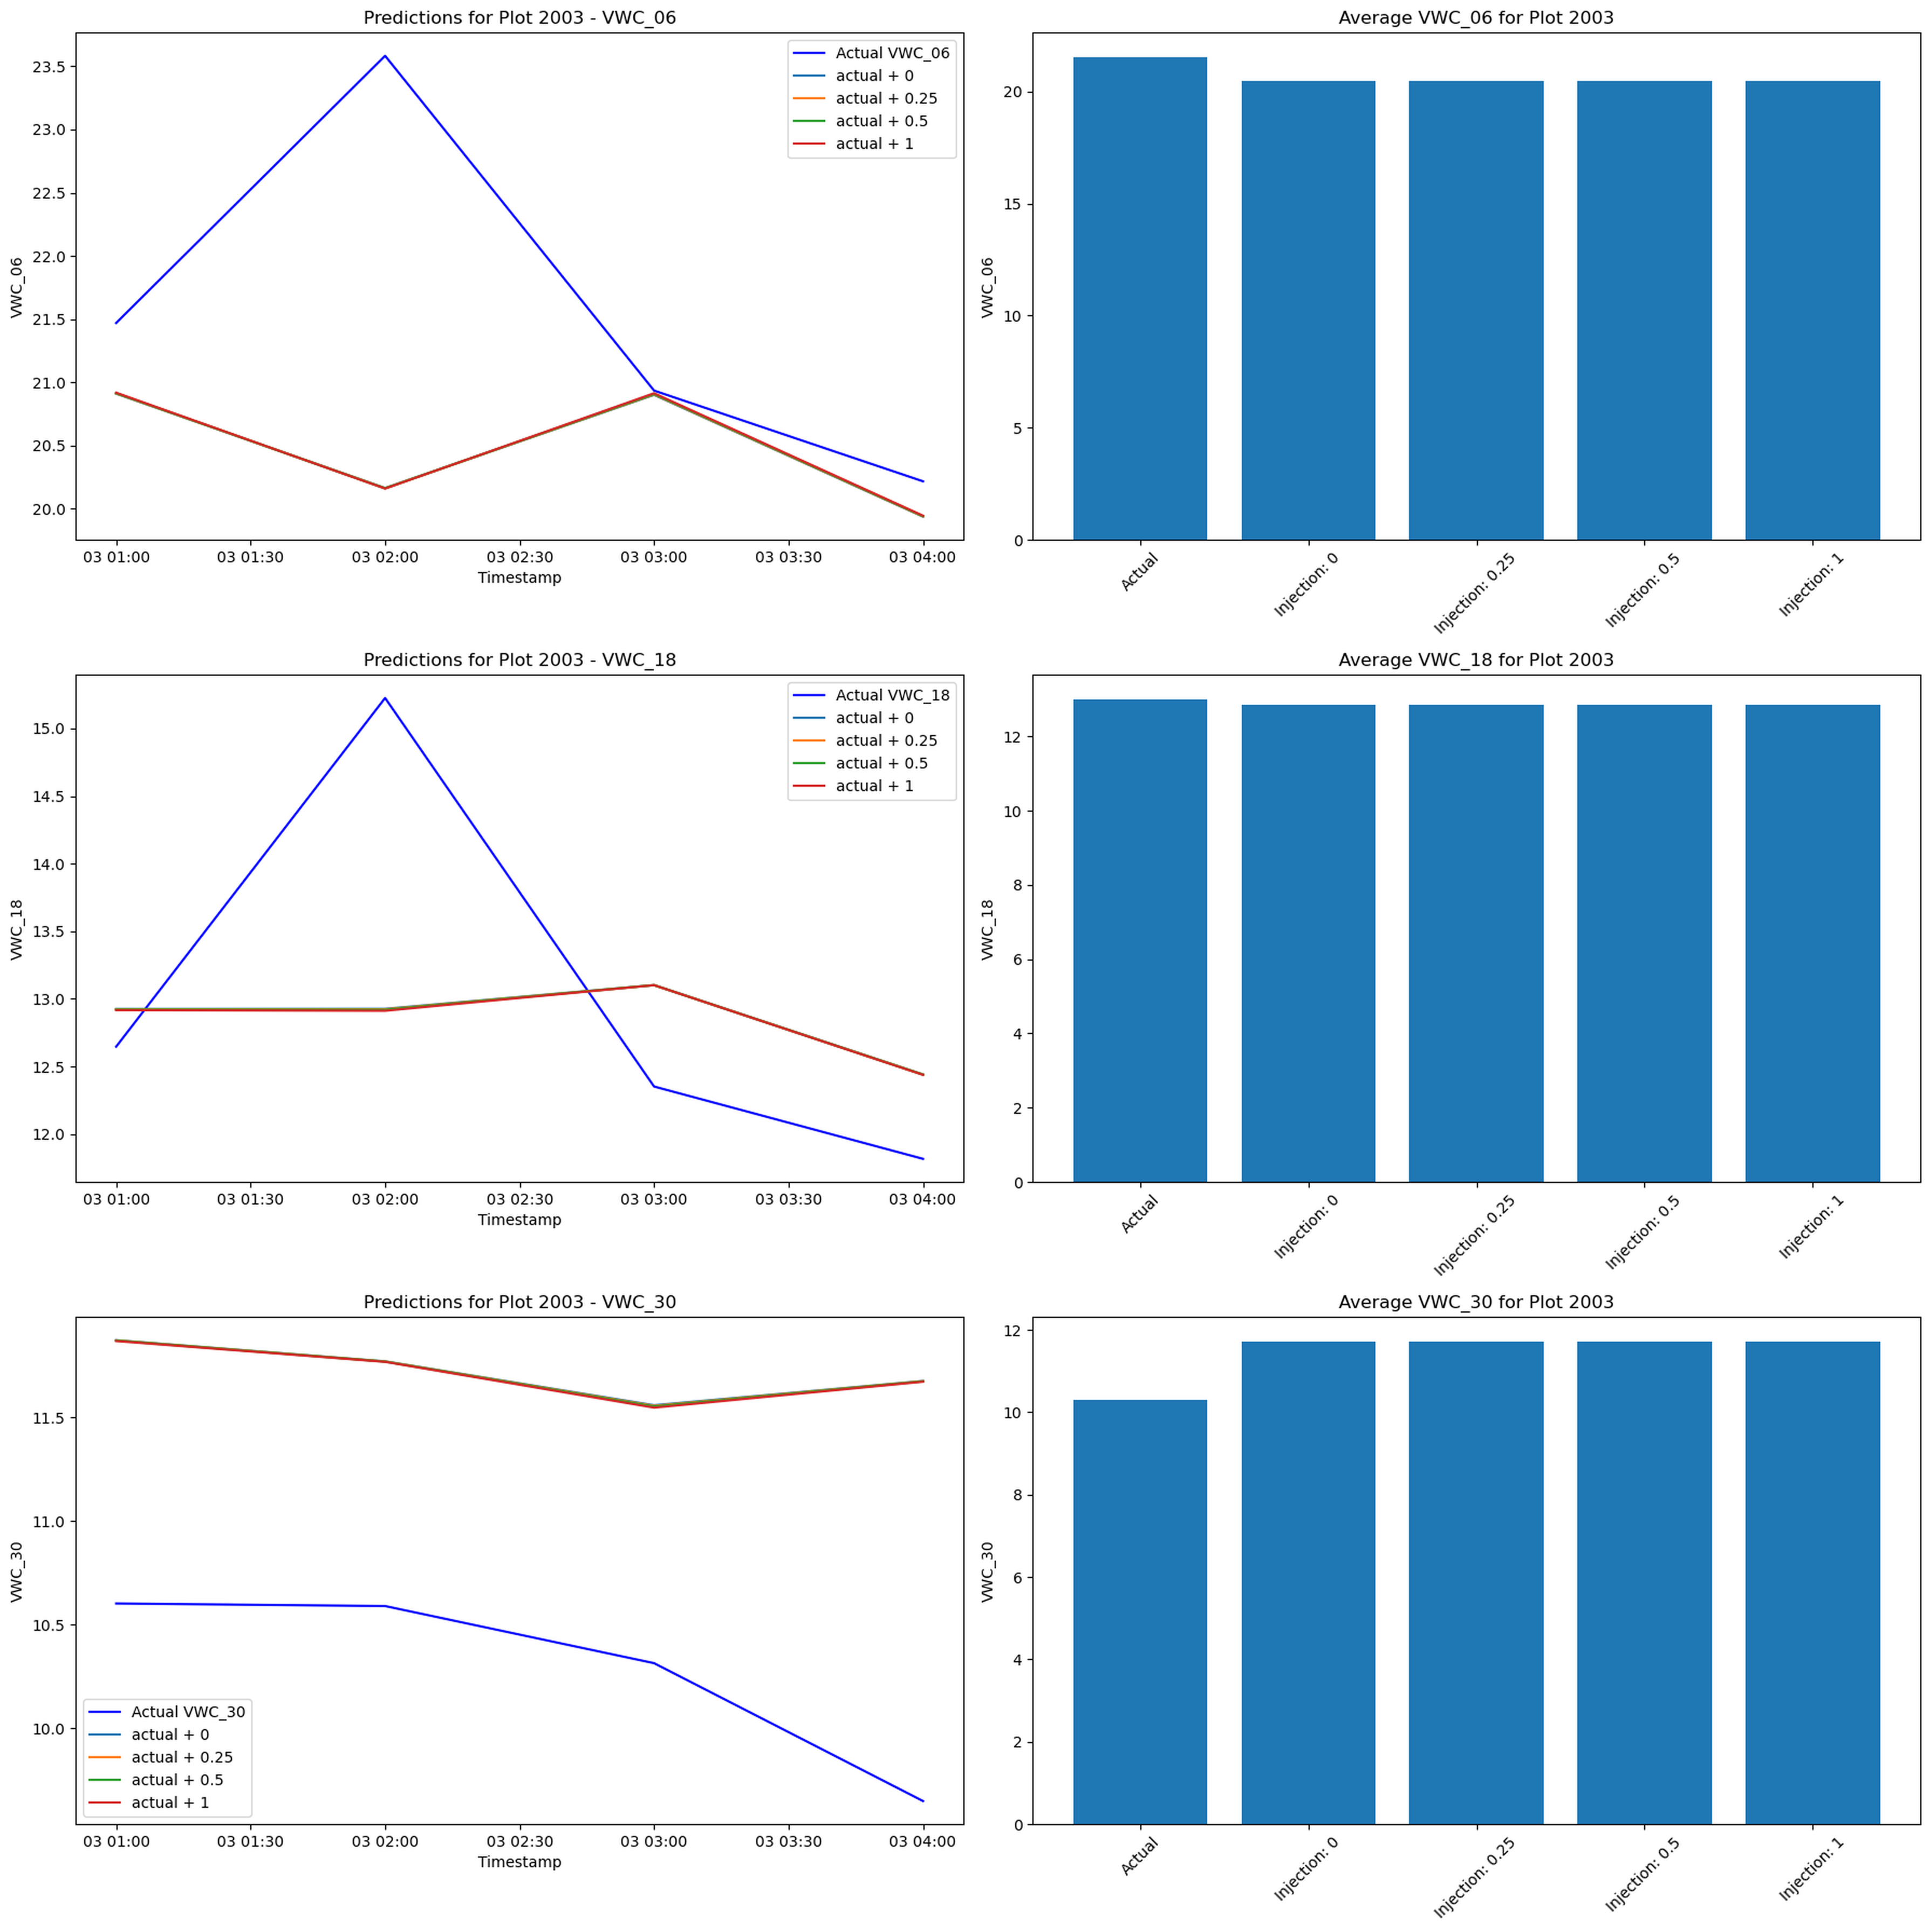
Injection Sensitivity Test
Injection sweep

Slide 19
Injecting +0.25 to +1.0 water after scaling failed to move predictions
Missing feature recompute + distribution shift explain the mismatch

Slide 20
Honest Takeaways
Cleaning + feature engineering are tailored to agronomic reality and reusable for next seasons
Model failure stems from evaluation bug + post-hoc injection design, not from lack of signal
Present the lessons learned and next steps as future work rather than unfinished business

Slide 21
Appendix – Swap-In Visuals
Add actual field/sensor photography on Slide 1
If available, include flatline sensor example or rain event on backup slide for Q&A
Keep the PPTX (presentation/eda_story/eda_story.pptx) handy for template styling

