Slide 1
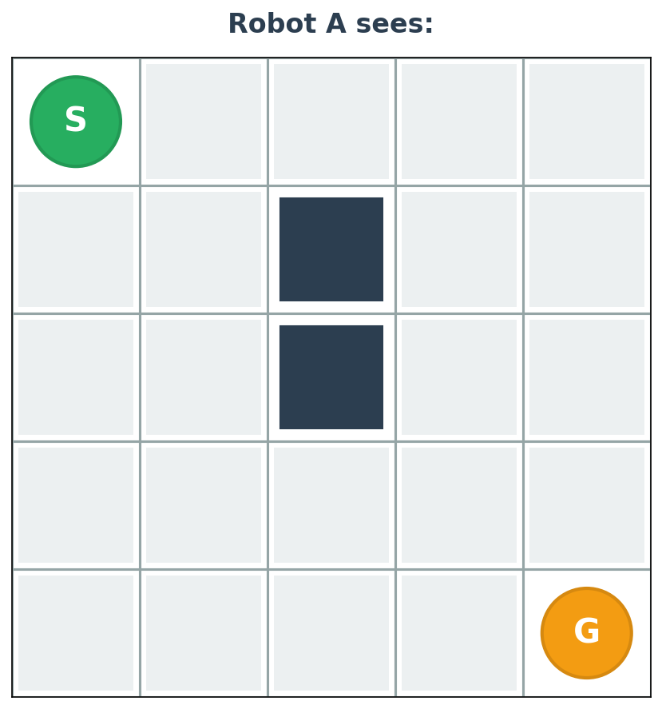
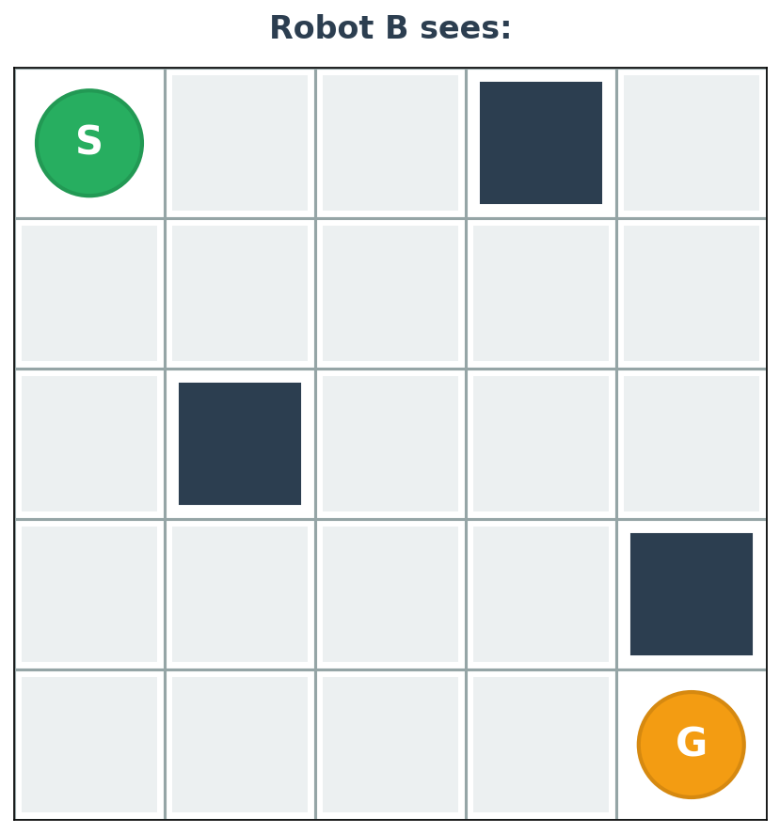
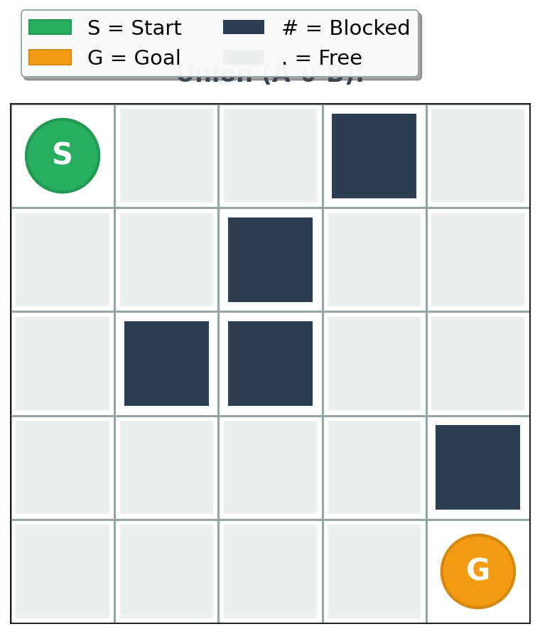
Two Robots Need to Agree. What Do They Send?
Can we reach G from S? → What to send?
❌ Send-All: Dump everything
A: "Blocked: (2,1), (2,2), (2,3), (2,4)..."
B: [rebuilds full map, runs solver]
B: "Yes, path exists"
Problem: Raw data, not proof. No attribution. Need solver.

Slide 2
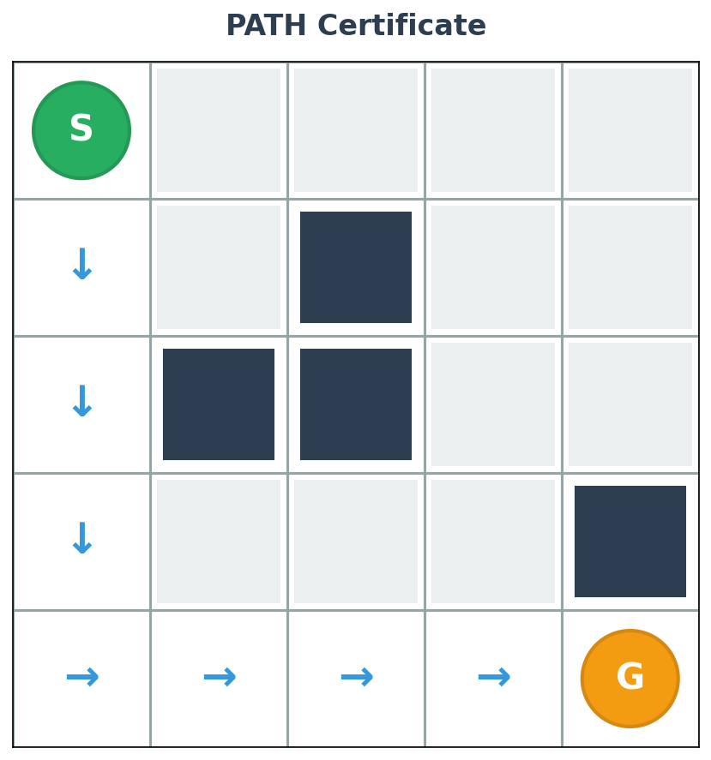
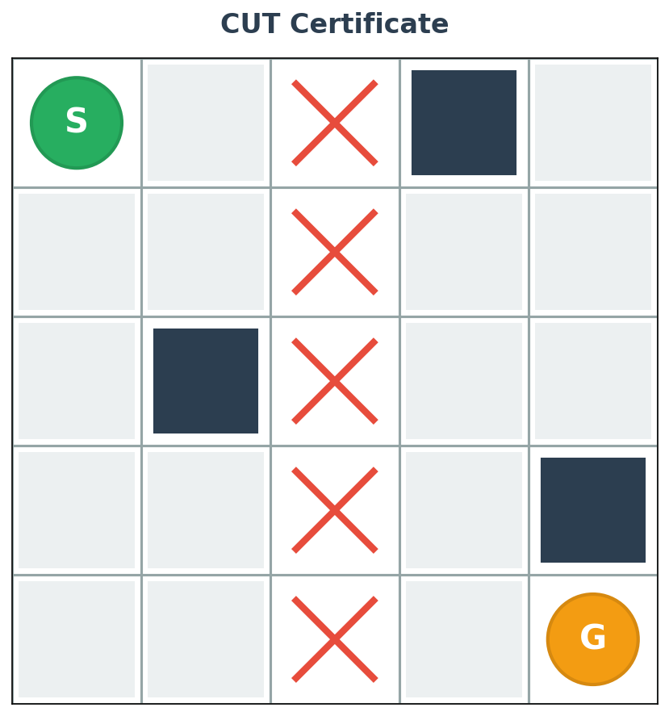
Send the Proof, Not the Data
✓ CertTalk: Send the certificate
If reachable → PATH_CERT
If blocked → CUT_CERT
"Here's the route"
"This wall blocks us"
~12 bytes
~20 bytes
How to verify (no solver needed):
PATH: Walk route cell-by-cell → check no obstacles → verify endpoints
CUT: Check cells blocked → remove barrier → verify S can't reach G
Simple checks, not recomputation. Visual proof.

Slide 3
What We'll Compare
Systems under test
Send-All
CertTalk
(baseline)
(this work)
"Dump raw data"
"Send proof"
A → All obstacle coords
A → Certificate proposal
B → All obstacle coords
B → Verify locally
B → Rebuild map
B → Certificate ✓
B → Run pathfinder
Final artifact: PATH or CUT proof
B → Answer
Opaque - need solver
Interpretable - visual proof
+ Other baselines (exploration strategies) tested on same 1,000 instances

Slide 4
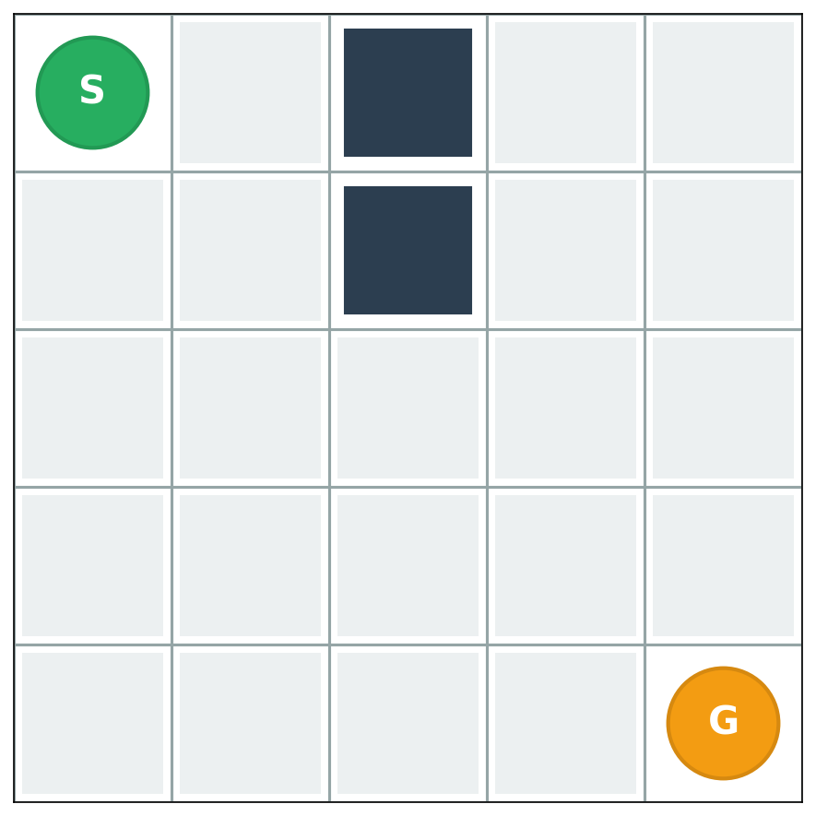
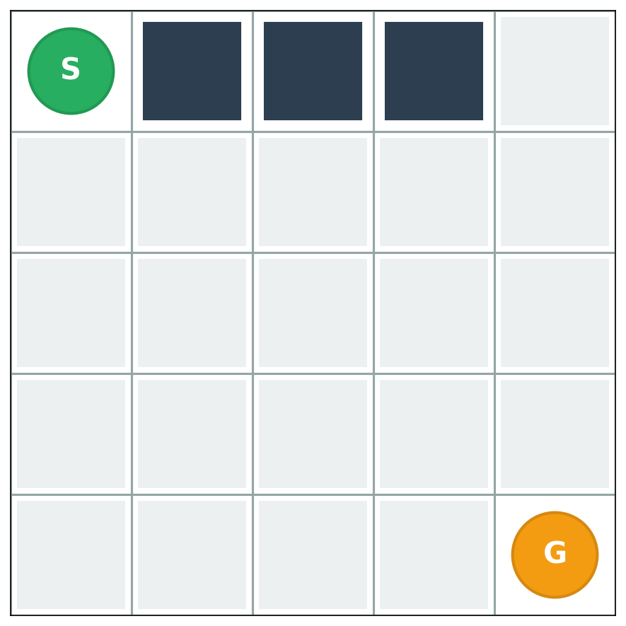
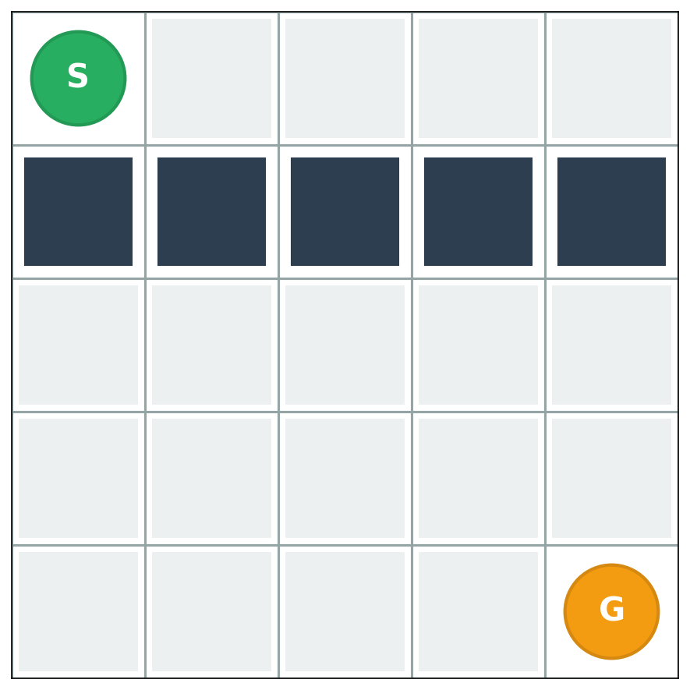
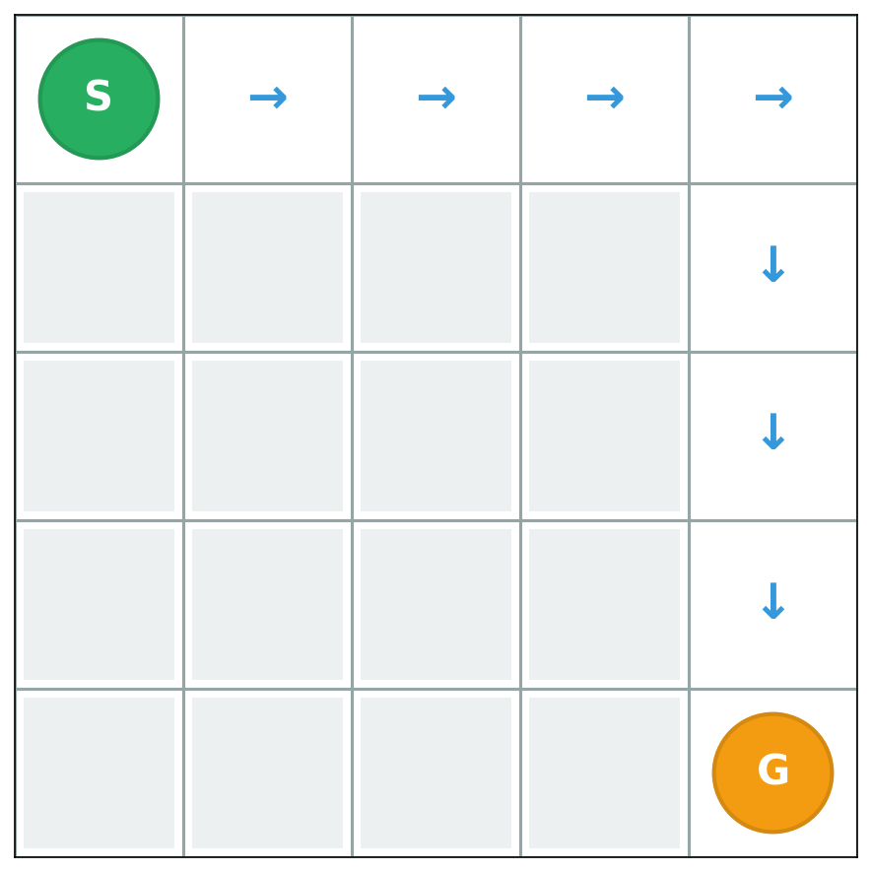
How We'll Test
We'll generate 1,000 cached 10×10 grid instances
Path exists
Path exists
Blocked barrier
Trivial path
Constraints (same for all):
Max 64 messages
Max 256 bytes per packet
Max 3,072 bytes total
What we'll measure & why:
✓ Correctness (oracle accepts) → Does it work?
✓ Efficiency (bytes, messages) → Practical overhead?
✓ Interpretability (human verification time) → Auditability feasible?

Slide 5
Our Approach: Implementation & Evaluation
How we'll build and test the system
1. What We'll Implement
CertTalk Protocol:
Baseline Systems:
PATH & CUT certificate encodings
Witness bit negotiation
Oracle verification module
Send-All (raw coordinates)
Other exploration strategies
2. Dataset & Testing
Generate 1,000 cached 10×10 grid instances (varied obstacle density 5%-30%)
Mix reachable and unreachable scenarios for comprehensive coverage
Run all systems under identical constraints (64 msg, 256 bytes/packet)
Oracle validates final artifacts for correctness
3. Metrics & Why We Measure Them
✓ Correctness: Oracle acceptance rate → Validates certificates work
✓ Efficiency: Bytes + messages per conversation → Ensures practical overhead
✓ Interpretability: Human verification time → Tests auditability feasibility

Slide 6
Timeline & Deliverables
Oct 26 → Early Dec
Week 1-2 (Oct 26 - Nov 8): Core Implementation
CertTalk protocol + PATH/CUT encodings
Witness bit negotiation + Oracle verification
✓ Checkpoint: 2-agent demo working
Week 3-4 (Nov 9 - Nov 22): Baselines & Dataset
Baseline systems + 1,000 grid instances generated
Test harness for running all systems
✓ Checkpoint: All systems run on samples
Week 5-6 (Nov 23 - Dec 6): Experiments & Analysis
Full experimental runs + Human study
Statistical analysis & paper draft
✓ Checkpoint: Results complete
Final Deliverables:
Code (GitHub)
Dataset (1K grids)
Paper (Arxiv)
Presentation

