Slide 1
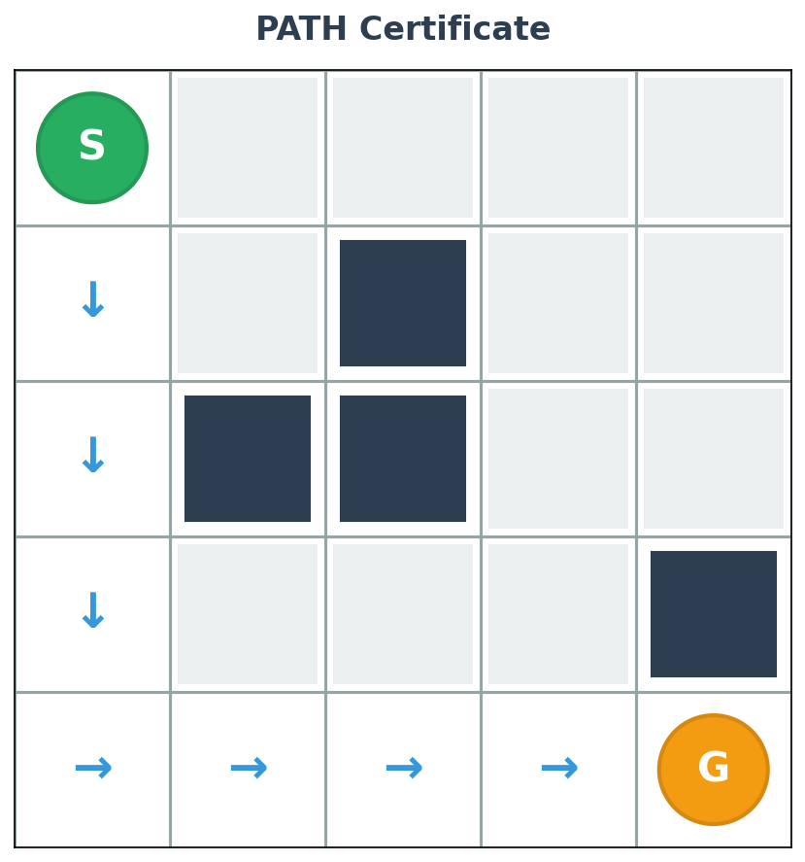
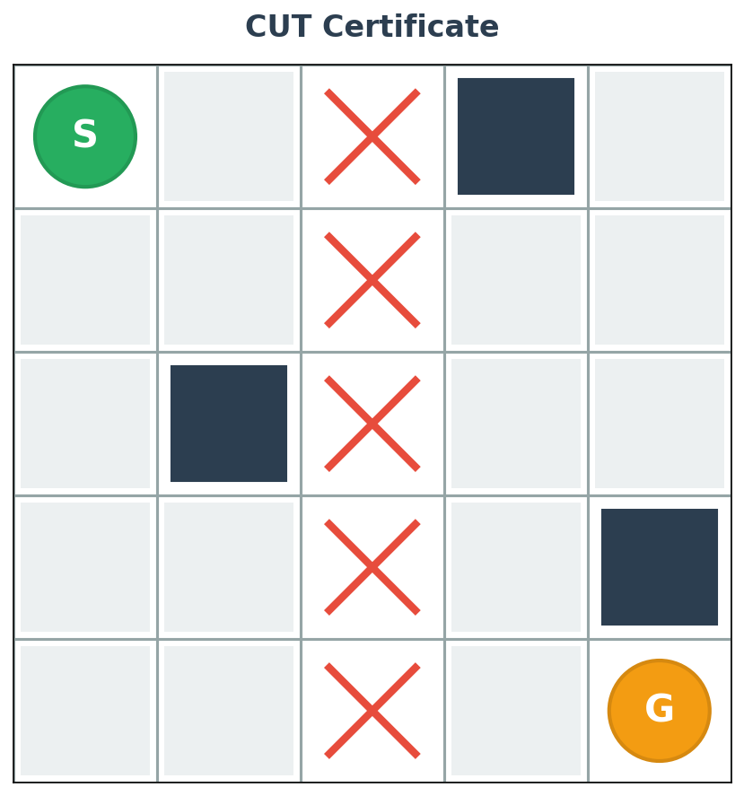
Send the Proof, Not the Data
✓ CertTalk: Send the certificate
If reachable → PATH_CERT
If blocked → CUT_CERT
"Here's the route"
"This wall blocks us"
~12 bytes
~20 bytes
What is a Certificate?
Certificate = Claim + Artifact + Attestation
Claim: "Path exists" or "Unreachable" • Artifact: RLE-encoded path/cut • Attestation: Witness bits
To verify: Certificate + Union map only. Send-All sends coords → rebuild + solve. CertTalk sends proof → direct check.

Slide 2
Breaking Epistemic Deadlock
How agents certify with partial knowledge
The Problem
The Solution
A proposes cut with 6 cells. B can only verify 3 of them:
Witness bits (1 per cell) encode WHO vouches:
✓
✓
✗
✗
✓
✗
1
1
0
0
1
0
B
B
A
A
B
A
What B sees
Who attests each cell
Without attribution:
B's acceptance rule:
B must NACK (can't verify 3 cells)
A sends PROBE
Deadlock: 5+ messages
Accept cell if: (I see blocked) OR (bit=0)
All 6 cells pass ✓
Fast path: 3 messages
Cost: 1 byte (6 bits) • Benefit: Eliminates probe round (~200 bytes)

Slide 3
What We'll Compare
Systems under test
Send-All
CertTalk
(baseline)
(this work)
"Dump raw data"
"Send proof"
A → All obstacle coords
A → Certificate proposal
B → All obstacle coords
B → Verify locally
B → Rebuild map
B → Certificate ✓
B → Run pathfinder
Final artifact: PATH or CUT proof
B → Answer
Opaque - need solver
Interpretable - visual proof
Preliminary 10×10 results:
Send-All: ~350B (100%) • CertTalk: ~470B (100%) • +34% overhead for proof
+ Other baselines (exploration strategies) tested on same 1,000 instances

Slide 4
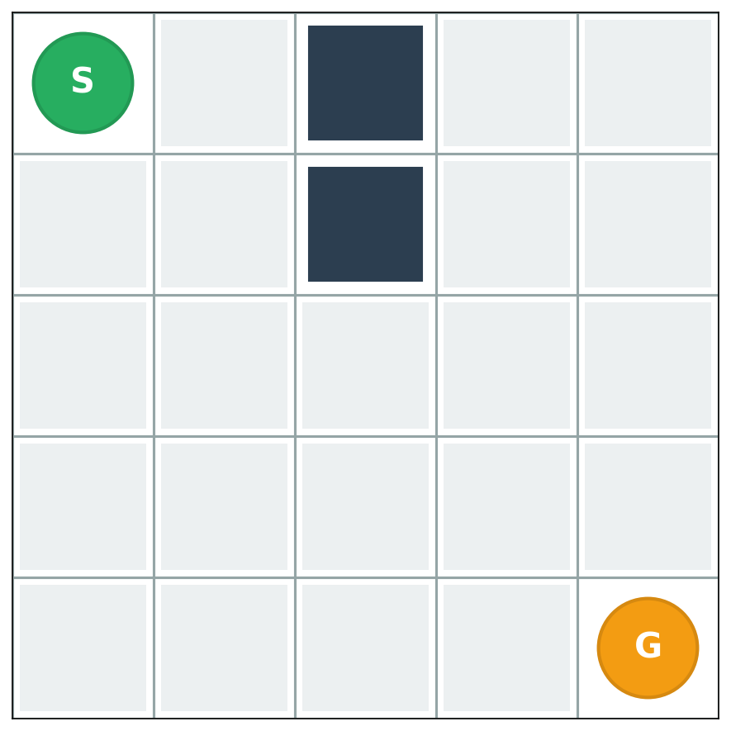
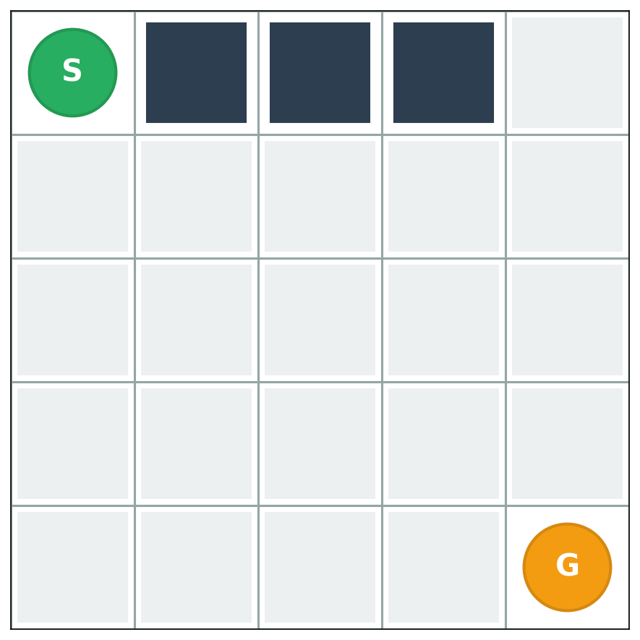
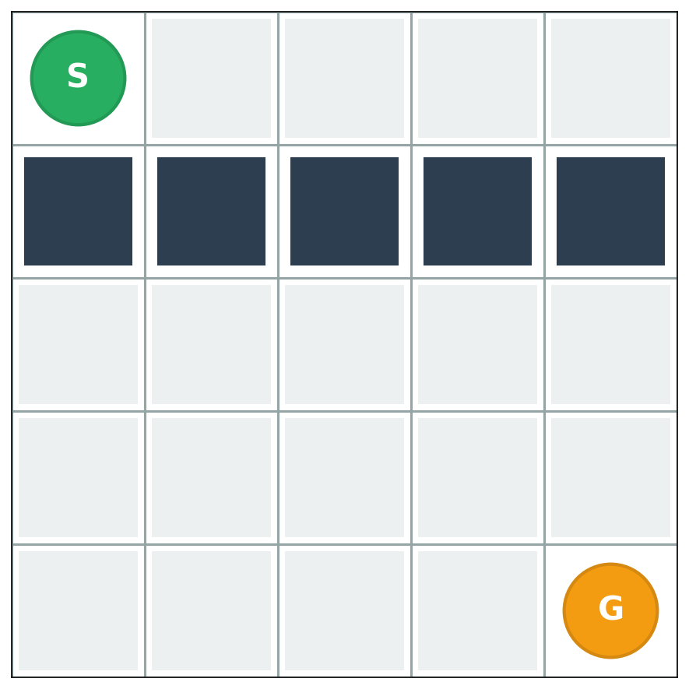
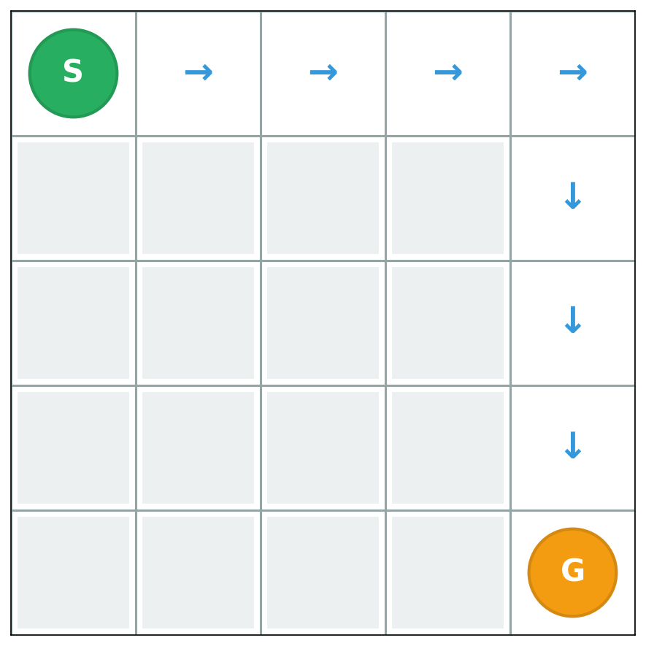
How We'll Test
We'll generate 1,000 cached grids (4×4 to 22×22, mixed density)
Path exists
Path exists
Blocked barrier
Trivial path
Constraints (same for all):
Max 64 messages
Max 256 bytes per packet
Max 3,072 bytes total
What we'll measure & why:
✓ Correctness (oracle accepts) → Does it work?
✓ Efficiency (bytes, messages) → Practical overhead?
✓ Interpretability (human verification time) → Auditability feasible?

Slide 5
Timeline & Deliverables
Oct 26 → Dec 6 (6 weeks)
Week 1-2
Week 3-4
Week 5-6
Core Implementation
Protocol + Encodings
Baselines & Dataset
1,000 grids + Test harness
Experiments & Analysis
Full runs + Paper
Final Deliverables:
Code (GitHub)
Dataset (1K grids)
Paper (Arxiv)
Presentation

Slide 6
Risks & Mitigation
Anticipated challenges and our strategies
⚠️ Computational Scalability
✓ Mitigation
Simulation caps at 22×22 grids (1,000 seeds max)
Focus on 4×4 to 22×22 range, vary density, document limits
⚠️ Timeline Pressure
✓ Mitigation
Dec 6 deadline: experiments + analysis + paper
Test other baselines only once Send-All vs CertTalk work rigorously

