Slide 1
Cybercops milestone meeting
Word2Vec and K Nearest Neighbors
By: bryan tuck & ebsa tufa
Notes:
dasdasdas

Slide 2
Why and what is word2vec?
Predict between every word and its context words
Two algorithms
1. Skip-grams (SG)
Predict context words given a target (position independent)
2. Continuous Bag of Words (CBOW)
Predict a target word from a bag-of-words context
Two training methods
Hierarchical SoftMax
Negative sampling
Notes:
Issues with prior approaches to distributional semantics:
Dimensionality curse.
No solution for unseen words.
Hardly capture semantic relations, such as is-a, has-a, synonym
Word order information is ignored
Slow for large vocabularies
On the other hand the benefits were:
Easy to implement
Human-interpretable results
Domain adaptation

Slide 3




Skip-gram prediction
$p(w_{t−1}|w_{t}$)
$p(w_{t+2}|w_{t}$)
$p(w_{t−2}|w_{t}$)
$p(w_{t+1}|w_{t}$)
The quick brown fox jumped over the lazy dog
Output
Context words
m word window
Center word
Position t
Output
Context words
m word window
Notes:
The model is going to find a probability distribution that is the probability of a word appearing in the context given this center word.
We are going to choose vector representations of words so we can try to maximize that probability distribution.

Slide 4
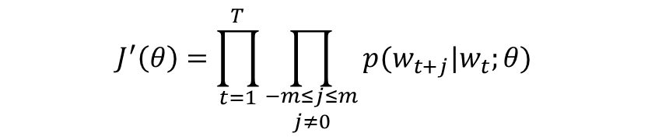
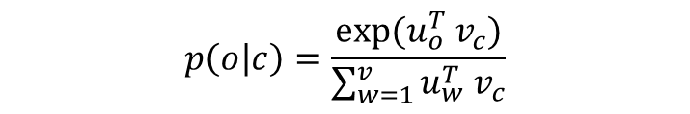
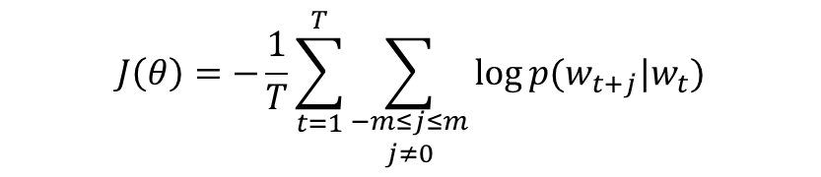
Objective Function
Predict the context of the central words
$$J^{′}\left(θ\right)=\prod_{t=1}^{T}{\prod_{\begin{aligned}−m≤j≤m \\ j≠0\end{aligned}}{p(w_{t+j}|w_{t};θ)}}$$
Softmax probability
$$p\left(o | c\right)=\frac{exp⁡(u_{o}^{T}{ v}_{c})}{\sum_{w=1}^{v}{u_{w}^{T}{ v}_{c}}}$$
Equivalently, also means to minimize the loss function
$$J\left(θ\right)=−\frac{1}{T}\sum_{t=1}^{T}{\sum_{\begin{aligned}−m≤j≤m \\ j≠0\end{aligned}}{\log{p(w_{t+j}|w_{t})}}}$$
Notes:
For each word t = 1 …T, predict surrounding words in a window of ‘radius’ m of every word. m before our center word and m after our center word and do that a lot of times and we want to choose word vectors that we are maximizing the probability of that prediction.
Then we will have a probability distribution that will give a probability to a word appearing in the context of the center word. What we would like to do is set the parameters of our model so that these probabilities of the words that do appear in the context is as high as possible.
Our theta is going to be the vector representations of the words.
Equivalently, we can do negative log likelihood.
How can we use these word vectors to minimize the negative log likelihood. We come up with a probability distribution of context words given the center word that is constructed out of word vectors.
SOFTMAX
C and o are indices of the vocabulary. Each word type is going to have a vector associated with them. Uo is the vector associated with context word in index o and Vc is the vector that is associated with the center word.
So, the probability that Uo is in the context of Vc, is defined as the SoftMax of their vector product.

Slide 5

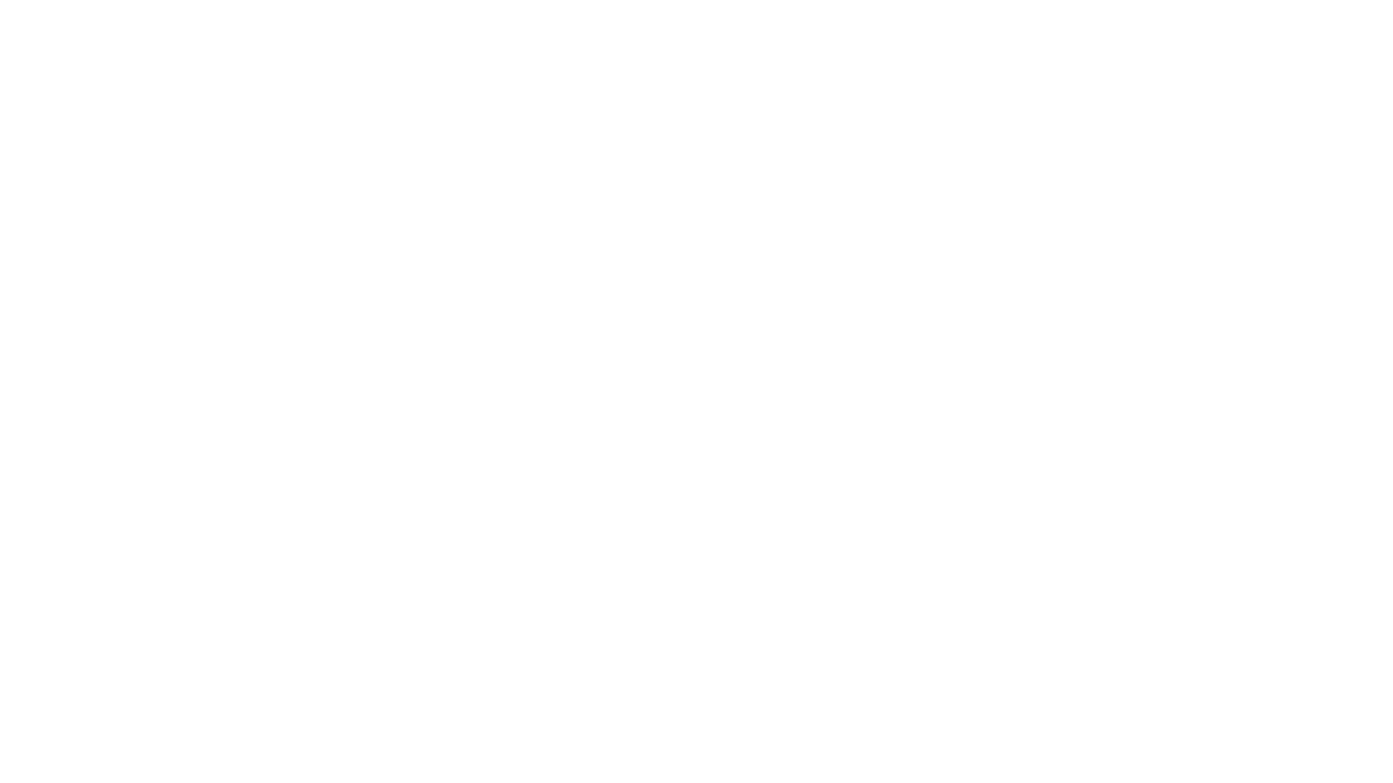
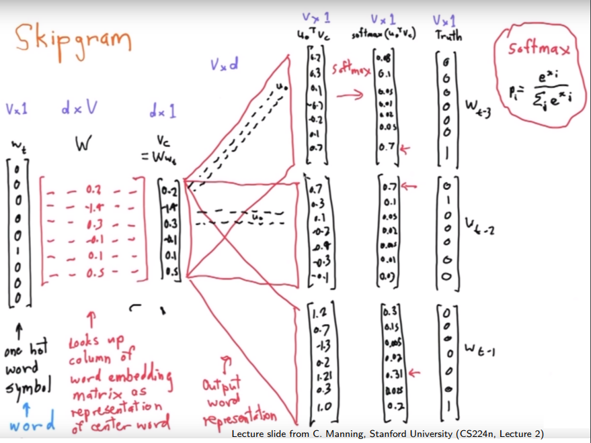
Notes:
Diagram by Chris Manning from Stanford
We have the center word which is a one hot vector
Then we have a matrix of the representations of the center words, if we do a multiplication of this matrix by the one hot vector, we selected out the column of the matrix that is the representation of the center word.
We have a second matrix that stores the representations of the context words. For each position in the context, multiply this Vc vector by this matrix. Same matrix for each position.
These dot products we softmax into a probability distribution.
The model as a generative model is predicting the probability of each word appearing in the context given that a certain word is the center word.

