Slide 1
realtime assistant AI
Catch bugs before they crash your code locally

Slide 2
Developers waste 50% of time debugging
42% of bugs come from loops/conditionals
Manual reviews miss hidden risks
One can use AI to debug after writing the full codes.
But this AI will debug when coding, instantly identify errors automatically.

Slide 3
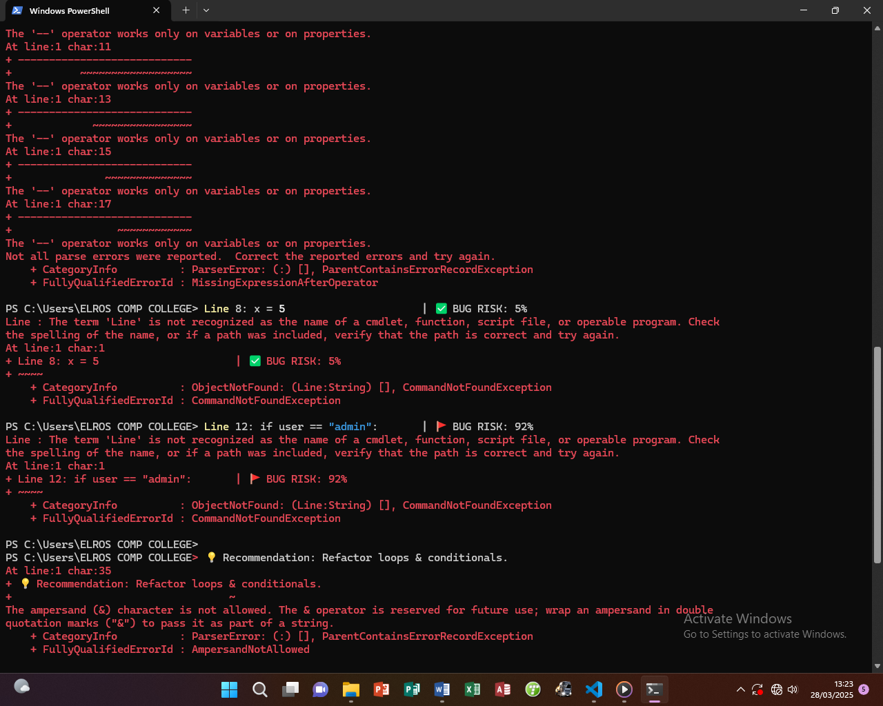
AI that flags risks in real-time

Slide 4
Machine Learning Made Simple
It runs locally.
Training AI to adapt to users way

Slide 5
Future Vision
Roadmap:
2024: VS Code extension
2025: Auto-fix suggestions Visual: Timeline with milestones.

