Slide 1
BLANCCO
Data Erasure & Sanitization Tool
Computer Forensics | Tool Presentation
What is Blancco?
How It Works
What Can It Do?
Install & Use
Real-World Use
Pros & Cons

Slide 2
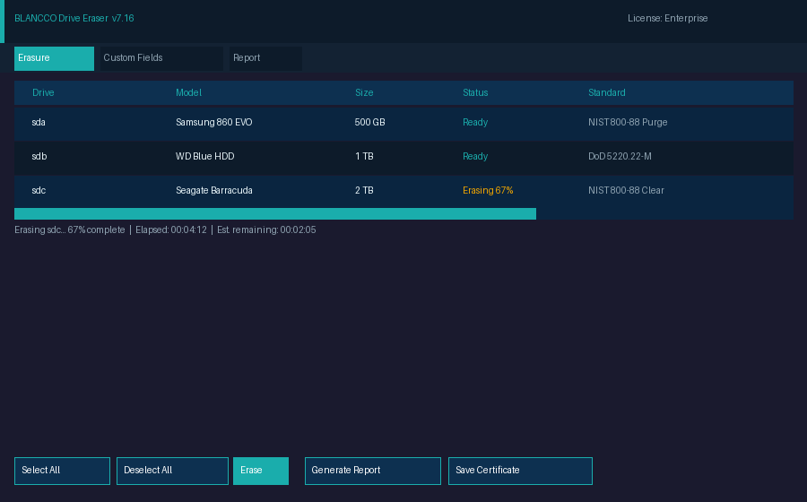
What is Blancco?
Certified data erasure software
Permanently wipes HDDs, SSDs & mobile devices
Used by 3,000+ organizations globally
Meets NIST, DoD, GDPR compliance standards
Generates tamper-proof erasure certificates
Trusted in forensics, ITAD & enterprise IT
Not just 'delete' — data is unrecoverable
Blancco Drive Eraser — UI Screenshot (simulated)

Slide 3
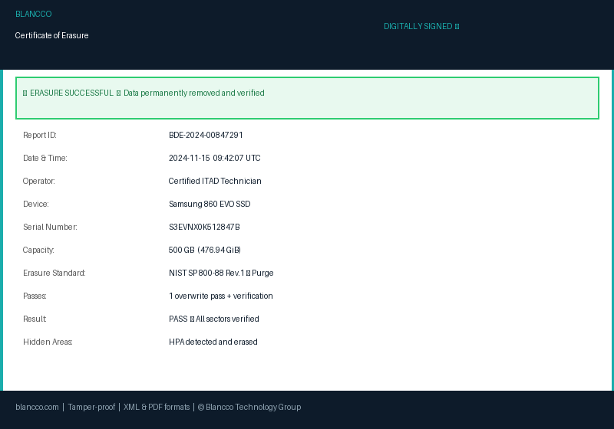
How It Works
1
Boot
2
Select
3
Erase
4
Certify
Boot device from Blancco USB or ISO
Choose erasure standard (NIST, DoD…)
Overwrites every sector + hidden areas
Signed PDF certificate auto-generated
▶
Watch: Blancco Drive Eraser
Official Product Overview Video
Click to play → blancco.com
Sample Erasure Certificate (auto-generated after each wipe)

Slide 4
What Can It Do?
Erase HDDs, SSDs, NVMe & USB drives
Wipe mobile devices (iOS & Android)
Sanitize servers & virtual machines
Supports 20+ global erasure standards
Erases hidden areas: HPA & DCO
Manage 1,000s of devices at once
Export signed PDF/XML certificates
Erasure Certificate — legally defensible proof of wipe

Slide 5
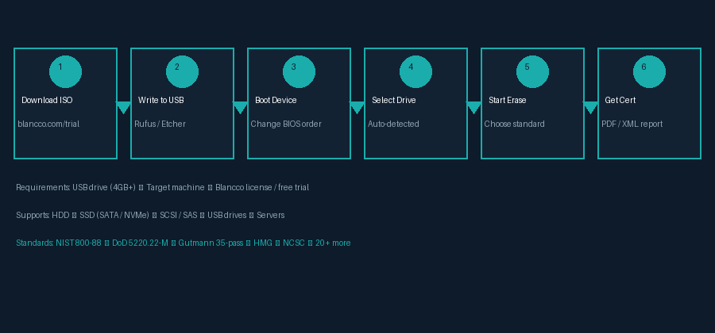
Installing & Using Blancco
Install Steps
Using the Tool
Download ISO from blancco.com
Write to USB using Rufus / Etcher
Boot target machine from USB
Blancco auto-detects all drives
Select drive + erasure standard
Start erasure — verify completes
Download signed certificate (PDF)
Store report for audit/compliance

Slide 6
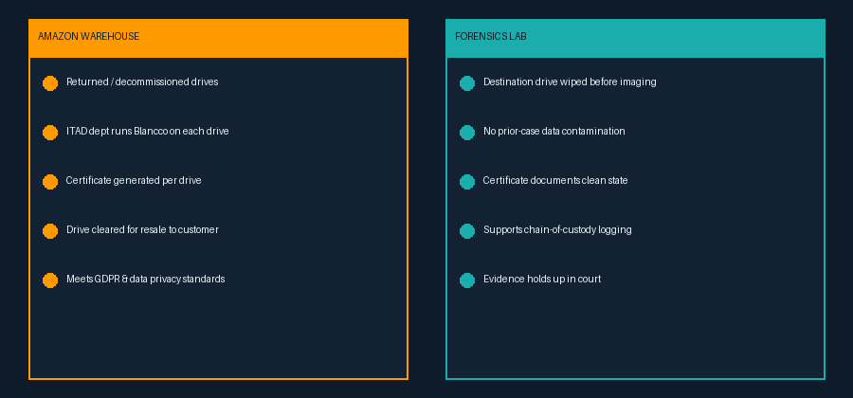
Real-World Use
My Experience @ Amazon
Forensics Lab Use
ITAD dept wipes returned/decommissioned drives
Each drive gets a Blancco certificate before resale
Meets GDPR & consumer data privacy requirements
Wipes destination drive before forensic imaging
Prevents evidence contamination from prior case
Certificate supports chain-of-custody in court

Slide 7
Pros & Cons
✔ Strengths
✖ Limitations
20+ certified erasure standards
Tamper-proof, legally valid certificates
Erases hidden areas (HPA & DCO)
Wide device support: HDD, SSD, mobile
Enterprise-scale management console
Common Criteria & ADISA certified
Regularly updated for new drive types
Commercial — licensing costs apply
Free trial limited in scope & time
Physical boot required for some tasks
Not a data recovery or imaging tool
Enterprise console has learning curve
NVMe erase varies by drive firmware
Closed-source — no public code audit

Slide 8
References
[1] Blancco Official Website
https://www.blancco.com
[2] Blancco Drive Eraser Product Page
https://blancco.com/products/drive-eraser/
[3] Blancco Drive Eraser Overview Video (Official)
https://blancco.com/resources/vd-blancco-drive-eraser-overview/
[4] Blancco How to Erase PCs & Laptops (Video)
https://blancco.com/resources/vd-how-to-securely-erase-pcs-and-laptops/
[5] NIST SP 800-88 Rev.1 — Guidelines for Media Sanitization
https://csrc.nist.gov/publications/detail/sp/800-88/rev-1/final
[6] DoD 5220.22-M — National Industrial Security Program
https://www.esd.whs.mil/Portals/54/Documents/DD/issuances/dodm/522022M.pdf
[7] ADISA Product Certification for Blancco
https://adisa.global

