Slide 1
Genomic variance of the 2019-nCoV coronavirus
Carmine Ceraolo | Federico M. Giorgi
Presented by;
Bryan Abuchery | Margaret Chifwete
Fred Kebaso | Virginiah Periah | Lmelias Luke
21st October, 2020

Slide 2
Introduction
Overview of the paper;
    Establishes the genomic variance of 2019-nCoV
    54 sequences of 2019-nCov, 6 seq SARS, 6 seq of BCoV, 2 seq of beta-CoVs(MERs) and 2 partial seq of Italian 2019-nCoV
    MSA was done using MUSCLE software
    Alignment was visualized using Jalview software
    Phylogenetic tree was constructed using Mega X

Slide 3
Objectives
General:
  Read, understand and reproduce the paper
Specific:
  To learn:
    Genomic data collection from Genbank and GISAID.
    Perform and visualize multiple sequence alignment(MSA)
    Generate and visualize phylogenetic tree.

Slide 4
Methodology
Data collection
  Genbank
  Gisaid
MSA
  MUSCLE 3.8.31
Visualize MSA
  Jalview 2.11.1.2
Phylogenetic Tree
  MEGAx 10.1.7
BLASTn
To obtain percentageidentity

Slide 5
Results
(i) Data Collection
Organism | Source | No. Of Sequences
Human SARS | Genbank | 6
Bat CoV | Genbank | 5
Bat CoV | GISAID | 1
Human MERS | Genbank | 2
Human 2019-nCoV | GISAID | 55
Human 2019-nCoV | Genbank | 1
Total Sequences |  | 70
Reference Sequences
Query sequences

Slide 6
(ii) BLASTn
We compared 56 sequences of the 2019-nCoV against 14 reference sequences in order to identify sequence similarities
  99.9 % similarity was observed within all the 2019-nCoV sequences
  There was a sequence identity of 96.2% between 2019-nCoV and the Bat CoVs with a query coverage of above 99%
  Human SARS had a query coverage of 98% and 80.26% sequence identity with the 2019-nCoV reference sequence.

Slide 7
(iii) Multiple Sequence Alignment
Alignment of more than 2 sequences
Why?
Its the basis for phylogenetic tree construction.
      To detect similarity between sequences. How close/distant sequences are
      To detect conserved regions

Slide 8
MSA Tools used
Multiple Sequence Comparison by Log Expectation (MUSCLE)
  One file containing all sequences was created and saved in FASTA format.
  MSA was performed using MUSCLE V 3.8.31.
  Command;
    Muscle -in <inputfile> -out <outputfile>
  The aligned sequences were visualized using Jalview v 2.11.1.2.

Slide 9
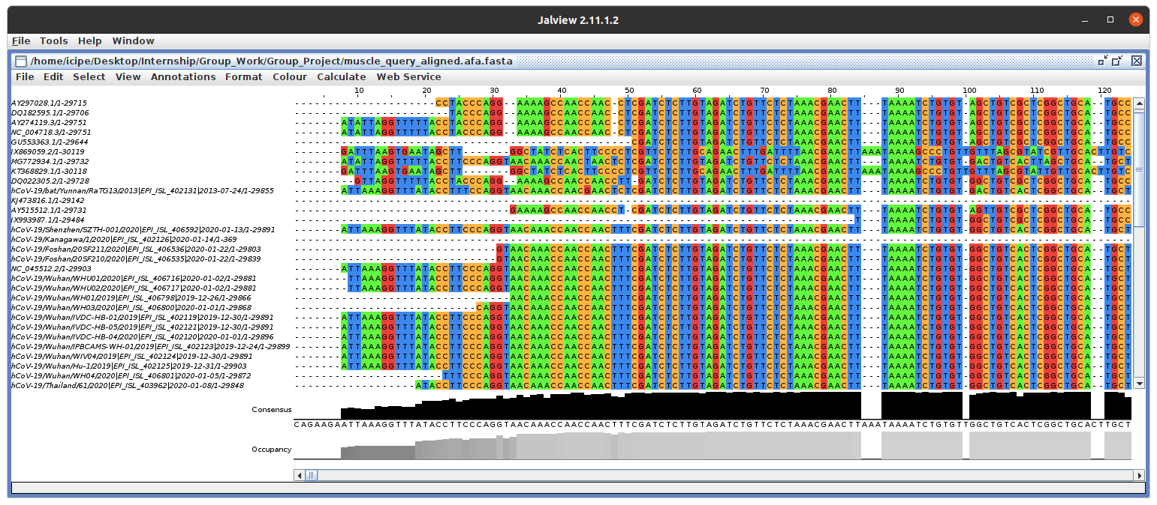
MSA Visualization

Slide 10
(iv) Phylogenetic Analysis
Study of evolutionary relationships among biological entities.
Why phylogenetics?
    Classification
    Identify pathogens
    Answer biological questions, forensics

Slide 11
MEGA
Molecular Evolutionary Genetics Analysis
    MEGAx V 10.1.7 was used for this analysis.
    Phylogenetic tree was constructed using Tamura-Nei model based on maximum-likelihood method.
    100 bootstraps were used as a measure of confidence with a cut-off of 50%.
    Our analysis confirms high sequence similarities within 2019-nCoVs genome.
    Phylogeny shows close sequence similarities between bat CoV and 2019-nCoVs.

Slide 12
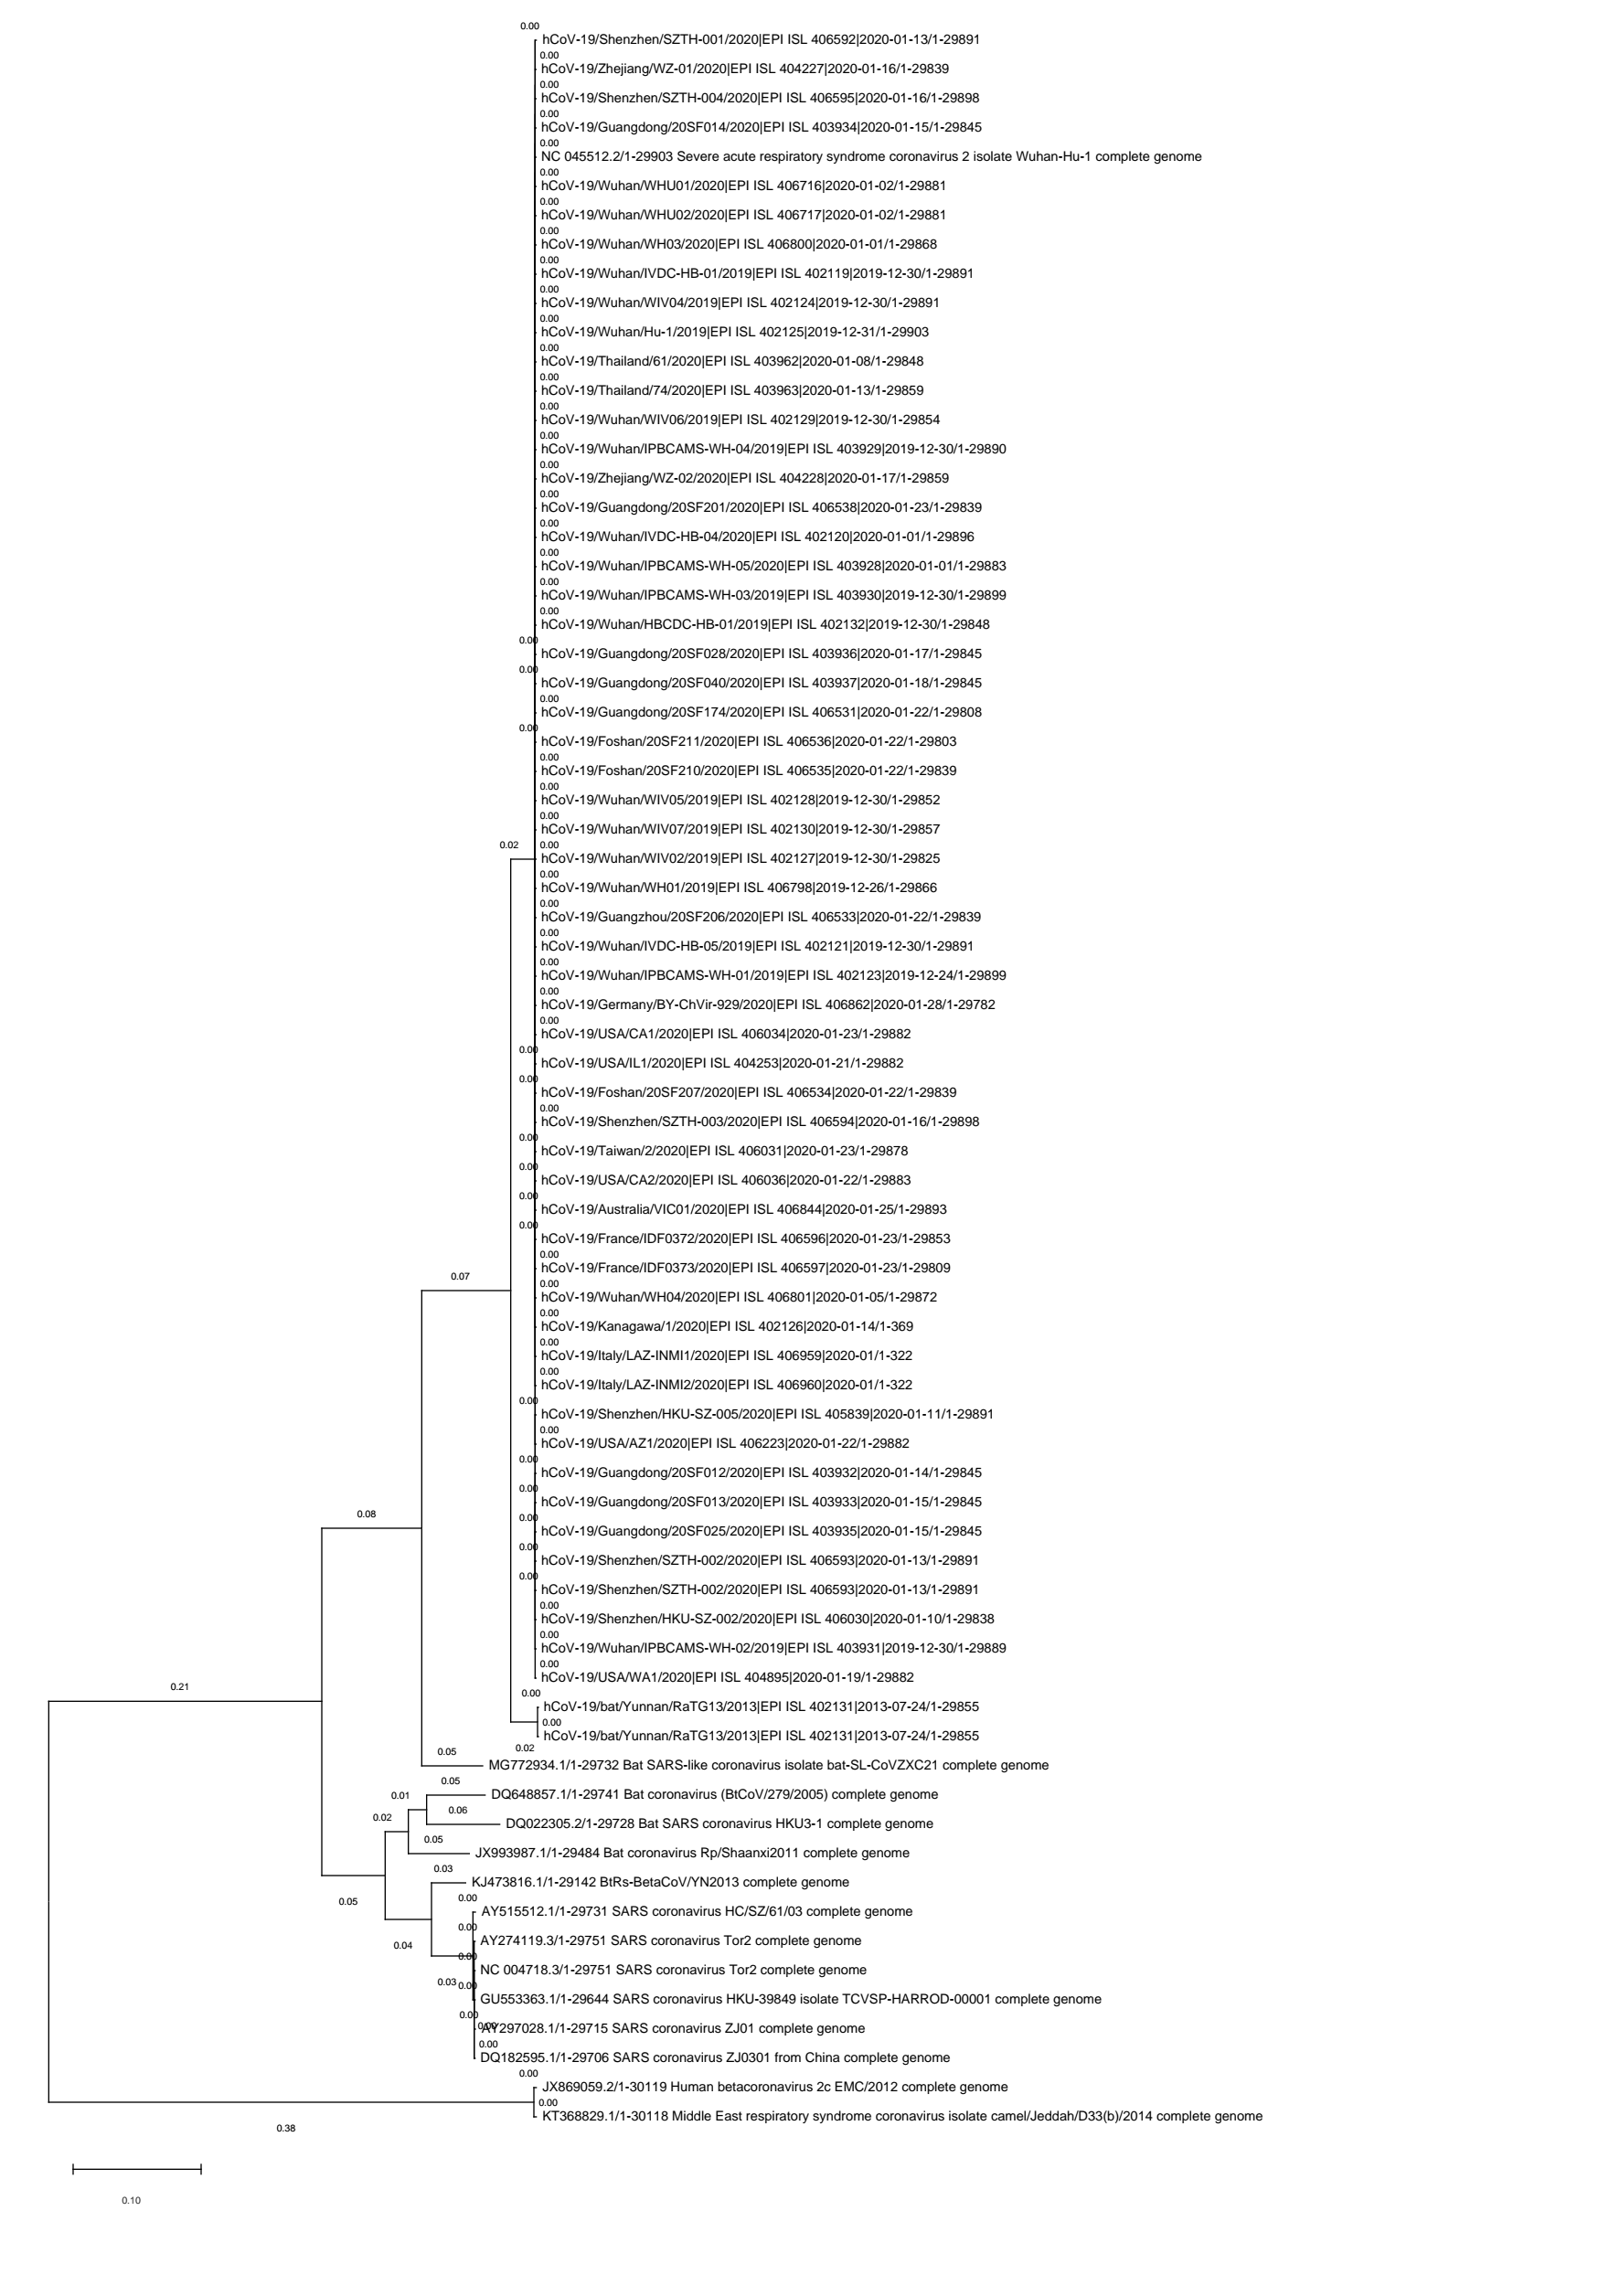
Phylogenetic Analysis...
Human 2019-nCoVs
Bat CoV
Human SARS
Human MERS

Slide 13
Bench-marking of Other Tools
Jalview
  Very useful in visualizing alignments
  Supports only two methods of computing phylogeny
  Does not handle large sequences especially to calculate phylogeny
Kalign
  It is very but fast, but may compromise accuracy
Seaview
  Can be used to align sequences
  Good for visualizing aligned sequences
Aliview
  Slow in performing MSA
  RAM intensive
  Good for visualizing aligned sequences

Slide 14
Challenges
Some software were slow
Technical challenges – high RAM consumption
File formats

Slide 15
Conclusion
Our analysis also confirms that the novel 2019-nCoV is closely related to the BCoVs
All tools work but efficiency matters
Their work is reproducible
Command-line tools are faster compared to GUI tools

Slide 16
Thank you
For
Listening

