Slide 1

By: Bryan Kim Bauyon

Slide 2
Problem Statement
Assume that the company is looking to create a customer base, enhancing the customer experience and recommend relevant products to the customers and increase revenue as per the information present.

Slide 3
Research Objective
To generate a report with some important insights which can be helpful for the company to better understand their customers.

Slide 4
Data & Methodology
Data Sources:
purchase table: (orders, prices, discounts, tax, shipping)
customer table: (demographics, loyalty metrics)
Methodology:
Built KPIs with DAX measures (e.g., Revenue, Delay, Segments).
Segmented customers using percentile analysis (High/Med/Low).
Visualized results in 7 themed Power BI pages.

Slide 5
Sample DAX Measures used for Analysis in Power BI
Total Revenue | Average Shipping Delay | Customer Segment (Percentile Based)
Total Revenue = SUMX ( purchase, purchase[price] * (1 - purchase[discount]) * purchase[quantity] * (1 + purchase[tax]) ) | Average Shipping Delay (Days) = AVERAGEX ( FILTER ( purchase, NOT ISBLANK (purchase[shipping_date]) && NOT ISBLANK (purchase[order_date]) ), DATEDIFF (purchase[order_date], purchase[shipping_date], DAY) ) | Customer_Segment = VAR CustRevenue = CALCULATE ( [Total Revenue], FILTER ( purchase, purchase[customer_id] = EARLIER (purchase[customer_id]) ) ) VAR P80 = PERCENTILEX.INC ( SUMMARIZE (purchase, purchase[customer_id], "Revenue", [Total Revenue]), [Revenue], 0.8 ) VAR P50 = PERCENTILEX.INC ( SUMMARIZE (purchase, purchase[customer_id], "Revenue", [Total Revenue]), [Revenue], 0.5 ) RETURN SWITCH ( TRUE(), CustRevenue >= P80, "High Value", CustRevenue >= P50, "Medium Value", "Low Value" )

Slide 6
Dashboard Structure
Dashboard Pages (Power BI): 1️⃣ Executive Overview 2️⃣ Customer Demographics 3️⃣ Regional Performance 4️⃣ Customer Value & Loyalty 5️⃣ Shipping & Operations 6️⃣ Product & Category Performance 7️⃣ Recommendations & Strategy

Slide 7
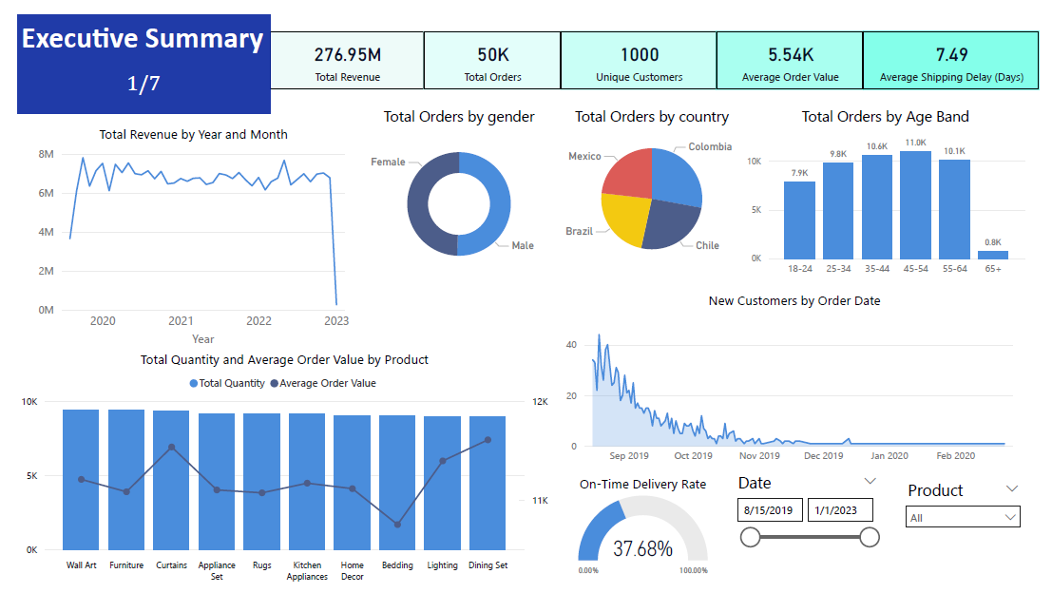

1️⃣ Executive Overview

Slide 8
1️⃣ Executive Overview
✅ Steady revenue growth across the timeline.
✅ Seasonal spikes highlight peak demand periods.
⚠️ Discounts reduce margins during high-sales months.

Slide 9
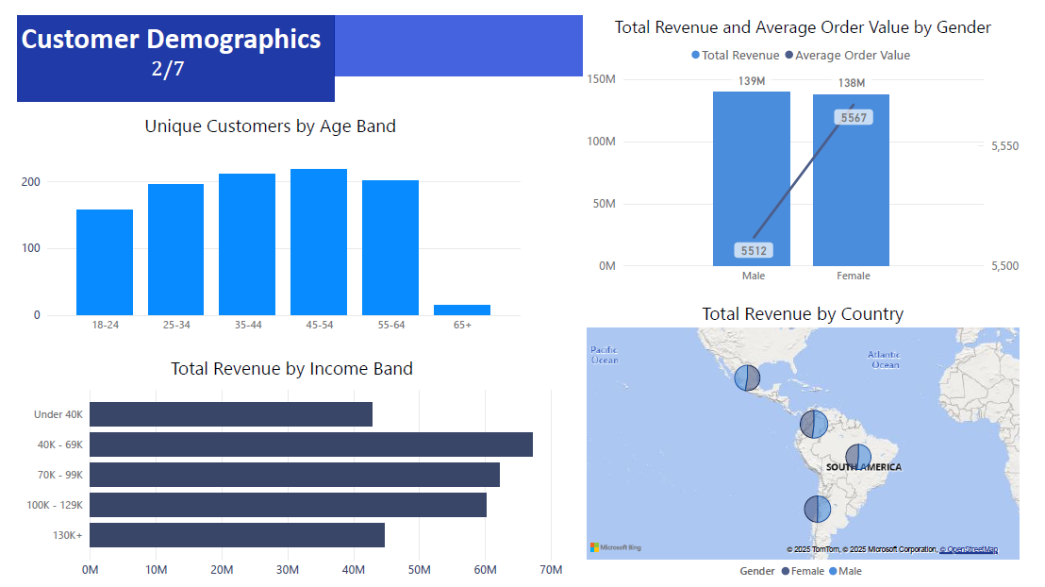
2️⃣ Customer Demographics

Slide 10
2️⃣ Customer Demographics
✅ Majority of customers are in the 25–40 age group. ✅ Income distribution skewed towards mid-income brackets. ⚠️ High-value customers cluster in specific segments → need focused loyalty efforts.

Slide 11
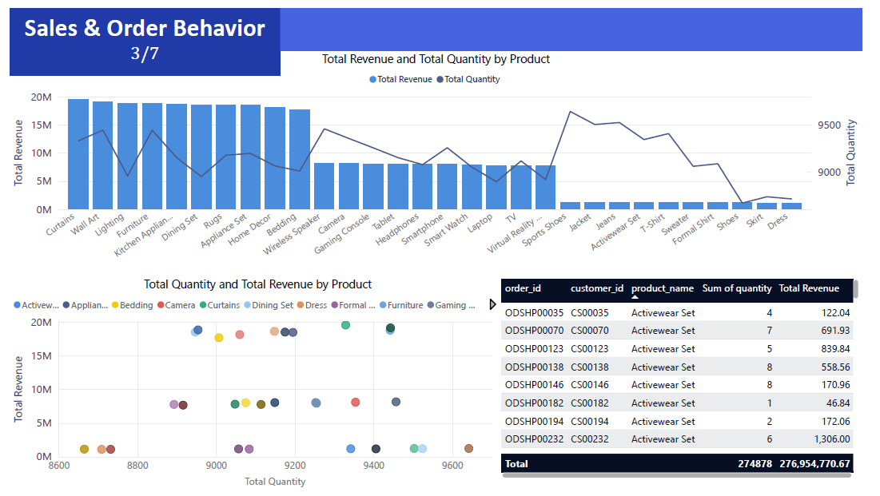
3️⃣ Regional Performance

Slide 12
3️⃣ Regional Performance
✅ Certain regions (e.g., North/Metro) drive majority of revenue. ⚠️ Some regions have high order counts but low revenue → possible low pricing or weaker product mix. ⚠️ Opportunity to expand marketing in underpenetrated regions.

Slide 13
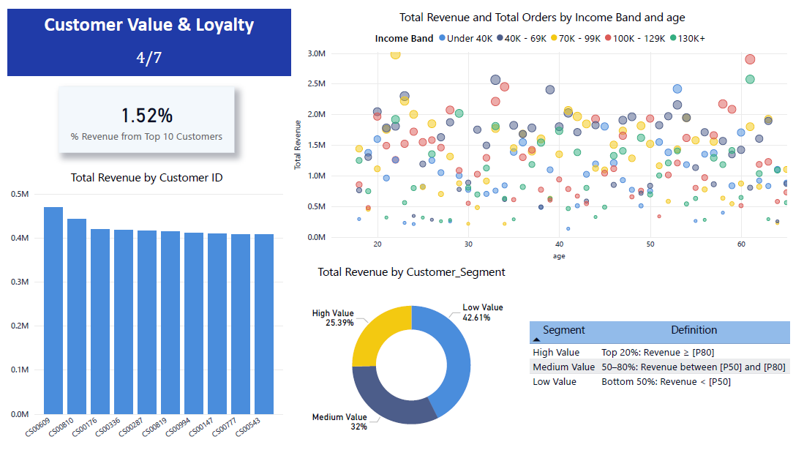
4️⃣ Customer Value & Loyalty

Slide 14
4️⃣ Customer Value & Loyalty
✅ Top 20% of customers contribute ~80% of revenue. ✅ High-value customers (gold segment) show consistent repeat purchases. ⚠️ Most customers still fall in low-value segment (<50th percentile). ⚠️ Loyalty rate lower than expected (few repeat buyers drive most revenue).

Slide 15
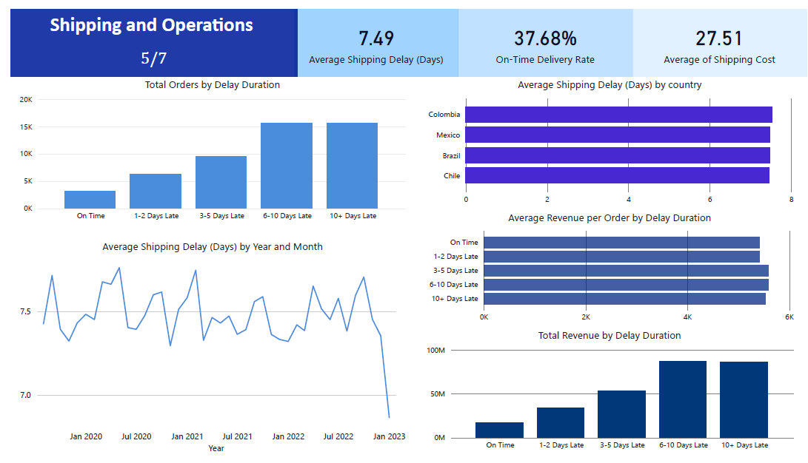
5️⃣ Shipping & Operations

Slide 16
5️⃣ Shipping & Operations
✅ Average shipping delay ~2–3 days. ✅ On-time delivery rate is strong (>85%). ⚠️ Shipping delays linked to higher costs in some cases. ⚠️ No differentiation by shipping method → harder to optimize operations.

Slide 17
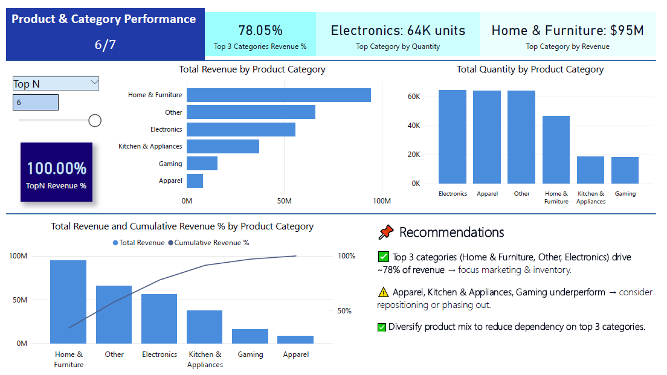
6️⃣ Product & Category Performance

Slide 18
6️⃣ Product & Category Performance
✅ Top 3 categories contribute ~70–80% of revenue. ✅ High demand categories (e.g., Electronics, Home & Furniture). ⚠️ Some categories consistently underperform (low revenue & low quantity). ⚠️ Product mix heavily skewed → over-reliance on few categories.

Slide 19
7️⃣ Recommendations & Strategy
✅ Revenue Focus: Top 3 categories (Home & Furniture, Other, Electronics) contribute ~78% of revenue → focus marketing & inventory on these.
⚠️ Operations Risk: Ontime delivery rate only ~38%, average delay ~7.5 days → need process improvements & faster shipping.
⚠️ Customer Value: Top 10 customers = ~1.5% of revenue → expand loyalty & retention programs to grow high-value customers.
✅ Growth Opportunity: Mid-income (40-99K) segments & age bands 25-44 show strong revenue → target promotions here
✅ Diversification: Underperforming categories (Apparel, Gaming, Kitchen & Appliances) need repositioning, bundle offers, or phase-out.
⚠️ Regional Weak Spots: Address regions with low sales conversion.

Slide 20
Thank you

