Slide 1

Capstone Project: Real- Estate Analysis of Price Trends, Affordability, and Benchmarking
Bryan kim bauyon

Slide 2
Problem Statement
In the real estate industry, accurate property valuation plays a crucial role in making informed buying and selling decisions. Property owners, investors, and real estate professionals rely on accurate and reliable valuation estimates to determine fair market prices, negotiate deals, and assess investment opportunities.

Slide 3
Research objectives
To develop an intuitive and comprehensive dashboard for descriptive analytics in the real estate industry.
The dashboard will provide users with valuable insights and visualizations based on key factors such as location, property characteristics ,market trends, and comparable sales data.
To create a user friendly and informative dashboard that enhances the understanding of real estate market dynamics

Slide 4
Methodology
⚙️ Data & Methods
Dataset: HDB Resale Transactions (2012–2023)
Data Cleaning: Standardized dates, created Year-Month field, calculated Price per sqm, extracted Lease Years Remaining
KPIs Derived:
Avg Price
Median Price per sqm
Total & Monthly Transactions
YoY Price Change %
Tools: Power BI (visualizations, filters, trend & benchmark analysis)

Slide 5
Dashboard Overview
📄 Page 1 – Overview (KPIs & Trends) High-level KPIs: Avg Price, Transactions, YoY Change. Monthly trend: shows market direction. ✅ Covers overall market performance. | 📄 Page 2 – Market Trends & Comparisons Avg Price & Transactions by Flat Type. Price per sqm distribution. Lease Remaining vs Price. ✅ Explains differences by property type & lease effect.

Slide 6
Dashboard Overview
📄 Page 3 – Geographic Insights Map & bar charts by Town. Median Price per sqm by Town. ✅ Covers location-based differences. | 📄 Page 4 – Comparables & Benchmarking Towns vs benchmark. Flat types vs benchmark. Scatter plot (floor area vs price per sqm). Comparable sales table. ✅ Provides benchmarking & detailed reference.

Slide 7
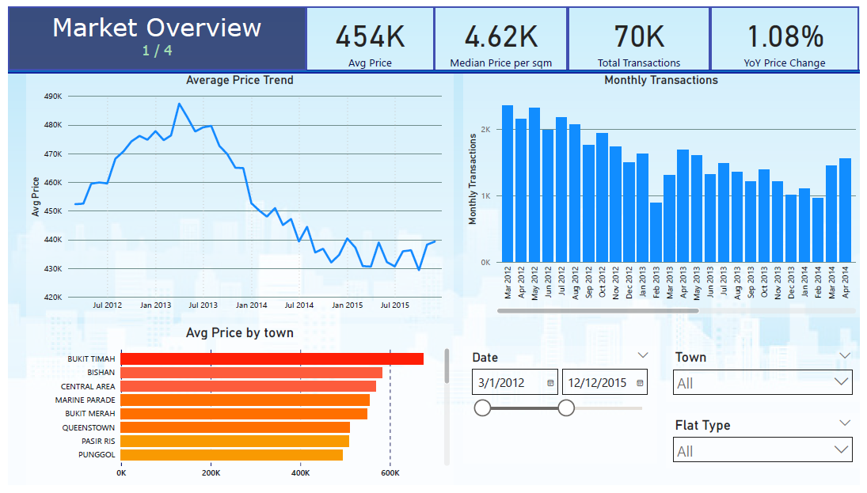
Page 1: Market Overview

Slide 8
Page 1: Market Overview
📊 KPIs & Trends
Avg Price, Median Price/sqm, Transactions, YoY Change
Monthly transactions trend line
💡 Insight: Market shows steady growth with cyclical transaction volumes.

Slide 9
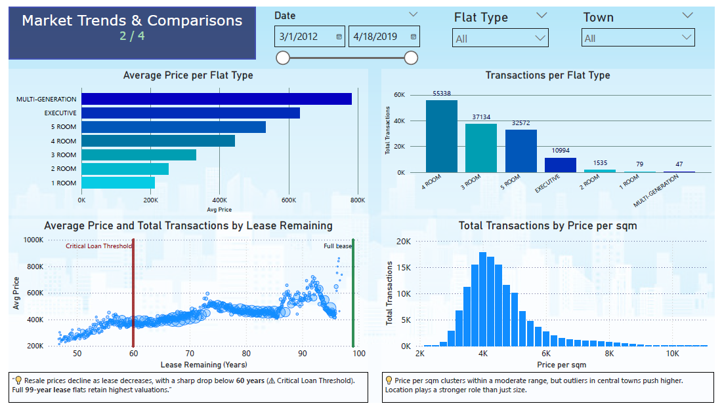
Page 2: Market Trends & Comparisons

Slide 10
Page 2: Market Trends & Comparisons
📊 Flat Type & Price Efficiency
Avg Price & Transactions by Flat Type
Price per sqm distribution (histogram)
Lease Years vs Avg Price scatter
💡 Insight: Lease length critically impacts pricing; smaller flats are affordable but less space-efficient.

Slide 11
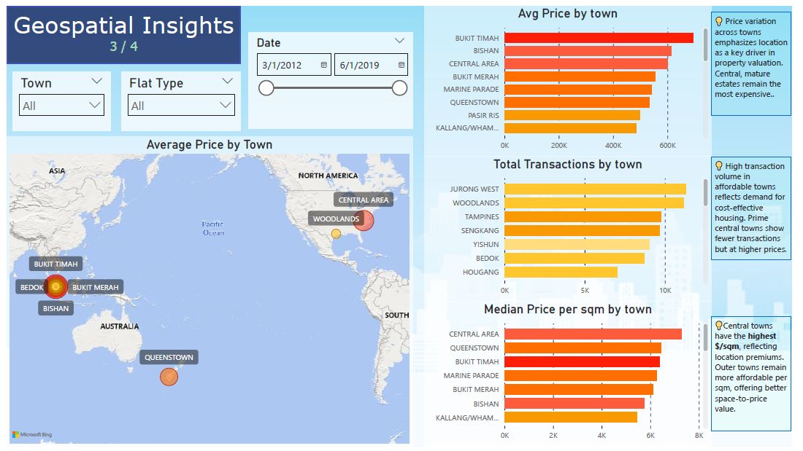

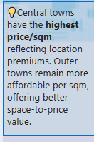
Page 3: Geographic insights

Slide 12
Page 3: geographic insights
🗺️ Town Comparisons
Map of Avg Price by Town (color = price, size = transactions)
Median Price per sqm by Town
Transactions by Town (bar chart)
💡 Insight: Central towns command premiums, outer towns remain value-for-money.

Slide 13
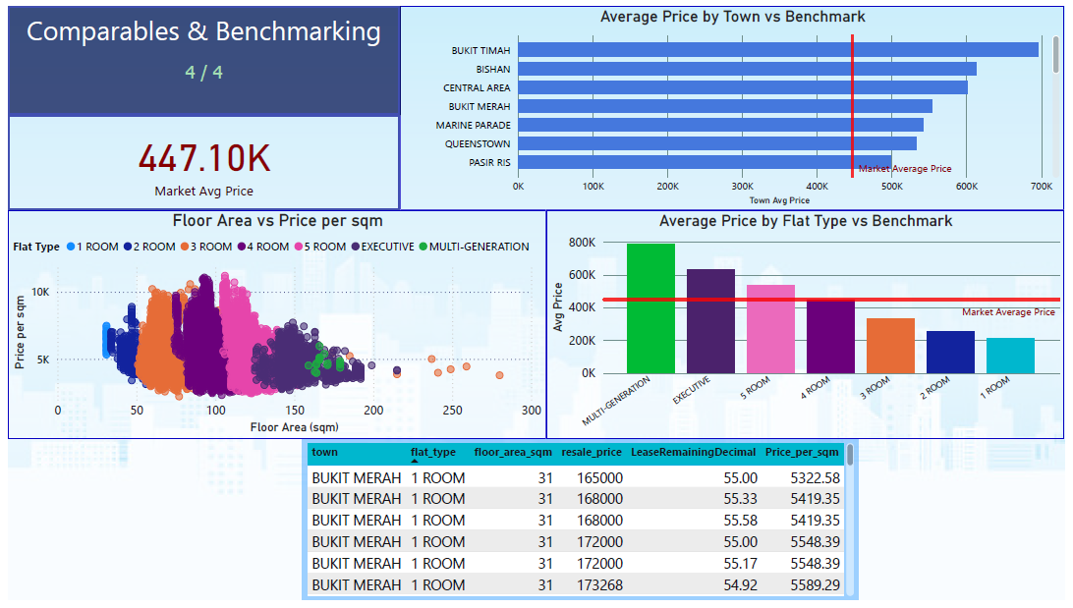
Page 4: comparables and benchmarking

Slide 14
Page 4: Comparables & Benchmarking
📊 Benchmarking Analysis
Avg Price vs Market Benchmark by Town
Price per sqm vs Floor Area (scatter)
Avg Price by Flat Type vs Benchmark
Comparable Sales Table
💡 Insight: Benchmarks help spot premium vs undervalued towns and flat types.

Slide 15
COnclusion
✅ Key Takeaways
Prices are rising steadily; affordability varies by location & flat type
Lease length is a critical driver of value
Central towns = premium, non-central = value buys
Benchmarking tools allow fairer comparisons

Slide 16
recommendations
📌 For Buyers
Consider price/sqm efficiency in addition to total price
Watch lease years closely (loan eligibility, future value risk)
📌 For Policymakers
Monitor affordability gaps across towns
Strengthen support for towns lagging in value retention

Slide 17
Thank you

