Slide 1
SSTIC 2016 Keynote
Brad Spengler – grsecurity
Rennes, France
June 1 2016
Notes:
LSM2002
Laurent Oudot

Slide 2
Outline
Update since PaX Team’s 2012 keynote
Advisory notice
State of infosec union
The future
Notes:
Skip mention of anything but update, pipacs promised an update of what we’ve been up to since his 2012 SSTIC keynote

Slide 3
Update (grsecurity)
KSTACKOVERFLOW
Kills stack overflow vuln class on 64-bit archs
RANDSTRUCT
Randomizes layout of critical marked structures
Auto-randomizes pure ops structures
HARDEN_IPC
Automatic “umask” of sorts for IPC objects
Prevents harm from common cases of overly-permissive IPC
Based on research by Tim Brown
http://labs.portcullis.co.uk/whitepapers/memory-squatting-attacks-on-system-v-shared-memory/
Notes:
Limit time on HARDEN_IPC, takes longer to explain

Slide 4
Update (grsecurity)
ARM v6/7 KERNEXEC/UDEREF
Provides protection equivalent to i386
Uses ARM domain support
USERCOPY improvements
Message queue buffers allocated in separate slab cache
RAND_THREADSTACK
Response to exploit by Exodus Intel against Asterisk
DENYUSB
Prevents recognition of all new USB devices after system boot
Or temporary allowance via sysctl toggle
Notes:
Skip mention of ARMv8 for time
UDEREF implementation mimic’d upstream in recent kernels without credit
Limit comments of rest, otherwise this becomes a 7min slide

Slide 5
Update (grsecurity)
Various “smaller” features/improvements
DEVICE_SIDECHANNEL
CHROOT_RENAME
Limiting *at() use in chroot to descendants of dir fd
Based on report by Jann Horn
Notes:
Mostly skip discussion of these, too much background information needed

Slide 6
Update (PaX)
Per-slab object sanitization
Contributed by Mathias Krause
CONSTIFY improvements
SIZE_OVERFLOW improvements
STRUCTLEAK
LATENT_ENTROPY improvements
Feeds boot-time RAM contents into entropy pool
After-boot entropy extraction (interrupt/fork codeflow etc)
REFCOUNT improvements
Non-public plugin to automate discovery of FPs
PPC port by Rodrigo Branco
UDEREF/x64 improvement
PCID enhancement
Notes:
Per object, with some caches whitelisted for performance (like for storing filenames)
CONSTIFY coverage greatly improved by marking often-used structures that were not fully ops structs
SIZE_OVERFLOW – coverage greatly increased through tracing back indirect calls and structure field dataflow analysis, coverage still limited to around 1/10th of its current potential (so that the hash table isn’t 10x as large)
STRUCTLEAK – new plugin, negligible perf hit, clears structs on stack that involve pointers with __user attributes (suggesting they may be copied to/from userland), based on several vulns discovered that matched this pattern
LATENT_ENTROPY – mostly used to help provide entropy on embedded systems that lack a hardware random number generator
REFCOUNT – without the plugin, these FPs would have taken months or years to discover, if at all / Rodrigo’s blog post
UDEREF – process context identifiers, we used the performance increase to default to providing better security guarantees vs the old x64 UDEREF implementation that involved a NX shadow userland map. PCID allows userland memory to be tagged and selectively flush those entries from the TLB around open/close of access to userland instead of requiring an expensive full TLB flush
~4min slide

Slide 7
Update (PaX)
RAP
Just launched limited form in public 4.5 patch last month
Verification of type hash on indirect control flow transfers
< 1/5th total RAP size in LOC
Death of ROP/JOP/etc
Notes:
Full version has C++ support, probabilistic return address checking, deterministic return address checking (which will be added shortly to the public version), etc
For more info on RAP, I published a lengthy FAQ on it – feel free to submit more questions

Slide 8
Advisory notice
Very difficult for any single person to have an all-encompassing view of security
I’ve worked in the industry in several capacities
Specifically not in internal security department or exploit development
Following are observations over the years from perspective of:
Free software developer
Defense/technology-focused
Maintaining intellectual independence
I’ve also invited the suggestions/feedback of several unnamed individuals in various segments of the industry whose opinions I greatly respect
Everyone has an agenda
Notes:
Mostly focused on the state of the art, belief is that good security design propagating to users is mostly a political game
In the words of FX in his 2013 H2HC keynote, what we do is create “political options”
Independence requires not taking jobs that create conflicts of interest, as would be created by anyone working in exploit development – they are effectively unable to contribute to real security improvements without undermining their own ability
~4min slide

Slide 9
State of infosec union
Central claim: lack of critical thinking and gullibility for hype in infosec leads to poor security decisions, perverse priorities, and questionable ethics
To deal with problems and change the current state, those problems must first be exposed
Notes:
Without the belief that finding/fixing bugs is how security is improved, there wouldn’t be the exorbitant focus on bug bounties and the rewarding of vuln finding
The problems caused are getting larger lately post-Snowden as many are stepping up to exploit fears and privacy concerns of people (c.f. anonabox kickstarter)
Not enough time to prove all claims/assumptions sufficiently, or to discuss all avenues of problems in infosec like academia, but hopefully some things mentioned will ring true and give food for thought

Slide 10
State of infosec union
Still obsessed with bugs in 2016 AD
More bugs than ever
NSA in grandma’s threat model
Nearly every unprivileged app now CVE-able
Despite bug obsession, security is improving
Memory corruption attacks trending away from generic to application-specific
Less being done with bugs in public
How many exploits against current state of art vs state of art in 2000?
Nearly no “real” Metasploit mem corruption exploits since hacking advanced past 0x0c0c heap spray
Every good exploit shop today has data-driven attack frameworks targeting weird machines and explicit interpreters for browsers/etc
For all the Project Zero talk of their individual bug finding, these guys just fuzz another bug to plug into their framework and laugh their way to the bank
Notes:
Security improving is correlated with bugs being fixed (as they always have been), but hasn’t caused the great increase in difficulty of exploitation and restriction of techniques
Push being driven by RAP, increasing impracticality of ROP, something actual attackers have known for some time
P0 isn’t the only bug whack-a-mole team mostly targeting competitors, but the others aren’t as good at it
Weird machine attacks get used to move from a limited exploit primitive to arbitrary read/write primitives
Currently no focus whatsoever on identifying or eliminating these weird machines, so fully reversing one and building an exploit framework off it gives competitive advantage and reliable revenue stream for years
~4min slide

Slide 11
State of infosec union
More data, less insight
Verizon DBIR report
Posting hundreds of presentations/papers online that are neither fact-checked nor understood doesn’t make one a security expert
Too many conferences, not enough quality to fill them all
Junk hacking
Plain false/misleading presentations with hyped up abstracts
Conferences poor method of knowledge transfer
Good method of making audience feel “knowledge” transfer
Accept that it’s basically show-and-tell, that understanding of a topic requires more than an hour, sometimes with weeks/months/years of background knowledge
Notes:
Verizon DBIR not new, has been published for 8 years now – ask yourself why it’s suddenly accepted as a fraud?
How many more UAFs need to be published to know it’s a problem?
Hyped up abstracts – looking at you, BlackHat
“Memory Sinkhole” talk promoted in 2015 with “universal privilege escalation” claim – but apparently “universal” doesn’t include Intel processors since Sandy Bridge (2011), and the attack isn’t possible in the first place in the presence of any hypervisor (including those in Windows Server 2008 / 8/10 by default), and the hyped abstract cleverly never mentioned the “escalation” already required ring0-equivalent access
Like much of the rest of modern culture, we’re moving from valuing entertainment over education
SSTIC’s model of providing papers alongside the talks is a good advance
Simplifying too much/replacing content with cat pictures makes people falsely believe they understood the content. Evidence: posts on /r/netsec with the most comments, vs those with 0 comments

Slide 12
State of infosec union
Charlatans/Captain Hindsight “thought-leaders”
Many trying to get famous/rich quick
Promoting bad advice to increase infosec handouts
General infosec populace depends on “authority” to call these out
Not done by most until there’s already a safe bandwagon to jump on
Calling out hype/lies harms profiting off them
Isolates from rest of infosec if not playing along
Tone argument – nice-sounding liars are preferred
Too much effort to expose falsehoods vs effort to create them
Notes:
See how much DARPA cheerleading was going on when infosec heavyweights were being given handouts for work that generally hasn’t improved state of security
See how honeypots have been ridiculed by most everyone since their existence, until now that it became the commercial venture of someone that infosec generally likes
We promote and congratulate those that manage to exploit investors/the system for monetary gain
Especially if those falsehoods align with infosec myths (e.g. the researcher can do no wrong)

Slide 13
State of infosec union
Entitlements abound
Extortion games played by “researchers” entitled to payment for unrequested work/non-existent bug bounties
Leeches entitled to free everything, never contributing to anything
Lots of “experts” talking/complaining but few people creating/publishing things of importance
State of art is far beyond what remain largest individual threats
APT is fashionable, widespread threats are not
Political / interface issues
Office macros / hidden file extensions / gullible users
Giving apps enough rope via poor defaults, overly-expressive languages
Notes:
Entitlements becoming a much bigger problem lately, ask anyone who develops software for the public for free, how it takes away enjoyment
How many talks/keynotes on “raising attacker cost” from people who have done no public work that accomplishes it?
Once poor defaults are in place, hard to change due to compatibility issues

Slide 14
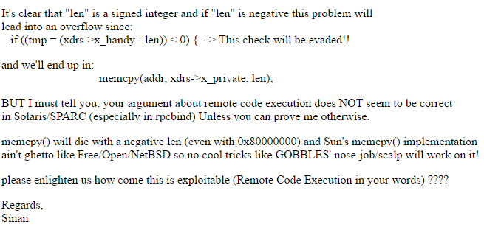
State of infosec union
2003, Bugtraq:
Lots of good technical talk happening in the open, a sense of trying to achieve a common goal

Slide 15
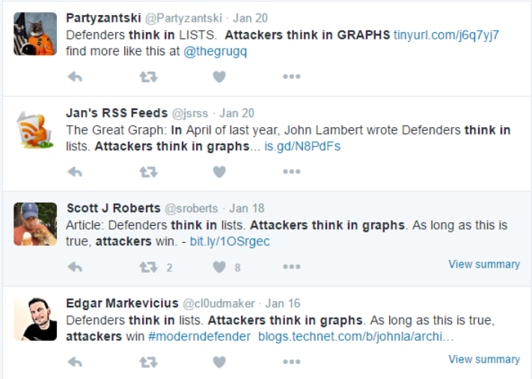
State of infosec union
2016, Twitter
Memes, oversimplifications, “proof” by analogy
Strategically designed/provocatively worded to get the most attention
Corrections/dampening expectations never as visible (e.g. BadBIOS)
Notes:
Like it or not, Twitter is the new medium for infosec discussion
Nuance doesn’t fit in 140 characters
Many people RT things and leave up the RTs even after they know the information is false/misleading
Search for “attackers think in graphs” and scroll forever
Mostly serves to rile up paranoids
Next slide, since no presentation is complete without pretty charts

Slide 16
State of infosec union
Fixing bugs improves security
Bug finders should be compensated
Selling bugs to anyone is fine for security professionals
Finding bugs is a job of a security professional
How bad assumptions lead to an industry protecting itself from its own “professionals”
Notes:
Making sure companies set up bug bounty programs vs hiring security engineers should be priority, says those running the centralized bug bounty programs and those with commercial interest in companies setting them up
Question: at the level of the state of the art, are we protecting ourselves from “bad guys” or from our infosec colleagues?

Slide 17
State of infosec union
Finder gets job at MS/Google/ Apple
Finder helps develop the next generation of weak defenses
Weak defense gets “bypassed”
Cycle of “it’s better than nothing” mitigations

Slide 18
State of infosec union
KASLR proposed for Linux, withdrawn due to private comments on attacks from us
2011
2013
“Practical Timing Side Channel Attacks Against Kernel Space ASLR” published
KASLR blog post released –
“Consider this our ‘I told you so’ that we hope you'll remember in the coming years as KASLR is ‘broken’ time and again.”
2013
2014
KASLR added to Linux 3.14 despite existing flaws and known generic bypasses
KASLR defeated in dozens of ways publicly
2014-Present
2016
Upcoming BH USA talk on defeating KASLR
Ignoring security principles feeds the circus
Notes:
Final slide on state of infosec union

Slide 19
The future
Have to imagine a world where current state of art in grsecurity becomes widespread
No more arbitrary code execution, no more executing existing code out of order
Memory corruption driven to application-specific data-only attacks on weird machines
http://www.cs.dartmouth.edu/~sergey/wm/
Each technique more valuable than the sum of bugs killed by members of Project Zero whose names are not James Forshaw
Necessary shift from privilege escalation to privilege abuse
Exposing and closing these techniques will produce real security improvements
Notes:
Slide of things that will happen
Still some gaps, of course
Important that people understand the concept of weird machines and what Halvar/Sergey Bratus/etc have been talking about for some time
http://www.cs.dartmouth.edu/~sergey/wm/
Think of weird machines as implicit/unintended interpreters of data (compared to explicit interpreters like bash/python/php/etc). Code is still executed in the intended order, but the results of the computation are unintended/undesirable
Sandboxing/access control/secure architecture becomes more useful

Slide 20
The future
Maybe we’ll realize that there are a million different ways to add some hardening that will help against some cookie-cutter exploits
Doesn’t mean they should be implemented – everything comes with some associated cost or tradeoff
One tradeoff is a false sense of security if the defense can’t possibly accomplish what it’s marketed for
Stop designing memory corruption defenses around a script kid model
Realize if a security feature will take years to iron out all its existing bypasses or vulnerabilities introduced from new attack surface, it’s not worth it
Realize attackers take the path of least resistance
Realize that security will never be achieved through bug reduction
Notes:
Slide of dreams in solving generally political/mindset problems
In grsec we come up with many more ideas than ever see the light of day – the public doesn’t see those tradeoff discussions
Doesn’t make much sense to put the cart before the horse
For instance, OpenBSD toying with copy+paste implementations of SROP mitigations while still allowing writable shellcode to be made executable

Slide 21
The future
Won’t fix most of the aforementioned complaints
Opposing motivations/rewards too great
Can only suggest how to be a useful member of “community”
Critical thinking
Learn it’s OK to say “I don’t know”
Use valid criticism as an opportunity for improvement
Reject the race for fame, submit a beefy paper to a content-rich ‘zine like Phrack
Don’t seek shortcuts, put in the necessary work and learn fundamentals
Anyone can complain, fix something
Notes:
Similar advice as I give people who email me and ask how they can be successful in infosec
Lucky to work in a field where there aren’t any real barriers to entry, don’t need to work for Microsoft or Google to make a difference or push the state of the art, don’t need expensive equipment or lots of space to get started
Advice I give is to be successful technically
Won’t tell anyone these days to give everything up for free as we’ve done for 15 years – the current climate is such that it’ll just result in your work being exploited for someone else’s profit and no one else really contributing
May need to separate “successful financially” from “successful technically”, as the latter may lead to the former over the long term, but not necessarily
Read the Intel manuals
Learn C
Learn how to understand code at the assembly level, what compiler transformations look like at assembly level
Read lots of source code

Slide 22
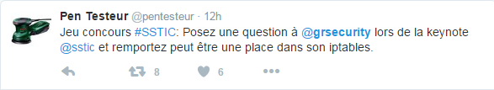
Questions?
Thanks to my ~dozen reviewers/complaint contributors
Thanks to the SSTIC committee for the invitation
Thank you for your time!
Notes:
Feel free to ask a question in French and we’ll have someone translate it for you so I can understand ☺
Final example of Twitter greatness for an attention-seeker

