Slide 1
Detection, Prevention, and Containment:
A Study of grsecurity
Brad Spengler
http://www.grsecurity.net
spender@grsecurity.net

Slide 2
The Problem

Slide 3
The Problem
Bugs in software cause unexpected results
Unexpected functionality can result from errors in design, implementation, or configuration
Bugs can often be wielded for malicious purposes by an attacker

Slide 4
Problems With the Current Solution
Avoid / Identify / Fix
Current state of security is a never ending rat race
Endless cycle of vulnerability discovery and fixing

Slide 5
Problems With the Current Solution
Ultimate goal of today’s security – removal of software bugs through auditing
Security utopia – greatest result, though impossible to achieve

Slide 6
Problems With the Current Solution
Auditing is expensive, slow, and requires a great deal of knowledge
Auditing provides no guarantees about the security of the software
Auditing cannot be fully automated
EXAMPLE: format-string vulnerabilities

Slide 7
The (Attainable) Solution

Slide 8
The (Attainable) Solution
Detection
Prevention
Containment

Slide 9
Advantages of the (Attainable) Solution
Inexpensive
Can be mostly automated
Works for known and unknown bugs
Allows administrators to focus more on administration (checking logs..etc) instead of rushing for the newest patch

Slide 10
Our solution:
grsecurity

Slide 11
Overview of grsecurity

Slide 12
Background on grsecurity
Started in February 2001
Initial release was for Linux 2.4.1
Originally a port of Openwall to Linux 2.4

Slide 13
Goals of grsecurity
Configuration-free operation
Complete protection against all forms of address space modification bugs
Feature-rich ACL and auditing systems
Operation on multiple processor architectures and Operating Systems

Slide 14
Features of grsecurity
A robust ACL system with an intelligent userspace administration tool
Extensive auditing capabilities
Measures to stop the most common methods of exploiting a system:
  Address space modification
  Races (specifically filesystem races, most common of which are /tmp races)
  Breaking a chroot(2) jail

Slide 15
Features of grsecurity
Supports sysctl so that it can be included with Linux distributions and allow the user to modify the options to his/her liking
Netfilter module that drops connections to unserved TCP and UDP ports
Many of the same randomness features as OpenBSD
An enhanced implementation of Trusted Path Execution (TPE)

Slide 16
Detection in grsecurity

Slide 17
Detection in grsecurity
Implemented in two forms
  Auditing
  Logging of real attacks
Inode and device numbers used wherever possible
Parent process info logged

Slide 18
Auditing
Audited events include:
  Exec (with arguments)
  Chdir(2)
  Mount(2)/unmount(2)
  IPC (semaphore, message queue, shared memory) creation and deletion

Slide 19
Auditing
  Signals: SIGSEGV, SIGABRT, SIGBUS, SIGILL
  Failed forks
  Ptrace(2)
  Time changes (stime(2), settimeofday(2))
  Execs inside chroot(2)
  Denied capabilities

Slide 20
Prevention in grsecurity

Slide 21
Prevention in grsecurity
Prevention is implemented through PaX and hardening certain sections of the kernel
Hardened syscalls include:
  Chroot(2)
  Ptrace(2)
  Mmap(2)
  Link(2)/symlink(2)
  Sysctl(2)

Slide 22
Prevention in grsecurity - PaX
What is PaX?
  PaX implements non-executable VM pages on architectures that do not support the non-executable bit (currently only ia-32, more to come)
  PaX makes use of hardware-supported non-executable bits (still to be tested, but should work for alpha, parisc, and ia-64)
  PaX provides full address space layout randomization (ASLR) for ELF binaries

Slide 23
Prevention in grsecurity - PaX
How does PaX accomplish this?
  Include/asm-<arch>/processor.h is modified to support executable and non-executable pages (if they don’t already exist)
  Rest of kernel is modified to use the non-executable pages, applied to ELF and a.out binaries if they carry the required PaX flags (enabled by default)

Slide 24
Prevention in grsecurity - PaX
  Non-executable pages are made supervisor in the TLB; executable pages are left as user
    If CPU is in user mode, access to the non-executable pages causes a page-fault which PaX handles
    Makes up the core logic of how PaX works
    Makes PaX ineffective against kernel overflows
  Mmap(2) and mprotect(2) restrictions/features
    Disallows anonymous mappings with PROT_EXEC present – stops one method of arbitrary code execution (another method, mapping a file with PROT_EXEC, is handled by ACL system)

Slide 25
Prevention in grsecurity - PaX
    Causes mmaps (applies to libraries) to be mapped at random locations below 0x01000000 until it’s full, then above 0x40000000
      Causes exploits to have to guess the library function address
      Makes the address contain a NULL byte, which stops ASCII shellcode from calling a library function
    Keeps non-executable pages from being mprotected to executable
    No performance impact

Slide 26
Prevention in grsecurity - PaX
  Full Address Space Layout Randomization (ASLR)
    Randomizes the base of mmaps, stack, and executable (if the binary is ET_DYN)
    Makes the leftover methods of exploitation a guessing game
 | With no-exec | Without no-exec
Stack smashing | Impossible | Guess 16-bit
Heap overflow | Impossible | Guess 32-bit
Ret-to-libc | Guess 32 or 48-bit | Guess 32 or 48-bit

Slide 27
Prevention in grsecurity - PaX
PaX with Full ASLR
Without PaX
0x0012d00 – 0x00391000 Libraries
0x08048000 – 0x0fd6b000
Executable 0x08048000 -0x08049000
256MB
0x0fd6b000 – 0x0fefc000 Executable
0x00fefc000 – 0x18048000
0x40000000 – 0x50000000
Libraries 0x40000000 – 0x40168000
256MB
0xbff00000 – bfff2000
1MB
0xbfff2000 – 0xbfffa000 Stack
0xbfffa000 – 0xc0000000
Stack 0xbfffe0000– 0xc0000000

Slide 28
Prevention in grsecurity - PaX
    Full ASLR can only be bypassed in the case of information leak. While there’s nothing that can be done about software vulnerabilities that allow information leaking without crashing, we’ve implemented the following features to stop local users from obtaining information about the random base addresses:
      Ptrace(2) restrictions in ACL system
      Restricted /proc
    For 64-bit architectures, the randomness provided by full ASLR could be increased to 48/64/80 bits (the amount the attacker has to overcome is determined by the type of exploit)

Slide 29
Prevention in grsecurity - PaX
What’s in it for me?
  No more arbitrary code execution
  No more stack smashing, heap or bss overflow exploitation
  No more return-to-libc exploitation
  (Soon) no more arbitrary execution flow redirection

Slide 30
Prevention in grsecurity - PaX
What’s coming for this section of grsecurity?
  New segmentation-based implementation of non-executable pages with an insignificant performance hit
  Increased stack base address randomness to 24 bits
  Binary instrumentation
    Stops ret-to-libc by checkpointing execution flow changes
    Ability to handle other vulnerabilities (eg. Stack based overflows, format string, info-leak)

Slide 31
Prevention in grsecurity
OpenBSD randomness features
  Random IP IDs
  Random RPC XIDs
  Random RPC privileged ports
  Random PIDs

Slide 32
Prevention in grsecurity
Random IP IDs
  Uses Niels Provos’ random IP ID generation function ported to Linux
    Little entropy use
    Values are not reused quickly
  Useful for preventing OS fingerprinting and spoofed scans

Slide 33
Prevention in grsecurity
Random RPC XIDs
  Uses same random IP ID code
  Useful for preventing RPC connection hijacking
Random PIDs
  Uses same random IP ID code
  Properties of returned values make the function almost always return an unused PID even on heavily loaded servers

Slide 34
Prevention in grsecurity
  Prevents filesystem races since getpid() is sometimes used as part of a temporary filename
  Adds additional randomness to programs that use getpid(2) for srandom(3) seeding

Slide 35
Prevention in grsecurity
Stealth netfilter module
  Based on the fact that OS fingerprinting relies greatly on the packets sent in reply to those sent to unserved TCP or UDP ports
  Matches unserved ports dynamically, so it can be used in shell-server environments
  Slows down blocking port-scanners

Slide 36
Prevention in grsecurity
Problems with chroot(2)
  Easy to use it insecurely
  Generally only filesystem-related functions care if a process is chrooted
  Easy for a root user in chroot to break out

Slide 37
Prevention in grsecurity
How we strengthen chroot(2):
  Make syscalls unrelated to the filesystem chroot-aware
    Deny double-chroots, pivot_root(2)
    Restrict signals outside of chroot
    Deny fchdir(2) outside of chroot
    Deny mounting
  Enforce chdir(“/”) upon chroot
  Lower capabilities upon chroot

Slide 38
Containment in grsecurity

Slide 39
Containment in grsecurity
Trusted Path Execution (TPE)
  Keeps users from executing untrusted binaries (those not in root-owned non-world writable directories)
  Hardened against evasion
    Silent removal of glibc environment variables that allow arbitrary code execution (eg. LD_PRELOAD)
    TPE checks implemented in mmap(2) (stops /lib/ld.so <executable> evasion)

Slide 40
Containment in grsecurity
Grsecurity’s ACL system
  Process-based : Allowed for a large reduction in code base
  ACL parsing handled via userspace, interacts with kernel via a /proc entry
    Include directive
    ACL analysis
      $PATH
      /etc/ld.so.conf
      Auto-add libraries for ELF executables
      /etc/lilo.conf

Slide 41
Containment in grsecurity
    Uses LEX/YACC
    Sends data to kernel in ready-to-use structures – further reduces necessary kernel code size
  Enable, disable, and administrator modes
  Hidden and protected processes
  Read, write, append and execute modes for file objects
  Inherit and hidden flags for file objects

Slide 42
Containment in grsecurity
  Capability support (including inheritance)
  Hardened against ACL evasion and privilege leaking
    Ptrace restriction – user can only ptrace a process if the default ACL allows writing to it
    Glibc environment variable handling
      Performs correct handling, not just a denied exec if LD_ is found
      Checks each path in glibc environment to see if the default ACL allows writing to it; if so, deny the exec and log pathname and environment variable used
    Applies executable restrictions in mmap(2), not just execve

Slide 43
Containment in grsecurity
  Human readable configuration files
  Insignificant performance impact due to efficient searching algorithms (hash tables == O(1) )

Slide 44
Containment in grsecurity
What’s coming for the ACL system?
  Redesign to become more modular and allow quicker implementation of new features
  Intelligent learning mode resulting in a least-privilege system with little or no configuration necessary
  Support of fine-grained resource restrictions and something similar to nergal’s segvguard
  Time-based ACLs
  Merging of GID-based grsecurity features
  Role-Based Access Control (RBAC)

Slide 45
Containment in grsecurity
  Domain-based authentication support

Slide 46
Performance

Slide 47
Performance of ACL system
Completed 150 runs of 16 dbench processes
Average throughput with ACL system was larger than a clean kernel
Standard deviation was 5MB/s, which was larger than the difference of throughput
RESULT: The ACL system causes no noticeable performance hit on filesystem access

Slide 48
Performance of ACL system
Results of kernel compile benchmark:
  Total time with ACL system – 265.86 seconds
  Total time w/o ACL system – 264.94 seconds
  .4% performance hit
Performance hit only due to execs in compiling and making – search is called twice, acl label is copied, acl label is set, checks are performed on the environment

Slide 49
Performance with PaX
Memory load latency microbenchmarks
MySQL benchmarks (real life example)
Test system:
  Dual AMD XP 1600+
  512MB PC2100 ECC DDR registered RAM
  266mhz FSB
  80GB ATA100 5400RPM HD

Slide 50
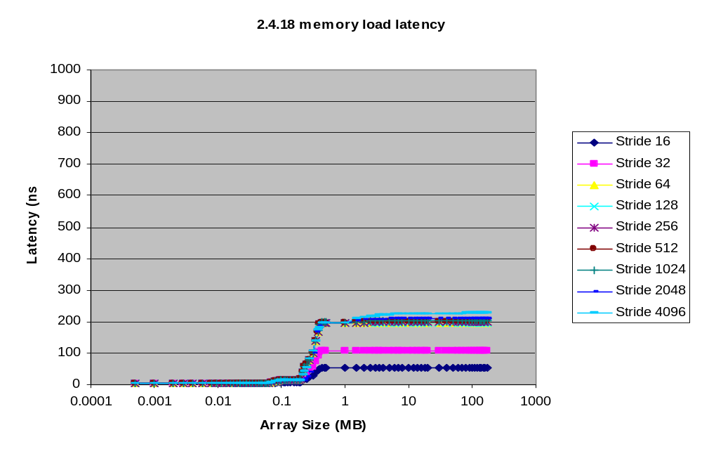
Performance with PaX

Slide 51
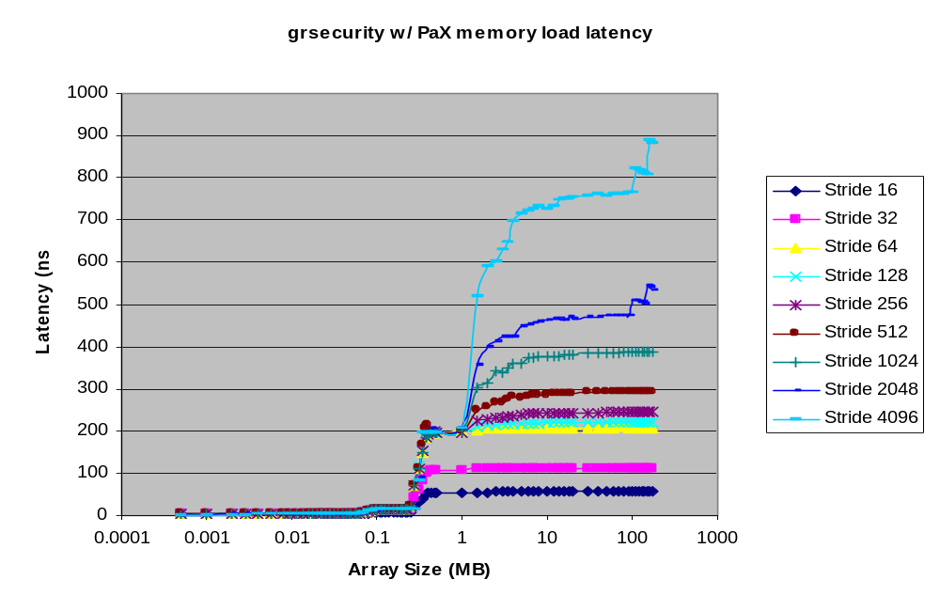
Performance with PaX

Slide 52
Performance with PaX
Athlons encounter less performance hit partially due to their 256 entry DTLB (4KB page x 256 = 1MB)
PaX starts showing its performance impact when the DTLB is full and expired entries are replaced
Performance with PaX can only be determined by the size and type of memory accesses performed by an application

Slide 53
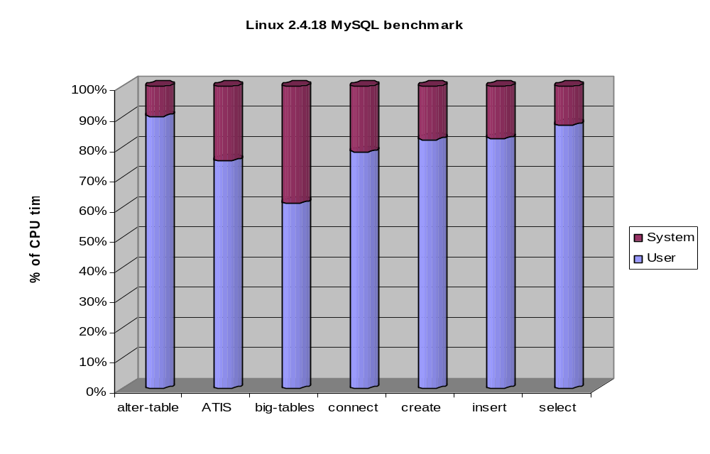
Performance with PaX

Slide 54
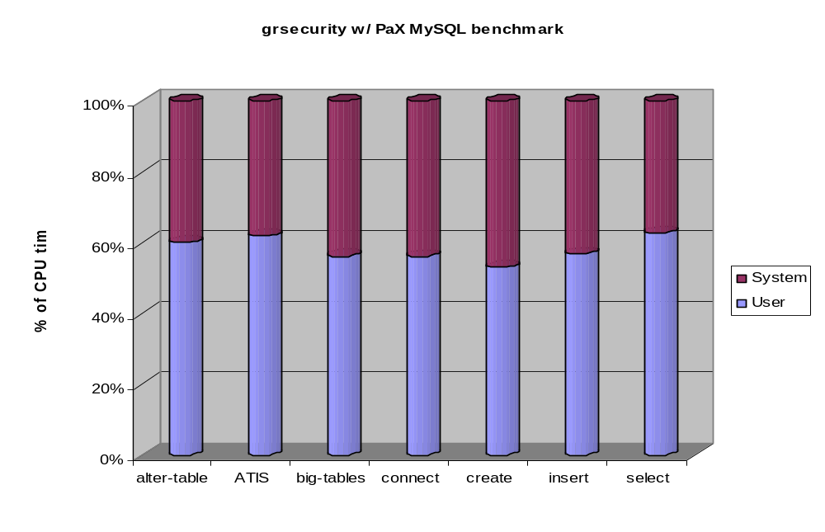
Performance with PaX

Slide 55
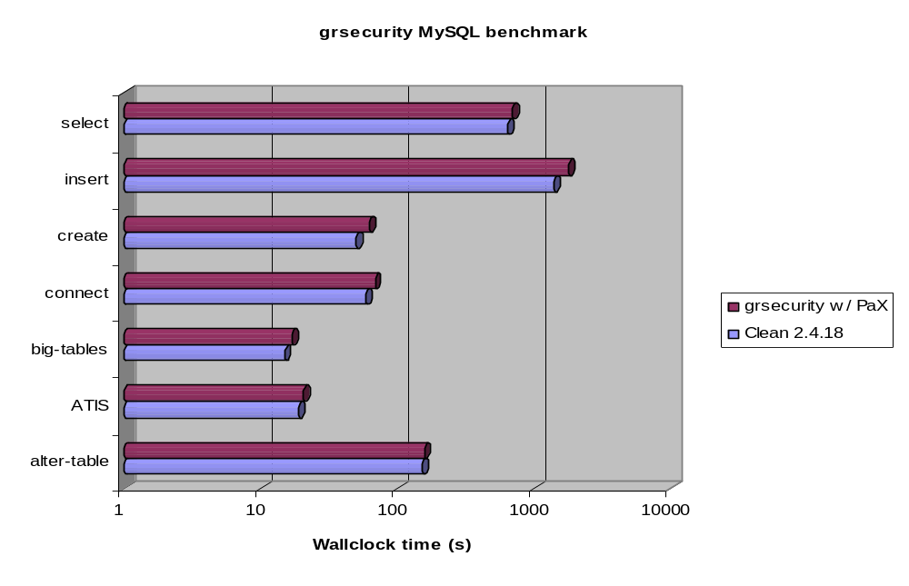
Performance with PaX

Slide 56
Performance with PaX
A result weighted according to an actual system’s load shows that for MySQL, PaX caused an overall performance hit of 13%
Since the memory access patterns of each test were different, the performance hits for each test ranged from 3% - 20%

Slide 57
For More Information…
grsecurity’s ACL documentation: http://www.grsecurity.net/gracldoc.htm
PaX
http://pageexec.virtualave.net

Slide 58
THANKS
PaX Team
Tim Yardley
Michael Dalton - grsecurity

