Slide 1

The Case For
Brad Spengler
Open Source Security, Inc.
2012

Slide 2
Overview
What is grsecurity?
History
Why grsecurity exists
Recent advances
Response strategy
Future improvements

Slide 3
What is grsecurity?
Kernel patch for Linux 2.6.32, 3.2, and the current “stable” Linux
Provides access control, auditing, chroot hardening, anti-bruteforcing, anti-infoleaking
Includes PaX for defense against exploitation of memory corruption vulns (and more)

Slide 4
What is grsecurity? (cont.)
Goals of detection, prevention, containment
Drive up exploit development costs, hopefully require specific targeting
Psychology of uncertainty – attempt using 0day and risk losing not only the vuln but exploit vectors used?

Slide 5
What is grsecurity? (cont.)
Ideal for webhosting environments
First work was in webhosting, so I experienced the problems first-hand
Very difficult security environment, can’t just throw Apache in a VM
Generally years ahead of mainstream security
See http://forums.grsecurity.net/viewtopic.php?f=7&t=2574for some examples

Slide 6
History
Feb 18, 2000 - First release
then called “GRKERNSEC”
Poor port of Openwall to 2.4 kernels
2.4 unsupported by Openwall at the time
2001 – Included PaX
2001 – Michael Dalton creates “Oblivion” ACL system for grsecurity

Slide 7
History (cont.)
Aug 3, 2002 – I create learning mode for ACL system
Sept 2002 – Anti-bruteforcing, IP tagging/tainting
April 6, 2003 – RBAC system, more advanced learning (full system policies)
2004 - HIDESYM
2009 – USERCOPY, limited size overflow prevention, MODHARDEN, fptr constifying
See http://grsecurity.net/news.php#develup

Slide 8
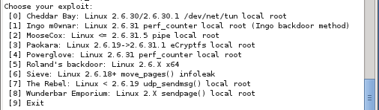
Why grsecurity Exists
Because a few hours over a couple months nets:

Slide 9
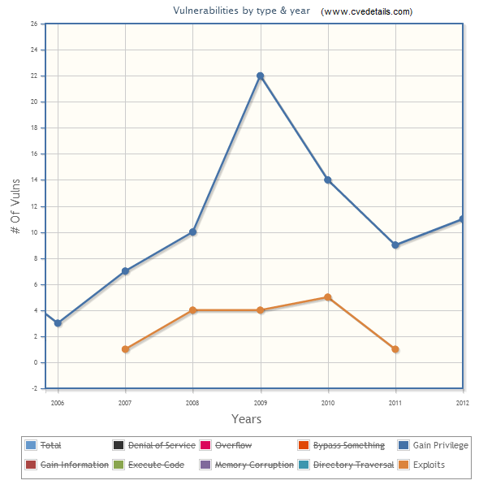
Why grsecurity Exists (cont.)
“I'll be curious to see what the CVE statistics are like for the kernel this year when they get compiled next year -- I'm predicting that when someone's watching the sleepy watchers, a more personal interest is taken in doing the job that you're paid to do correctly.” – exp_moosecox.c, 2009
Notes:
Note the huge jump in number of *privesc* vulns, also the inaccurate reporting of exploits for 2009 (I released more than 4 myself that year)

Slide 10
Why grsecurity Exists (cont.)
Culture of anti-security upstream
“I literally draw the line at anything that is simply greppable for. If it's not a very public security issue already, I don't want a simple "git log + grep" to help find it.” – Linus Torvalds, LKML
“I just committed this to mainline, and it should also go into stable. It's a real DoS fix, for a trivial oops (see the security list for example oopser program by Oleg), even if I didn't want to say that in the commit message ;)” – Linus Torvalds, not LKML
“I have tried to camouflage the security fix a bit by calling it a PROT_NONE fix and using pte_read(), not pte_user() (these are the same on x86). Albeit there's no formal embargo on it, please consider it embargoed until the fix gets out.” – Ingo Molnar, 2005, private bugtraq for RHEL

Slide 11
Why grsecurity Exists (cont.)
Vendor-sec compromised at least twice
2005, 2011 (finally shut down)
No accountability, sat on IA64 hardware DoS for two years
Embargoed vulns basically guaranteed head-start for blackhats
Replacement list is better, but lessons learned from vendor-sec show failure of reactive security
Users disempowered when information is controlled by a few (see http://blog.xen.org/index.php/2012/08/23/disclosure-process-poll-results/, decision to pre-release to “genuine cloud providers”)
Notes:
Despite lessons from vendorsec, etc, some still want to pursue this goal of releasing information only to a small number of people, generally leaving out those without money

Slide 12
Why grsecurity Exists (cont.)
Eight “stable” kernel trees
Upstream focus is on adding new features (with new vulns)
From series of infoleak vulns found by Mathias Krause (minipli):
11 affected 2.6.32 (released 2010)
15 affected 3.2 (released Jan 2012)
17 affected 3.5 (released July 2012)

Slide 13
Why grsecurity Exists (cont.)
Vuln is DoS if not clever enough to exploit
See sudden spike in 2009 of privesc
Generally no defense in depth on the kernel level
beyond copying grsecurity, that is
Find bug / patch bug cycle
Whitelist vs blacklist
Exploit vectors vs vulnerabilities
The “many eyes” of open source are blind, uninterested, or selling to governments for profit (it’s not the 1992 AD scene anymore)
Notes:
Can’t rely on distro vulnerability assessments to judge risk
Faith in open-source mantras isn’t a reliable security strategy

Slide 14
Why grsecurity Exists (cont.)
3.x uname stack infoleak fixed in grsec Sept 19th, mentioned in both grsec and PaX changelogs
“Fix 3.x uname emulation infoleak” in grsec
“fixed kernel stack disclosure in sys_newuname affecting linux 3.x” in PaX
Not spotted for several weeks by anyone else, notified Google
Patch submitted recently, finally in Linus tree Oct 19
Many eyes, right?
Notes:
Against a skilled attacker, little point in taking a month to patch a vulnerability for which an exploit can be developed/published much faster
Would have been fixed much later or not at all if I hadn’t contacted Google about the issue and mentioned it explicitly (upstream patch came from Kees Cook, Google employee)
For examples of other infoleak fixes in grsecurity in plain sight in grsecurity (under ifdefs for a feature intended to fix such things) see our blog, some took many years to be rediscovered (and there are still more)

Slide 15
Recent advances
Since 2011:
GRKERNSEC_BRUTE
Bruteforce deterrence for suid/sgid binaries
GRKERNSEC_MODHARDEN
mount via root can only auto-load filesystem modules
Netdev code can only auto-load netdev modules
No udisks auto-load
Notes:
GRKERNSEC_BRUTE previously only applied to remote bruteforcing of forking network daemons

Slide 16
Recent advances (cont.)
Since 2011:
GRKERNSEC_KERN_LOCKOUT
Attack by uid 0 or in interrupt handler, panic()
Attack by non-priv user, ban until reboot
PAX_USERCOPY
Whitelisting of slab caches that can be used for copies to/from userland
Ex: no copying to/from cred, task, dentry structs
Notes:
GRKERNSEC_KERN_LOCKOUT is a friendlier version of panic_on_oops, may allow additional live forensics

Slide 17
Recent advances (cont.)
Since 2012:
GRKERNSEC_PTRACE_READEXEC
Disallow ptracing unreadable binaries
GRKERNSEC_SETXID
Uid 0 setuid to non-root, change performed across all threads
Required per-arch changes
GRKERNSEC_SYMLINKOWN
Race-free implementation of Apache’s SymLinksIfOwnerMatch
Notes:
Gentoo was marking suid binaries 4711, but was mostly pointless without the existence of GRKERNSEC_PTRACE_READEXEC
Glibc implements GRKERNSEC_SETXID in userland by signaling other threads, other libcs/languages don’t (Google Go discovered this the hard way)

Slide 18
Recent advances (cont.)
Since 2012:
GRKERNSEC_PROC_MEMMAP
Per-CPU, non-overflowable exec ID to ensure sensitive /proc entries can only be read/written by the same process that opened them
Arg/env pages limited to 512KB for suid/sgid binaries (defuse entropy reduction)
RLIMIT_STACK bounded, 3GB personality cleared to prevent alternate memory layout for suid/sgid binaries

Slide 19
Recent advances (cont.)
Since 2012:
GRKERNSEC_HIDESYM
Reused PAX_USERCOPY slab cache whitelisting code, made generic caches
Made seqfile code allocate out of whitelisted generic cache
Added check to *printf() that sanitizes kernel pointers printed with %p in buffers allowed to be copied to userland
Prevented useful leak via /proc/net/ptype (hi Dan!)
Notes:
Kptr_restrict essentially not maintained by upstream, and no one cares about ensuring it continues to do what it claims
Dan himself released an exploit abusing a deficiency of his own feature! (Who does this?)

Slide 20
Recent advances (cont.)
Backported ~110 security fixes to the 2.6.32.59 kernel in 2012 that upstream missed
Notified maintainer, who added ~70 of these to 2.6.32.60 based on my changelogs
Number of backports are even higher for newer kernels, as many vulns are in code recently introduced
Notes:
I’m quite good at spotting “weasel words” from upstream, things like:
“don’t copy overly-long strings”
To find the really serious vulns, compile a list of email addresses of security people, look for some commit from Linus without any previous discussion in public with one of them on cc, where Linus says something like the old code being “ridiculous” or “silly” and the new code “robust” – he is so transparent with his non-transparency ;) In a way, making sure that only the people he doesn’t want to help are the ones who know the security impact

Slide 21
Response strategy
Motivation for many advances: spite
Scorched-earth exploit response
“A scorched earth policy is a military strategy or operational method which involves destroying anything that might be useful to the enemy while advancing through or withdrawing from an area.” - Wikipedia
Upstream kills the vulnerability exploited, we kill exploit vectors found along the way
Must be weighed against produced disincentive to publish, as this harms reactive security users more than us

Slide 22
Response strategy (cont.)
Stackjacking (2011)
30 minutes advance notice, killed in a week before repeat presentation
Original presentation “demo” needed an artificial, best-case arbitrary-write and infoleak vuln
6 enhancements made to grsecurity/PaX which have been improved further since
A year later, still presenting on the same techniques that were “promptly demolished by the PaX Team” – Jon Oberheide
Notes:
Stackjacking: arbitrary write with a stack leak to cause an arbitrary read (eg. By modifying source addr arg to copy_to_user), allowing to leak cred ptr address, then target it with the arbitrary write
Arbitrary writes are optimistic
Amd64 RANDKSTACK
Thread_info moved off kernel stack (removed addr_limit / fptr target)
USERCOPY cache whitelisting
Kernel anti-bruteforcing
Userland anti-bruteforcing applied to suid/sgid binaries through user “banning”
MODHARDEN – kept netdev/fs code from being able to load any module, verify that modules loaded via mount actually provide a filesystem

Slide 23
Response strategy (cont.)
Sudo format string vuln (VNSecurity, 2012)
6 improvements made to grsecurity/PaX
Most already mentioned
Increased heap randomization in higher order bits
Increased stack randomization in lower order bits on x64
Small randomization in gap between program stack and arg/env strings
Despite all this, however, VNSecurity still able to create a one-shot exploit, aided by some unique sudo characteristics
Very nice work! See the progression here: http://www.vnsecurity.net/2012/02/exploiting-sudo-format-string-vunerability/
Short term vs long term strategy
Notes:
Improvements already mentioned were from grsecurity, ones on this slide are PaX improvements

Slide 24
Future improvements
Kernel self-protection in place pushes many exploits into the code-reuse + infoleak space
Drive up complexity of code reuse, force some data attacks into this space (e.g., cred struct modification)
Eliminate known offsets/heuristic scanning as a technique against important kernel targets (GCC plugin)

Slide 25
Future improvements (cont.)
Make it easier – official, unique kernel packages without distro kernel drawbacks
RBAC improvements
Improved learning system using real machine learning algorithms instead of heuristics
Not just reduction of path accesses to directories, but regular expression learning for more usable policies across software updates
Automatically mark PaX flags for problem apps with a simple configurable daemon
Notes:
Just last night! Detecting after initscripts have completed if all sysctl options have been set, warning if one has not been touched (to catch bad configurations, people who miss SYSCTL_ON, people who enable new features via oldconfig but forget to enable them, etc)

Slide 26
Questions/Requests?
Feel free to email me at spender@grsecurity.net
http://www.grsecurity.net
Thanks to my sponsors for their support
Most of all, thanks to pipacs and Emese ☺
Notes:
Many don’t get to see how we work together behind the scenes, maybe a little bit in the #grsecurity channel
The back and forth, exchanging of ideas, attacking ideas, it has worked incredibly well for us and caused a large number of features to be created
It’s been an honor and a privilege for all these years ☺

