Slide 1
Recipe iOS App
CSC 690
Bryan Caldera
5.13.21

Slide 2
Inspiration
Wanted to use a free public API
Gives me a chance to load data to different pages
A recipe app would be very useful

Slide 3
What it does
Gives you a list of food categories
You can click on a category to view all it’s recipes
You can view a recipe’s ingredients and instructions

Slide 4


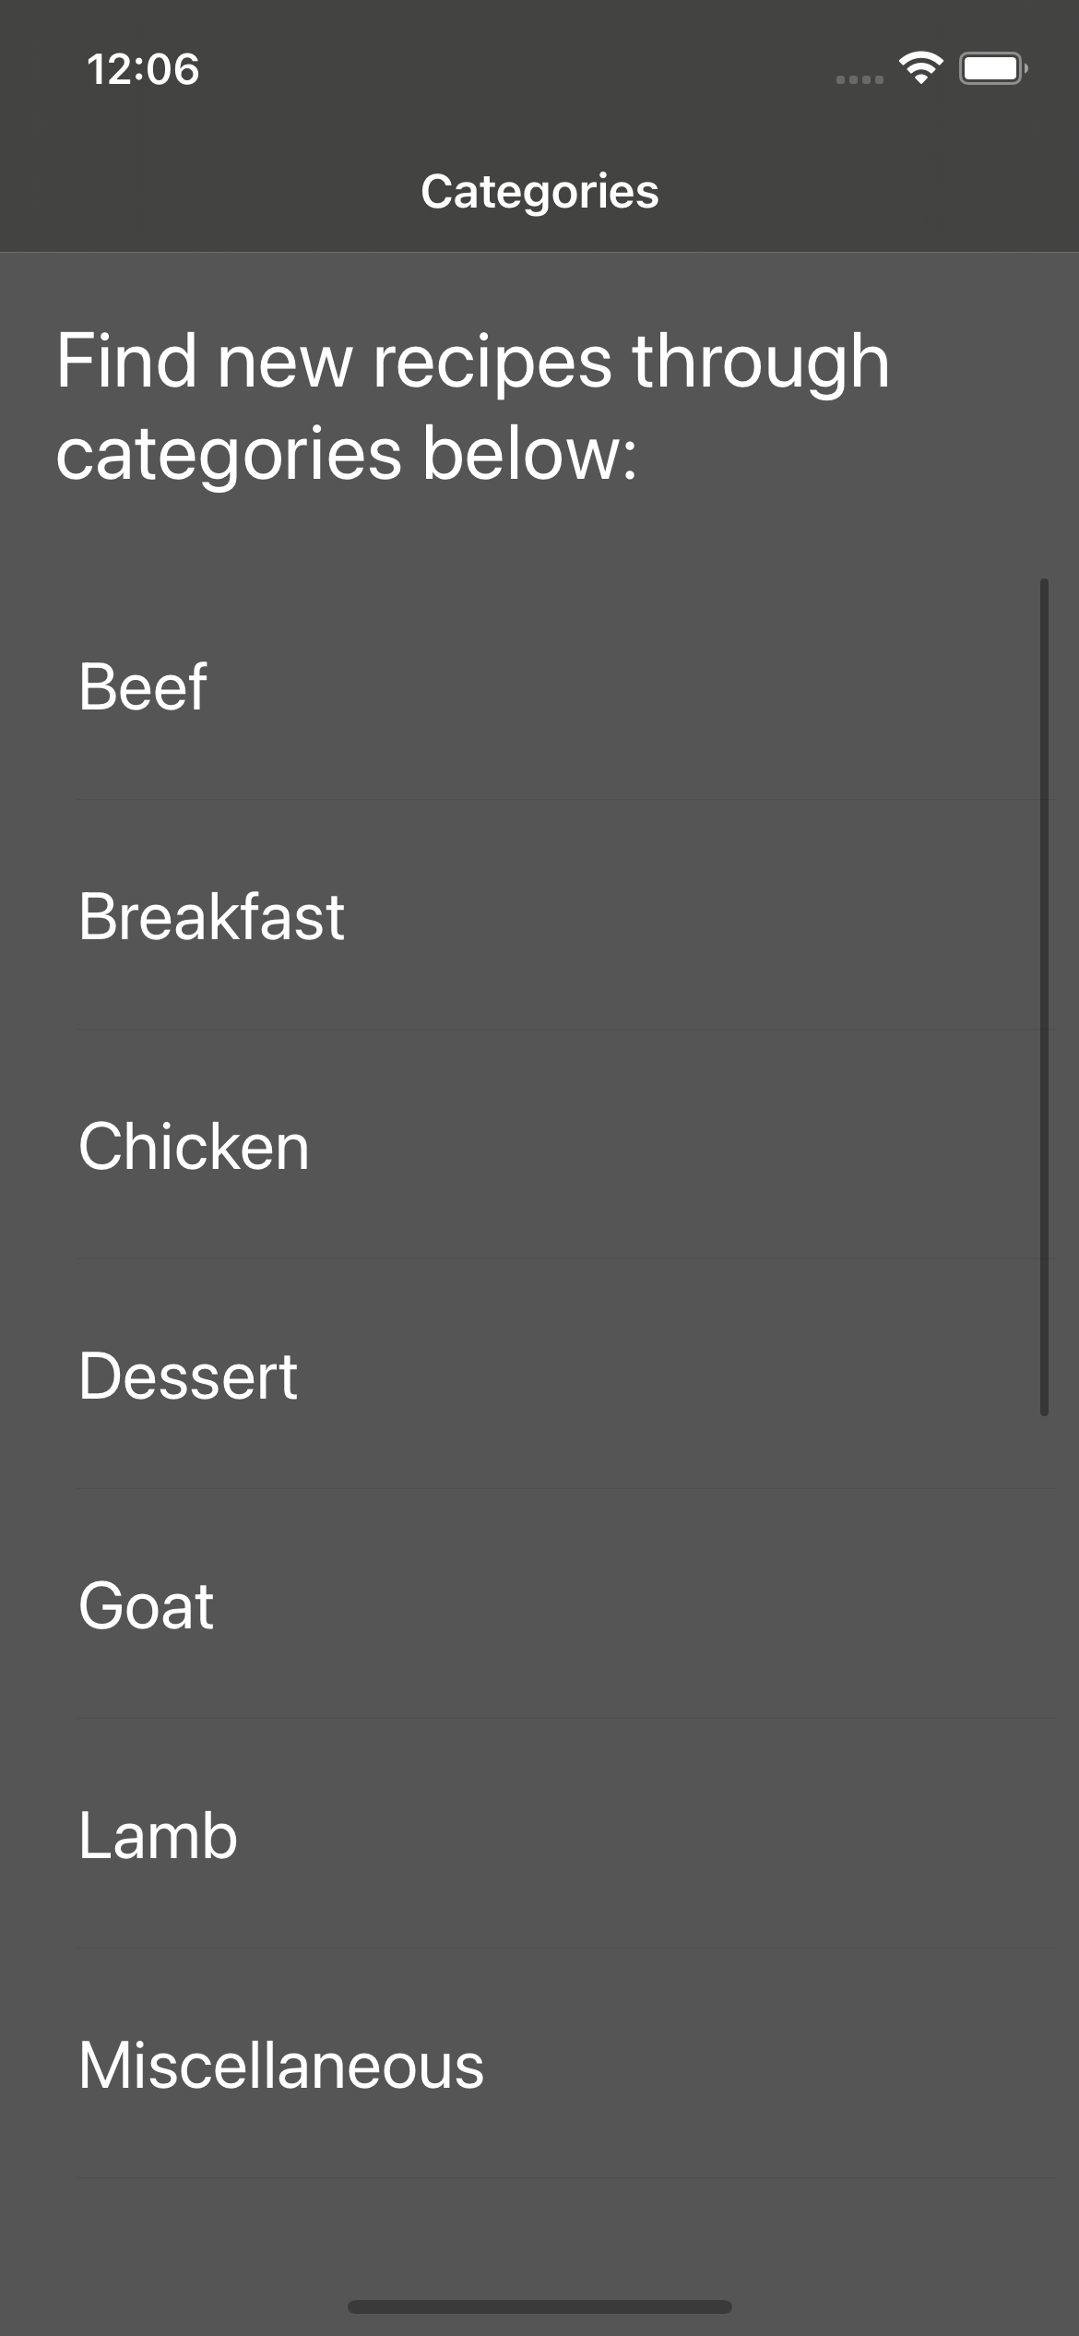
View Controller calls API to get a list of all food categories
Table View makes a row for each category

Slide 5
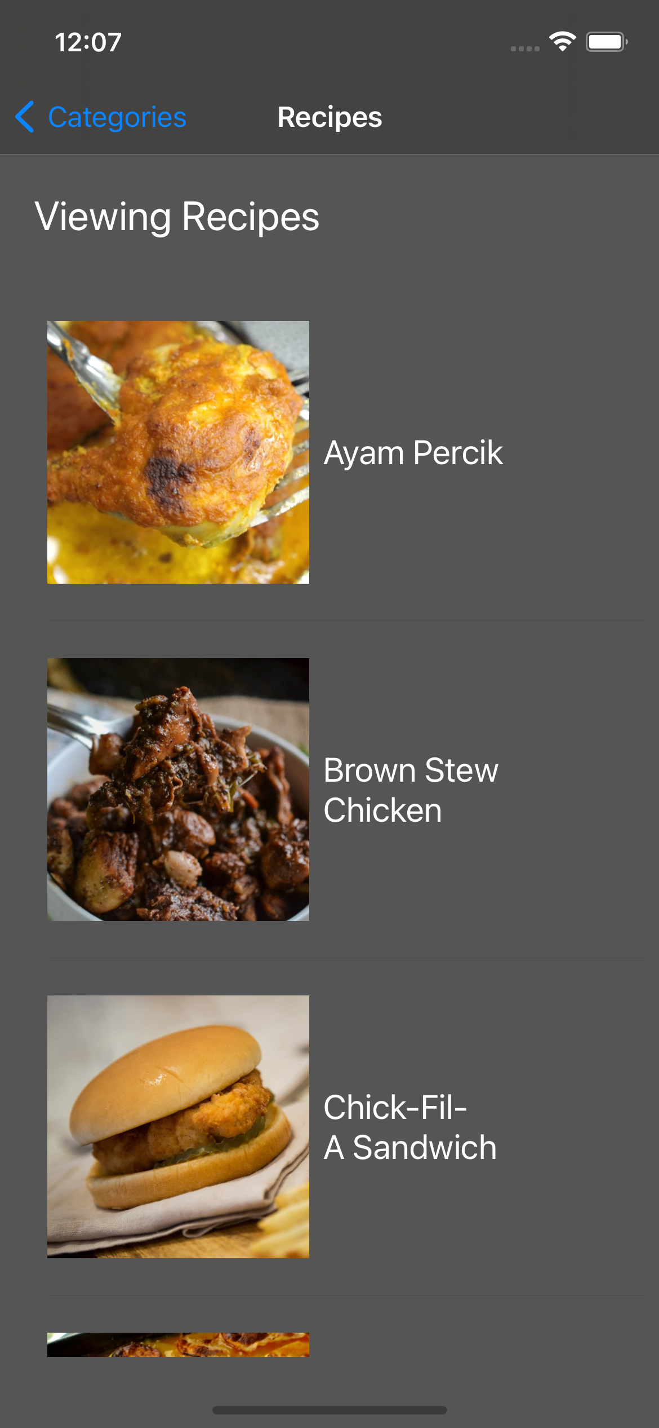
View Controller calls API to get a list of all recipes of a given category
Table View creates cells with thumbnail and title

Slide 6
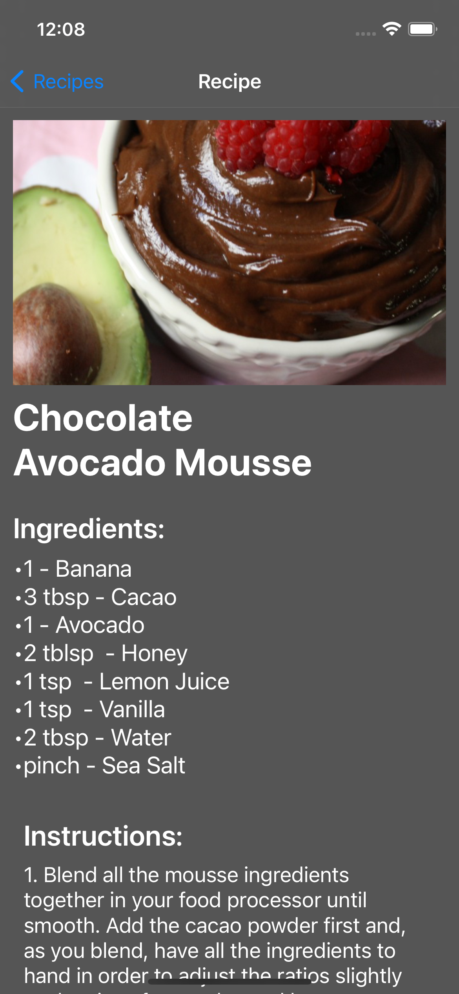
Show all recipe information
Picture, Name, Ingredients and Measurements, and Instruction

Slide 7
How it was built
Navigation Controller
TableViews
ImageViews
Labels
API Class
Many Cell Types

Slide 8
The Meal DB
Free database API of recipes
Crowdsourced recipes
JSON API
Easy to use
https://www.themealdb.com/api.php

Slide 9
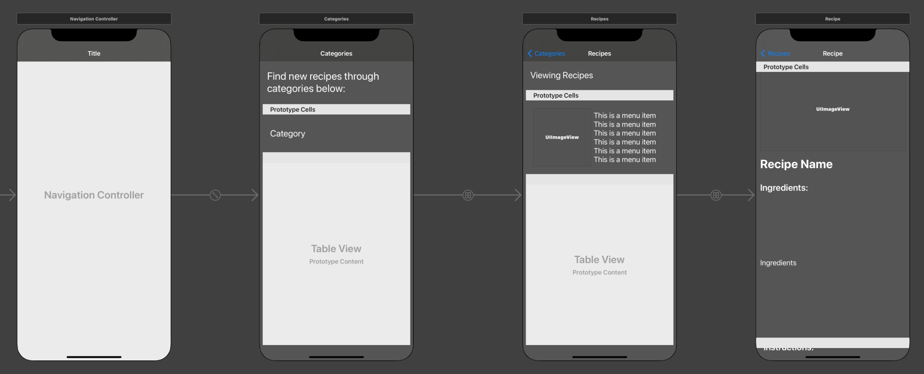

Slide 10
Difficulties
Decoding the JSON to use in my app
TableView inside a TableCell attempt did not go well
Need more practice with StoryBoard
Segue from TableCell to ViewController

Slide 11
Improvements for the future
Be able to save recipes you like as favorites
Tab that shows your favorite recipes
Create your own recipe to save to app
Search bar for recipes
Improve performance when loading images

Slide 12
The end

