Slide 1

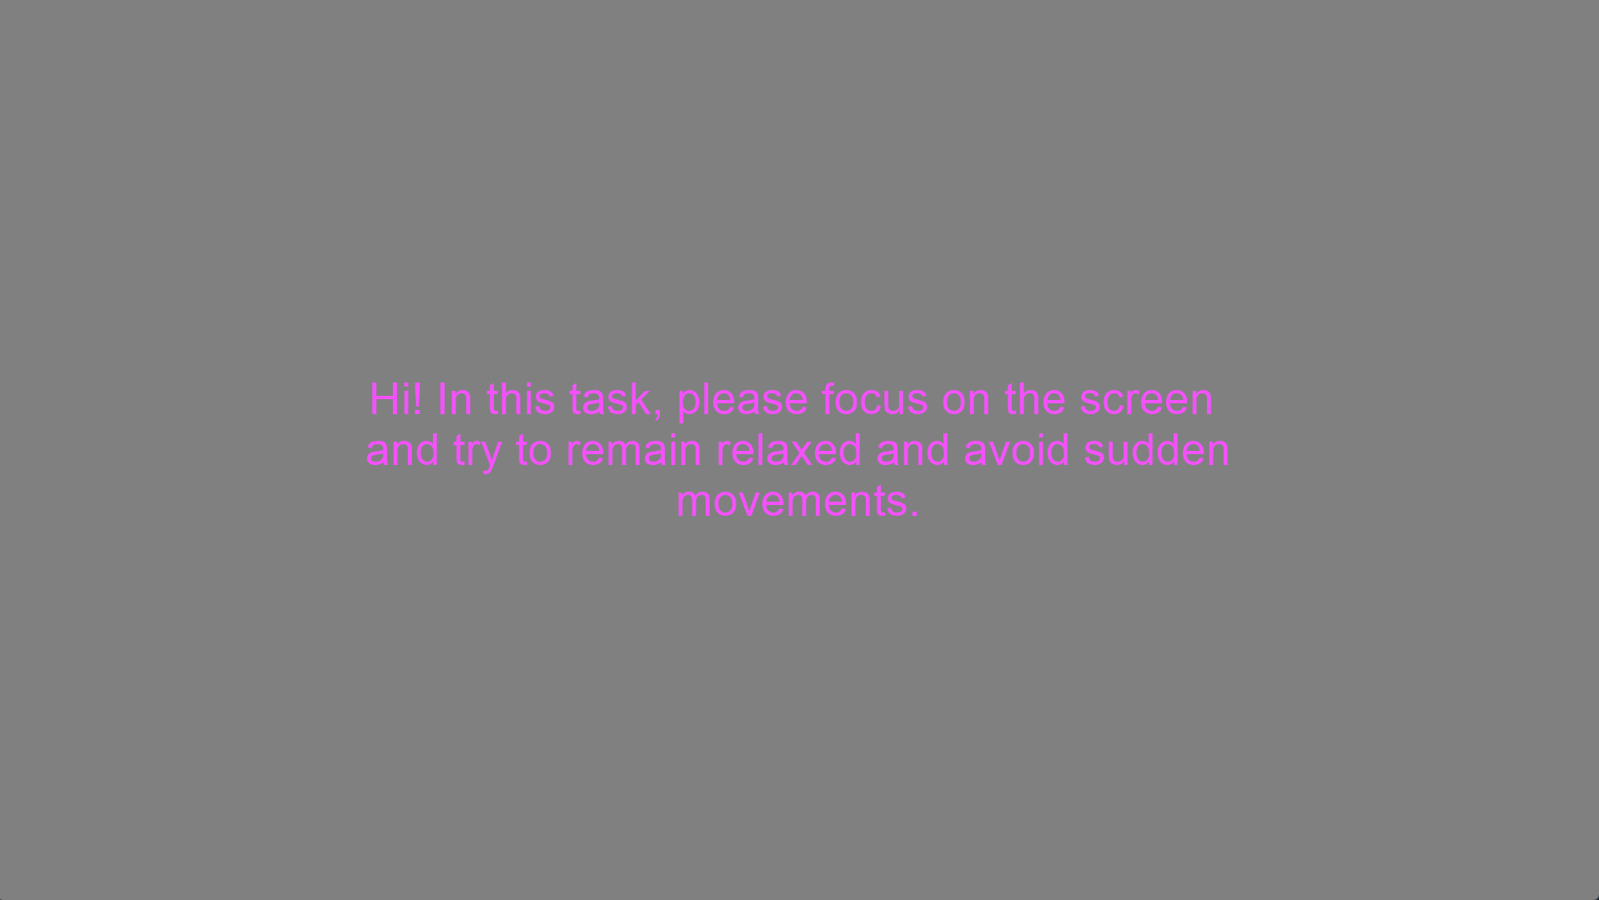

Experimenter initiates LSL Recording before the Experiment Onset
Instructions for Resting State
Blue Border: Experimenter advances screen w/ keypress
Resting State
(5 minutes)
Black Border: Participant advances with mouse click
Green Border:
Timing is pre-set

Slide 2
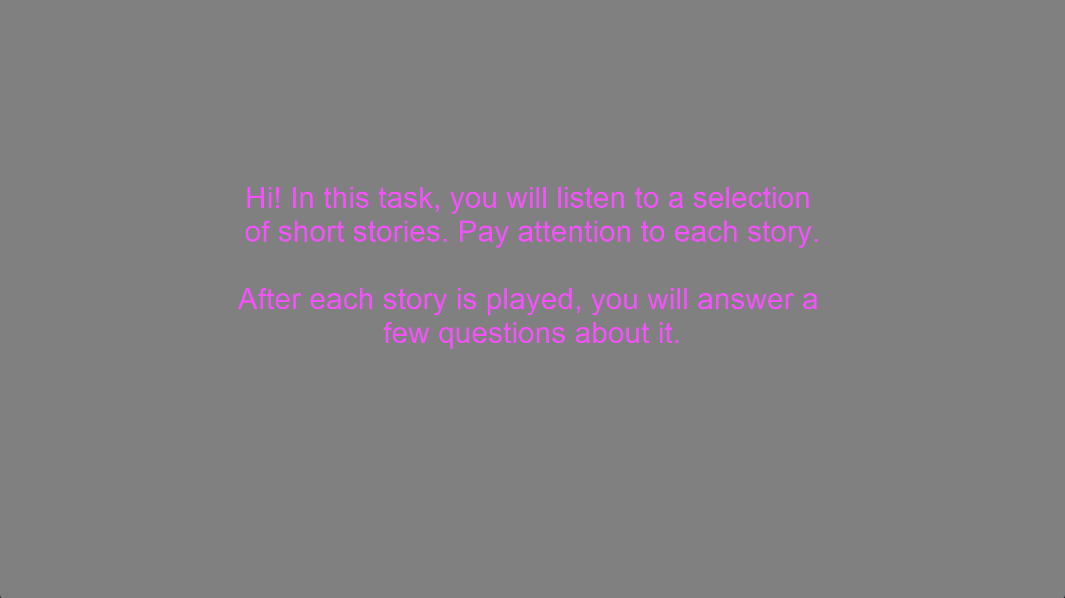
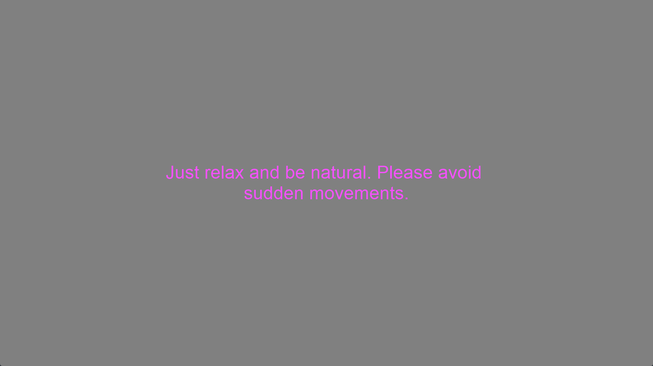
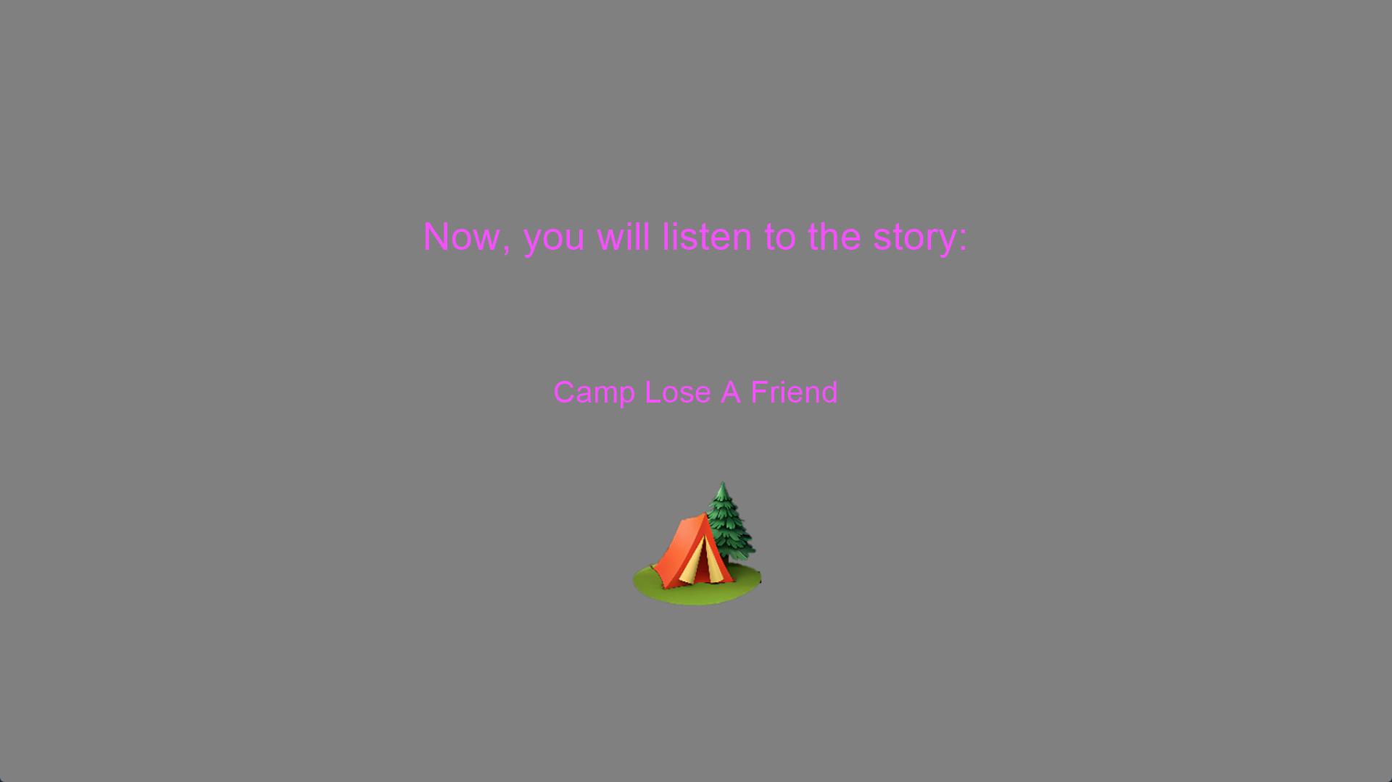
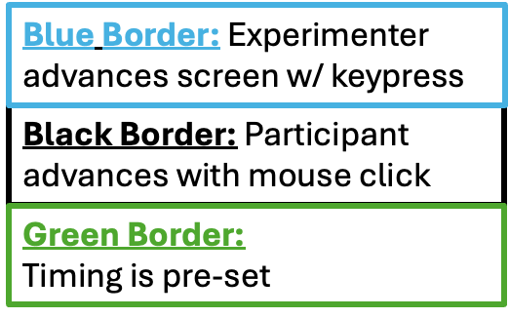
Instructions for Passive Listening Block
Instructions for Passive Listening Block
Introduction to story stimulus
Repeats for each story (6x)
Story plays … Timing varies (~ 2.5minutes each)

Slide 3
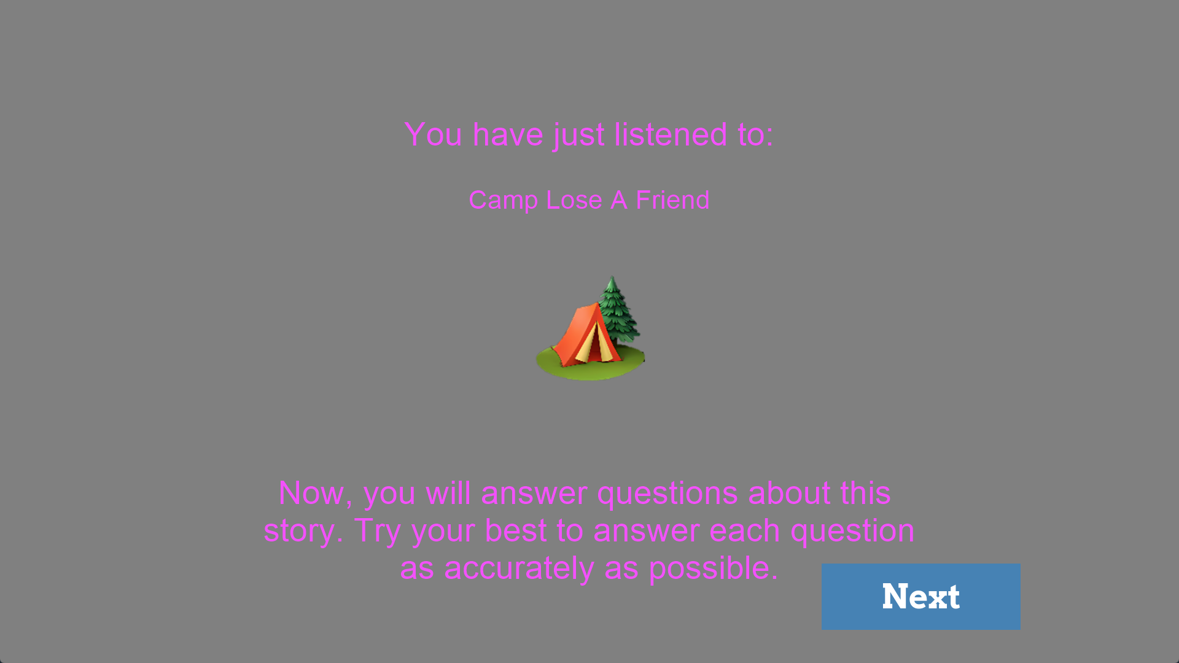
Story Ends, Instructions for self report
Repeats for each story (6x)

Slide 4
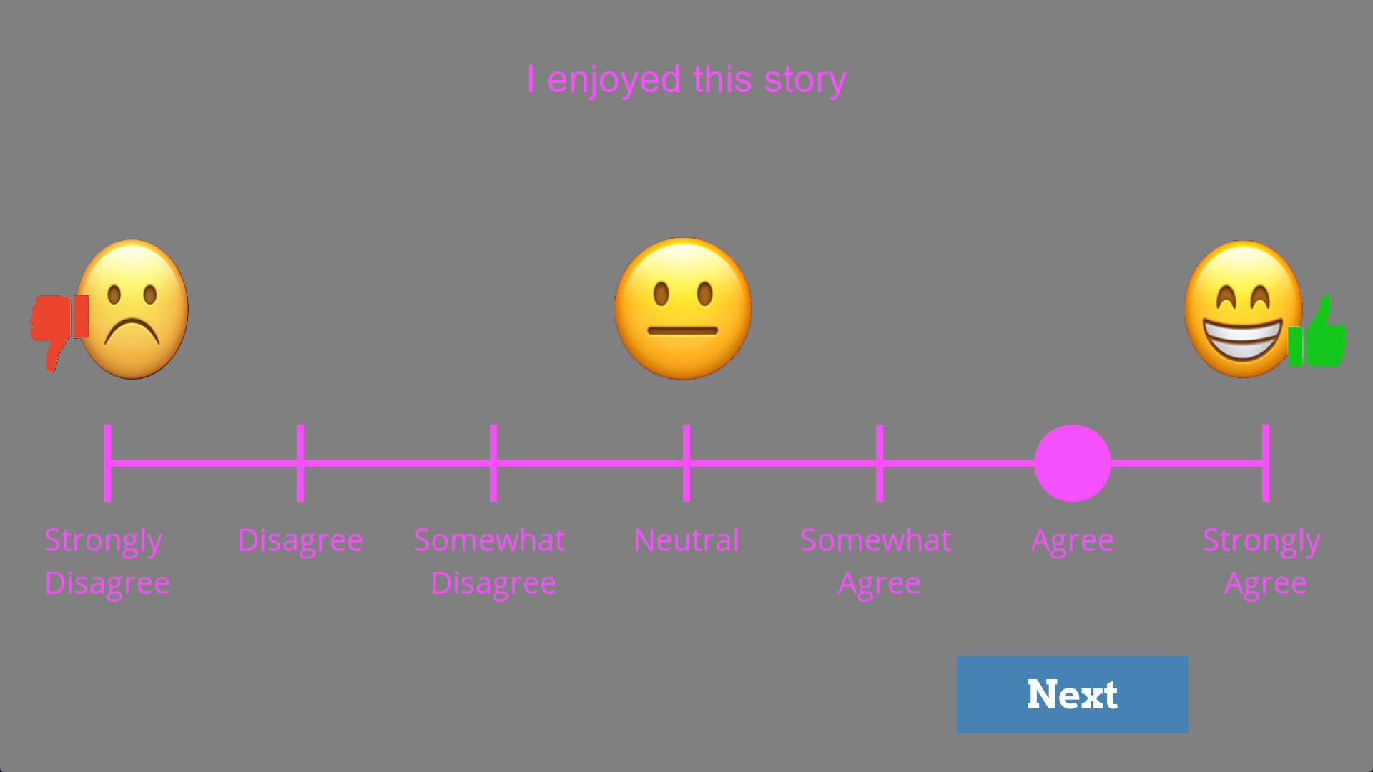

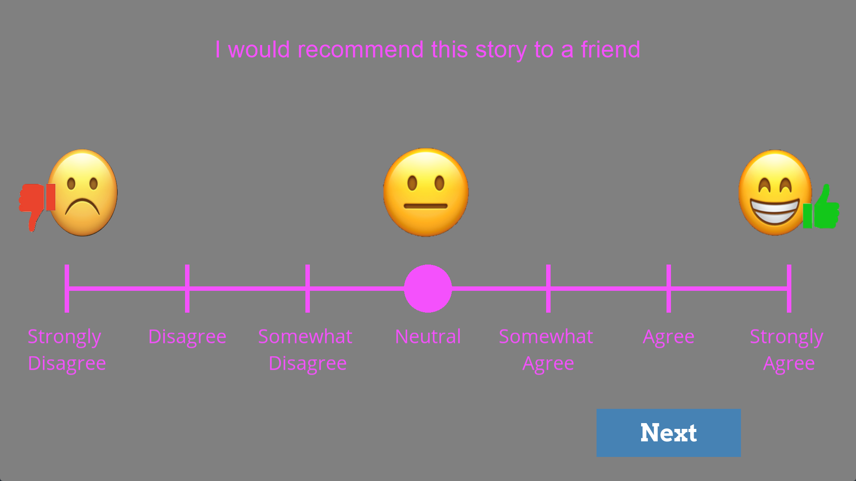
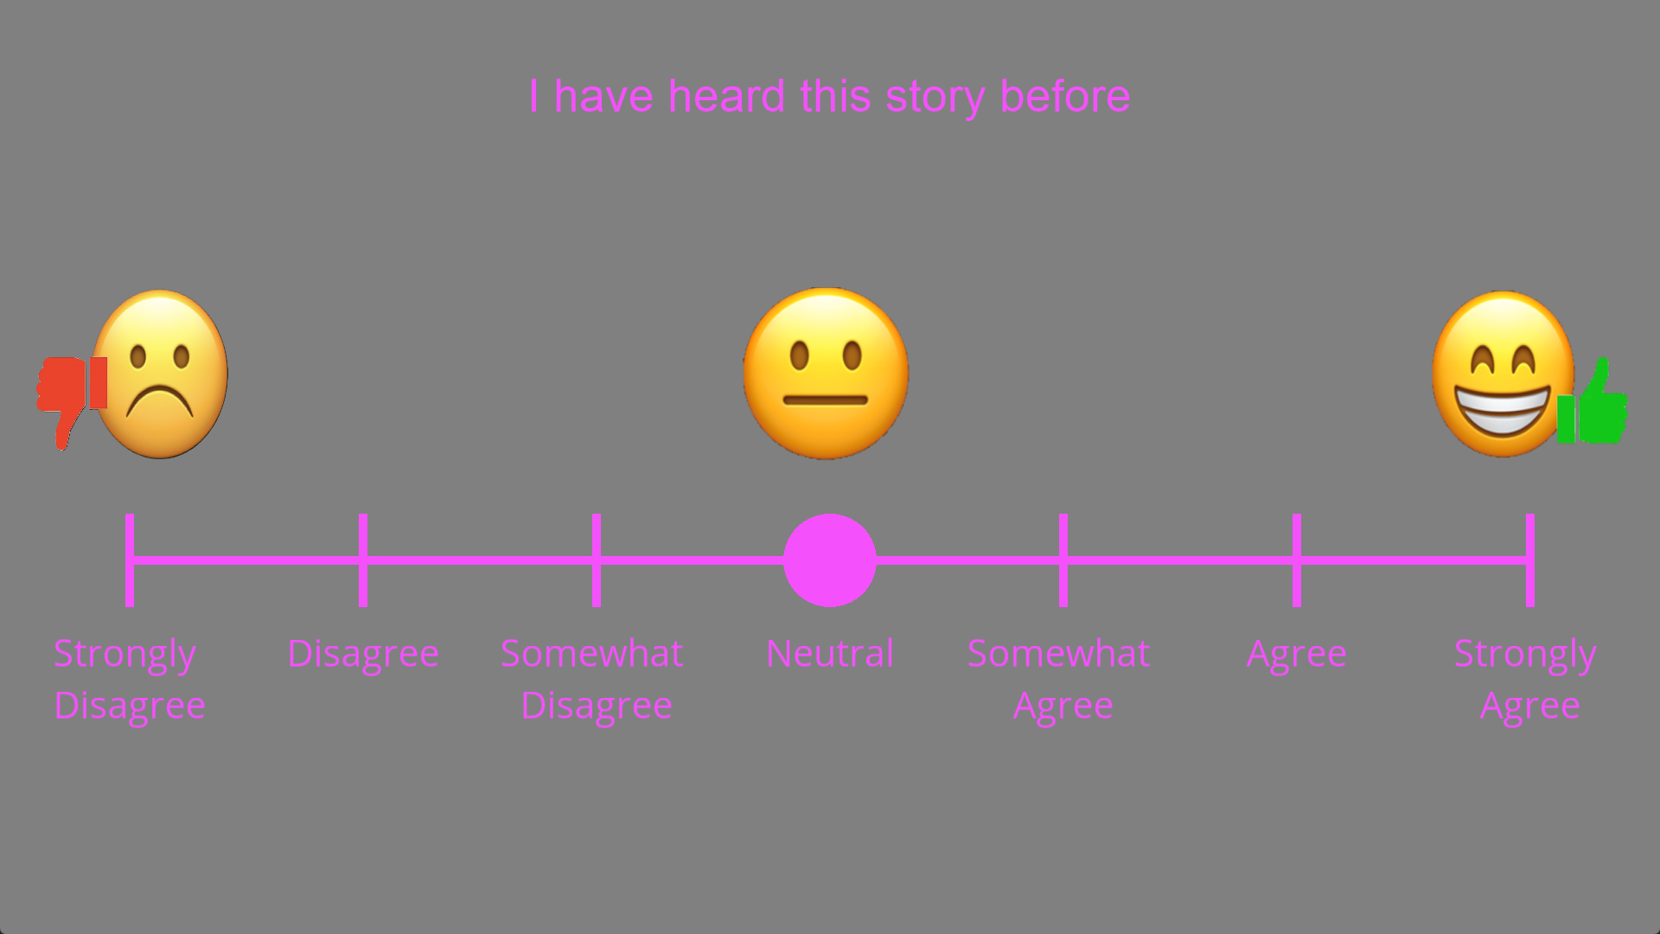
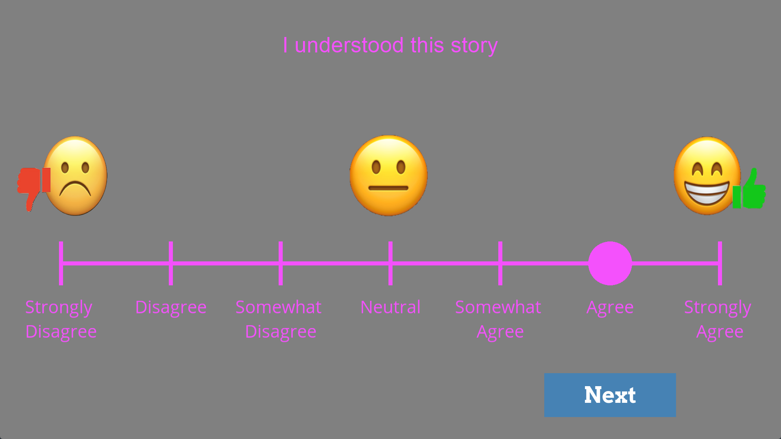
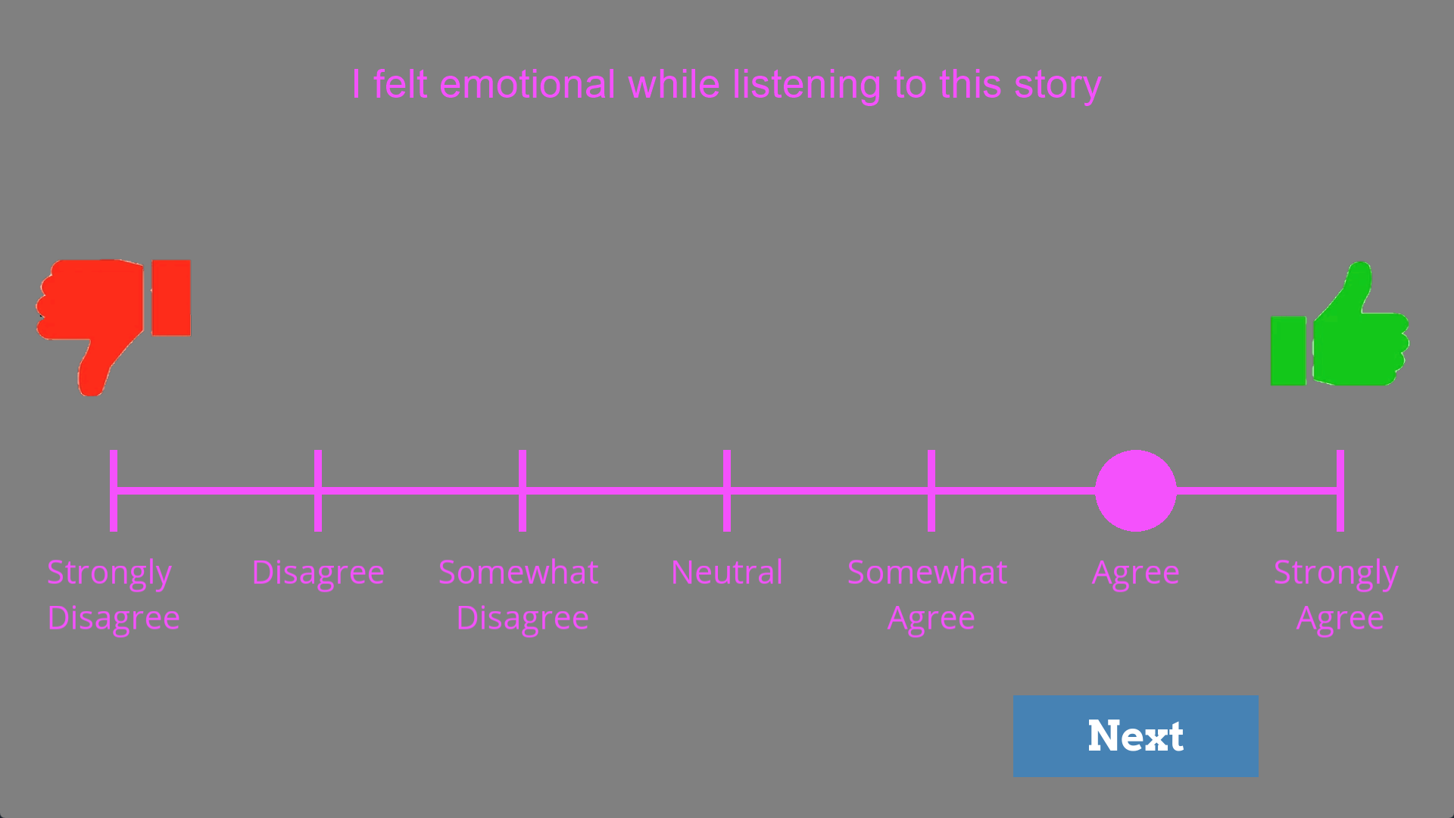
Self Report Input
Repeats for each story (6x)

Slide 5
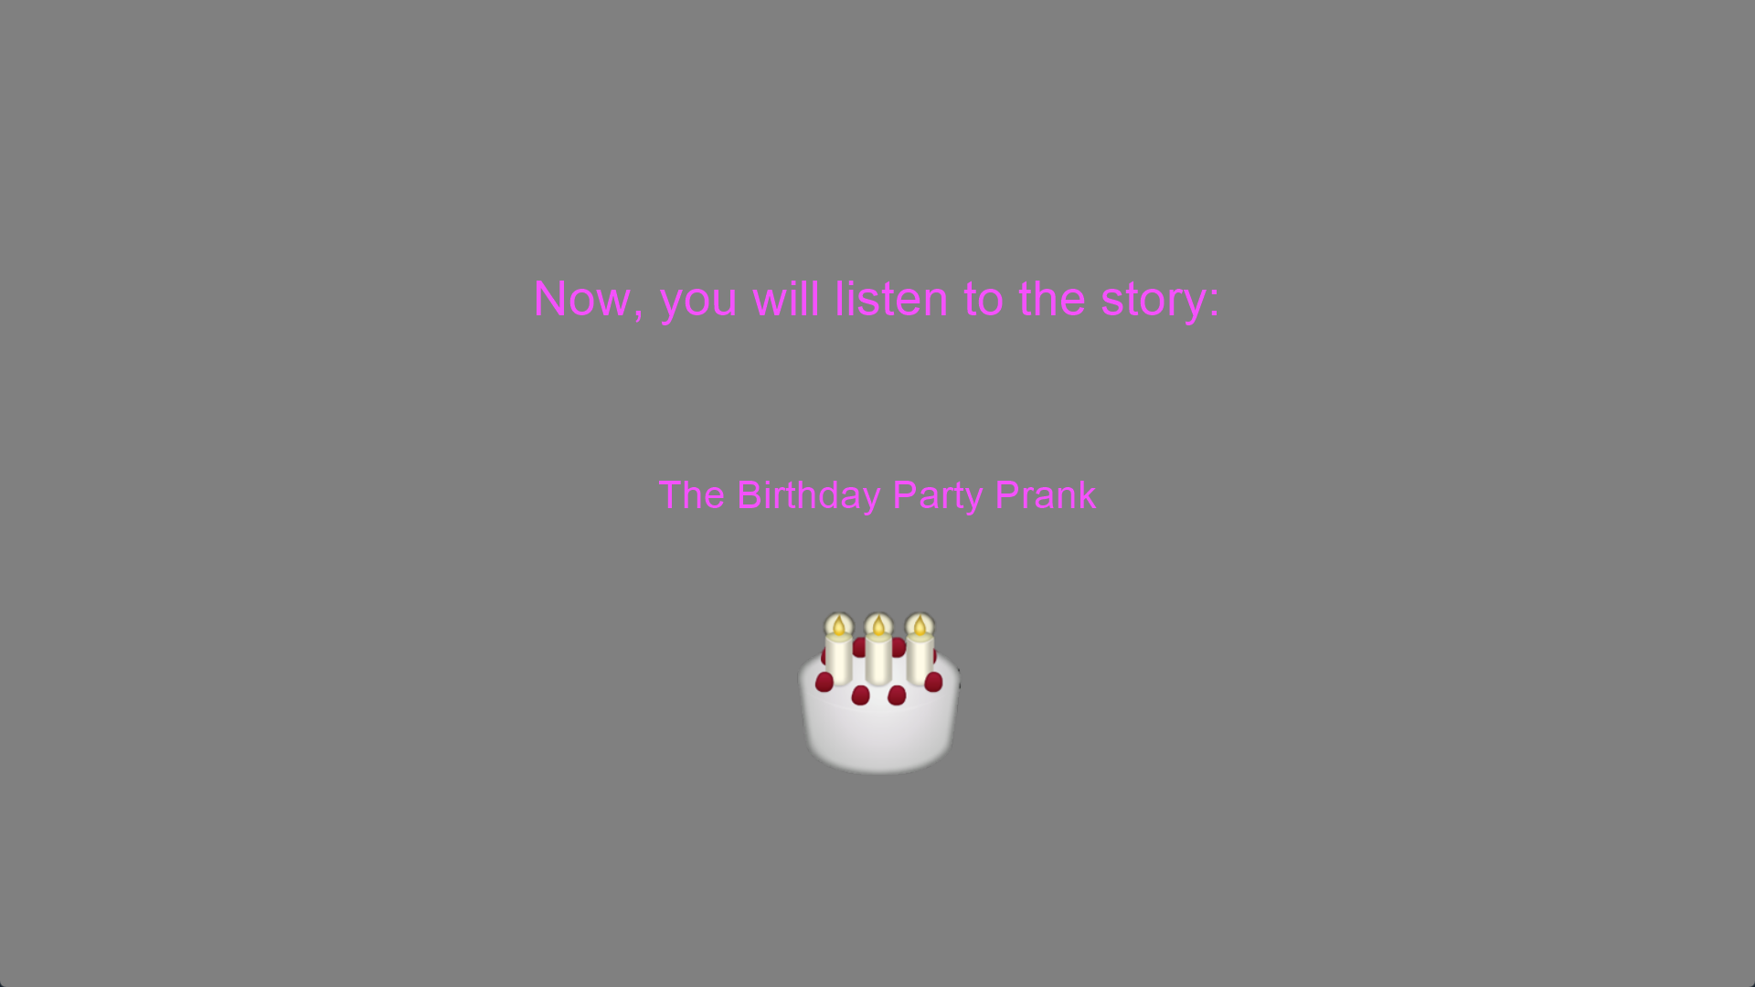
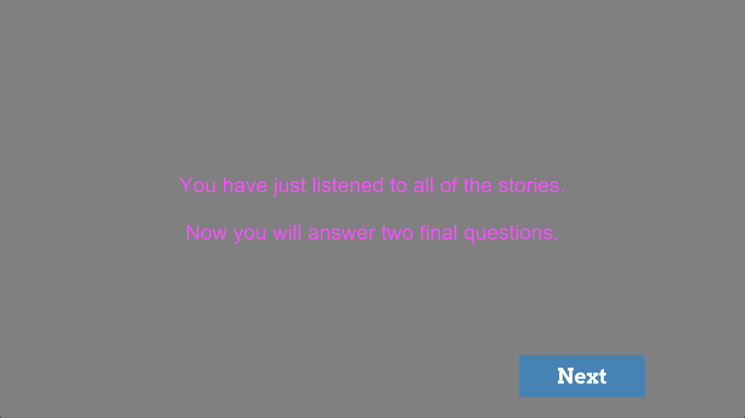
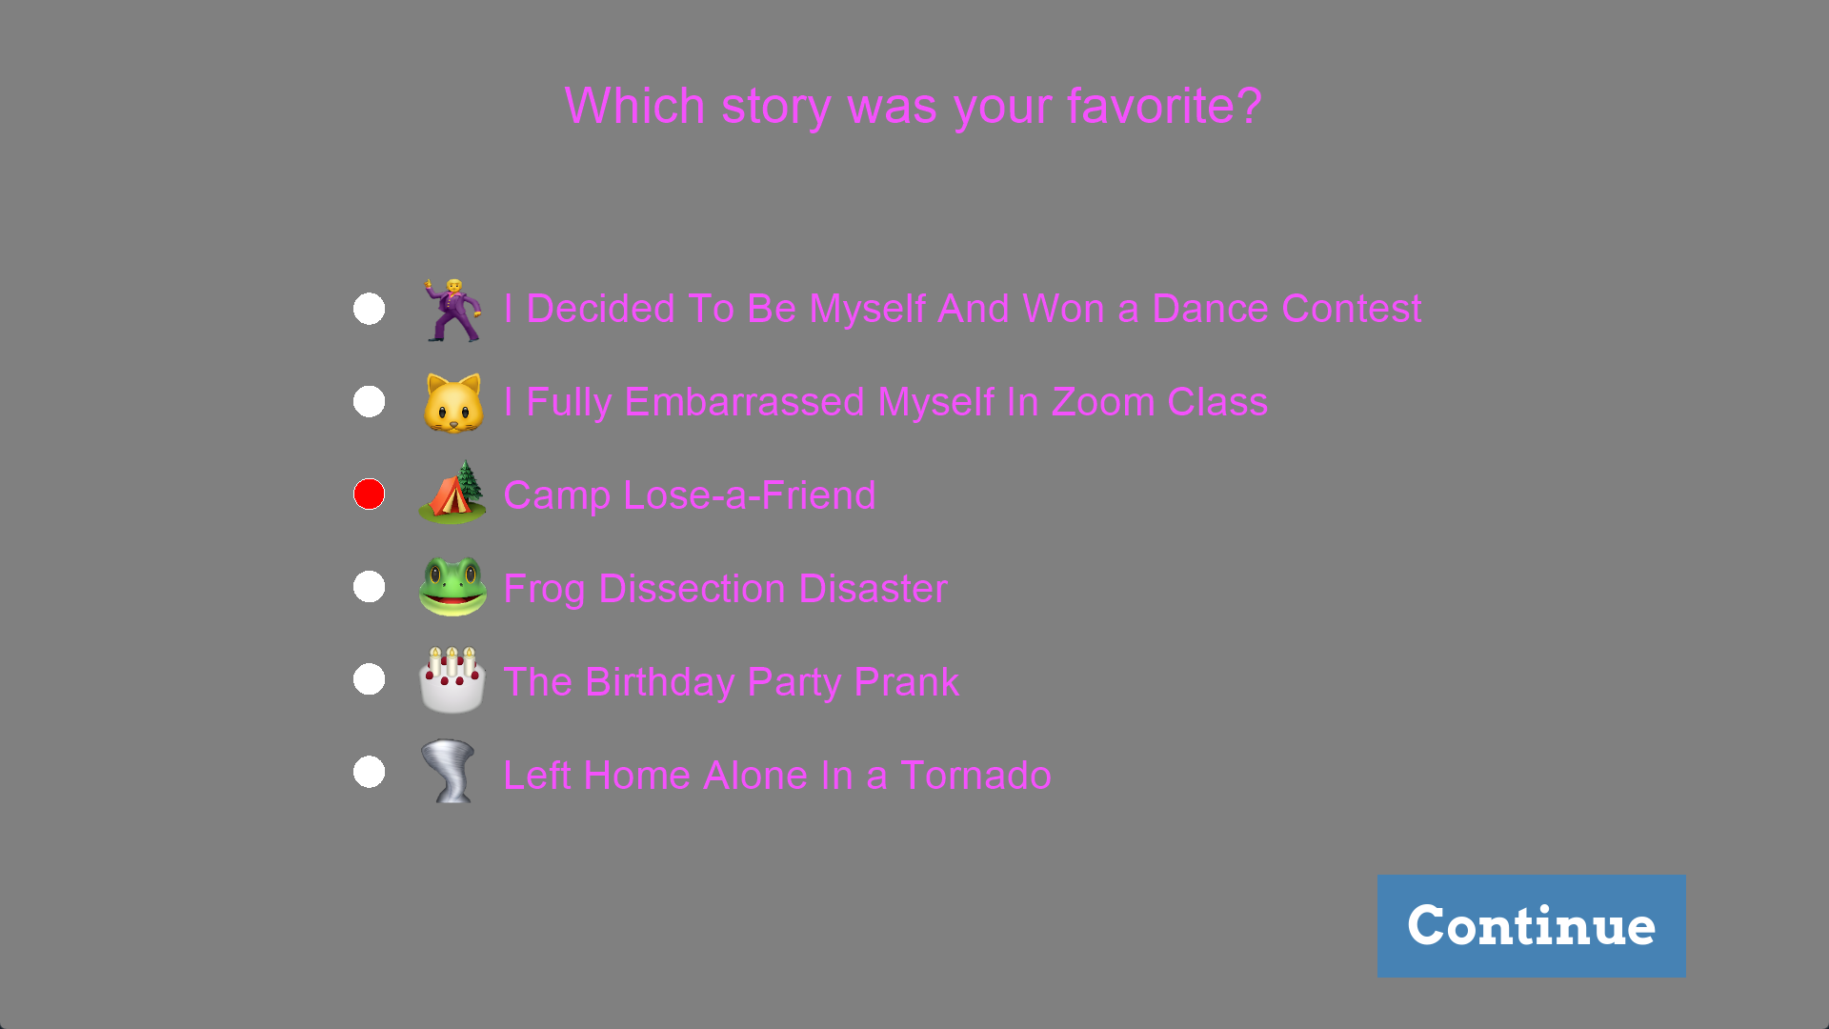
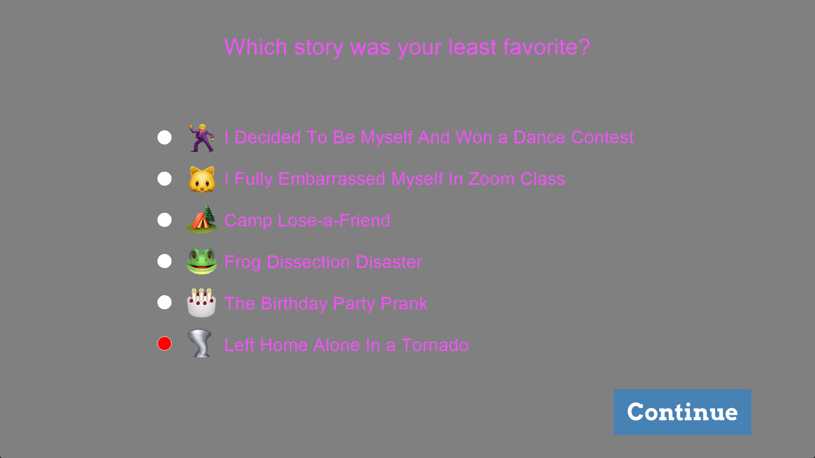
Transition to final questions
Favorite Story
Least Favorite Story

Slide 6
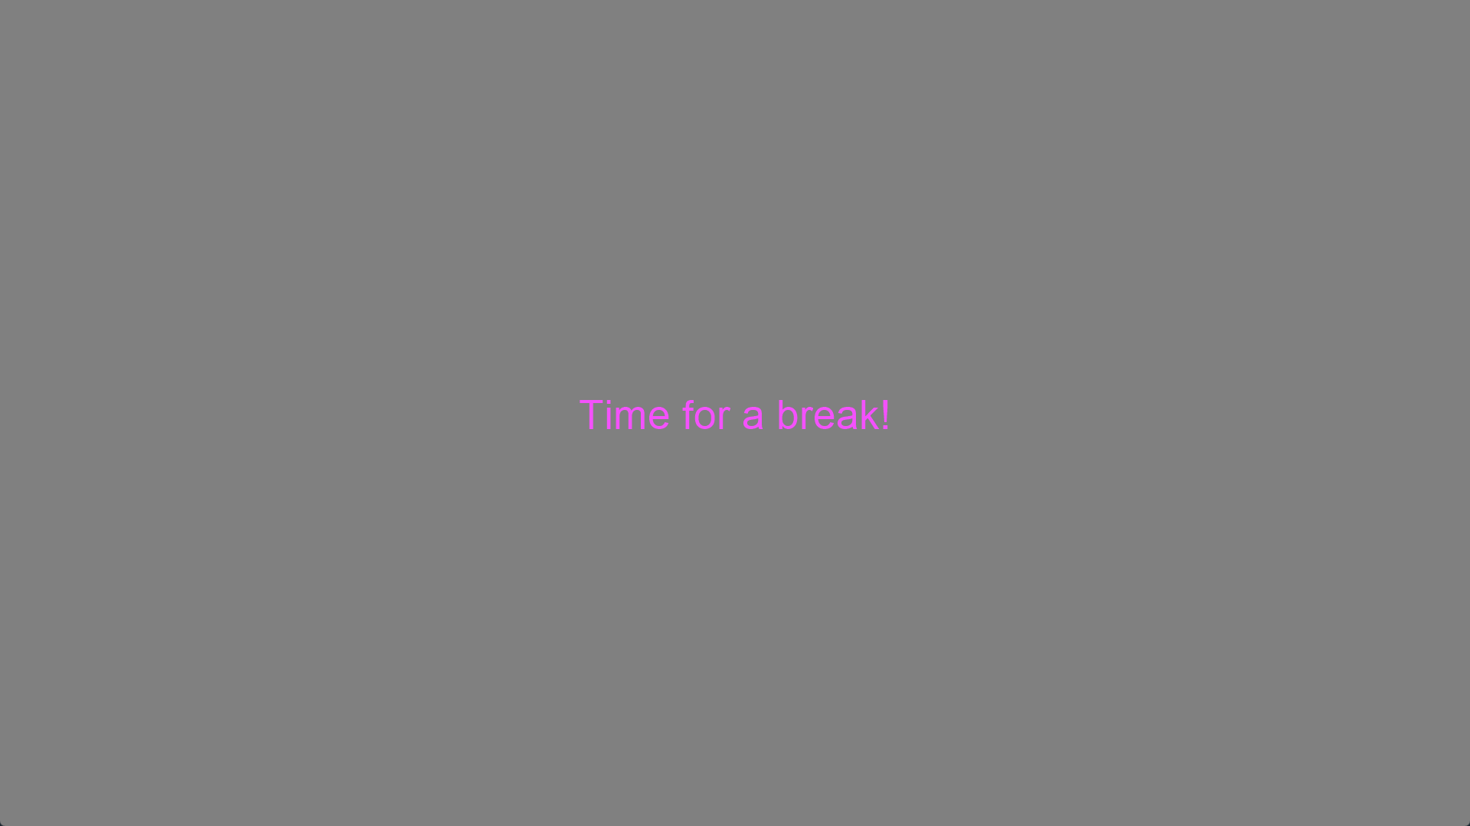
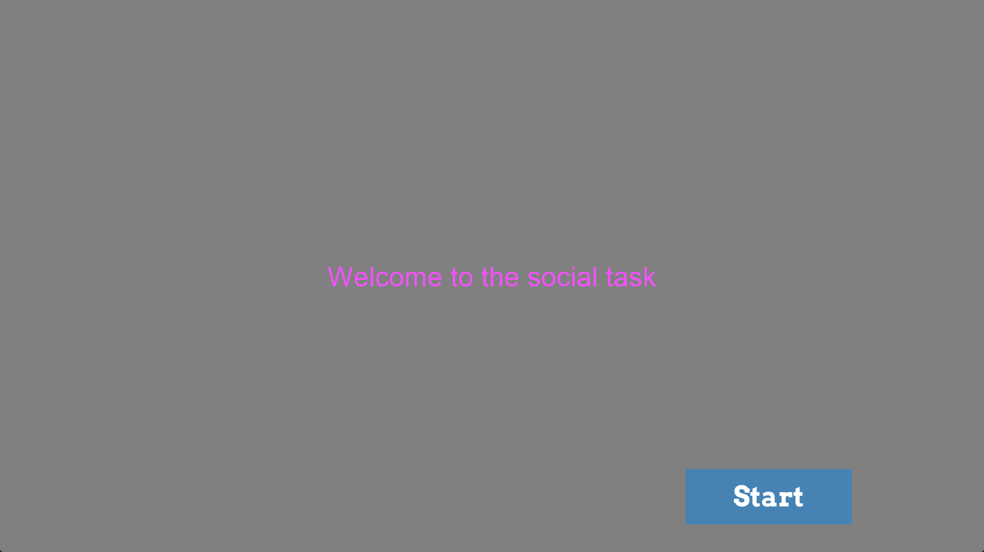

Break: EEG Impedances are re-checked and adjusted.
Timing may vary
Introduction to the Active Social Block
Social Block (5 minutes)
End

